Slide 1
Modeling numerical variables
In this unit we will learn to quantify the relationship between two numerical variables

Slide 2
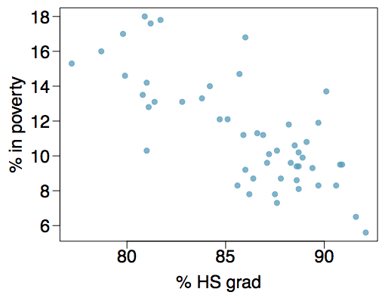
Poverty vs. HS graduate rate
The scatterplot below shows the relationship between HS graduate rate in all 50 US states and DC and the percent of residents who live below the poverty line (income below $23,050 for a family of 4 in 2012).
Response variable?

Slide 3
Poverty vs. HS graduate rate
The scatterplot below shows the relationship between HS graduate rate in all 50 US states and DC and the percent of residents who live below the poverty line (income below $23,050 for a family of 4 in 2012).
Response variable?
% in poverty

Slide 4
Poverty vs. HS graduate rate
The scatterplot below shows the relationship between HS graduate rate in all 50 US states and DC and the percent of residents who live below the poverty line (income below $23,050 for a family of 4 in 2012).
Response variable?
% in poverty
Explanatory variable?

Slide 5
Poverty vs. HS graduate rate
The scatterplot below shows the relationship between HS graduate rate in all 50 US states and DC and the percent of residents who live below the poverty line (income below $23,050 for a family of 4 in 2012).
Response variable?
% in poverty
Explanatory variable?
% HS grad

Slide 6
Poverty vs. HS graduate rate
The scatterplot below shows the relationship between HS graduate rate in all 50 US states and DC and the percent of residents who live below the poverty line (income below $23,050 for a family of 4 in 2012).
Response variable?
% in poverty
Explanatory variable?
% HS grad
Relationship?

Slide 7
Poverty vs. HS graduate rate
The scatterplot below shows the relationship between HS graduate rate in all 50 US states and DC and the percent of residents who live below the poverty line (income below $23,050 for a family of 4 in 2012).
Response variable?
% in poverty
Explanatory variable?
% HS grad
Relationship?
linear, negative, moderately strong

Slide 8
Quantifying the relationship
Correlation describes the strength of the linear association between two variables.

Slide 9
Quantifying the relationship
Correlation describes the strength of the linear association between two variables.
It takes values between -1 (perfect negative) and +1 (perfect positive).

Slide 10
Quantifying the relationship
Correlation describes the strength of the linear association between two variables.
It takes values between -1 (perfect negative) and +1 (perfect positive).
A value of 0 indicates no linear association.

Slide 11
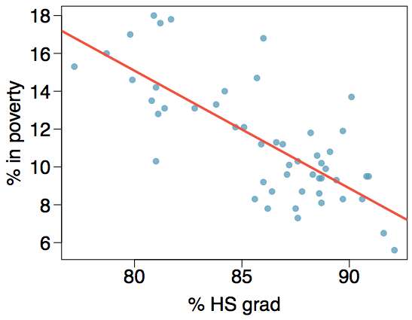
Guessing the correlation
Which of the following is the best guess for the correlation between percent in poverty and percent HS grad?
0.6
-0.75
-0.1
0.02
-1.5

Slide 12
Guessing the correlation
Which of the following is the best guess for the correlation between percent in poverty and percent HS grad?
0.6
-0.75
-0.1
0.02
-1.5

Slide 13
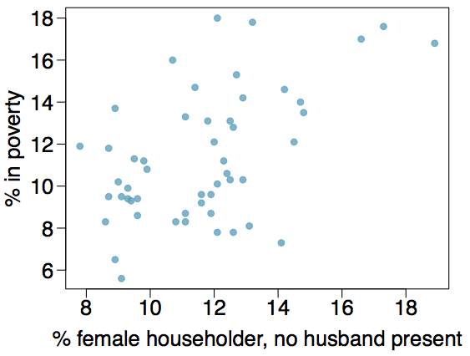
Guessing the correlation
Which of the following is the best guess for the correlation between percent in poverty and percent female householder?
0.1
-0.6
-0.4
0.9
0.5

Slide 14
Guessing the correlation
Which of the following is the best guess for the correlation between percent in poverty and percent female householder?
0.1
-0.6
-0.4
0.9
0.5

Slide 15
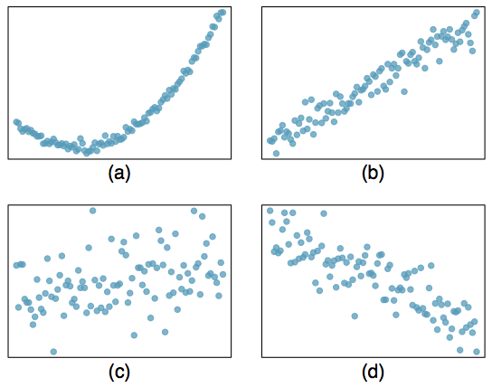
Assessing the correlation
Which of the following is has the strongest correlation, i.e. correlation coefficient closest to +1 or -1?

Slide 16
Assessing the correlation
Which of the following is has the strongest correlation, i.e. correlation coefficient closest to +1 or -1?
(b) → correlation means linear association

Slide 17
Fitting a line by least squares regression

Slide 18
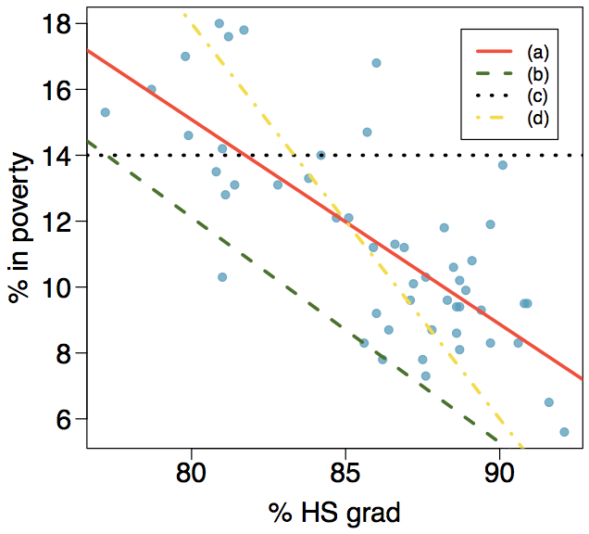
Eyeballing the line
Which of the following appears to be the line that best fits the linear relationship between percent in poverty and percent HS grad? Choose one.

Slide 19
Eyeballing the line
Which of the following appears to be the line that best fits the linear relationship between percent in poverty and percent HS grad? Choose one.
(a)

Slide 20
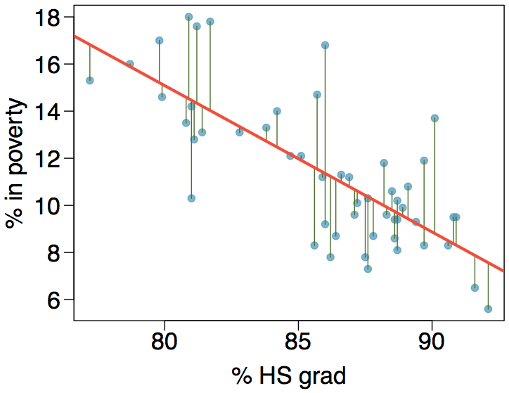
Residuals
Residuals are the leftovers from the model fit: Data = Fit + Residual

Slide 21
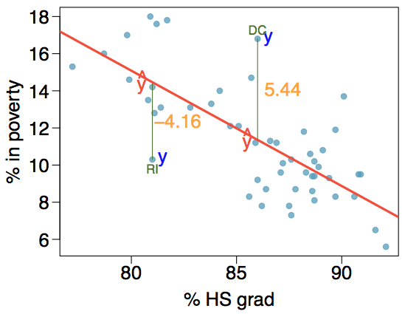
Residuals (cont.)
Residual is the difference between the observed (y_{i}) and predicted ŷ_{i}.
e_{i} = y_{i} - ŷ_{i}
% living in poverty in DC is 5.44% more than predicted.
% living in poverty in RI is 4.16% less than predicted.

Slide 22
A measure for the best line
We want a line that has small residuals

Slide 23
A measure for the best line
We want a line that has small residuals
Option 1: Minimize the sum of magnitudes (absolute values) of residuals |e₁| + |e₂| + … + |e_{n}|

Slide 24
A measure for the best line
We want a line that has small residuals
Option 1: Minimize the sum of magnitudes (absolute values) of residuals |e₁| + |e₂| + … + |e_{n}|
Option 2: Minimize the sum of squared residuals -- least squares
e₁² + e₂² + … + e_{n}²

Slide 25
A measure for the best line
We want a line that has small residuals
Option 1: Minimize the sum of magnitudes (absolute values) of residuals |e₁| + |e₂| + … + |e_{n}|
Option 2: Minimize the sum of squared residuals -- least squares
e₁² + e₂² + … + e_{n}²
Why least squares?

Slide 26
A measure for the best line
We want a line that has small residuals
Option 1: Minimize the sum of magnitudes (absolute values) of residuals |e₁| + |e₂| + … + |e_{n}|
Option 2: Minimize the sum of squared residuals -- least squares
e₁² + e₂² + … + e_{n}²
Why least squares?
Most commonly used

Slide 27
A measure for the best line
We want a line that has small residuals
Option 1: Minimize the sum of magnitudes (absolute values) of residuals |e₁| + |e₂| + … + |e_{n}|
Option 2: Minimize the sum of squared residuals -- least squares
e₁² + e₂² + … + e_{n}²
Why least squares?
Most commonly used
Easier to compute by hand and using software

Slide 28
A measure for the best line
We want a line that has small residuals
Option 1: Minimize the sum of magnitudes (absolute values) of residuals |e₁| + |e₂| + … + |e_{n}|
Option 2: Minimize the sum of squared residuals -- least squares
e₁² + e₂² + … + e_{n}²
Why least squares?
Most commonly used
Easier to compute by hand and using software
In many applications, a residual twice as large as another is usually more than twice as bad

Slide 29
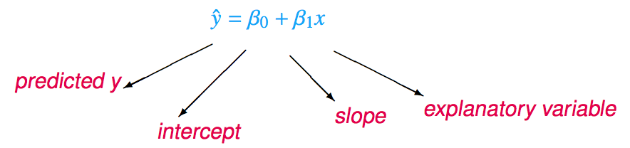
The least squares line
Notation:
Intercept:
Parameter: β₀
Point estimate: b₀
Slope:
Parameter: β₁
Point estimate: b₁

Slide 30
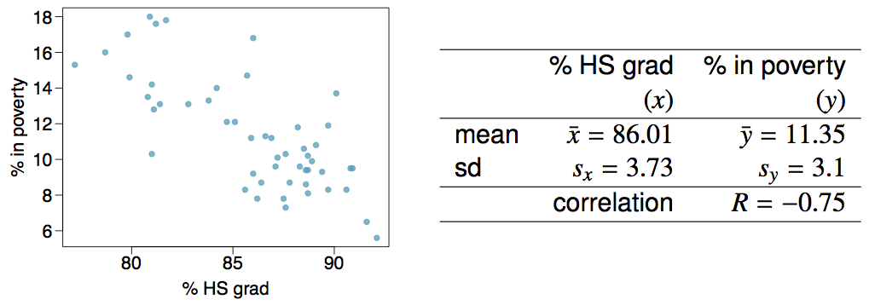
Given...

Slide 31

Slope
The slope of the regression can be calculated as

Slide 32

Slope
The slope of the regression can be calculated as
In context...

Slide 33
Slope
The slope of the regression can be calculated as
In context...
Interpretation
For each additional % point in HS graduate rate, we would expect the % living in poverty to be lower on average by 0.62% points.

Slide 34
Intercept
The intercept is where the regression line intersects the y-axis. The calculation of the intercept uses the fact the a regression line always passes through (x̄, ȳ).
b₀ = ȳ - b₁ x̄

Slide 35
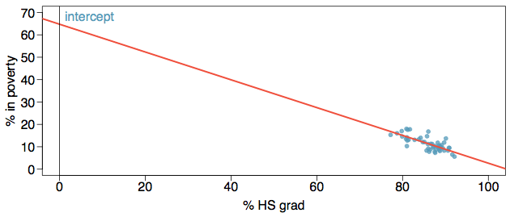
Intercept
The intercept is where the regression line intersects the y-axis. The calculation of the intercept uses the fact the a regression line always passes through (x̄, ȳ).
b₀ = ȳ - b₁ x̄

Slide 36
Intercept
The intercept is where the regression line intersects the y-axis. The calculation of the intercept uses the fact the a regression line always passes through (x̄, ȳ).
b₀ = ȳ - b₁ x̄
b₀ = 11.35 - (-0.62) x 86.01
= 64.68

