Slide 1
Fitting a line by least squares regression

Slide 2
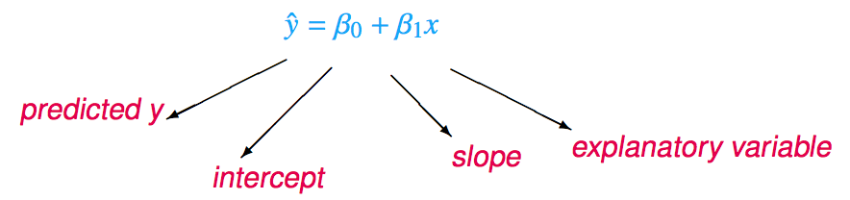
The least squares line
Notation:
Intercept:
Parameter: β₀
Point estimate: b₀
Slope:
Parameter: β₁
Point estimate: b₁

Slide 3
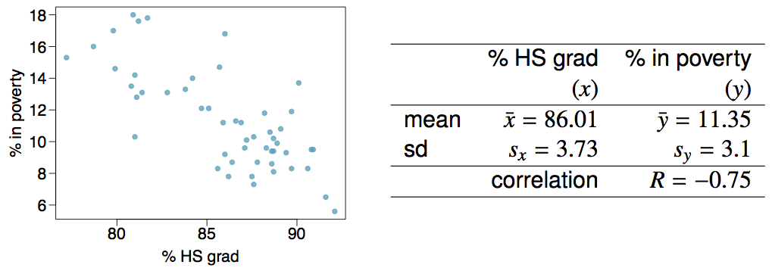
Given...

Slide 4

Slope
The slope of the regression can be calculated as

Slide 5

Slope
The slope of the regression can be calculated as
In context...

Slide 6
Slope
The slope of the regression can be calculated as
In context...
Interpretation
For each additional % point in HS graduate rate, we would expect the % living in poverty to be lower on average by 0.62% points.

Slide 7
Intercept
The intercept is where the regression line intersects the y-axis. The calculation of the intercept uses the fact the a regression line always passes through (x̄, ȳ).
b₀ = ȳ - b₁ x̄

Slide 8
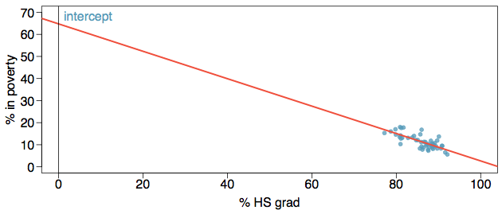
Intercept
The intercept is where the regression line intersects the y-axis. The calculation of the intercept uses the fact the a regression line always passes through (x̄, ȳ).
b₀ = ȳ - b₁ x̄

Slide 9
Intercept
The intercept is where the regression line intersects the y-axis. The calculation of the intercept uses the fact the a regression line always passes through (x̄, ȳ).
b₀ = ȳ - b₁ x̄
b₀ = 11.35 - (-0.62) x 86.01
= 64.68

Slide 10
Which of the following is the correct interpretation of the intercept?
For each % point increase in HS graduate rate, % living in poverty is expected to increase on average by 64.68%.
For each % point decrease in HS graduate rate, % living in poverty is expected to increase on average by 64.68%.
Having no HS graduates leads to 64.68% of residents living below the poverty line.
States with no HS graduates are expected on average to have 64.68% of residents living below the poverty line.
In states with no HS graduates % living in poverty is expected to increase on average by 64.68%.

Slide 11
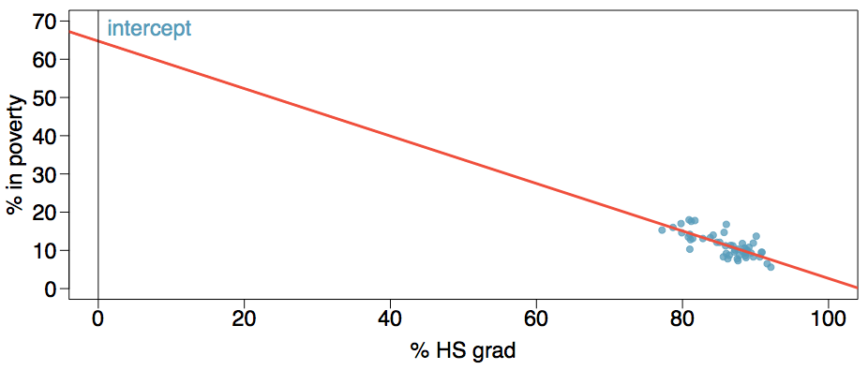
More on the intercept
Since there are no states in the dataset with no HS graduates, the intercept is of no interest, not very useful, and also not reliable since the predicted value of the intercept is so far from the bulk of the data.

Slide 12
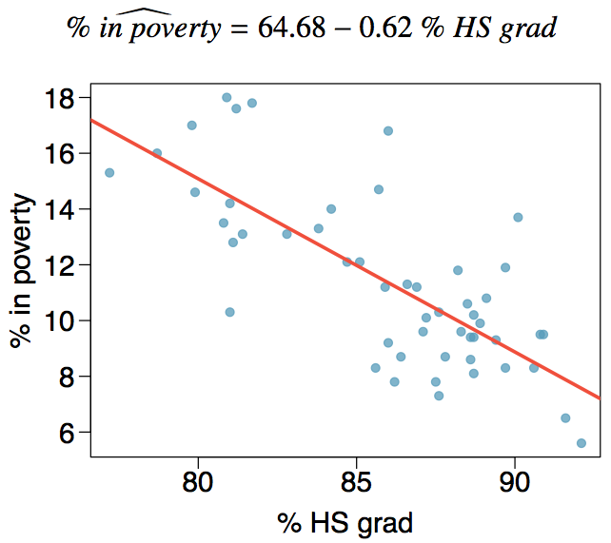
Regression line

Slide 13
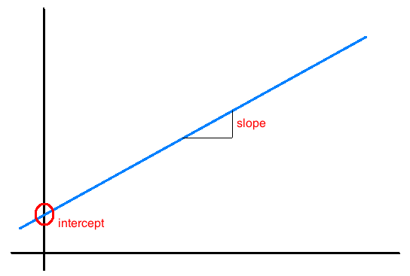
Interpretation of slope and intercept
Intercept: When x = 0, y is expected to equal the intercept.
Slope: For each unit in x, y is expected to increase / decrease on average by the slope.
Note: These statements are not causal, unless the study is a randomized controlled experiment.

Slide 14
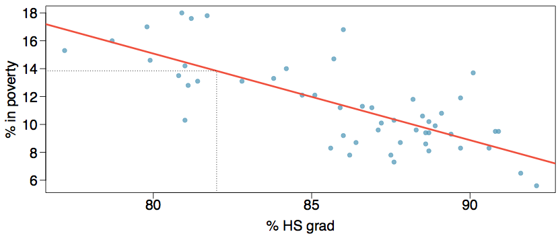
Prediction
Using the linear model to predict the value of the response variable for a given value of the explanatory variable is called prediction, simply by plugging in the value of x in the linear model equation.
There will be some uncertainty associated with the predicted value.

Slide 15
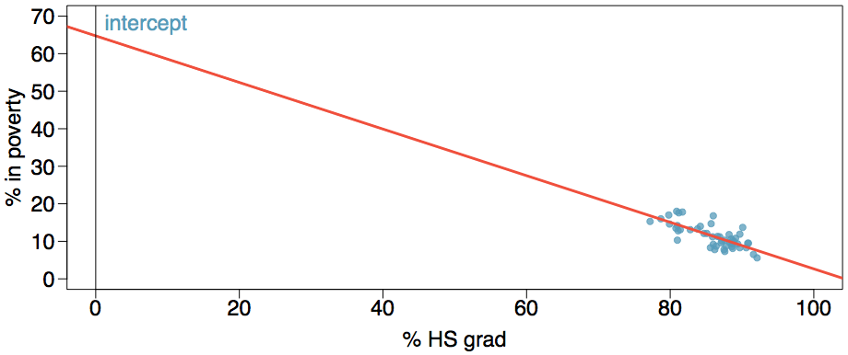
Extrapolation
Applying a model estimate to values outside of the realm of the original data is called extrapolation.
Sometimes the intercept might be an extrapolation.

Slide 16
Conditions for the least squares line
Linearity
Nearly normal residuals
Constant variability

Slide 17
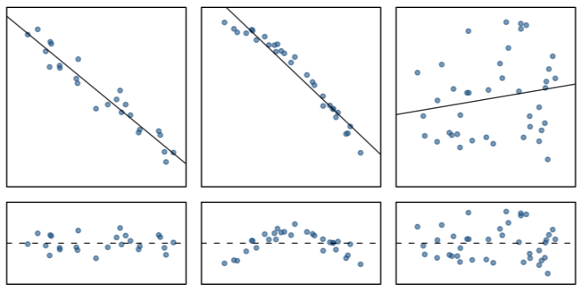
Conditions: (1) Linearity
The relationship between the explanatory and the response variable should be linear.
Methods for fitting a model to non-linear relationships exist, but are beyond the scope of this class. If this topic is of interest, an Online Extra is available on openintro.org covering new techniques.
Check using a scatterplot of the data, or a residuals plot.

Slide 18
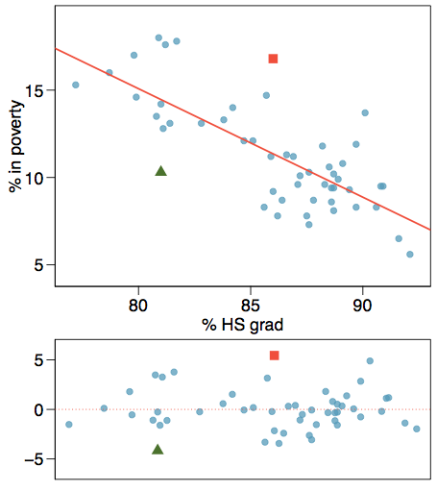
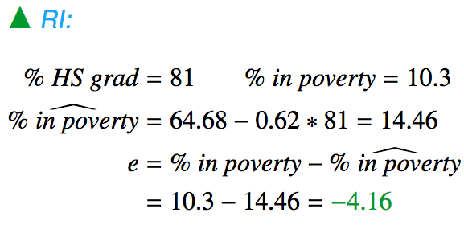
Anatomy of a residuals plot

Slide 19
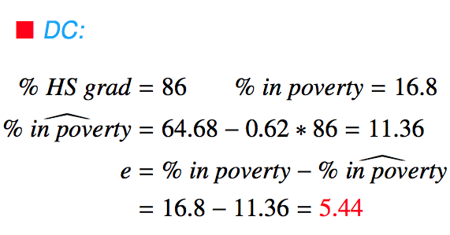
Anatomy of a residuals plot

Slide 20
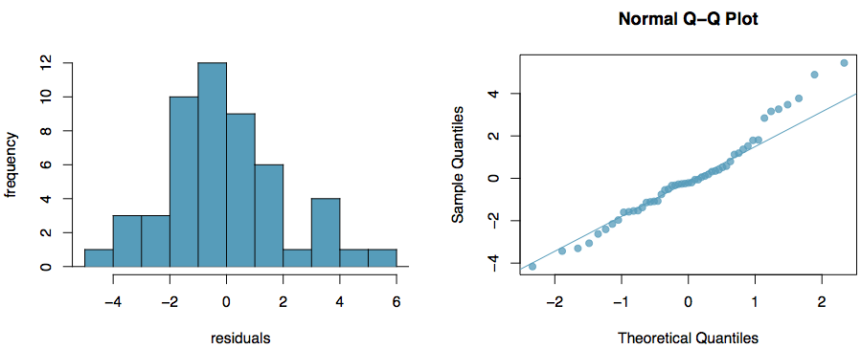
Conditions: (2) Nearly normal residuals
The residuals should be nearly normal.
This condition may not be satisfied when there are unusual observations that don't follow the trend of the rest of the data.
Check using a histogram or normal probability plot of residuals.

Slide 21
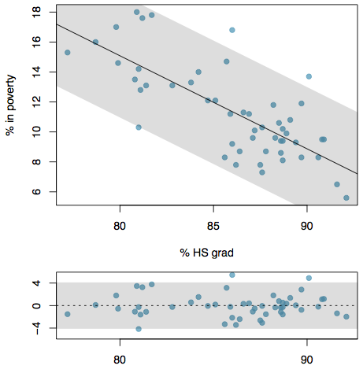
Conditions: (3) Constant variability
The variability of points around the least squares line should be roughly constant.
This implies that the variability of residuals around the 0 line should be roughly constant as well.
Also called homoscedasticity.
Check using a histogram or normal probability plot of residuals.

Slide 22
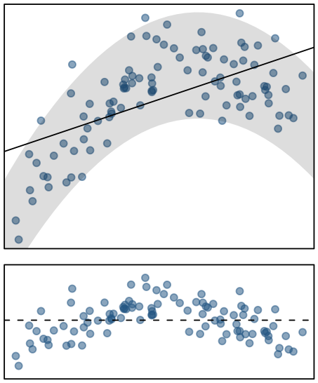
Checking conditions
What condition is this linear model obviously violating?
Constant variability
Linear relationship
Normal residuals
No extreme outliers

Slide 23
Checking conditions
What condition is this linear model obviously violating?
Constant variability
Linear relationship
Normal residuals
No extreme outliers

Slide 24
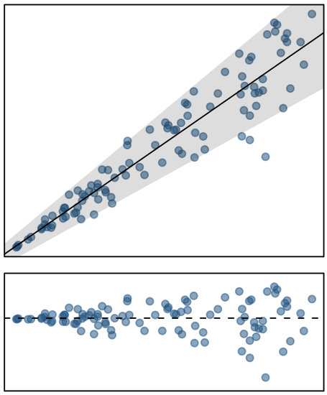
Checking conditions
What condition is this linear model obviously violating?
Constant variability
Linear relationship
Normal residuals
No extreme outliers

Slide 25
Checking conditions
What condition is this linear model obviously violating?
Constant variability
Linear relationship
Normal residuals
No extreme outliers

Slide 26
R²
The strength of the fit of a linear model is most commonly evaluated using R².
R² is calculated as the square of the correlation coefficient.
It tells us what percent of variability in the response variable is explained by the model.
The remainder of the variability is explained by variables not included in the model or by inherent randomness in the data.
For the model we've been working with, R² = -0.62² = 0.38.

Slide 27
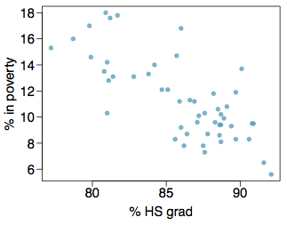
Interpretation of R²
Which of the below is the correct interpretation of R = -0.62, R² = 0.38?
38% of the variability in the % of HG graduates among the 51 states is explained by the model.
38% of the variability in the % of residents living in poverty among the 51 states is explained by the model.
38% of the time % HS graduates predict % living in poverty correctly.
62% of the variability in the % of residents living in poverty among the 51 states is explained by the model.

Slide 28
Interpretation of R²
Which of the below is the correct interpretation of R = -0.62, R² = 0.38?
38% of the variability in the % of HG graduates among the 51 states is explained by the model.
38% of the variability in the % of residents living in poverty among the 51 states is explained by the model.
38% of the time % HS graduates predict % living in poverty correctly.
62% of the variability in the % of residents living in poverty among the 51 states is explained by the model.

