Slide 1
Inference for
Linear Regression

Slide 2
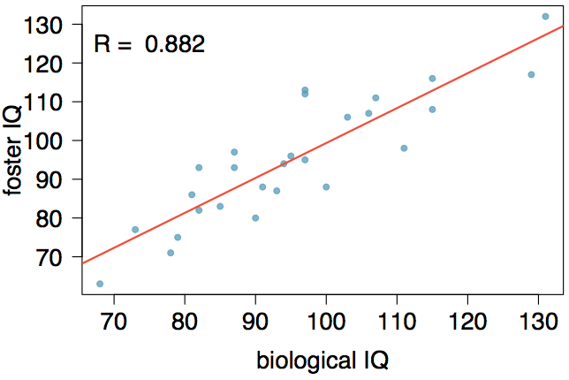
Nature or nurture?
In 1966 Cyril Burt published a paper called "The genetic determination of differences in intelligence: A study of monozygotic twins reared apart?" The data consist of IQ scores for [an assumed random sample of] 27 identical twins, one raised by foster parents, the other by the biological parents.

Slide 3
Practice
Coefficients:
Estimate Std. Error t value Pr(>|t|)
(Intercept) 9.20760 9.29990 0.990 0.332
bioIQ 0.90144 0.09633 9.358 1.2e-09
Residual standard error: 7.729 on 25 degrees of freedom
Multiple R-squared: 0.7779, Adjusted R-squared: 0.769
F-statistic: 87.56 on 1 and 25 DF, p-value: 1.204e-09
Roughly 78% of the foster twins' IQs can be accurately predicted by the biological IQs

Slide 4
Testing for the slope
Assuming that these 27 twins comprise a representative sample of all twins separated at birth, we would like to test if these data provide convincing evidence that the IQ of the biological twin is a significant predictor of IQ of the foster twin. What are the appropriate hypotheses?
H₀: b₀ = 0; H_{A}: b₀ ≠ 0
H₀: β₀ = 0; H_{A}: β₀ ≠ 0
H₀: b₁ = 0; H_{A}: b₁ ≠ 0
H₀: β₁ = 0; H_{A}: β₁ ≠ 0

Slide 5
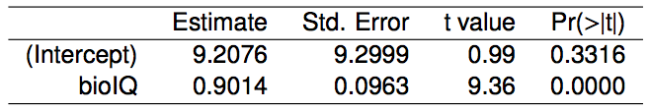
Testing for the slope (cont.)
We always use a t-test in inference for regression.
Remember: test statistic T = (point estimate - null value) / SE
Point estimate = b₁ is the observed slope.
SE_{b1} is the standard error associated with the slope.
Degrees of freedom associated with the slope is df = n - 2, where n is the sample size.
Remember: we lose 1 degree of freedom for each parameter we estimate, and in simple linear regression we estimate 2 parameters, β₀ and β₁.

Slide 6
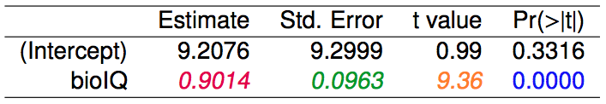


Testing for the slope (cont.)

Slide 7


Recap
Inference for the slope for a single-predictor linear regression model:
Hypothesis test:
Confidence interval:
The null value is often 0 since we are usually checking for any relationship between the explanatory and the response variable.
The regression output gives b₁, SE_{b1}, and two-tailed p-value for the t-test for the slope where the null value is 0.
We rarely do inference on the intercept, so we'll be focusing on the estimates and inference for the slope.

Slide 8
Conditional
Probability

Slide 9
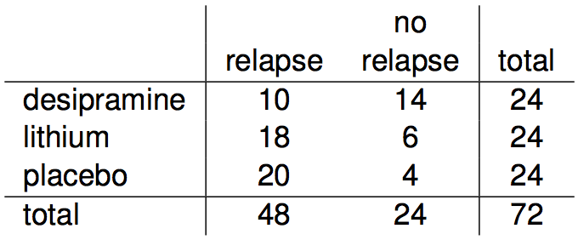
Relapse
Researchers randomly assigned 72 chronic users of cocaine into three groups: desipramine (antidepressant), lithium (standard treatment for cocaine) and placebo. Results of the study are summarized below.
http://www.oswego.edu/~srp/stats/2_way_tbl_1.htm

Slide 10
Marginal probability
What is the probability that a patient relapsed?
P(relapsed) = 48 / 72 ~ 0.67

Slide 11
Joint probability
What is the probability that a patient received the antidepressant (desipramine) and relapsed?
P(relapsed and desipramine) = 10 / 72 ~ 0.14

Slide 12

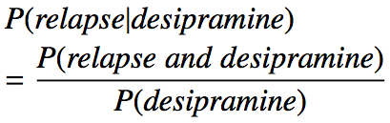
Conditional probability
The conditional probability of the outcome of interest A given condition B is calculated as

Slide 13



Conditional probability
The conditional probability of the outcome of interest A given condition B is calculated as

Slide 14
Conditional probability (cont.)
If we know that a patient received the antidepressant (desipramine), what is the probability that they relapsed?
P(relapse | desipramine) = 10 / 24 ~ 0.42
P(relapse | lithium) = 18 / 24 ~ 0.75
P(relapse | placebo) = 20 / 24 ~ 0.83

Slide 15
Conditional probability (cont.)
If we know that a patient relapsed, what is the probability that they received the antidepressant (desipramine)?
P(desipramine | relapse) = 10 / 48 ~ 0.21
P(lithium | relapse) = 18 / 48 ~ 0.38
P(placebo | relapse) = 20 / 48 ~ 0.42

Slide 16
General multiplication rule
Earlier we saw that if two events are independent, their joint probability is simply the product of their probabilities. If the events are not believed to be independent, the joint probability is calculated slightly differently.
If A and B represent two outcomes or events, then P(A and B) = P(A | B) x P(B) Note that this formula is simply the conditional probability formula, rearranged.
It is useful to think of A as the outcome of interest and B as the condition.

Slide 17
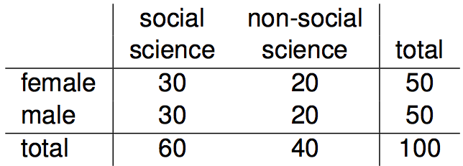
Independence and
conditional probabilities
Consider the following (hypothetical) distribution of gender and major of students in an introductory statistics class:
The probability that a randomly selected student is a social science major is
60 / 100 = 0.6.
The probability that a randomly selected student is a social science major given that they are female is
30 / 50 = 0.6.
Since P(SS | M) also equals 0.6, major of students in this class does not depend on their gender: P(SS | F) = P(SS).

Slide 18

Independence and
conditional probabilities (cont.)
Generically, if P(A | B) = P(A) then the events A and B are said to be independent.
Conceptually: Giving B doesn’t tell us anything about A.
Mathematically: We know that if events A and B are independent, P(A and B) = P(A) x P(B). Then,

Slide 19
Breast cancer screening
American Cancer Society estimates that about 1.7% of women have breast cancer. http://www.cancer.org/cancer/cancerbasics/cancer-prevalence
Susan G. Komen For The Cure Foundation states that mammography correctly identifies about 78% of women who truly have breast cancer. http://ww5.komen.org/BreastCancer/AccuracyofMammograms.html
An article published in 2003 suggests that up to 10% of all mammograms result in false positives for patients who do not have cancer. http://www.ncbi.nlm.nih.gov/pmc/articles/PMC1360940
Note: These percentages are approximate, and very difficult to estimate.

Slide 20
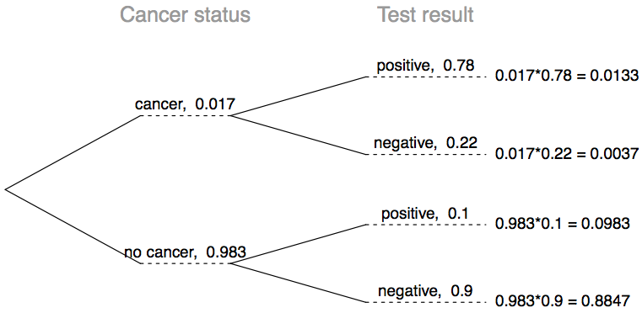




Inverting probabilities
When a patient goes through breast cancer screening there are two competing claims: patient had cancer and patient doesn't have cancer. If a mammogram yields a positive result, what is the probability that patient actually has cancer?
Note: Tree diagrams are useful for inverting probabilities: we are given P(+|C) and asked for P(C|+).

Slide 21
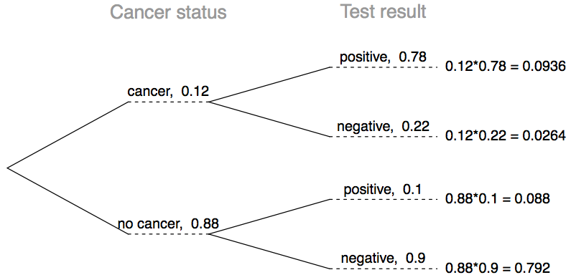
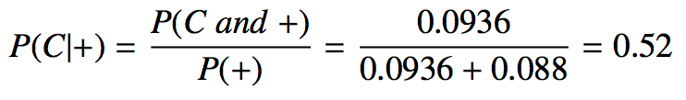
Practice
What is the probability that this woman has cancer if this second mammogram also yielded a positive result?
(a) 0.0936
(b) 0.088
(c) 0.48
(d) 0.52

Slide 22
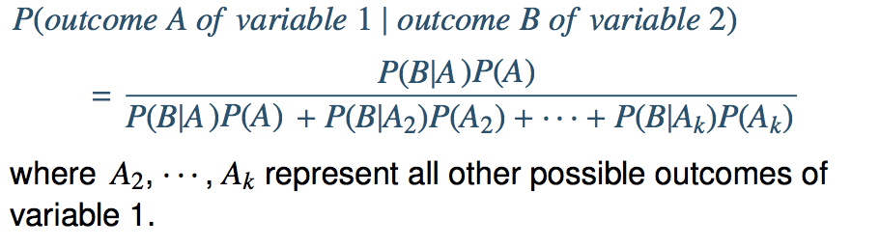
Bayes' Theorem
The conditional probability formula we have seen so far is a special case of the Bayes' Theorem, which is applicable even when events have more than just two outcomes.
Bayes’ Theorem

