Slide 1



RAINFALL PREDICTION SYSTEM
MENTOR:
MS. MEENAKSHI MAINDOLA
AAMOLIKA PURI
Made By:

Slide 2

to
INTRODUCTION
Rainfall Prediction System
In the field of meteorological phenomena, a great deal of data is produced, and because there are so many factors involved, forecasting future events becomes more challenging. Typically, probabilistic models are utilized for this, providing forecasts with a margin of error, meaning they are frequently not particularly accurate.
The application of machine learning algorithms can help to enhance forecasts because of the previously described circumstances.
An exploratory study on using machine learning to forecast the occurrence of rain is described in this article. In order to accomplish this, a set of data was used as an example, which explains the data collected on rainfall in the major cities of Australia .
In the past ten years, Australia has implemented several machine learning techniques, including neural networks, decision trees, random forests, and KNNs. The outcomes demonstrate that the neural network-based model is the best one.
Predicting rainfall is a crucial component of weather forecasting, with broad implications for disaster preparation, agriculture, and the management of water resources, among other socioeconomic activities.
Planning and decision-making can be aided by precise projections of rainfall. The goal of this project is to develop a Rainfall Prediction System that uses machine learning techniques to increase the accuracy and dependability of rainfall predictions For residents of smart cities to plan their activities appropriately, weather forecasting is essential. Precise and prompt rainfall forecasting is especially useful in smart cities for pre-planning and security measures related to aviation, agriculture, water reservoir systems, construction, and transportation.

Slide 3
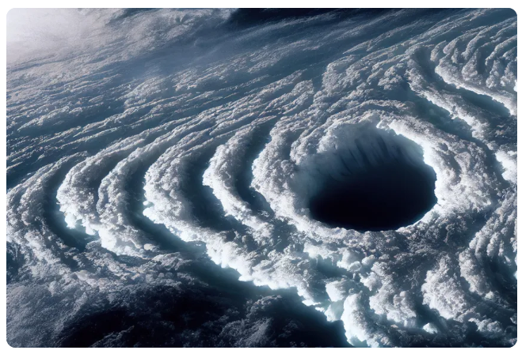
Problem Statement
Design and develop Rainfall Prediction model using Machine Learning to automatically tell whether or not it will be a sunny day or will it rain tomorrow, it tells the output just with the help of some basic features provided by the user.

Slide 4
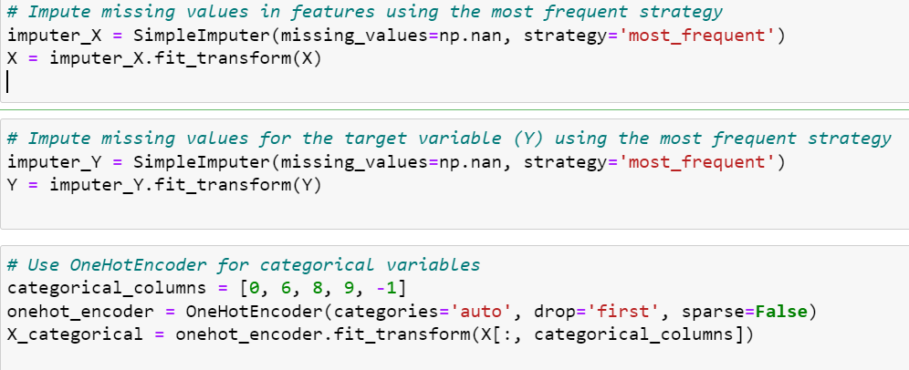
METHODOLOGY
•To start the project we are going to follow the Steps given below:
The very first step is to import the necessary libraries which are used in the code, like pandas ,numpy ,sklearn, seaborn.
Now we are going to upload our dataset to our notebook.
After uploading the .csv file, we check if our data set has null or missing values.
To get understanding of the dataset, a thorough analysis of the data is conducted. Distributions, correlations between variables, and statistical summaries are looked at. This stage informs subsequent preprocessing phases and helps identify trends and abnormalities. Preprocessing is done on the data in order to standardize or normalize numerical features, encode categorical variables, and account for missing values. Then, in order to facilitate the creation and assessment of models, the dataset is split into training and testing sets. Training and testing cannot be conducted directly using the collected data. We must preprocess the data first. Outlier-containing rows are removed, attributes that are not required to predict the outcome—in this case, the date—are removed from the dataset, and Python functions are used to assign values to missing variables. To replace unavailable values with the 'most common' value for that feature, I used Simple Imputer.

Slide 5
Finding a suitable machine learning model that best meets our objective of providing a response to the problem statement is the next step in the technique. For the task, an appropriate machine learning algorithm is chosen. The classification abilities of the Hist Gradient Boosting Classifier are being examined in this context. It is possible to test a variety of algorithms to see which fits best. While Support Vector Machine and Random Forest Classifier models were also tested, Hist Gradient Boosting Classifier and Cat Boost Classifier outperformed them on the selected dataset. The model is utilized for real-time predictions if it works sufficiently. Systems are put in place to handle new data and generate precise forecasts in a timely manner. The model, a Cat boosting classifier model.
The training dataset is used to train the chosen model. Performance is enhanced by adjusting hyper parameters, and the resilience of the model is evaluated by cross-validation methods. The testing dataset is used to evaluate the model's performance. Its performance is assessed using metrics such as confusion matrix, F1 score, accuracy, precision, and recall. Possible issues related to either an under fit or an over fit are discussed. Approaches of deciphering and interpreting the model's decisions are explored, particularly in situations when model transparency is crucial. Methods like feature relevance checking are under investigation.

Slide 6
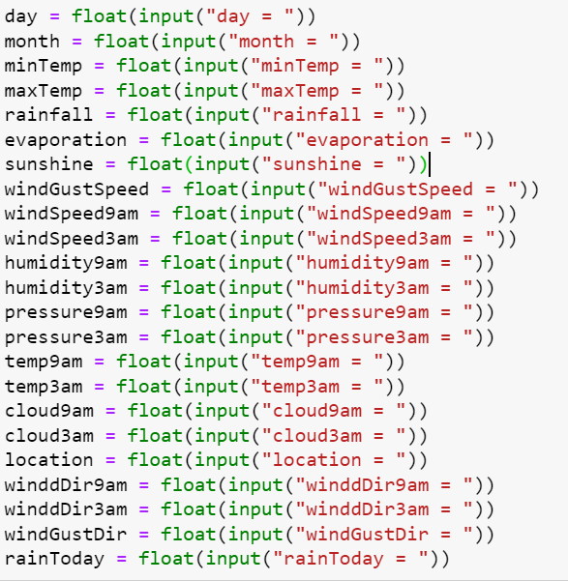

RESULT AND DISCUSSION
After extensive implementation and evaluation, the Hist Gradient Boosting Classifier algorithm and Cat boost classifier Algorithm produced promising results for the Rainfall Prediction System. The algorithm makes an extremely accurate prediction about whether it will rain tomorrow based on historical weather data.
Performance indicators such as accuracy and precision score demonstrate how well the model interprets the relationships and patterns in the data. Thanks to careful feature engineering and hyper parameter tuning, the system exhibits stability and generalizability and provides reliable predictions even on previously observed data.
The First model accuracy scores were:-

Slide 7
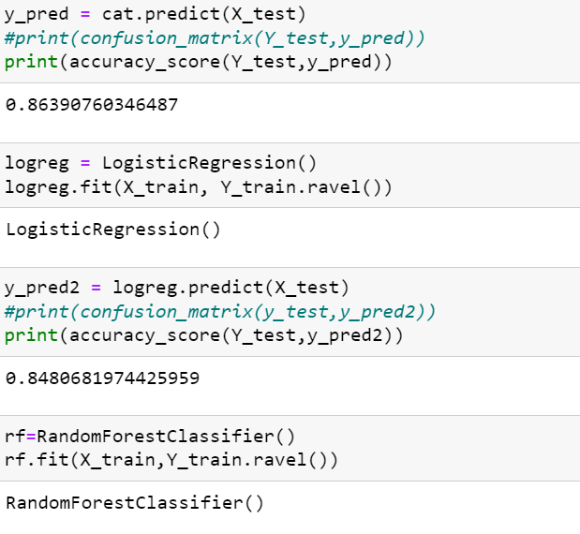
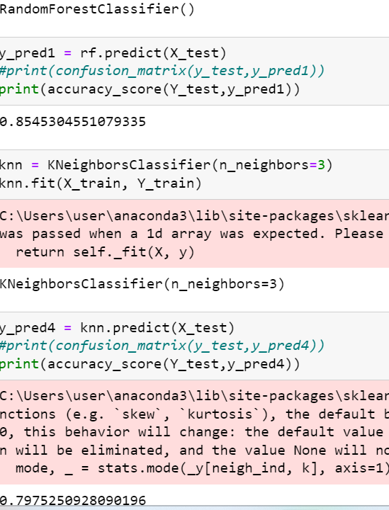

Slide 8
Conclusion and Future Work
In conclusion, the Rainfall Prediction System effectively applies machine learning methods to a practical weather forecasting issue. Based on historical weather data, the algorithm use the Hist Gradient Boosting Classifier to generate accurate forecasts. The efficacy and dependability of the system are guaranteed by the application of a thorough approach that includes steps like feature engineering, data preparation, and model validation. The model is a useful and significant tool for decision-makers in a variety of industries since it can be used to generate forecasts in real-time and can be integrated with monitoring systems.
To maintain the system's functionality and applicability over time, ongoing monitoring, retraining, and documentation are necessary, much like in any machine learning effort. This endeavor highlights the potential for enhancing decision-making processes in domains affected by rainfall patterns and contributes to the growing field of machine learning applications in meteorology. Nonetheless, ongoing evaluation and modification are required to guarantee the model's reliability in practical settings.

Slide 9
Future Work:-
Lastly, the possibility of improving the results by changing the training data's quality and actual values was investigated, however the results did not improve over earlier analyses. Thus, this latest research enabled
I'll sum up a few points here. On the one hand, the opportunities presented by machine learning techniques as substitutes for traditional rain forecasting methods (which also have some advantages over traditional forecasting methods, like the ability to estimate the results'
reliability using indicators and performance keys, or the ability to modify the algorithms' performance by changing their input parameters, allowing them to be tailored to specific situations.
Similarly, it is evident that neural network-based algorithms are effective at modeling nonlinear natural processes. Lastly, by evaluating the data separately, the phenomenon's localization can be determined.
The algorithms function and are more effective by city.

Slide 10
Thanks

