Slide 1
CS M117
Computer Networks:
The Physical Layer
Tuesday January 8; Winter 2013
Instructor: Mario Gerla-BH 3732F;
gerla@ee.ucla.edu
Co-instructor: Revaz Dzhanidze-3732K
revazd@cs.ucla.edu
TA: Seongwon Han ; 3704 BH; Ph: 5-8659
swhan@cs.ucla.edu

Slide 2
Office Hours (tentative)
Professor M.Gerla T/R 1:00-2:00 PM
3732K or 3704 BH
TA - Lab 1 A Wednesday 9:00 - 10:00 AM; 3704 BH
TA - Lab 1 B Wednesday 1:00 - 2:00 PM; 3704 BH
Additional lab time may be scheduled by appointment with the TA.
The TA may announce additional lab time during the quarter.
Newsgroup and Website
http://www.cs.ucla.edu/classes/winter13/cs117
ucla.classes.cs.cs117 - available on CSnet and SEASnet news servers

Slide 3
Course Objectives
To provide fundamental knowledge of the theory underlying wireless data communication systems relevant to digital data communications.
To provide hands-on experience by performing a series of laboratory experiments with a number of important laboratory instruments.
To gain experience in preparing formal technical project and report based upon series of laboratory experiments and special experiments using set of wireless communication network.

Slide 4
CS M117 is a 4 unit course.
Workload
Weekly
2 hours lecture
2 hours homework
2 hours lab experiment
2 hours report
2 hours outside study
2 hours project
No Midterms, No Finals

Slide 5
Lab Experiments
Laboratory Experiments:
Lab 1 - Amplitude & Frequency modulation
Lab 2 - 802.11b Wireless LAN
Lab 3 - Bluetooth communications
PJ. Lab– Special Wireless Experiments
(SWE)

Slide 6
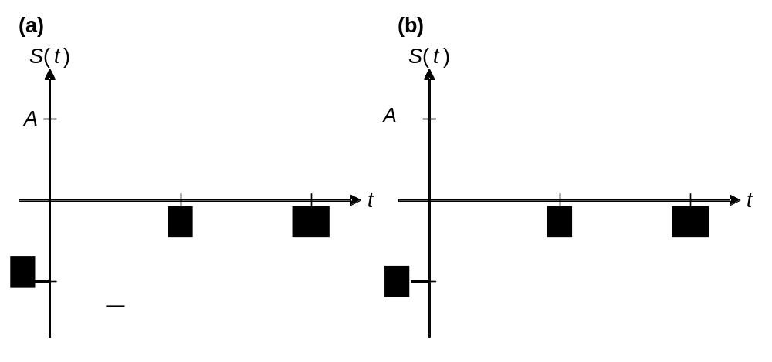
HW Sketch
Pre-Laboratory Home Work #1; (Due 04/12/09).
Students Name____________________________
Signals in Time and Frequency Domains
1) Draw plots of amplitude versus time for the following rectangular signals with period T and amplitude A:
(a) Duty cycle d = 50% (also called a “square wave”)
(b) Duty cycle d = 25%

Slide 7
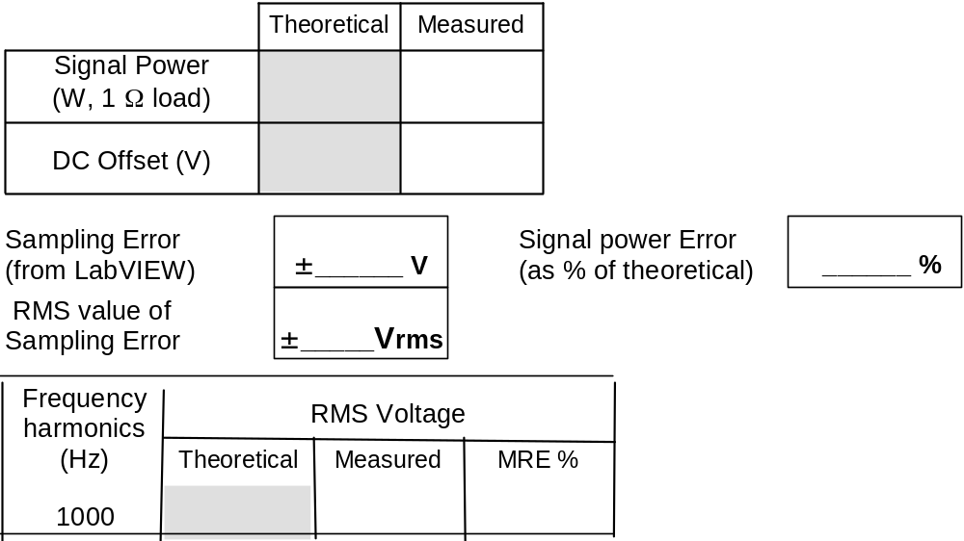
RDS Sketch
Part A: Sine Wave
Signal Amplitude = 2 V (from -2V to +2V)
Fundamental Frequency: ffund = 1000 Hz
DC Offset = 0 V

Slide 8
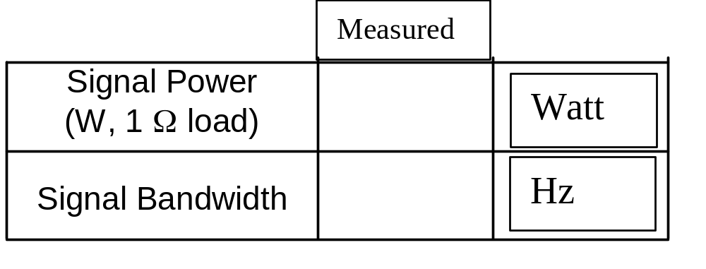
Σ Section Sketch
Σ Section: (Include with RDS 1, and Report 2)
From Part A: Sine Wave
Signal Amplitude = 2 V (from -2V to +2V)
Fundamental Frequency: ffund = 1000 Hz
DC Offset = 0 V

Slide 9
Quiz Test Sketch
CS M117
Multiple-Choice
b) Ability to design and conduct experiments, as well as to analyze and interpret data;
19. Before data can be transmitted, they must be transformed to _______.
a. Periodic signals b. Electromagnetic signals
c. Aperiodic signals d. Low-frequency sine waves
31. As frequency increases, the period ________.
a. Decreases b. Increases
c. Remains the same d. Doubles

Slide 10
Report
“Wireless Data Transmission”
Chien _ _ _ _
Report Title Page Sample
CS M117
Spring 11
Partners:
Alexander _ _ _ _
Xiaohang _ _ _ _

Slide 11
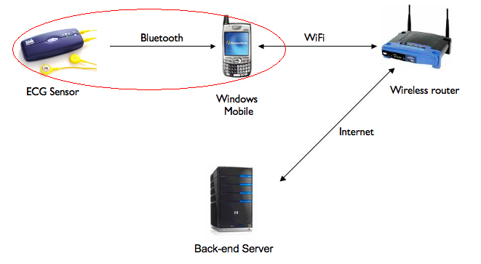
Abstract
Report is implementing a mobile application that receiver medical data (electrocardiogram/ECG) from the Alive heart-monitoring sensor through Bluetooth and send the data to a server through TCP/IP.
Our Team is responsible for retrieving medical data from the ECG sensor.

Slide 12
CS 117: Project List

Slide 13
Proposed project: by choice:
Project #1 “Health. Net
Connecting Patients & Doctors”,
Project #2 “Gateway System Implementation”
(These projects are developed as part of Special Wireless Lab Experiments)

Slide 14
Grading
Grading:
Homework (HW) (3) = 20%
Lab Report (1) = 20%
Project (1) = 50%
Quiz Test (1) = 10%
RDS (2) P., No P.
Final Grade (FG) 100%

Slide 15
CS 117 Project Grading Policy
Project proposal Presentation – 15%
Attendance – 10%
  You can absent up to two times.
Final Presentation – 35%
  Group presentation; all member will participate; up to 15 minutes
Final Report – 40%

Slide 16
Recommended References
M. Gerla, R. Dzhanidze: Course Notes for CS 117. 2012. Course Reader Material; 1081 Westwood Blvd. (310) 443 3300.
A.S. Tanenbaum, “Computer Networks”, Prentice Hall, 2002, Fourth Edition, ISBN 0-13-066102-3
B.A. Forouzan. “Data Communications and Networking”, Mc-Graw Hill Higher Education, 2004, Third Edition. ISBN 0-07-292005-X.
Materials on CS M117 course Web Site

Slide 17
Lecture Schedule A.
Tuesdays 2:00-3:50 PM
Prof. M. Gerla All Lectures in 5440 BH
Lecture 1a Introduction to Computer
Communications and Networking
Lecture 2a WLAN, Wireless MAC, TCP
Lecture 3a-A Ad-Hoc network
Lecture 3a-B ZigBee PAN
Lecture 3a-C Cellular Communications

Slide 18
Lecture Schedule B.
Thursdays 2:00-3:50 PM
Prof. R. Dzhanidze All Lectures in 5440 BH;
Lecture 1b Signal Modulation, AM, FM, & PM
Lecture 2b Wireless Communication
Channels
Lecture 3b Bluetooth Communications
Lecture R. Data Encoding (Reading)

Slide 19
W E E K | Lectures Tuesday. 2:00-3:50 pm 5440 BH |  | Group 1A, 1B; 1A: W, 10:00-11:50 am 1B: W. 12:00-1:50 pm BH, 3704 | Lectures Thursday. 2:00-3:50 pm 5440 BH
1 | Lec.1a. Introduction January8th |  | Training Exercise January 9th | Lec.1b. AM, PM& FM; (Prelab HW1, due 01/16) January 10th
2 | Lec.2a Wireless MAC, TCP January 15th |  | Lab #1 AM, FM & PM RDS* due on 01/23/13 January 16th | Lec.2b W-LAN (Prelab HW2, due 01/23) January 17th
3 | Lec.3a Ad-Hoc, ZigBee, Cell Communications January 22nd |  | Lab # 2 (W LAN) RDS* due on 01/30/13 January 23rd | Lec.3b. BT PAN (Prelab HW3, due 01/30) January 24th
4 | Project designs proposed. January 29th |  | Lab # 3 BT PAN REP due on 02/08/13 January 30th | SWE– project designs proposed by students January 31st
5 | SWE* for Project With tutor supervision PROJECT Due 03/16 | Project Assignments February 7th | equipment handed out; teams formed February 8th | (SWE)* Special Wireless Experiments are presented February 9th
6 |  | February 14th | February 15th | February 16th
7 |  | February 21st | February 22nd | February 23rd
8 |  | February 28th | March 1st | March 2nd
9 |  | March 7th | March 8th | Project Discussion March 9th
10 |  | Quiz Test March 14th | Project Presentation March 15th | Project Presentation March 16th

