Slide 1
Lecture 1B (01/10)
Signal Modulation
Introduction
Signal Analysis
Advantages of Signal Modulation
Amplitude Modulation
Amplitude Modulation of Digital Signals
Reducing Power and Bandwidth of AM Signals
Frequency Modulation
Power and Bandwidth of FM Signals
Conclusion

Slide 2
Introduction
The tasks of communication is to encode information as a signal level, transmit this signal, then decode the signal at the receiver.
An analog signal varies continuously with time, and has an infinite number of possible signal levels.
A discrete signal changes only once during a certain time interval. The signal value during this time interval (sampling period) is one sample. Each sample has a infinite number of possible signal levels.
A digital signal is discrete, but each sample has a finite number of possible signal levels. The limited number of levels means that each sample transmits a single information. It also means that each sample can be represented as digital data, a string of ones and zeroes.
A digital signal is preferred in computer communications because computers already store and process information digitally.

Slide 3
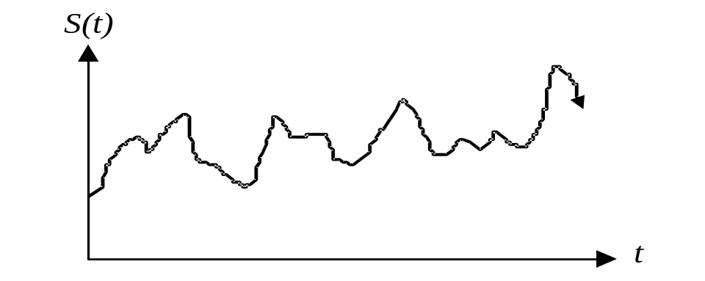
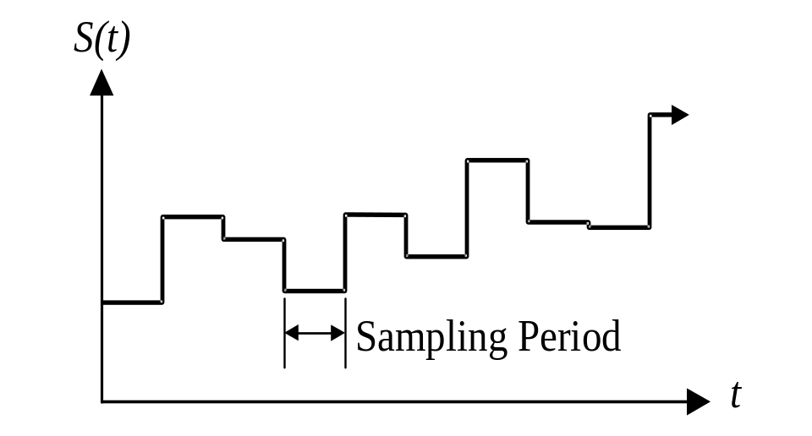
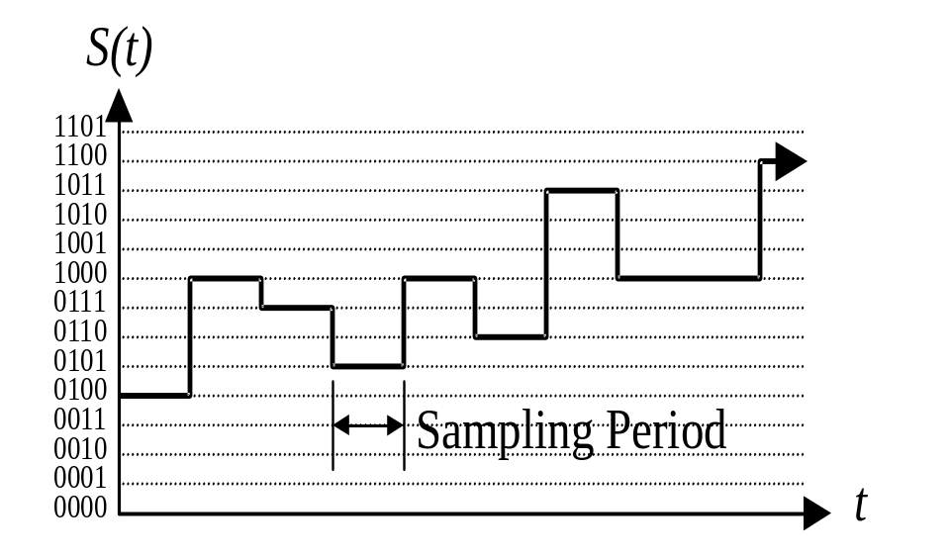
In an analog signal, noise are added to the signal during transmission. The received signal will never be identical to the original signal.
A digital signal will still be subject to noise, but the difference between signal levels (an “0101” and an “0110”) will be sufficiently large so that the receiver can always determine the original signal level in each sampling period. The regenerated, so that the received digital data is an exact replica of the original digital data.
Analog to digital conversion reduces the amount of information of the signal by approximating the analog signal with a digital signal. The sampling period and number of levels of the digital signal should be selected in order to capture as much information of the original signal as possible

Slide 4
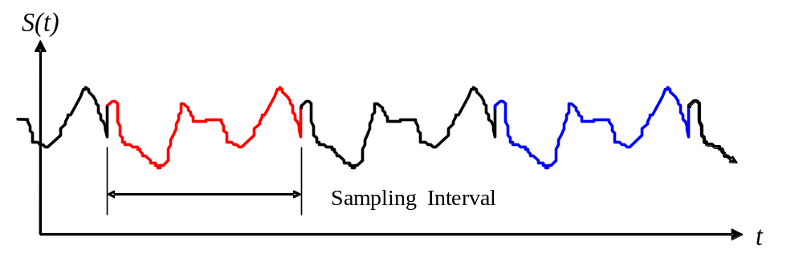
Signal Properties
A periodic signal satisfies the condition:
“Period” of the signal.
“Aperiodic.” signals
An even function S (t) = S (-t)
“Symmetric”.
The phase of the signal.

Slide 5
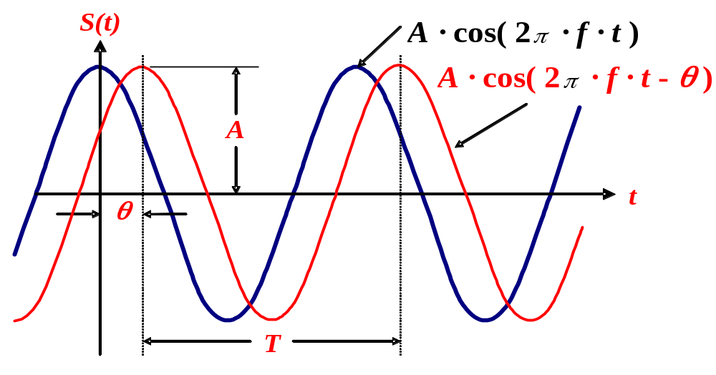
A
A
f
1/T
A
θ=0
A
1/T
f
θ=π/4
1/T
f

Slide 6
Digital signals in the time and the frequency domain.
The time domain is the signal level expressed as a function of time.
The frequency domain is comprised of amplitude and a phase for an infinite number of sinusoidal functions. These correspond to the superposition of an infinite number of sinusoidal waveforms in the time domain.
To convert from the time domain to the frequency domain, we take the Fourier transform of the time domain representation.
The frequency domain representation of a signal does not change with time, but the Fourier transform for the signal over an infinitely long time period would be impossible. Instead, we assume that the signal has some finite duration, over a sampling interval:
1. We assume that outside of the sampling interval, the signal repeats itself, so that the signal is periodic.
2. An alternative assumption is that the time-domain signal has a zero value outside of the sampling interval, so that the signal is aperiodic.

Slide 7
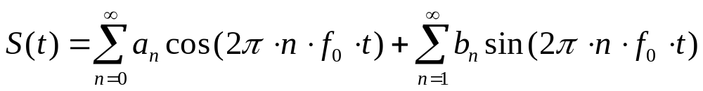
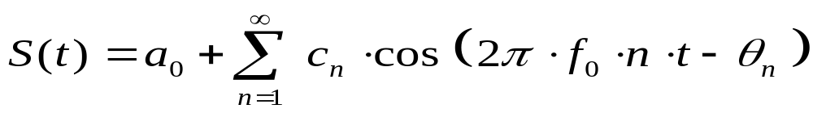
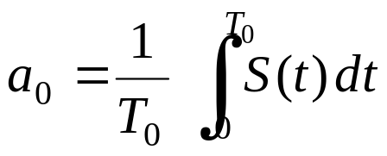
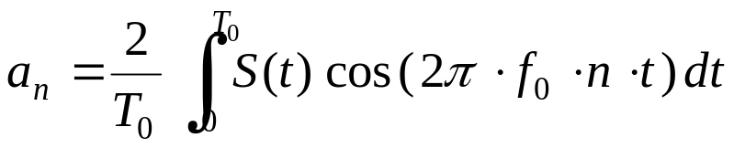
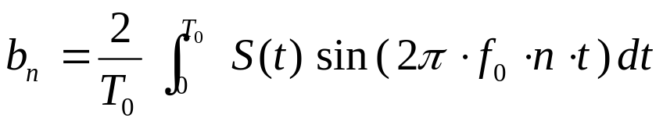
Fourier Series Expansion of Periodic Signals
a. There are a finite number of discontinuities in the period T.
b. It has a finite average value for the period T.
c. It has a finite number of posit. and negat. Max. in the period T.
f₀ : Fundamental frequency,
n · f₀ : Frequency of each term
a_{n} , b_{n} : Fourier series coefficients :

Slide 8
According to Fourier analysis, any composite signal can be represented as a combination of simple sine waves with different frequencies, phases, and amplitudes.

Slide 9
Introduction
A network and transport layers basic services comprise the end-to-end transport of the bit streams over a set of routers (switches). They are produced using six basic mechanisms:
a. Multiplexing
b. Switching
c. Error control
d. flow control
e. congestion control
f. and resource allocation.

Slide 10
Multiplexing
Combines data streams of many such users into one large bandwidth stream for long duration. Users can share communication medium.
a. Switch b. Multiplexer/Demultiplexer
a. Fully connected network
b. network with shared links.

Slide 11
Signal Modulation is:
The process of encoding a baseband (data), source signal S_{m} (t) onto a carrier signal.
The carrier waveform is varied in a manner related to the baseband signal.
The carrier can be a sinusoidal signal or a pulse signal. The result of modulating the carrier signal is called the modulated signal.

Slide 12
Signal Modulation
S_{c} ( t ) = A · cos ( 2π f t+ φ )
A. Amplitude Modulation (AM), or Amplitude Shift Keying (ASK): The amplitude A of the carrier signal changes in proportion to the baseband signal.
B. Phase Modulation (PM), or Phase Shift Keying (PSK): The phase φ of the carrier signal changes in proportion to the baseband signal.
C. Frequency Modulation (FM), or Frequency Shift Keying (FSK): The frequency f of the carrier changes in proportion to the baseband signal.

Slide 13
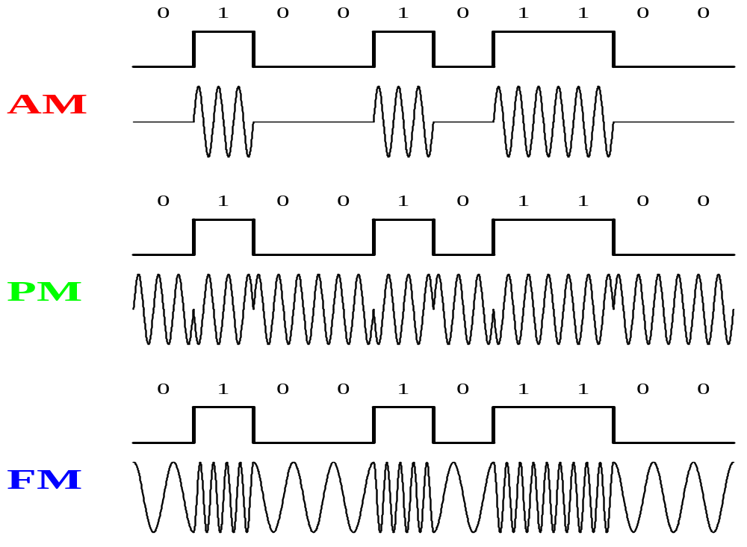
Amplitude, Phase, and Frequency Modulation of a digital baseband signal

Slide 14
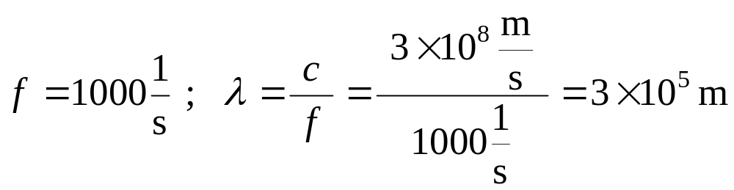
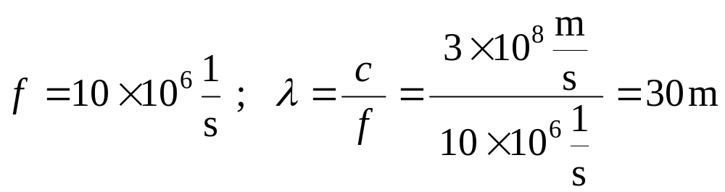
Advantages of Signal Modulation
FDM
WDM
Radio transmission of the signal.
Sc ( t ) = A · cos ( 2π fc )
range (fc + f) and (fc - f) .
5GHz
6 cm

Slide 15
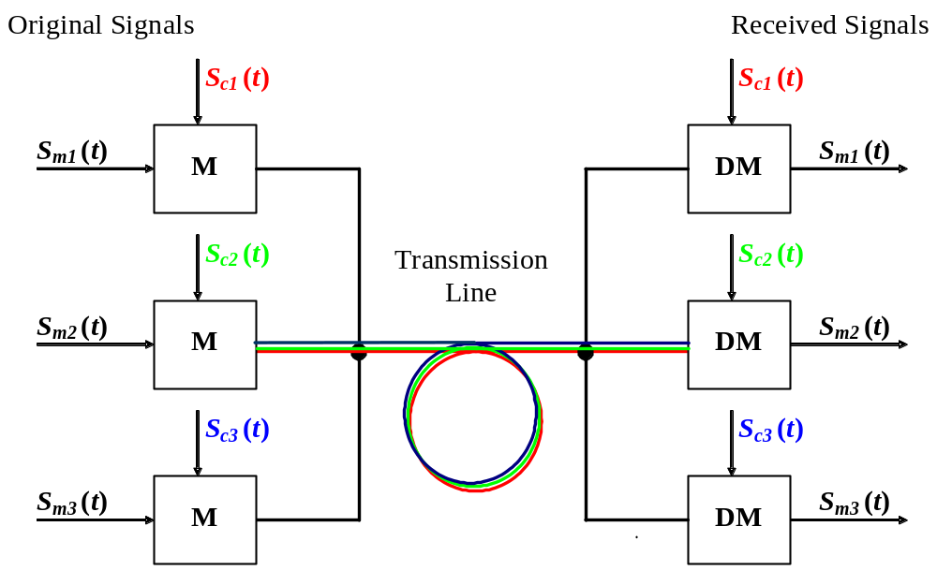
FDM
Guard band
f
fc1-fm1 fc1 fc1+fm1 fc2-fm2 fc2 fc2+fm2 .......................

Slide 16
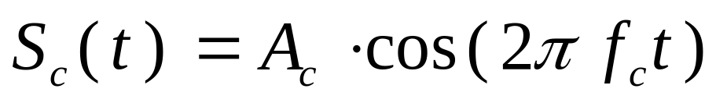
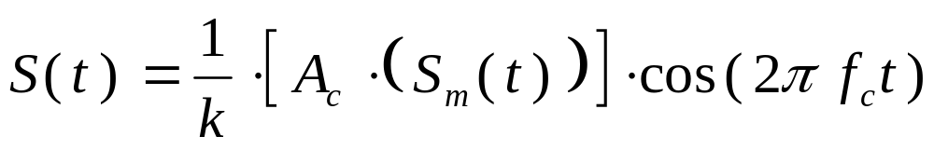
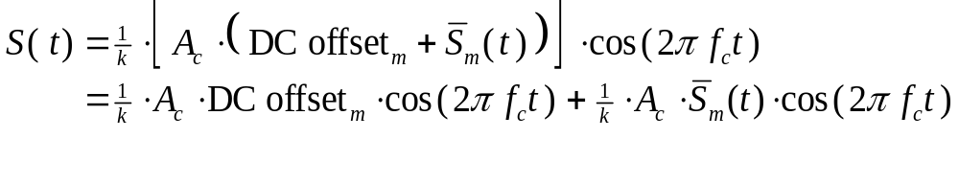
Amplitude Modulation
AM is simply the multiplication of the baseband signal with the carrier signal.
X
Sm ( t )
Modulation coefficient k describes
how efficiently the modulator device multiplies the two signals.

Slide 17
DSBTC AM
DSBTC AM. DC = Ac .
Modulation index i of a DSBTC AM signal
The simplest case of DSBTC AM, where the baseband signal is a sinusoidal signal with:
DC = Ac

Slide 18
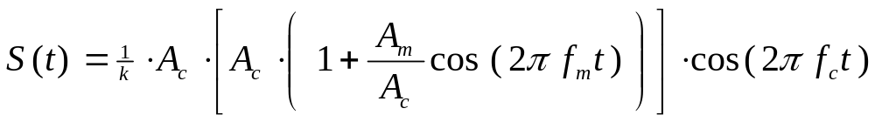
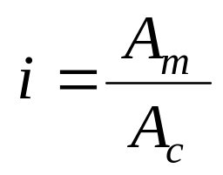
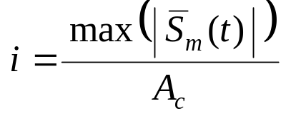
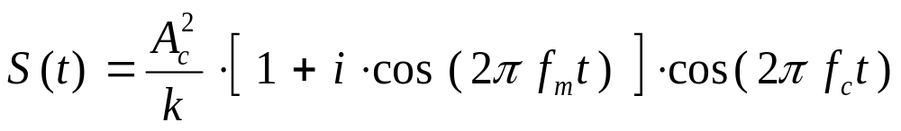
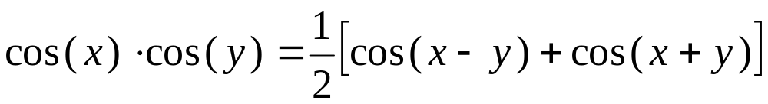
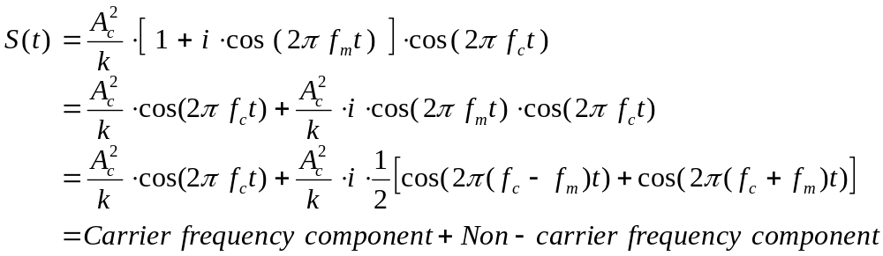
(without DC offset)

Slide 19
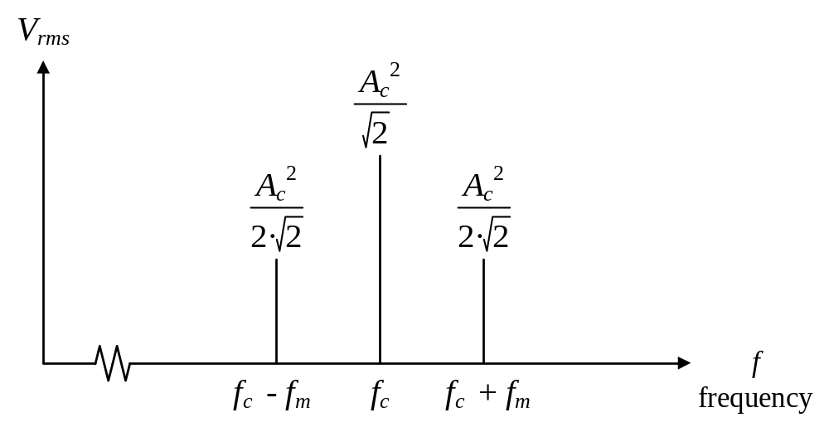
Power spectrum of DSBTC AM signal with sinusoidal baseband signal, i = 100%, k = 1.

Slide 20
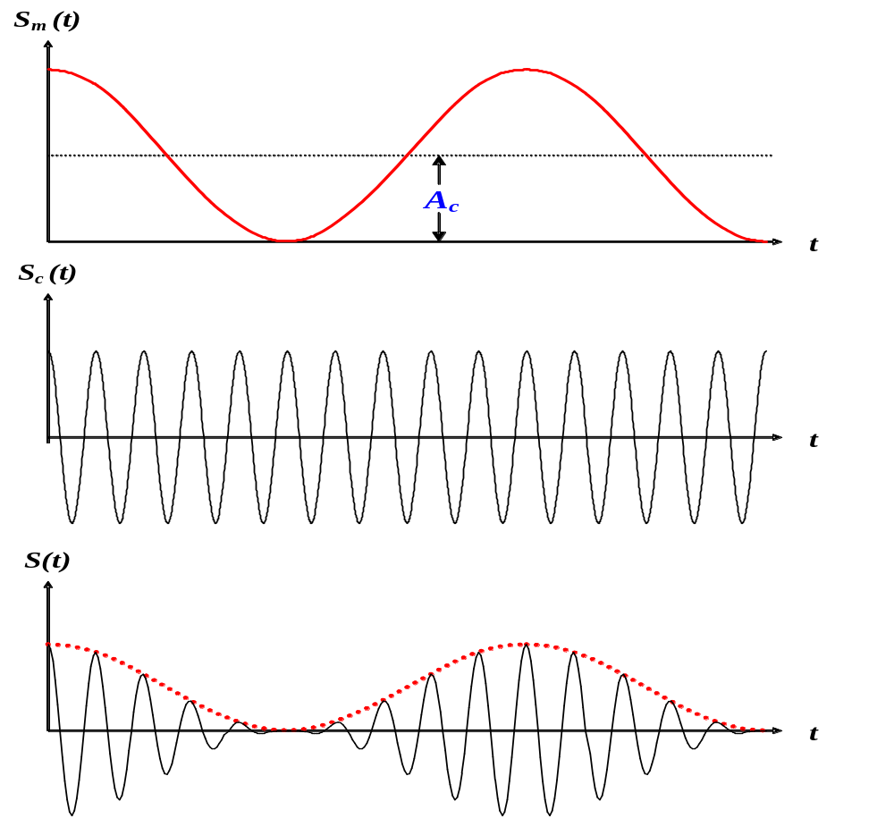

Slide 21
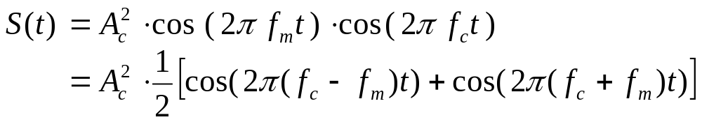
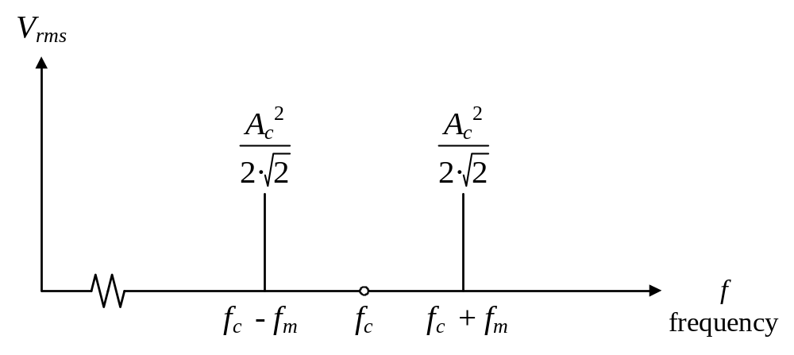
DSBSC AM
Sm ( t ) = Ac · cos ( 2π fm t)

Slide 22
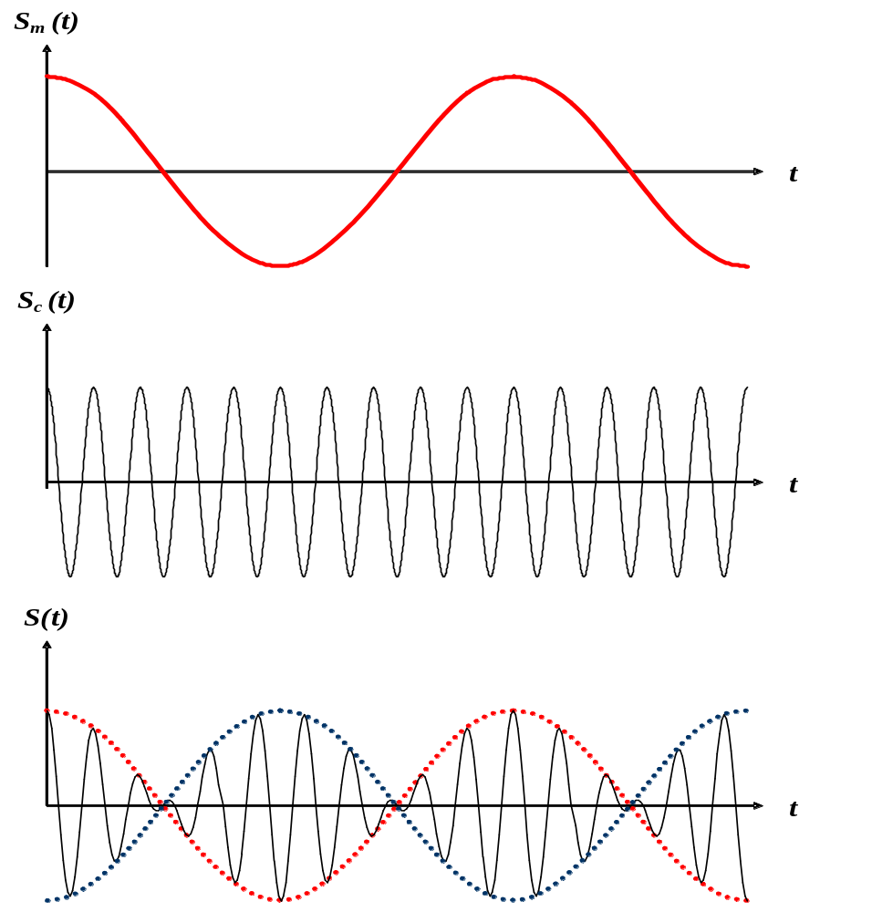

Slide 23

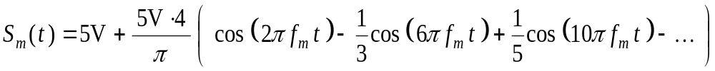
Amplitude Modulation of Digital Signals
Baseband Signal
Carrier Signal
Baseband Signal with DC shift

Slide 24
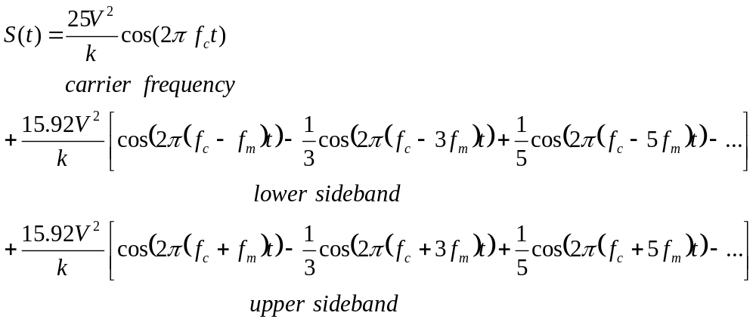
Transmitted Signal

Slide 25
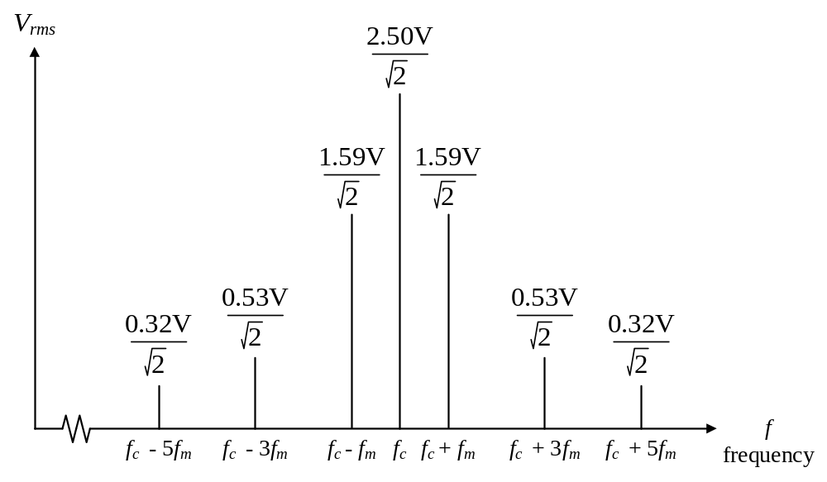
DSBTC AM signal with square wave baseband signal, i = 100%, k = 10.

Slide 26
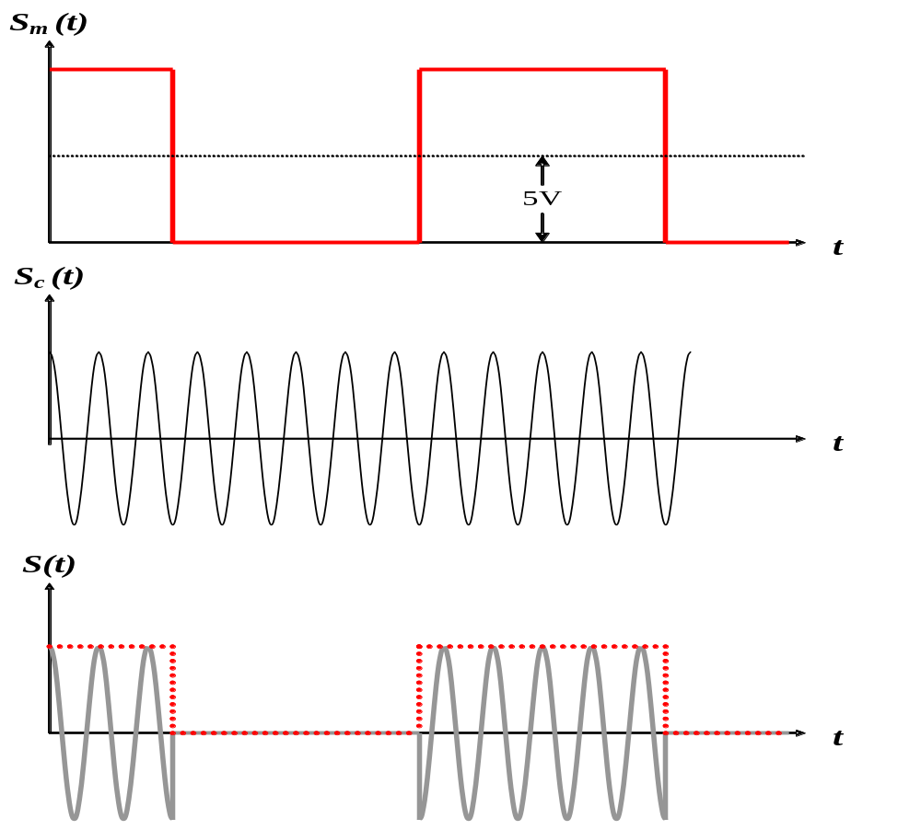
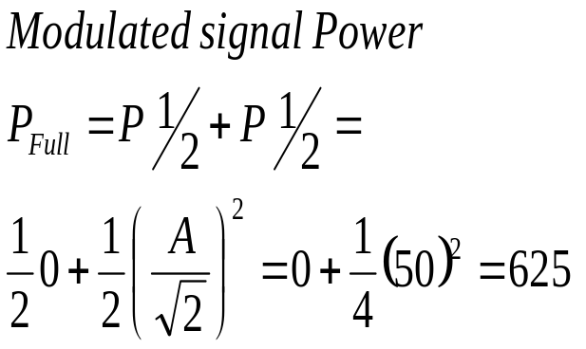
10V
5V
1/2
50V
1/2

Slide 27
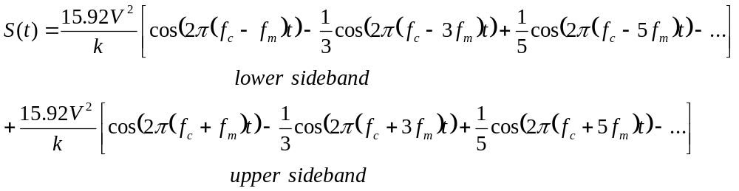
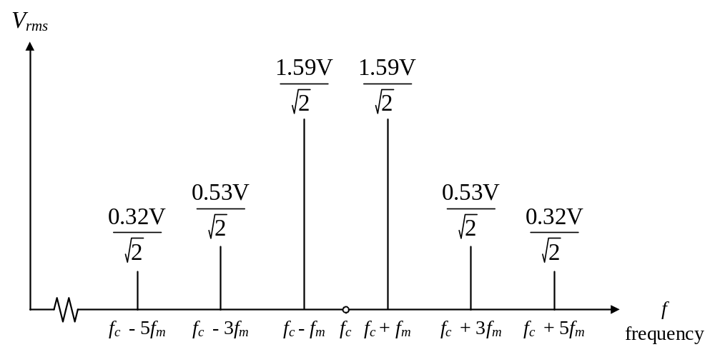
DSBSC AM

Slide 28
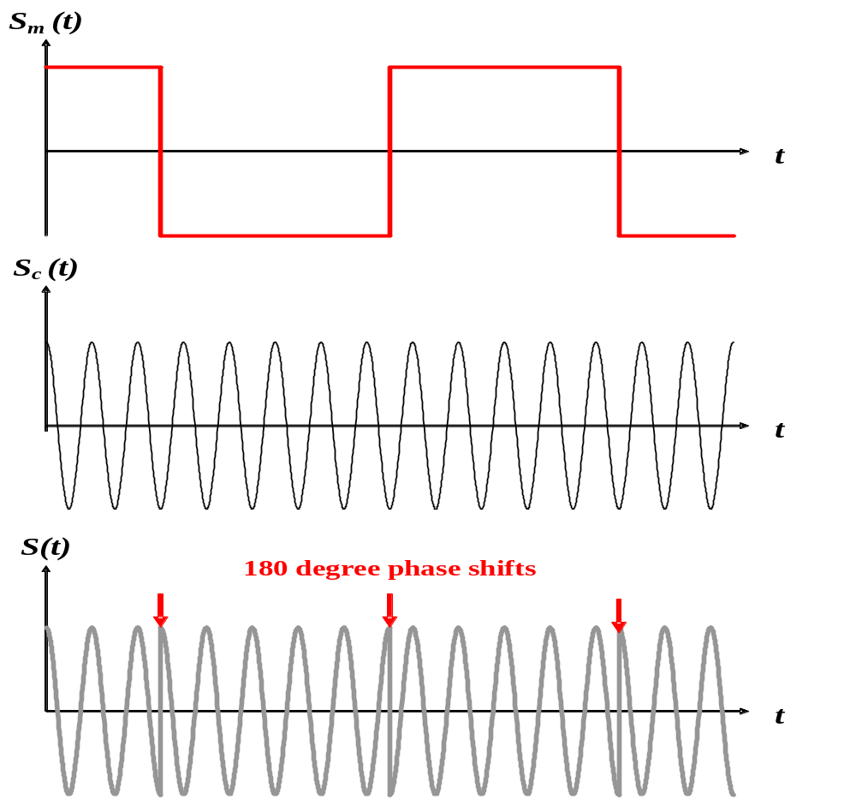

Slide 29
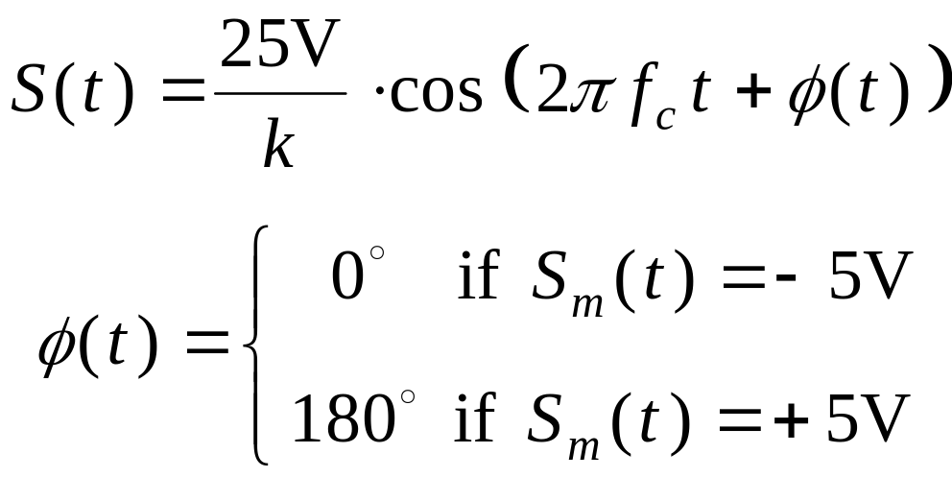
Binary Phase Shift Keying and Quadrature Phase Shift Keying
Since the phase of the transmitted signal can take one of two values (phase jumping), this type of modulation is called binary phase-shift keying (BPSK). It is a constant-amplitude method of modulation.

Slide 30
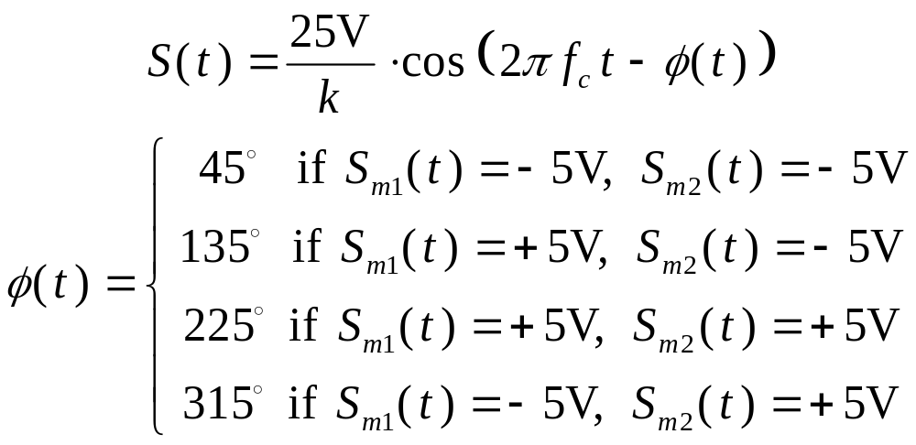
If we add together two BPSK signals that are offset by a 90 degree phase shift, there are four possible phase jumping during every sampling period. Instead of one possible shift of 180º, there are three possible transitions: +90º, 180º, and ‑90º (+270º). The signal can be represented by the following formula:

Slide 31
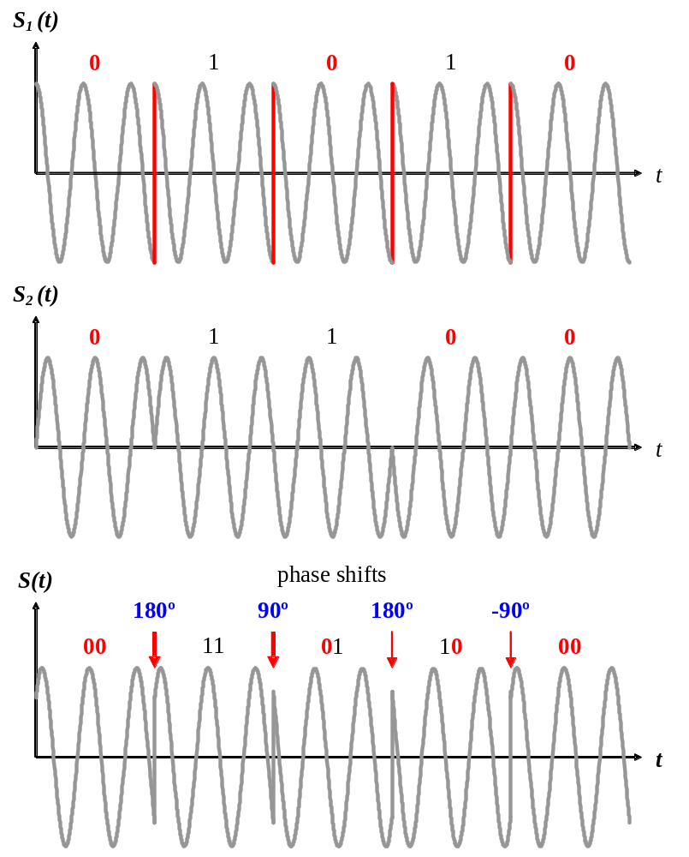
Time domain representation of QPSK signal, created: by combining BPSK signals S1 and S2 .

Slide 32
Reducing Power and Bandwidth of AM Signals
In DSBTC AM, the carrier frequency component carries no information.
In all forms of amplitude modulation, the two sidebands contain identical information.
Eliminating one of the two sidebands.
There are four possibilities for transmitting an amplitude modulated signal
A. Dual sideband, transmitted carrier (DSBTC AM)
B. Vestigial sideband
C. Dual sideband, suppressed carrier (DSBSC AM)
D. Single sideband
Selecting the type of transmission can depend on the following factors:
Power limitations
• Bandwidth limitations
• Simplicity of Demodulation Equipment

Slide 33
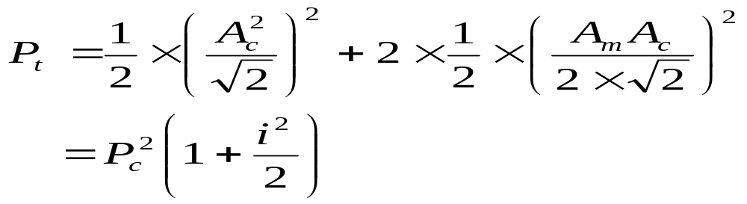
The power required for transmitting a sinusoidal baseband signal with DSBTC AM is:
P_{t} : Transmitted power, A_{c} :Carrier Signal Amplitude
i : Modulation index
i=100%, the Pt =1.5 times the power squared of the carrier frequency. Each sideband contributes 0.25 times the power of the carrier frequency.
Vestigial sideband uses only one of the two sidebands of the signal.

Slide 34
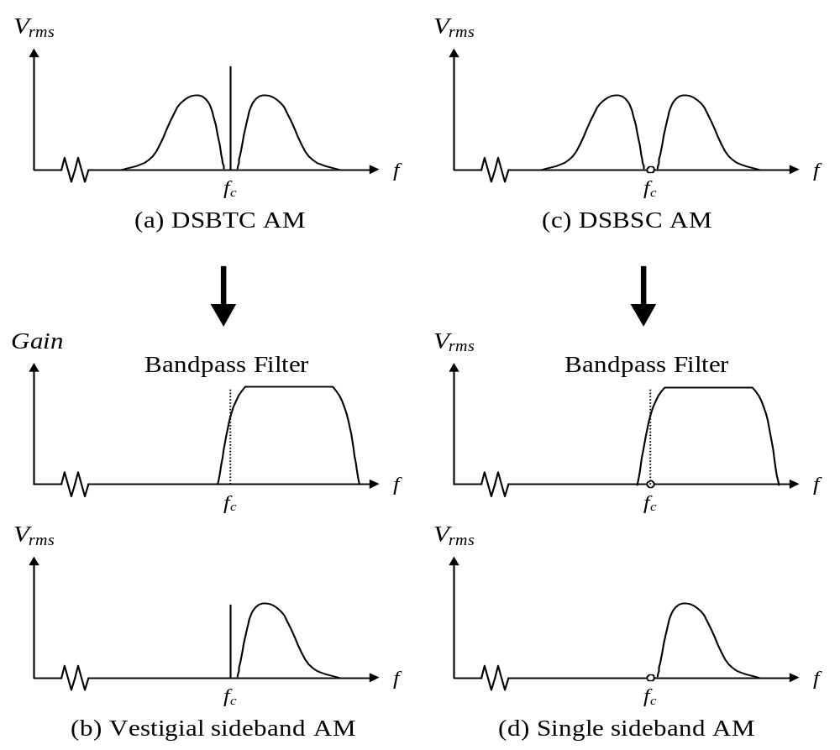
Four possible ways to transmit an AM signal.

Slide 35
Concept 1:
The total bandwidth required for AM can be determined from the bandwidth of the audio signal:
BWt = 2 x BWm.
Example
We have an audio signal with a bandwidth of 4 KHz. What is the bandwidth needed if we modulate the signal using AM? Ignore FCC regulations.
Solution
An AM signal requires twice the bandwidth of the original signal:
BW = 2 x 4 KHz = 8 KHz

Slide 36
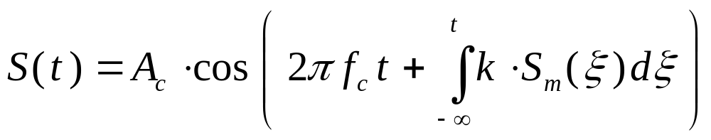
Frequency Modulation
Additive noise
Frequency modulation is a special case of phase modulation, where the phase of the transmitted signal accumulates according to the amplitude of the baseband signal:
k : Constructional coefficient of the modulator

Slide 37
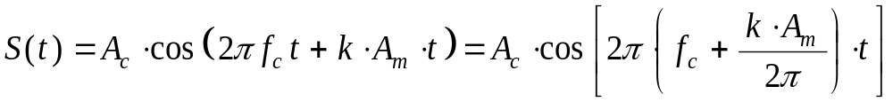
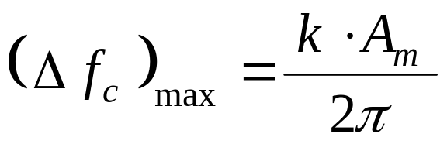
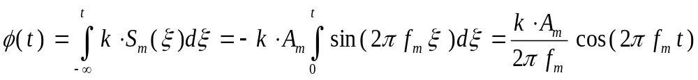
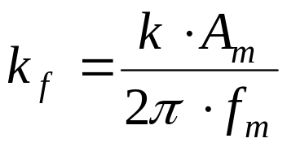
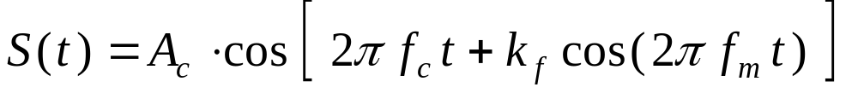
To find the maximum possible frequency deviation of an FM signal, we can assume the baseband signal is a constant voltage of +A_{m} , then the integral will reduce to a linear function of t :
Sm ( t ) = Am · sin (2π fm t )

Slide 38
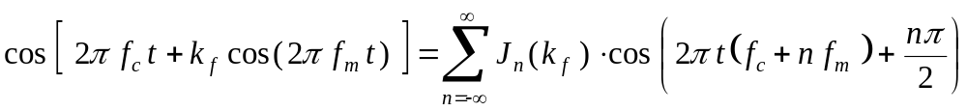

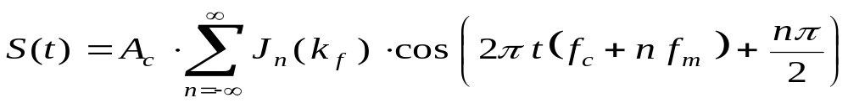
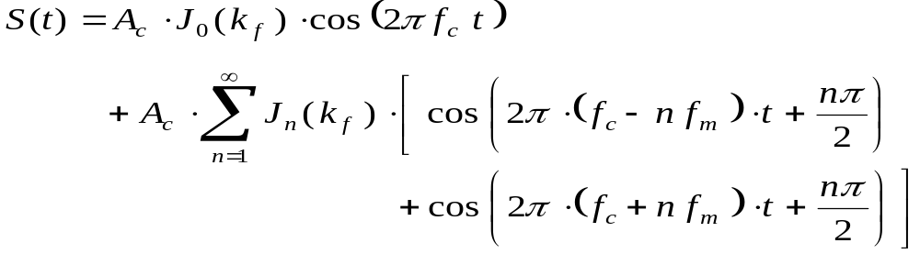
Equation can be expanded using Bessel's trigonometric identities into a series of phase-shifted sinusoidal terms.
The amplitude of each term is determined by the Bessel function of the first kind J_{n} ( k_{f} ), where k_{f} is the modulation index.

Slide 39

First five Bessel coefficients for varying values of kf .

Slide 40


Power and Bandwidth of FM Signals
Calculating the power of an FM signal is much simpler in the time domain.
In this equation B is effective bandwidth of baseband signal,
but BT is absolute bandwidth of FM signal

Slide 41

Ac · cos ( 2π fc + k_{f} cos ( 2π fm ) ) at various values of k_{f} .

Slide 42
Concept 2:
The total bandwidth required for FM can be determined from the bandwidth of the audio signal:
BWt = 10 x BWm.
We have an audio signal with a bandwidth of 4 MHz. What is the bandwidth needed if we modulate the signal using FM? Ignore FCC regulations.
Example 1
Solution
An FM signal requires 10 times the bandwidth of the original signal:
BW = 10 x 4 MHz = 40 MHz

