Slide 1
CS 117
Class Project Examples
Mobile Applications on Android

Slide 2
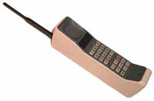
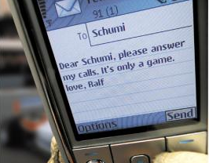
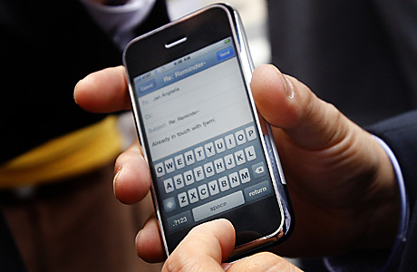

Mobile Device Evolution
Mobile Phone Users (Billion)
4
3
2
1
2000 2009 2015
New uses for mobile computing
You will be asked to develop an application on a Smartphone.

Slide 3
Project Examples from Previous Classes

Slide 4
1. Smart Alarm

Slide 5
Motivations
The Heart Rate Variability (HRV) presents characteristic oscillations connected to REM (deep sleep stage) and Non-REM sleep stages.
During deep sleep heart rate decreases, and it increases during light sleep.

Slide 6
Objective
Finished product: a user-friendly application in the Android environment
Easy to use GUI
Monitor the heart activity through a heart monitoring device that transfers the data through Bluetooth™
End product will wake the person up when the light sleep stage is detected and the time is near the time to wake up

Slide 7
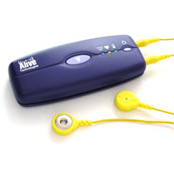

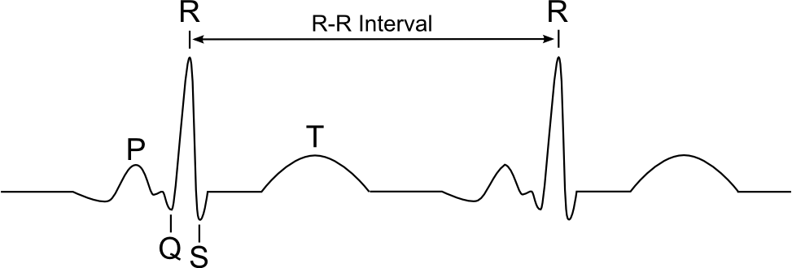
System Implementations
1. Bluetooth
Connection
2. Heart Beat
Calculation
ECG (Electrocardiogram) Sensor
- heart signals
Smart phone
4. Wake a person up
3. Analyze sleep status

Slide 8
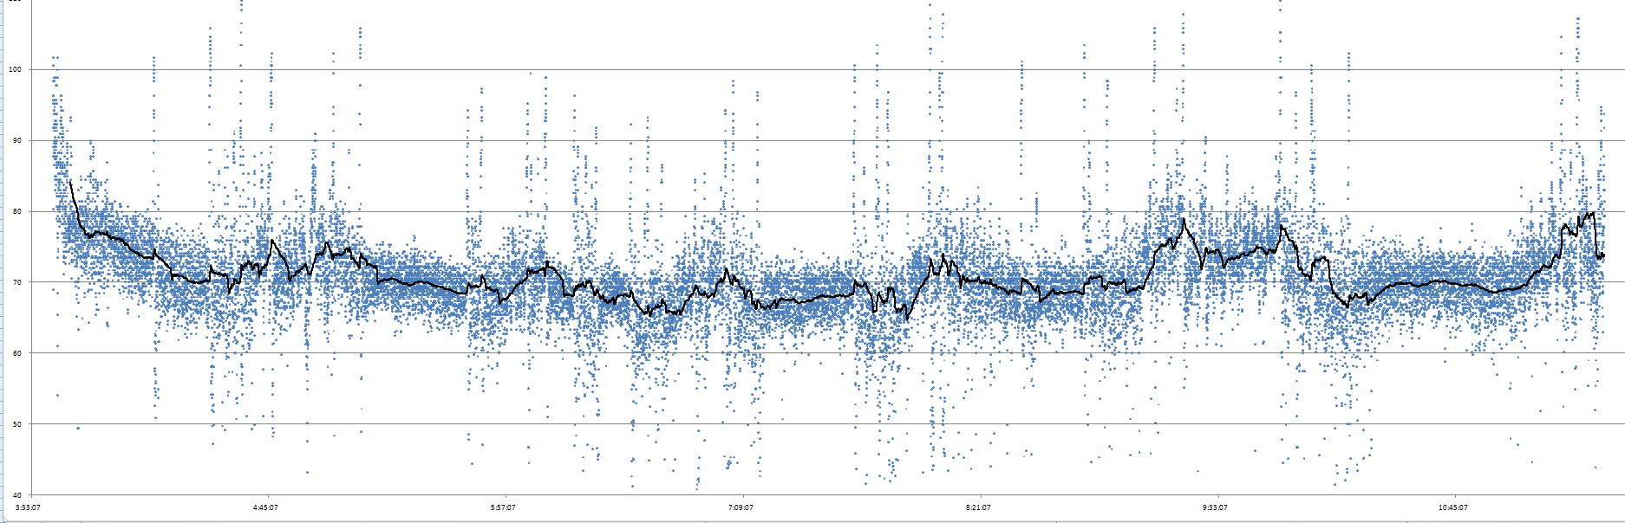
Analyzing the Heart Data
Wake up user here

Slide 9
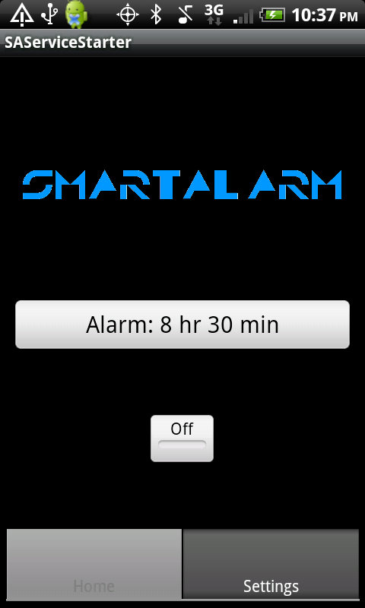
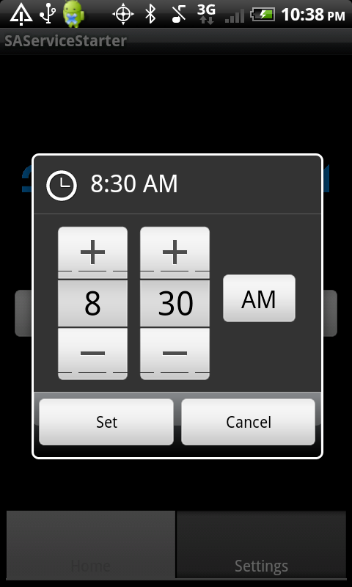
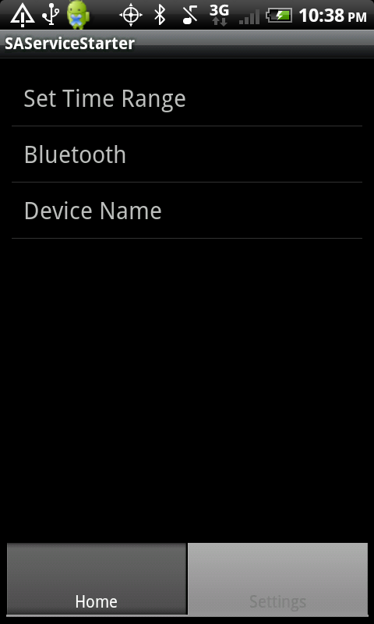
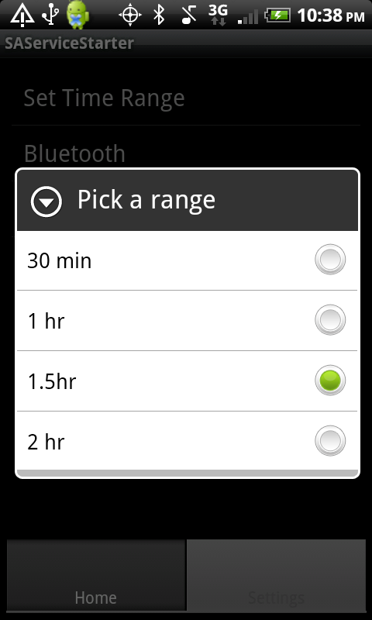
Final GUI

Slide 10
2. Ambient Radiation Monitoring

Slide 11
Motivations
Recent studies show that radiation from WiFi is harmful to trees.
Impact of wireless radiation on humans are still controversial.
  It may be harmful or not
It would be helpful if we have a radiation map

Slide 12
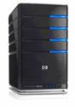
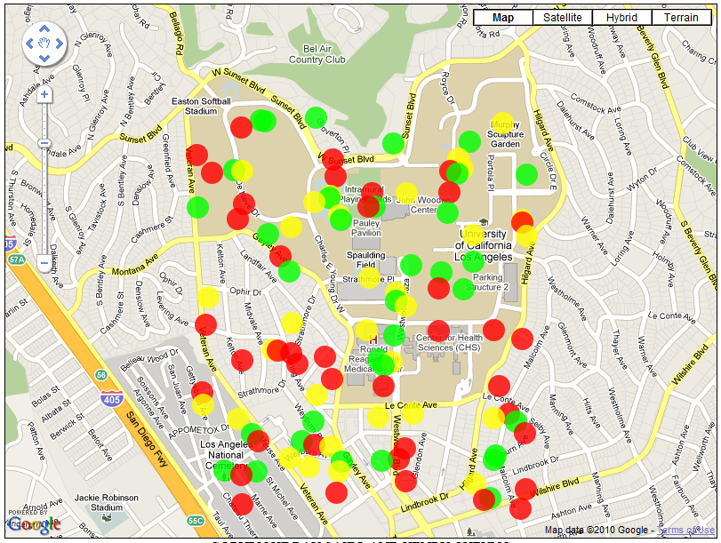
System Implementations
1. WiFi and Cellular
Signal Collection
2. Transfer Data to Server
Smart phones move around
3. Draw Radiation Map
4. Display Map Online

Slide 13
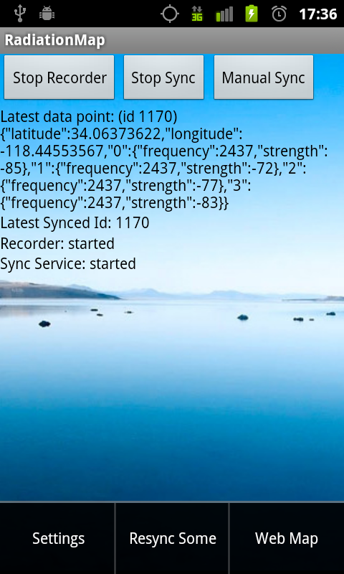
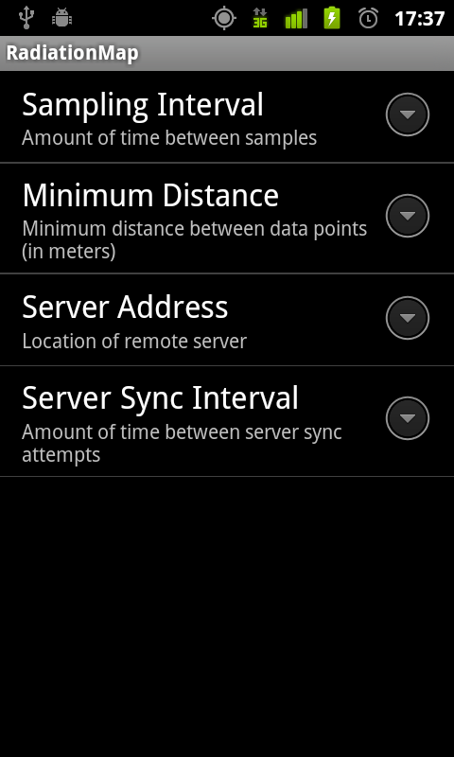
User Interface

Slide 14

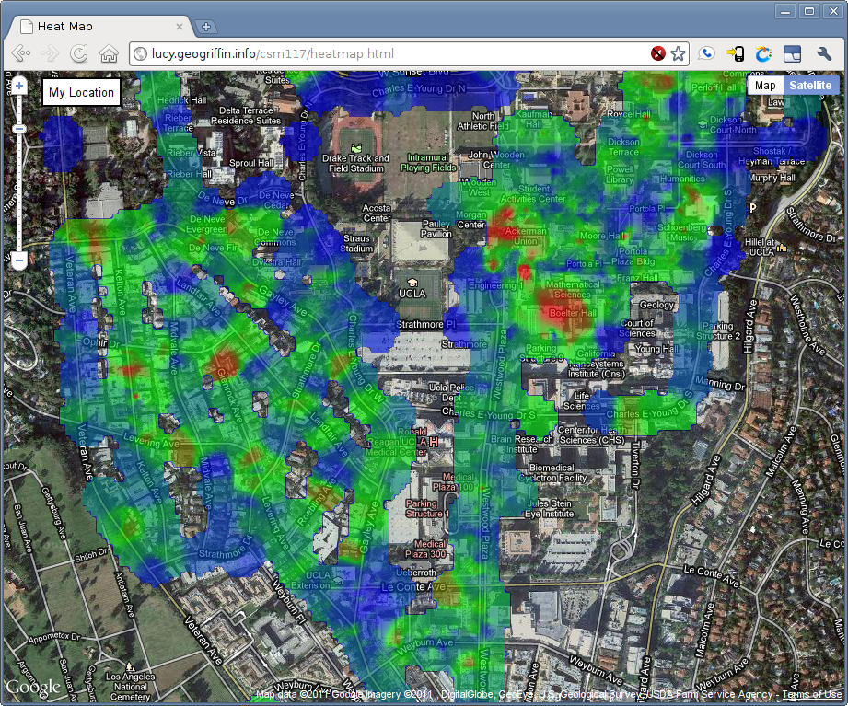

Final Product

Slide 15
Propose your projects!!

Slide 16
Project Requirements
Smart phone application
  You can use other platforms, e.g. iPhone or Windows mobile, if you have phones
Wireless Communications
  You must use at least one wireless interface
    Connection with ECG sensors via Bluetooth
    Upload data to web server via WiFi
    Communication between two phones over BT or WiFi

Slide 17
Lab Devices
2-3 ECG Sensors
At least one phone will be issued per Group
  (4) HTC Incredibles & (2) Eris (Android 2.2)
  (2) Motorola Droids (Android 2.2)
  More Android phones may be available
  OSs are all updatable.

Slide 18
CS 117 Project Grading Policy
Project – 50% of the total grading
Attendance – 10%
  You should come in twice for your progress reports(Mid-term, Final).
Proposal presentation – 10%
Progress presentation & discussion – 20%
Final Presentation – 40%
  Group presentation
  All members should participate.
  Up to 20 minutes.
Final Report (Friday of finals week) – 20%

Slide 19
Recommendation
Start EARLY
  Find your team members (3-4 students)
  Get familiar with mobile app development
    Android SDK
    Java language
  Think about your project
    Let me know if you have an idea!

Slide 20
Project topic to avoid
Please no IM chatting programs.

