Slide 1
CS 117 Class Project Examples
Mobile Applications on Android

Slide 2
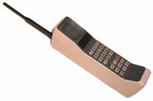
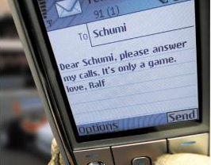
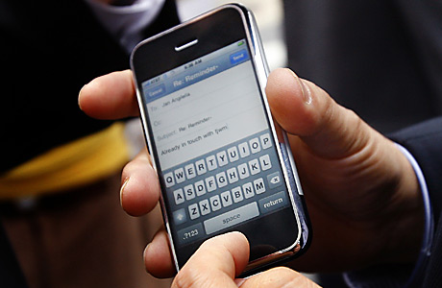

Mobile Device Evolution
Mobile Phone Users (Billion)
4
3
2
1
2000 2009 2015
New uses for mobile computing
You will be asked to develop an application on a Smartphone.

Slide 3
Project Examples from Previous Classes

Slide 4
1. Mobile Activity Monitor

Slide 5
Activity Monitoring
Use the android smart-phone as a data collection device
Run a software pedometer to classify and count steps
Upload hourly step counts to central server
Provide interesting statistics and views
Focus: Ease of use, non-interference

Slide 6
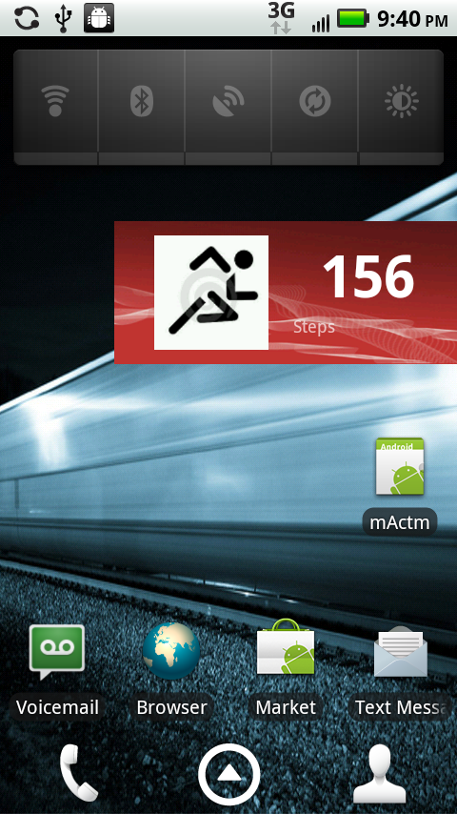
Android Pedometer Module
Pedometer Widget displaying steps on Home Screen
Count reset at the end of each hour
Screen scrape of the android display shown on the right

Slide 7
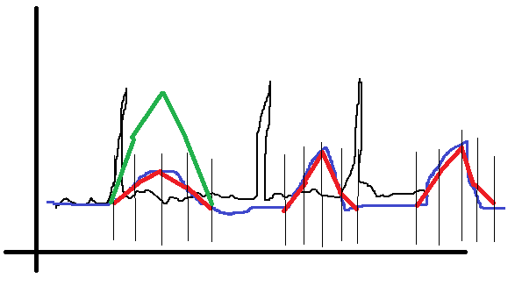
Android Pedometer Module
Accelerometer Sensor Service
High Resolution Accelerometer values
Process:
Apply Kalman filter
Calculate magnitude
Calculate moving average based on window
Filter based on moving average window (spike type classifier)
Different thresholds
Green -> Run threshold
Red -> Walk threshold
Blue -> Moving average
Black -> Accelerometer data

Slide 8
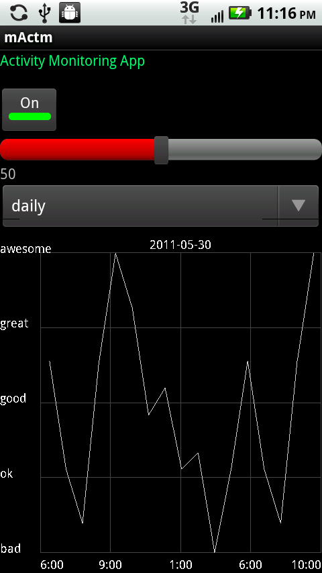
Android User-Interface & Data Display
Provides control over the Activity Monitor
Control over the pedometer sensitivity
Choice of views: daily, weekly, monthly
Graphical Representation.
Metrics that make more sense

Slide 9
2. Ambient Radiation Monitoring

Slide 10
Motivations
Recent studies show that radiation from WiFi is harmful to trees.
Impact of wireless radiation on humans are still controversial.
It may be harmful or not
It would be helpful if we have a radiation map

Slide 11

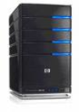
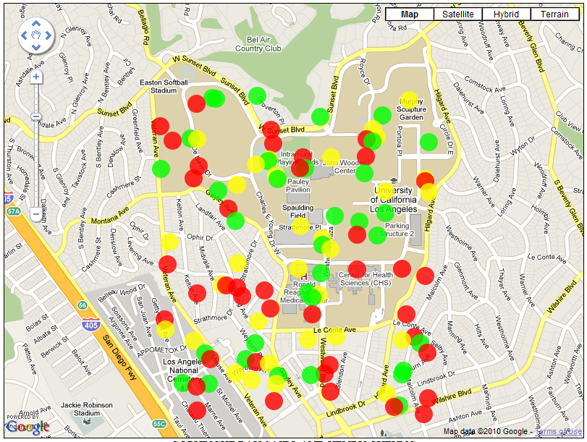
System Implementations
1. WiFi and Cellular
Signal Collection
2. Transfer Data to Server
Smart phones move around
3. Draw Radiation Map
4. Display Map Online

Slide 12
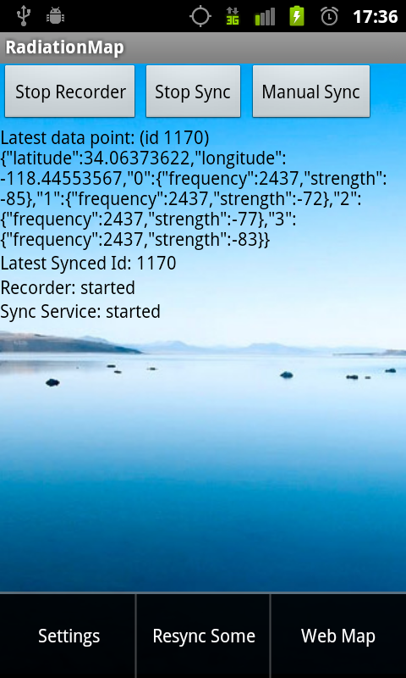
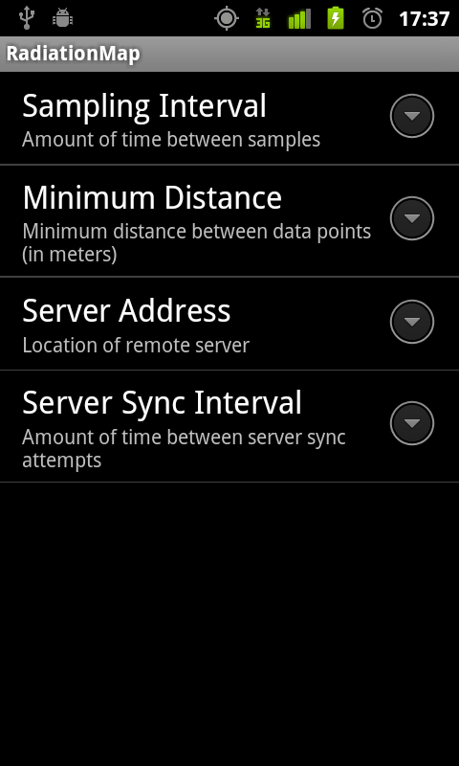
User Interface

Slide 13

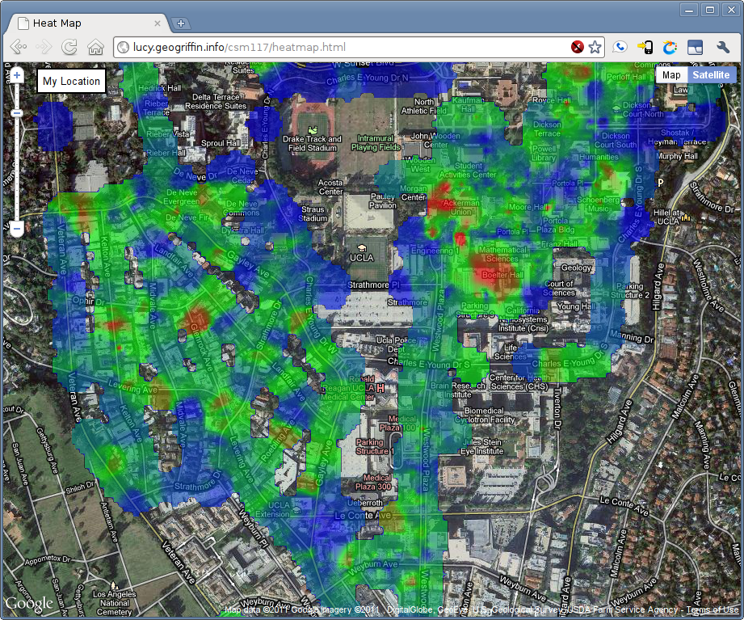
Final Product
UCLA

Slide 14
Proposed projects
1. Implementing network simulator on Sewer Net (Not an Android project) Tutor : Jungsoo Lim (jungsoo.lim@lacity.o​rg)
2. EyeGuardian: A Framework of Eye Tracking and Blink Detection for Mobile Device Users (Android project) Tutor : Seongwon Han (swhancs@gmail.com)
If you are interested in these projects please contact tutors

Slide 15
2. EyeGuardian: A Framework of Eye Tracking and Blink Detection for Mobile Device Users

Slide 16
Motivations
Computer Vision Syndrome (CVS)
The symptoms of CVS - eye irritation, such as dry eye; red, itchy, and watery eyes; fatigue, difficulty in focusing the eyes, headaches, neck aches, backaches and muscle spasms.
Cause of CVS
Reading information on a computer screen often increases burden on the human eyes.
To adapt to this screen-saturated viewing situation, people tend to blink less than usual.
Tears covering the eyes evaporate more rapidly during long non-blinking phases, resulting in dry eyes.

Slide 17
Solution
CVS is a real problem and we can certainly appreciate the need for solving it
The simplest way to avoid CVS is to blink frequently.
HOW? Develop an Application to solve it
EyeGuardian : a mobile application that keeps track of the reader's blink rate and prods the user to blink if an exceptionally low blink rate is detected.

Slide 18
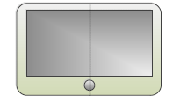
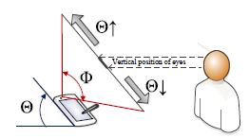
System Implementations
Using front facing camera, it monitors users blink rates
!!!
Galaxy tab 10.1 tablet PC
2. recommends the users to rest their eyes if the number of eye blinks is lower than thresholds
We will use front camera of Samsung Galaxy tab 10.1 and Android version of OpenCV libraries for image processing

Slide 19
Propose your projects!!

Slide 20
Project Requirements
Smart phone application
You can use other platforms, e.g. iPhone or Windows mobile, if you have phones
Wireless Communications OR Health related issues
It’s recommended to use at least one wireless interface
Upload data to web server via WiFi
Communication between two phones over BT or WiFi
But NOT limited to wireless interface
If you use at least one of the sensors on the phone e.g.) Accelerometer, 3-axis gyroscope, GPS, Digital compass, NFC, Camera, Microphone etc.

Slide 21
Lab Devices
NFC tags
Two phones will be issued per Group
(10) Samsung Nexus S with NFC capability (Android 2.3.4)
(5) Samsung Galaxy SII (Android 2.3.4)
(10) Motorola Droid Bionic with unlimited Data plan (Android 2.3.4)
(1) iPad2 & (1) Galaxy tab 10.1
More Android phones may be available

Slide 22
Project Schedule
Week | Tuesday | Wednesday | Thursday
4 | 01/31 PA2232 Teams formed & Project design proposed | 02/01 BH3704 Lab # 3 BT PAN HW # 3 & RDS 2 due | 02/02 PA2232 Projects proposed by students (5 min)
5 | 02/07 BH3704 Equipments handed out | 02/08 No class | 02/09 BH3704
6 | 02/14 BH3704 | 02/15 No class | 02/16 BH3704 REP & RDS 3 due
7 | 02/21 PA2232 Progress presentations by students (10 min) | 02/22 No class | 02/23 BH3704
8 | 02/28 BH3704 | 02/29 No class | 03/01 BH3704
9 | 03/06 BH3704 | 03/07 No class | 03/08 BH3704
10 | 03/13 PA2232 Final presentations (1) | 03/14 BH3704 Quiz test | 03/15 PA2232 Final presentations (2)
Finals week |  |  | 03/22 Project reports submission due
*Red bold text - you are required to come to the class

Slide 23
CS 117 Project Grading Policy
Project – 50% of the total grading
No attendance checks – 0%
Lab (3704BH) will be open for discussion Tuesdays and Thursdays (2 – 4pm)
Tues for Dis 1A and Thurs for Dis 1B recommended to avoid congestion
Proposal presentation – 10%
Progress presentation & discussion – 20%
Final Presentation – 50%
Group presentation
all members will participate
up to 20 minutes
Final Report (Friday of finals week) – 20%

Slide 24
Final Report
Due: 03/22 Midnight
Electronic submission only
Send to swhancs@gmail.com
One submission for one team
No strict format
Can be either single or double column
No minimum/maximum page length
Usually 8-10 pages (single column, single space)
Can include pictures/figures
Do not include source codes

Slide 25
Recommendation
Start EARLY
Find your team members (4 students) by Jan 31st.
Get familiar with mobile app development
Android SDK
Java language
http://developer.android.com/
Think about your project
Let me know if you have an idea!

Slide 26
Contact Information
Seongwon Han
swhancs@gmail.com
Jungsoo Lim (project on sewer net)
jungsoo.lim@lacity.o​rg
Sungwon Yang
swyang@cs.ucla.edu

