Slide 1
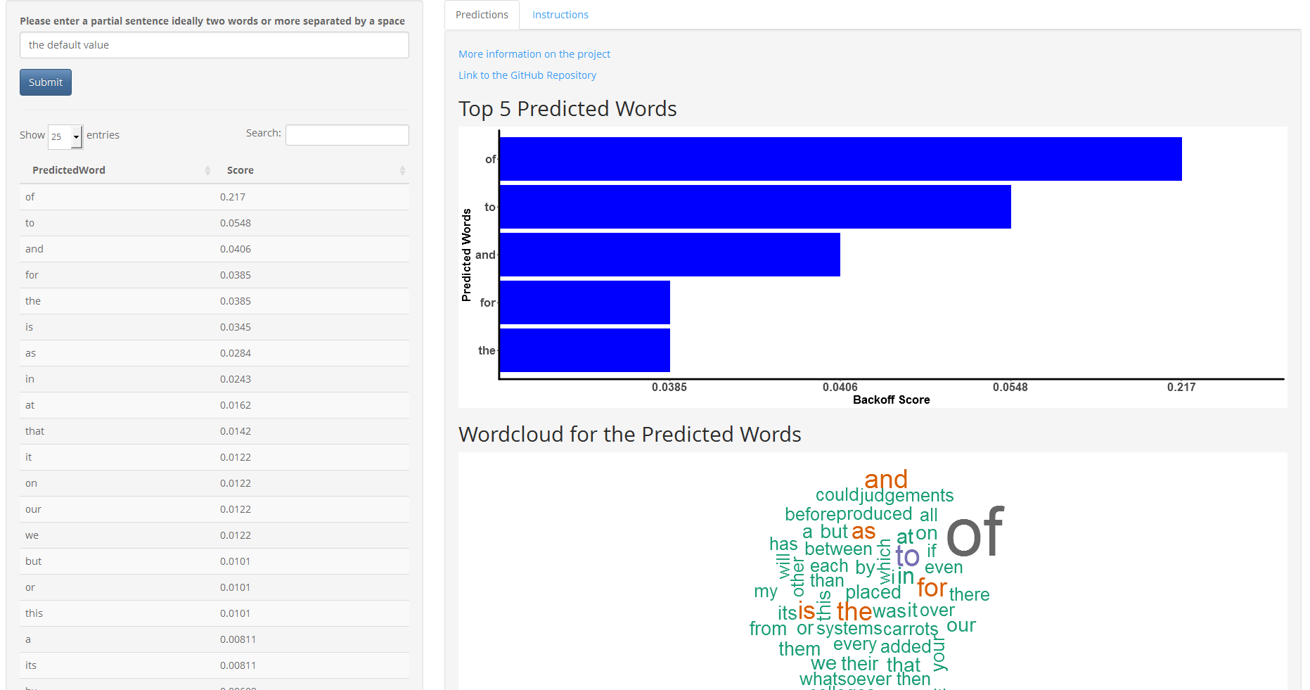

Slide 2
n≥5
Split the last 5 words into a quadragram and end word
Check the quadragram table for a match
Yes
Match the quadragram to the pentagram start in pentagram table
Output the end of the matching pentagrams as the predicted word
Input partial sentence
Match found?
n=4
No
Split the sentence into a trigram and end word
Check the quadragram table for a match
Yes
Match the trigram to the quadragram start in quadragram table
Output the end of the matching quadragrams as the predicted word
Check the length (n) of the sentence
Match found?
No
n=3
Match the bigram to the trigram start in trigram table
Output the end of the matching trigrams as the predicted word
Split the sentence into a bigram and end word
Check the trigram table for a match
Yes
Match found?
n≤2
Split the sentence into a unigram and end word*
Check the bigram table for a match
Match the bigram to the trigram start in trigram table
Output the end of the matching bigrams as the predicted word
Match found?
*For n=1, the start and end word are the same
No

