Slide 1
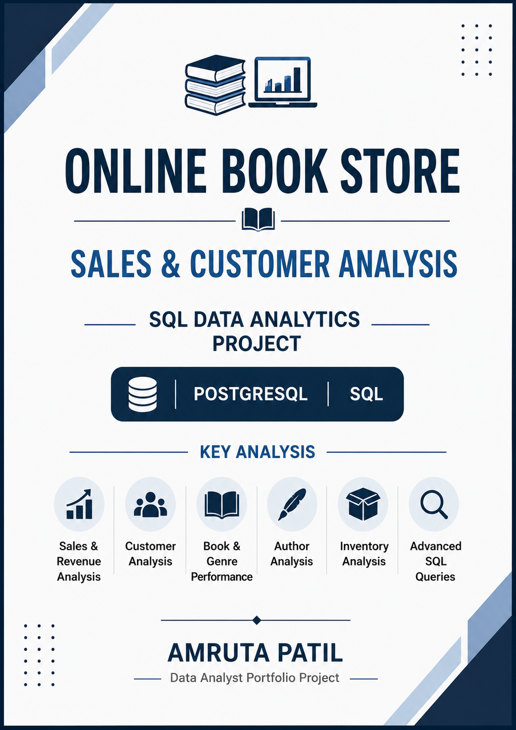

Slide 2
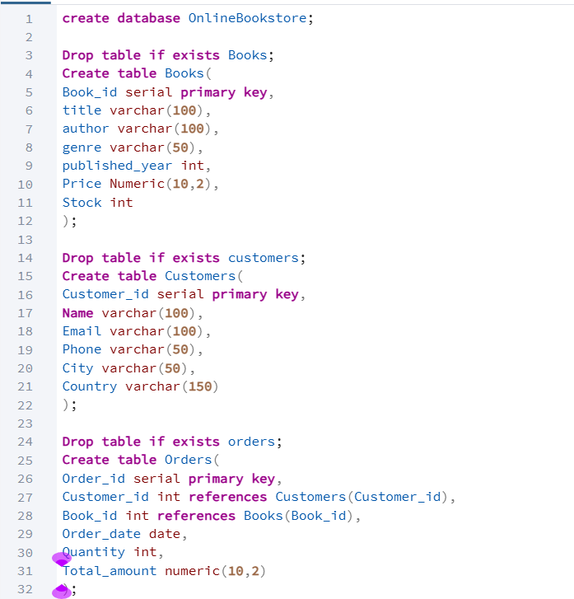
DATABASE DESIGN
Database Structure: Designed a relational Online Book Store database using Books, Customers, and Orders tables connected through primary and foreign keys.

Slide 3
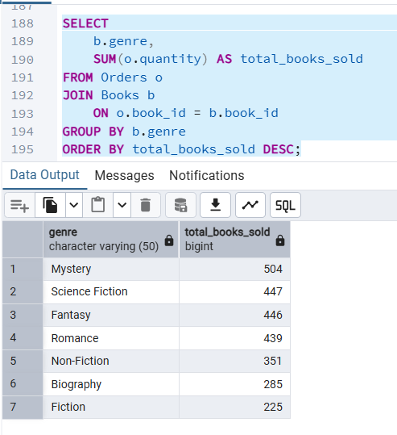
SALES ANALYSIS BY GENRE
SQL Concepts Used: JOIN • SUM() • GROUP BY • ORDER BY
Business Objective: Identify the book genres generating the highest sales volume.

Slide 4
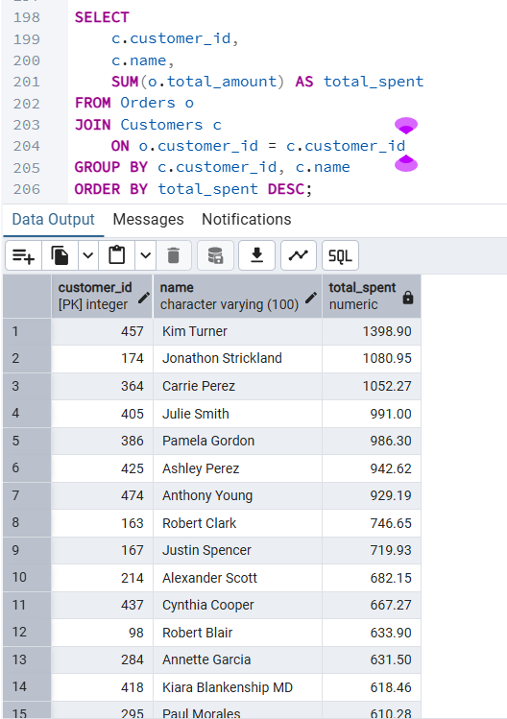
CUSTOMER SPENDING ANALYSIS
SQL Concepts Used: JOIN • SUM() • GROUP BY • ORDER BY
Business Objective: Identify high-value customers based on their total spending

Slide 5
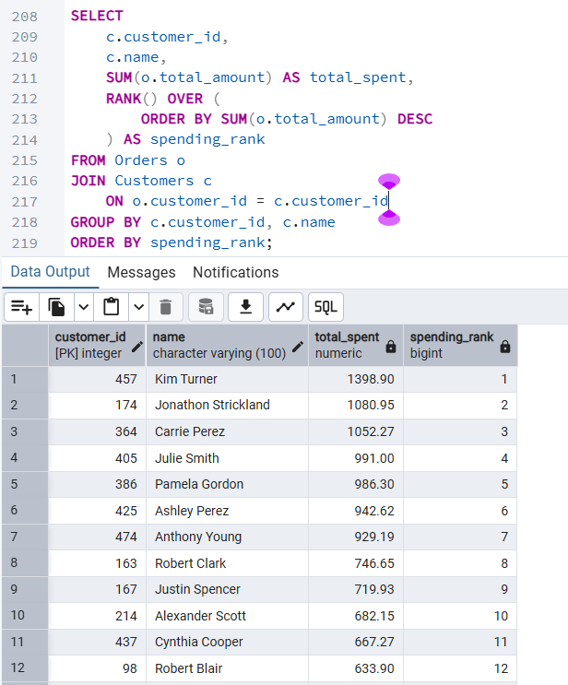
CUSTOMER RANKING USING WINDOW FUNCTIONS
Advanced SQL Concepts: RANK() • Window Functions • JOIN • GROUP BY • Aggregate Functions
Business Objective: Ranked customers based on their total spending to identify high-value customers.

Slide 6
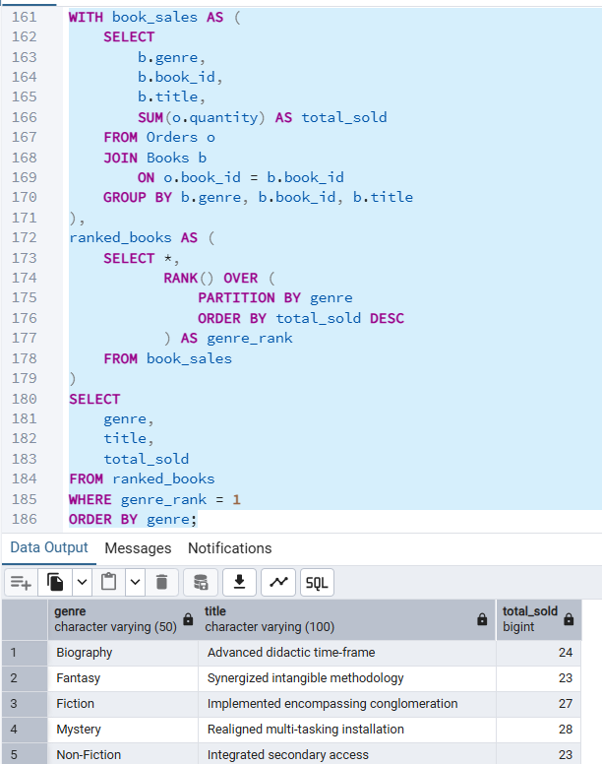
BEST-SELLING BOOK BY GENRE
Advanced SQL Concepts: CTE • RANK() • PARTITION BY • JOIN • GROUP BY
Business Objective: Identify the best-selling book within each genre to understand product-level performance.

Slide 7
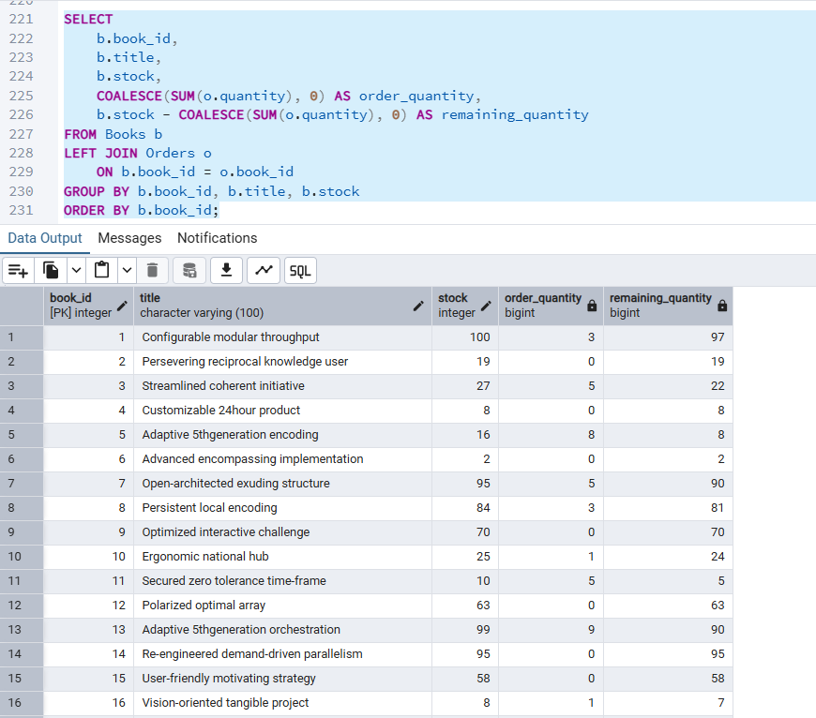
INVENTORY ANALYSIS
SQL Concepts Used: LEFT JOIN • COALESCE() • SUM() • GROUP BY
Business Objective: Calculate ordered quantities and remaining inventory for each book to
support stock monitoring.

Slide 8
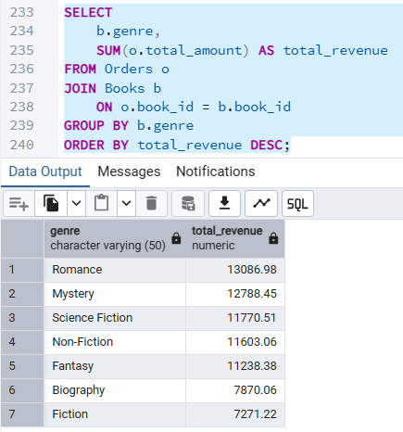
REVENUE ANALYSIS BY GENRE
SQL Concepts Used: JOIN • SUM() • GROUP BY • ORDER BY
Business Objective: Analyse revenue contribution by genre and identify the highest-performing book categories.

