Slide 1

Data Analytics on Conference Session Catalog using Jupyter Notebooks handson workshop
Lucas Jellema
Conclusion Machine Learning Gilde
21 februari 2019

Slide 2
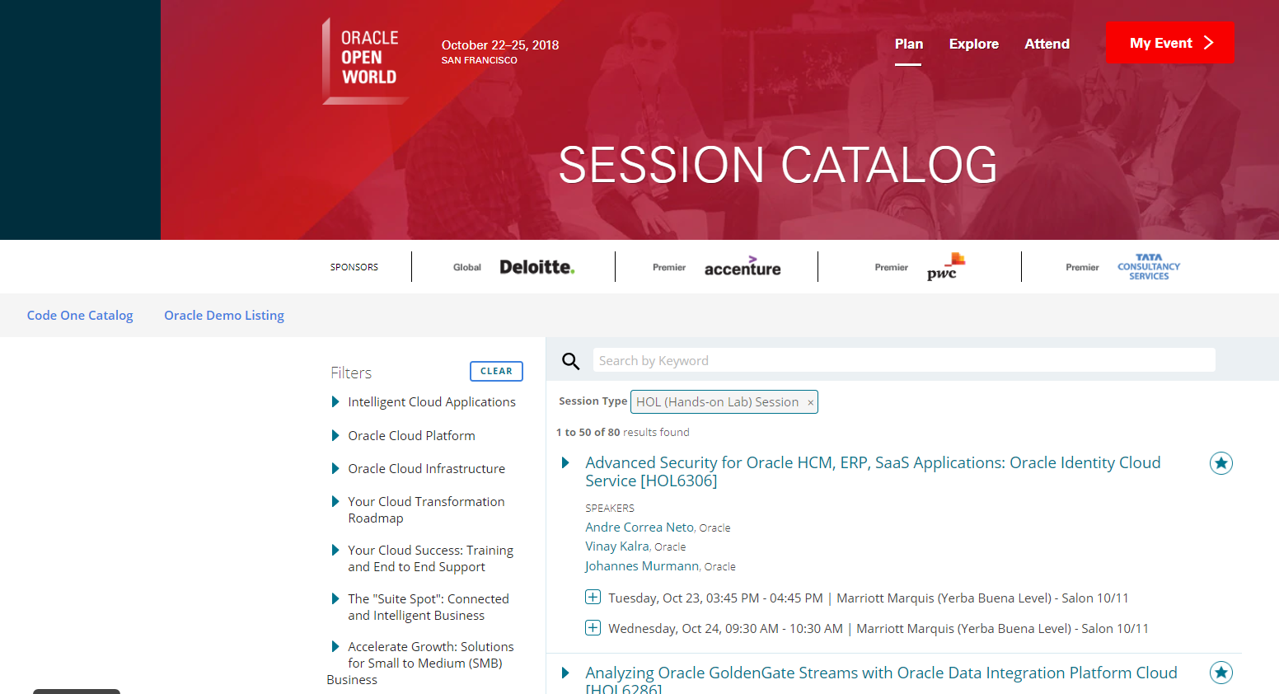
Data Analytics on Oracle OpenWorld 2018 Session Details

Slide 3

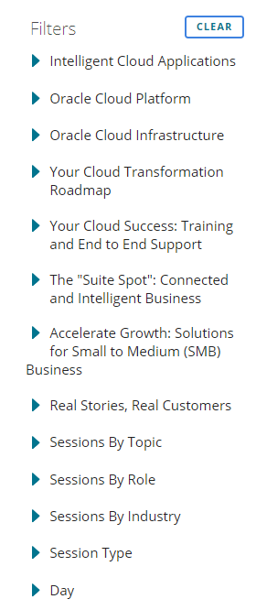

High level overview
Two events: Oracle OpenWorld 2018 and Oracle CodeOne 2018
Over 2000 sessions
Over 2500 speakers
Various dimensions:

Slide 4
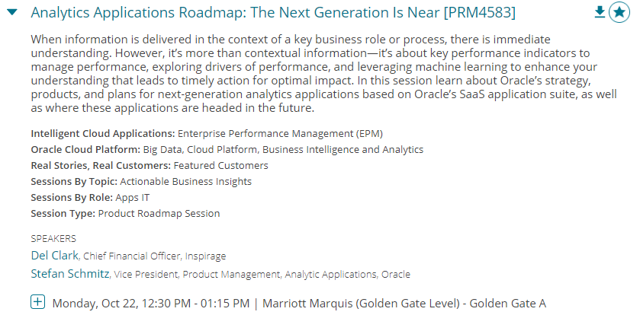
High level overview
Details per session:

Slide 5

High level overview
Details per speaker:

Slide 6

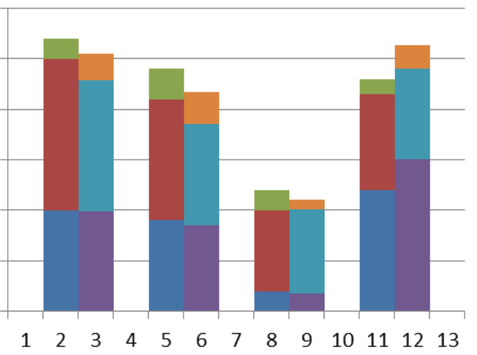

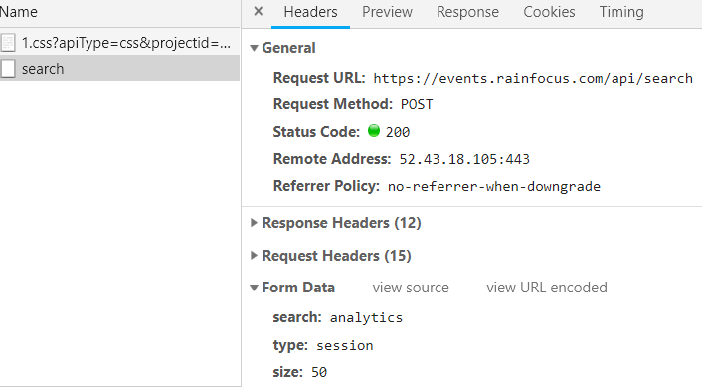
Flow for Oracle OpenWorld 2018 Session Data Analytics
Data Gathering
Data Wrangling
Business Intelligence
Report & Visualization on Speakers
API for session details in JSON
Report & Visualization on Sessions
Machine Learning
AMIS Kick Off 2019 - Proposities & Data Analytics

Slide 7

Flow for Oracle OpenWorld 2018 Session Data Analytics
3
Exploration of Conference Speakers , visualizations, business insights and answers.
1
2
From Raw, External, Slow/Unavailable Data
to local, accessible, still fairly raw Data Lake
To a consolidated, cleansed, formatted, unified Data Set with derived and enriched values
Gender guesser
Jupyter Notebook & Python
Visualizations
API for session details in JSON
Jupyter Notebook & Python
Jupyter Notebook & Python
JSON file
JSON files
Jupyter Notebook & Python
Visualizations
AMIS Kick Off 2019 - Proposities & Data Analytics
4
Exploration of Session Details, visualizations, business insights and answers.

Slide 8
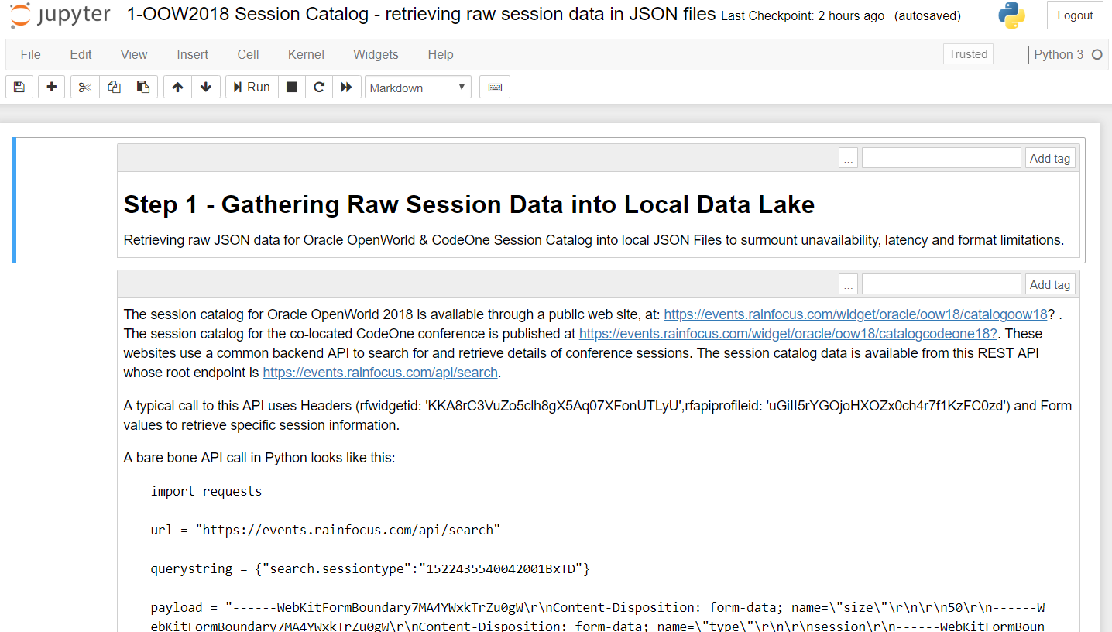
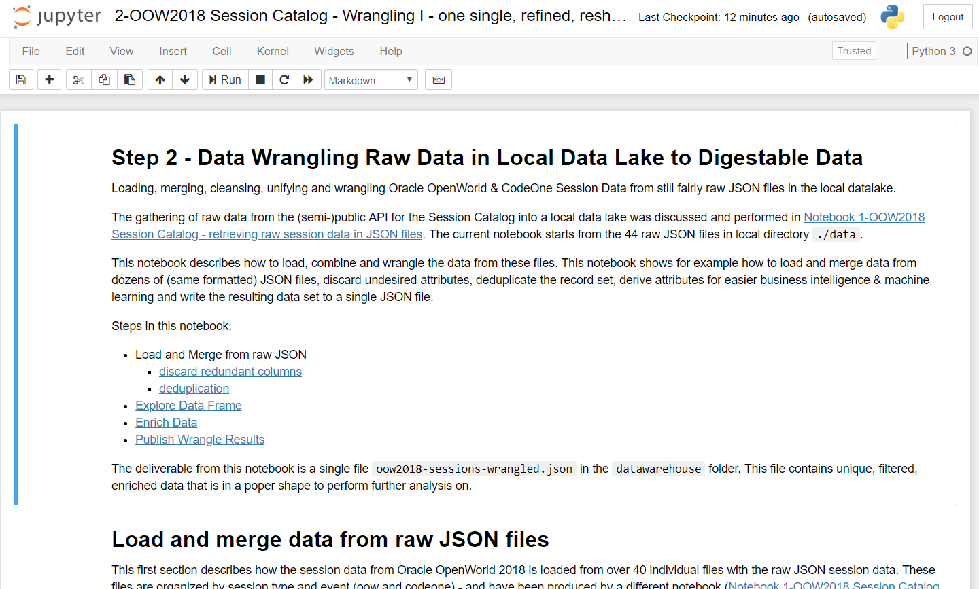
Data flow for Oracle OpenWorld 2018 Session Data
Speakers:
Read JSON file, extract speaker details, visualize and analyze speaker data
Fetch all raw session data per Event and per Session Type from API and write to 44 local JSON files
Read all JSON files, discard unneeded attributes, derive new attributes, deduplicate records and write to a single local JSON file
Gender guesser
Jupyter Notebook & Python
Visualizations
API for session details in JSON
Jupyter Notebook & Python
Jupyter Notebook & Python
JSON file
JSON files
Jupyter Notebook & Python
Visualizations
oow2018-sessions-wrangled.json
AMIS Kick Off 2019 - Proposities & Data Analytics
Sessions:
Read JSON file, visualize and analuyze session data
/datalake
/datawarehouse

Slide 9

Data flow for Oracle OpenWorld 2018 Session Data
Fetch all raw session data per Event and per Session Type from API and write to 36 local JSON files
Read all JSON files, discard unneeded attributes, derive new attributes, deduplicate records and write to a single local JSON file
API for session details in JSON
Jupyter Notebook & Python
Jupyter Notebook & Python
JSON file
ML Model
JSON files
Jupyter Notebook & Python
Machine Learning
AMIS Kick Off 2019 - Proposities & Data Analytics
Sessions:
Decision Tree & Classification
- Predict “slides available?”
- Assign track

