Slide 1
Tour Booking Management System
Hengpan Han, Wen Liang, Arnold Aristotle Tayag
MSE800 (Professional Software Engineering)
Yoobee College of Creative Innovation

Slide 2

Introduction
The rapid growth of tourism has increased demand for efficient booking systems. This Tour Booking Management System will allow users to easily search, book, and manage tours, while helping operators oversee their offerings.
Technology & Development
Frontend: HTML, CSS, JavaScript
Backend: Node.js, Python
Agile development with weekly sprints for flexibility
Project Goals
Provide a user-friendly platform for booking and managing tours
Enable operators to manage tours, users, and reviews effectively
Focus
The project focuses on New Zealand tours, with three phased releases, starting with an MVP.
Notes:
1. Here is our technology & Development
2. The project focuses on New Zealand tours, witch is local project. 3. we plan three phased releases. starting with an MVP

Slide 3
Project Overview
Key Features:
** Release 1 **:
Tour Browsing: View detailed information (description, price, schedule, ratings)
Manage Online Booking: Secure booking, email confirmations, real-time status updates
Multi-language switching : such as Maori, Chinese. More languages will be available
Admin Interface: Manage user accounts, generate reports, and monitor system performance
Benefits:
Easy to Use
Smooth Process
Culturally Aware
Increased Visibility
Release 2 & 3:
Customer Support: Email support for inquiries
Tour Review: Users can leave reviews and rate their experiences, helping future customers make informed decisions
System Monitoring & Reporting: Centralized performance and error log tracking
User Registration and Profiles: Users can create accounts to manage bookings, save favorite tours, and receive personalized recommendations
System Integration: API for third-party integrations
Notes:
1.For the releases, we can see Project Overview. Release 1 being our main focus In Release 1, we’ll include:
2. We have some additional features in Release 2&3 These features will be implemented in a future release
3. Overall, this system is designed to be easy to use, with a smooth booking process. It’s culturally aware through language options and offers increased visibility for operators and customers.

Slide 4
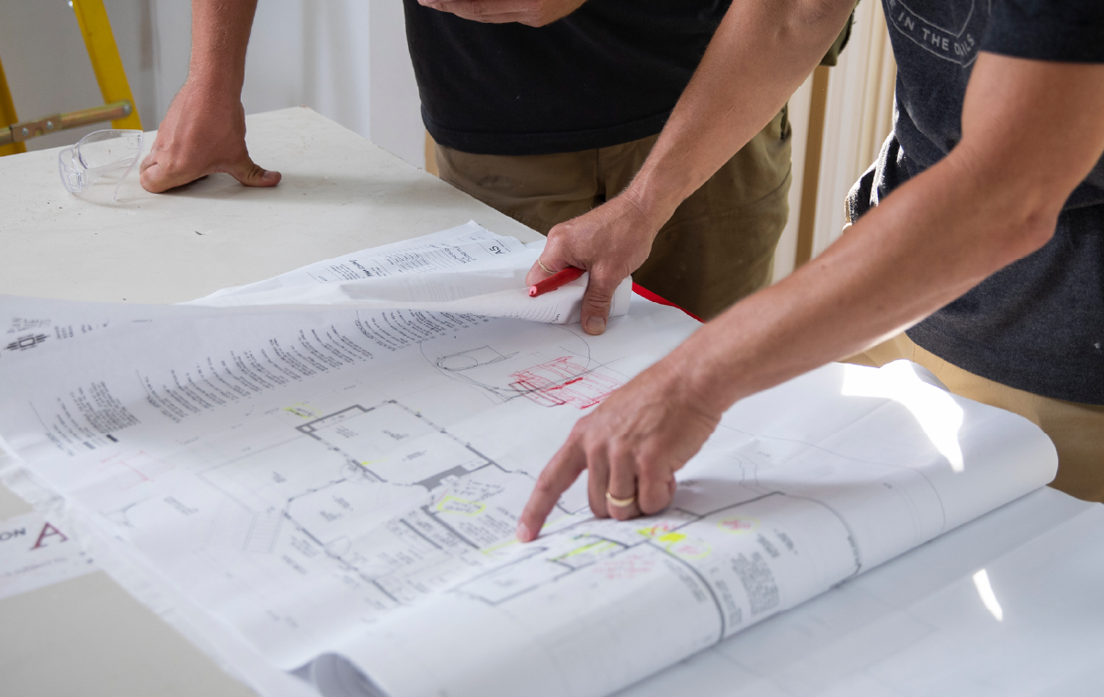
Project Plan
Development Environment:
Frontend: HTML, CSS, JavaScript (React/Vue)
Backend: Node.js + Python
Database: SQLite
Hosting: Local server or cloud-based
Tools: Git for version control, Jira for project management
GitHub repository: https://github.com/aamtayag/mse800-assessment2.git
Development Approach:
Agile methodology (Scrum + XP)
1-week sprint
Relative estimation (using Fibonacci) : 1, 2, 3, 5, 8, 13
Stakeholders:
Product Owner / Business Users (Tourists/Customers/Tour Operators/Tour Owners) / Sponsor – provides requirements and feedback on the product's functionality
Agile Facilitator/Project Manager – oversees project progress, facilitates meetings, and ensures agile practices are followed
Project Team – responsible for designing, developing, and testing the system
Notes:
1.Node.js is an open-source and cross-platform, client-server JavaScript runtime environment.
2.Agile is fit for knowledge work that has many unknowns
3.Delivery approach, 1-week sprint iteration

Slide 5
Team Structure
Architect
Team Member: Arnold Aristotle Tayag
Responsibility:
Responsible for the overall design of the system architecture
Develop and maintain the technical architecture and core design of the system
Guide technology selection and choose the right technology stack and tools for the project
Ensure the system has good scalability and efficient data processing capabilities
Collaborate with front and back-end teams to ensure proper implementation of architectural design
Frontend Developer
Team Member: Wen Liang
Responsibility:
Responsible for the design and implementation of the user interface
Implement user interface design and interaction features to ensure compatibility on various devices
Collaborate with the back-end team to integrate APIs and ensure seamless interaction of data with the interface
Optimize front-end performance to improve system loading speed and response time
Focus on user experience details to optimise interface elements and interaction logic

Slide 6
Team Structure
Backend Developer
Team Member: Hengpan He
Responsibility:
Responsible for the implementation of the system's data processing and business logic
Implement core business logic and handle complex data operations and processes
Design and implement system database and API interfaces to ensure smooth data interaction between front and back end
Configure system security to protect user data and prevent security breaches
Ensure the stability of the back-end system through unit testing and integration testing.
Project Manager
Team Member: Arnold Aristotle Tayag
Responsibility:
Key coordinator and bridge of communication for project time planning, resource management and schedule control
Manage project schedules to ensure phases are completed on time
Maintain open communication to ensure unobstructed flow of information between the client, development team and test team
Identify and manage project risks and develop prevention strategies
Organize regular project status meetings to support the team and resolve issues

Slide 7
Project Kick-off Meeting
Meeting Objectives
Define the main functions of the system and the operating privileges of key user roles
Establish communication process and feedback mechanism to ensure timely problem solving during the development process
Identify project risks, analyze potential challenges and discuss initial response strategies.
Key Participants:
Client representative: Arnold Aristotle Tayag
Development team Representative: Wen Lian
Project Manager: Hengpan He
Meeting Outcomes:
Confirm the process of publishing basic information (e.g., name, description, price, etc.) about a tour product and the authority to modify it
Discuss the key steps in the booking process, including the process design for booking confirmation and cancellation
Clarify the notification mechanism for users and administrators to ensure transparency and real-time system operation
Discuss the key steps in the booking process, including the process design for booking confirmation and cancellation

Slide 8
Project Kick-off Meeting
Meeting Outcomes:
Confirm the process of publishing basic information (e.g., name, description, price, etc.) about a tour product and the authority to modify it
Clarify the notification mechanism for users and administrators to ensure transparency and real-time system operation
Discuss how to achieve efficient communication and ensure two-way feedback between the client team and the development team. Specifically includes:
Weekly project update meetings to report on the week's progress and the work plan for the following week
An assessment of the time point to the next milestone
Task tracking and issue management using the project management tool Jira
Project risks identification:
Identify technical or business challenges that may be encountered in the project, conduct risk analyses and initially discuss response strategies. Key considerations include:
User booking cancellation timeliness issues and system responsiveness during peak periods
System stability, including Service Level Agreement (SLA) related elements
Horizontal expansion capability of the system and disaster recovery requirements
Objectives and requirements of the system's core data storage and backup strategy

Slide 9

Scope of Work
The system focuses on providing tour booking services exclusively for tours within
New Zealand. It will cover the following key features:
Tour Browsing: Displays detailed information such as tour descriptions, prices, itineraries, and ratings.
Online Booking: Supports email confirmation, payment processing, and tracking of booking statuses.
Tour Review: Allows users to provide feedback and ratings after the tour.
User Management: Enables administrators to manage user accounts and permissions.
System Integration: Offers APIs for integrating with third-party payment services and tour information providers
The following items are beyond the scope of this project:
（X）Offline travel arrangements or services outside of New Zealand
（X） Travel insurance management: The system will not handle or process insurance requests or claims
（X） Multi-currency support: The platform will only process payments in New Zealand dollars (NZD) without exchange rate calculations
Notes:
1. in the Scope of Work section
2. there are a few things outside the scope of this project
3. We won’t handle

Slide 10

System Design
System Architecture:
Frontend: HTML, CSS, JavaScript (responsive UI)
Backend: Python + Node.js (business logic, API)
Database: SQLite (tour details, user data)
Module Breakdown:
Tour Browsing: Load and display tours
Online Booking: Manage bookings, payments, confirmations
Admin Interface: User, booking management, reports
Review Module: User feedback collection
System Integration: Third-party API integration
Notes:
1. Here is our system architecture
2. Here is a 5 Module Breakdown:

Slide 11
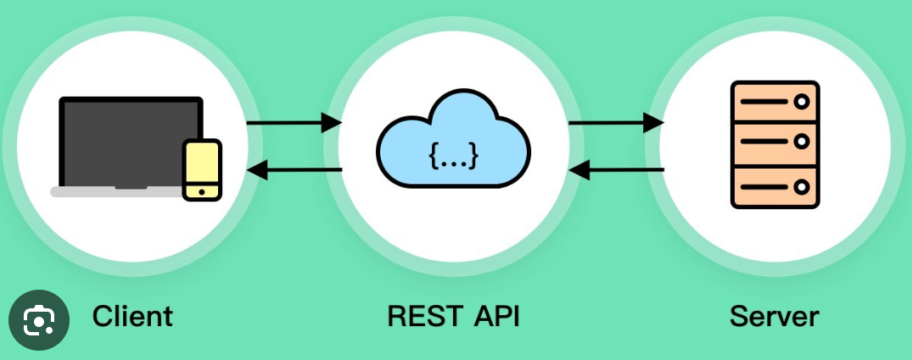
System Design
System Interfaces
Tour Listing: Filter tours by preferences
User/Admin Login: Separate login for tourists and admins
Booking: Collect traveler info, confirm availability, process payments
Data Flow and Communication:
Frontend-Backend Communication: REST APIs
Database Operations: SQLite (future migration ready)
Scalability: Initial phase with SQLite, scalable to MySQL/PostgreSQL if needed
Notes:
1. This slide shows our system interfaces, including 2. the data flow and communication using REST APIs. 3. If needed, we can scale our database to MySQL.

Slide 12
Project Backlog Planning
Summary:
19 user stories, 113 story points
Release 1: 10 user stories, 50 story points, 4 sprints
Release 2: 7 user stories, 42 story points, 4 sprints
Release 3: 2 user stories, 21 story points, 2 sprints
Notes:
Sit down with various users/stakeholders to discuss the features that will be included in the system

Slide 13

Release Planning
Release 1:
Tour browsing
Online booking
Admin Interface
Customer Support
Release 2:
Tour browsing: show computed average rating, tour management
Tour review: 1 rating from 1 to 5, customer comments/recommendations
Admin Interface: report generation
System Monitoring & Reporting: system performance, monitor error logs, booking report and analytics
Release 3:
System integration
API for third-party integrations
Notes:
1. Product backlog refinement

Slide 14
Sprint Planning
Sprint Plan for Release 2
Sprint Plan for Release 1
Sprint Number | User Story # | Estimation (Fibonacci)
1 | 6 | 3
 | 8 | 5
2 | 9 | 8
 | 10 | 5
3 | 11 | 5
 | 14 | 8
4 | 16 | 8
Sprint Number | User Story # | Estimation (Fibonacci)
1 | 1 | 2
 | 2 | 2
 | 3 | 5
2 | 4 | 5
 | 5 | 5
 | 7 | 5
3 | 12 | 4
 | 13 | 5
4 | 17 | 13
 | 18 | 4
Sprint Plan for Release 3
Sprint Number | User Story # | Estimation (Fibonacci)
1 | 15 | 8
2 | 19 | 13

Slide 15
Costing / Budget
Assumptions:
Sample budget outline (baseline only) for a Tour Booking Management System, broken down into Development, Infrastructure, and Operational expenses
Budget allocated is based on a mid–sized tour agency
Actual cost will vary based on system complexity, user volume, and additional features, such as analytics or advanced reporting features
Development Costs: $31,500 - $65,000
Planning & Design
Software Development
Testing & Quality Assurance
Infrastructure & Licensing Costs: $3,000 - $12,500
Hosting & Server Costs
Software Licensing & Subscriptions
Operational Costs: $26,000 - $66,000
Content Creation & Marketing
Ongoing Maintenance & Updates
Staff Training & Support
Total Estimated Cost:
Initial Development & Setup Costs: $35,000 - $78,000
Ongoing Monthly Costs: $2,000 - $5,000
Total Yearly Operational Cost: $26,000 - $66,000

Slide 16
Project Sign-Off
Project Title : Tour Booking Management System Project ID : Alpha-1xB.1257 Date : 31 October 2024 Project Manager : Wen Liang Client/Stakeholder : Arnold Aristotle Tayag
Deliverables Checklist
The following project deliverables have been completed, reviewed, and approved:
Requirement Specification, System Design Document, Database Design, Application Development
System Testing, User Acceptance Testing (UAT), Training & Documentation, Go–Live/Deployment
Acceptance Criteria
All project requirements, deliverables, and acceptance criteria have been reviewed and meet the standards agreed upon in the original project plan, including:
Functional and non-functional requirements
Performance and scalability requirements
Security and compliance requirements
Usability and user interface requirements

Slide 17
Project Sign-Off
Sign-Off
By affixing your signature below, both parties agree that the project meets all user specifications and requirements and is considered officially complete. Any addendum, modifications, enhancements, or new functionalities added will be treated as new requirements and will be the subject of a new project proposal
Project Manager: Wen Liang ___________________________
Client/Stakeholder: Arnold Aristotle Tayag ___________________________
Technical Lead: Hengpan Han ___________________________
Date: 31 October 2024

Slide 18

Reflection
Key Takeaways:
This system development project has allowed the team to put in practice key elements that are essential for project success:
Clear and thorough requirements gathering
Importance of stakeholder engagement & customer-centric focus
Realistic planning and scheduling
Early and frequent delivery of value
Quality assurance and testing
Risk management and early issue resolution
Efficient communication and collaborativer approach
Adaptability to change
Project retrospective and continuous improvement

Slide 19
Thank You...

