Slide 1
SafeRoads Navigator
A Real-Time Road Hazards Monitoring with Dual Vetting Approach
Arnold Aristotle Tayag (270559700)

Slide 2

Introduction
Road safety is a critical public health and transportation concern, with 1.19M global fatalities annually (WHO, 2023)
NZ: 341 fatalities & 2,442 serious injuries in 2023
NZ has one of the highest road death rates in the OECD (NZTA 2024, Fig. 1)
Traditional inspections of road infrastructure are expensive, slow, reactive
Crowdsourced reporting offers timely, wide coverage but suffers from data reliability challenges
Proposed solution strives to introduce a dual vetting mechanism to ensure accuracy and reliability
Notes:
World Health Organization Global Status Report on Road Traffic Injuries. 2023
Organisation for Economic Co-operation and Development (OECD)

Slide 3
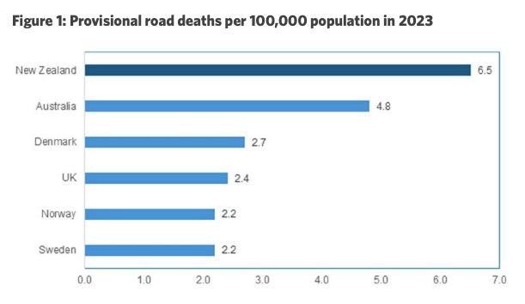
Introduction
Notes:
NZ has the highest road death rate in OECD, so there is much that should be done to improve the state of road safety in the country
5,200,000 / 100,000 = 52 x 6.5 = ~340 deaths per year

Slide 4
Literature Review
Crowdsourced platforms like FixCyprus (Christou, et al., 2023) and EDDA+ (Olma et al., 2022) demonstrated improved hazard reporting coverage and timeliness. Both identified trust criteria as a limitation and suggested to introduce trust metrics or criteria to enhance the reliability and credibility of crowdsourced reports.
Telima et al. (2023) used crowdsourcing platform to collect & analyze pedestrian safety within urban areas of Cairo, Egypt (spatial analyses using KDE to identify high-risk areas).
Studies by Cafiso et al. (2022) & Bhoyar et al. (2023) used IoT-based sensors to monitor and assess urban road pavement conditions (focus on potholes). One enhancement suggested in the study is the addition of real-time data integration platforms for road maintenance agencies & introduce crowdsourcing to reduce variability and improve data reliability.
Notes:
FixCyprus: Assessing the potential of crowdsourced data for identifying and managing road safety hazards, Christou et al. (2023)
Road Users’ Reports on Danger Spots: The Crowd as an Underestimated Expert?, Olma et al. (2022)
The use of crowdsourcing data for analyzing pedestrian safety in urban areas, Telima et al., (2023)-Kernel Density Estimation (KDE)
Urban road pavements monitoring and assessment using bike and e-scooter as probe vehicles, Cafiso et al. (2022)
IoT Based Pothole Detection and Alert System, Bhoyar et al. (2023)

Slide 5
Literature Review
A similar study by Carlos Pena-Caballero et al. focused on detection of a limited scope of road hazard classes, i.e. Manhole, Pothole, Blurred Crosswalk, & Blurred Street Line
In a study by Kim et al. (2023), they explored the use of crowdsourced data collected through an app, Road Inconvenience Reporting System (RIRS), to evaluate the efficiency of road hazard maintenance performed by different regional agencies across South Korea (focus more on data analysis)
Notes:
Real-Time Road Hazard Information System, Pena-Caballero et al. (2020)-video deep learning (CNN/semantic segmentation)
Evaluating Road Hazard Maintenance Efficiency Using Citizen Science Data to Improve Road Safety, Kim et al. (2023)
Capstone: this study more an action research (participatory approach combining action (change interventions) and research)

Slide 6
Problem Definition
Key Gaps:
Unreliable crowdsourced data without robust vetting
Lack of unified end-to-end hazard management
Limited integration & use of analytics for policy insights
Research Questions:
How to design a real-time alert system with dual-layer vetting to deliver timely, reliable road hazards information?
What models enable seamless end-to-end integration?
How to embed analytics & open-data interfaces for stakeholder insights and decision-making?
Notes:
1. This addresses the first gap identified which is about increasing the reliability of crowdsourced data by minimizing false or malicious submissions
2. This addresses the second gap identified by creating a unified solution covering the aspects of crowdsourced reporting, multi–layer verification, operational response, and strategic trend analysis
3. This addresses the third gap enumerated above by enabling the proposed solution to export datasets on road hazard incidents to be used by city planners, researchers, maintenance teams, and other concerned relevant parties

Slide 7
Proposed Solution
Objectives:
Implement dual-layer verification to enhance data trustworthiness
Develop a unified platform: reporting, verification, response, analysis
Embed dashboards & open-data exports for stakeholder decision-making
Solution:
SafeRoads Navigator: A web-based system that features crowdsourced hazard reporting, dual vetting (peer & admin), interactive map, heatmap analytics, admin dashboard
React front-end & Node.js/Express back-end
SQLite database & Google Maps API integration
Real-time map markers, heatmaps, and alerts
Admin dashboard for verification & analytics

Slide 8
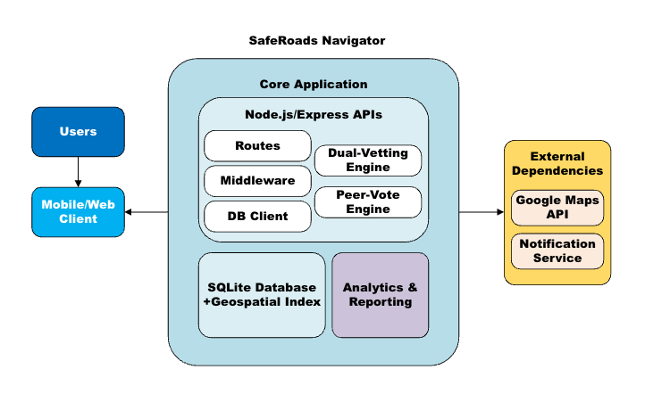
Proposed Architecture Diagram

Slide 9
Methodology
This capstone project will employ a design and development methodology typical of software engineering projects. The approach can be outlined in several phases:
Requirements Analysis
Functional/non-functional requirements, data requirements, data flows, formulate the use cases
System Design and Architecture
Design system architecture, API endpoints, database schema, user interfaces, prepare 3rd-party components
Implementation (Iterative Development)
Implement the APIs, code the user interfaces, simulate the use cases
Testing and Evaluation
Test the components, unit testing, integration tests, functional tests
Project Management and Milestones / Deliverables
Work with supervisor, monitor deliverables against project timeline

Slide 10
Project Timeline
Month 1: Design & Requirements
Milestone(s): Requirements & Design Document finalized; development environment set up (Node.js server skeleton, SQLite schema created)
Month 2: Core Implementation
Milestone(s): By end of Month 2, internal demo of the system showing multiple users reporting and confirming hazards, with the map updating live
Month 3: Feature Completion & Refinement
Milestone(s): Feature–complete beta version of SafeRoads Navigator by end of Week 12. At this point, all primary use cases can be executed on the system
Month 4: Testing, Evaluation & Finalization
Milestone(s): Week 15, project completion. Deliverables include the final research proposal document, a working prototype deployed for demonstration, and a presentation for the academic panel

Slide 11
Evaluation Plan
The evaluation of SafeRoads Navigator will concentrate on three core dimensions:
Accuracy and Reliability
Precision & recall of verified hazards vs. ground truth, i.e. field inspections
False Positive Rate (FPR) or the proportion of flagged hazards that are not real
False Negative Rate (FNR) or the proportion of real hazards missed by dual vetting
System Integration & Performance
API response times, i.e. throughput under simulated workloads
Throughput, i.e. maximum reports processed per second under load
System Uptime, i.e. percentage over evaluation period, i.e. target ≥ 99.5%
Analytical Utility & Stakeholder Impact
Dashboard Usage, i.e. number of dashboard sessions by planners/authorities
Data Export Count, i.e. number of CSV/API exports performed
Policy Actions Triggered, i.e. number of maintenance actions initiated via system alerts

Slide 12
Conclusion
SafeRoads Navigator bridges community reporting and authority action thru dual vetting for trusted, proactive road safety management. Specifically:
SafeRoads Navigator aims to improve road safety through crowdsourced vigilance
Dual vetting enhances trust without sacrificing speed
Interactive analytics empower stakeholders for data-driven decisions
Expected outcomes: improved road safety, increased crowd participation, informed decision-making for road safety, and fewer road fatalities/deaths & accidents

Slide 13






Thank You!
Do you have any questions?
270559700@yoobeestudent.ac.nz

