Slide 1
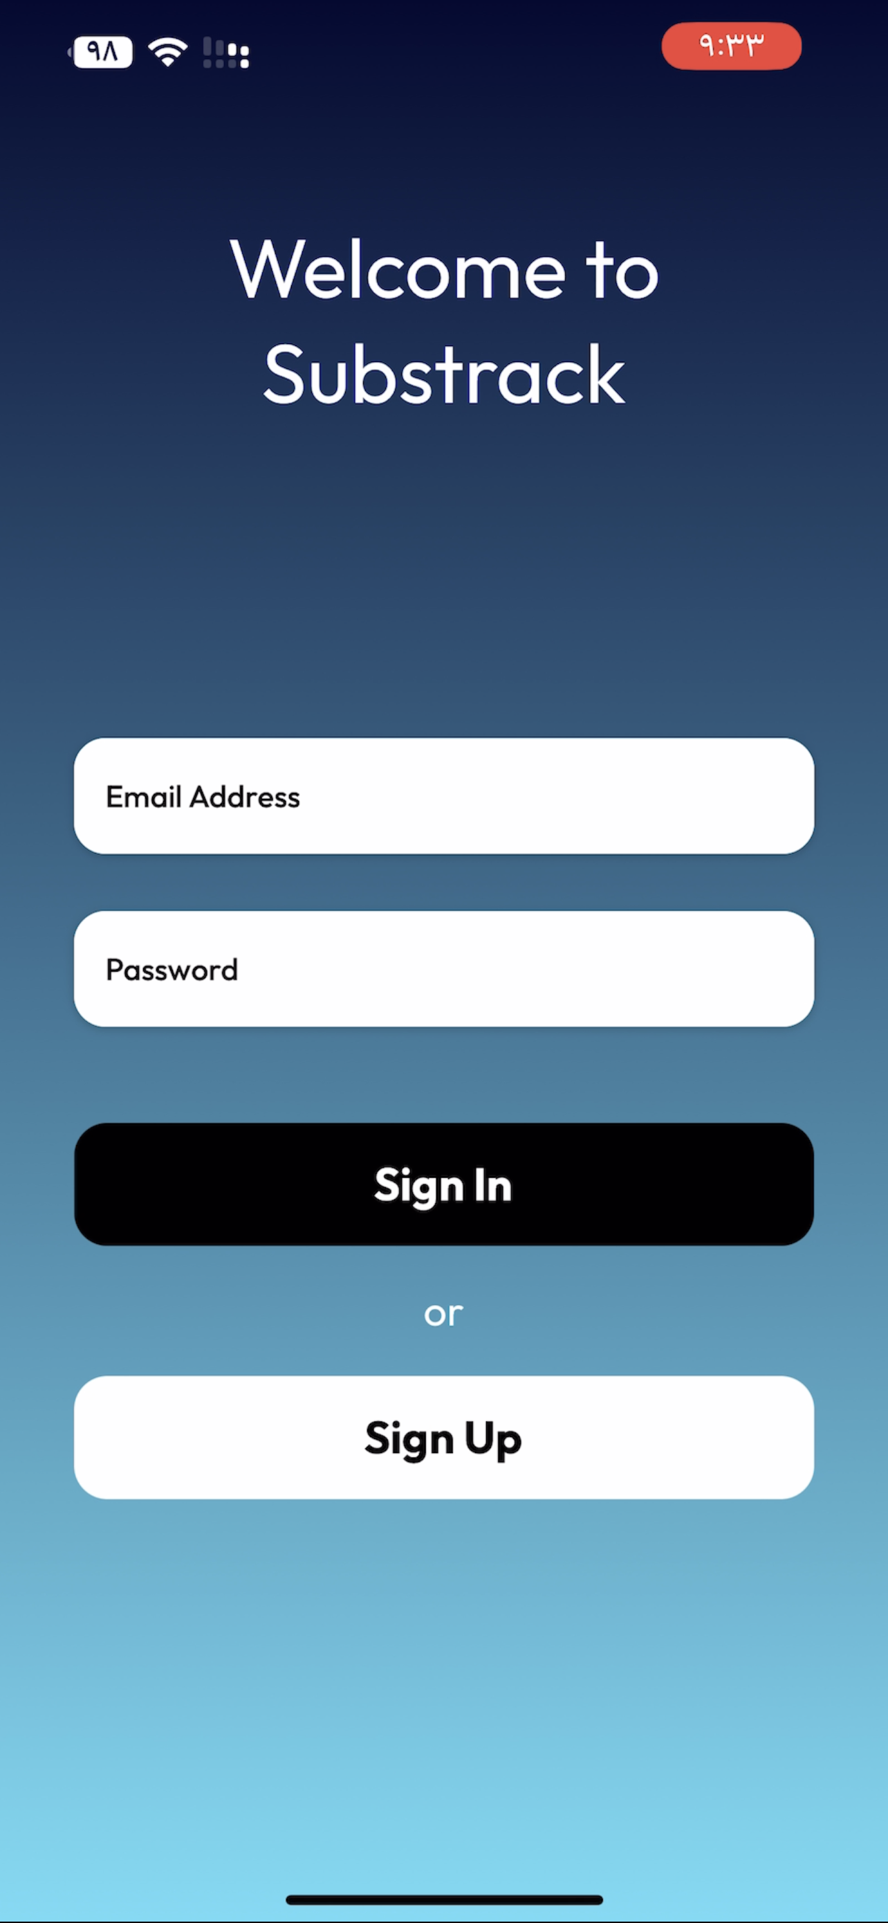
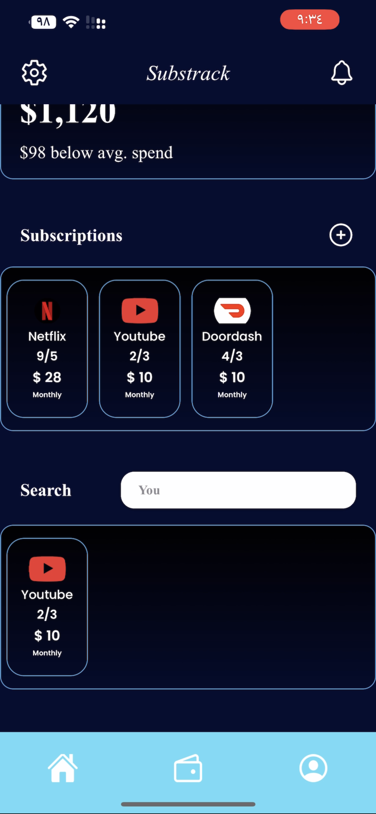
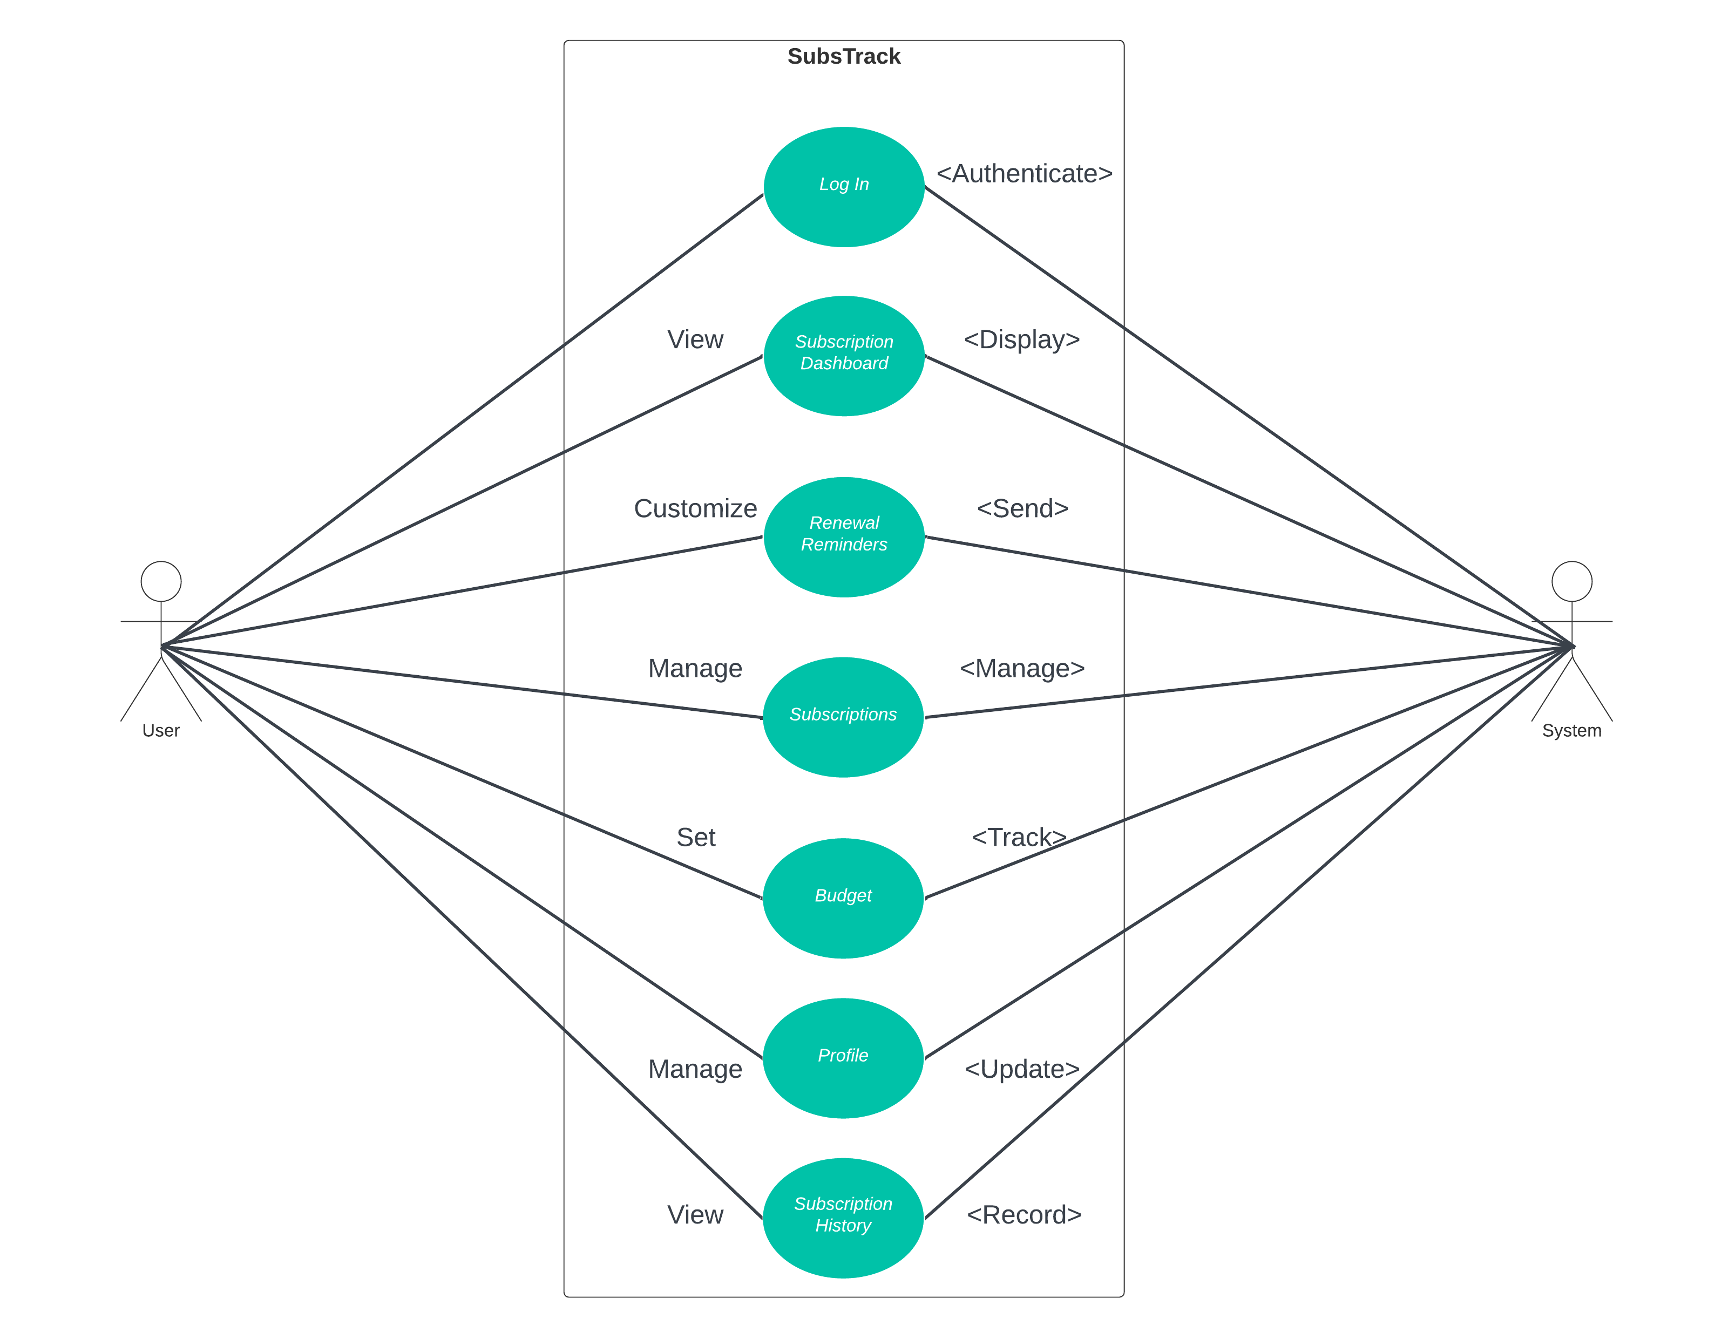
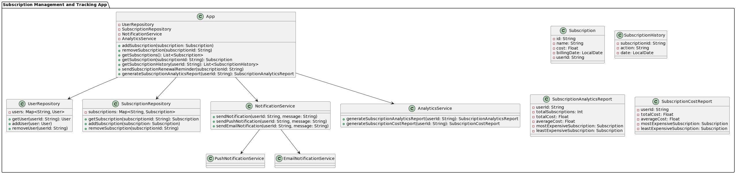
Subscriptions Management and Tracking App
Abdulwahab Alnemer, Yosef Alhedr
Faculty Advisor(s): Dr. Khaled Slhoub, Dept. of CES, Florida Institute of Technology
GUI Goal Design
The Subscription Management and Tracking App aims to simplify and streamline the management of users' subscriptions to enhance their overall well-being and satisfaction. Recognizing the overwhelming number of subscriptions users face, from streaming services to utility bills, the app seeks to address frustrations and financial strain caused by fragmented and unclear management systems. By empowering users to effortlessly manage subscriptions, achieve greater financial control, and avoid unnecessary expenses, the app aims to bring relief and happiness to users.
Architecture
Future Work
* Implementing Adding Subscriptions Automatically
Features
* Manage Subscriptions
Track Subscriptions
Alert users for subscriptions due dates
Budget features

