Slide 1

MSPM’S Deogiri Institute of Engineering and Management Studies, Aurangabad Academic Year 2019-20 Department of Computer Science and Engineering Theory Of Computation Topic: DFA for Regular Expression GitHub link: Submitted by Ashwini Nemade(36157) Sanyukta Waghmare(36158) Under the Guidance of Dr. S. M. Chavan Asst.Prof.Department of CSE (Deogiri Institute Engineering and Management Studies)

Slide 2
CONSTRUCT DFA FOR REGULAR EXPRESSION ((0 +1)* 01)

Slide 3
Deterministic Finite Automaton (DFA)
DFA refers to deterministic finite automata. Deterministic refers to the uniqueness of the computation. The finite automata are called deterministic finite automata if the machine is read an input string one symbol at a time.
In DFA, there is only one path for specific input from the current state to the next state.
Formal Definition of a DFA
A DFA can be represented by a 5-tuple (Q, ∑, δ, q₀, F) where −
Q: finite set of states.
∑: finite set of the input symbol.
δ: Transition function.
q0: initial state.
F: final state.

Slide 4

Let a deterministic finite automaton be →
Q = {q0, q1, q2}
∑ = {0, 1}
q0 = {q0}
F = {q2}
Present State | Next state for Input 0 | Next State of Input 1
→q0 | q0 | q1
q1 | q2 | q1
*q2 | q2 | q2

Slide 5
Regular Expressions
The language accepted by finite automata can be easily described by simple expressions called Regular Expressions. It is the most effective way to represent any language.
The languages accepted by some regular expression are referred to as Regular languages.
A regular expression can also be described sas a sequence of pattern that defines a string.
Regular expressions are used to match character combinations in strings. String searching algorithm used this pattern to find the operations on a string.

Slide 6
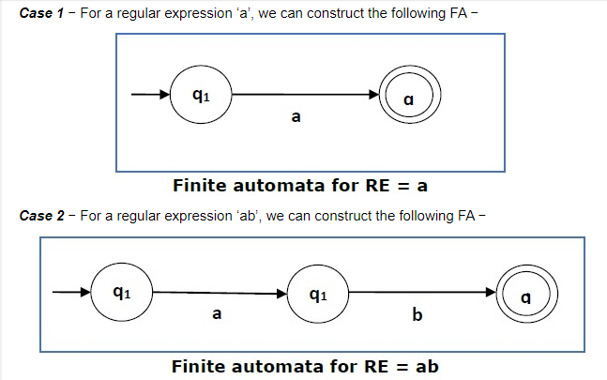

Slide 7
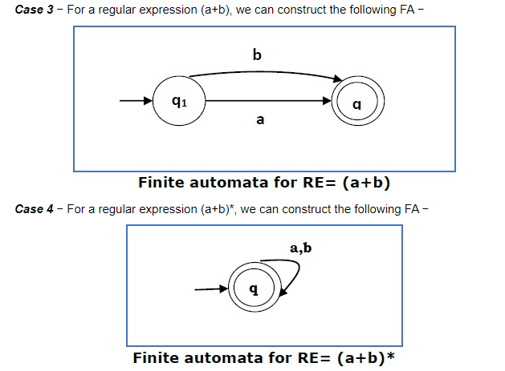

Slide 8
Program Input and Output
Input: Language L = {01,001,101,1101,000101, 001101 }
Few examples of invalid strings ={ 000,11100,01010}
Output: Valid String or Invalid String.

Slide 9
Applications of DFA
It is used in language processing systems
Used for applications that accept typed command
Text processors
It is applied is speech processing systems
It is needed in signal processing systems
Controllers apply the properties of DFA
In tracking systems
In text filters

Slide 10
Applications of Regular Expression
Regular Expressions in UNIX
Lexical Analysis
Finding Patterns in Text

Slide 11
Program
case 3:
if(Temp=='0')
State=2;
if(Temp=='1')
State=1;
break;
}
c++;
}
if(State==3)
printf("Valid string \n");
else
printf("InValid string \n");
getch();
return 0;
}
while(c<l) {
Temp=s[c];
switch(State) {
case 1:
if(Temp=='0')
State=2;
if(Temp=='1')
State=1;
break;
case 2:
if(Temp=='0')
State=2;
if(Temp=='1')
State=3;
break;
#include <stdio.h>
#include <string.h>
#include<conio.h>
int main()
{
char s[20];
int l, State, c;
char Temp;
printf("\n enter string to check: \n");
gets(s);
l=strlen(s); //length of the string
printf("String length is %d \n", l);
c=0;
printf("count is %d \n", c);
State=1; //initial state
printf("State is %d \n", State);

Slide 12
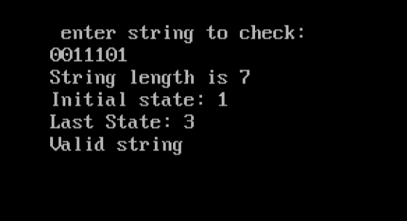

Output

Slide 13
Conclusion
Using C programming language we have implemented a program of construction of DFA for regular expression ((0+1)*01).

Slide 14


