Slide 1
A Framework to Build A Graph based Knowledge Base from Scientific Literature with Search Functionality
Amrita Anam
PhD Student
University of Maryland Baltimore County

Slide 2
Motivation
Problem
Pool of scientific literature that are not being analyzed as a network
The papers are not easy to decipher without reading the whole paper
Analyzing different members of the community along with their work can be beneficial to academic and research institutions
Approach
Build a domain specific knowledgebase with structured information (Task 1)
Identify and retrieve evaluation methods (Task 1)
Analyze the documents as a network connected by metadata and content (Task 2)
Provide users with a search functionality to assess community interaction (Task 3)

Slide 3
Tasks
Task1
Create a Graph from Scientific Literature
Jan – Apr 17 (Part 2)
Task2
Analyze the Research Community and Trends
Sep to Dec 16
Task3
Test, Optimize and Validate Search Queries
May to Aug 17

Slide 4
Task 1 Create a Graph from Scientific Literature
Data collection (document list, metadata and full text)
Data Preprocessing (parsing and cleaning)
Information retrieval using NLP
Convert text data to graph data
Create the document graph

Slide 5
Process Flow: Parsing and Tagging
Download PDF
XML from parser tool (Contains in-built tags)
Add attributes
Add XML tags for retrieved information
Information retrieval from text (study, methodology)
Add XML tags from rules
Structured XML
Document list
Get metadata

Slide 6
Data Collection: Scientific Literature
Google Scholar API (Metadata)
Title
Google Scholar, PubMed and PubMed Central API
Complete Text
Authors
Journal
Year of Publication
Download Link
Data Format : JSON, BIBTEX
Data Format : XML
Publisher

Slide 7
PDF to XML Parsing
Direct Parser (pypdfx)
Rule Based Parser
Generate More Rules
Pre-defined rules
Rules from document syntax
Rules from parser syntax
Validation
TPR
FPR
Decision Tree
http://pdfx.cs.man.ac.uk

Slide 8
Structured Data
Attributes
Tags
Number of sentences
Number of words
Number of occurrences
Contains bullets
All capitals
Contains URL
Contains “journal” / “proceeding” / “article” / “manuscript” , “published at” + date, “page” + number
Contains parser tags <image>, <table>
Title
Author
Side note
Heading
Text
Header – footer
Text
Reference

Slide 9
Document Parsing: Pre-defined rules
Identifying sections from document syntax
Class | Rules (Examples)
Heading | Number of sentences = 0 All capital letters Preceded by a bullet (e.g., 1,2,3 or I, ii, iii or a,b,c)
Text | Number of sentence >2
Header-Footer | Number of sentence <2 Number of occurrence >3 3. Contains “page” followed by a number
Side note | Contains “journal” / “proceeding” / “article” / “manuscript” Contains URL contains “published at” + date
Reference | Identify header Detect section until next section header

Slide 10
Document Parsing: Pre-defined rules
Identifying sections from parser syntax
Language: Python
Package: XML, JSON, Re – Regular Expression, NLTK – Natural Language Tool Kit, Spacy
Class | Rules (Examples)
Meta Tag | Parser adds some metadata
Image | Images are identified and stored in a <image> tag
Table | Tables are stored in a <table> tag Values are stored by specifying <row> and <column>
Email | Emails are identified and stored in a <email> tag

Slide 11
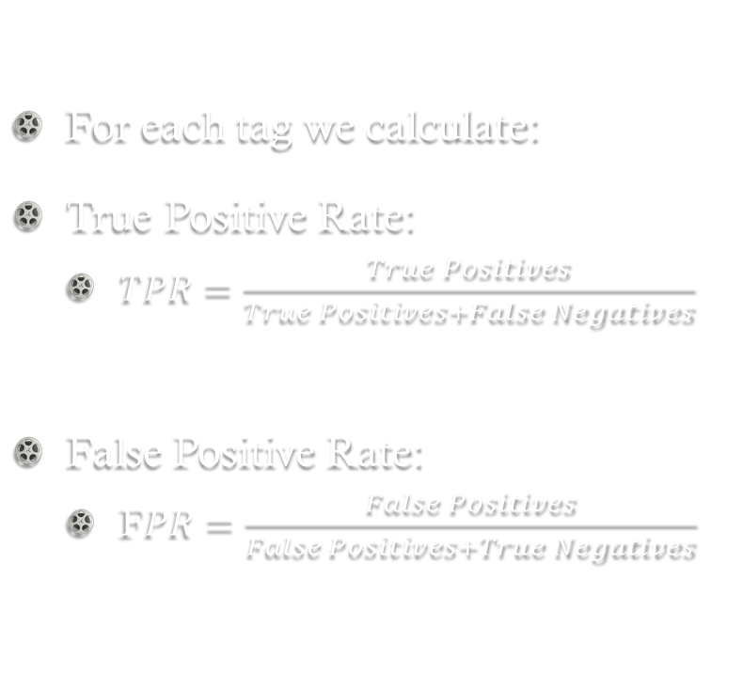
Parsing Validation
For each tag we calculate:
True Positive Rate:
$TPR=\frac{True Positives}{True Positives+False Negatives}$
False Positive Rate:
F$PR=\frac{False Positives}{False Positives+True Negatives}$
 | Assigned tag | Did not assign tag
Element should be tagged | TP: Element was tagged | FN: Element was not tagged
Element should not be tagged | FP: Wrong element was tagged | TN: Wrong element was not tagged

Slide 12
Information Retrieval: Citation
Tokenization: Number of sentences
Yes
Dictionary look up: Match with list of document titles
No
Add to citation list
Contains names
Contains Dates
All Numeric
Yes
Yes
No
No
Yes
No
Parsing citation from “reference”
Store for future use
Break down text into words, phrases and sentences
AND

Slide 13
Information Retrieval: Methodology
Parsing evaluation method
Tokenization
Semantic Tagging: Dictionary Lookup
Calculate similarity
Sentence level
N-Grams: N adjacent words

Slide 14
Graph Database
Organization
A graph database prioritizes relationships and follows a graph structure
Nodes – entities
Identified by a unique identifier
Defined by a “type”
Can have incoming and outgoing edges
Can have multiple attributes
Edges – relationships between nodes
Can have a label to define the “type” of relationship
Can have multiple attributes
Can be directed or undirected
FDA
Person
Works for
Aryya Gandopadhyay
Person
Amrita Anam
Mentors
Works for
Brandon Gallas
Works for
Mentors
Works for
UMBC
Person
Organization

Slide 15
Why Graph DB?
Advantages
Flexible schema
Avoid complex joins
Graph analytics
Easy to visualize
Limitations
Lack of unified query language

Slide 16
Document-Graph Components: Nodes
Document
Study
Author
Journal
Category
{ title, year, citations}
e.g., title:"Digital pathology: current status and future perspectives",no_citations:121,year:2012
{first_name, last_name}
e.g., first_name:'Shaimaa', last_name: 'Al-Janabi'
{journal_name, abbr.}
e.g., journal_name:Histopathology
{publication_type}
e.g., publication_type:’’survey
Evaluation_Method
{disease, no_patients}
{statistical_test}
Publisher
{publisher_name}
e.g., publisher_name:‘Wiley Online Library’

Slide 17
Document-Graph Components: Relationships
Document
Author
Journal
Publisher
Study
Evaluation Method
Document
WRITTEN_BY
PUBLISHED_IN
USES
CONTAINS
PUBLISHED_BY
CITES

Slide 18
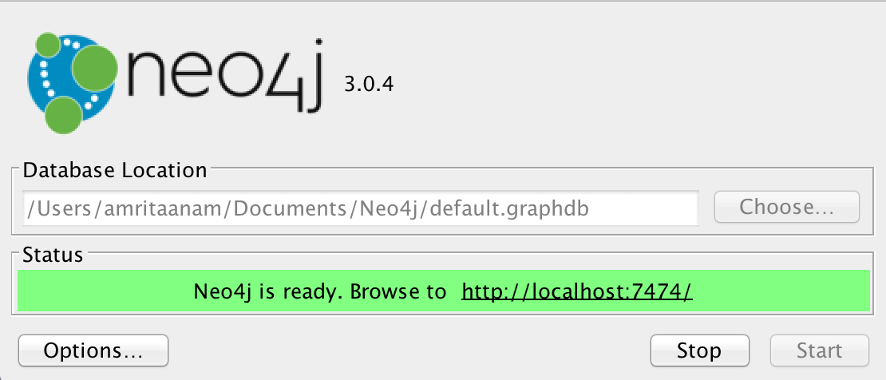
neo4j
Open source graph repository
Supports CRUD (Create, Read, Update, Delete) operations
Supports CQL (Cypher Query Language)
Can be integrated with distributed platforms (hadoop and spark)

Slide 19
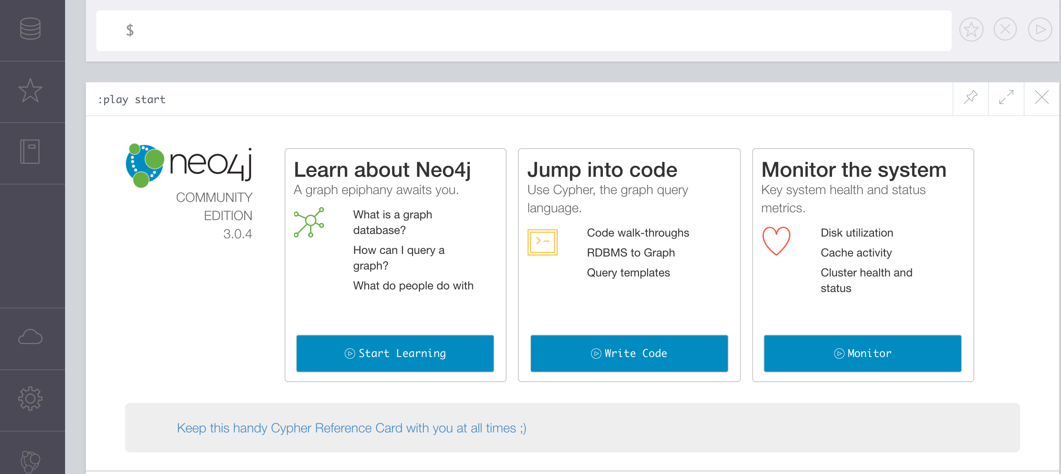
neo4j

Slide 20
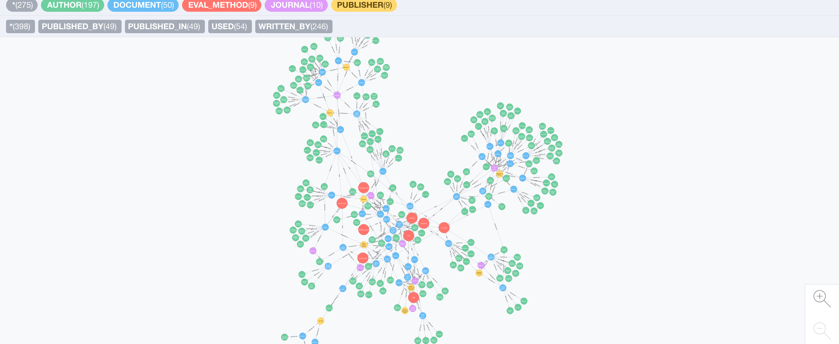
Document Graph with neo4j

Slide 21
Document Graph
Total Nodes: 275
Total Relationships: 398
DOCUMENT: 50
AUTHOR: 197
JOURNAL: 10
PUBLISHER: 9
EVALUATION_METHOD: 9
WRITTEN_BY: 246
PUBLISHED_BY: 49
PUBLISHED_IN: 49
USED: 54

Slide 22
Task 3 Analyze the Research Community and Trends
Analyze Document-Network Characteristics
Analyze importance of nodes with Centrality measures (degree, betweenness, closeness)
Analyze importance of nodes by using PageRank, Hub and authority score

Slide 23
Network Characteristics
Connected component : Sub graph where any two nodes are connected by a path of edge(s)
Network diameter: Number of hops between the two most distant nodes
Document Graph (50 Documents)
Connected Component: 1
Network Diameter: 10

Slide 24
Centrality Measure
Helps understand importance/dominance of nodes
Degree Centrality
Ranks nodes based on in and out degree
Betweenness Centrality
Ranks nodes based on their occurrence in the shortest path
Closeness Centrality
Ranks nodes based on their distance to other nodes in the local connected component

Slide 25
Task 2 Test, Optimize and Validate Search Queries
Multi-layered graphical view
Join sub-graphs using union, intersection
Test graph partitioning in Big Data Platform
Validate using precision and recall scores

Slide 26
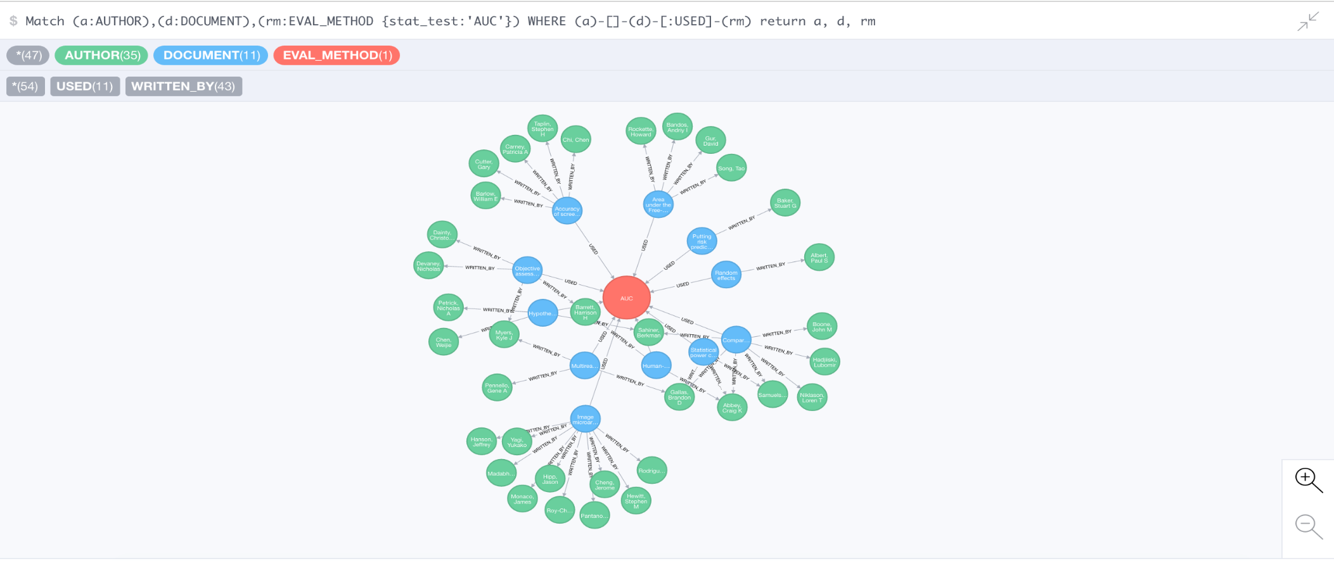
User query and Graph Retrieval
Find authors who used a study in their documents

Slide 27
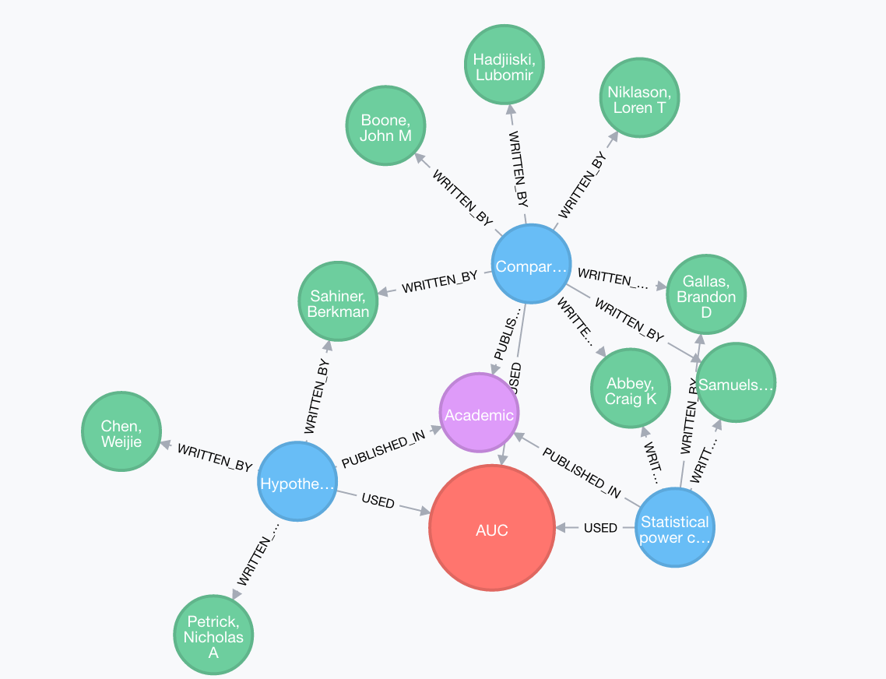
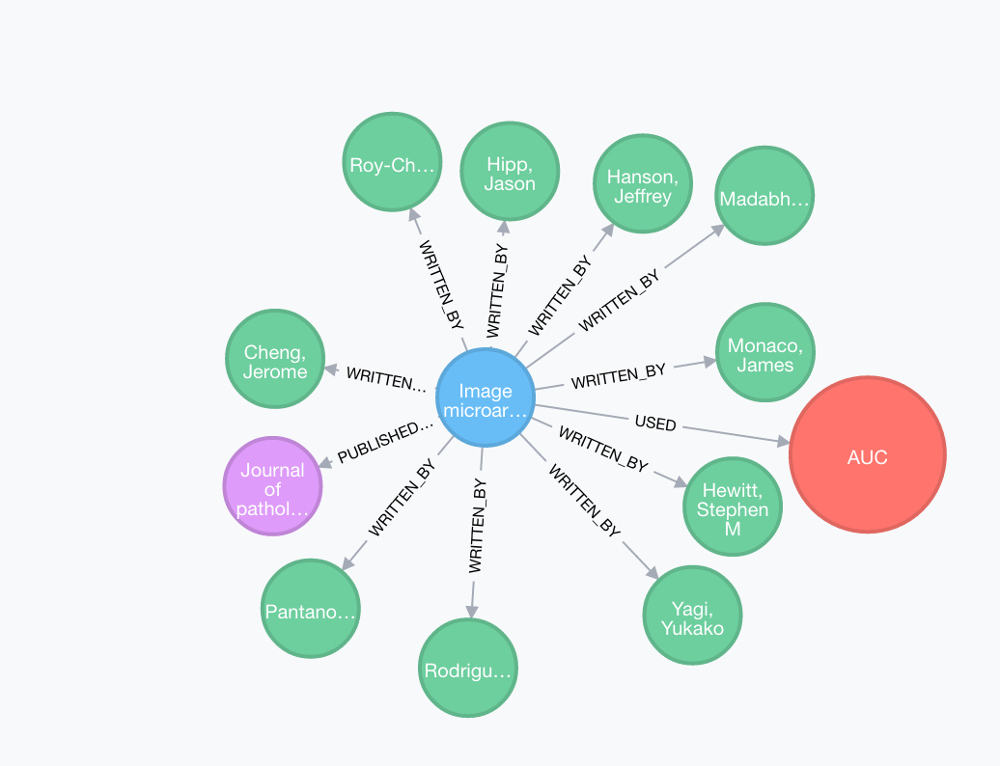
User query and Graph Retrieval
Academic Radiology
Journal of pathology informatics

Slide 28


Graph Retrieval: Validation
Precision
Recall
$precision=\frac{|\{relevant documents\}⋂ \{retrieved documents\}|}{|\left\{retrieved documents\right\}|}$
How relevant are the retrieved documents
$recall=\frac{|\{relevant documents\}⋂⋃\{retrieved documents\}|}{|\left\{relevant documents\right\}|}$
How much of the relevant documents were retrieved

Slide 29
Why Graph Search
Interaction between sub-graphs
More filtering options
Helps understand the trend in research
Helps understand the community and its members
Hierarchical drill down

Slide 30
Challenges and Limitations
Automation of parsing
Domain specific method retrieval
Graph Partitioning
Scalability

Slide 31
Future Work
Author name ambiguity
Build author profiles
Temporal analysis of the network
Comparison between different base-parsing tools

Slide 32
Discussion
The community will get a overview of the study designs and methods used in the field
One does not need to know about a specific information to search
More domain specific components can be added in the future based on community needs

