Slide 1
BANK OF CANADA
BANQUE DU CANADA
Microsoft
WORKSHOP SESSION 02
LaTeX (Overleaf) &
‘Copilot (AI)
Follow-up — turning Colin's requirements into a buildable shape
MAY 27, 2026 · BoC + MICROSOFT · OTTAWA

Slide 2
TODAY'S AGENDA
Agenda
Get aligned on what we built, what Colin asked for, and how we'd scale it inside the Bank.
1
Where are we?
Status since May 11 — what's built, what's emerging.
2
Demo review
Live walkthrough of the GHCP-based LaTeX Copilot PoC.
3
Colin's requirements
The five explicit asks plus the implied context.
4
Overleaf Process Workshop & Requirements Elicitation
MAIN ACTIVITY
Walk an economist's day end-to-end. Strawman → discussion → capture. Switch to the mindmap.
5
Development methodology
Requirements → GHCP prototype → GHCP in BoC env → IT maintenance + MVP governance.
LaTeX (Overleaf) Copilot · Workshop Session 2 · May 27, 2026
2 / 13

Slide 3
01 · WHERE ARE WE?
Background
Since Colin's May 11 email we've moved from 'understanding the ask' to 'demonstrating the art of the possible' — and we've stumbled into a bigger question worth surfacing.
We heard the requirements
We built a lightweight PoC
We surfaced "the long tail"
Colin's five explicit asks, in writing
Plus implied context: sovereignty, render quality, springboard intent
Captured as a working list, not a wishlist
GHCP-driven LaTeX Copilot, runnable on localhost:5200
Compliance-checker agent + BoC house-style rules (YAML)
Proves the art of the possible, not production-ready
New model: AI coding tools to satisfy software the Bank traditionally couldn't justify a heavyweight project for
Opens the door for personas previously under-served
Requires BoC EA + IT to break new ground on process & governance — and worth it
LaTeX (Overleaf) Copilot · Workshop Session 2 · May 27, 2026
3 / 13

Slide 4
02 · COLIN JONES' REQUIREMENTS
Requirements Background
Bank of Canada · Colin Jones · email of May 11, 2026
EXPLICIT
IMPLIED FROM THE THREAD
1
Easy LaTeX editor
BoC-controlled LLM
Low friction for authors — not a developer-grade tool.
Sovereignty — the model is one the Bank can configure and govern.
2
Inline GHCP suggestions
Assistance happens in-place. No copy/paste between tools.
Web wrapper around Overleaf is OK
Don't replace Overleaf; wrap it.
3
Start from a template repo
Colin's template already includes the Agent configuration.
Render quality matters
4
One-button Overleaf sync
Complex documents must render well.
Single git push/pull to sync with Overleaf.
Easy collaboration
Springboard, not a silo
5
A starting point for broader workflow streamlining.
Works across the Bank / external boundary.
LaTeX (Overleaf) Copilot · Workshop Session 2 · May 27, 2026
4 / 13

Slide 5
03 · DEMO REVIEW
PoC review
LIVE
http://localhost:5200
overleaf-copilot · Express + GHCP · GitHub Models
WHAT TO LOOK FOR
QUESTIONS TO DISCUSS
The 3-panel surface — chat / LaTeX editor / live preview
GHCP-style inline suggestions in the editor
BoC house-style rules applied by the compliance agent
Sample prompts: policy note, working paper, abstract
How close the rendered output is to a Bank deliverable
Does the 3-panel UX match how an economist actually drafts?
Which house-style rules are highest value to enforce automatically?
What's the right "surface" — a wrapper, an extension, or a standalone web tool?
Where in today's Overleaf flow does this slot in?
LaTeX (Overleaf) Copilot · Workshop Session 2 · May 27, 2026
5 / 13

Slide 6
04 · MAIN ACTIVITY
Overleaf Process Workshop
& Requirements Deep Dive
We walk an economist's day end-to-end — and let the requirements fall out of the conversation.
THE STRAWMAN
THE DISCUSSION
THE CAPTURE
We start on the assumption diagram — six steps drawn from Colin's features. Use it to anchor the conversation.
For each step we ask: current state? pain points? target state with the Copilot? Switch to the mindmap to drill in.
We write down requirements as they emerge — keep / change / new / parking lot — using the on-screen template.

Slide 7
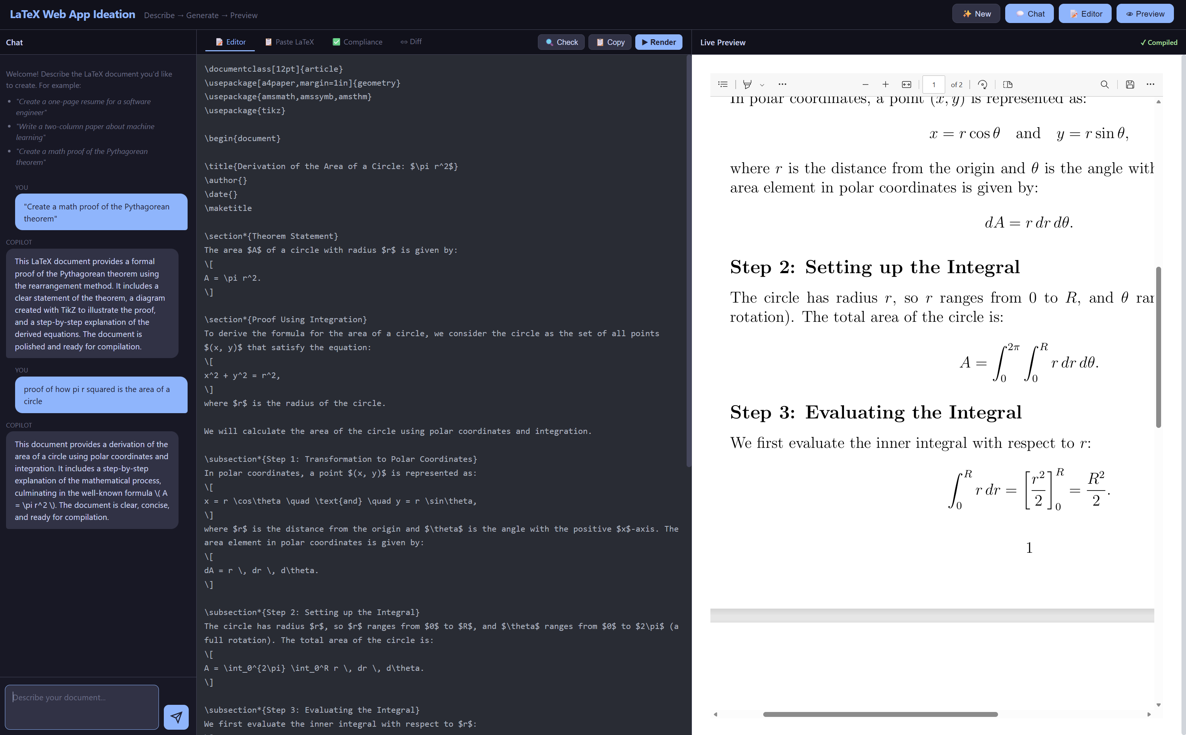
The May 11 demo — what we showed – fire it up…
What it proved
You can use an LLM you control and configure to generate LaTeX
A web wrapper can complement Overleaf without replacing it
Rendering of complex LaTeX is already good out of the gate
Demo screenshot — GHCP PoC: LaTeX prompt → render
Becomes a springboard to streamline broader Economist workflow
What it did not yet cover
Inline (no copy/paste) agent UX inside the editor
Template-based start + one-click Overleaf sync

Slide 8
Colin's requirements
From his May 11 email — the ‘what’, not the ‘how’
1
Easy LaTeX editor
2
Inline Copilot Agent
3
Template from a repo
A clean authoring interface for Economists — not a developer IDE.
GitHub Copilot suggestions in-place. No copy/paste between tools.
Start from a pre-configured repo that already includes the Agent.
4
One-click Overleaf sync
5
External + internal collaboration
Easy git push/pull to Overleaf — single button, not a workflow.
Works across the BoC/external boundary by default.

Slide 9
04 · MAIN ACTIVITY · STRAWMAN — END-TO-END OVERLEAF PROCESS
From blank page to published paper — drawn from Colin's five features.
Switch to the mindmap to drill into any step.
1
2
3
4
5
6
Start from template
Open in easy editor
Draft with GHCP
Compliance check
Sync to Overleaf
Collaborate & publish
Repo with GHCP config
Web wrapper around Overleaf
Inline suggestions
BoC house-style agent
One-button git push/pull
Internal + external
REQ #3
REQ #1 + implied
REQ #2 + BoC-controlled LLM
Implied: render quality
REQ #4
REQ #5
⟲ iterate as needed (draft ↔ check)
ASSUMPTION
The economist's day starts and ends in the same place — Overleaf. The Copilot wraps that flow without forcing them to leave. GHCP is the assistant; the BoC-controlled LLM is the engine; git is the connective tissue.
LaTeX (Overleaf) Copilot · Workshop Session 2 · May 27, 2026
7 / 13

Slide 10



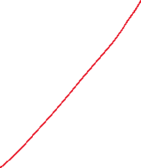
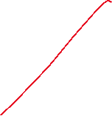


Walkthrough — the Economist's workflow
Assumption based on Colin's 5 requirements — toggle with the mindmap to refine
Start from template
Open in editor
Write with Copilot Agent
Clone repo (template includes Agent config)
Lightweight LaTeX editor, friendly to non-devs
Inline suggestions — no copy/paste
Style Check
BoC house-style agent
Render & publish
We’re done
Sync to the Overleaf Github Repo (sync on the interface)
LaTeX render → final PDF artifact
Internal + external co-authors
One-button git push/pull
Boxes show steps; arrows show single-direction flow. Replace any step with manual process where integration isn't yet built.
Notes:
Details and Issues:
If somebody started with a template, writing a paper, writing and editng and pushed to overleaf
Somebody comes back in overleaf
In this case you sync to overleaf and work in Overleaf

Slide 11
Start doc
Edit in overleaf
When ‘ready to check’ (grab
Check in to Overleaf Github Rep
Checker Web App
Updated doc version
(not synched yet)

Slide 12
04 · MAIN ACTIVITY · DISCUSSION PROMPTS PER STEP
Questions to capture in Mindmap.
#
Step
Current state?
Pain points?
Target with Copilot?
1
Start from template
Where does the template live today?
Who maintains it and what's already pre-loaded?
How does a new author get a copy without friction?
2
Open in easy editor
What does an Economist use today — Overleaf web, local TeX, Word?
What's good / painful about each?
What's the minimum the editor must do well?
3
Draft with GHCP
Where would inline AI help the most — boilerplate, prose, math, tables?
Where would it NOT be welcome (citations, conclusions)?
What constraints on the LLM (sovereignty, audit, prompt-injection)?
4
Compliance check
Which BoC house-style rules are highest value to enforce?
Manual today vs. should be automated tomorrow?
Block on violation or flag and let the author override?
5
Sync to Overleaf
Premium Overleaf git, GitHub mirror, or manual push?
Who 'owns' the source of truth — Overleaf or git?
What's the rollback story when a sync goes wrong?
6
Collaborate & publish
Who else touches the doc — peers, editors, externals?
Where do external collaborators sit (entitlement, sponsorship)?
What does 'published' actually mean — PDF, web, Bank library?
LaTeX (Overleaf) Copilot · Workshop Session 2 · May 27, 2026
8 / 13

Slide 13
04 · MAIN ACTIVITY · WHAT WE'RE CAPTURING
Every comment lands in one of four buckets.
Use this template in the mindmap so the readout writes itself.
✓
KEEP
✎
CHANGE
Already in Colin's 5 requirements + works as drawn. Confirm and move on.
Step exists but the shape is wrong. Capture the delta.
+
NEW
⏸
PARKING LOT
Missing requirement surfaced in the walkthrough — add it to the backlog.
Important but out of scope for the Copilot MVP. Note the owner.
HOW TO WRITE EACH ITEM
[STEP # · BUCKET] — one-line statement · raised by: · owner / next-step
LaTeX (Overleaf) Copilot · Workshop Session 2 · May 27, 2026
9 / 13

Slide 14
05 · DEVELOPMENT METHODOLOGY
How we go from prototype to something IT can stand behind.
1 · Gather requirements
OWNERS Microsoft + BoC business owner
STATUS DONE — Colin's email + this workshop
Listen, write down, validate. We did this with Colin on May 11 and continue today.
2 · Prototype in GitHub Copilot
OWNERS Microsoft (Amit) with GHCP
STATUS DONE — localhost:5200 demo
Build the lightweight PoC on a Microsoft laptop using GHCP to demonstrate the art of the possible.
3 · Stand up GHCP inside BoC
OWNERS BoC EA + IT + Economists + Microsoft
STATUS PROPOSED — the work ahead
Same shape of solution, now in a BoC-deployed environment, serving the Economists' needs. Keep integrations where they exist, allow manual process where they don't.
4 · IT maintenance + MVP security/governance
OWNERS BoC IT, Security, EA
STATUS TO DEFINE — first cut today
Operating model for the long tail: who owns it, how it's patched, what's the minimum viable security & governance set.
LaTeX (Overleaf) Copilot · Workshop Session 2 · May 27, 2026
10 / 13

Slide 15
THE PROVOCATION · A NEW MODEL
Serving the long tail of
BoC software needs.
AI coding tools make it possible to solve the kind of software needs the Bank has historically had to leave on the floor — too small for a heavyweight project, too important to ignore. The LaTeX Copilot is one specific instance of that pattern.
Quality of life
New ground
Worth exploring
Personas previously under-served (economists, analysts, content authors) get bespoke tooling.
Process & governance need to break new ground — EA + IT support is a prerequisite, not a nice-to-have.
Software will increasingly be built this way. Doing it now puts the Bank ahead of the curve.

Slide 16
Walkthrough — the delivery lifecycle
?
How BoC and Microsoft hand the work between them
MICROSOFT
Requirements
GHCP prototype
Propose deploy model
Refine ‘what’ with BoC
Working PoC, Microsoft side
GHCP inside BoC env
BANK OF CANADA
Deploy in BoC env
Maintenance model
MVP security + governance
BoC dev team picks up
Operate, evolve, support
Shift left, minimum viable
Keep integrations wherever they exist — fall back to manual process when they don't.

Slide 17
?
DECISIONS NEEDED TODAY
Things we want to leave the room having agreed.
Q1
Q2
Q3
Target user surface
BoC-controlled LLM choice
Template-repo ownership
Wrapper, extension, or standalone web tool?
Which model and how is it hosted?
Who owns Colin's template repo and how is it kept current?
Q4
Q5
Q6
Overleaf sync mechanism
Compliance rule scope
Engagement model
Overleaf Premium git? Mirror through GitHub? Manual push?
What's in the MVP rule set? What's deferred?
Who from BoC EA / IT joins the next two weeks?
LaTeX (Overleaf) Copilot · Workshop Session 2 · May 27, 2026
12 / 13

Slide 18
Next steps:
Who manages web apps – how? Lifecycle
Plan #16
Update the web app to push/pull to Git hub
After that Amit can push the webapp to Github for BoC use only
Is this the way to go vs Vs Code (great question)
Can you do this in VS Code more familiarly
Other notes:
LLM model could be selected for best bang for buck
Who would maintain
DDS?
ITS?
There is no protected B:
Therefore security model is much more relaxed
Tension of maintaining 2 approaches (VS Code vs Web App), Masoud preference is Web App, BUT VS Code people love it…
Style agent would stay within the bank
Timing…
Ideally something quickly – End of June Colin tied up – for demanding projects
Look into a CSA

Slide 19
🍁
BANK OF CANADA
BANQUE DU CANADA
Microsoft
Where do we go from here?
MICROSOFT TAKES AWAY
BoC TAKES AWAY
Sharpen the demo against the agreed user surface
Write up the proposed BoC-deployed GHCP shape
Draft the IT operating-model strawman for review
Capture today's decisions in a one-pager
Confirm BoC-controlled LLM availability + procurement path
Identify EA + IT partners for the next two weeks
Validate Colin's template repo + GHCP agent config
Surface the next 2-3 "long-tail" candidates we could attack the same way
Thank you.
MAY 27, 2026 · BoC + MICROSOFT · LaTeX (Overleaf) COPILOT

