Slide 1

TicketMaster Analysis A brief analysis on major concert tickets sold during 2021
Group 15
Ramdayal Rewaria
Chaitanya Shekar
Sangeetha Ramesh
Aanchal Dusija
Samiksha Thikekar

Slide 2

INTRODUCTION
Ticketmaster is the world's largest ticket distribution company in the United States, completely dominating its market niche. The company distributes tickets for more than 10,000 clients whose events range from professional wrestling matches and rock concerts to Broadway shows and operas.
The face value of Ticketmaster tickets is determined by the artist or client. In addition to the face value price, venues and Ticketmaster add fees to pay for their services.
Fee amounts vary between events and are dependent on the venue, available delivery methods, and preferences of the artist.
Objective:
To check which factors affect the minimum price of the concert ticket.

Slide 3
DATASET
CITY
City of the Concert in US
ARTIST
Artists Performing in the Concert
VENUE
Venue of the Concert
WEEKEND
1: Weekend,
0: Weekday
POPULATION
Population of the Concert City
MONTH
Month of the Concert
SCORE
Popularity of the Artist
GENRE
Music Type
MINIMUM PRICE
Minimum Price of the Concert Ticket

Slide 4
PRELIMINARY ANALYSIS
UNIQUE NUMBER OF SHOWS ON WEEKDAYS: 525
UNIQUE NUMBER OF SHOWS ON WEEKDAYS: 406
UNIQUE CITIES: 137
UNIQUE GENRES: 15
UNIQUE ARTISTS: 82

Slide 5

REMOVING OUTLIERS
Cooks Distance >1
Interquartile Range
Boxplot

Slide 6
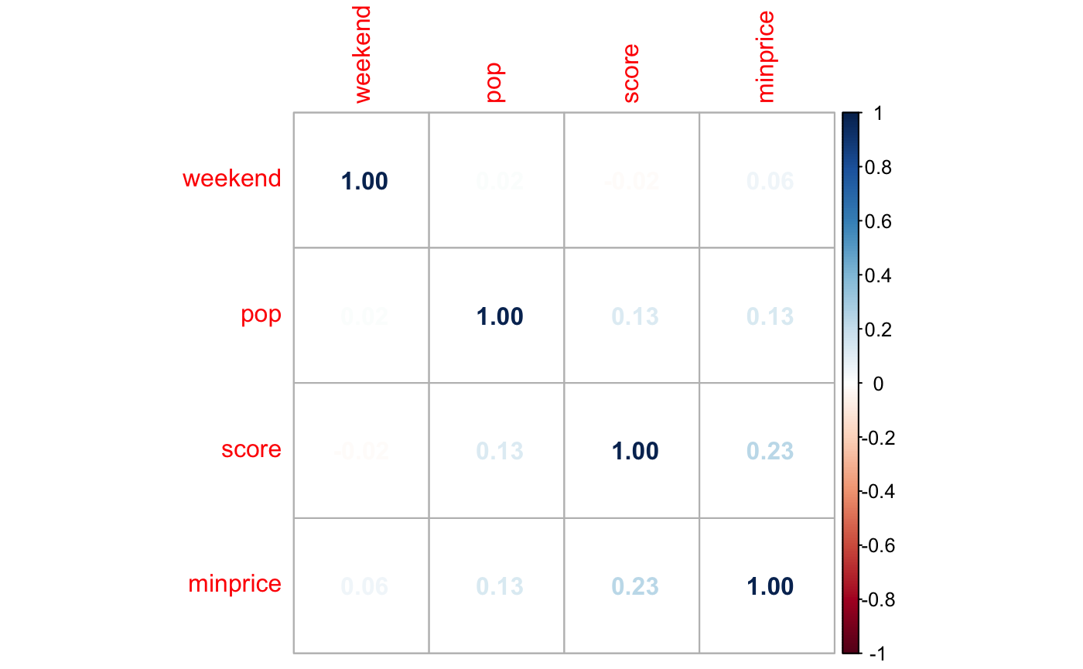
CORRELATION PLOT

Slide 7
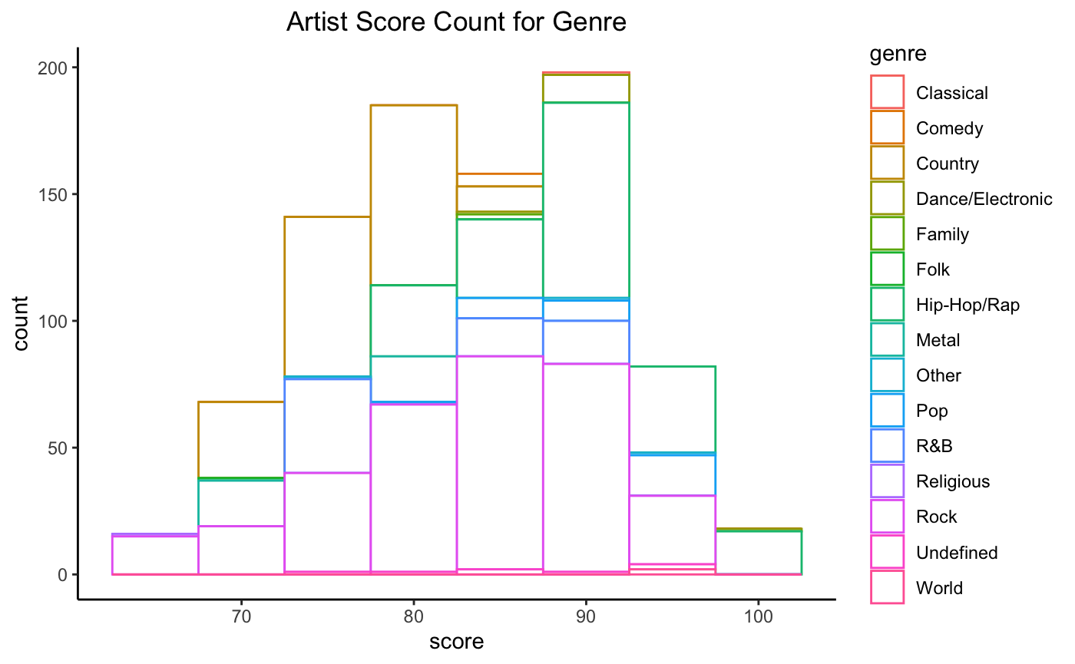
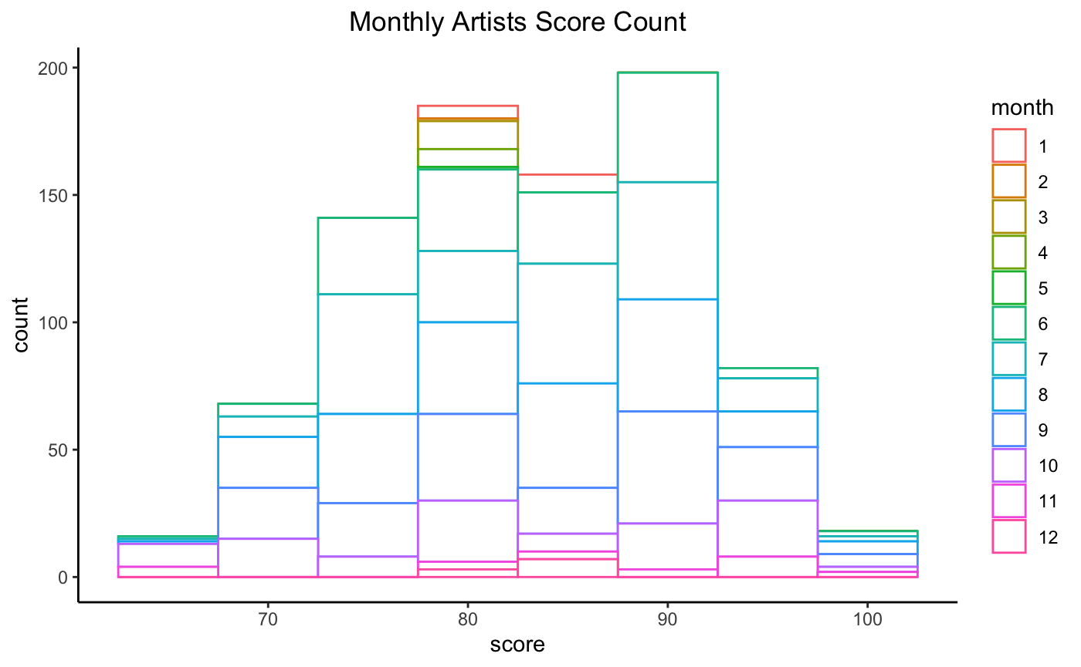
EXPLORATORY DATA ANALYSIS

Slide 8
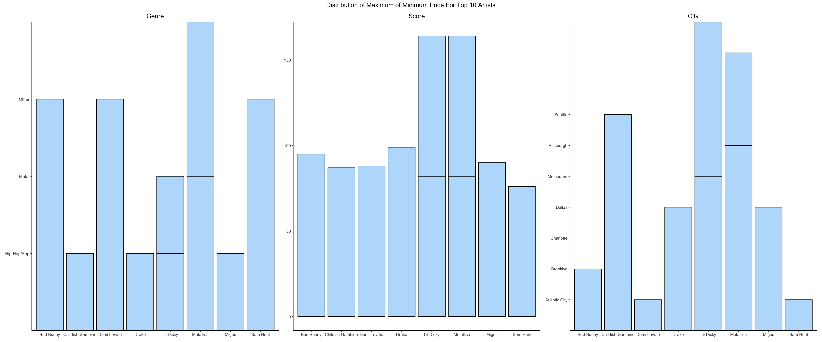
EXPLORATORY DATA ANALYSIS

Slide 9
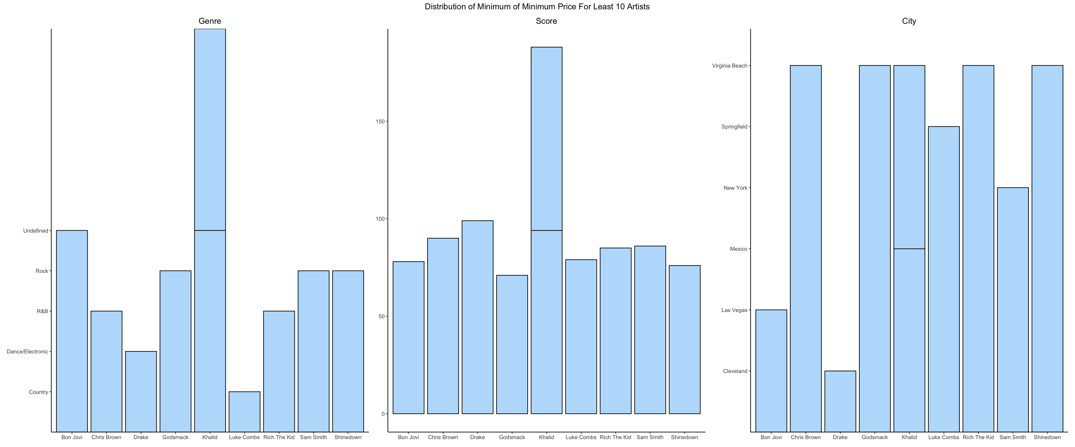
EXPLORATORY DATA ANALYSIS

Slide 10
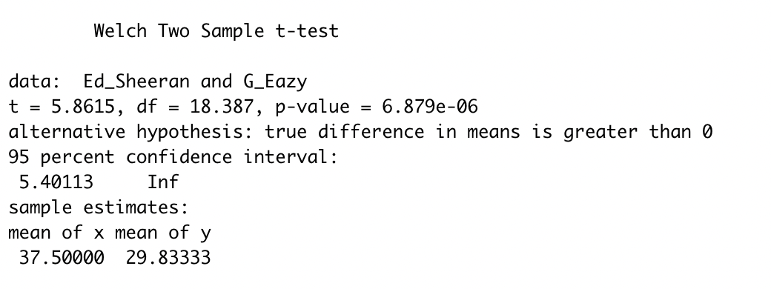
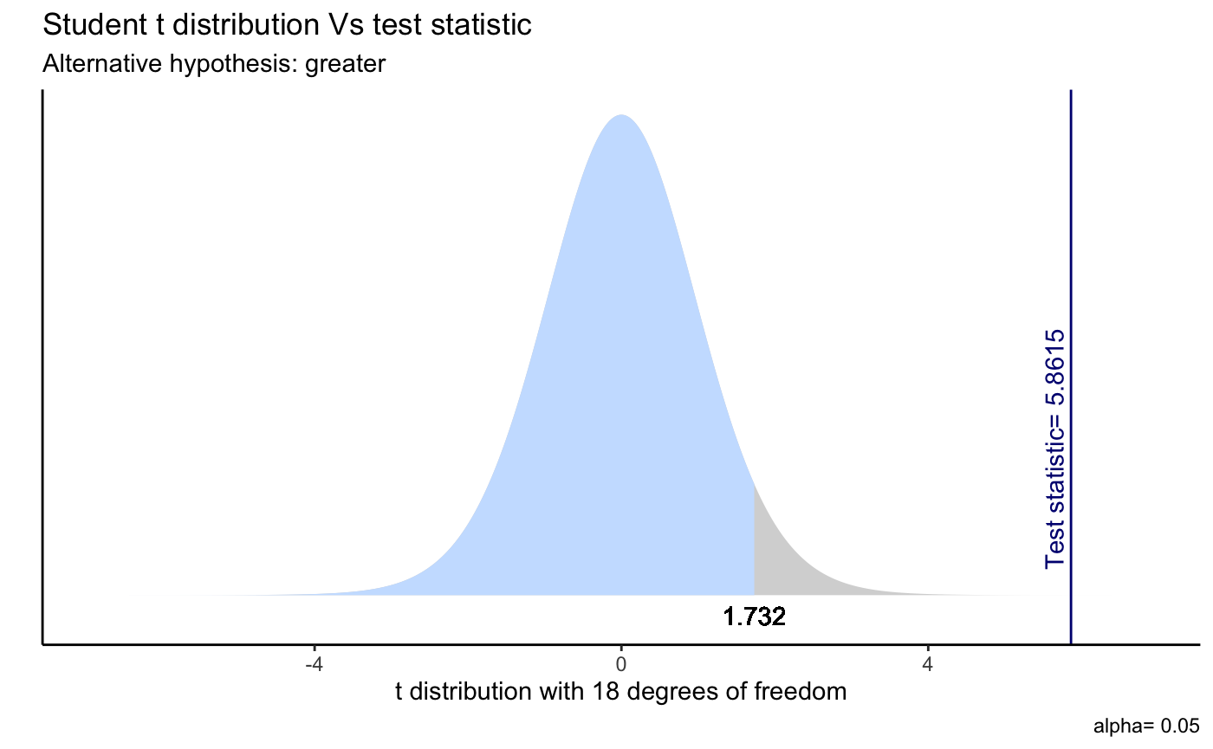
T-TESTING
Results:
Hypothesis:
Null hypothesis, H0:μE−μG=0 v/s
Alternative hypothesis, Ha:μE−μG>0.
Where,
μG= mean minimum price of G-Eazy
μE= mean minimum price of Ed Sheeran.
Conclusion:
Since p value is less than 0.05, At 5% significance level, we have enough evidence to reject the null hypothesis.
Therefore, there is strong evidence that the mean minimum price of Ed Sheeran and G-Eazy were not the same but in fact the average minimum price of Ed Sheerant were greater than the average minimum price of G-Eazy.

Slide 11
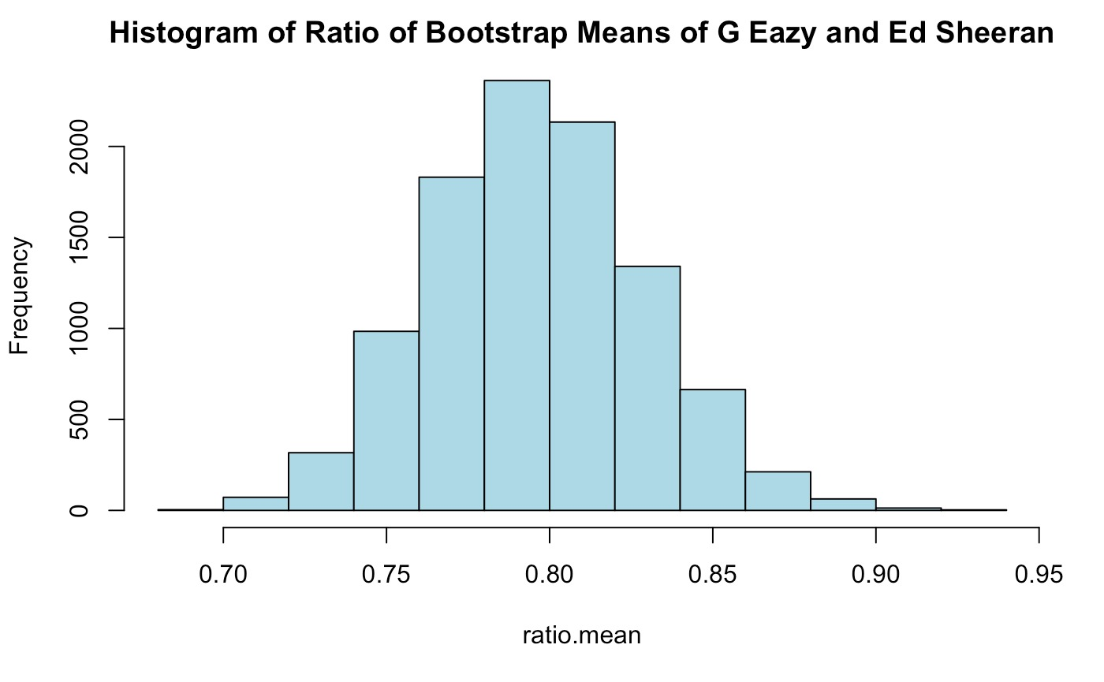

BOOTSTRAPING
Conclusion:
At 95% bootstrap percentile interval, mean ratio of G-Eazy’s minimum price to Ed Sheeran’s minimum price is between 0.7332200 and 0.8629818..
Results:

Slide 12
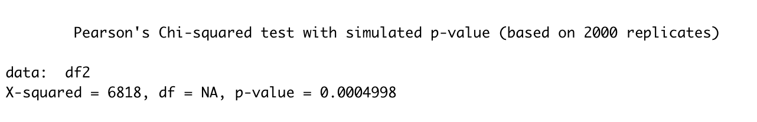
CHI-SQUARE TEST
Hypothesis:
Null Hypothesis: Minimum Price and Score are independent
Alternative Hypothesis: Minimum Price and Score are not independent
Results:
Conclusion:
Since p value is less than 0.05, At 5% significance level, we have enough evidence to reject the null hypothesis.
Therefore, there is strong evidence that the minimum price and Score of the Artists are dependent.

Slide 13
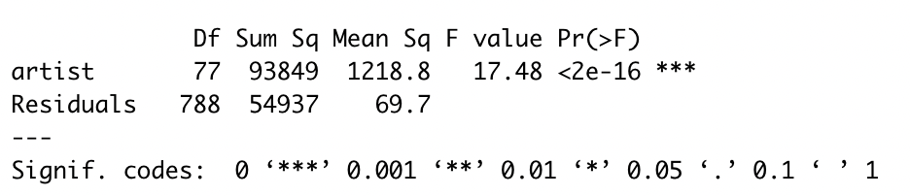
ANOVA TESTING (ONE-WAY)
Hypothesis:
Null Hypothesis : There is no effect of the Artist on the Minimum Price
Alternative Hypothesis: There is an effect of the Artist on the Minimum Price
Results:
Conclusion:
P-value: 2e-16. Since p value is less than 0.05, At 5% significance level, we have enough evidence to reject the null hypothesis.
Therefore, there is strong evidence that there is an effect of the Artist on the Minimum Price.

Slide 14
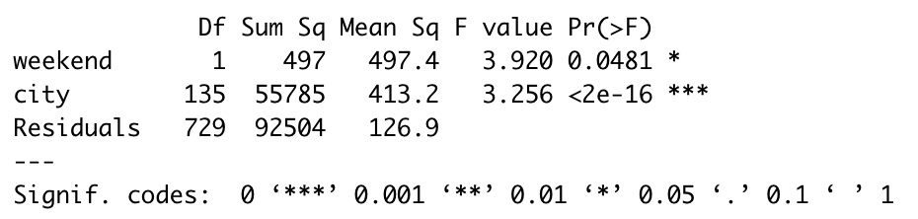
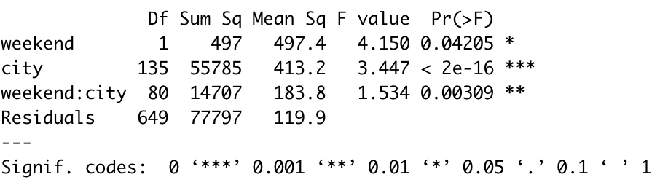
ANOVA TESTING (TWO-WAY)
Hypothesis 1:
Null Hypothesis : There is no effect of the City and Weekend on the Minimum Price
Alternative Hypothesis: There is an effect of the City and Weekend on the Minimum Price
Hypothesis 2:
Null Hypothesis : There is no interaction effect of the City and Weekend on the Minimum Price
Alternative Hypothesis: There is an interaction effect of the City and Weekend on the Minimum Price
Results:
Conclusion:
P-value: 2e-16. Since p value is less than 0.05, At 5% significance level, we have enough evidence to reject the null hypothesis.
Therefore, there is strong evidence that there is an effect of the City and Weekend on the Minimum Price. Additionally, their interaction effect also has an effect on the Minimum Price.

Slide 15
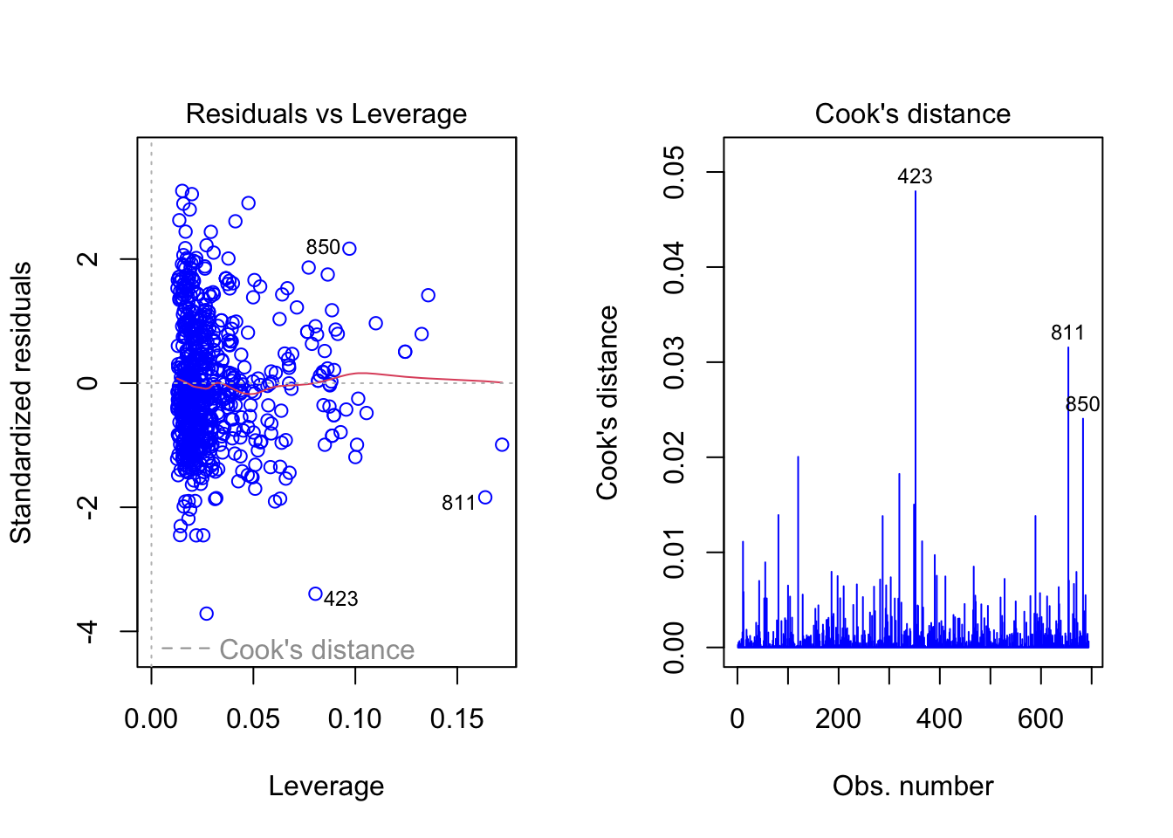
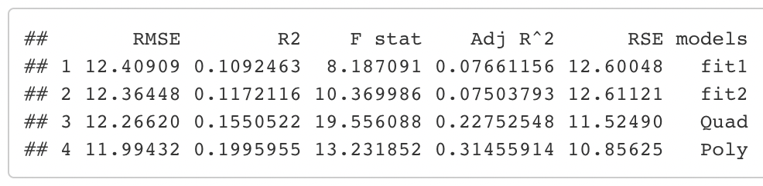
MULTIPLE LINEAR REGRESSION
Some data pre-processing steps were applied such as converting the data to numerical, remove unnecessary columns, normalizing the data using Z-score standardization and splitting the data into train and test.
A total of 4 different models were run before selecting the best one:
Normal Model with all the feature columns.
Normal Model with significant feature columns.
Quadratic Model with significant feature columns.
Polynomial Model with significant feature columns.
Results:

Slide 16
CONCLUSION

