Slide 1
PROJECT TITLE: Early Detection and Spreading Awareness Regarding Sepsis
TEAM NAME: Estrella
TEAM MEMBERS: Aanchal Singh [Leader]
Namrata Gupta Aditi Shreya
DEMO LINK: Website Link

Slide 2
Early Detection and Spreading Awareness Regarding Sepsis
IDEA STATEMENT:
The main idea is “ early detection of sepsis using physiological data in real time using ML model “.
Develop a digital solution that uses artificial intelligence to detect patient deterioration before it’s too late and trigger notifications to clinicians and care teams.
Front-end interface developed as a website and telegram chatbot ,a tool for spreading awareness regarding sepsis.
Educate preventing infections in health care settings and in the community so that infections that can lead to sepsis can be stopped before they happen.
Provide guidelines to follow infection control requirements (e.g., Hand hygiene) and ensure one to receive recommended vaccines
Trained machine learning model and integrated it with our website through a portal.

Slide 3
TECHOLOGY STACK:
Machine Learning Model:
Scikit Learn and xgboost.
Logistic Regression and Gradient Boosting Algorithm.
Jupyter Notebook.
MatPlot, Pandas, NumPy
Web Scraping
Website
HTML5,CSS, Bootstrap 4, JavaScript, jQuery.
Python in combination with Flask.
Telegram Chatbot
Python, PHP
Telegram API

Slide 4
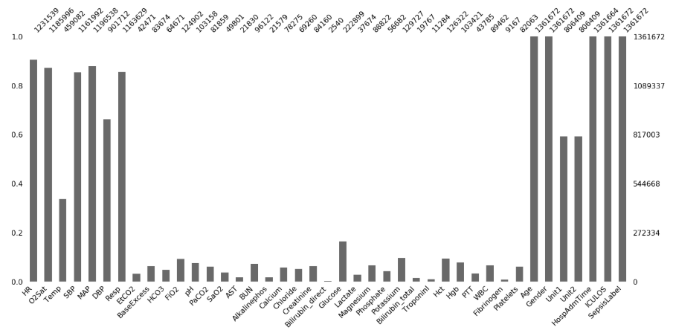
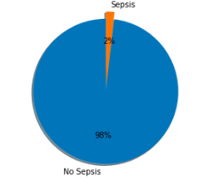
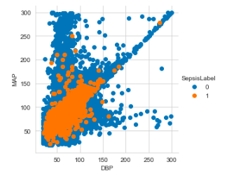
How Detection Model Works ?
Raw Data
Raw dataset collected from the physionet website.
42 physiological features have been selected initially.
The data has been combined in non-temporal way i.e. the hourly instance has been converted in independent and identical
Prediction now can be made with or without patient past data.
Combine Data
Many features have missing values in various instances
Imputation with mean values was excluded.
Features with more than 92% missing values were removed.
Others were encoded with a particular label.
Handling
Missing
Values
Feature Engineering
Correlation of features contributing to Sepsis was checked.
Major indicators foundain research journals were selected.
New features to generalize prediction were introduced.
Handling Missing Values
Data Imbalance
For imbalanced dataset, aspects such as over-sampling & under-sampling were considered to eliminate this problem.
Finally Decision-tree algorithm was used.
Processed Data and Baseline Prediction
Tested and trained model on 2 algorithms on the processed data obtained.
Working on 2 more training algorithm.
Data Imbalance
Correlation Diagram

Slide 5
Use Case Diagram
P Predicts SOFA score
Training
Interface
Features
HR,BP,RR
Etc.
Trained Model
Provides Data
User
High Risk
Low Risk
Output
Decision Tree Generation
Recursively Repeat Each Process
Select best using features ASM like
Gain Ratio
Break Dataset into smaller subset.
Training Data
Data
Testing Data
Model Evaluation
Performance Evaluation means
Accuracy
Precision
Recall
Processed Data

Slide 6
HOW DO WE SPREAD AWARENESS ?
Website
Covers all the aspects regarding prevention and symptoms.
ML prediction model is integrated with it that will do the task of early detection through SOFA score.
Training modules have been also included.
Telegram Bot
A Telegram chatbot will be included as a tool to spread awareness.
Real-time assistance along with better interaction will be provided once the chatbot gets trained enough.
More people can be handled as 24/7 service will be provided and only necessary queries will be forwarded to a real-person.

Slide 7
Notification to Clinicians and care-teams
Our website has a notification section to express alerts if the prediction for sepsis label is positive.
A separate user-interface will be designed using Python library for triggering alerts to the hospital staff.
Training of the Front-line Staff
We aim to design training program with different learning styles. Materials that appeals to various techniques: verbal, visual, hands-on, etc.
Make programs more interactive through quizzes and games to reduce lecture-based implementation.
Embrace computer based training modules for completing training courses online.They can be remotely accessed and would be more convenient for the participants.
Evaluation program after training to ensure it has been effective. As there is no purpose of training if certain outcomes are not attained.

