Slide 1
Supply Chain Management
SWAMI KESHVANAD INSTITUTE OF TECHNOLOGY,
MANAGEMENT &GRAMOTHAN
Submitted to:
Sourabh Ranjan Shrivastav
Submitted by:
Archana Sharma
Aanchal Garg
Ayushi Jain
Submitted to:
Sourabh Ranjan Shrivastav

Slide 2
ABSTRACT
All facilities, functions, activities, associated with flow and transformation of goods and services from raw materials to customer, as well as the associated information flows
An integrated group of processes to “source,” “make,” and “deliver” products

Slide 3
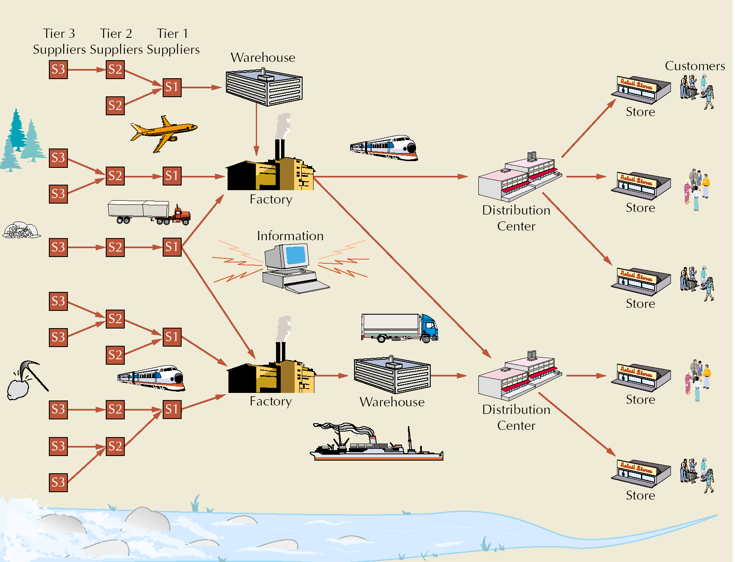
Supply Chain Illustration

Slide 4
Supply Chain for Service Providers
More difficult than manufacturing
Does not focus on the flow of physical goods
Focuses on human resources and support services
More compact and less extended

Slide 5
Value vs. Supply Chain
Value chain
  every step from raw materials to the eventual end user
  ultimate goal is delivery of maximum value to the end user
Supply chain
  activities that get raw materials and subassemblies into manufacturing operation
Terms are used interchangeably

Slide 6
Supply Chain Management (SCM)
Managing flow of information through supply chain in order to attain the level of synchronization that will make it more responsive to customer needs while lowering costs
Keys to effective SCM
  information
  communication
  cooperation
  trust

Slide 7
Supply Chain Uncertainty
One goal in SCM:
  respond to uncertainty in customer demand without creating costly excess inventory
Negative effects of uncertainty
  lateness
  incomplete orders
Inventory
  insurance against supply chain uncertainty
Factors that contribute to uncertainty
  inaccurate demand forecasting
  long variable lead times
  late deliveries
  incomplete shipments
  product changes batch ordering
  price fluctuations and discounts
  inflated orders

Slide 8
E-business and Supply Chain
Cost savings and price reductions
Reduction or elimination of the role of intermediaries
Shortening supply chain response and transaction times
Gaining a wider presence and increased visibility for companies
Greater choices and more information for customers

Slide 9
E-business and Supply Chain (cont.)
Improved service as a result of instant accessibility to services
Collection and analysis of voluminous amounts of customer data and preferences
Creation of virtual companies
Leveling playing field for small companies
Gaining global access to markets, suppliers, and distribution channels

Slide 10
Key Performance Indicators
Cost of goods sold
Inventory turns =
Average aggregate value of inventory
Average aggregate value of inventory =
=
X (unit value item i)
(average inventory for item i)
Average aggregate value of inventory
Days of supply =
(Costs of goods sold)/(365 days)

Slide 11
Key Performance Indicators: Example
Cost of goods sold: $425 million
Production materials and parts: $4,629,000
Work-in-process: $17,465,000
Finished goods: $12,322,000
Total average aggregate value of inventory (2+3+4): $34,416,000
$425, 000, 000
Inventory turns =
= 12.3
$34,416,000
$34,416,000
Days of supply =
= 29.6
($425,000,000)/(365)

Slide 12
Other Measures of Supply Chain Performance
Process Control
  used to monitor and control any process in supply chain
Supply Chain Operations Reference (SCOR)
  establish targets to achieve “best in class” performance

Slide 13
Global Supply Chain
To compete globally requires an effective supply chain
Information technology is an “enabler” of global trade
Nations form trading groups
No tariffs or duties

Slide 14
Obstacles to Global Chain Transactions
Increased documentation for invoices, cargo insurance, letters of credit, ocean bills of lading or air waybills, and inspections
Ever changing regulations that vary from country to country that govern the import and export of goods
Trade groups, tariffs, duties, and landing costs
Limited shipping modes
Differences in communication technology and availability

Slide 15
Obstacles to Global Chain Transactions (cont.)
Different business practices as well as language barriers
Government codes and reporting requirements that vary from country to country
Numerous players, including forwarding agents, custom house brokers, financial institutions, insurance providers, multiple transportation carriers, and government agencies
Since 9/11, numerous security regulations and requirements

Slide 16
Duties and Tariffs
Proliferation of trade agreements
Group members charge uniform tariffs
Member nations have a competitive advantage within the group
Trade specialists
  include freight forwarders, customs house brokers, export packers, and export management and trading companies

Slide 17
Web-based International Trade Logistic Systems
International trade logistics web-based software systems reduce obstacles to global trade
  convert language and currency
  provide information on tariffs, duties, and customs processes
  attach appropriate weights, measurements, and unit prices to individual products ordered over the Web
  incorporate transportation costs and conversion rates
  calculate shipping costs online while a company enters an order
  track global shipments

Slide 18
Recent Trends in Globalization for U.S. Companies
Two significant changes
  passage of NAFTA
  admission of China in WTO
Electronic Industry
  70% of cost is in components
  major supply chains have moved to China
Proliferation of counterfeit parts

