Slide 1



WORLD ELECTRICITY
ANALYSIS
Presented By:
Group-3a
Aanchal Singh Chauhan
Nikunja Berman
Divik Maheswari
Shikha

Slide 2

TABLE OF CONTENTS
PROBLEM STATEMENT
OBJECTIVE AND OVERVIEW
CHALLENGES FACED
INSIGHTS
DASHBOARD
CONCLUSION

Slide 3
PROBLEM STATEMENT
1
Initially data was in Json format
2
Converted data from Json format to csv format using python
3
Data cleaning using
Python & power query
5
Used power bi for creating beautiful dashboard
4
Connected data with SQL for data manipulation &valuable insights

Slide 4



OBJECTIVE AND OVERVIEW
Dataset Overview
World Electricity Access of all countries since 1960
Electricity Production across the world by different sources (nuclear , oil , renewable)
Overall transmission loss across the world
Objective
Analysis of access to the electricity based on different parameter as a function of time
Getting meaningful insights of Electricity Production by different Sources (nuclear , oil , renewable)
Transmission loss across the world and getting trends & insights
Analysis on rural and urban electricity accessibility.

Slide 5
CHALLENGES FACED
Incomplete data
Cleaning & handling of datasets
Insufficient knowledge
No prior practice

Slide 6
REGION WISE ACCESS TO ELECTRICITY
There is high proportion of electrification in developed regions ( North America & Europe )
There is no difference in access to electricity between urban and rural areas of those economically developed regions
In Developing economies there is stark difference between the distribution of electricity between the rural and urban areas.
Rural areas of developing countries have considerably less access to electricity as compared to their urban counterparts.

Slide 7
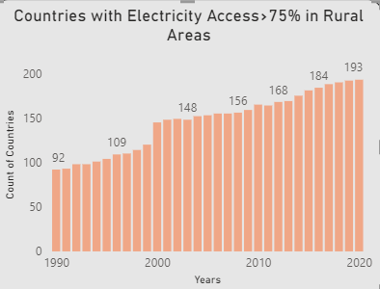
COUNT OF COUNTRIES (75%+ ACCESS)
There has been gradual increase in countries having minimum 75% of electrification.
Most of growth in count of these countries comes from countries belonging to lower economic group.
2000s have seen a sharp increase in total count of countries having minimum 75% electricity access as such
countries are gradually developing.
Developing countries have contributed most in increasing Trend.

Slide 8
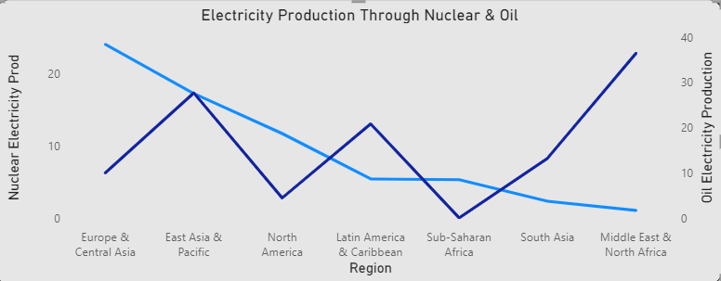
COMPARISION OF ELECTRICITY PRODUCTION THROUGH NUCLEAR & OIL
As we know Oil is non-renewable source of energy and cheaper source to produce electricity and easier to acquire
Producing electricity using oil or non - renewable sources produces lots of hazardous waste and pollutes the environment.
As we can see , reliance on nuclear energy is more in North-America and Europe whereas rest regions relies more on oil sources.

Slide 9
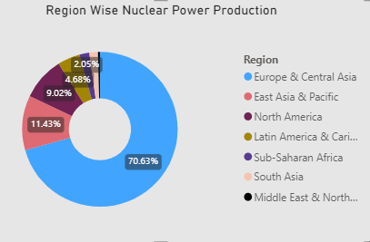
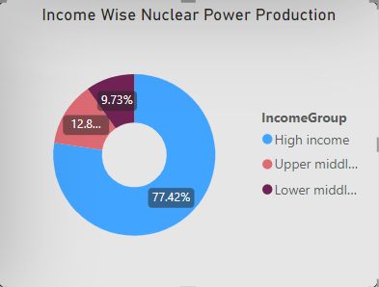
NUCLEAR POWER PRODUCTION REGION WISE AND INCOME WISE
Nuclear sources are quite hard to acquire and much expensive to generate electricity. But it the one of the cleaner and efficient source of generating electricity.
As we can see , high income and upper middle income countries relies more on nuclear sources as compared oil.
Oil being overall easy to acquire and comparatively cheaper to generate electricity.
As seen in chart , low income and lower middle income countries contributes less in production of nuclear power. They prefer oil sources as compared to nuclear as they also face technological hurdles to produce nuclear energy.

Slide 10
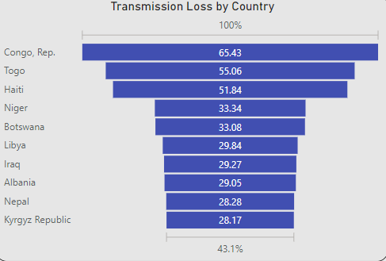
TRANSMISSION LOSS (TOP 10 COUNTRIES)
On research , its found that most countries having higher proportion of transmission loss belongs to poor economy.
Which on further inspection, proved that one of the main reason could be faulty infrastructure among many others.
Due to poor economies, there could be funds issues which result into outdated infrastructure.
Many countries are going through or went through issues such as political conflicts , civil war etc. which exacerbated to the above given issues.

Slide 11
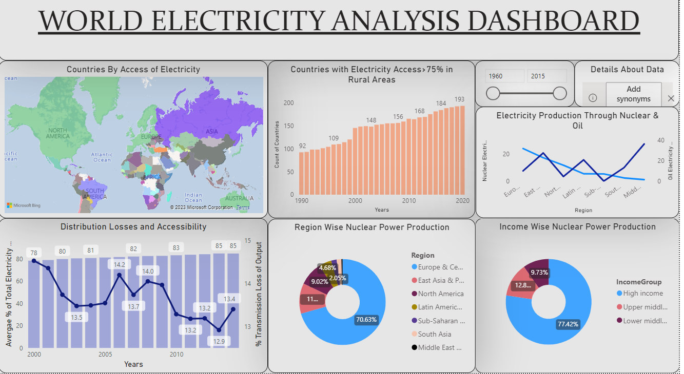

Slide 12
CONCLUSION
North America And Europe have the highest average electrification in both rural and urban areas as they are among highly developed regions in the world.
Regions belonging to lower and lower middle income have comparatively lower electrification along with considerable difference of distribution between rural and urban areas.
There is gradual increase in number of developing countries accomplishing minimum 75% electrification over the last two decades.
Developed regions have increased their electricity production through nuclear sources whereas some developing regions have gradually started increasing their foothold in nuclear power generation while some regions have been unable to do so.
Transmission loss has been highest among the countries having poor economy, political instability , infrastructure issues and outdated technologies.
Countries having emphasis on tourism , geographical & demographic constraint have seen highest growth rate of electrification in the last two decades.
Electricity accessibility has increased from 78% to 85% from year 2000-2014.
Distribution loss has been reduced from 80% to 13% from year 2000-2014.

Slide 13
THANK YOU!

