Slide 1



WORLD ELECTRICITY
ANALYSIS
Presented By:
Group-3a
Aanchal Singh Chauhan
Nikunja Berman
Divik Maheswari
Shikha

Slide 2

TABLE OF CONTENTS
PROBLEM STATEMENT
OBJECTIVE AND OVERVIEW
CHALLENGES FACED
INSIGHTS
DASHBOARD
CONCLUSION

Slide 3
PROBLEM STATEMENT
1
Initially data was in Json format
2
Converted data from Json format to csv format using python
3
Data cleaning using
Python & power query
5
Used power bi for creating beautiful dashboard
4
Connected data with SQL for data manipulation &valuable insights

Slide 4

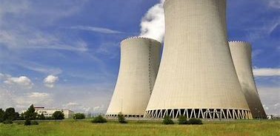
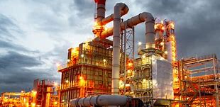
OBJECTIVE AND OVERVIEW
Dataset Overview
World Electricity Access of all countries since 1960
Electricity Production across the world by different sources (nuclear , oil , renewable)
Overall transmission loss across the world
Objective
Analysis of access to the electricity based on different parameter as a function of time
Getting meaningful insights of Electricity Production by different Sources (nuclear , oil , renewable)
Transmission loss across the world and getting trends & insights
Analysis on rural and urban electricity accessibility.

Slide 5
CHALLENGES FACED
Cleaning & handling of datasets
Data
processing
and analysis
Incomplete
data
Technical
Expertise

Slide 6
REGION WISE ACCESS TO ELECTRICITY
The developed regions such as North America and Europe have achieved high levels of electrification, and there is no significant difference in access to electricity between urban and rural areas in these regions.
However, in developing economies, there is a stark contrast in the distribution of electricity between rural and urban areas. The rural areas in these countries have considerably less access to electricity compared to their urban counterparts.
This difference in electrification rates between rural and urban areas of developing countries is a challenge that needs to be addressed in order to improve the overall access to electricity in these regions.

Slide 7
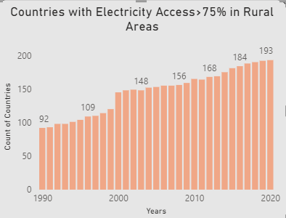
COUNT OF COUNTRIES (75%+ ACCESS)
Over the past two decades, there has been a gradual increase in the number of countries that have achieved a minimum of 75% electrification. This growth is primarily driven by countries in the lower economic group that are gradually developing.
The 2000s in a particular saw a sharp increase in the total count of countries that achieved minimum 75% electrification. This positive trend reflects the efforts made by developing countries to increase their electrification rates and improve the living standards of their citizens.
Furthermore, the developing countries have contributed the most to this increasing trend, reflecting their sustained efforts in improving their energy infrastructure and access to electricity.

Slide 8
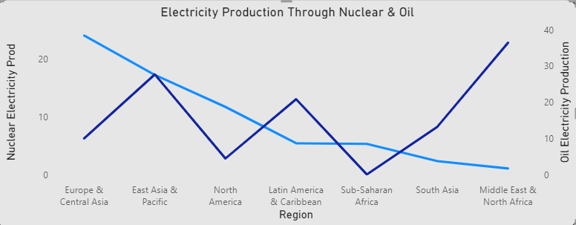
COMPARISION OF ELECTRICITY PRODUCTION THROUGH NUCLEAR & OIL
Oil is a non-renewable source of energy that is cheaper to produce electricity with and easier to acquire.
However, producing electricity from non-renewable sources like oil can result in hazardous waste and pollution of the environment.
North America and Europe have a greater reliance on nuclear energy, while other regions rely more on oil sources.

Slide 9
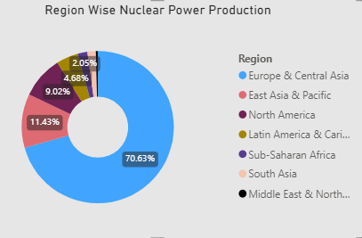
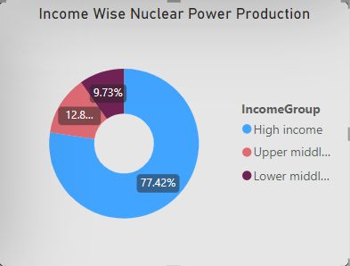
NUCLEAR POWER PRODUCTION REGION WISE AND INCOME WISE
Nuclear sources of energy are a relatively expensive and challenging energy source to acquire for generating electricity, but they are considered one of the most efficient and cleaner sources of energy.
High income and upper middle-income countries tend to rely more on nuclear sources than on oil due to their higher economic capacity and advanced technological infrastructure.
In contrast, low income and lower middle-income countries contribute less to the production of nuclear power and rely more on oil sources to generate electricity, as they may face significant technological hurdles in developing nuclear energy.
Despite being an overall easier and cheaper energy source to acquire, oil production has its drawbacks, such as hazardous waste and pollution of the environment.

Slide 10
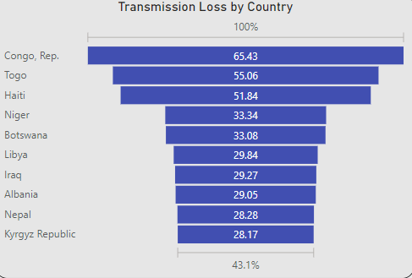
TRANSMISSION LOSS (TOP 10 COUNTRIES)
Research has shown that countries with poor economies tend to have a higher proportion of transmission loss in their electricity systems.
Upon further examination, it was discovered that one of the main reasons for this trend is faulty infrastructure, which can be due to inadequate funds resulting from poor economic conditions.
Additionally, many of these countries may be experiencing political conflicts, civil wars, or other social issues, which exacerbate these problems and make it difficult to address infrastructure issues.
These challenges can ultimately lead to significant losses of energy during transmission, which can have far-reaching implications for energy access and economic development.

Slide 11
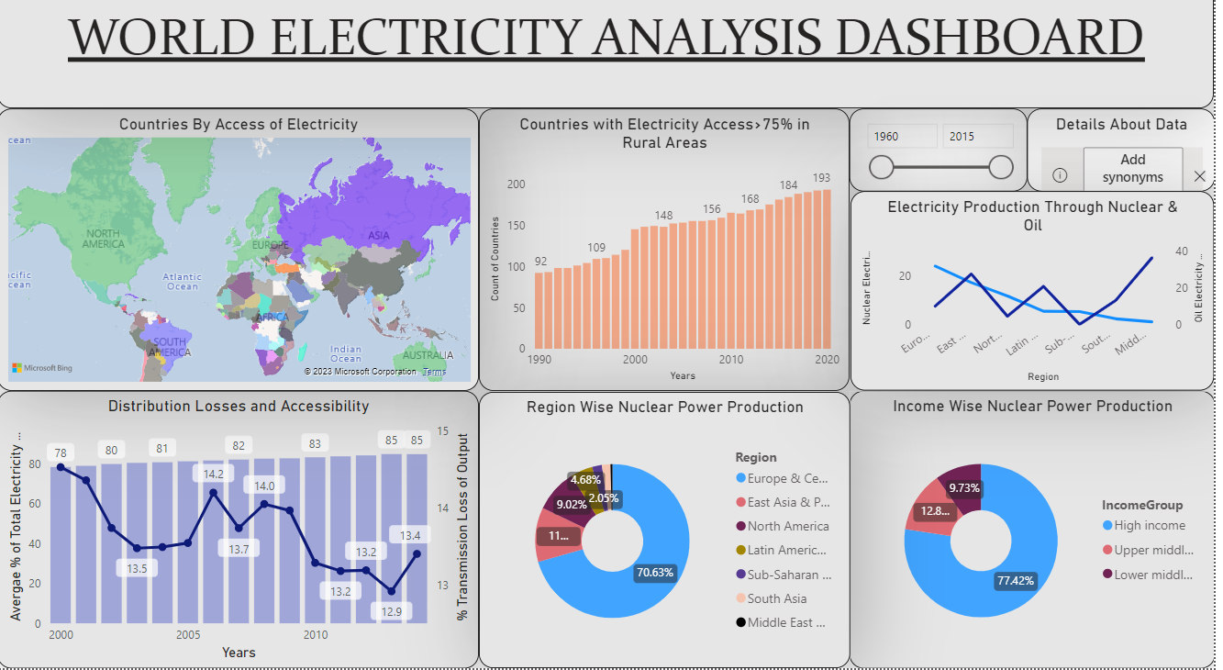

Slide 12
Access to electricity has improved globally, with electrification rates increasing from 78% to 85% between 2000 and 2014.
However, there are significant disparities in access to electricity between high-income and low-income countries, with countries in the lower and lower-middle income categories having comparatively lower electrification rates, particularly in rural areas.
Transmission loss is a significant issue in many countries, particularly those with poor economic conditions, outdated infrastructure, and political instability.
Nuclear energy is a cleaner and more efficient source of energy compared to oil but is more challenging to acquire and relatively expensive to generate electricity.
North America and Europe have the highest average electrification rates in both rural and urban areas, reflecting their advanced economic development and energy infrastructure.
Countries with a focus on tourism and facing geographical and demographic constraints have experienced the most significant growth in electrification in the last two decades.
Improving access to electricity can have a significant impact on economic development and improving living standards, particularly in low-income countries.
Addressing transmission loss and transitioning to cleaner and more efficient energy sources are critical steps towards achieving sustainable energy access and reducing environmental impacts.
CONCLUSION

Slide 13
THANK YOU!

