Slide 1

NOVOTECH
E-Commerce Website
FEE
PROJECT
Presented by: Aanchal Sharma
Roll No: 2110990009
Group No: 5
Submitted To - Mr. Lavish Arora

Slide 2
OVERVIEW
1.
2.
3.
Introduction
Why was this name chosen
Goals
4.
5.
6.
Challenges
Project Overview
Future Scope

Slide 3
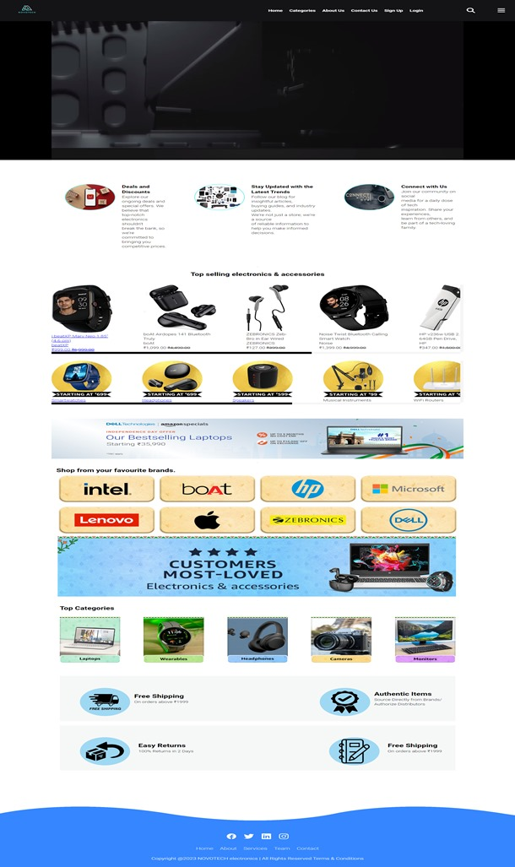

INTRODUCTION
This project was created using JavaScript, HTML, and CSS to demonstrate my ability to design a user-friendly and visually appealing website.
My primary focus was on delivering an exceptional user experience while applying best practices in front-end development.
It reflects my dedication to web development and showcases my problem-solving skills.
In the following sections, we'll delve into the project's features and technologies used to bring it to life. Thank you for joining us on this journey through our project.

Slide 4




WHY WAS THIS NAME CHOSEN?
The choice of the name NOVOTECH can be influenced by several factors:
Innovation - "Novo" is a Latin word that means "new" or "innovative"
Technology
Global Appeal
Brandability
Uniqueness
Suggestive of Expertise

Slide 5



GOALS
Design a streamlined and secure checkout process with multiple payment options, guest checkout feature, and real-time order tracking, minimizing cart abandonment and ensuring a smooth transaction flow
·Integrate interactive elements such as product sliders, image zoom, and quick view options, allowing customers to engage with products before making a purchase decision.
:Implement intuitive navigation with clear categories, filters, and search functionality, enabling users to quickly find the products they are looking for without any hassle

Slide 6
Challenges
·Handling and displaying a large volume of product data, including images, descriptions, prices, and customer reviews, while maintaining website performance can be challenging.
1.
Keeping the HTML, CSS, and JavaScript codebase organized, scalable, and maintainable, especially as the project grows, is crucial to facilitate future updates and additions.
2.
·Ensuring the website is accessible to users with disabilities by adhering to web accessibility standards (WCAG) can be complex and requires careful attention to design and functionality.
3.
·Protecting against common web security threats such as SQL injection, cross-site scripting (XSS), and data breaches requires constant vigilance and proactive security measures.
4.
Continuously monitoring and optimizing the website's performance, including load times and responsiveness, to provide a smooth user experience, especially as the site's content and traffic increase.
5.

Slide 7
Project Overview
In the project that has been shown below, I have tried to create a website using HTML, CSS and JavaScript with a clean user interface which provides an easy shopping and exploring experience for the user. Colour and aesthetics of site has been kept simple and minimal to further increase user appeal. Different category pages are made for easier browsing to find your favourite in a nick of a time.

Slide 8
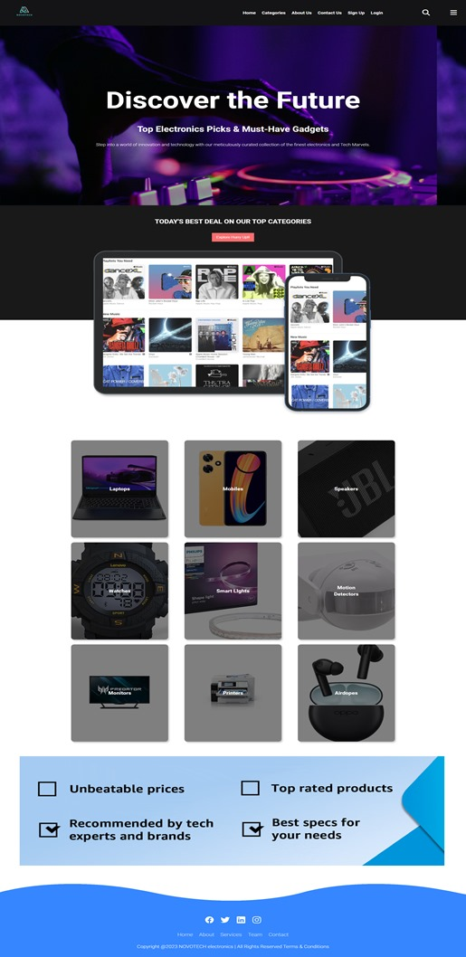
Category Page

Slide 9

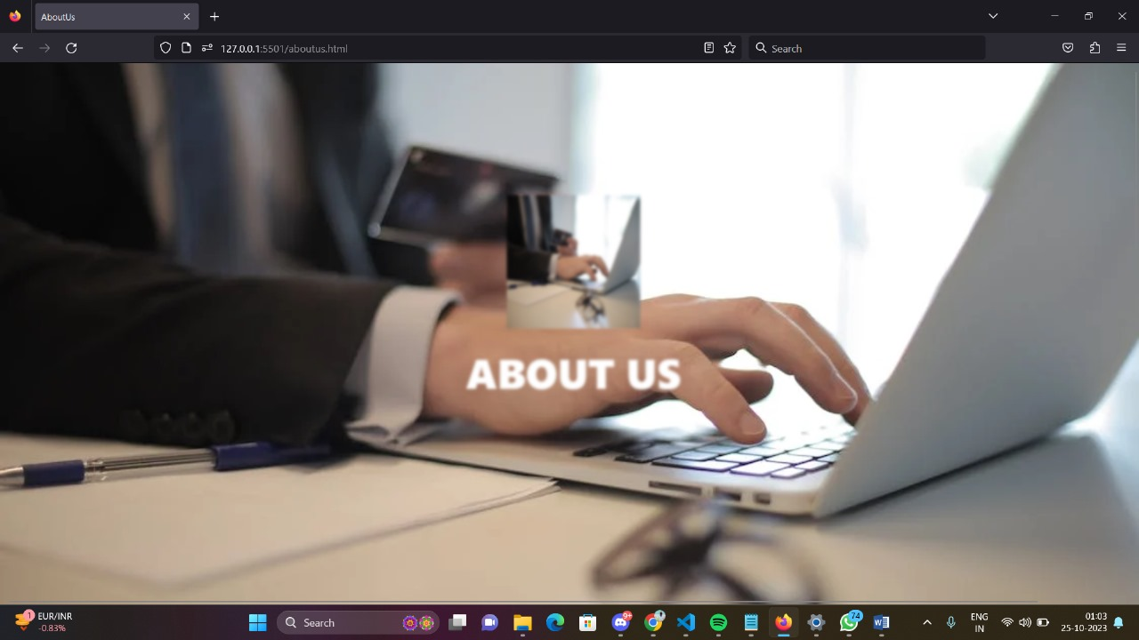
About us Page

Slide 10
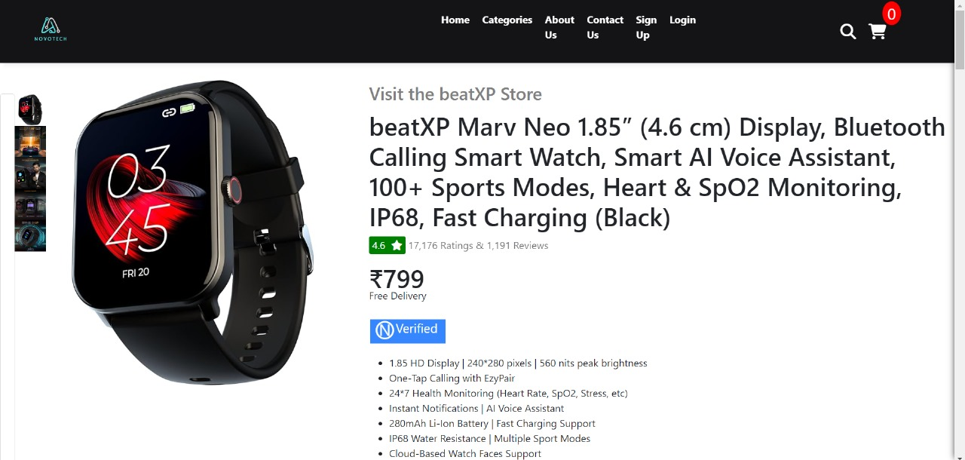
Product Page

Slide 11
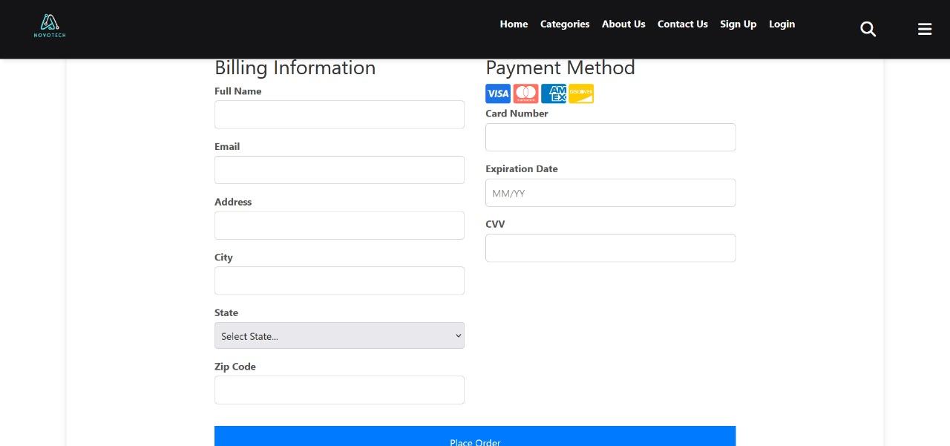
Checkout Page

Slide 12



FUTURE SCOPE
Enabling voice search and voice-assisted shopping for hands-free browsing and ordering through voice-activated devices
·Allowing customers to visualize appliances in their own space using AR technology, which can enhance the decision-making process.
·We will consider developing a dedicated mobile application for NOVOTECH to provide a seamless and optimized shopping experience for mobile users.

Slide 13

NOVOTECH
E-Commerce Website
Thank You!

