Slide 1
Chapter 1
Introduction
To
Computers

Slide 2
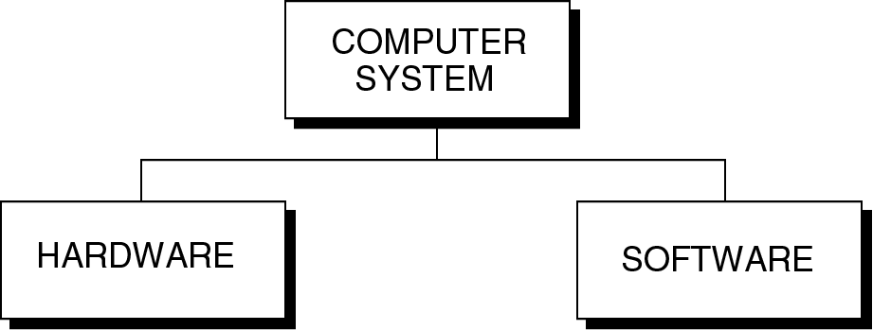
Figure 1-1

Slide 3
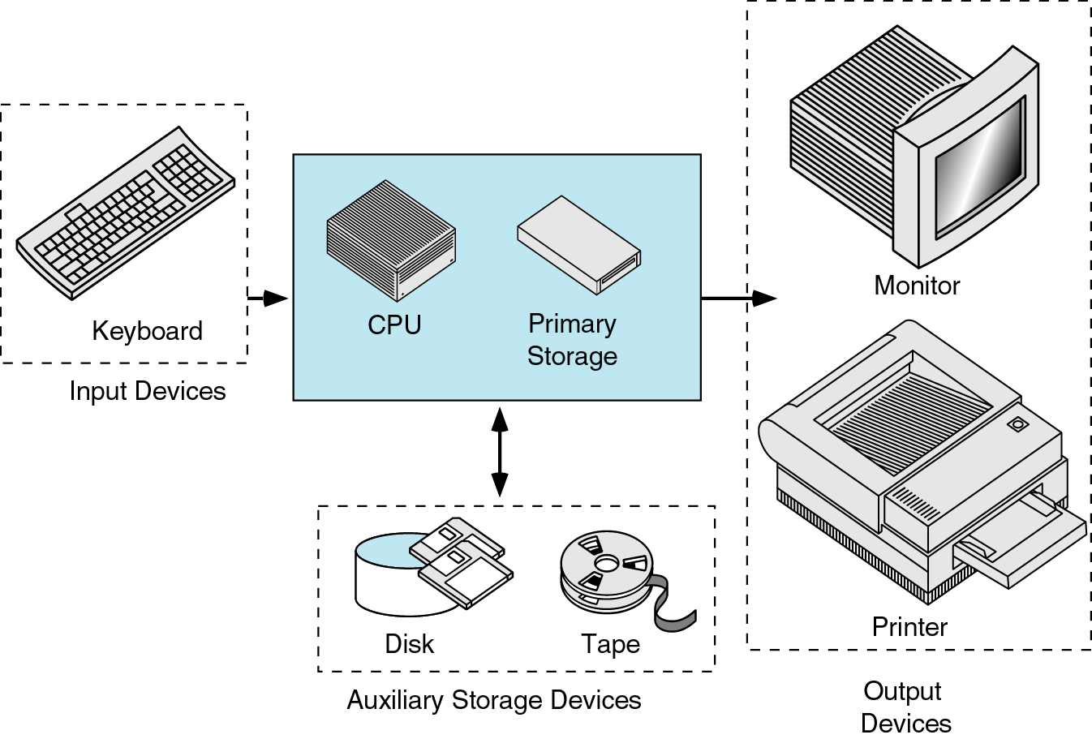
Figure 1-2

Slide 4
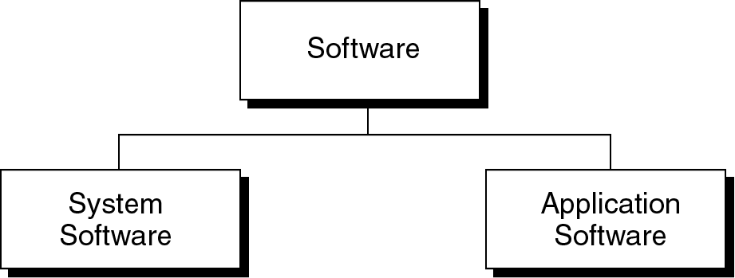
Figure 1-3

Slide 5
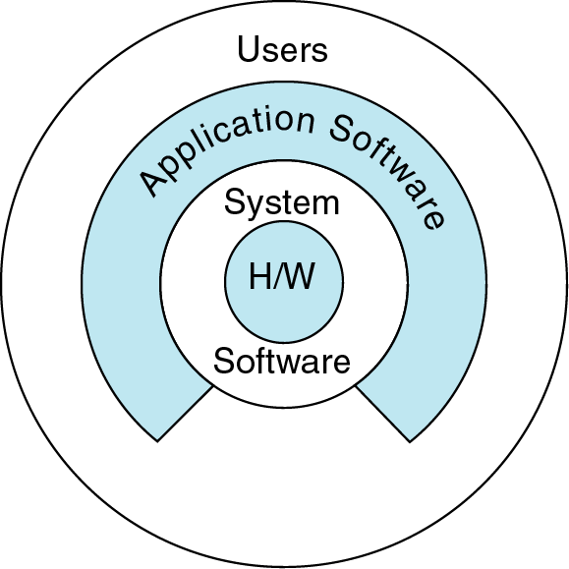
Figure 1-4

Slide 6
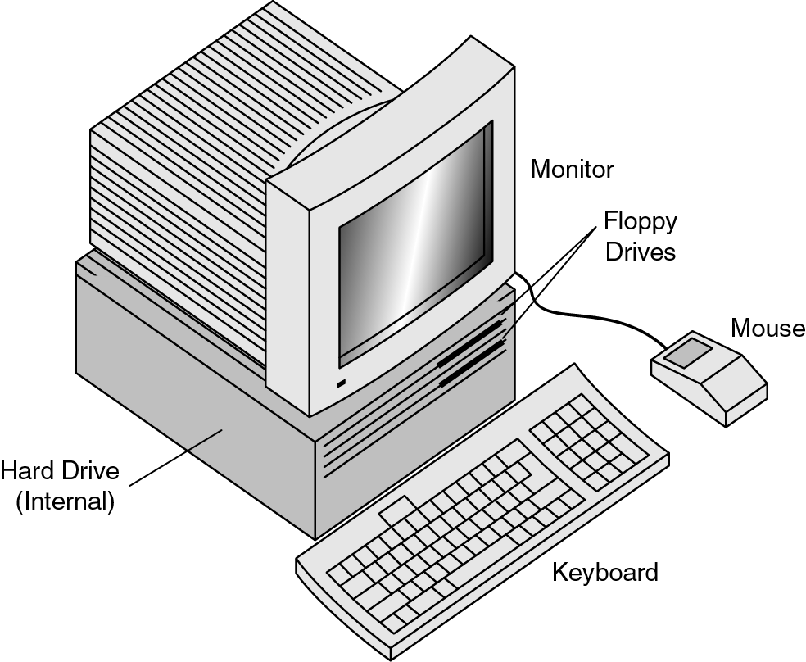
Figure 1-5

Slide 7
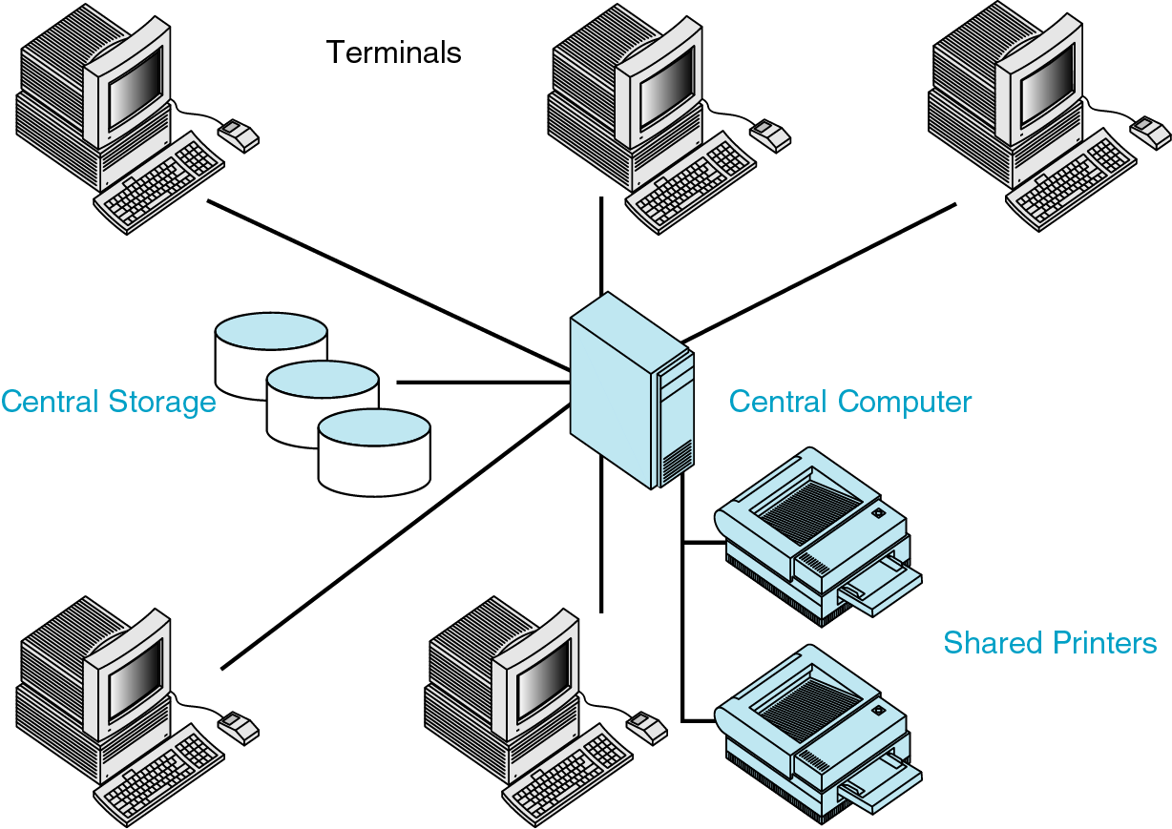
Figure 1-6

Slide 8
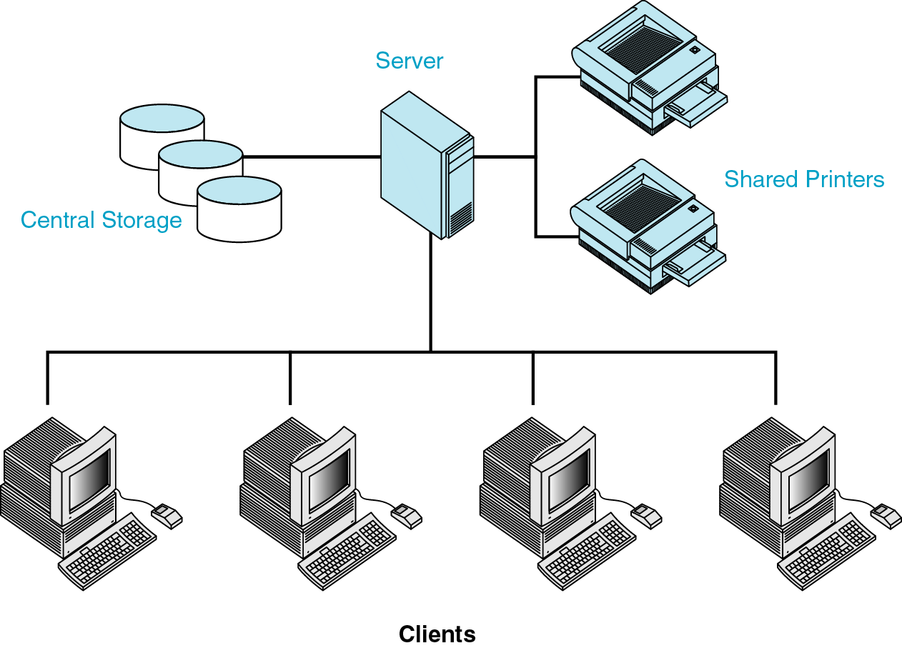
Figure 1-7

Slide 9
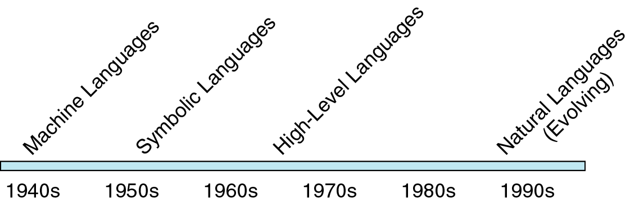
Figure 1-8

Slide 10
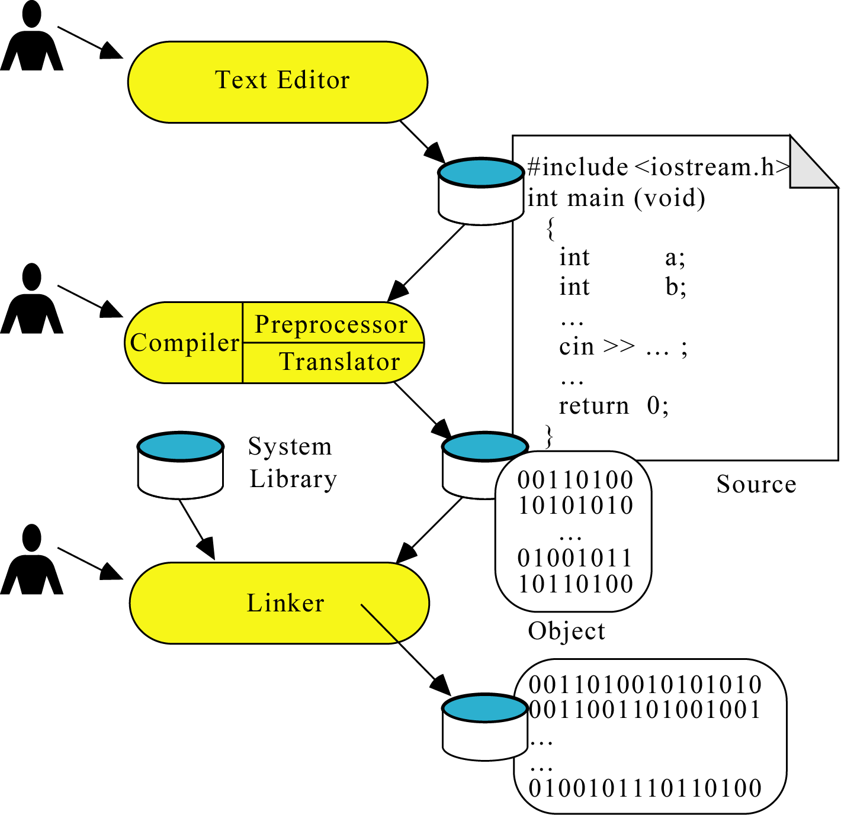
Figure 1-9

Slide 11
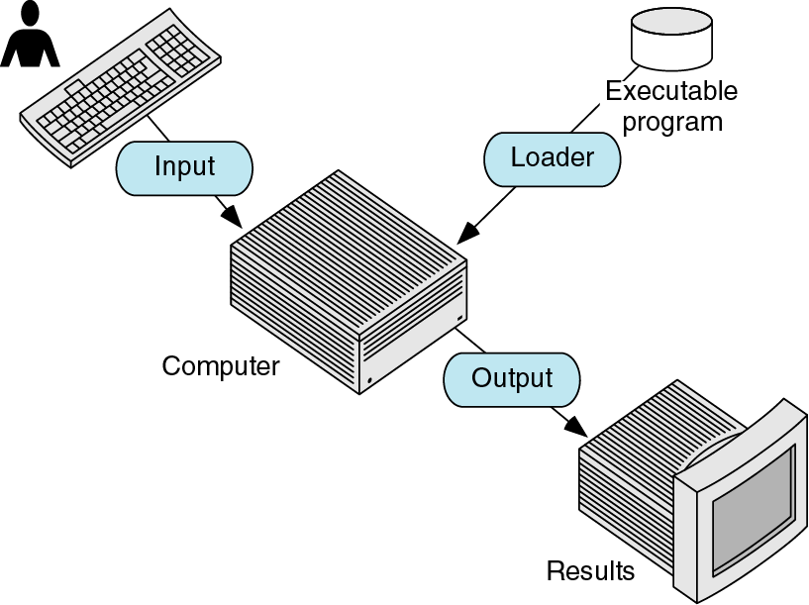
Figure 1-10

Slide 12
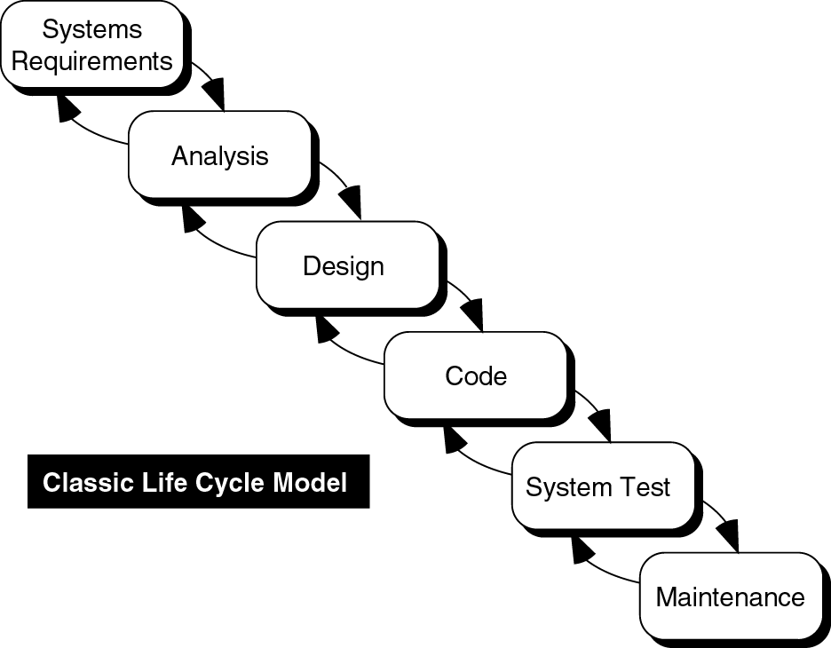
Figure 1-11

Slide 13
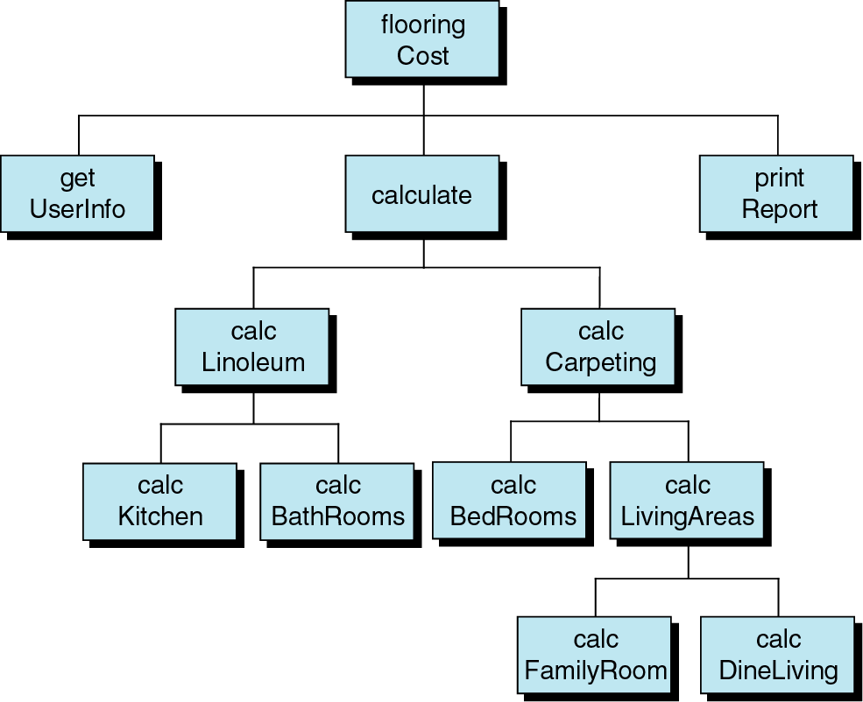
Figure 1-12

Slide 14
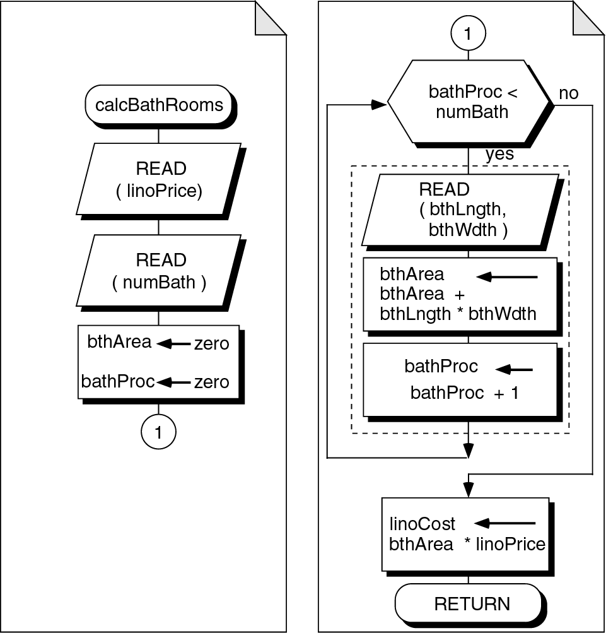
Figure 1-13

