Slide 1
Chapter 2
Introduction to
The C++
Language

Slide 2
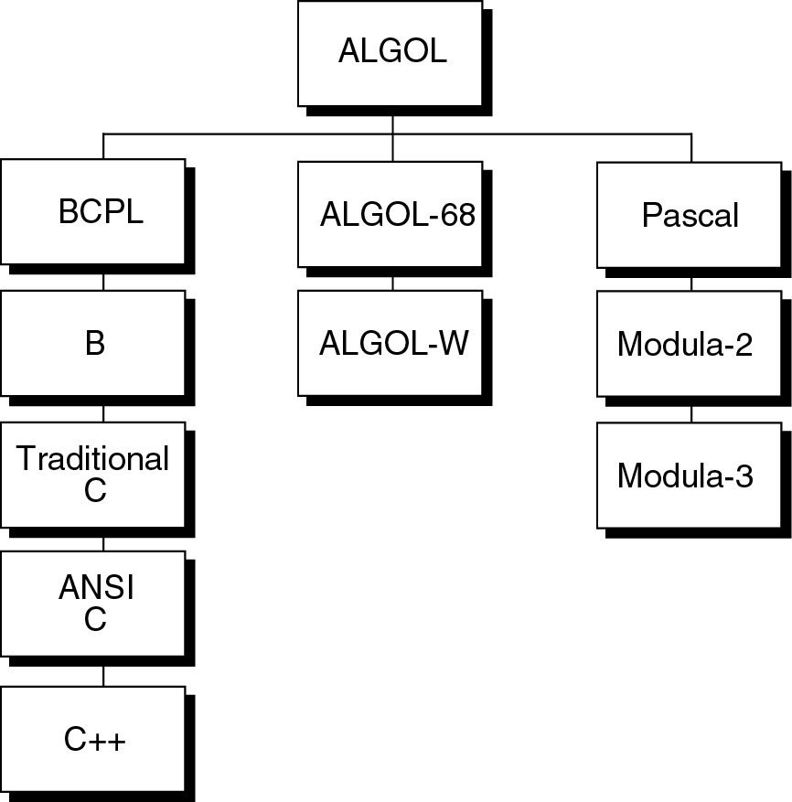
Figure 2-1

Slide 3
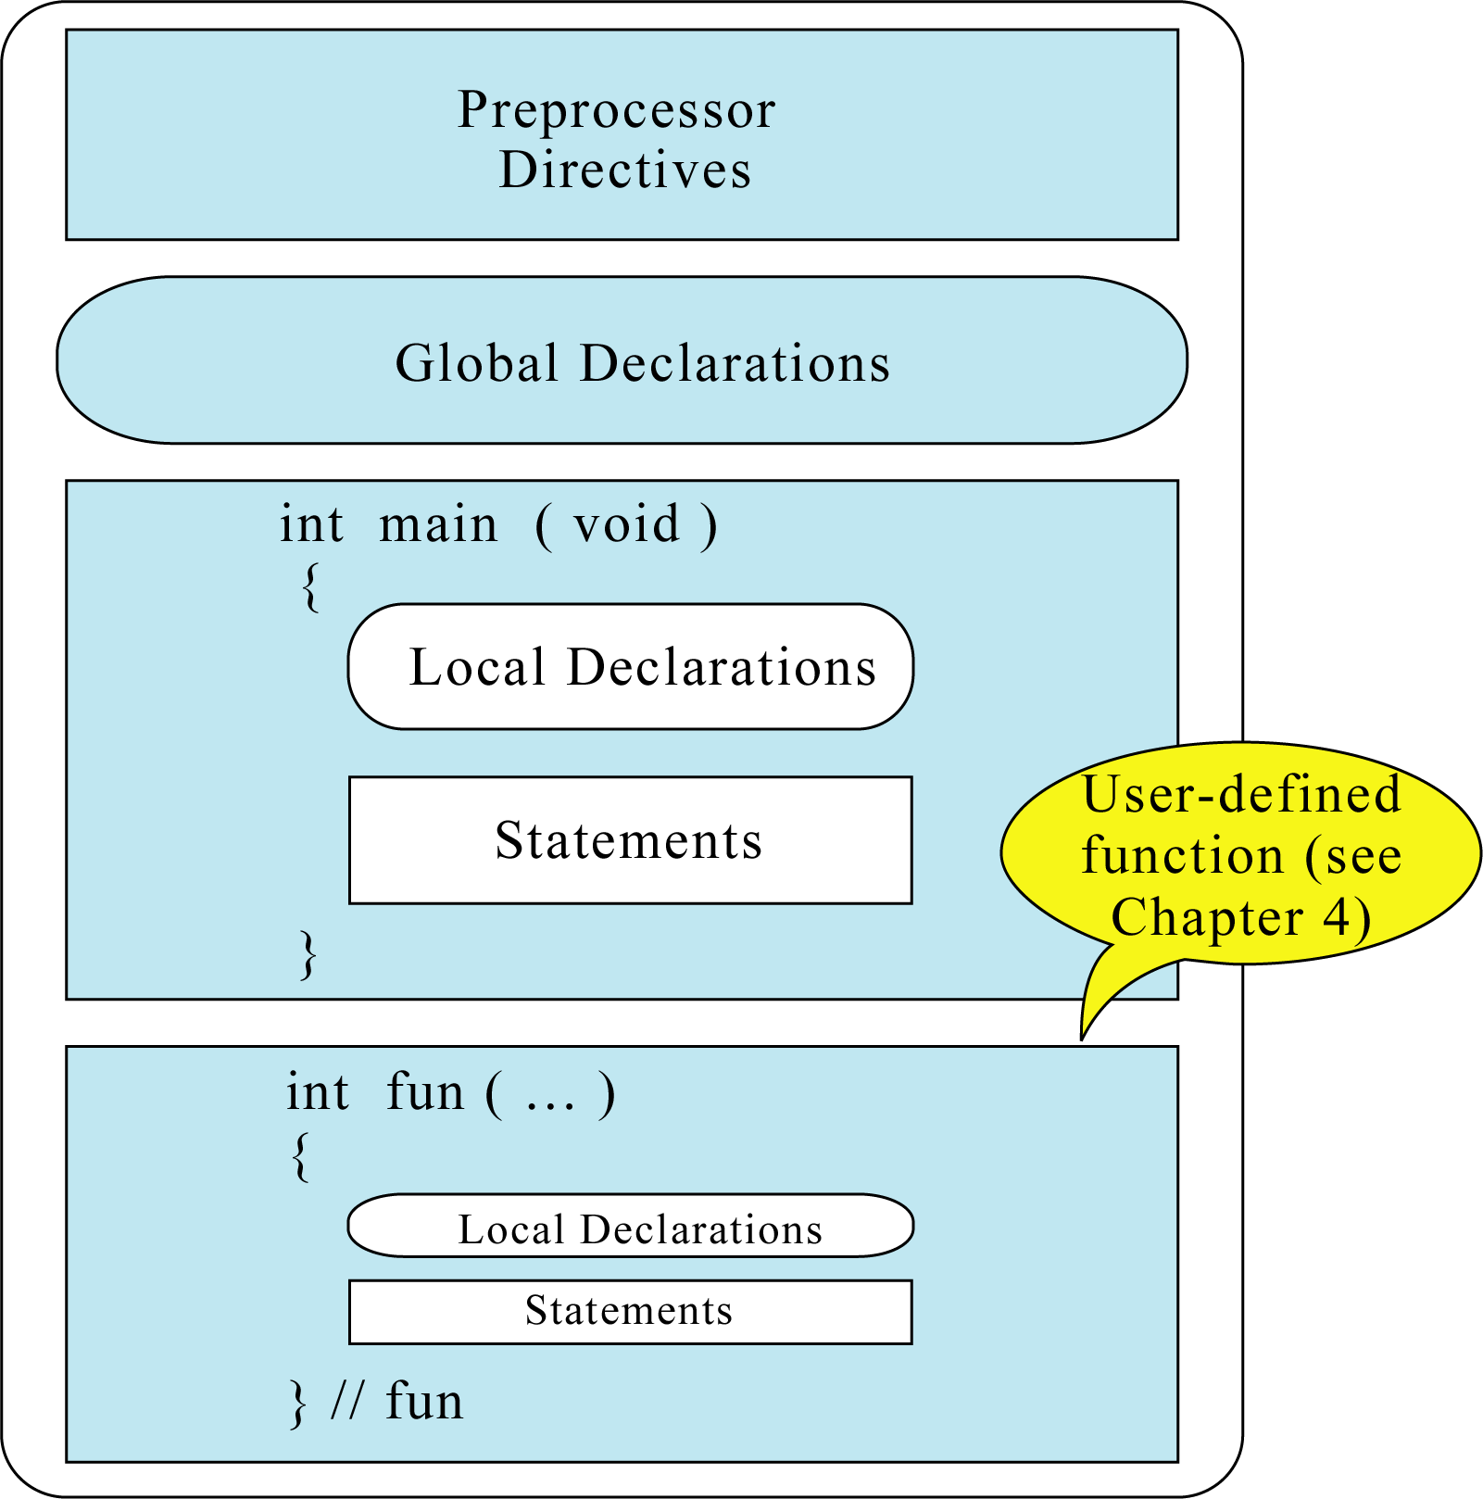
Figure 2-2

Slide 4
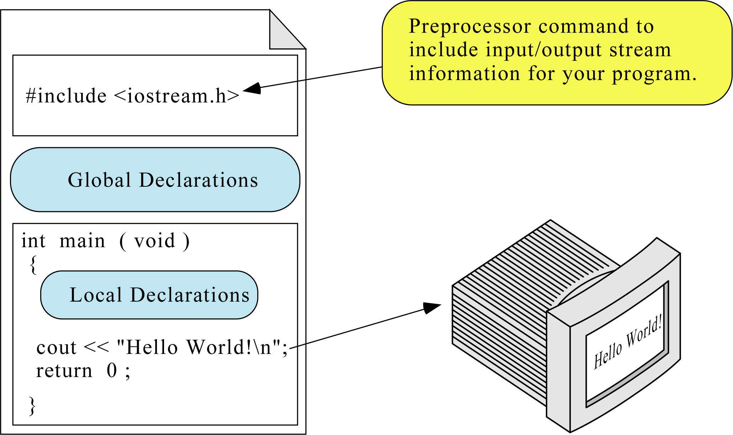
Figure 2-3

Slide 5
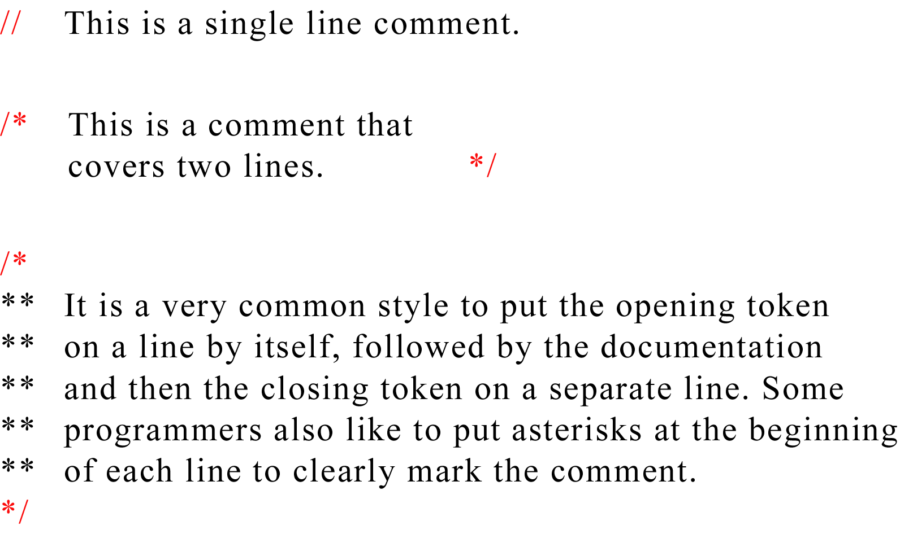
Figure 2-4

Slide 6
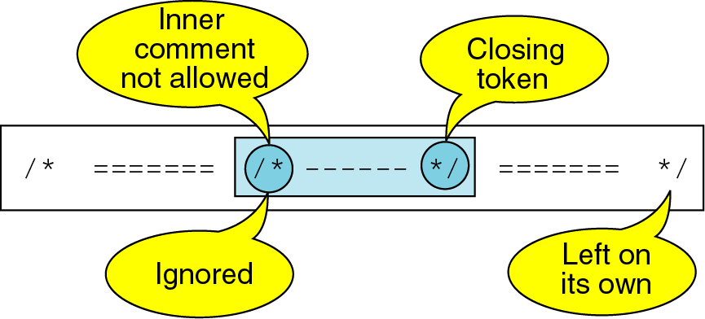
Figure 2-5

Slide 7
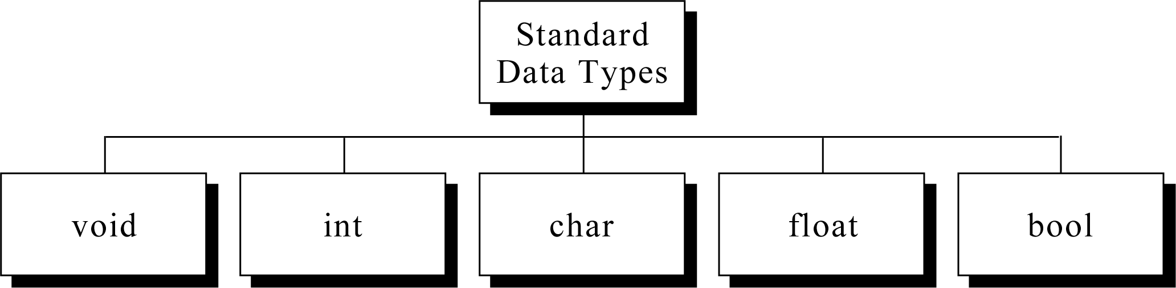
Figure 2-6

Slide 8
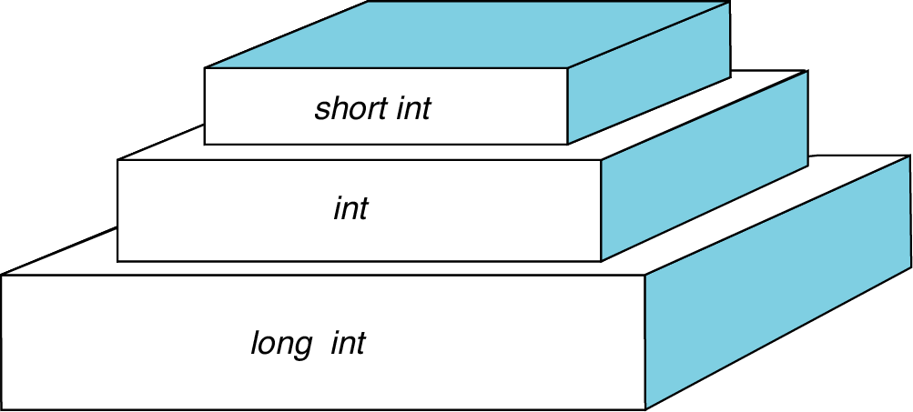
Figure 2-7

Slide 9
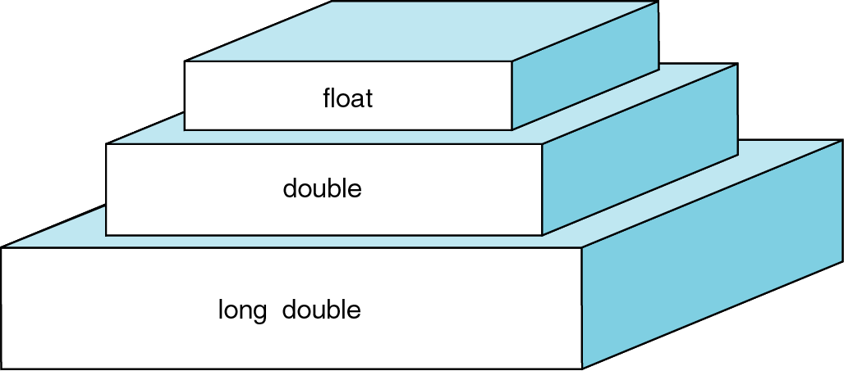
Figure 2-8

Slide 10
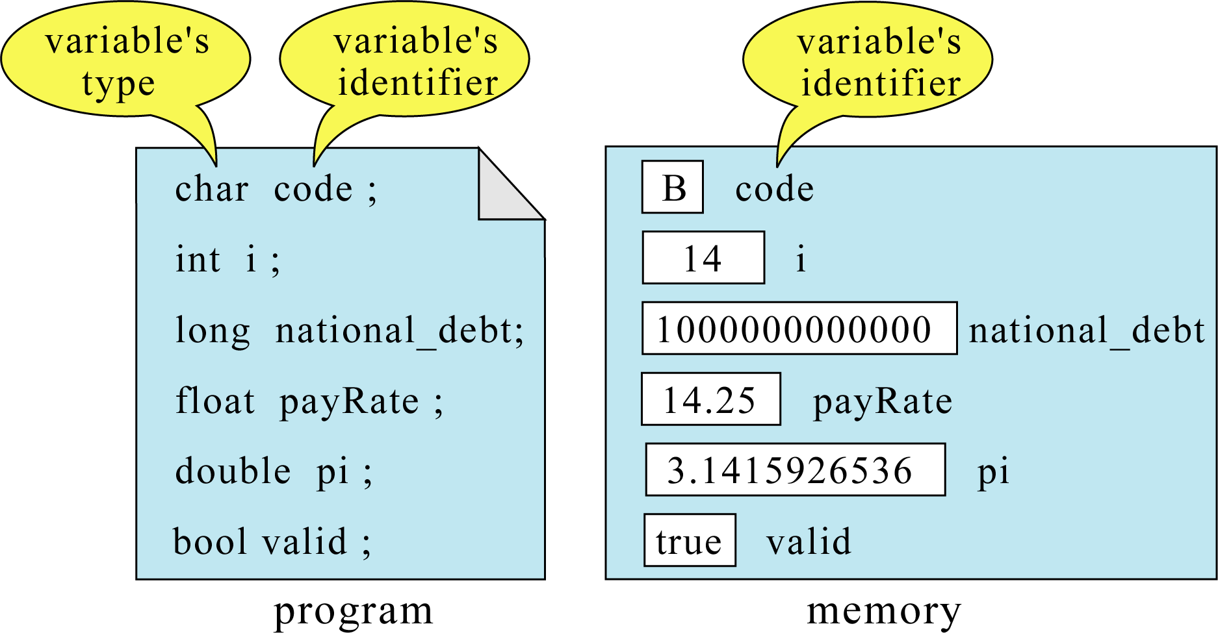
Figure 2-9

Slide 11
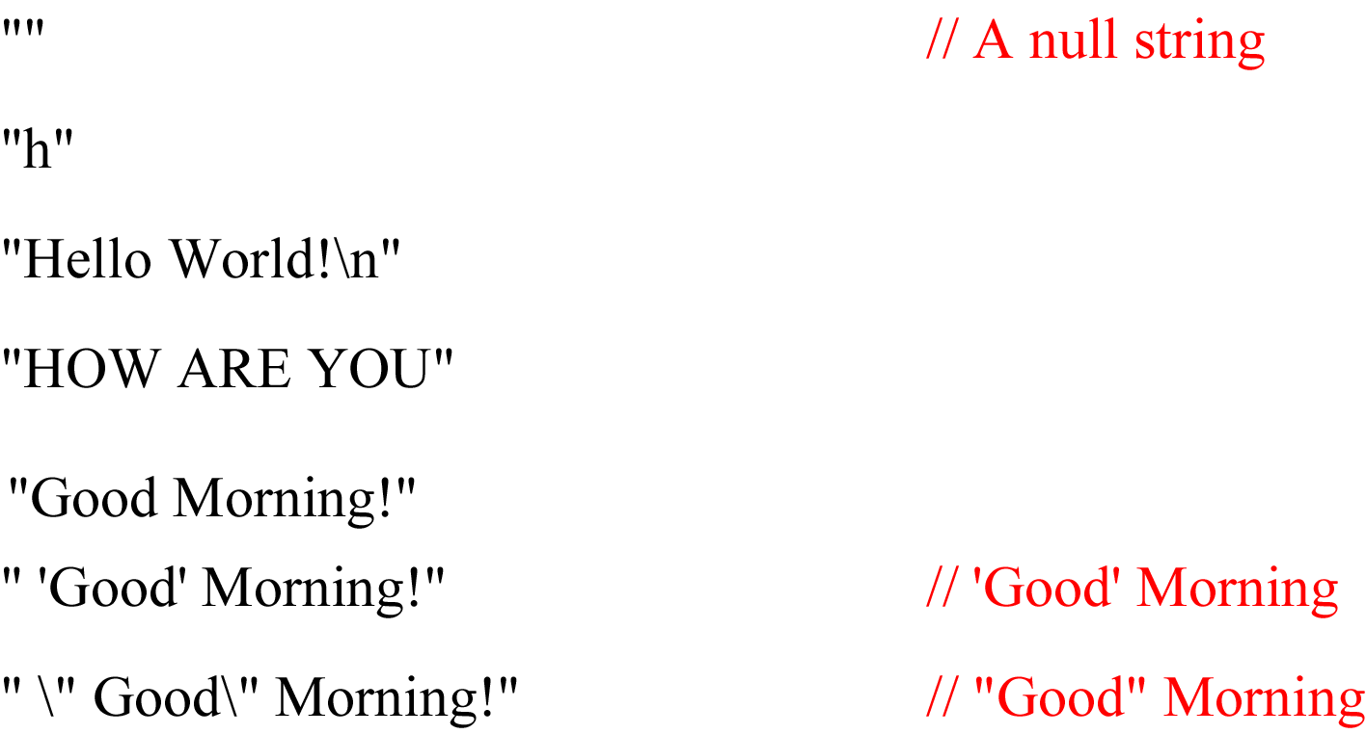
Figure 2-10

Slide 12
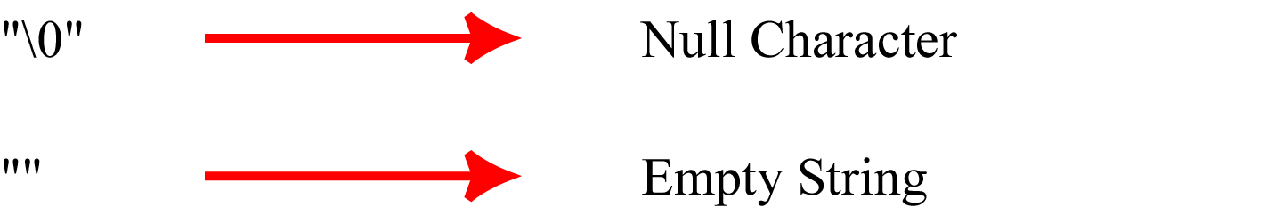
Figure 2-11

Slide 13
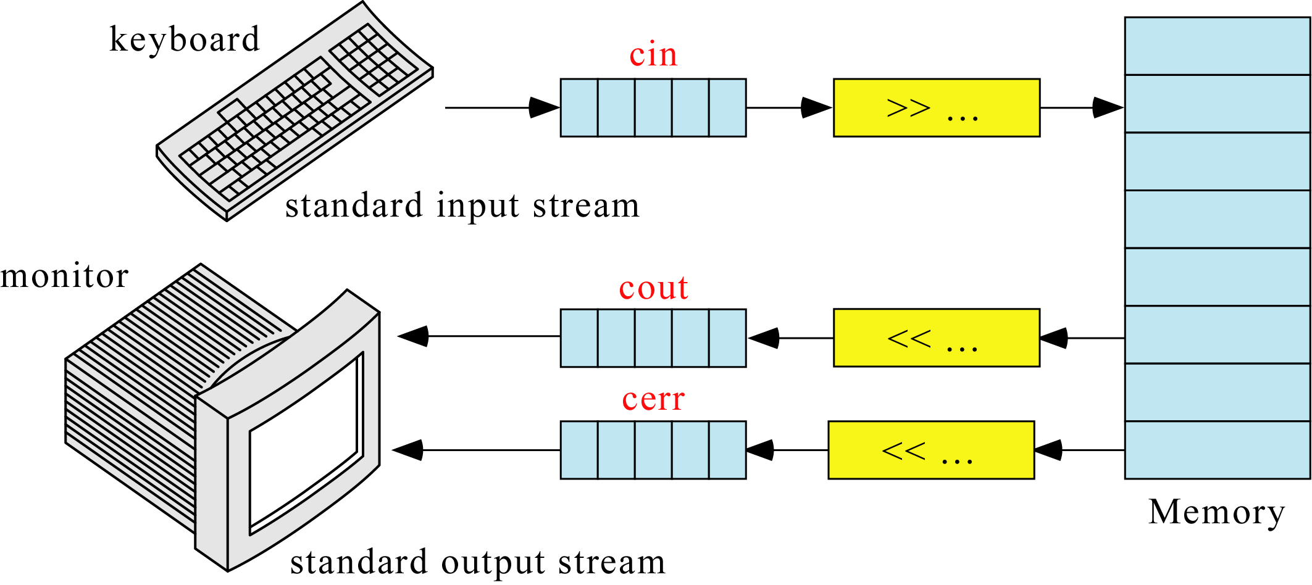
Figure 2-12

Slide 14
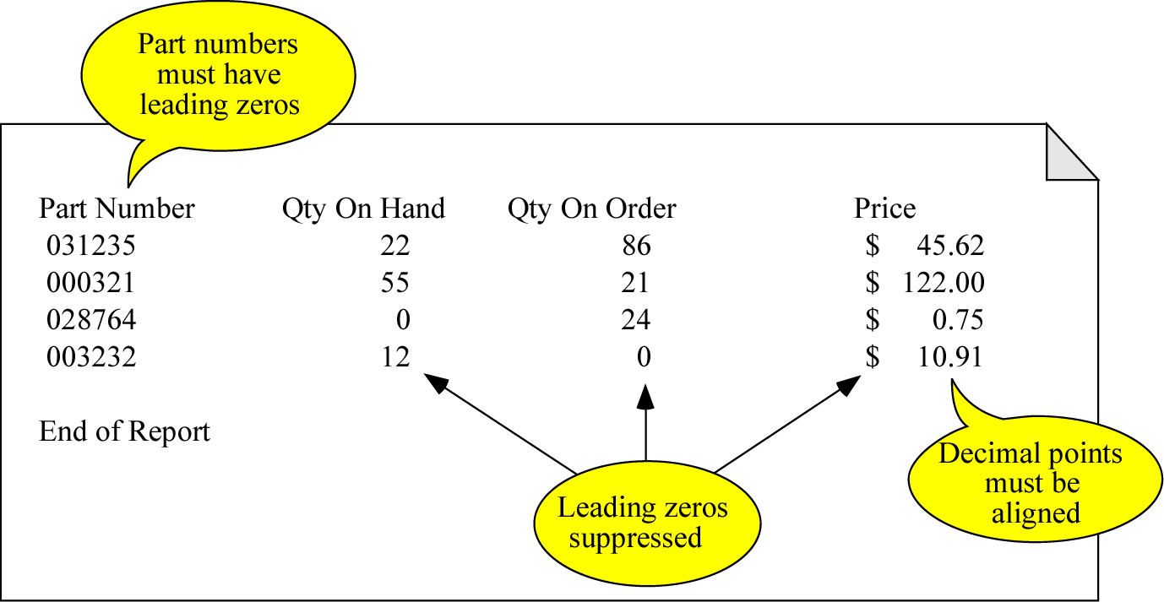
Figure 2-13

