Slide 1
Chapter 3
Structure of a
C++
Program

Slide 2
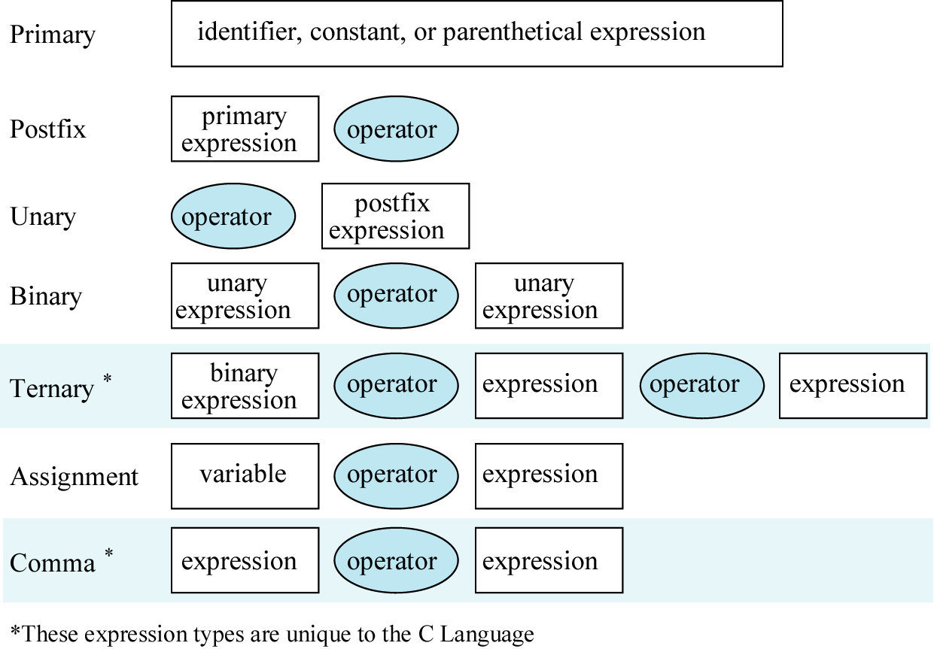
Figure 3-1

Slide 3
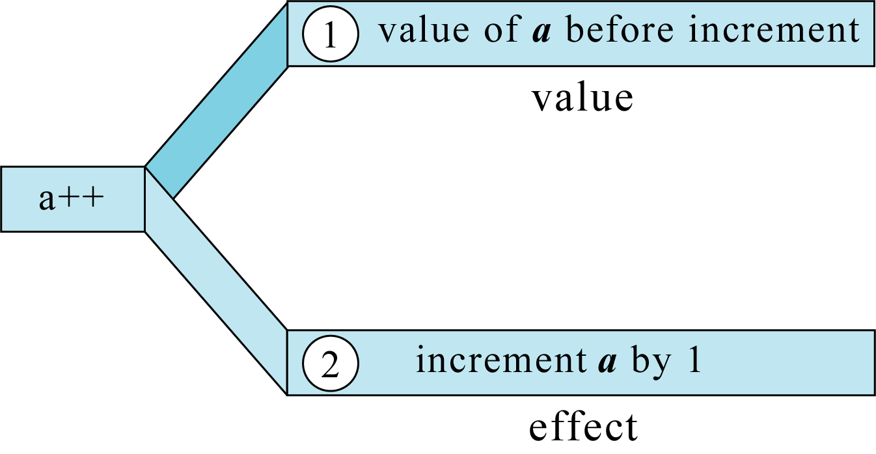
Figure 3-2

Slide 4
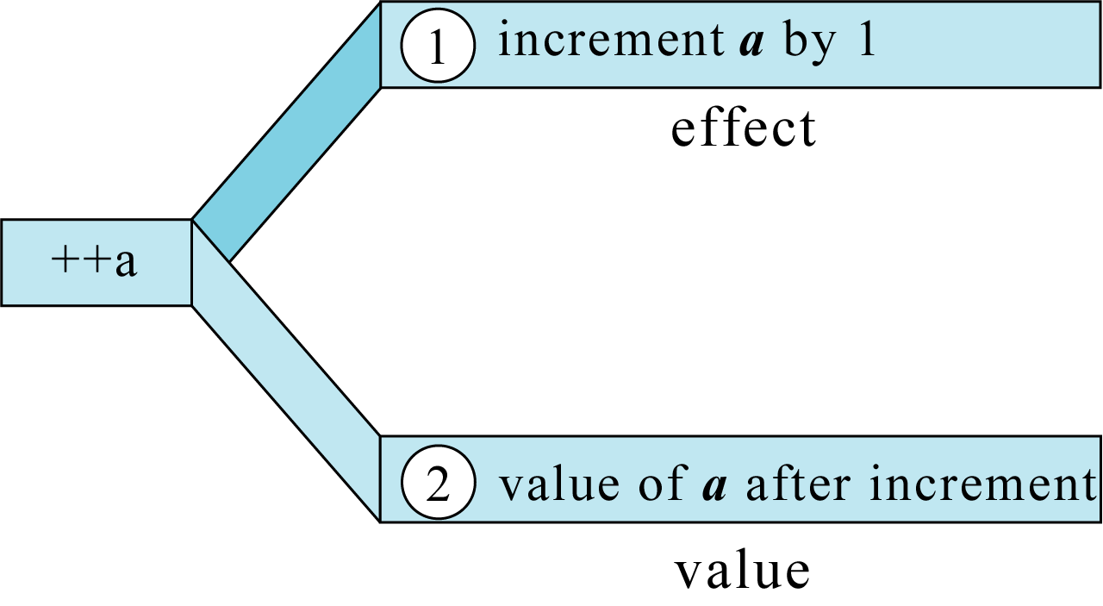
Figure 3-3

Slide 5
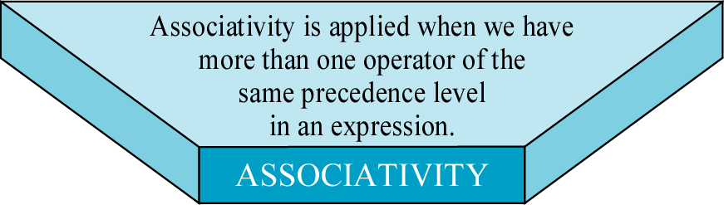
Figure 3-4

Slide 6
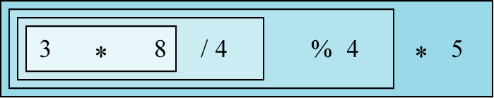
Figure 3-5

Slide 7
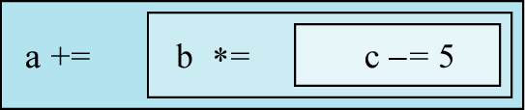
Figure 3-6

Slide 8
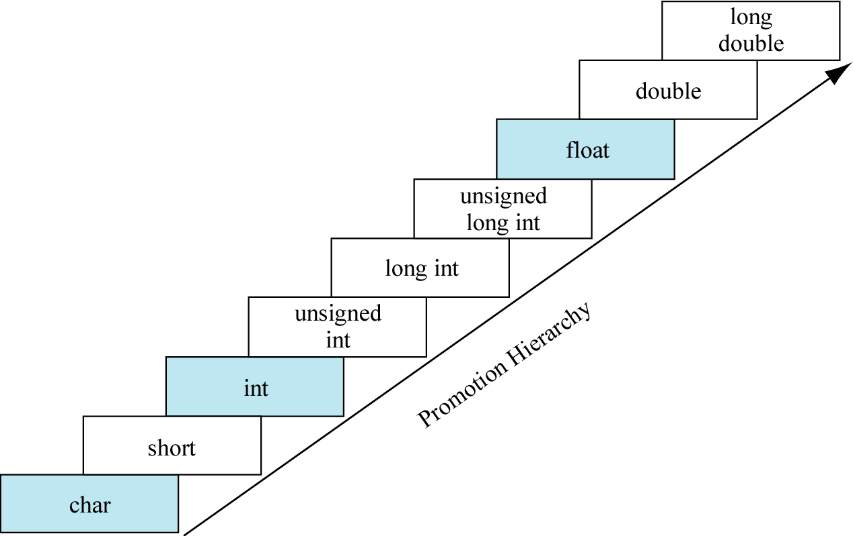
Figure 3-7

Slide 9
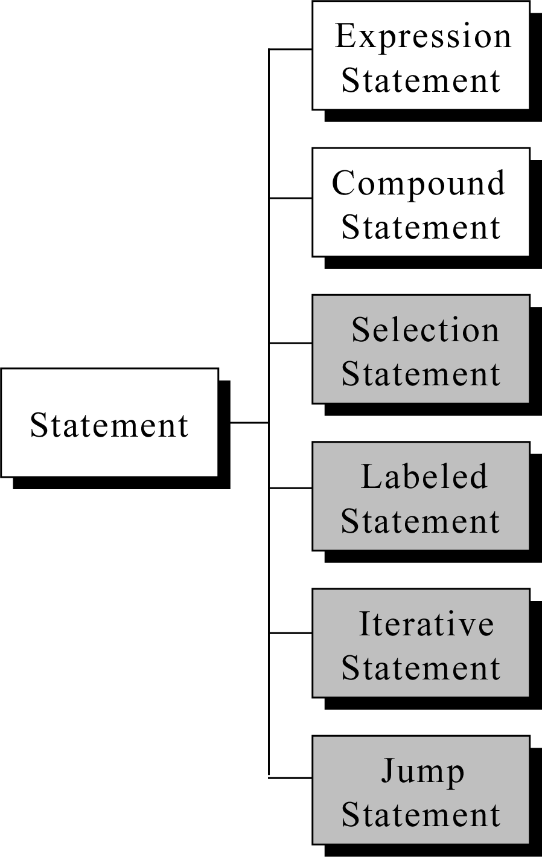
Figure 3-8

Slide 10
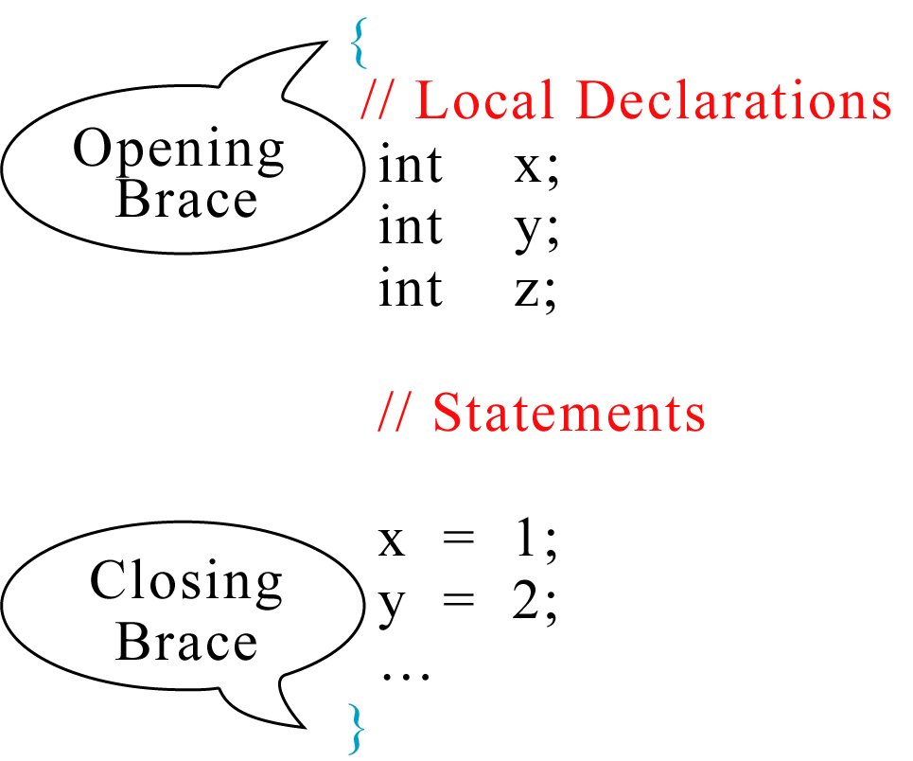
Figure 3-9

