Slide 1
Chapter 5
Selection--
Making
Decision

Slide 2

Figure 5-1

Slide 3
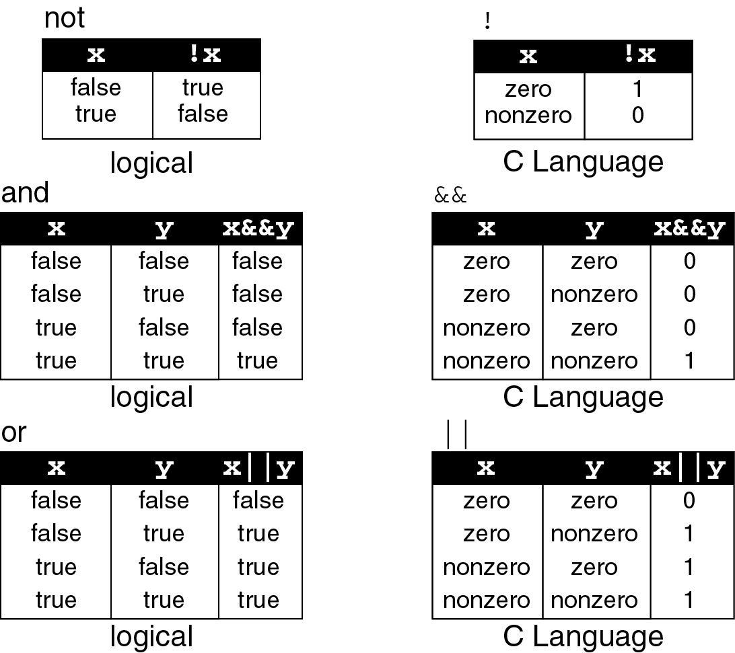
Figure 5-2

Slide 4

Figure 5-3

Slide 5
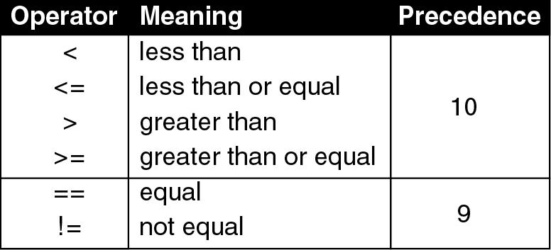
Figure 5-4

Slide 6
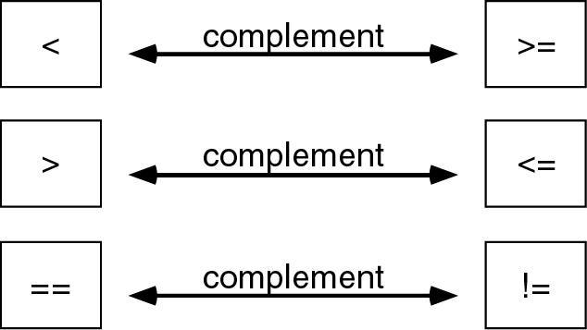
Figure 5-5

Slide 7
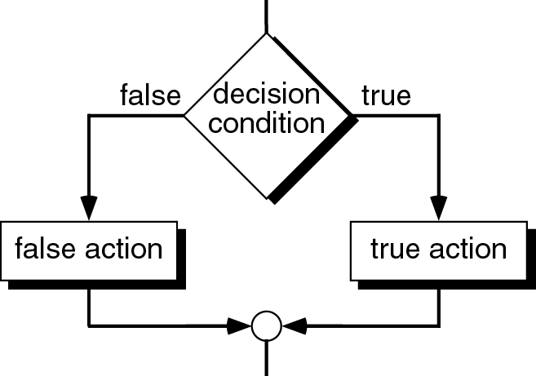
Figure 5-6

Slide 8
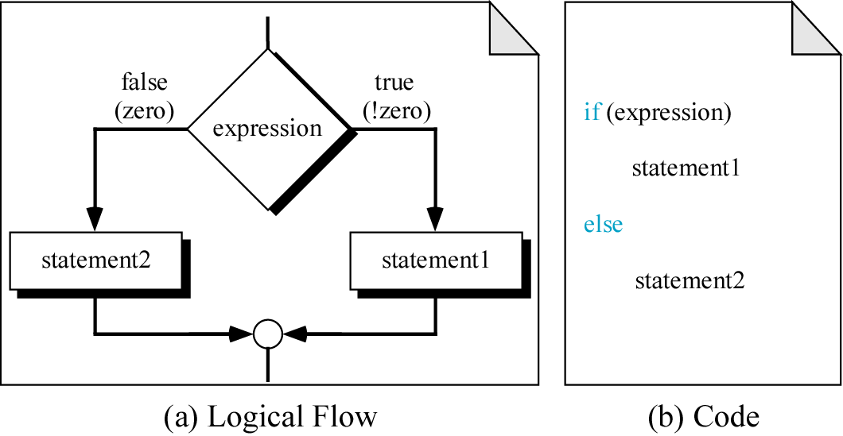
Figure 5-7

Slide 9
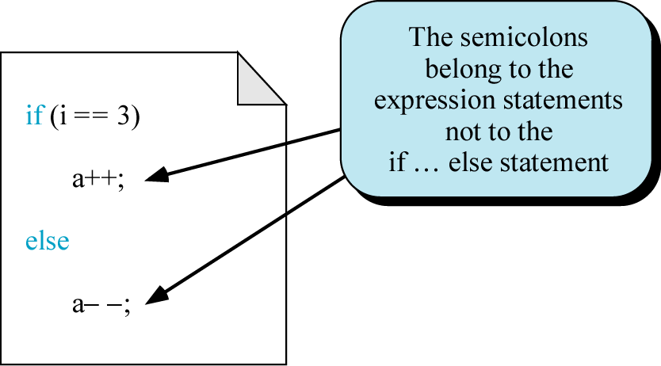
Figure 5-8

Slide 10
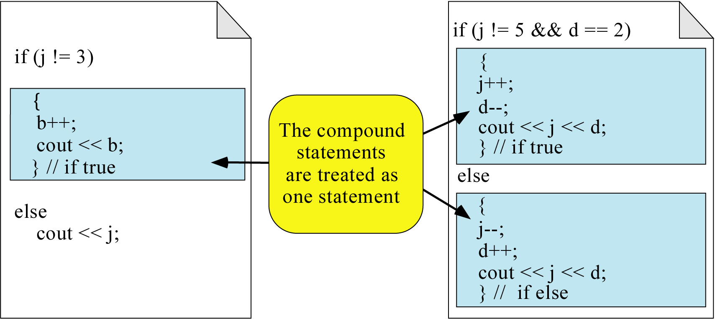
Figure 5-9

Slide 11
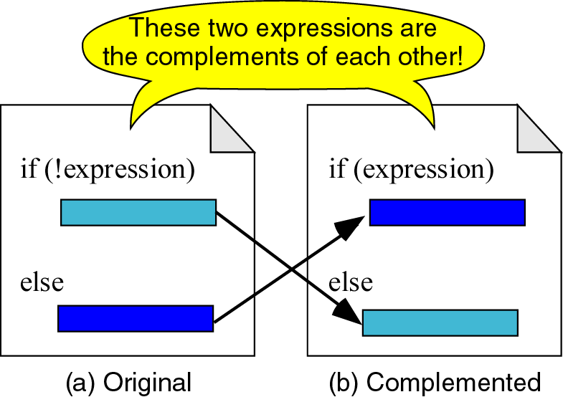
Figure 5-10

Slide 12
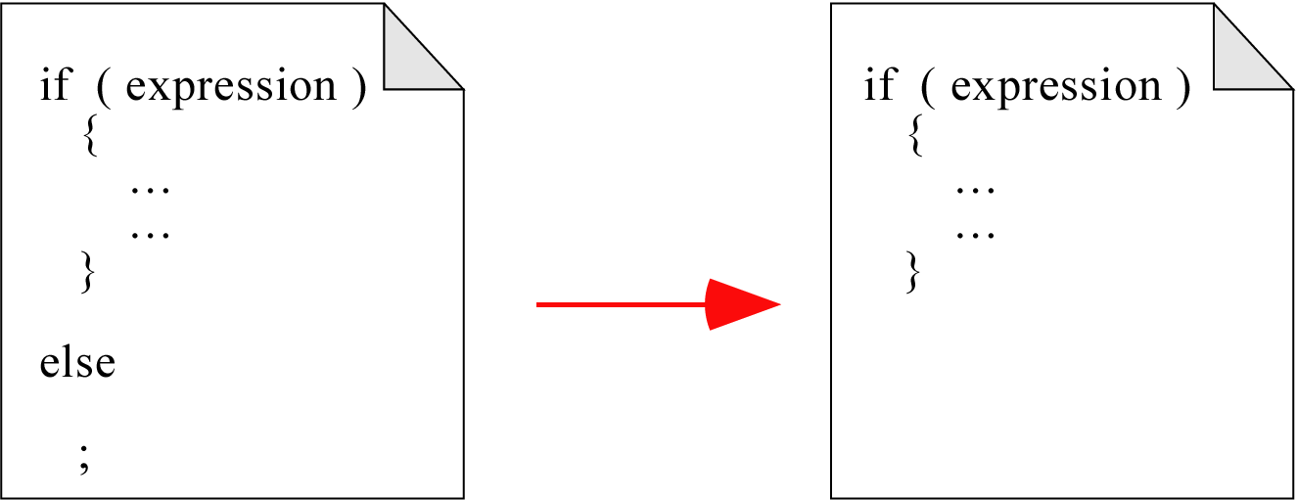
Figure 5-11

Slide 13
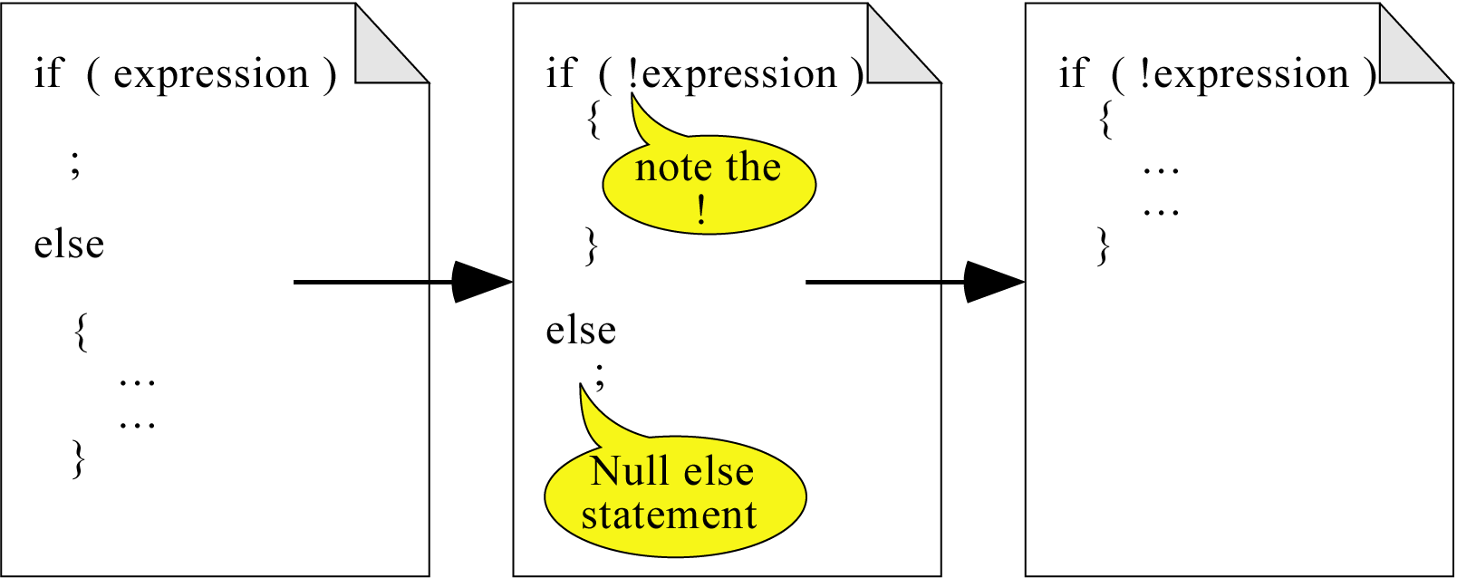
Figure 5-12

Slide 14
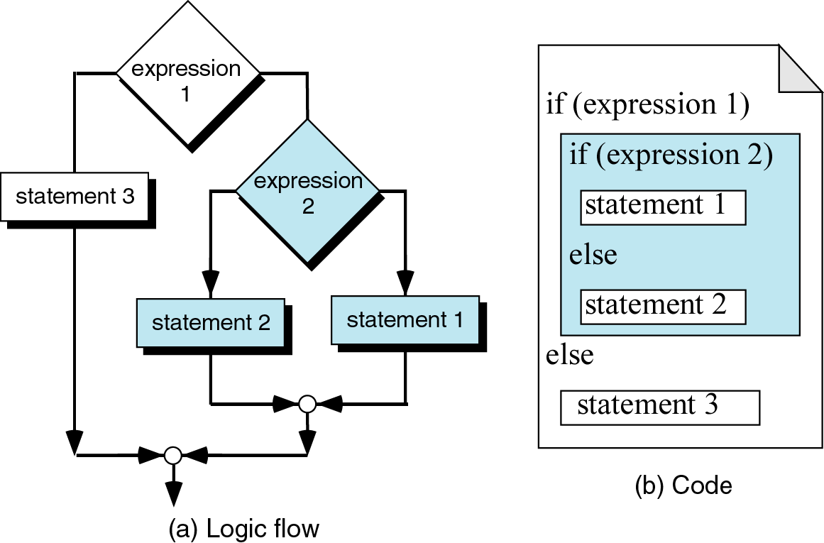
Figure 5-13

Slide 15
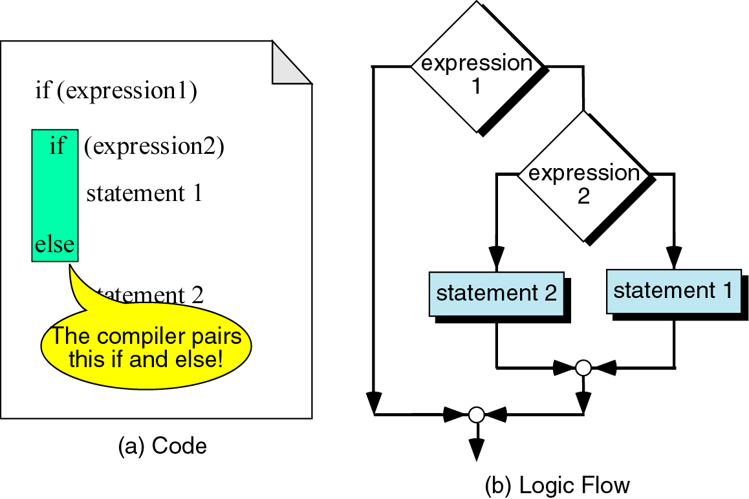
Figure 5-14

Slide 16
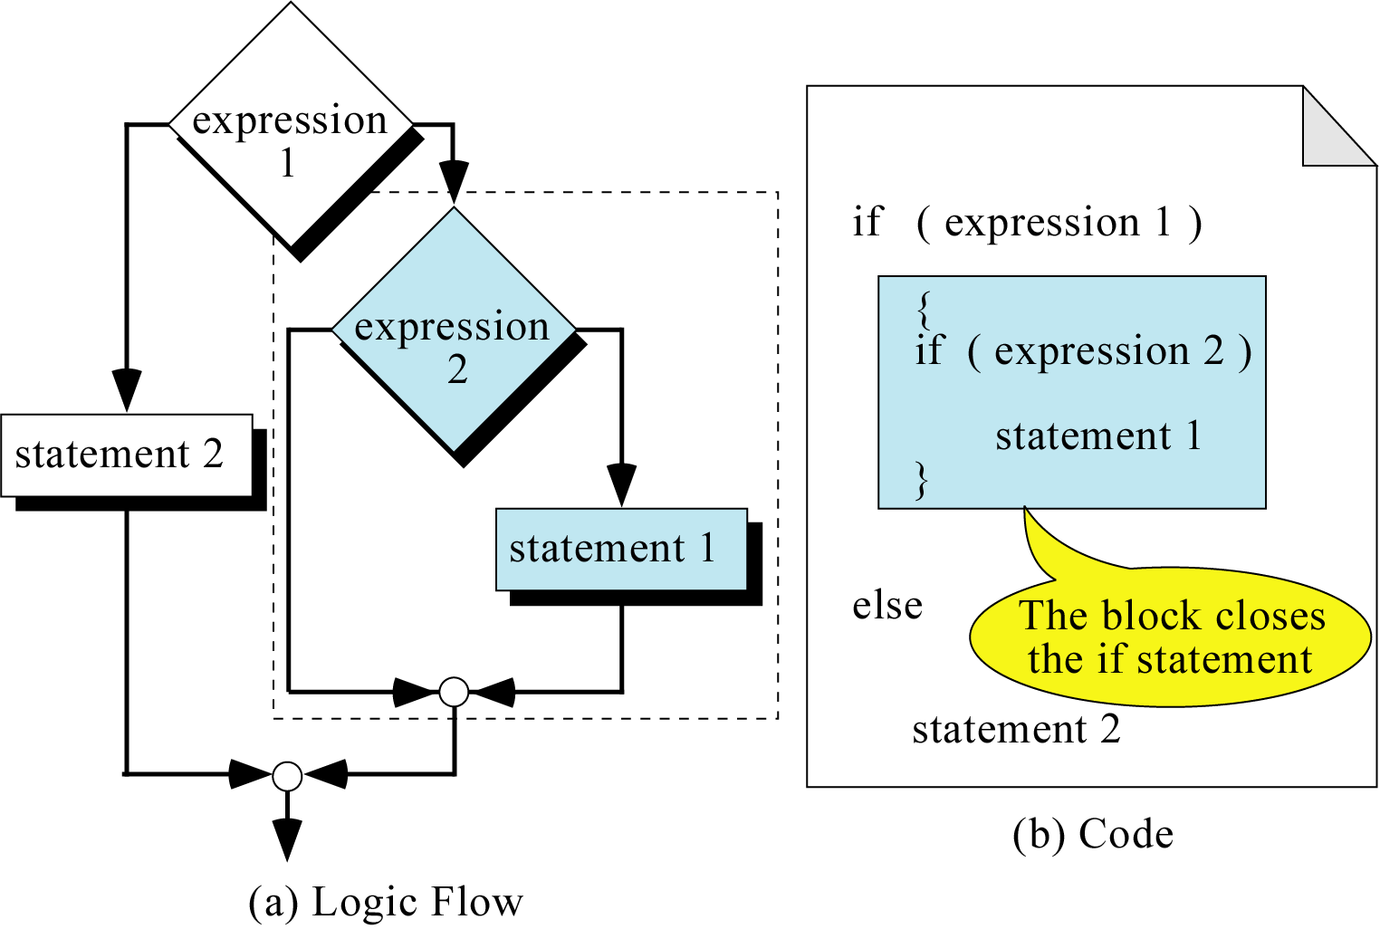
Figure 5-15

Slide 17
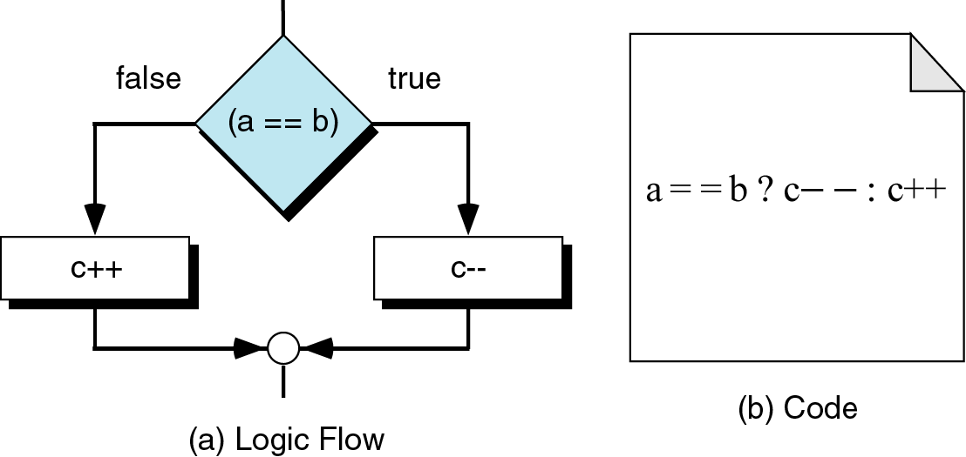
Figure 5-16

Slide 18
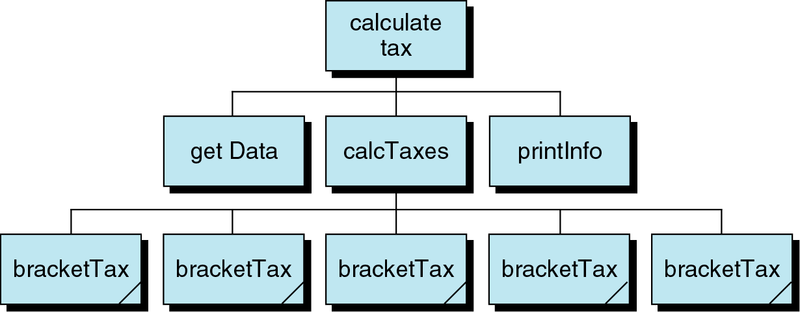
Figure 5-17

Slide 19
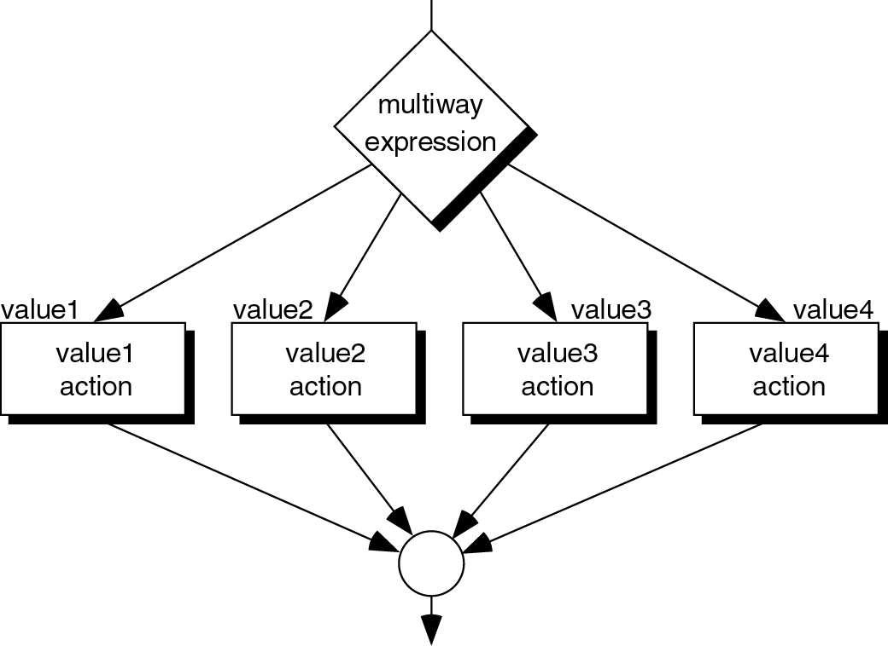
Figure 5-18

Slide 20
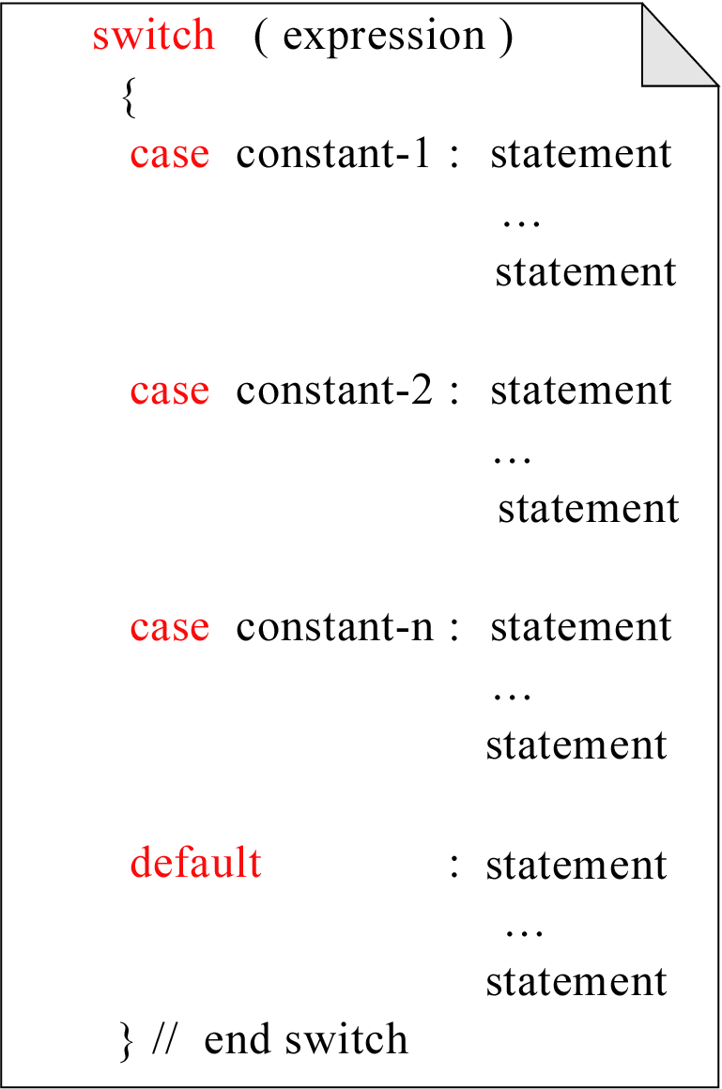
Figure 5-19

Slide 21
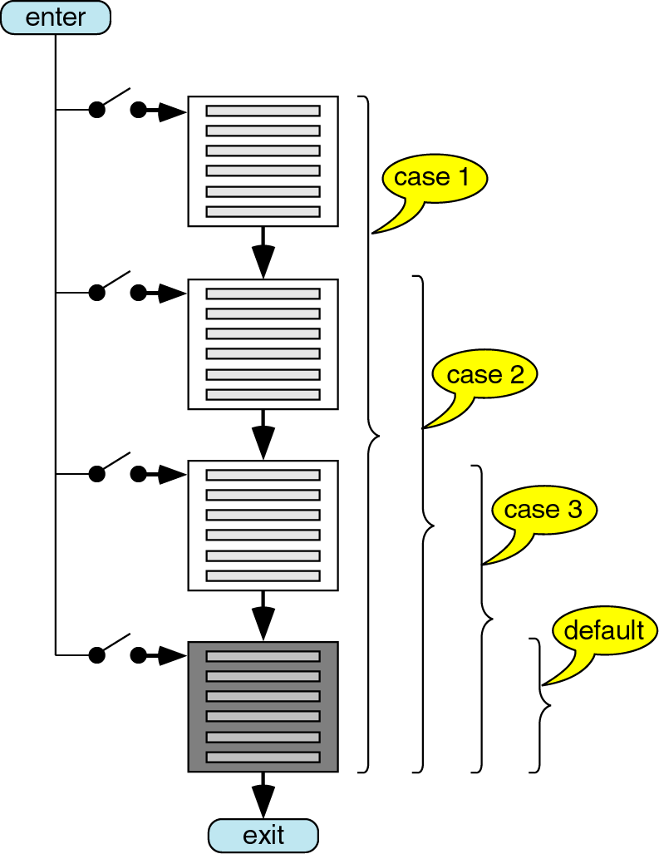
Figure 5-20

Slide 22

Figure 5-21

Slide 23
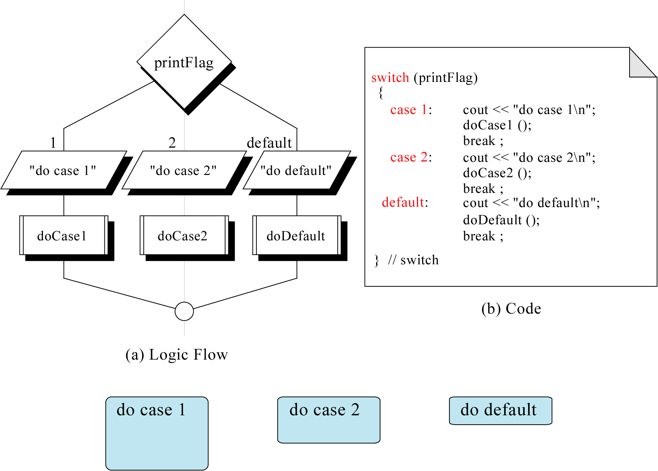
Figure 5-22

Slide 24
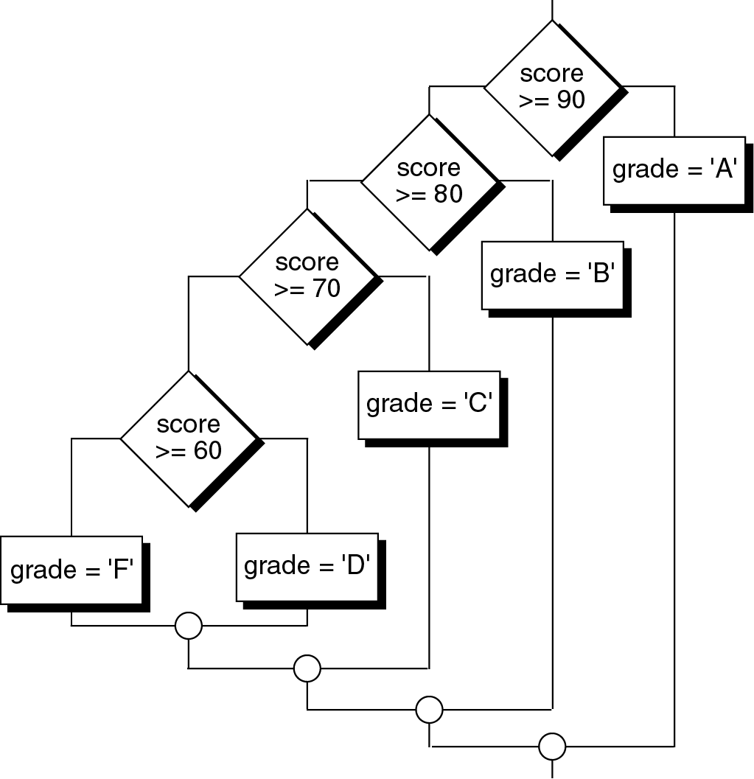
Figure 5-23

Slide 25
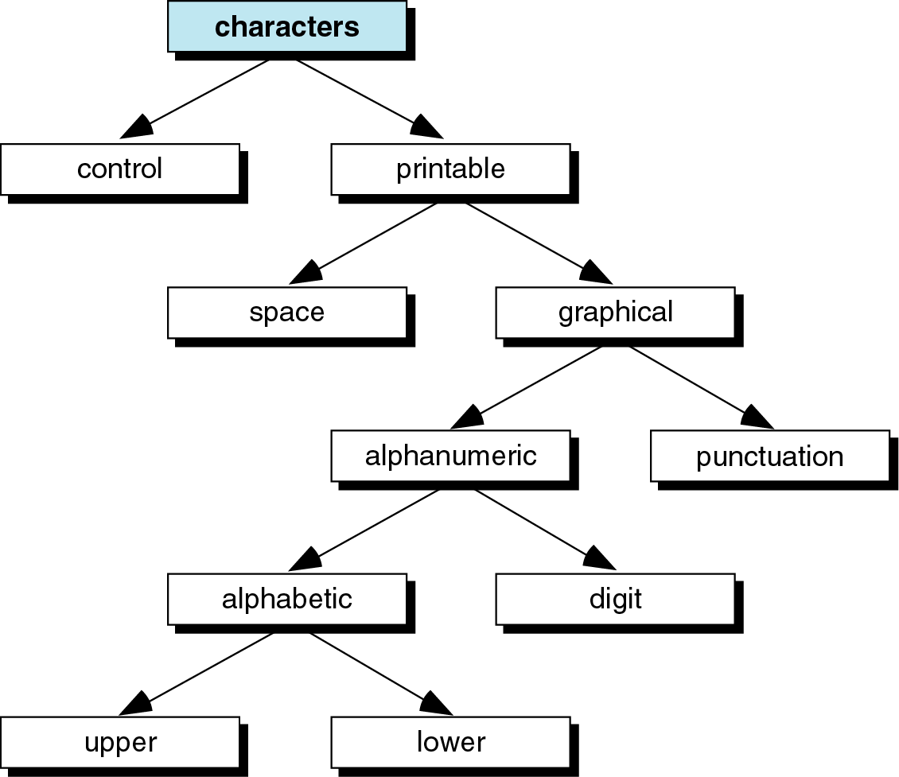
Figure 5-24

Slide 26
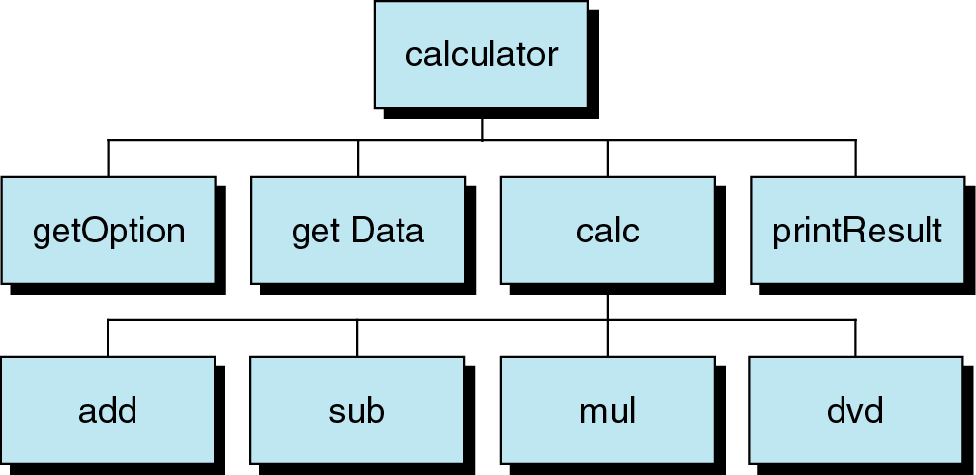
Figure 5-25

Slide 27
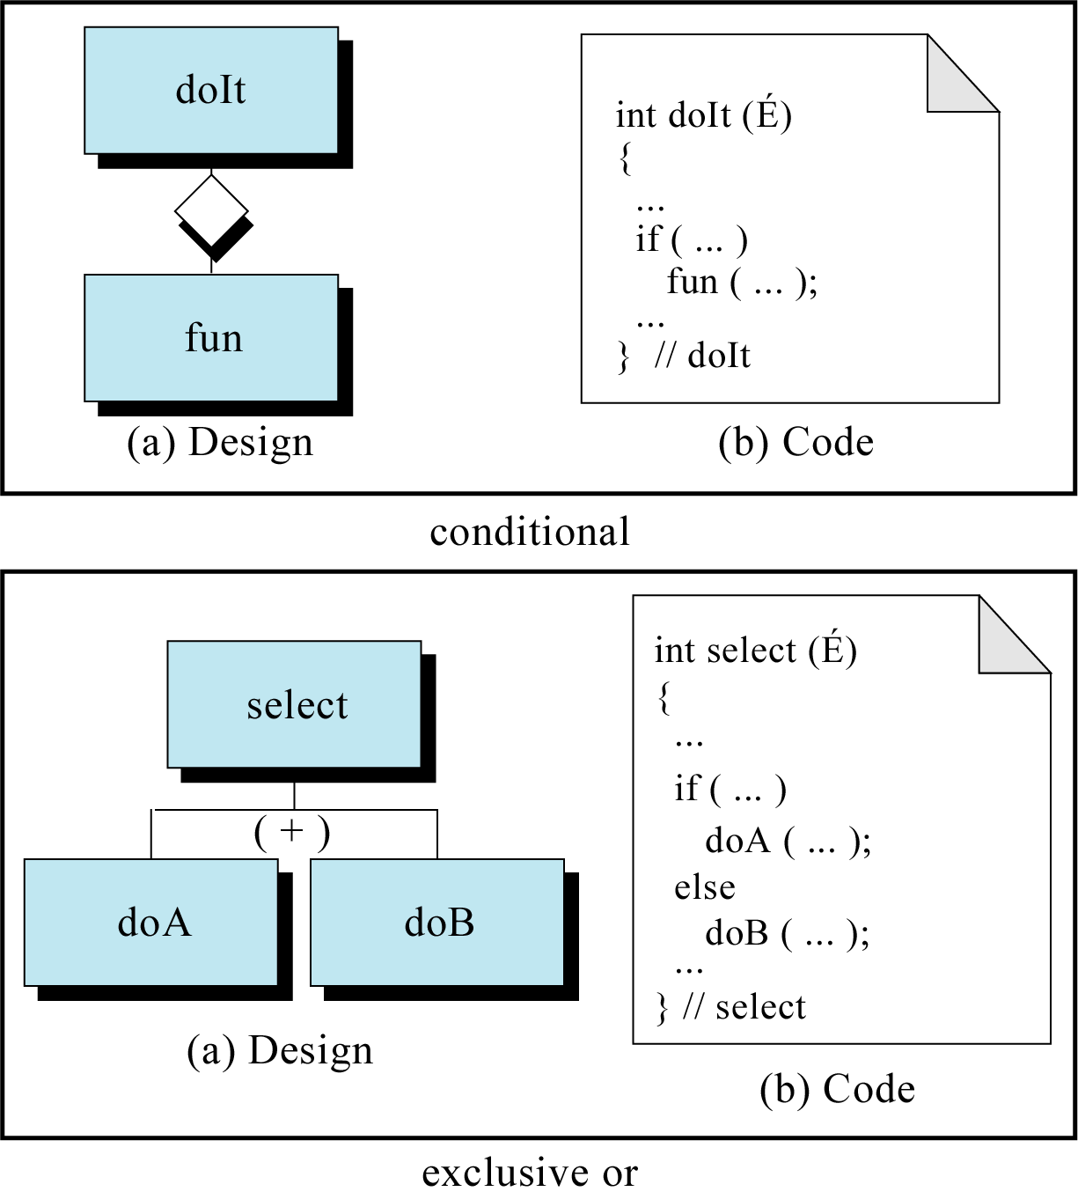
Figure 5-26

Slide 28
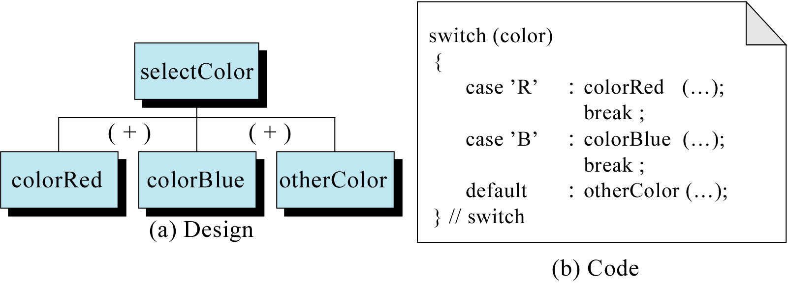
Figure 5-27

Slide 29
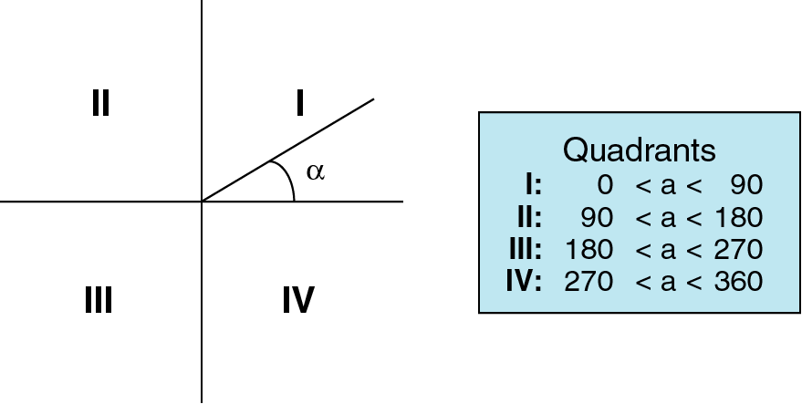
Figure 5-28

