Slide 1
Chapter 6
Repetition

Slide 2
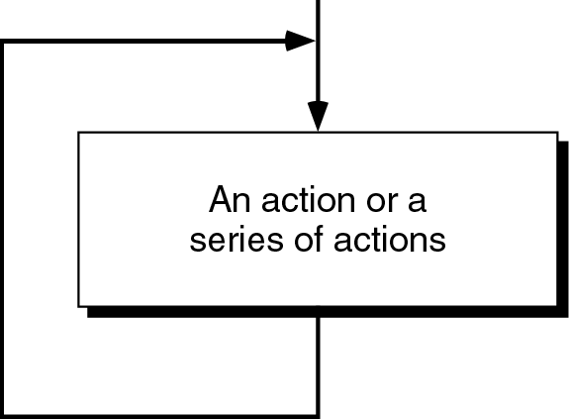
Figure 6-1

Slide 3
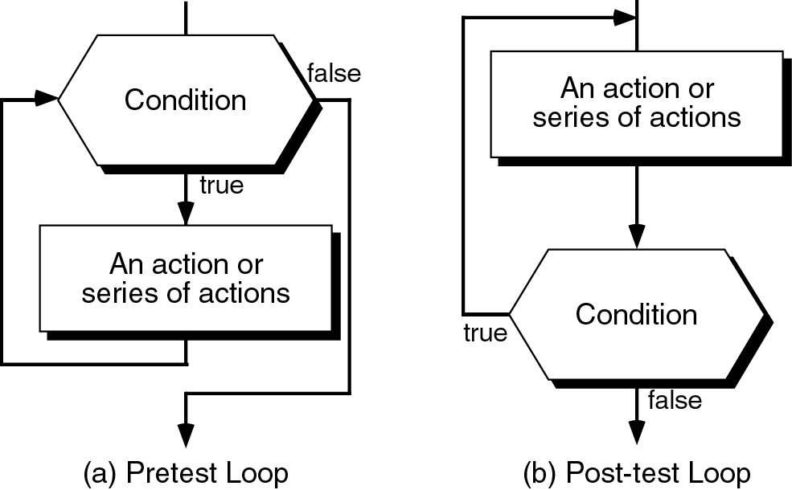
Figure 6-2

Slide 4
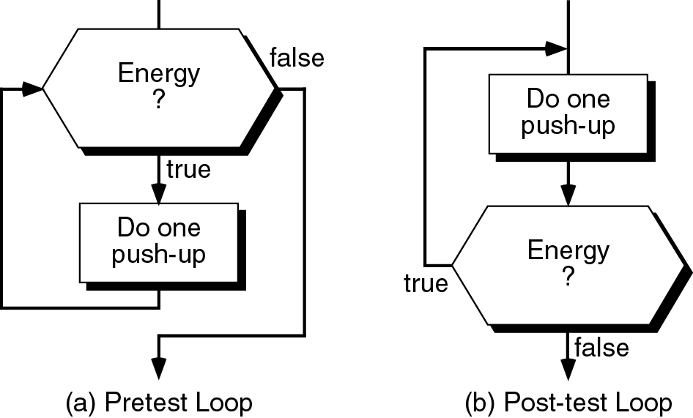
Figure 6-3

Slide 5
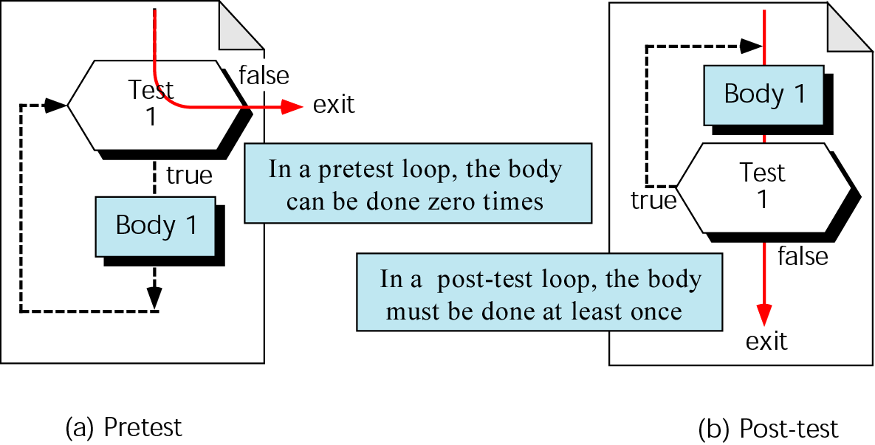
Figure 6-4

Slide 6
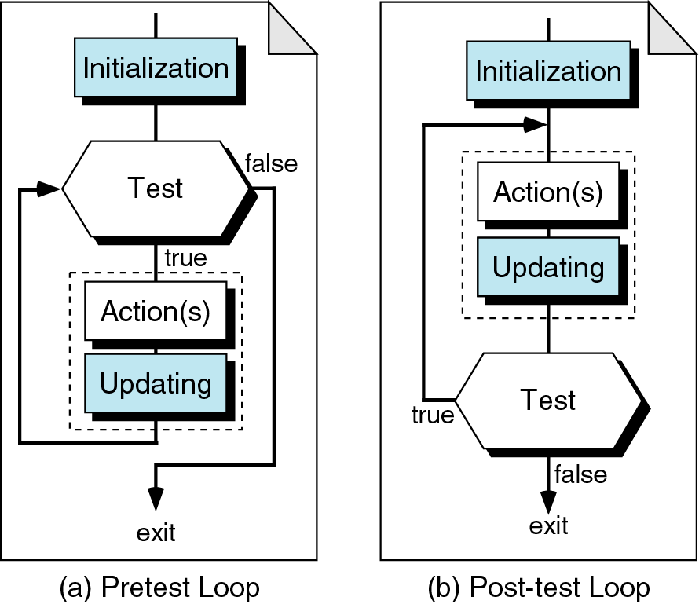
Figure 6-5

Slide 7
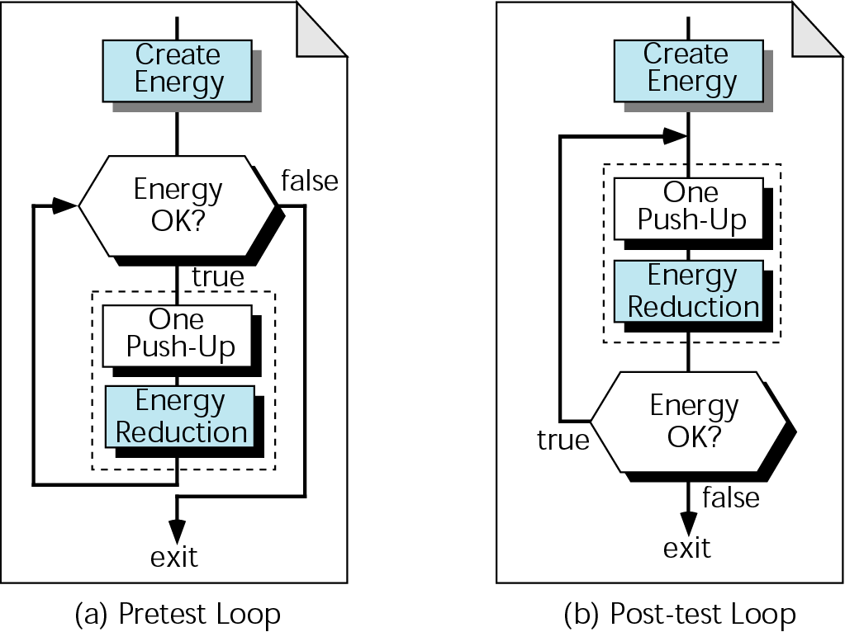
Figure 6-6

Slide 8
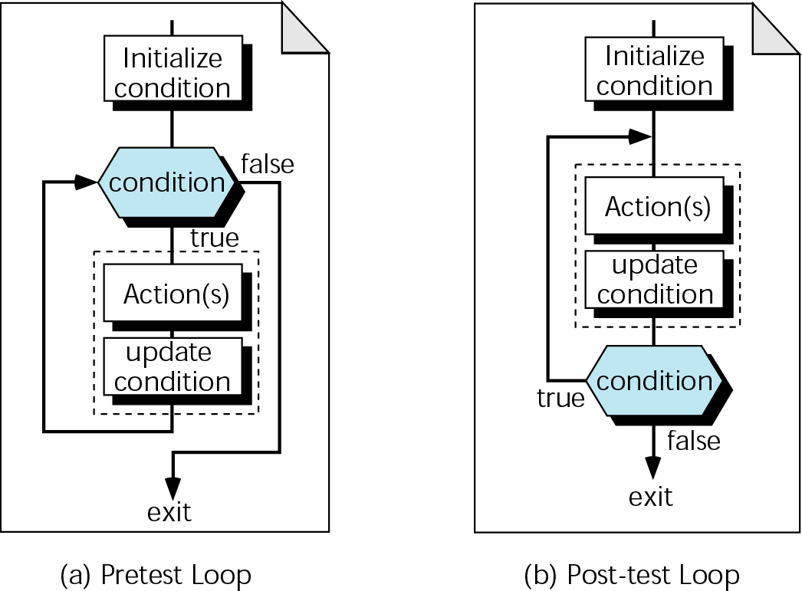
Figure 6-7

Slide 9
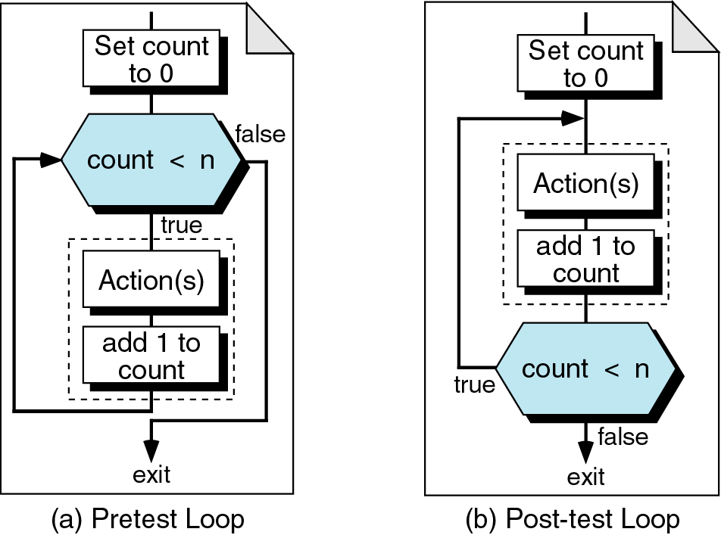
Figure 6-8

Slide 10
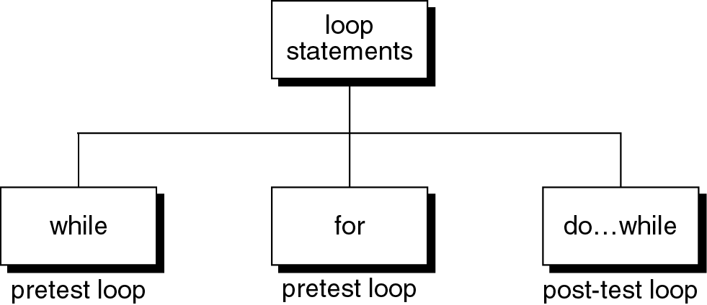
Figure 6-9

Slide 11
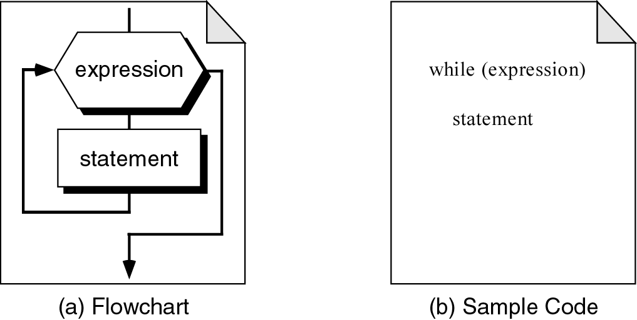
Figure 6-10

Slide 12
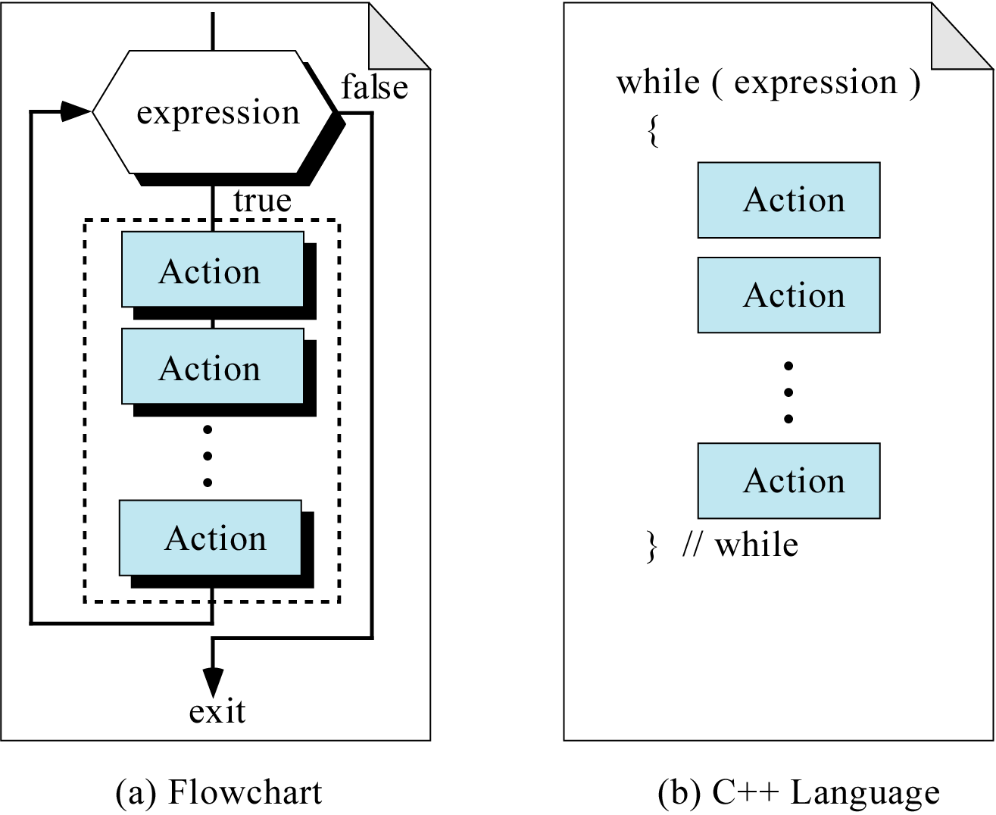
Figure 6-11

Slide 13
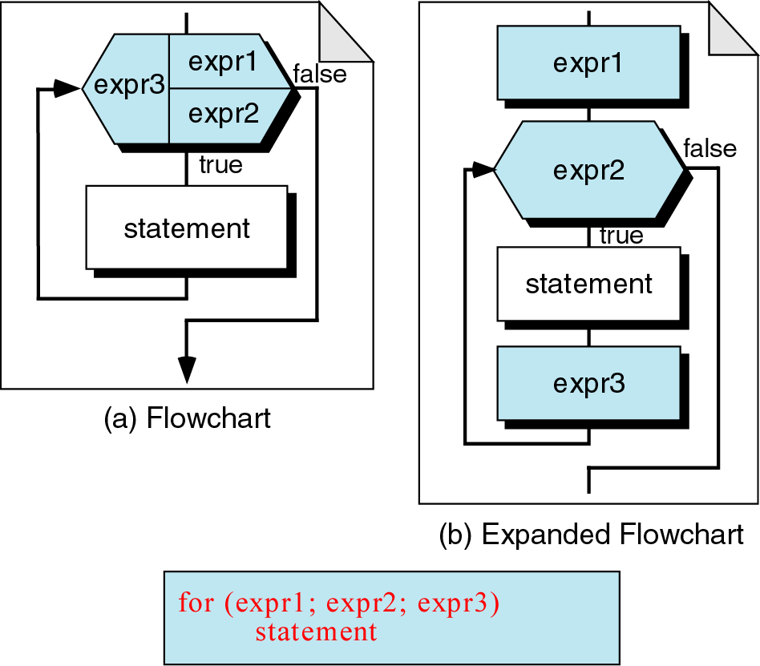
Figure 6-12

Slide 14
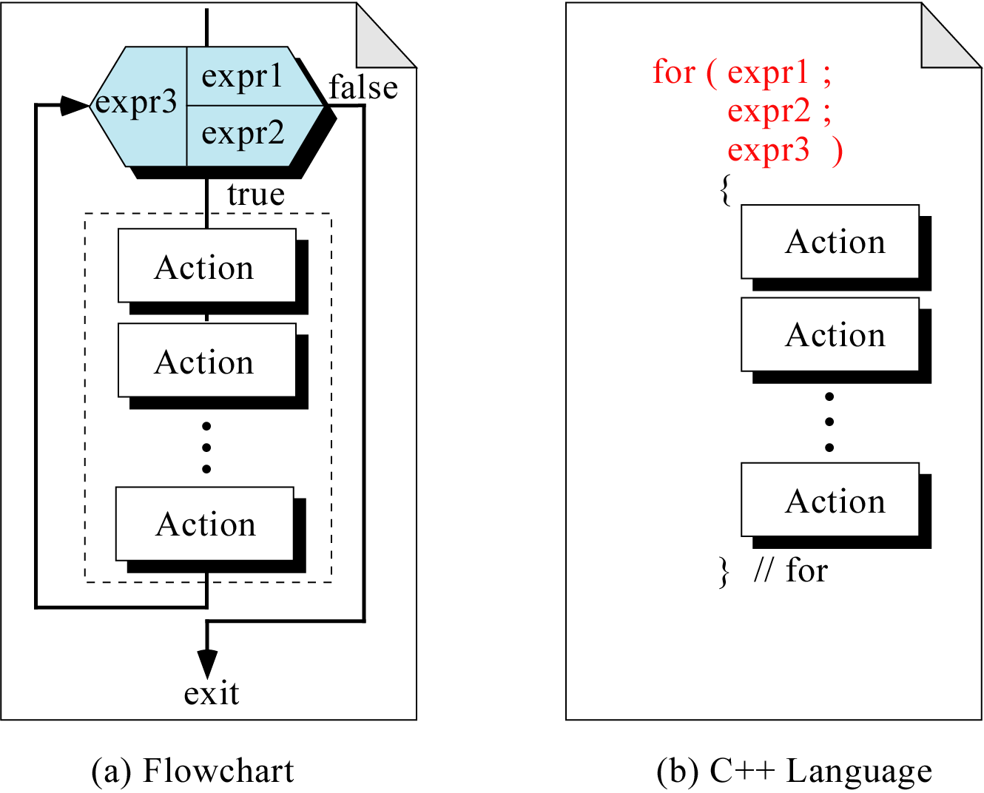
Figure 6-13

Slide 15
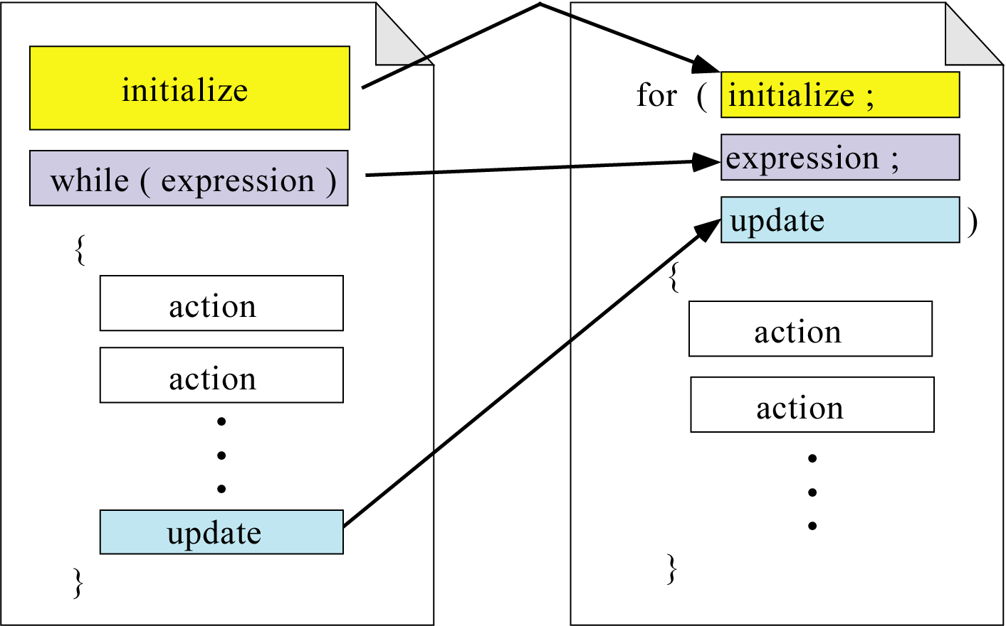
Figure 6-14

Slide 16
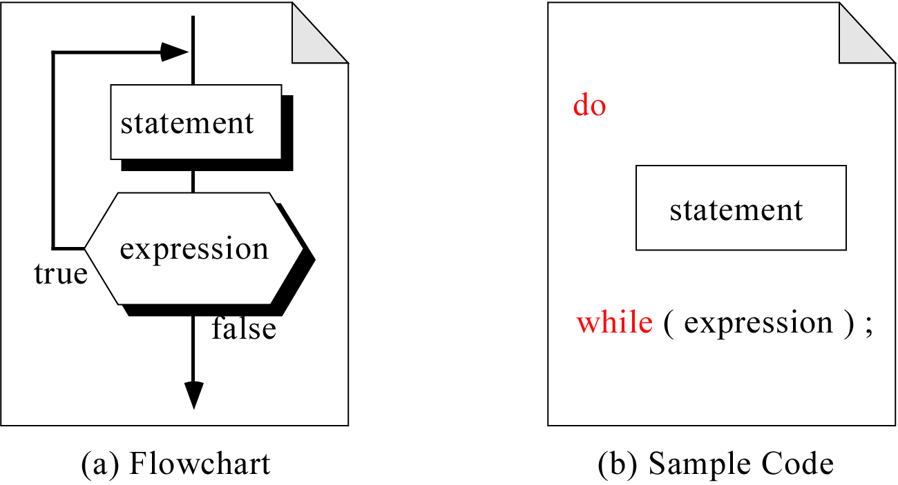
Figure 6-15

Slide 17
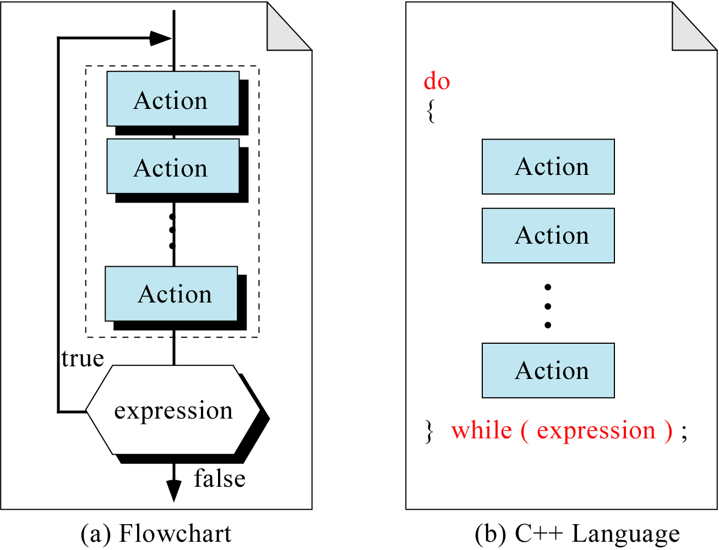
Figure 6-16

Slide 18

Figure 6-17

Slide 19
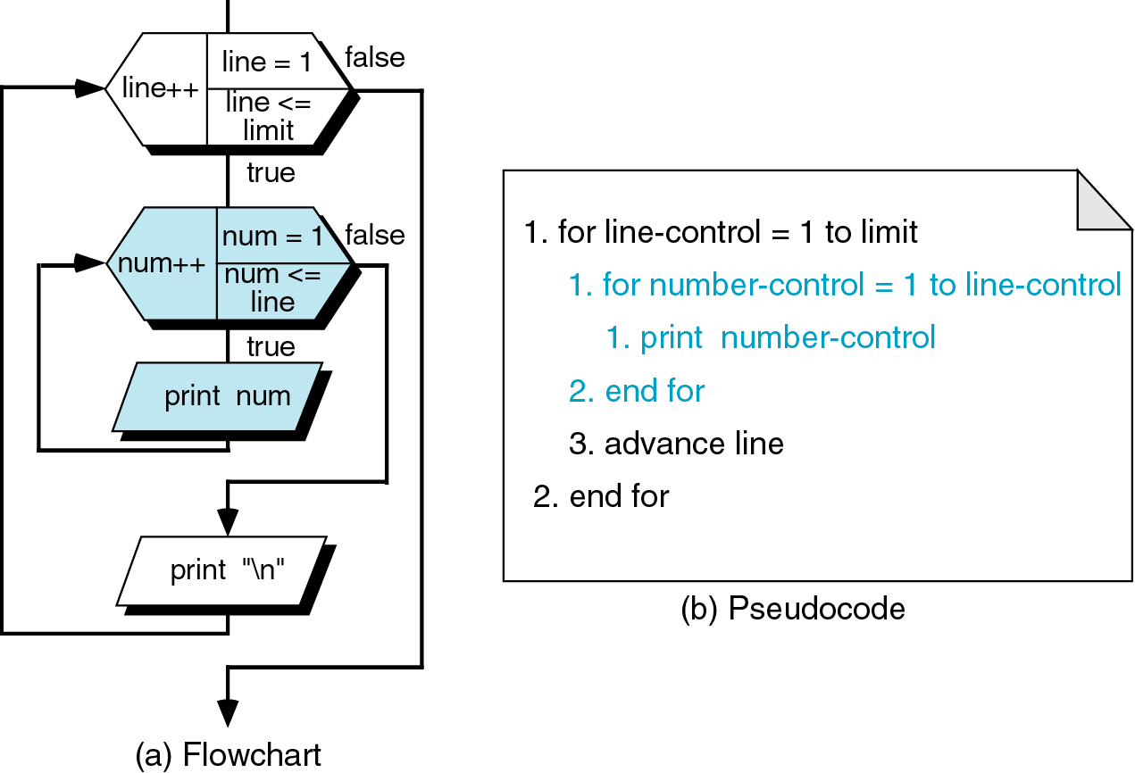
Figure 6-18

Slide 20
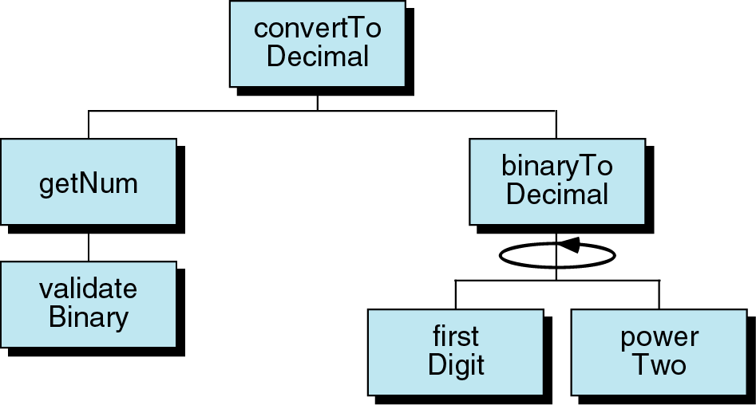
Figure 6-19

Slide 21

Figure 6-20

Slide 22
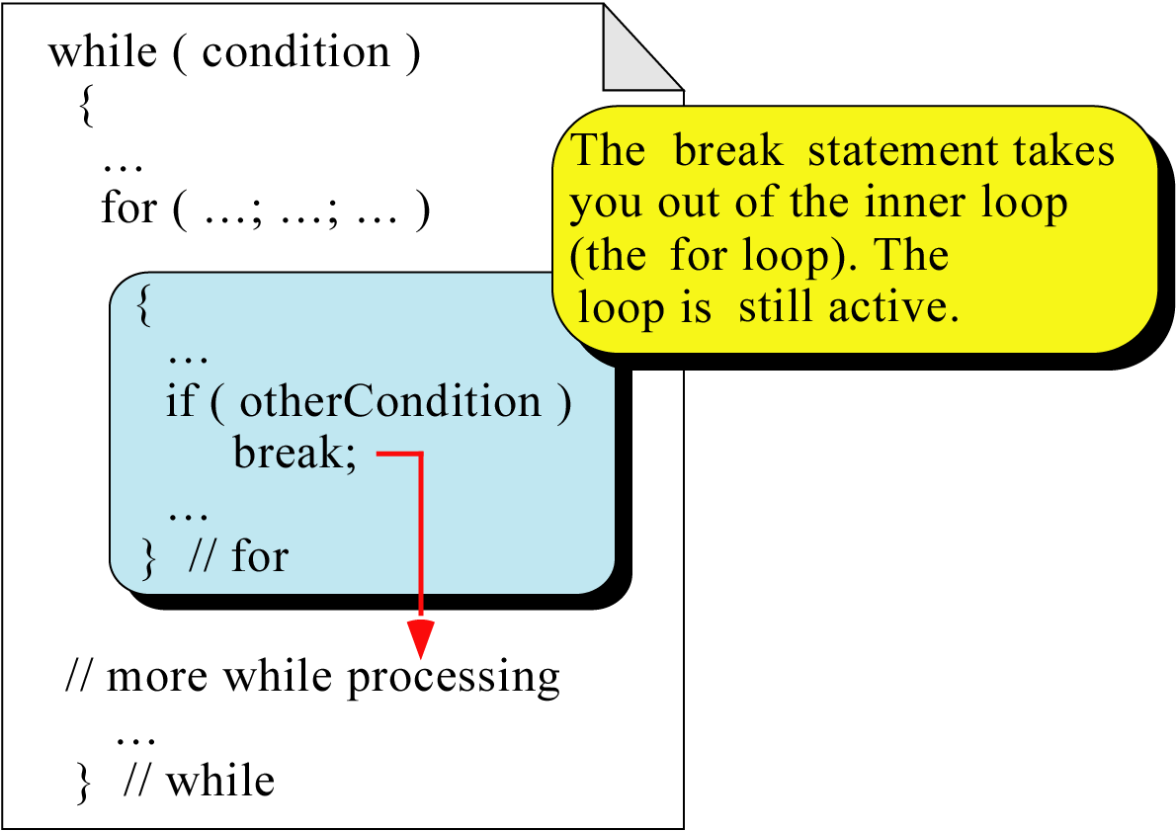
Figure 6-21

Slide 23
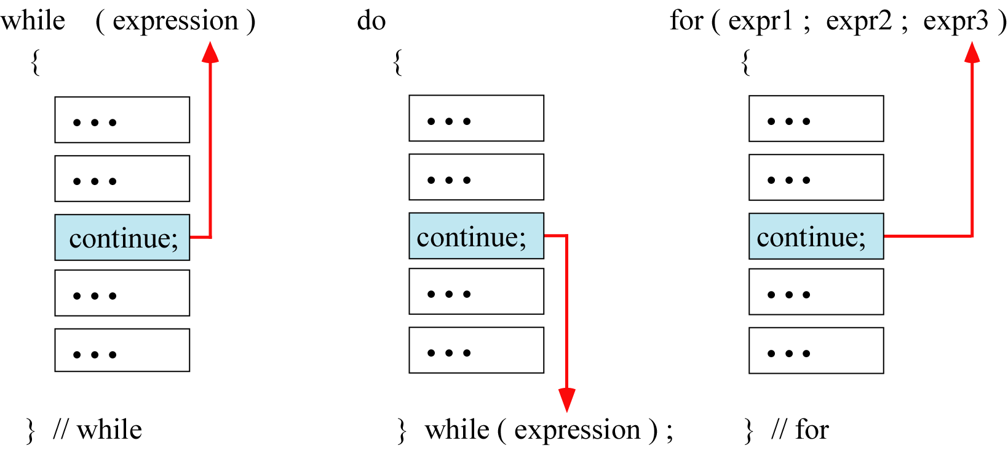
Figure 6-22

Slide 24
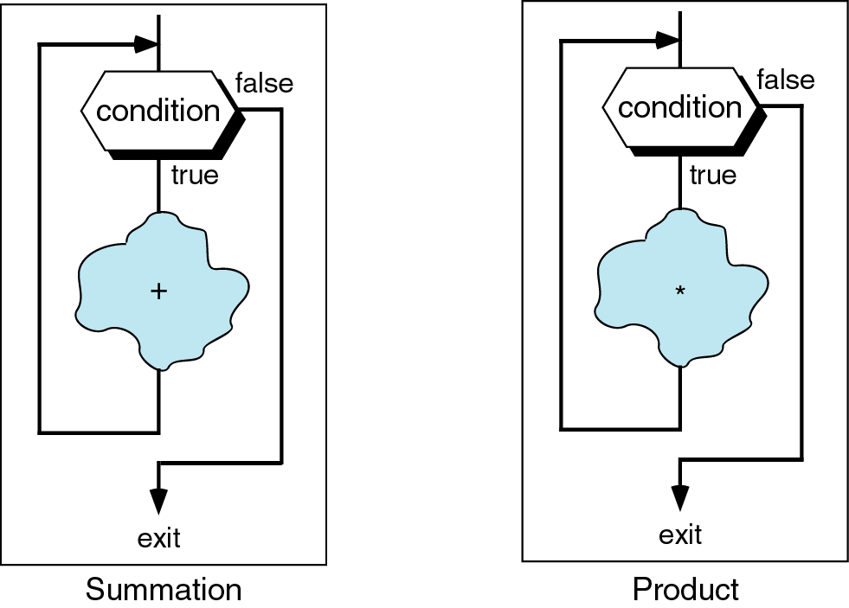
Figure 6-23

Slide 25
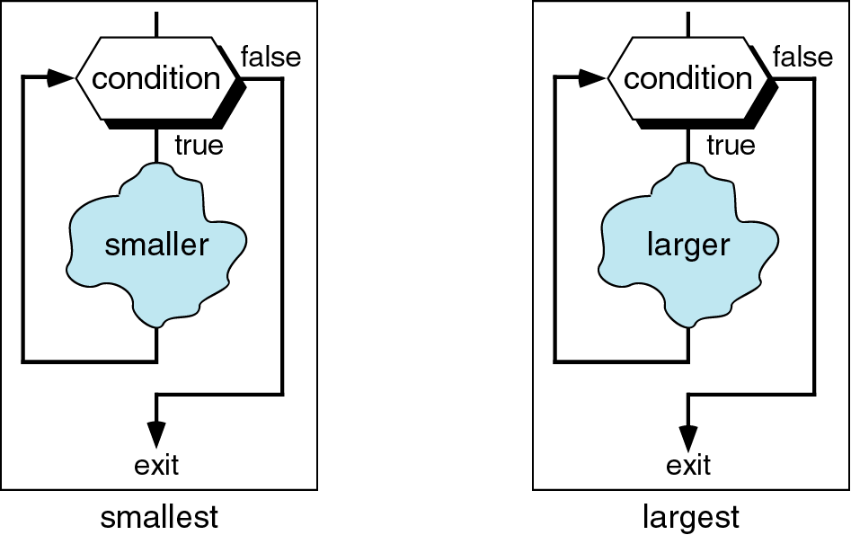
Figure 6-24

Slide 26
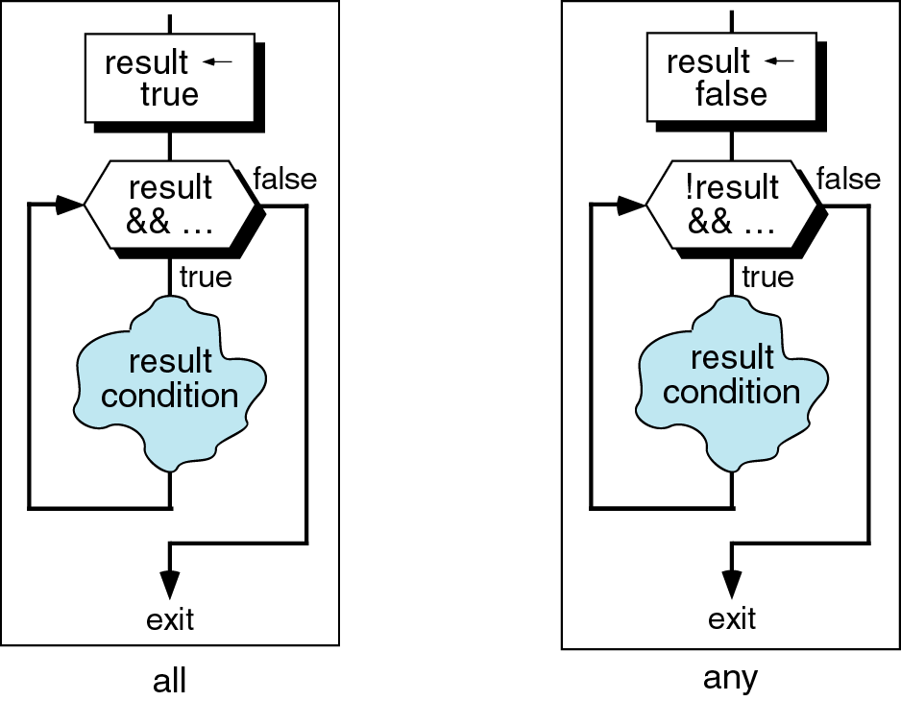
Figure 6-25

Slide 27
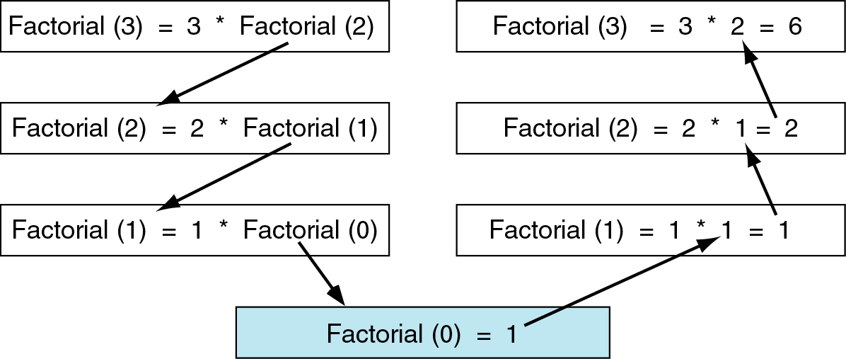
Figure 6-26

Slide 28
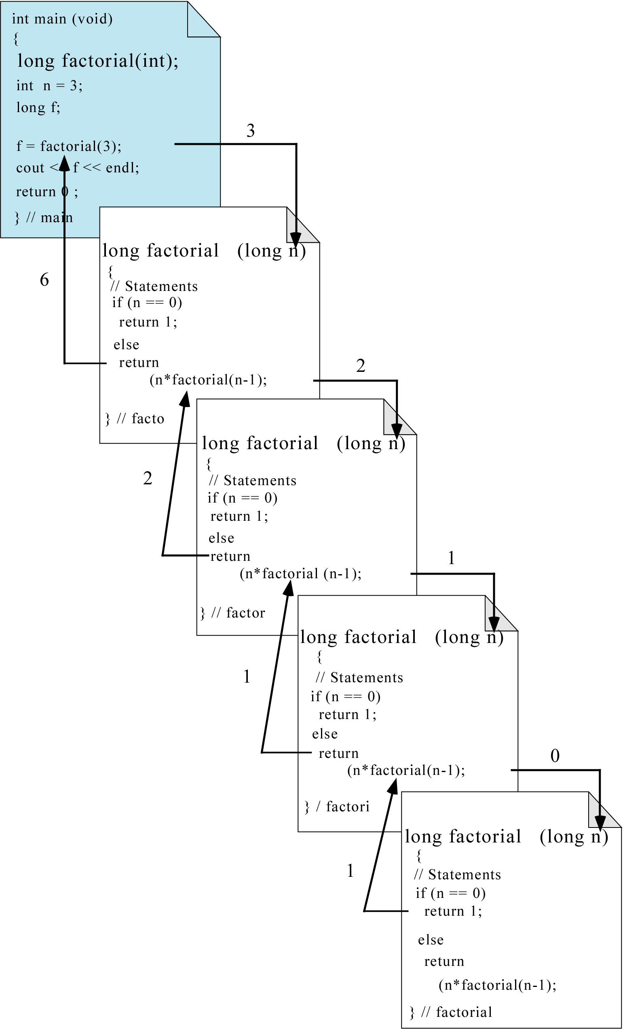
Figure 6-27

Slide 29
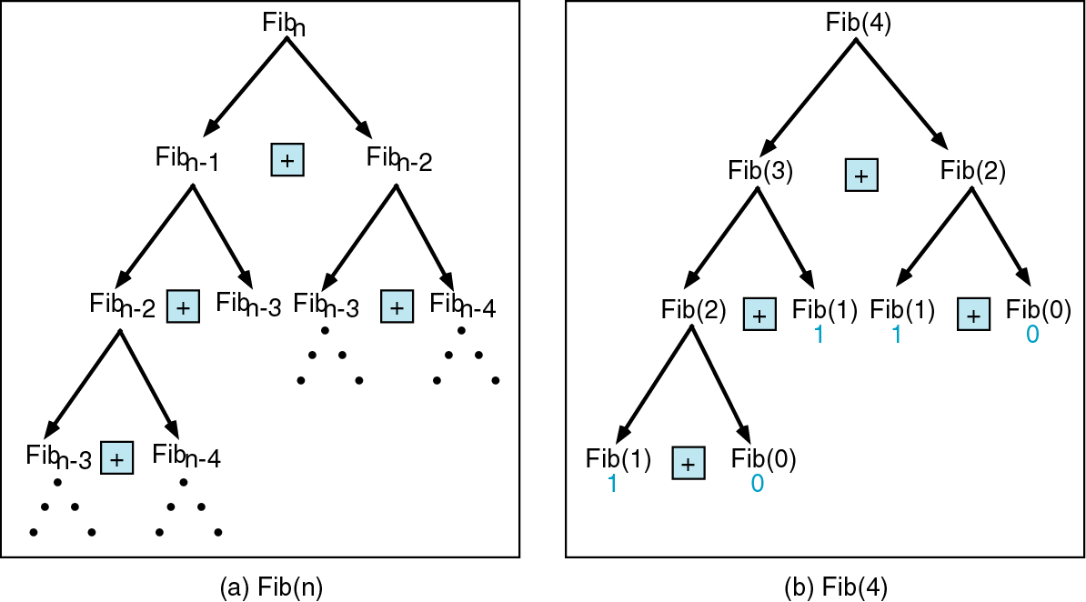
Figure 6-28

Slide 30
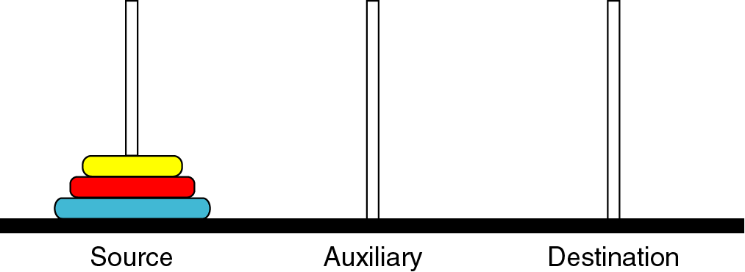
Figure 6-29

Slide 31
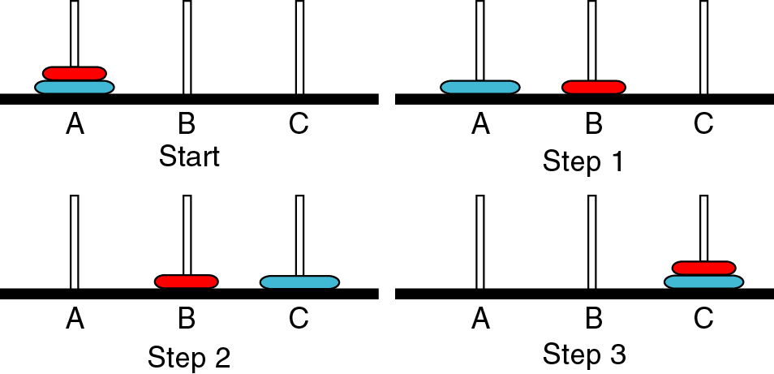
Figure 6-30

Slide 32
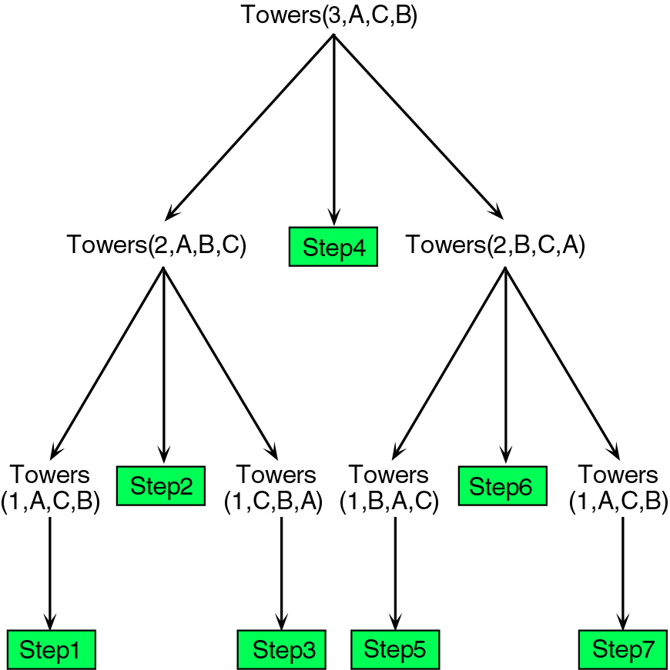
Figure 6-31.a

Slide 33
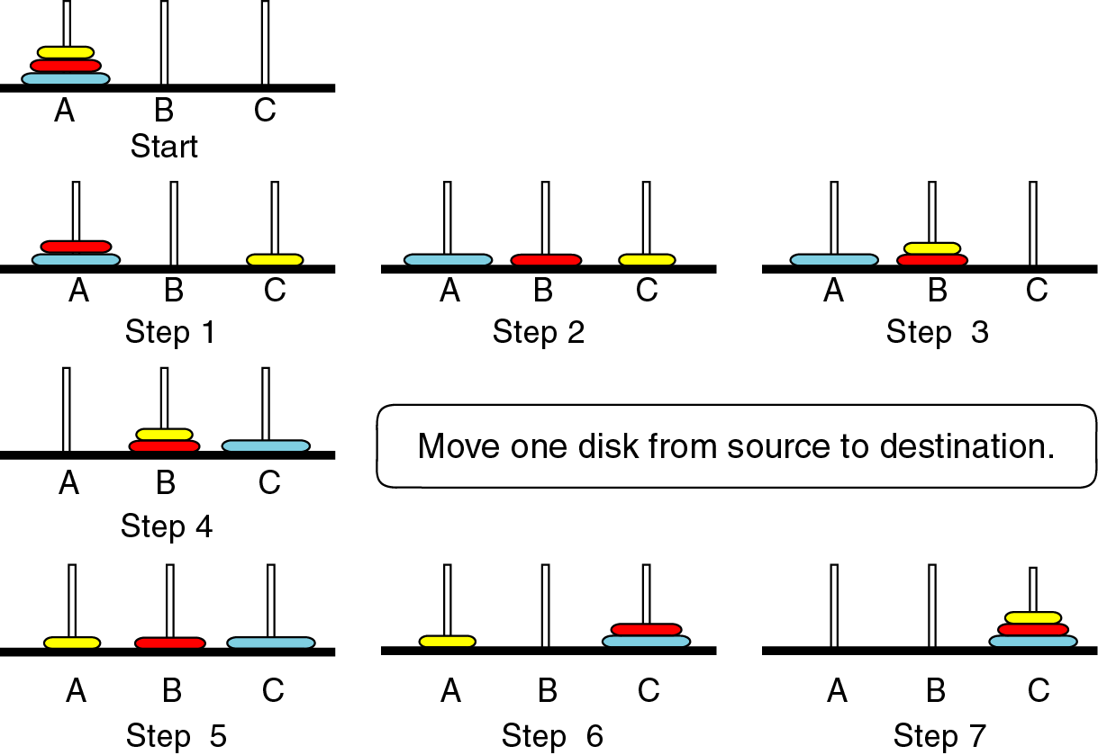
Figure 6-31.b

Slide 34
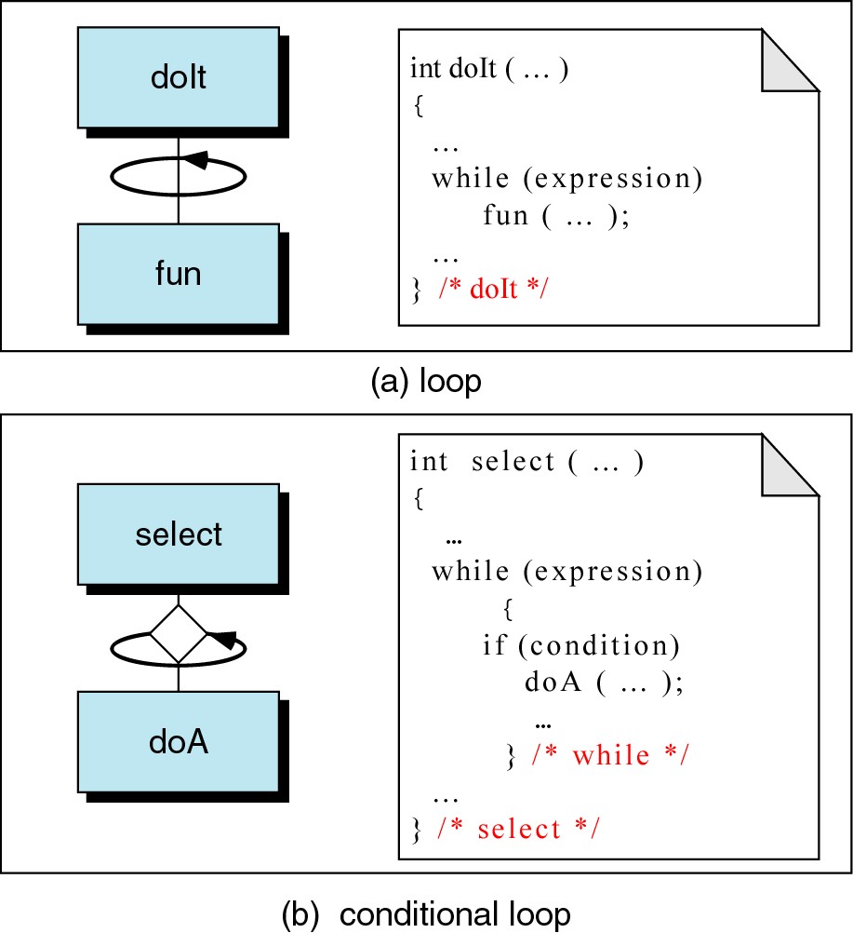
Figure 6-32

Slide 35
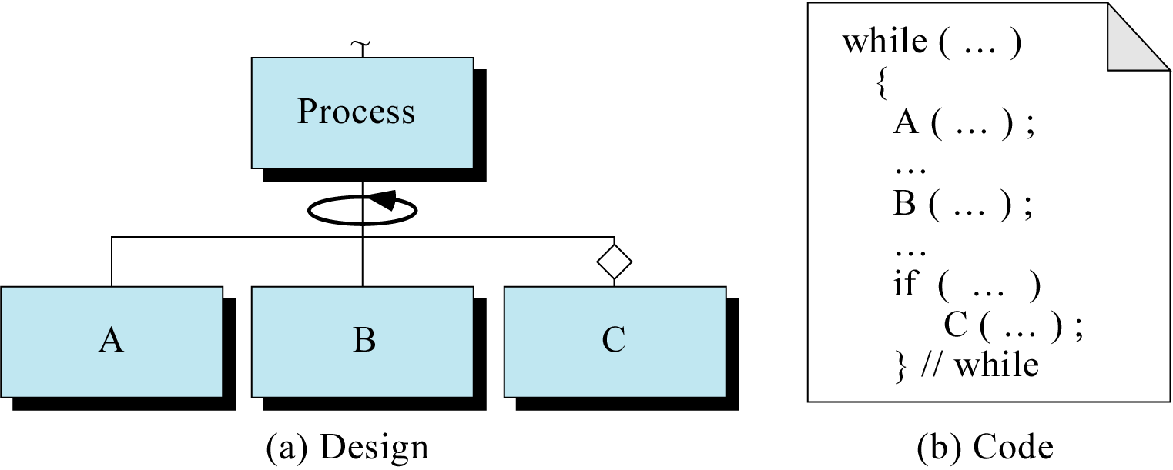
Figure 6-33

Slide 36
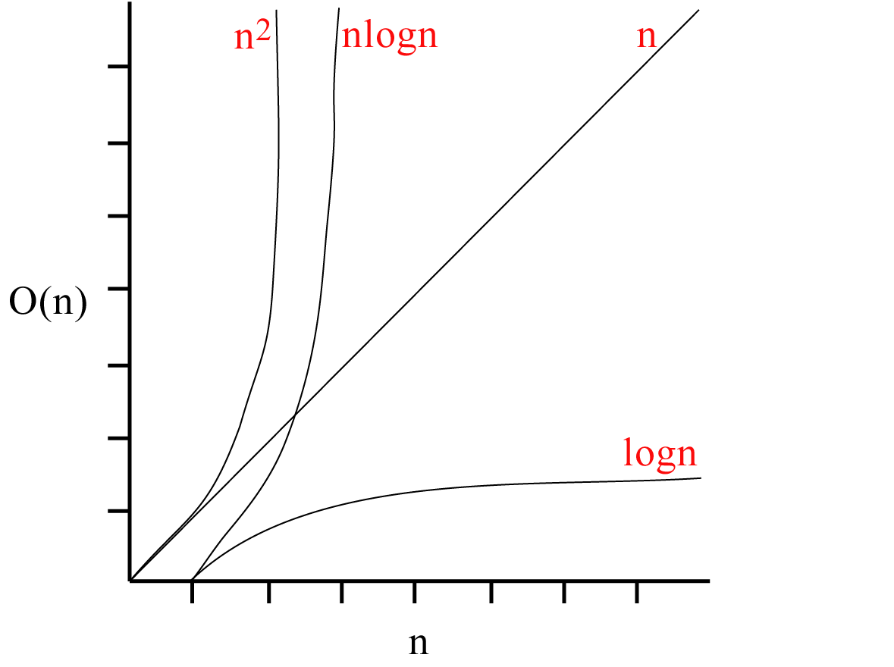
Figure 6-34

