Slide 1
Chapter 7
Text Files

Slide 2
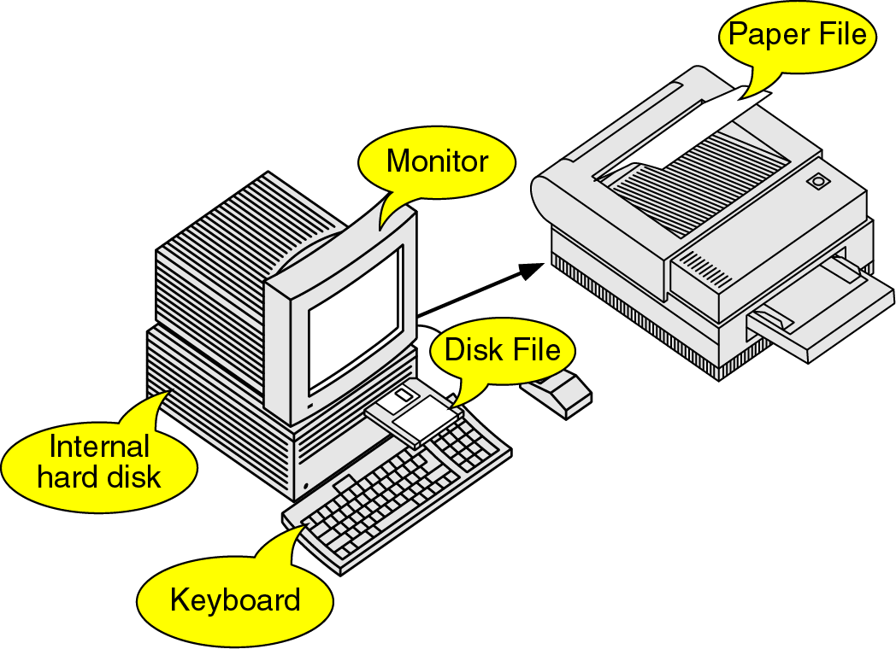
Figure 7-1

Slide 3
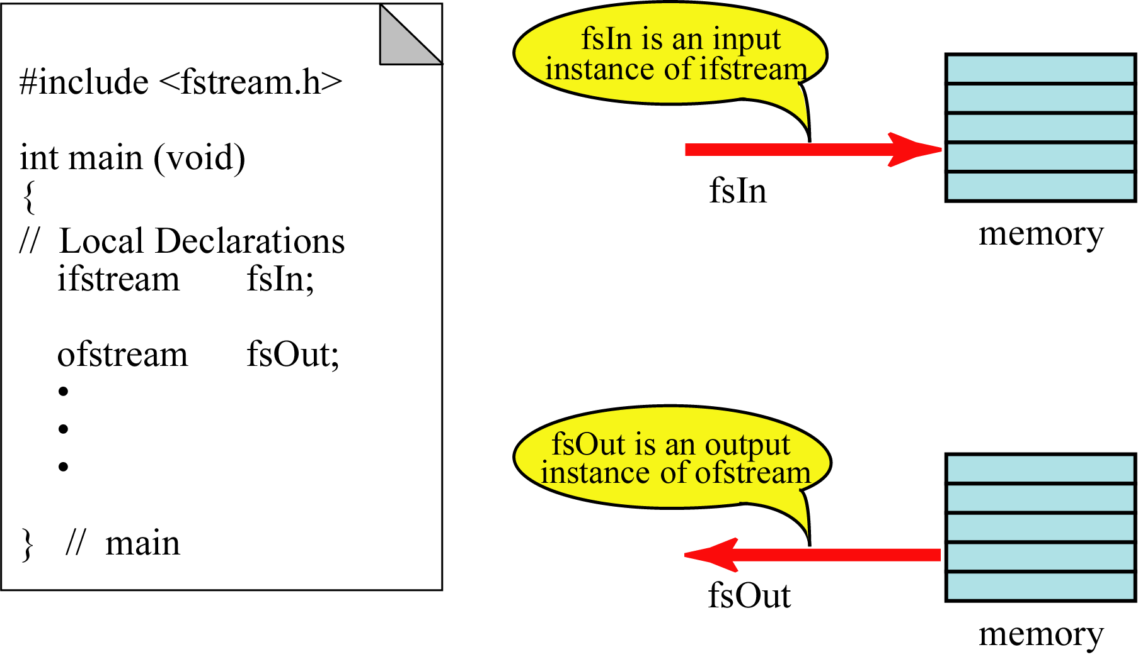
Figure 7-2

Slide 4
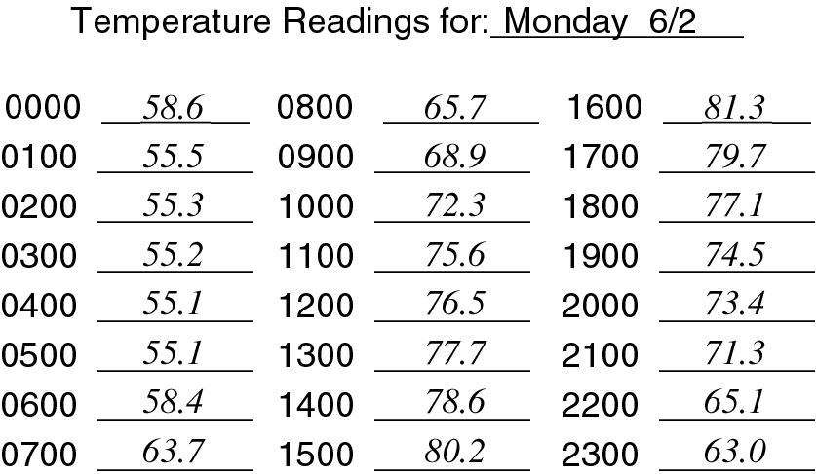
Figure 7-3

Slide 5
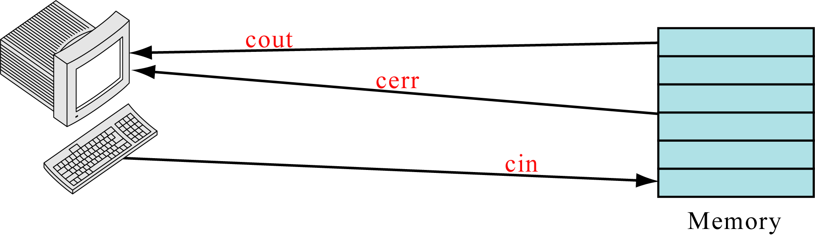
Figure 7-4

Slide 6
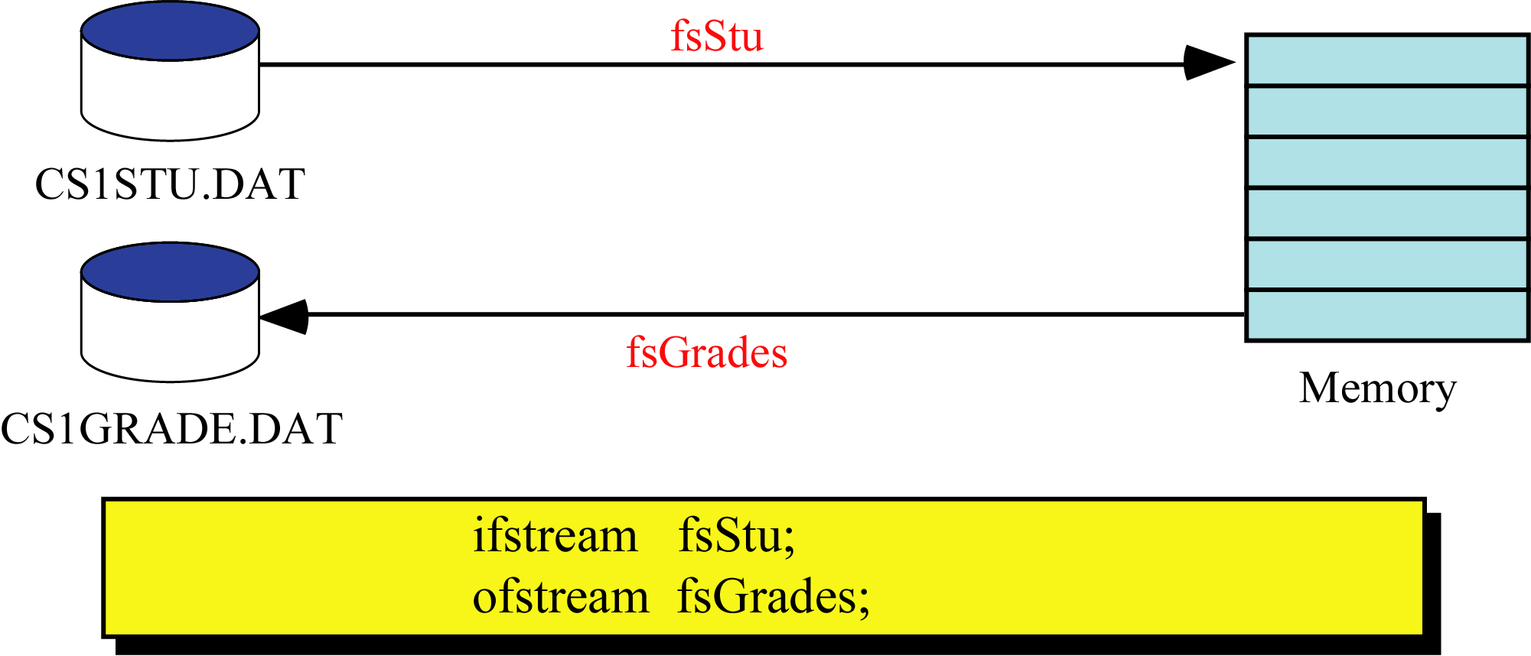
Figure 7-5

Slide 7
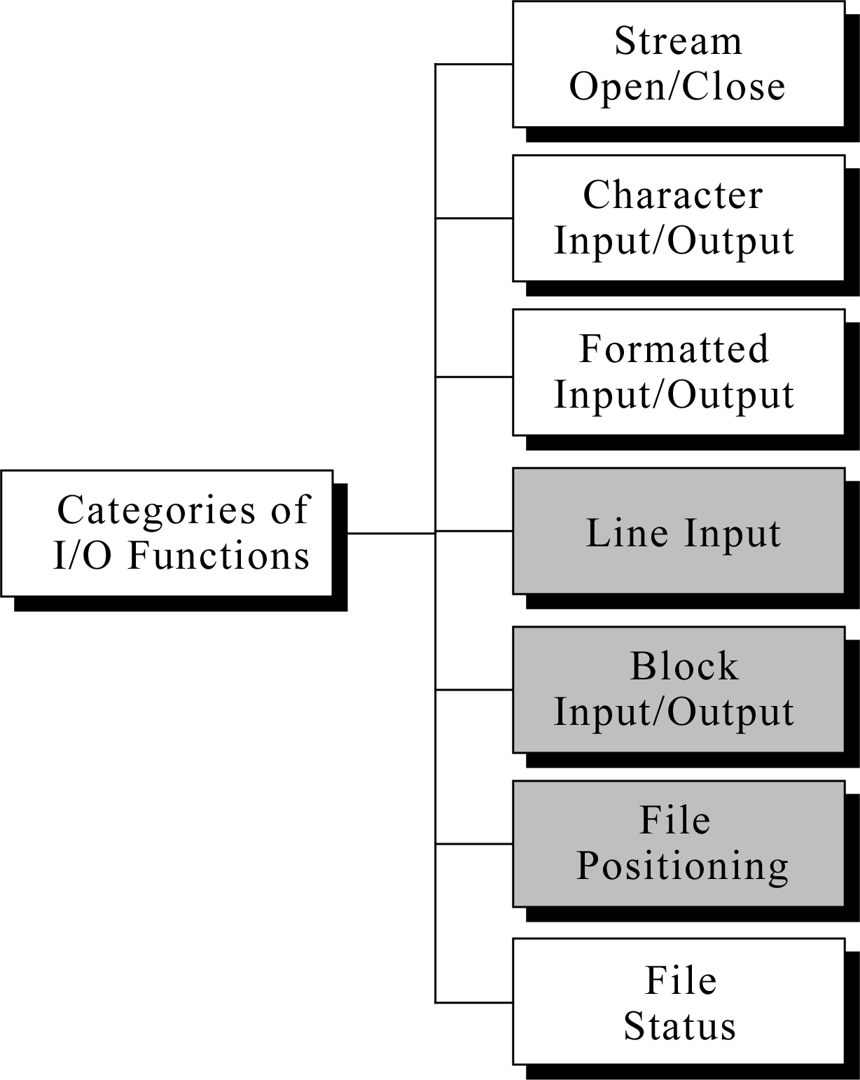
Figure 7-6

Slide 8
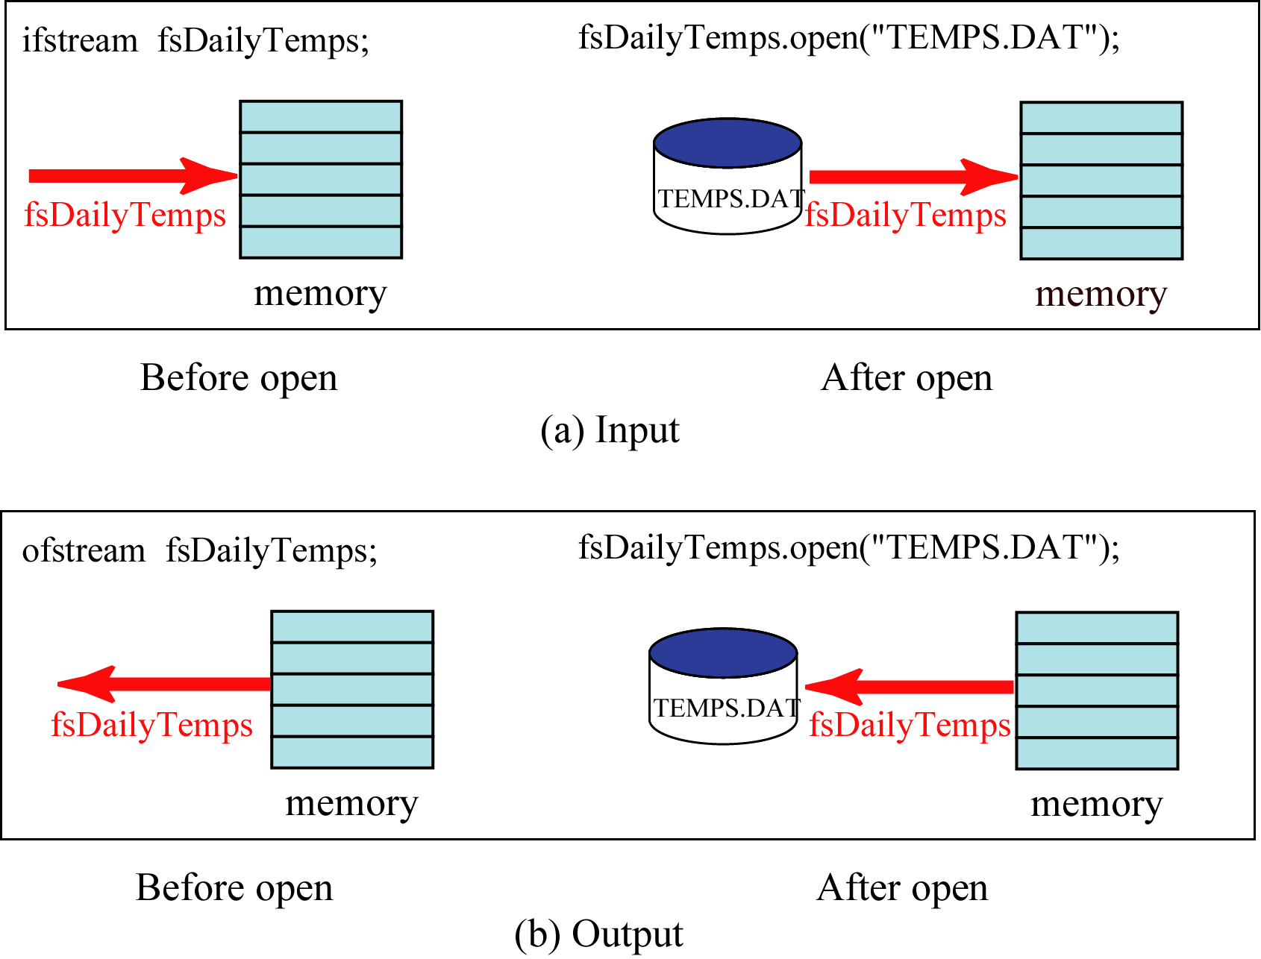
Figure 7-7

Slide 9
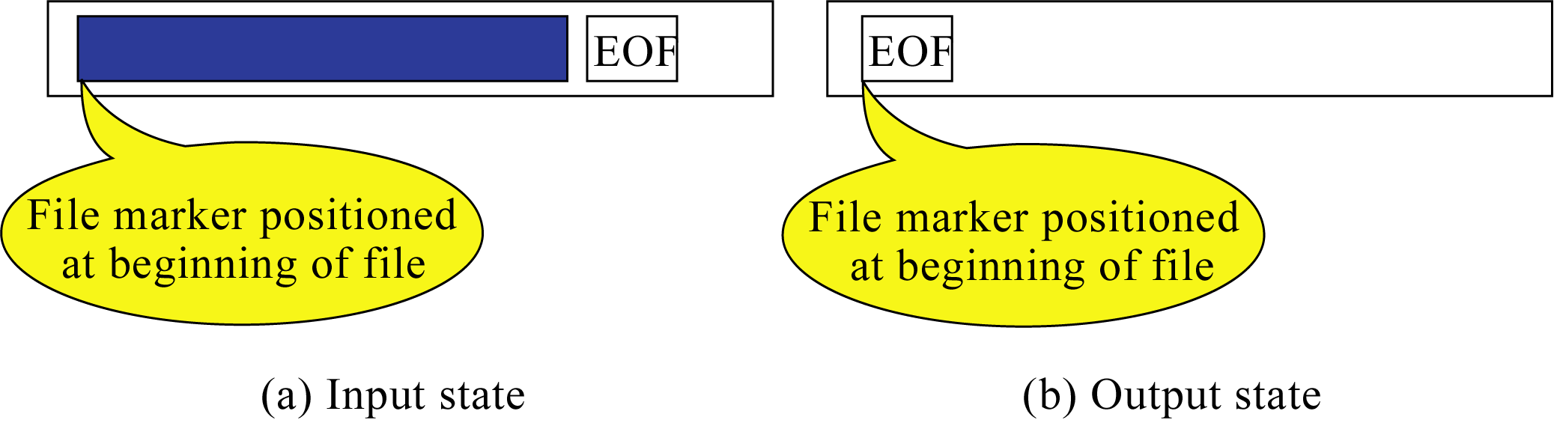
Figure 7-8

