Slide 1
Chapter 8
Arrays

Slide 2
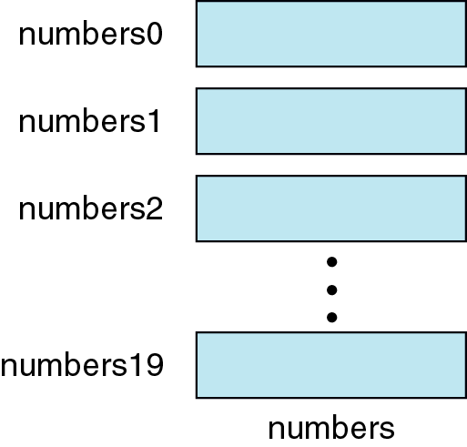
Figure 8-1

Slide 3
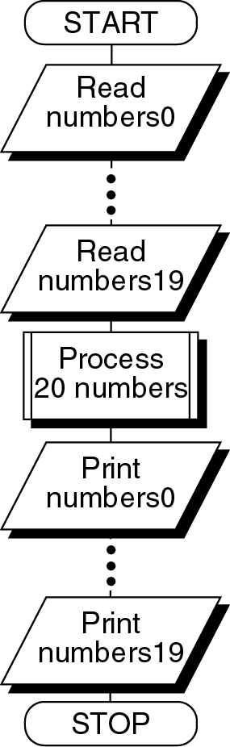
Figure 8-2

Slide 4
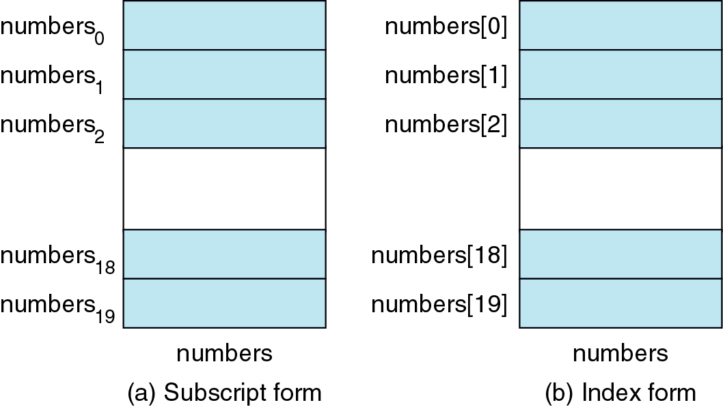
Figure 8-3

Slide 5
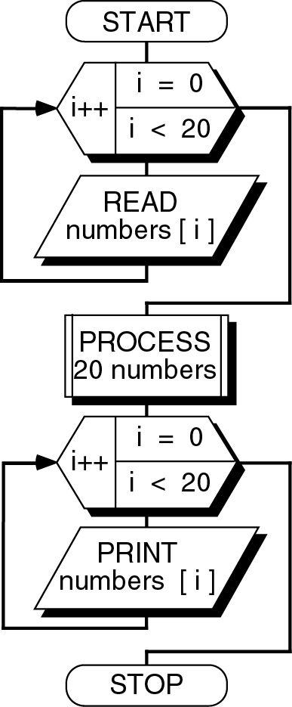
Figure 8-4

Slide 6
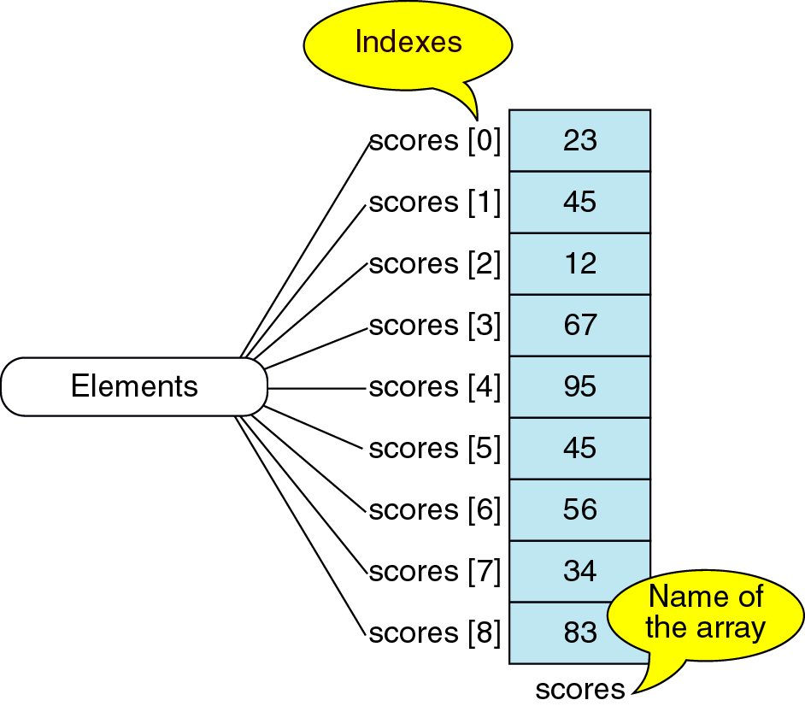
Figure 8-5

Slide 7
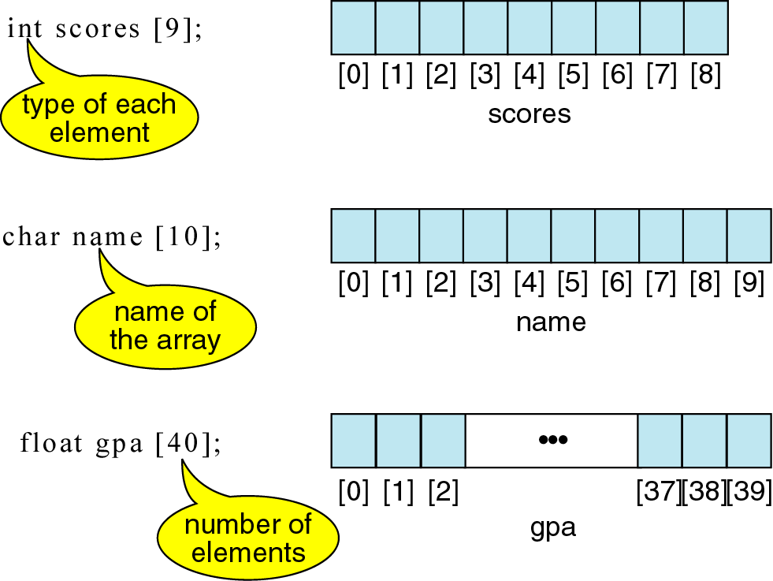
Figure 8-6

Slide 8
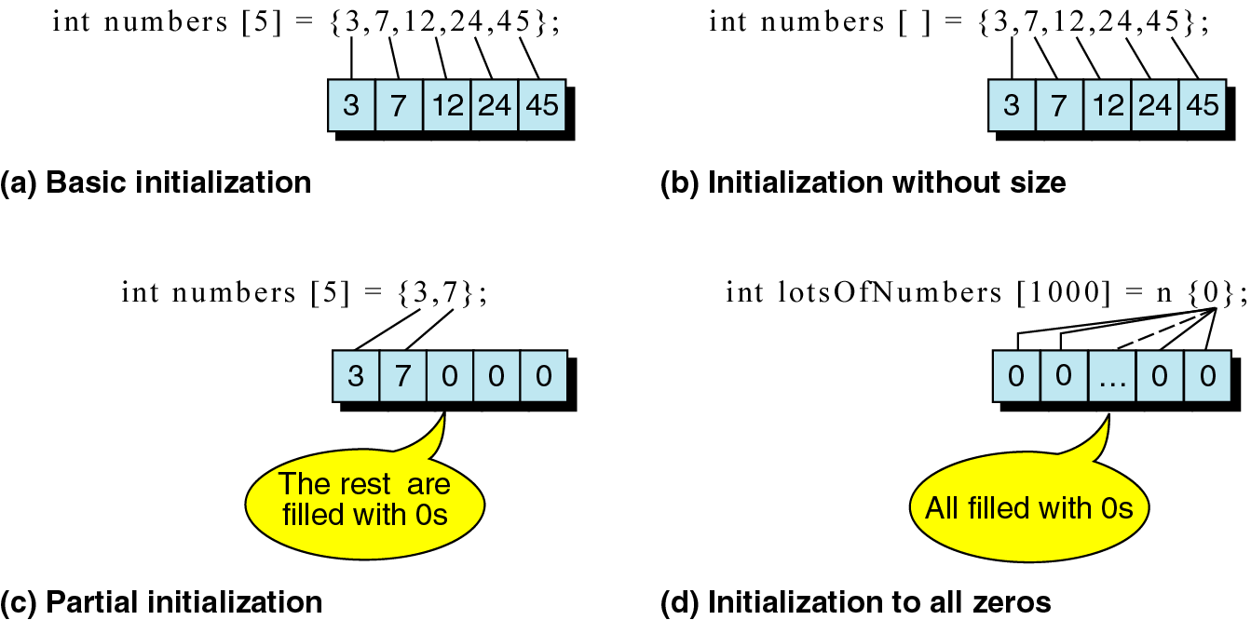
Figure 8-7

Slide 9
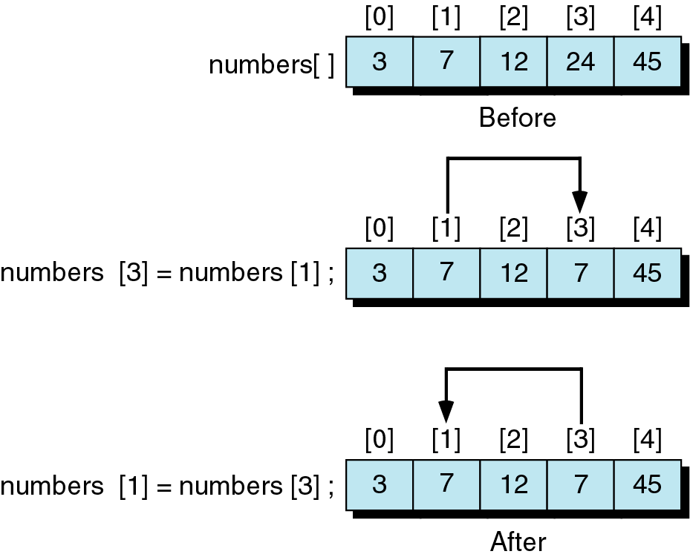
Figure 8-8

Slide 10
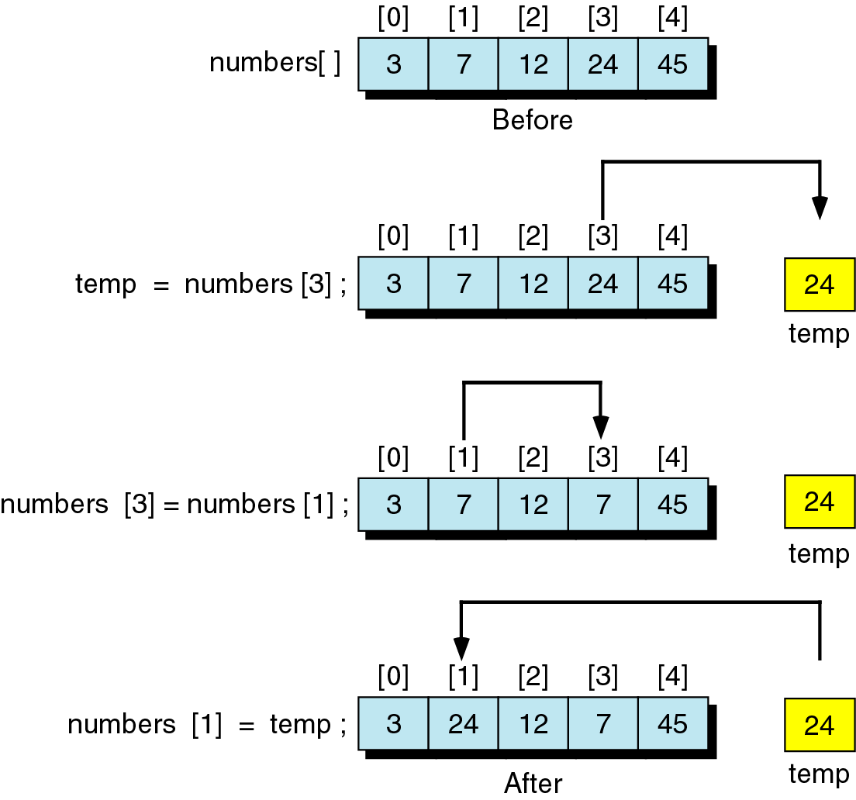
Figure 8-9

Slide 11
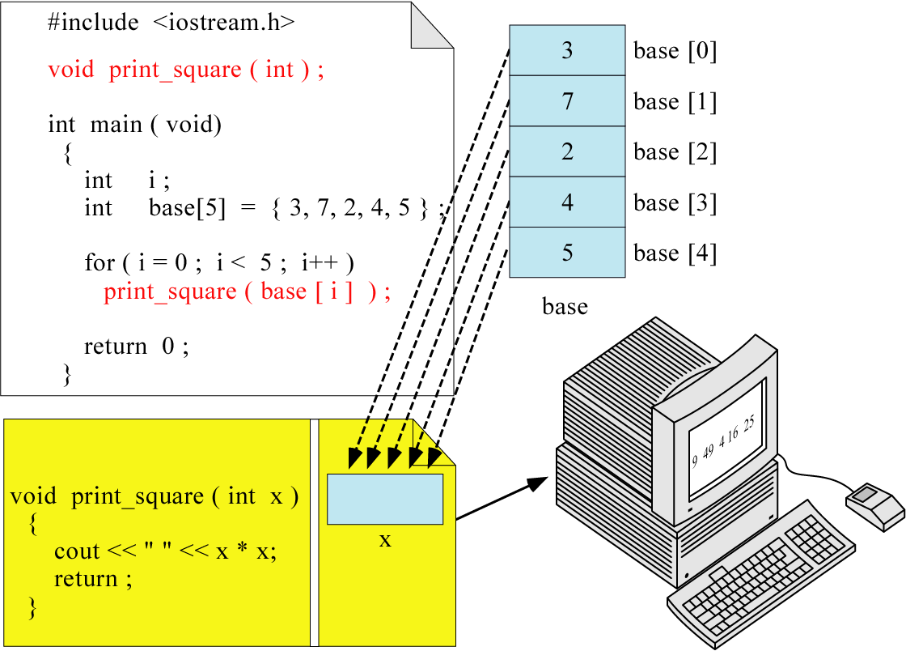
Figure 8-10

Slide 12
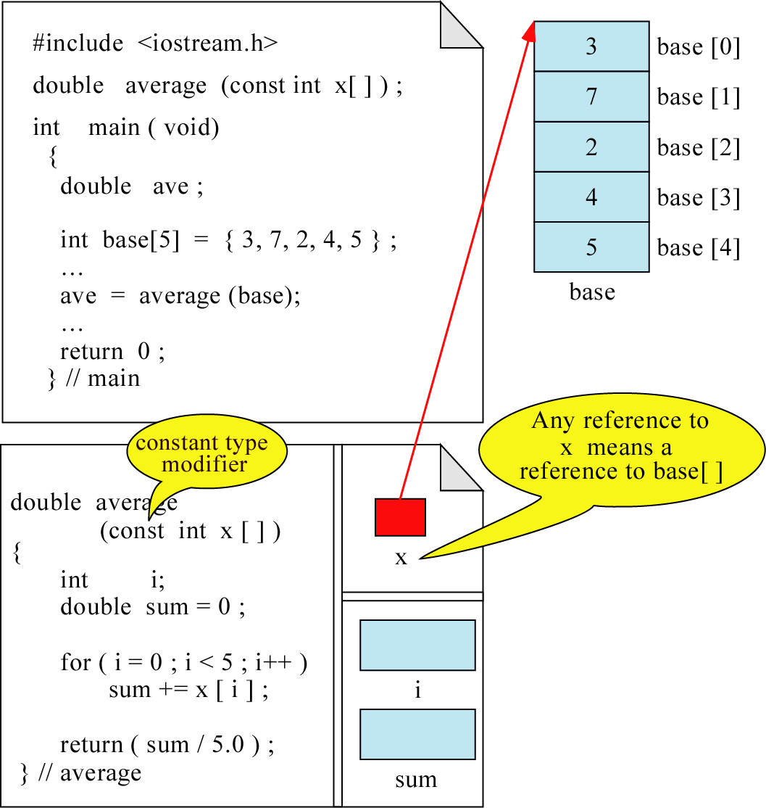
Figure 8-11

Slide 13
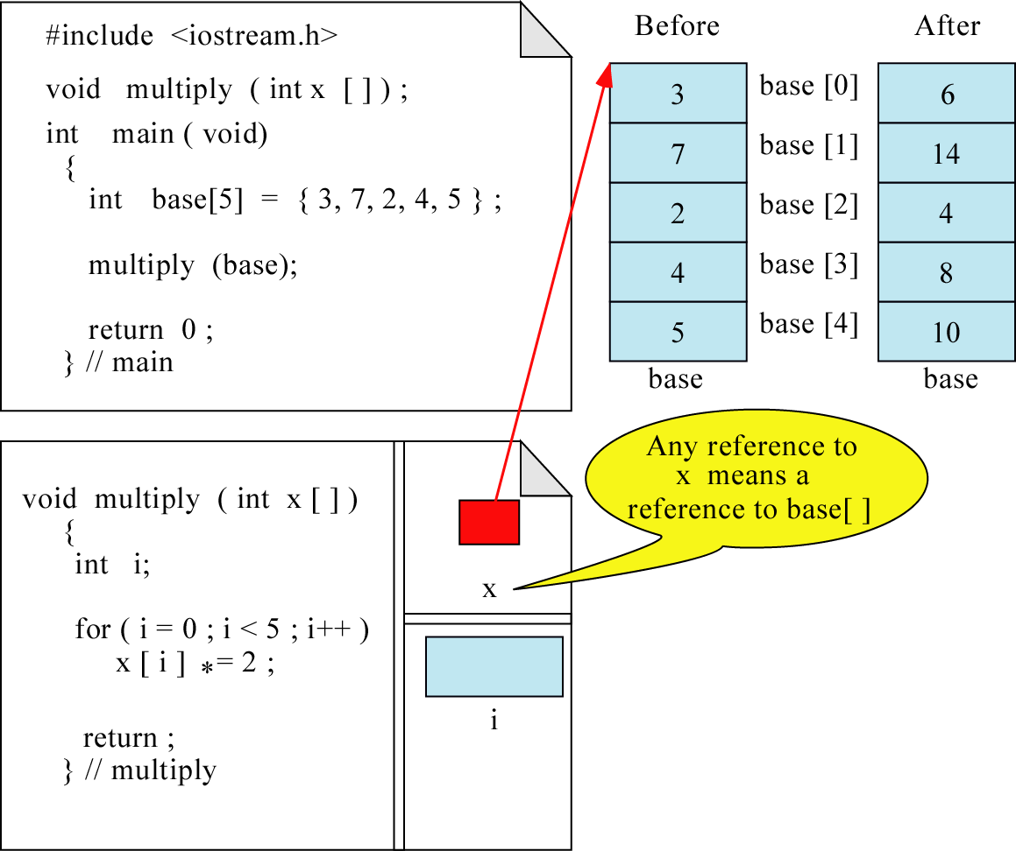
Figure 8-12

Slide 14
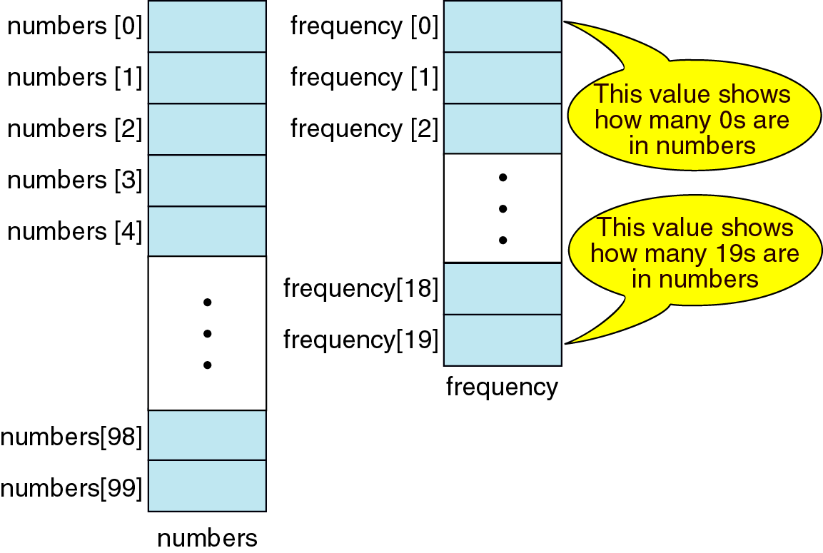
Figure 8-13

Slide 15
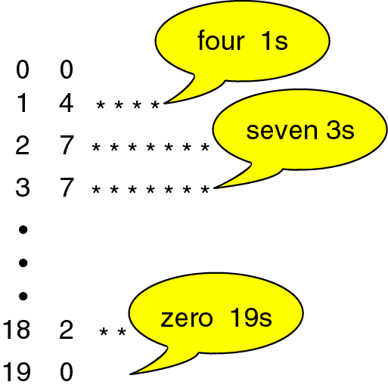
Figure 8-14

Slide 16
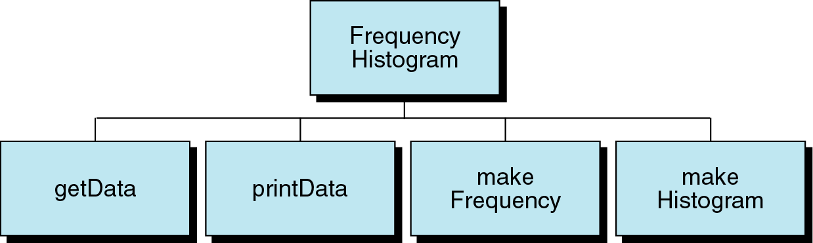
Figure 8-15

Slide 17
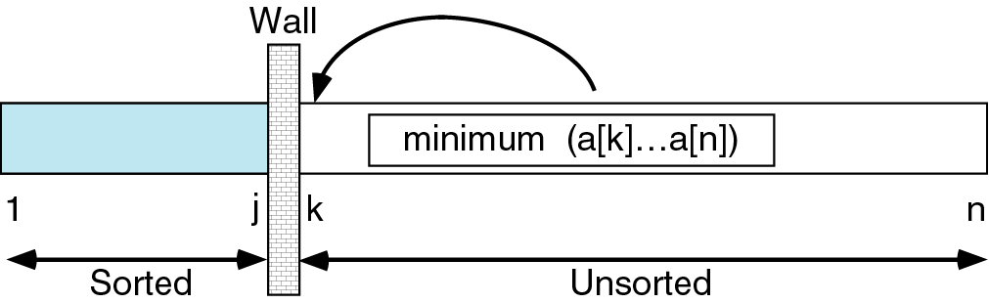
Figure 8-16

Slide 18
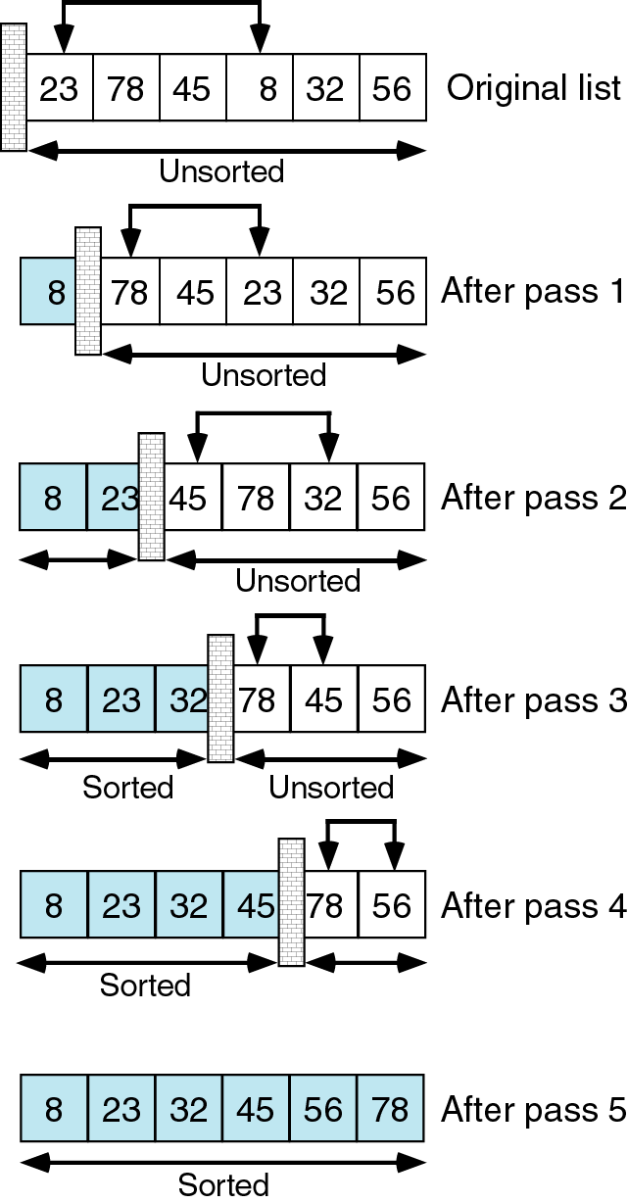
Figure 8-17

Slide 19
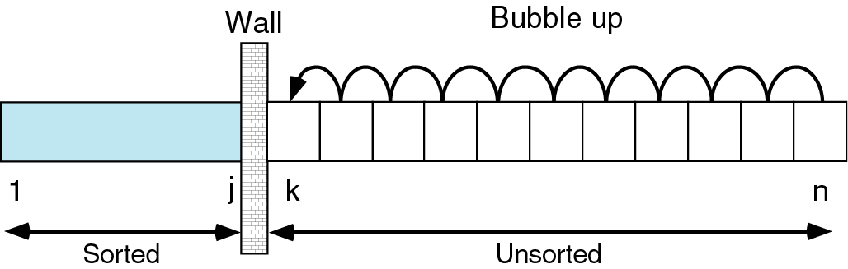
Figure 8-18

Slide 20
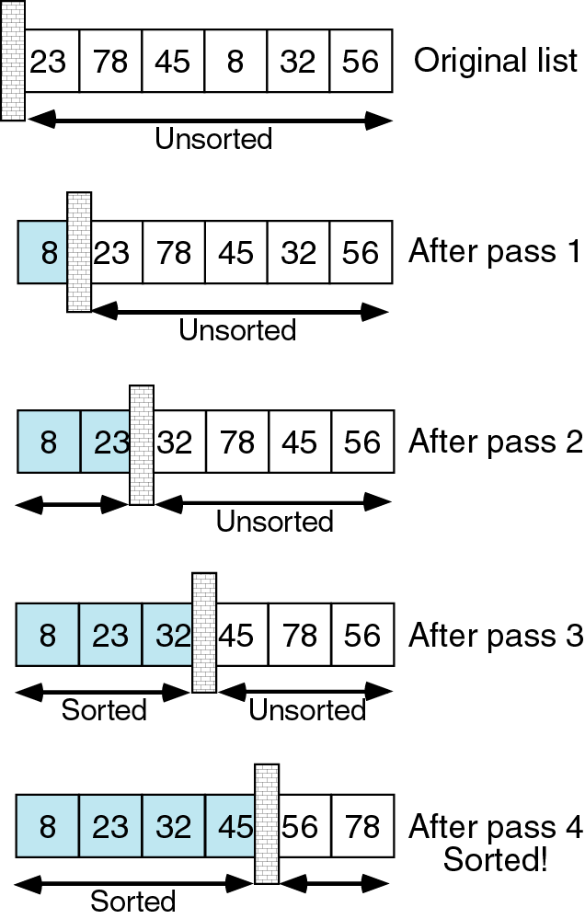
Figure 8-19

Slide 21
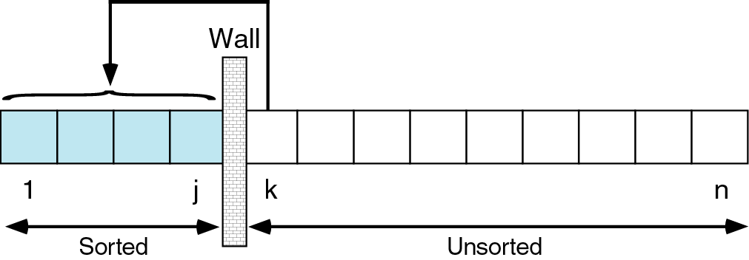
Figure 8-20

Slide 22
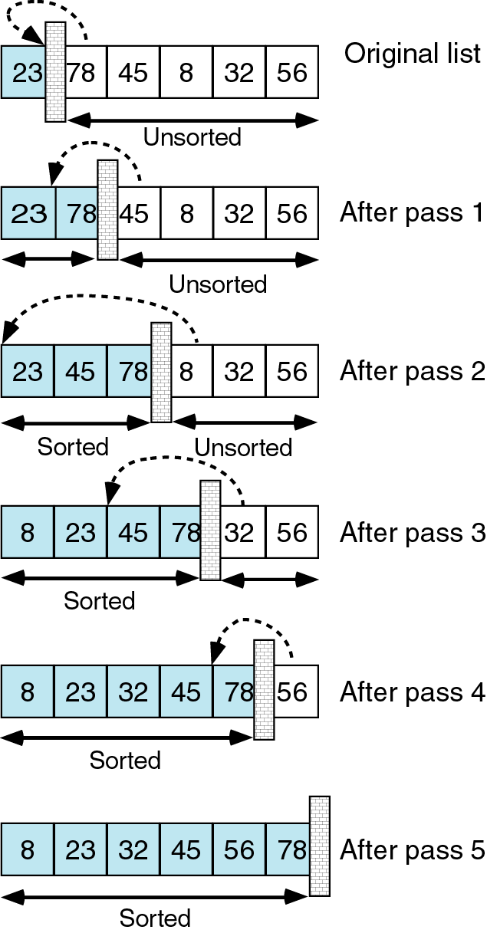
Figure 8-21

Slide 23
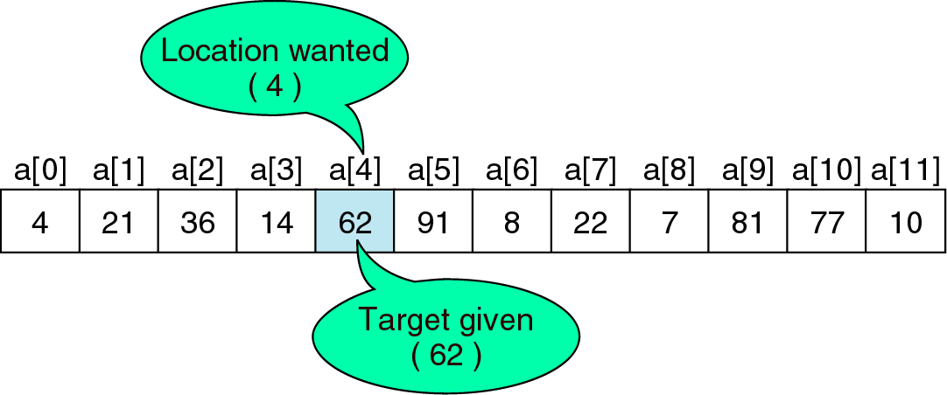
Figure 8-22

Slide 24
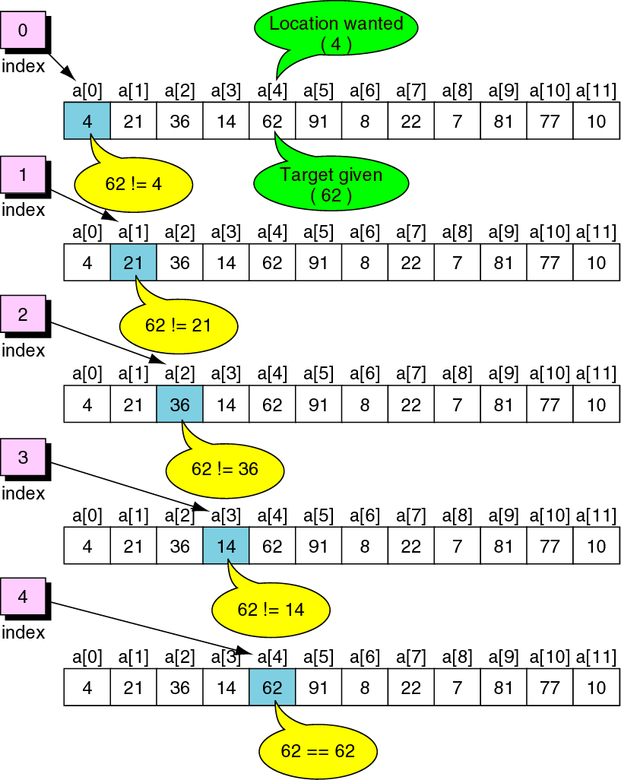
Figure 8-23

Slide 25
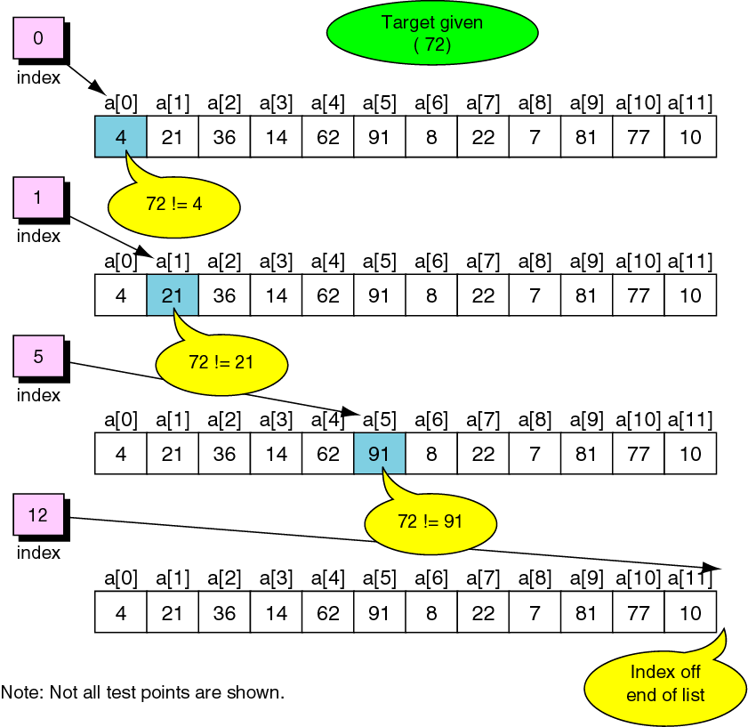
Figure 8-24

Slide 26
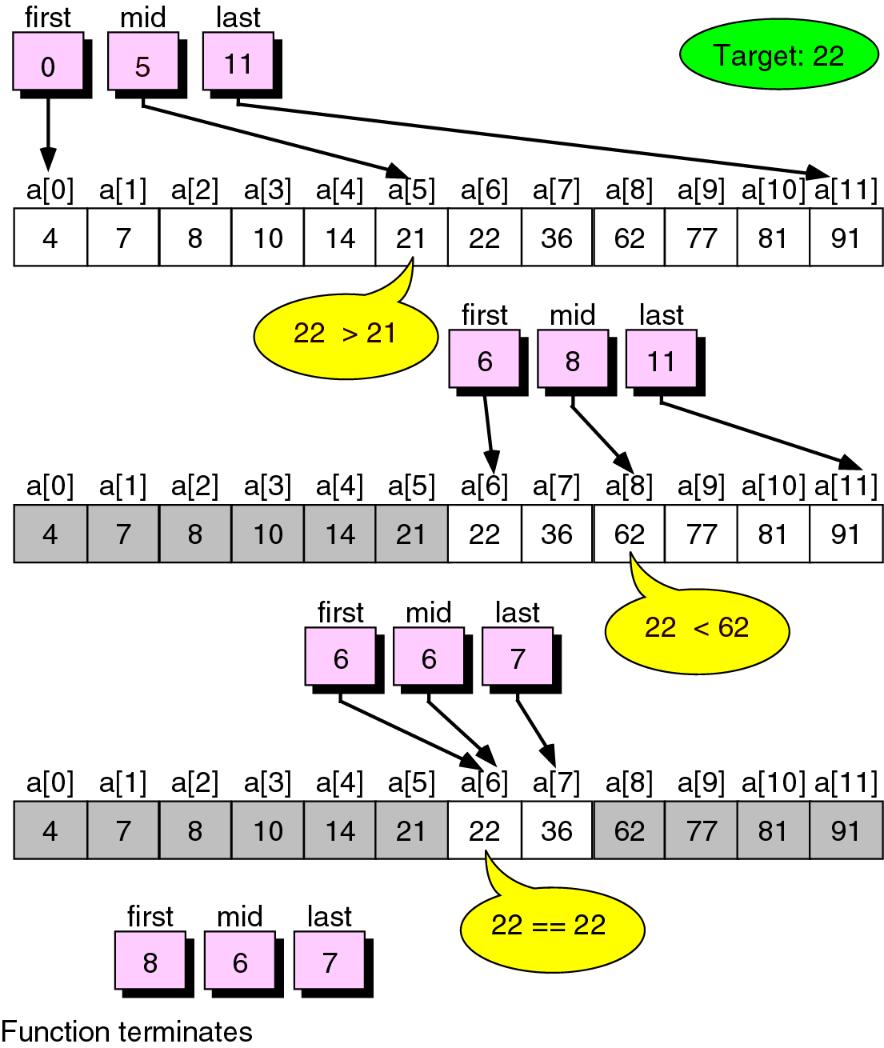
Figure 8-25

Slide 27
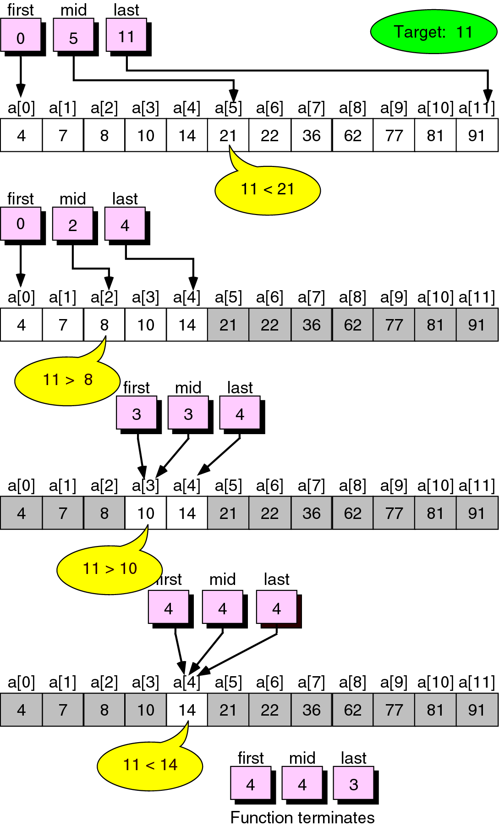
Figure 8-26

Slide 28
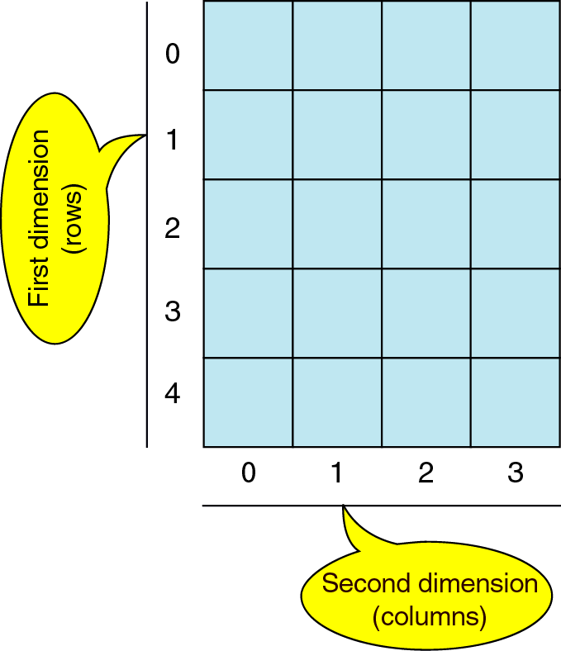
Figure 8-27

Slide 29
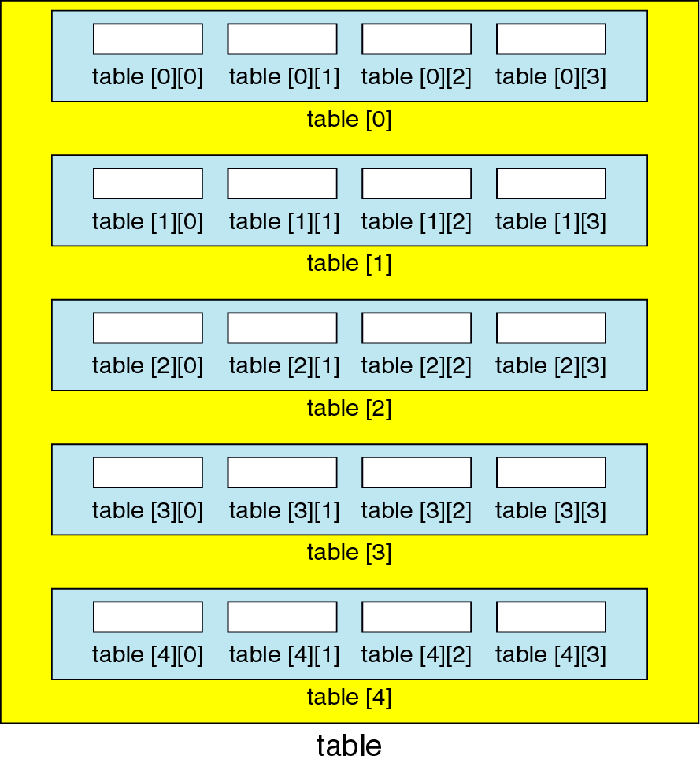
Figure 8-28

Slide 30
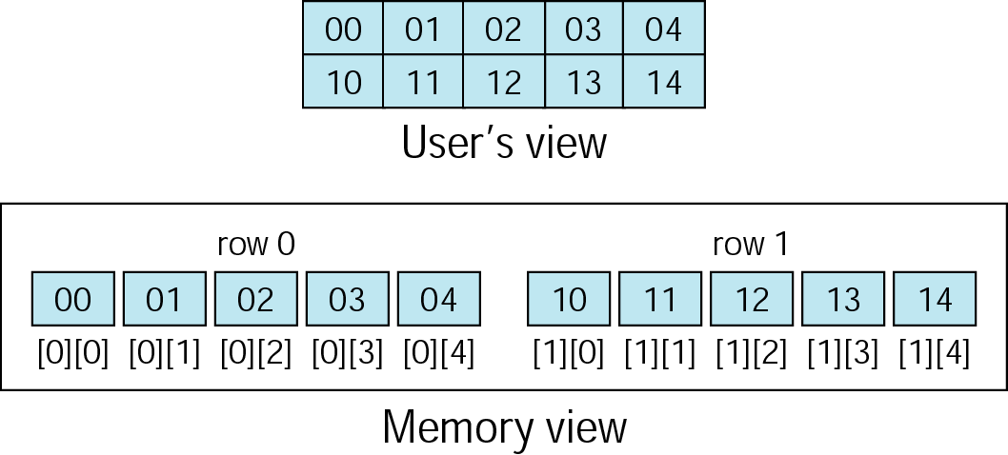
Figure 8-29

Slide 31
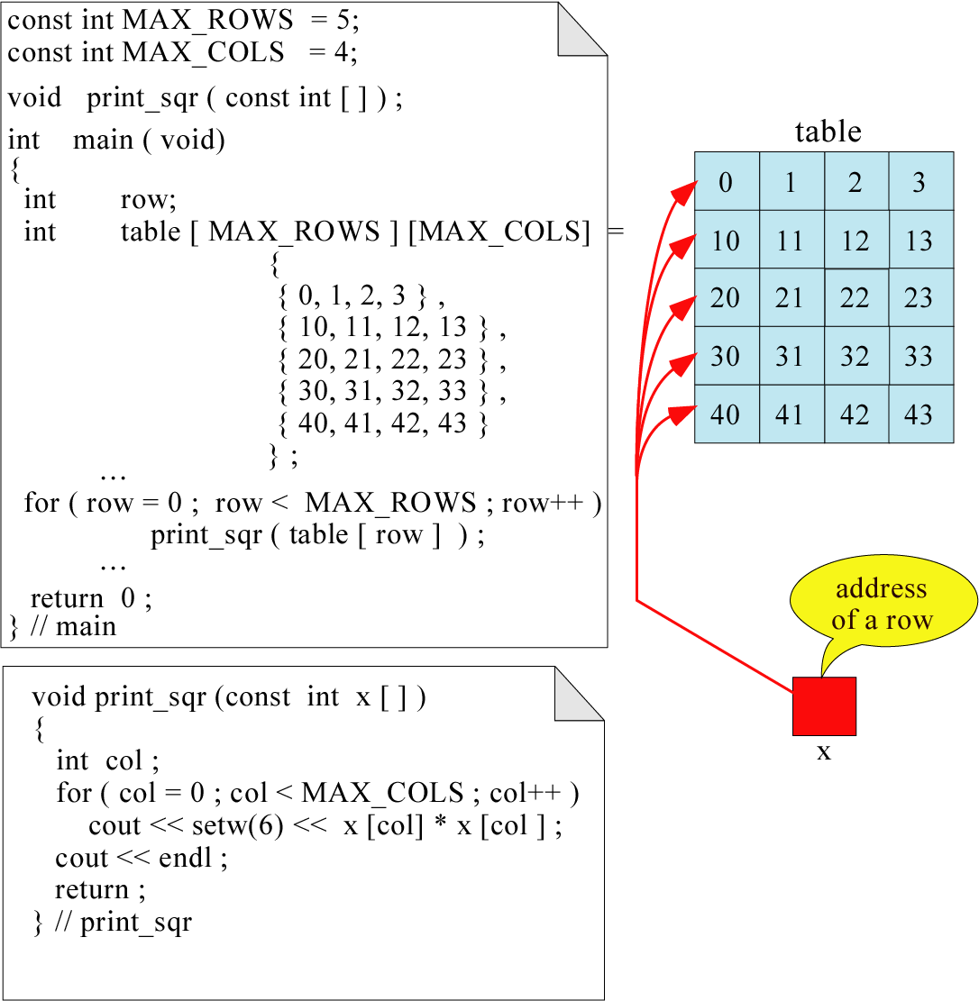
Figure 8-30

Slide 32
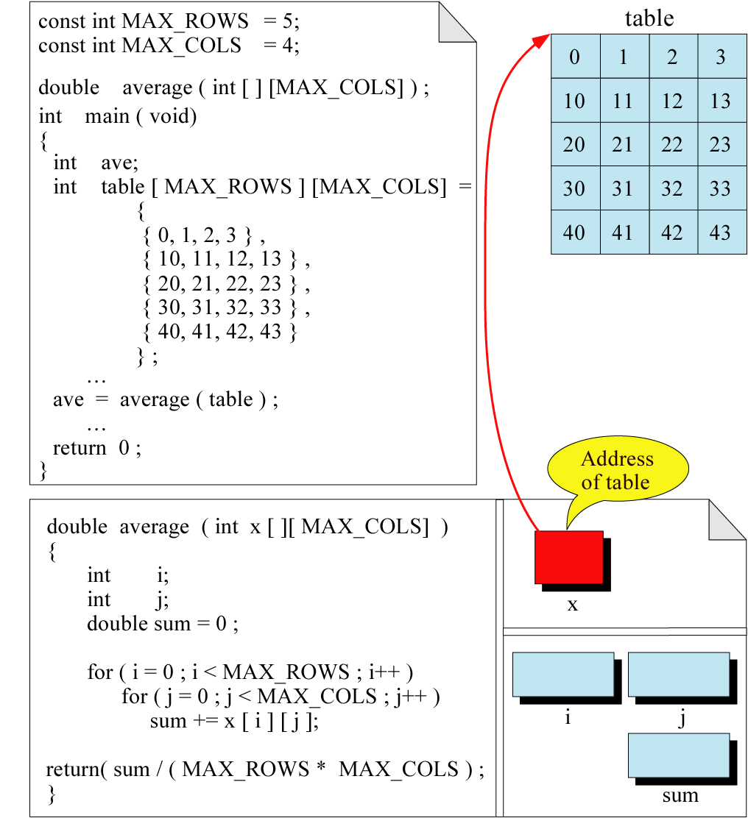
Figure 8-31

Slide 33
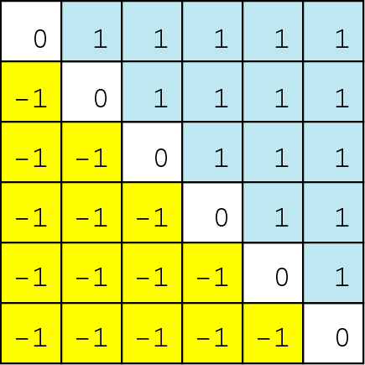
Figure 8-32

Slide 34
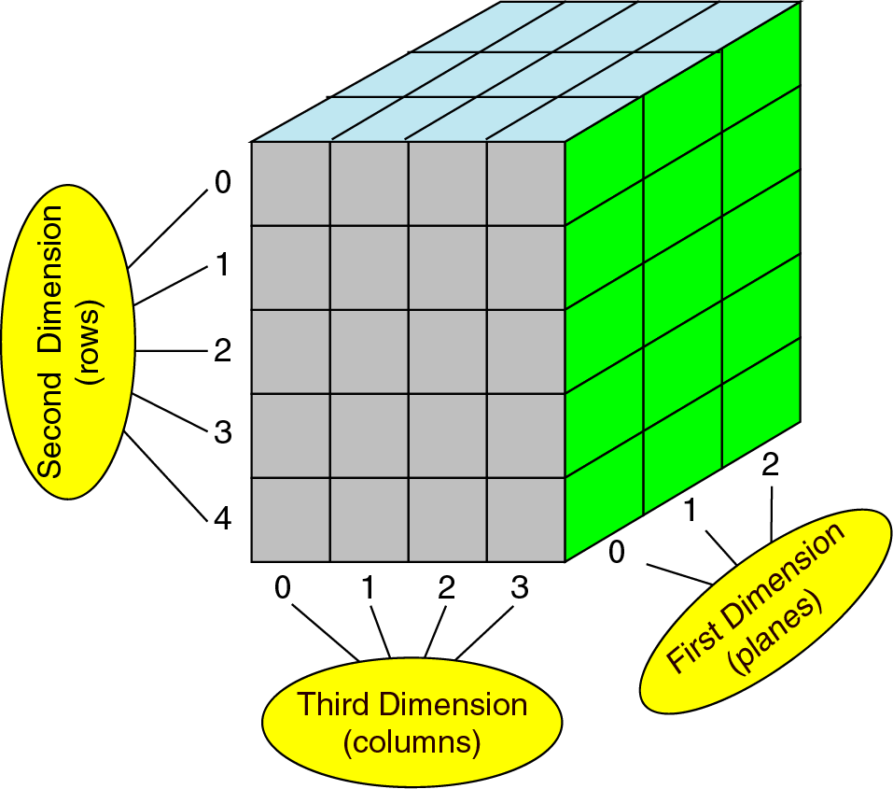
Figure 8-33

Slide 35
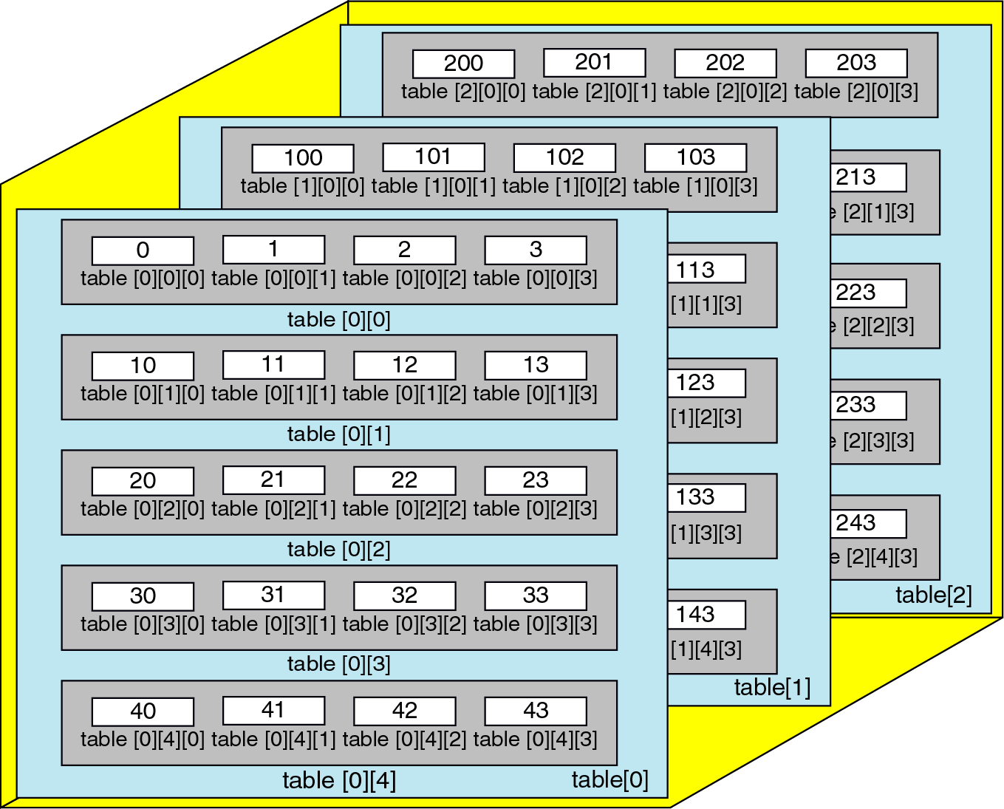
Figure 8-34

Slide 36
Figure 8-35
Int table [3][5][4] =
{
{ // Plane 0
{ 0, 1, 2, 3 } //Row 0
{10, 11, 12, 13 } //Row 1
{20, 21, 22, 23 } //Row 2
{30, 31, 32, 33 } //Row 3
{40, 41, 42, 43 } //Row 4
{ // Plane 1
{100 , 101, 102 , 103 } //Row 0
{110, 111, 112, 113 } //Row 1
{120, 121, 122, 123 } //Row 2
{130, 131, 132, 133 } //Row 3
{140, 141, 142, 143 } //Row 4
{ // Plane 2
{200 , 201, 202 , 203 } //Row 0
{210, 211, 212, 213 } //Row 1
{220, 221, 222, 223 } //Row 2
{230, 231, 232, 233 } //Row 3
{240, 241, 242, 243 } //Row 4
} // table

Slide 37
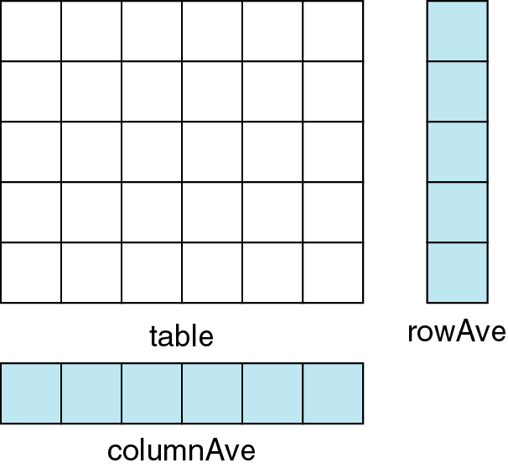
Figure 8-36

Slide 38
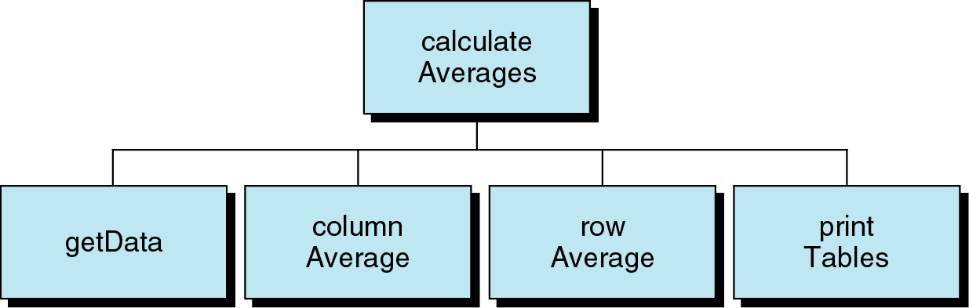
Figure 8-37

Slide 39
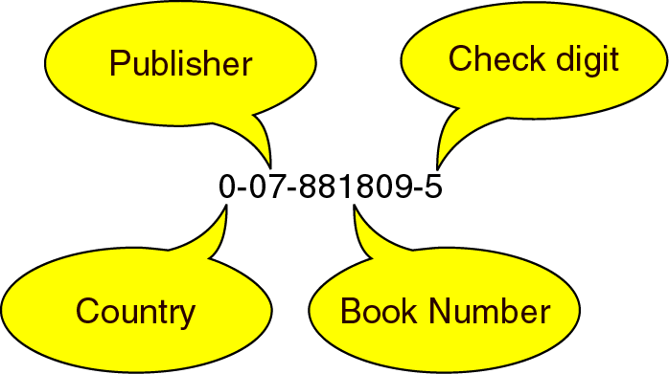
Figure 8-38

Slide 40
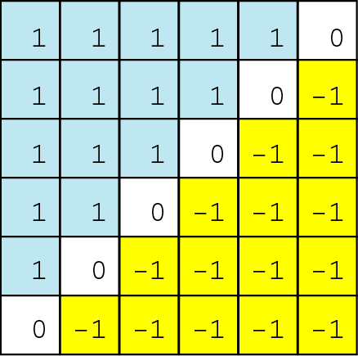
Figure 8-39

Slide 41
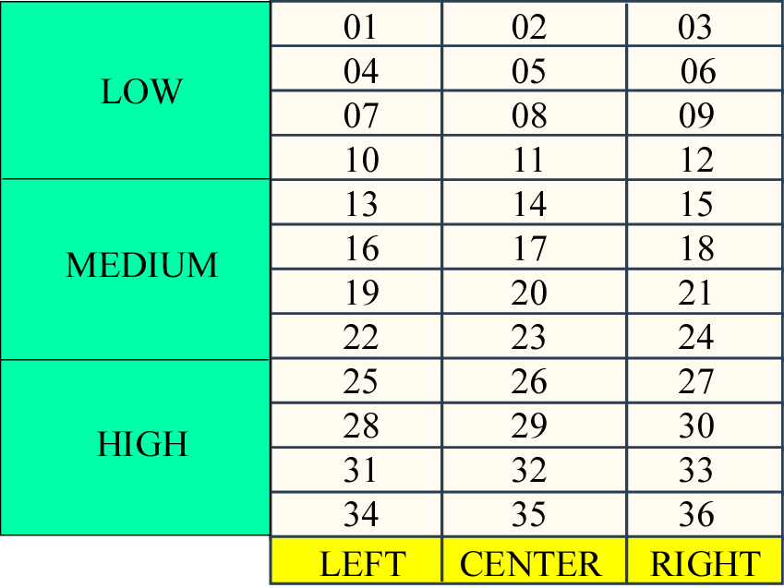
Figure 8-40

