Slide 1
Chapter 9
Pointers

Slide 2
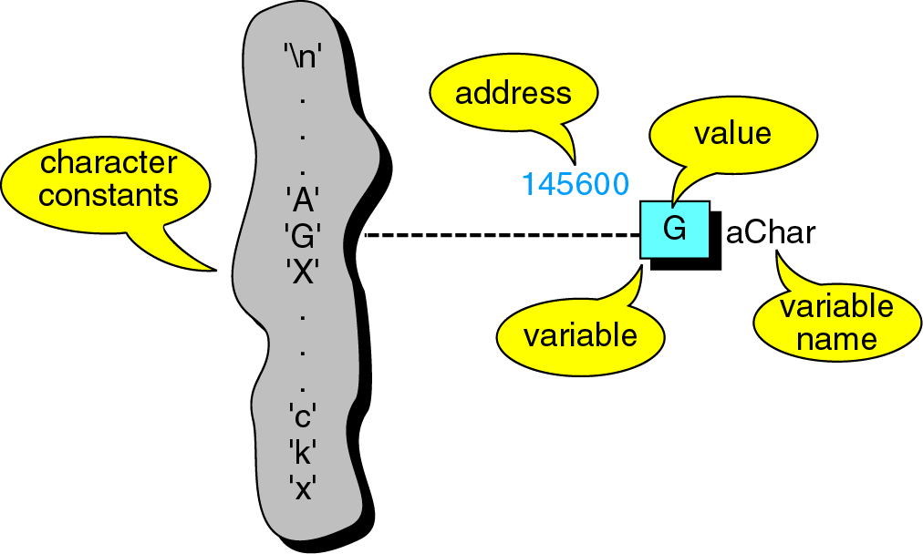
Figure 9-1

Slide 3
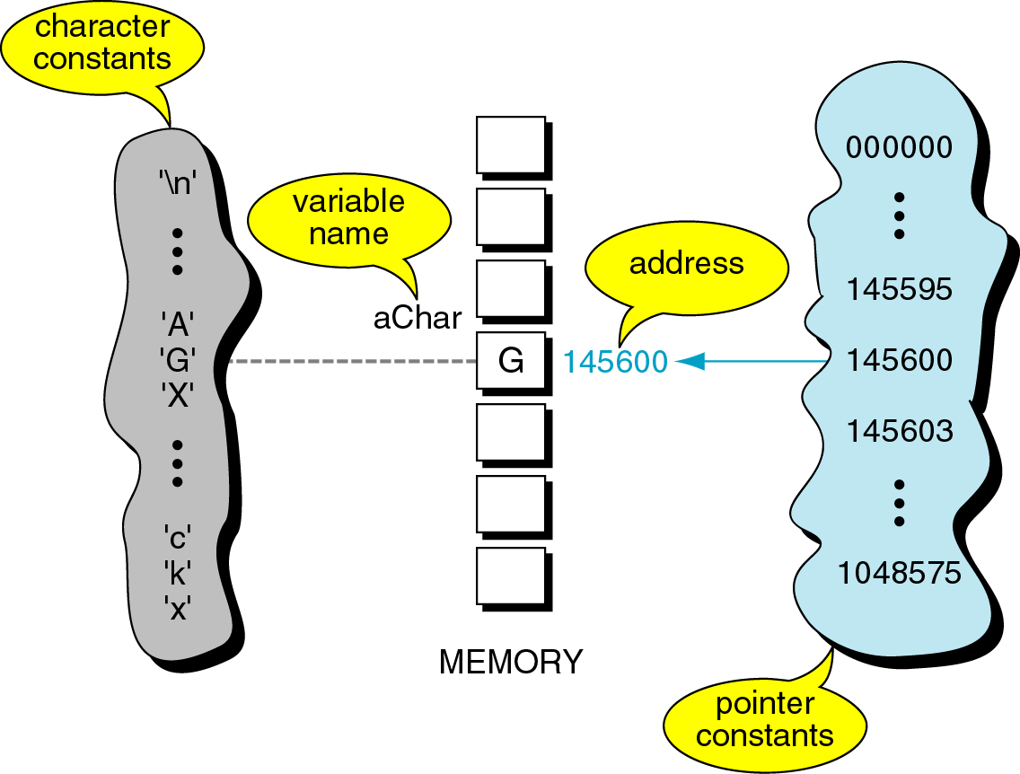
Figure 9-2

Slide 4
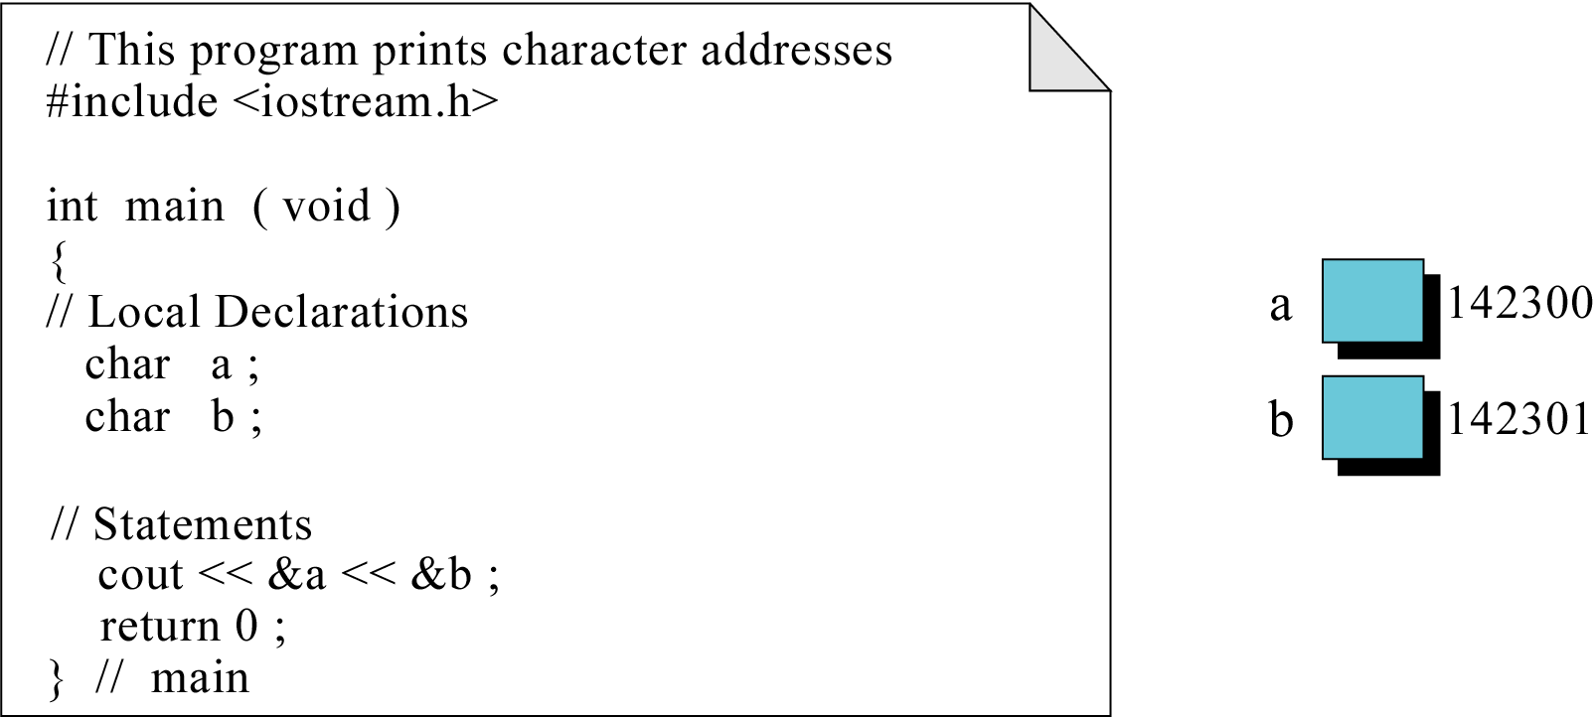
Figure 9-3

Slide 5
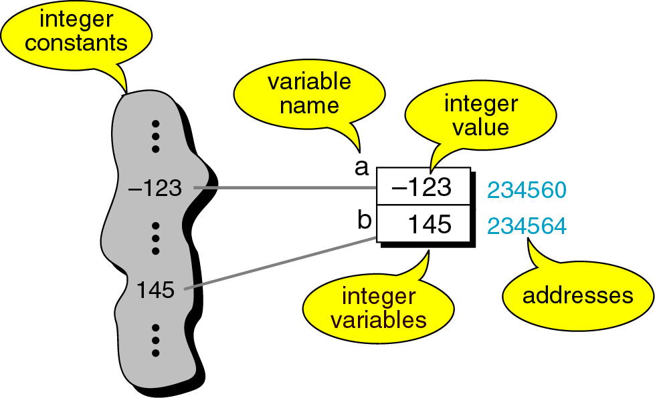
Figure 9-4

Slide 6
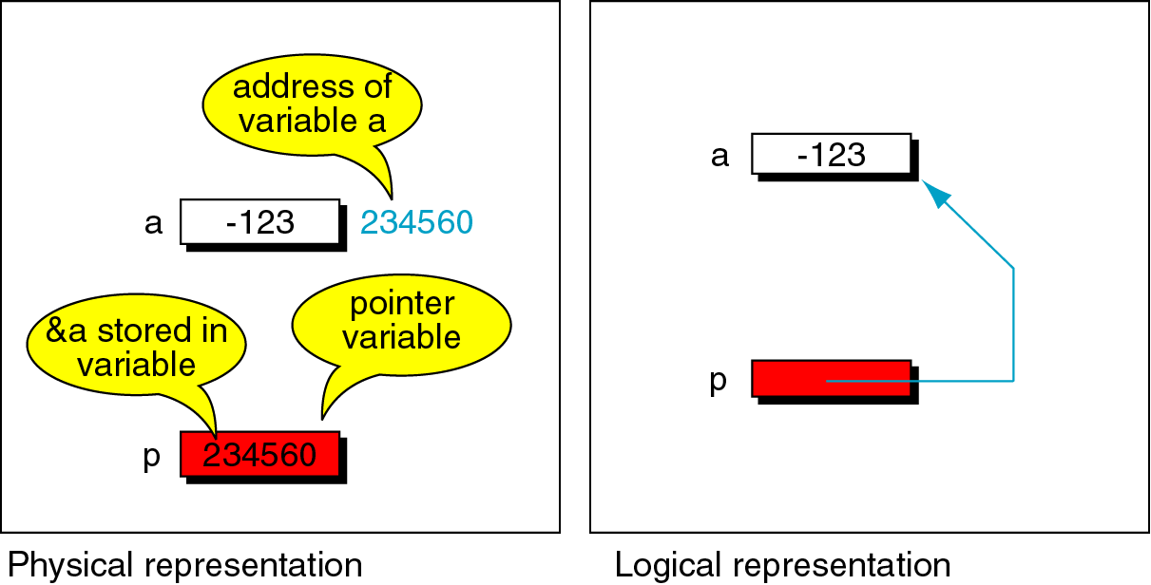
Figure 9-5

Slide 7
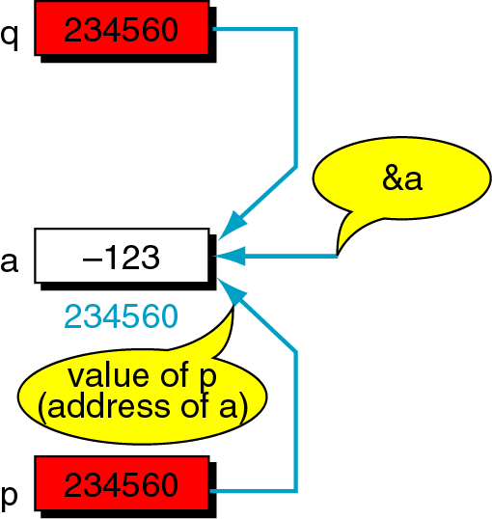
Figure 9-6

Slide 8
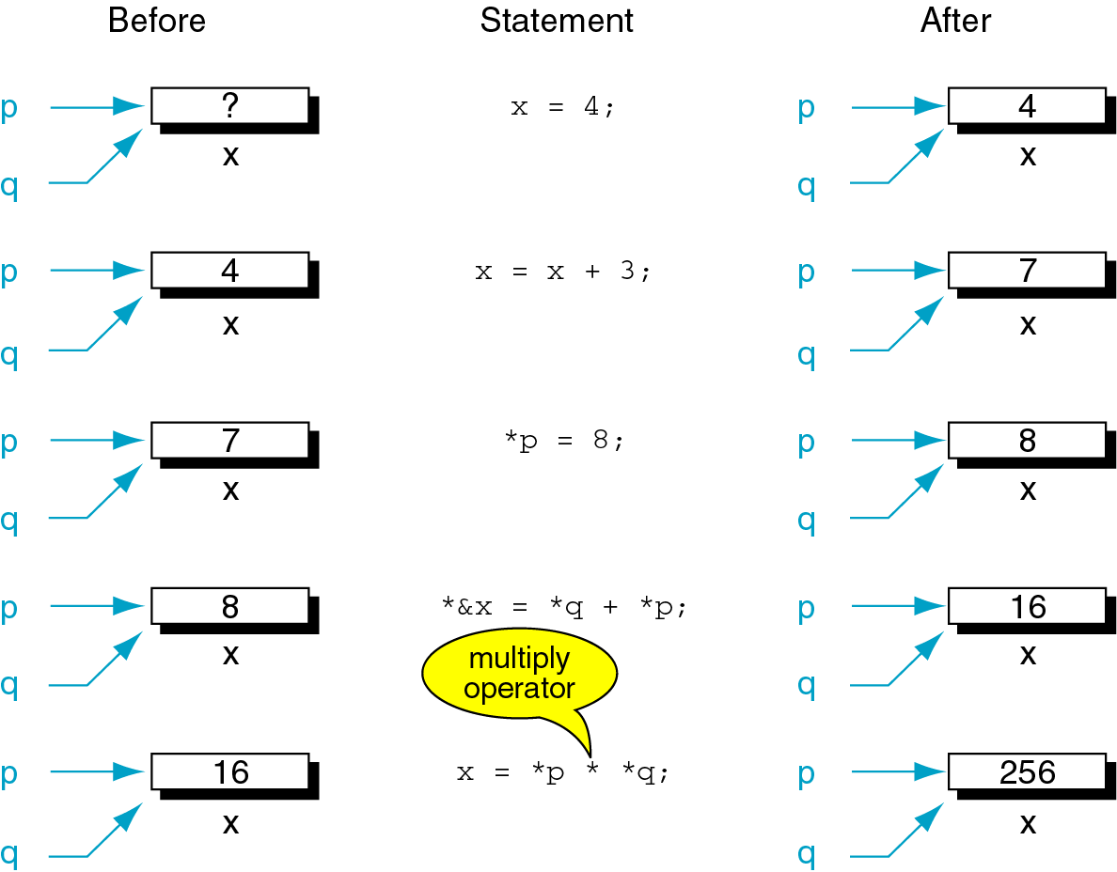
Figure 9-7

Slide 9

Figure 9-8

Slide 10
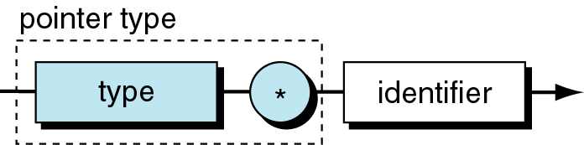
Figure 9-9

Slide 11
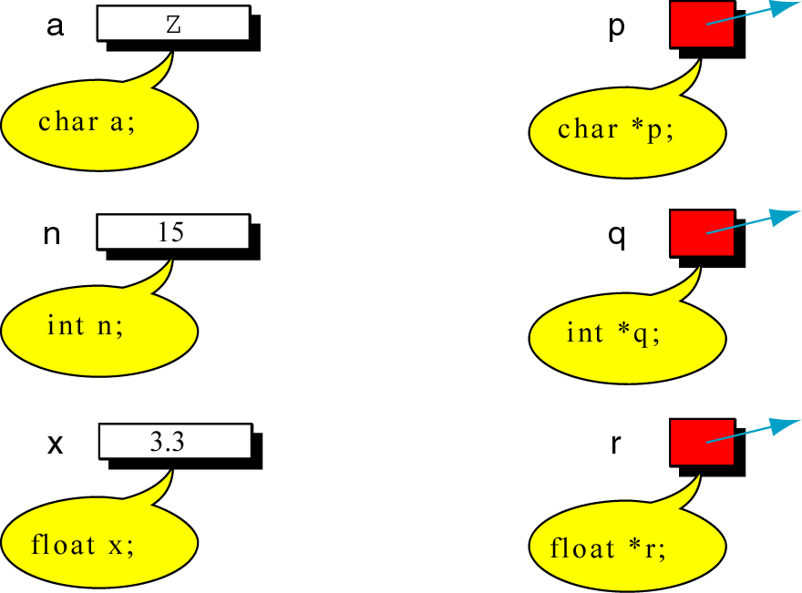
Figure 9-10

Slide 12
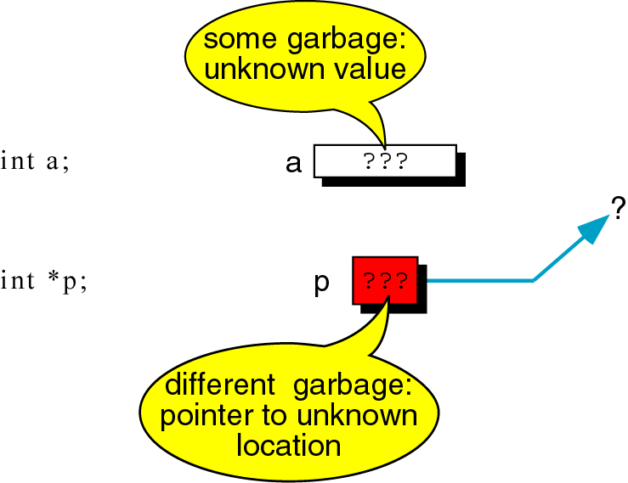
Figure 9-11

Slide 13
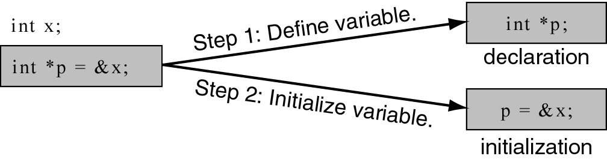
Figure 9-12

Slide 14
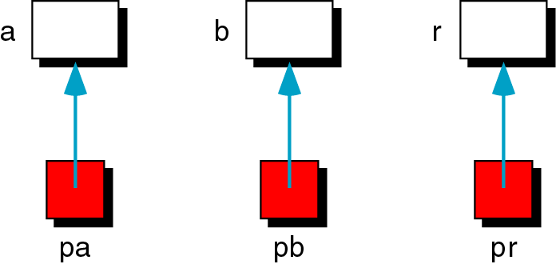
Figure 9-13

Slide 15
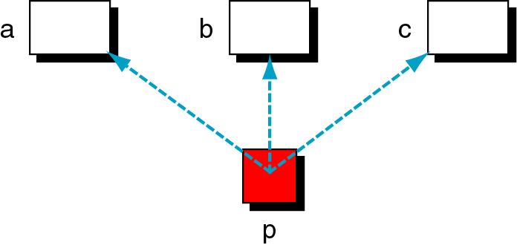
Figure 9-14

Slide 16
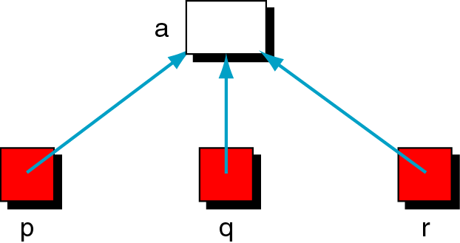
Figure 9-15

Slide 17
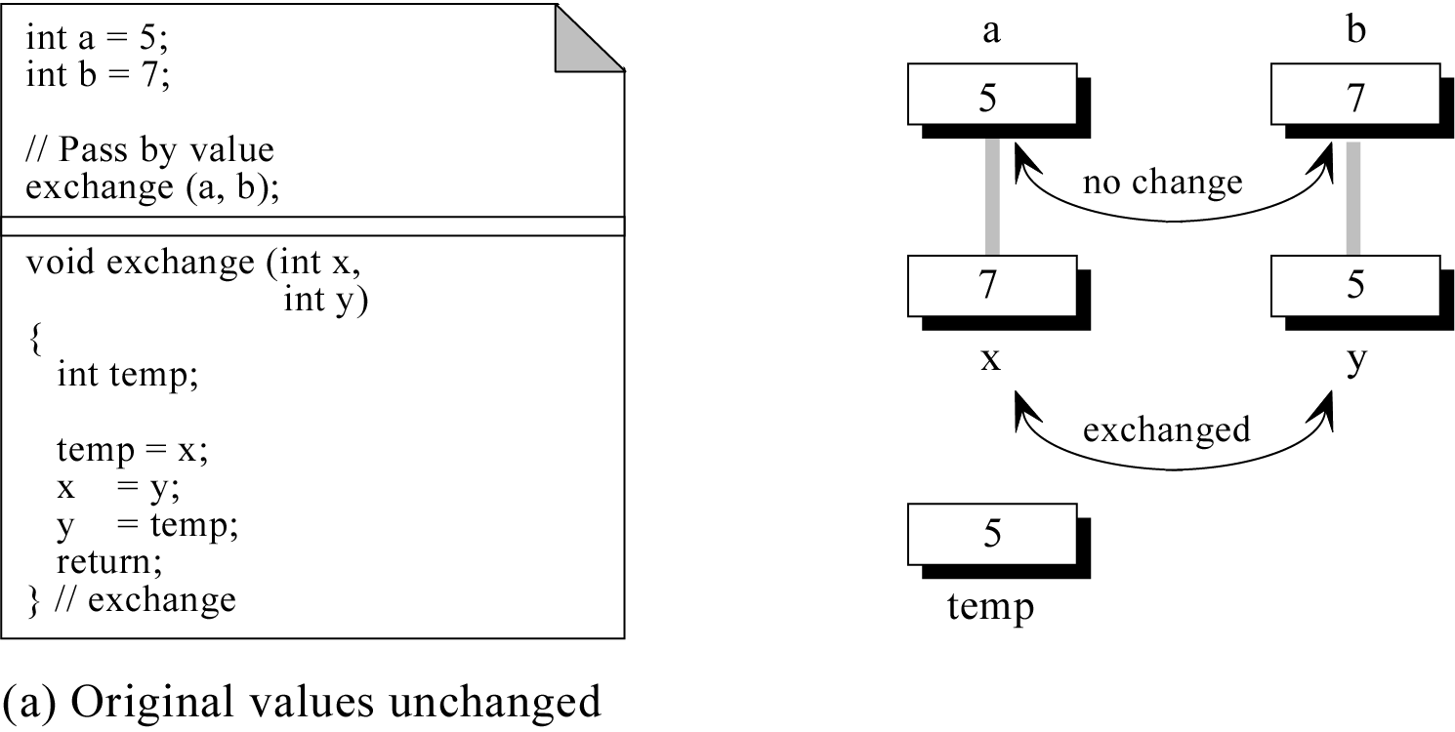
Figure 9-16.a

Slide 18
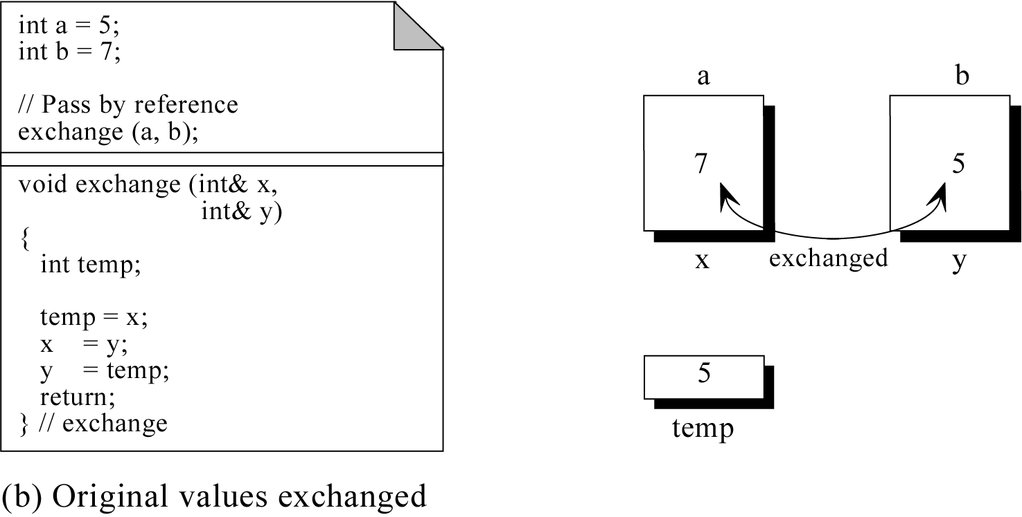
Figure 9-16.b

Slide 19
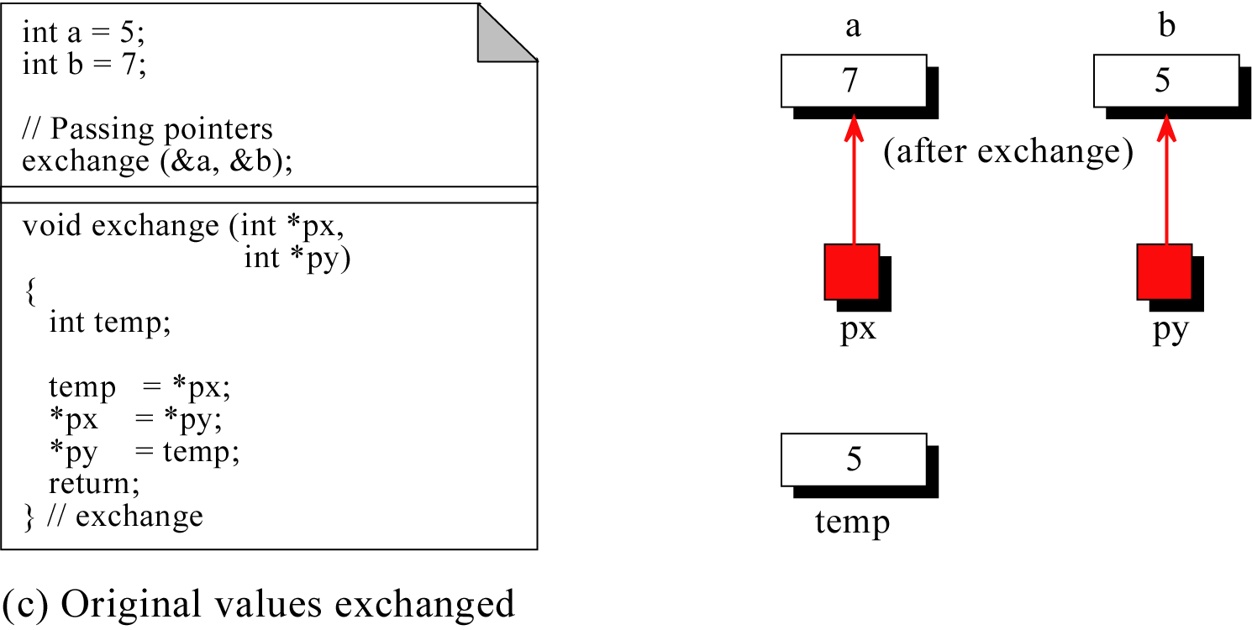
Figure 9-16.c

Slide 20
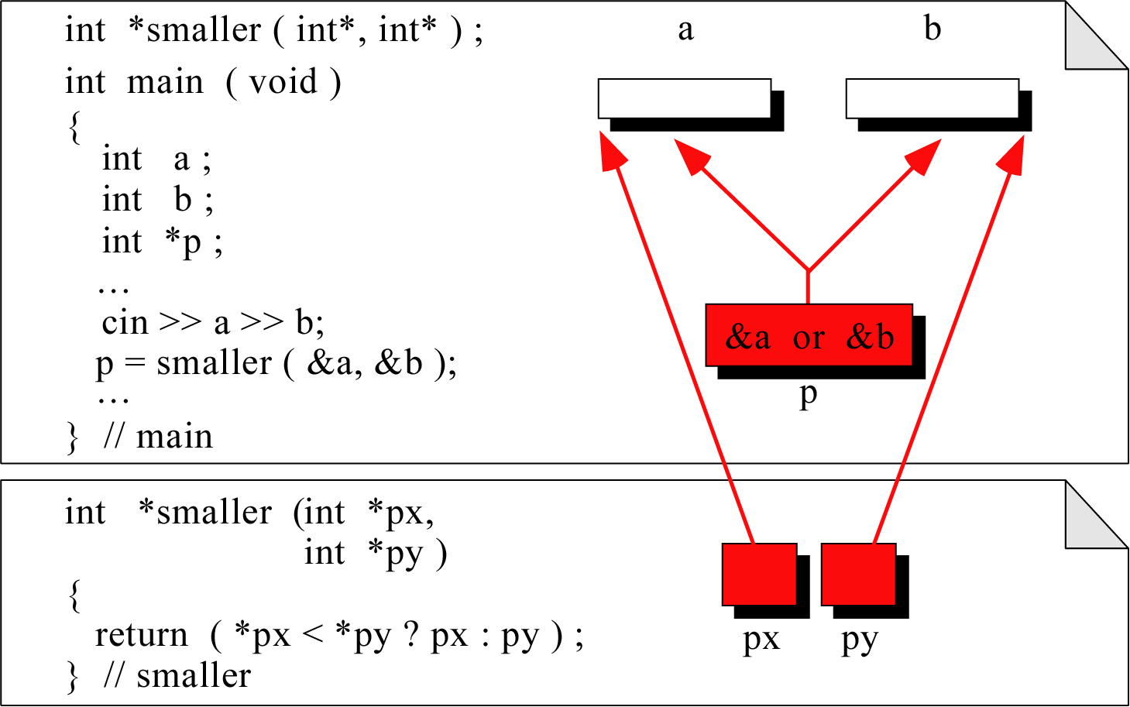
Figure 9-17

Slide 21
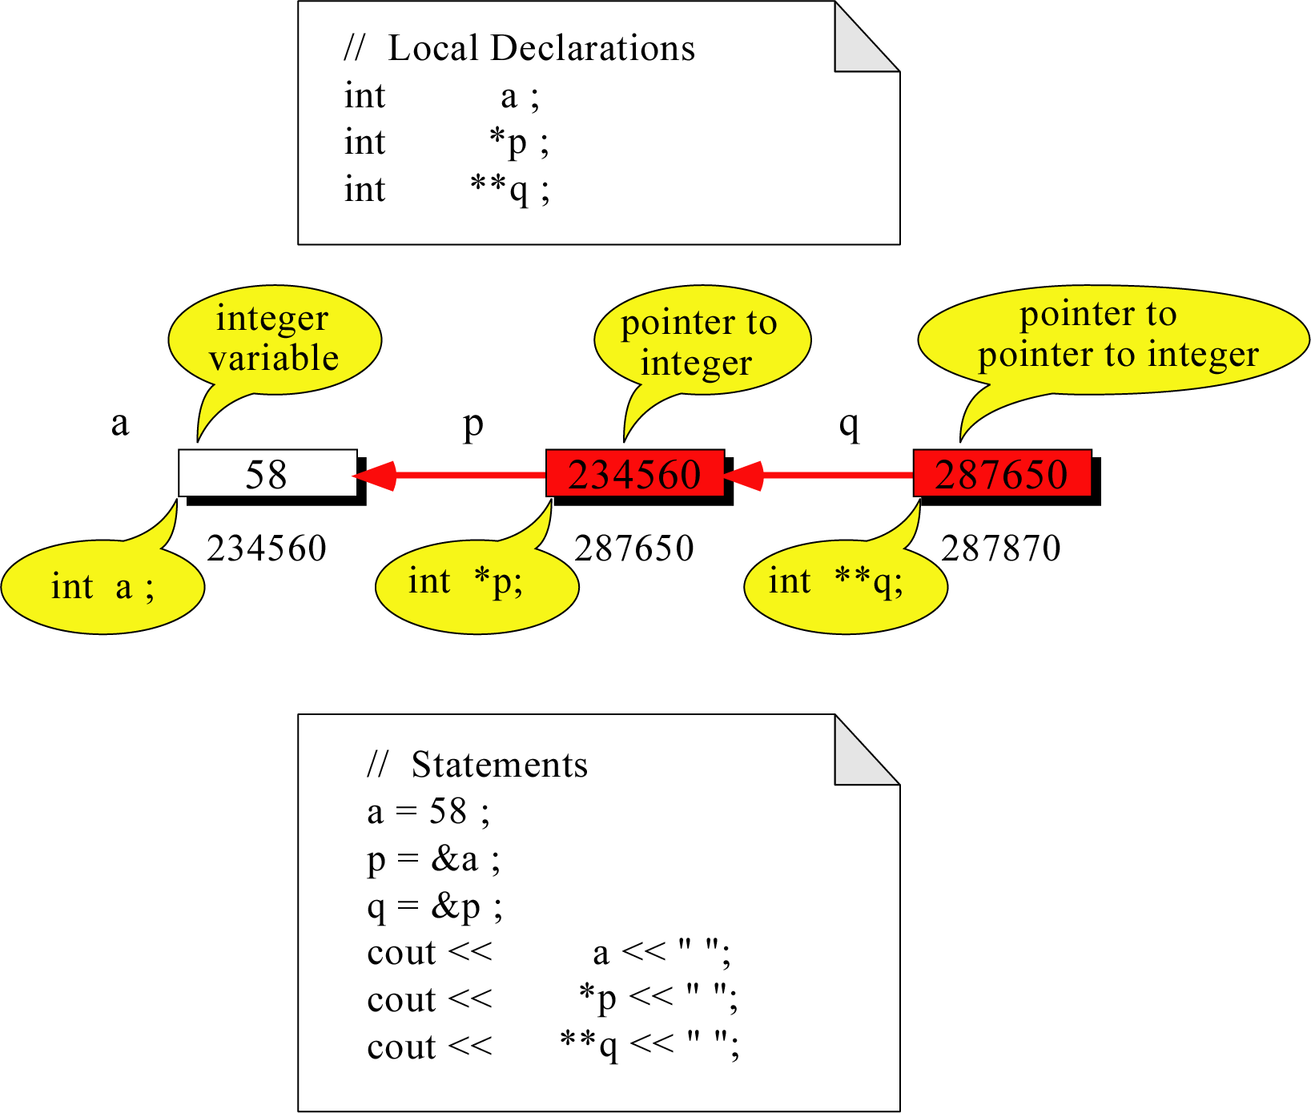
Figure 9-18

Slide 22
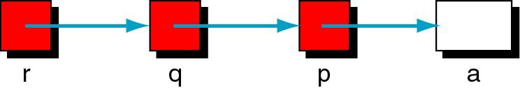
Figure 9-19

Slide 23
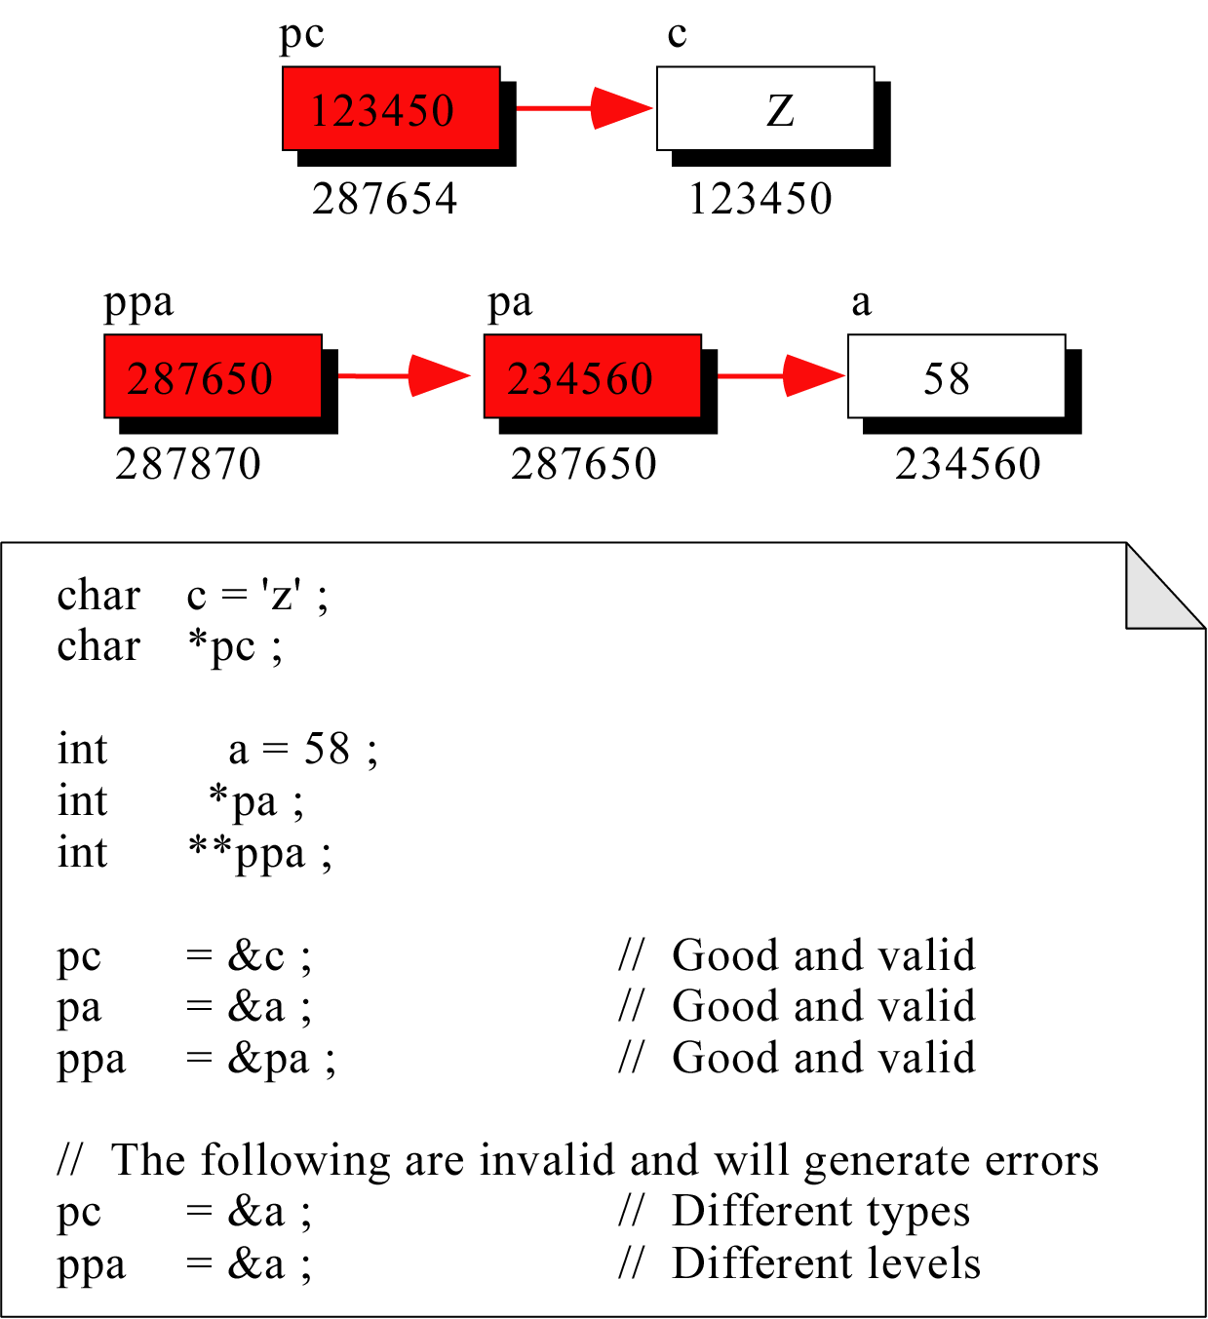
Figure 9-20

Slide 24
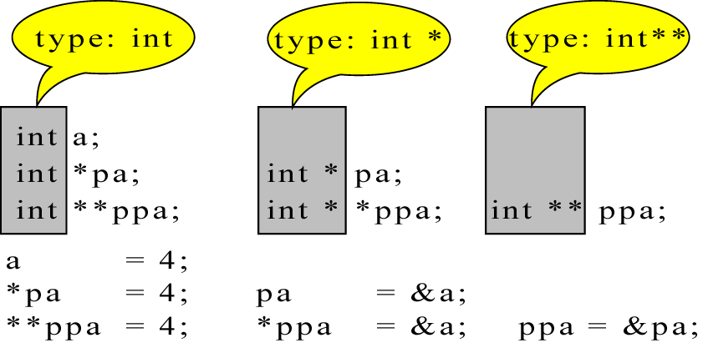
Figure 9-21

Slide 25
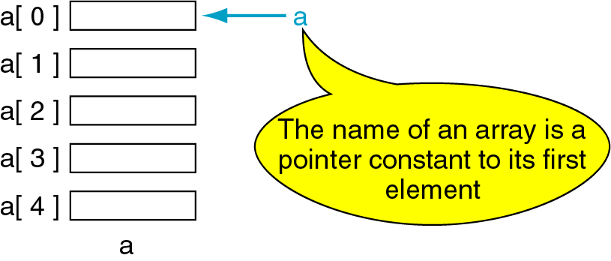
Figure 9-22

Slide 26
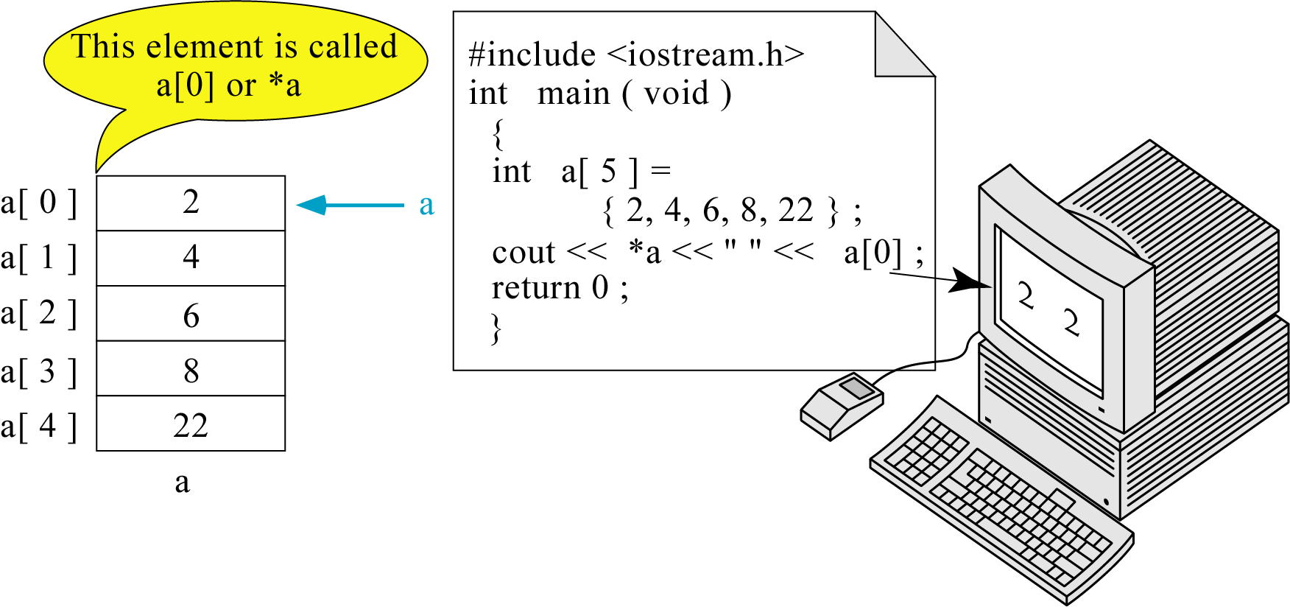
Figure 9-23

Slide 27
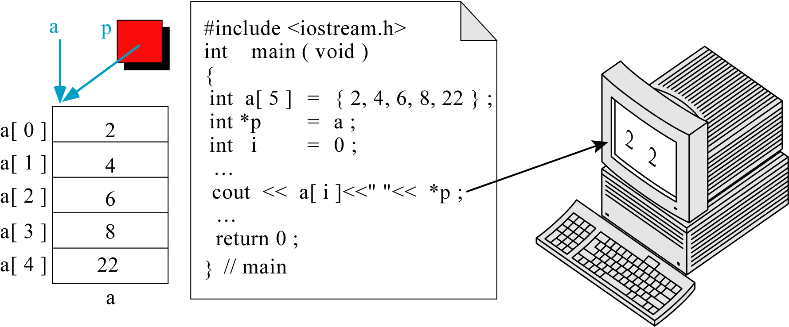
Figure 9-24

Slide 28
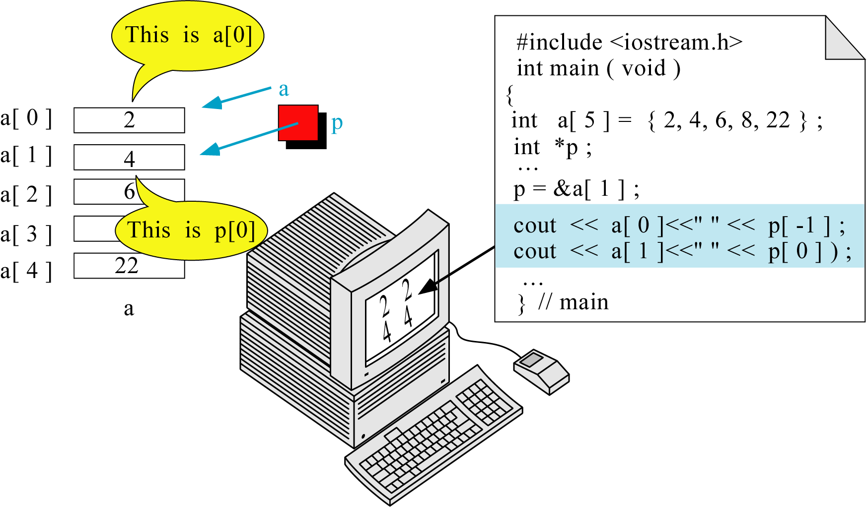
Figure 9-25

Slide 29
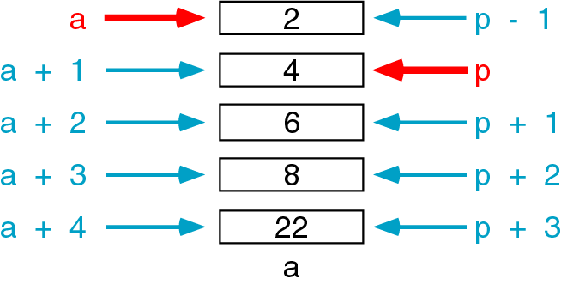
Figure 9-26

Slide 30
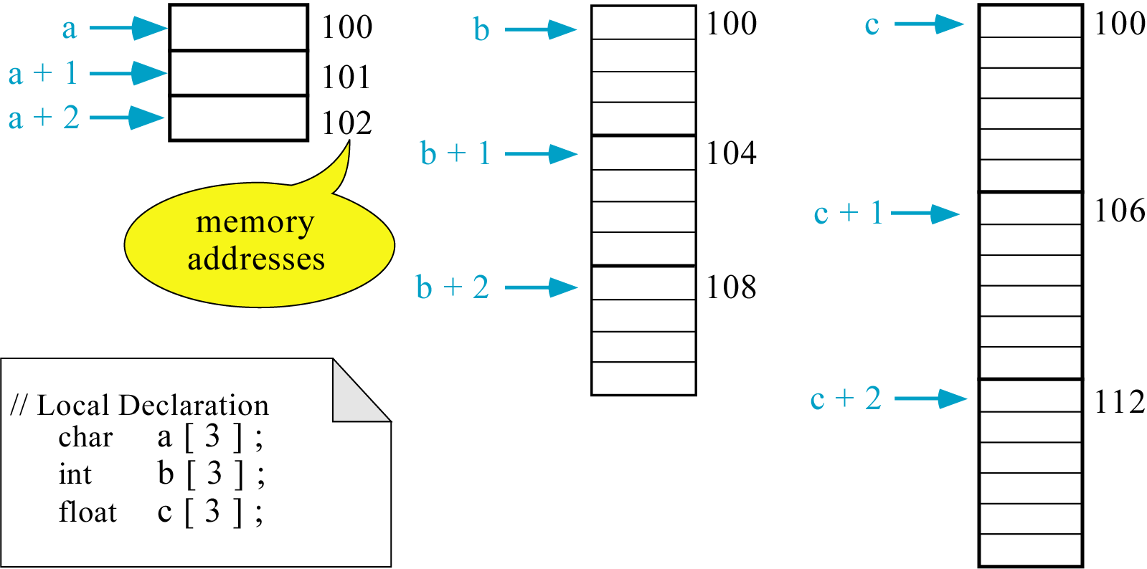
Figure 9-27

Slide 31
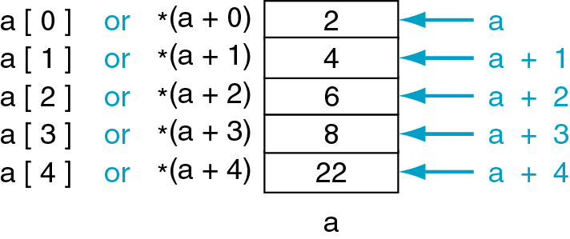
Figure 9-28
*(a+n) is identical to a(n)

Slide 32
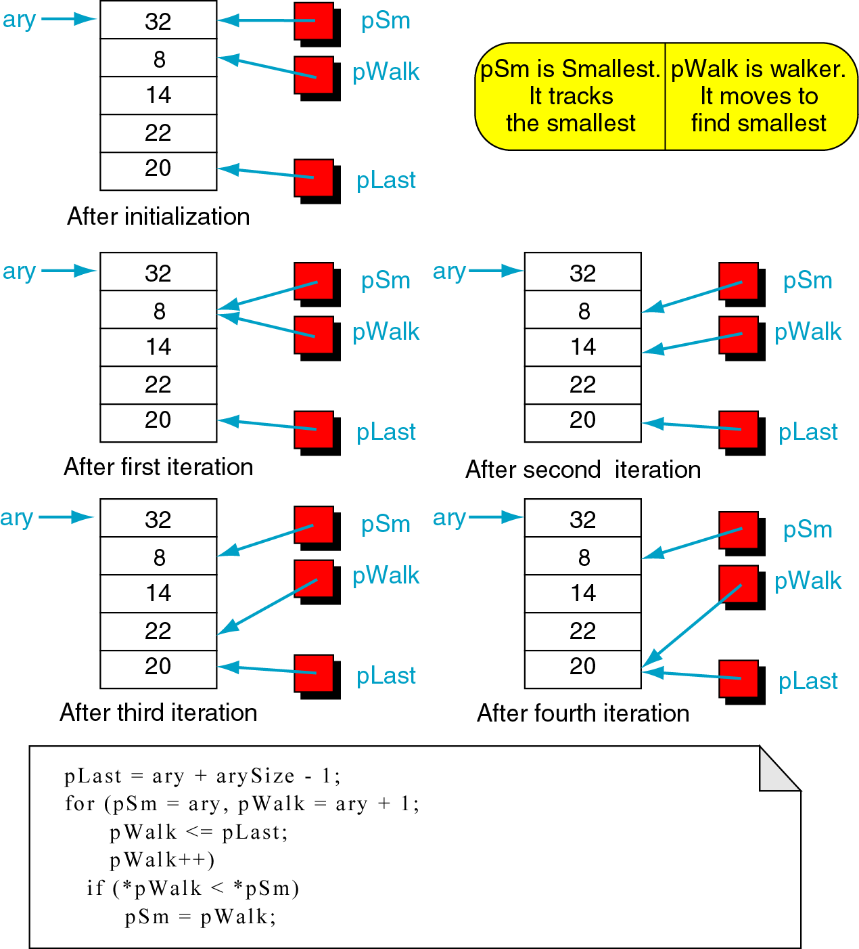
Figure 9-29

Slide 33
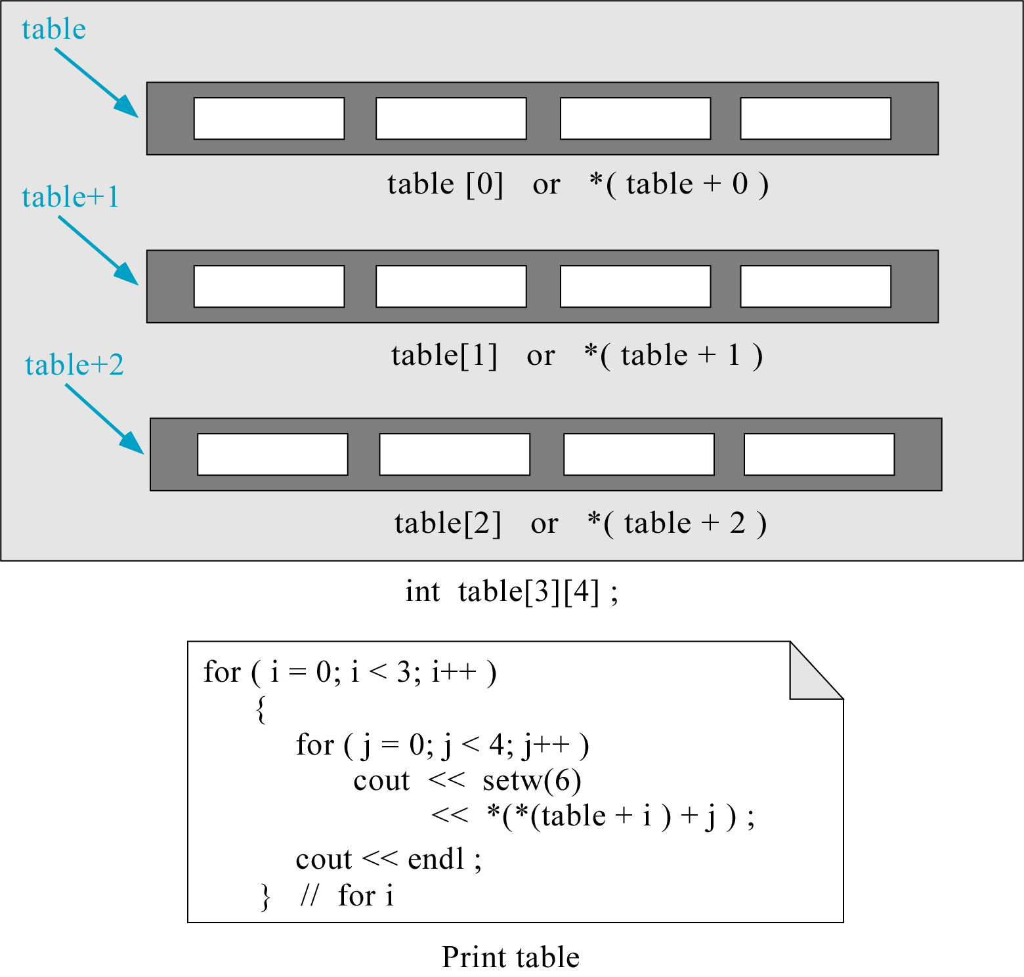
Figure 9-30

Slide 34
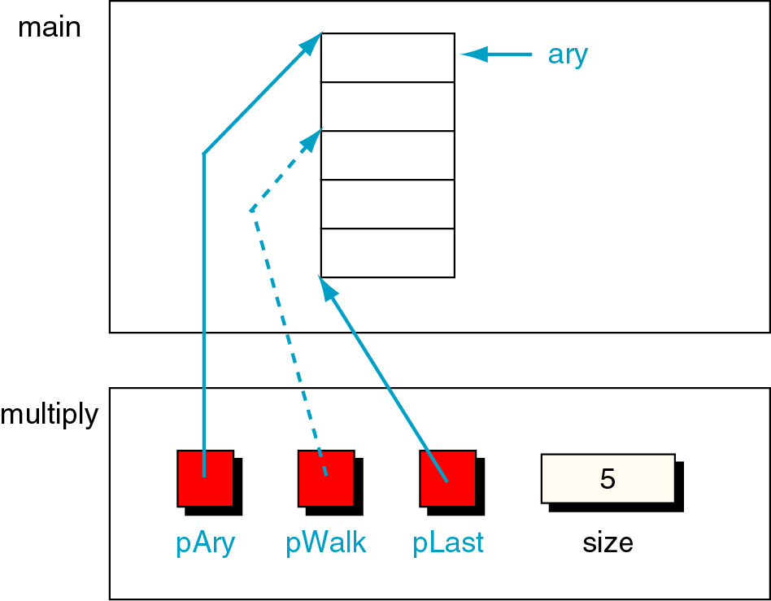
Figure 9-31

Slide 35
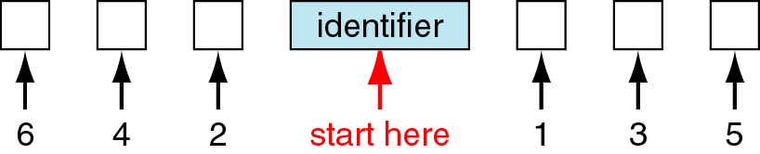
Figure 9-32

Slide 36
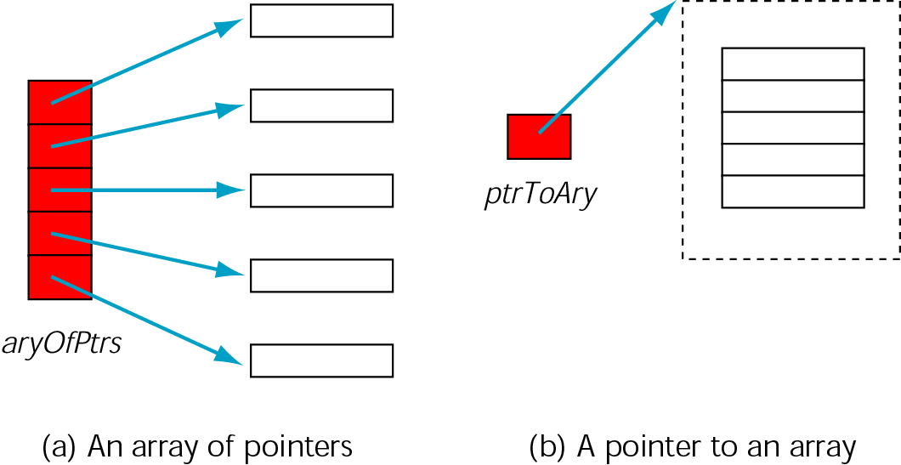
Figure 9-33

Slide 37
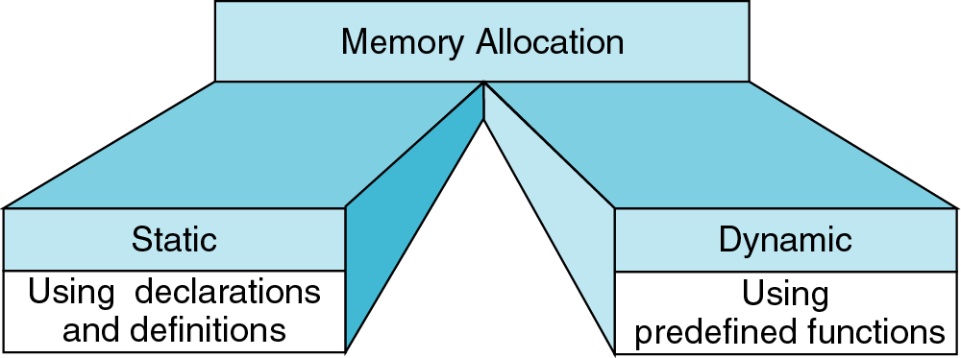
Figure 9-34

Slide 38
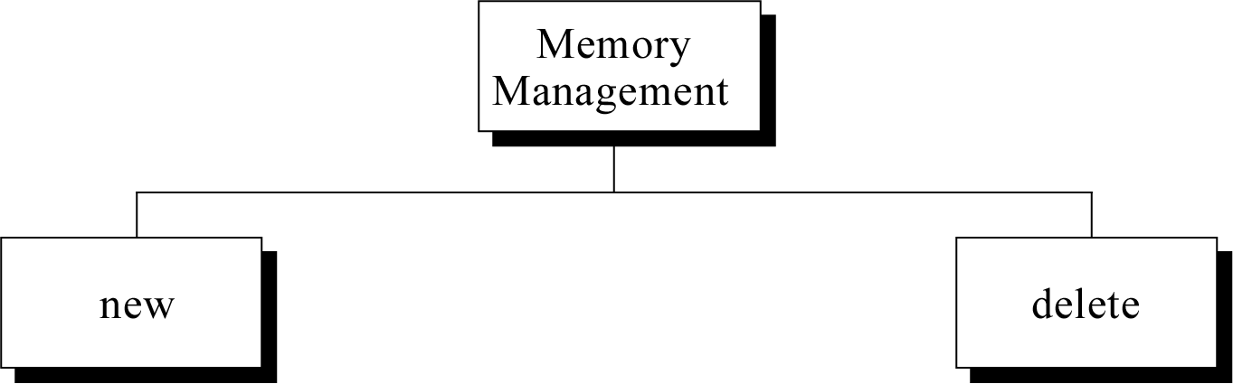
Figure 9-35

Slide 39
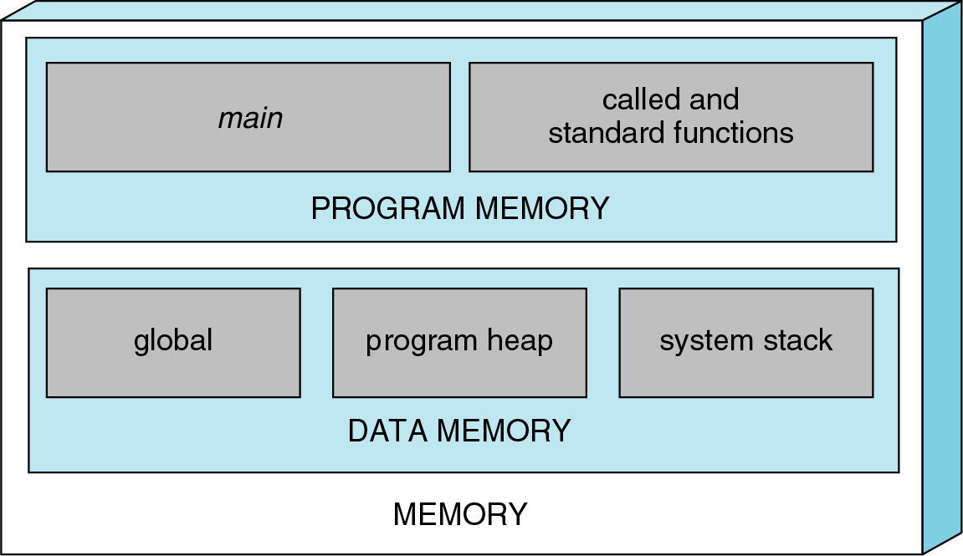
Figure 9-36

Slide 40
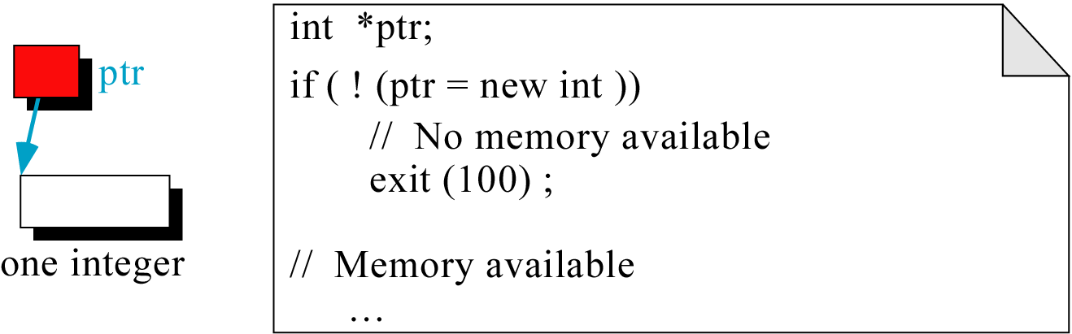
Figure 9-37

Slide 41
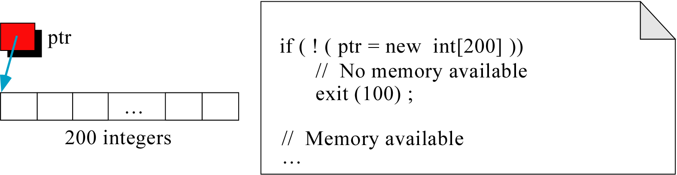
Figure 9-38

Slide 42
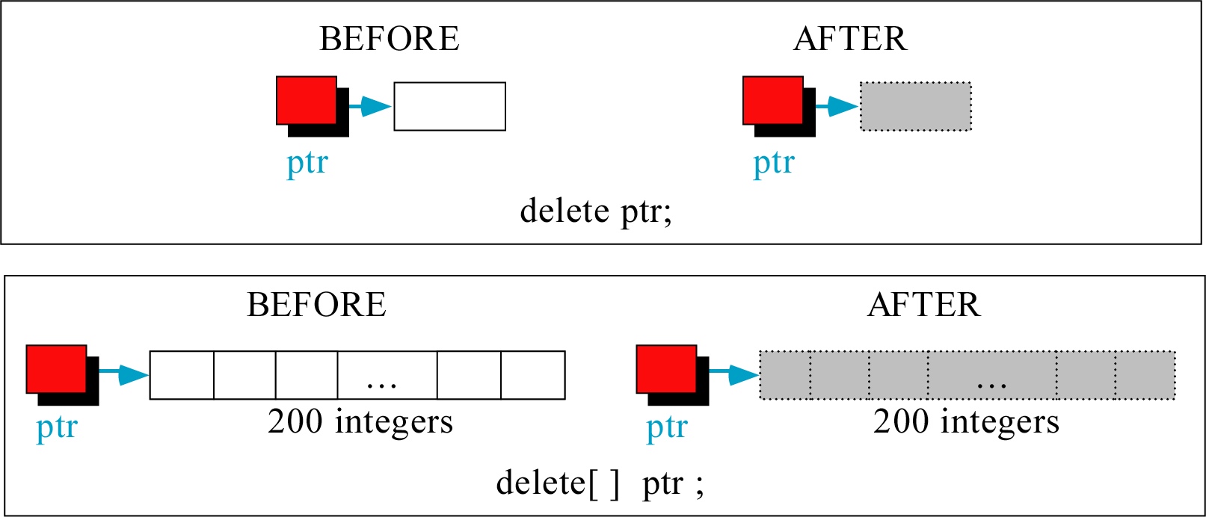
Figure 9-39

Slide 43
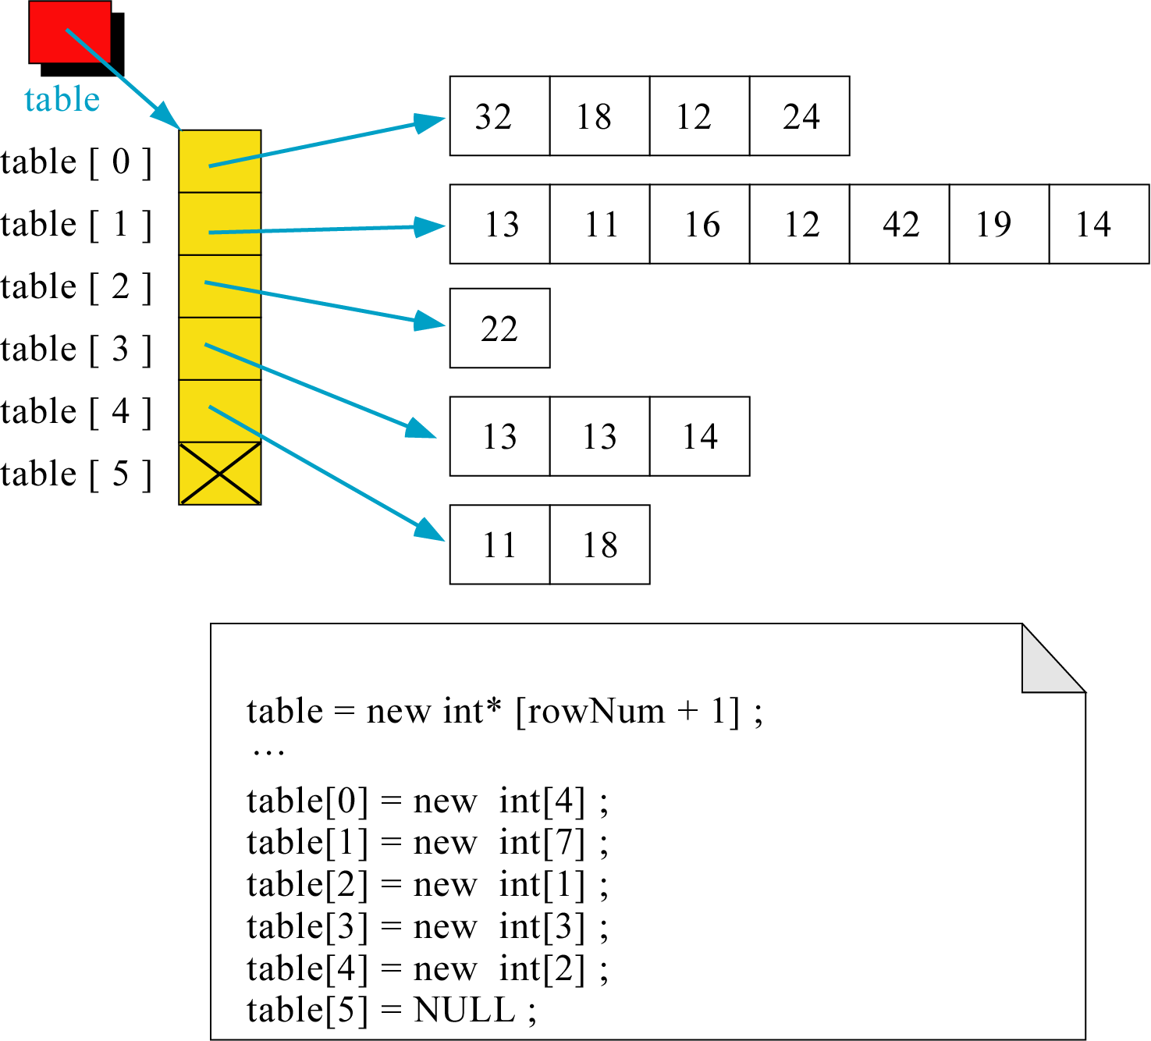
Figure 9-40

Slide 44
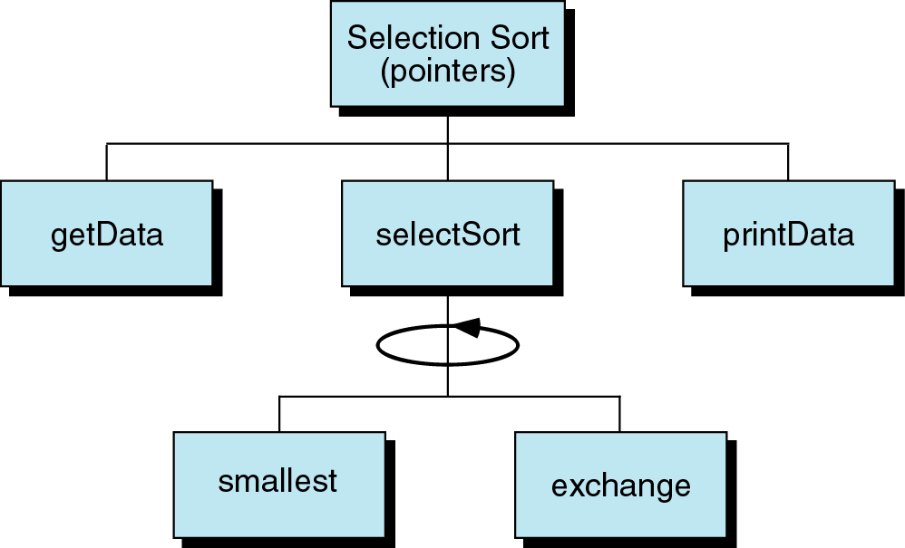
Figure 9-41

Slide 45
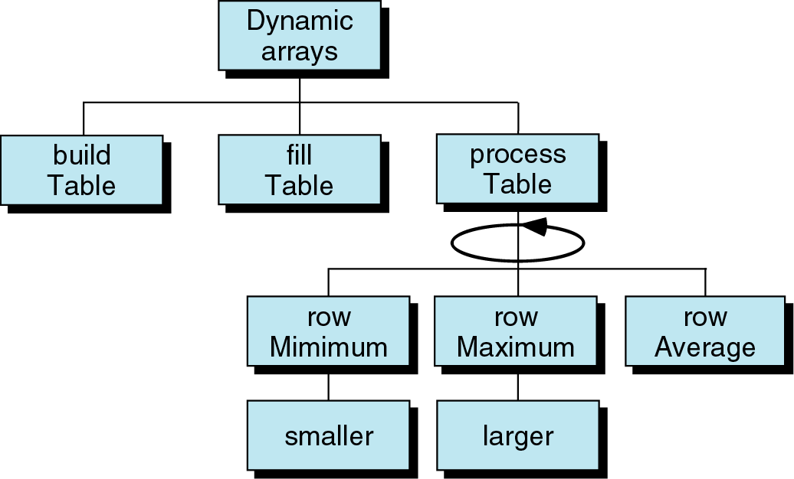
Figure 9-42

Slide 46
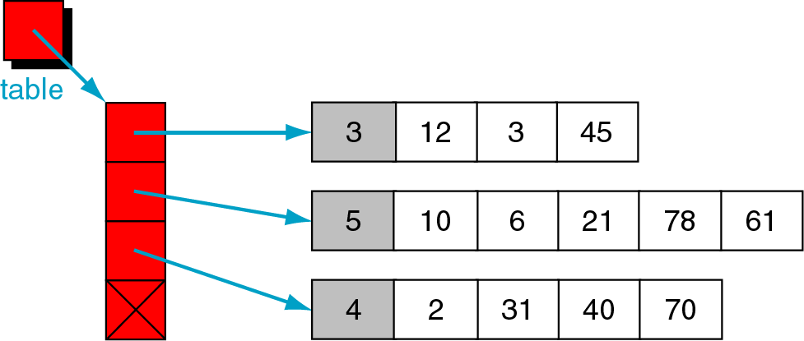
Figure 9-43

Slide 47
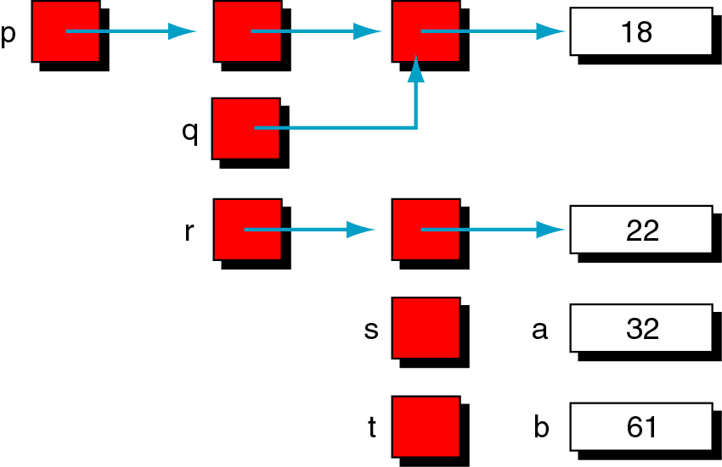
Figure 9-44

Slide 48
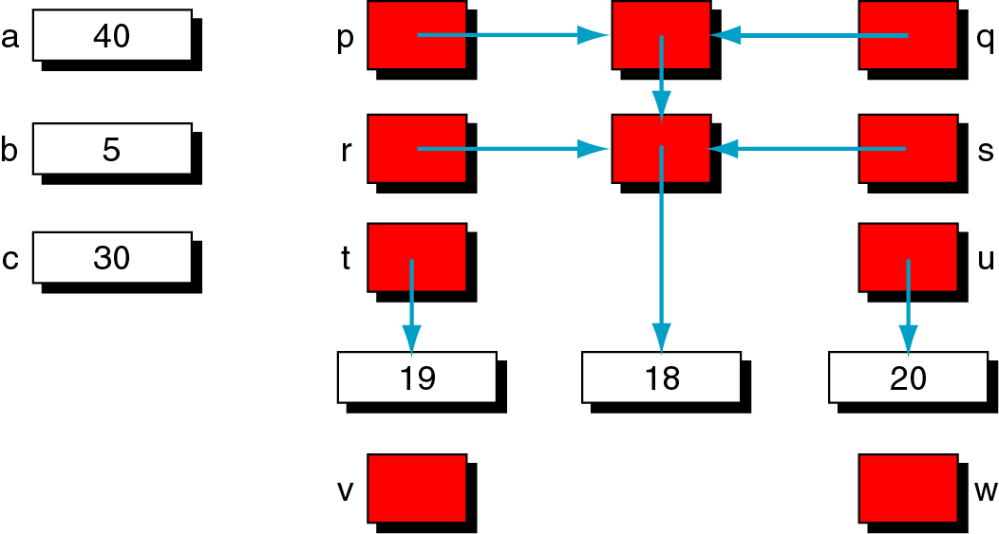
Figure 9-45

Slide 49
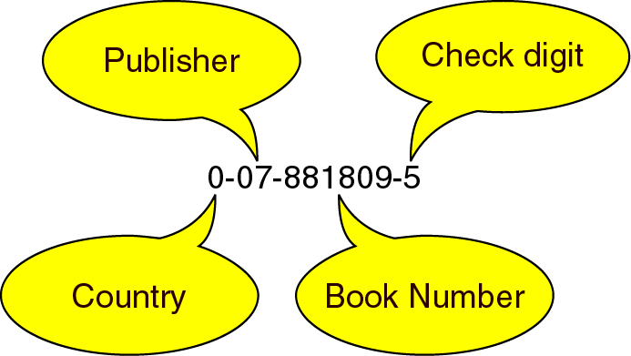
Figure 9-46

Slide 50
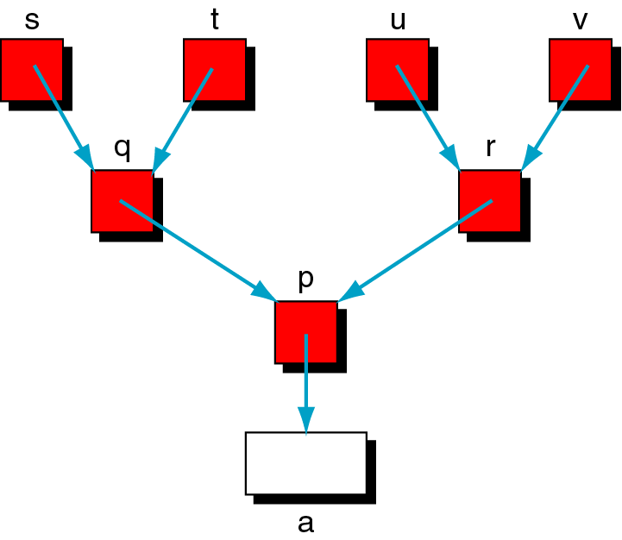
Figure 9-47

Slide 51
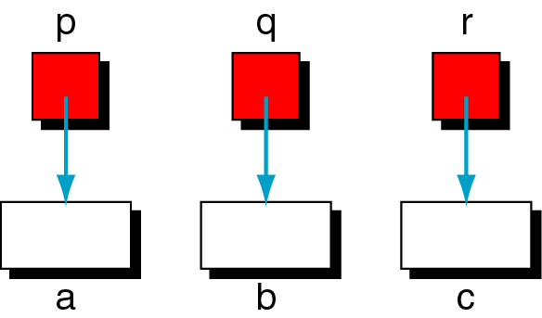
Figure 9-48

Slide 52
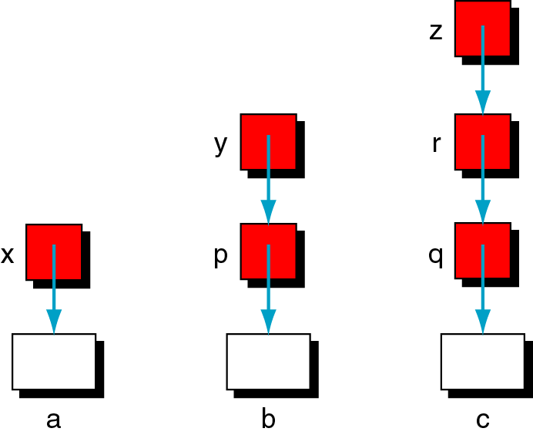
Figure 9-49

Slide 53

Figure 9-50

