Slide 1
Chapter 10
Derived Types--
Enumerated,
Structure
and Union

Slide 2
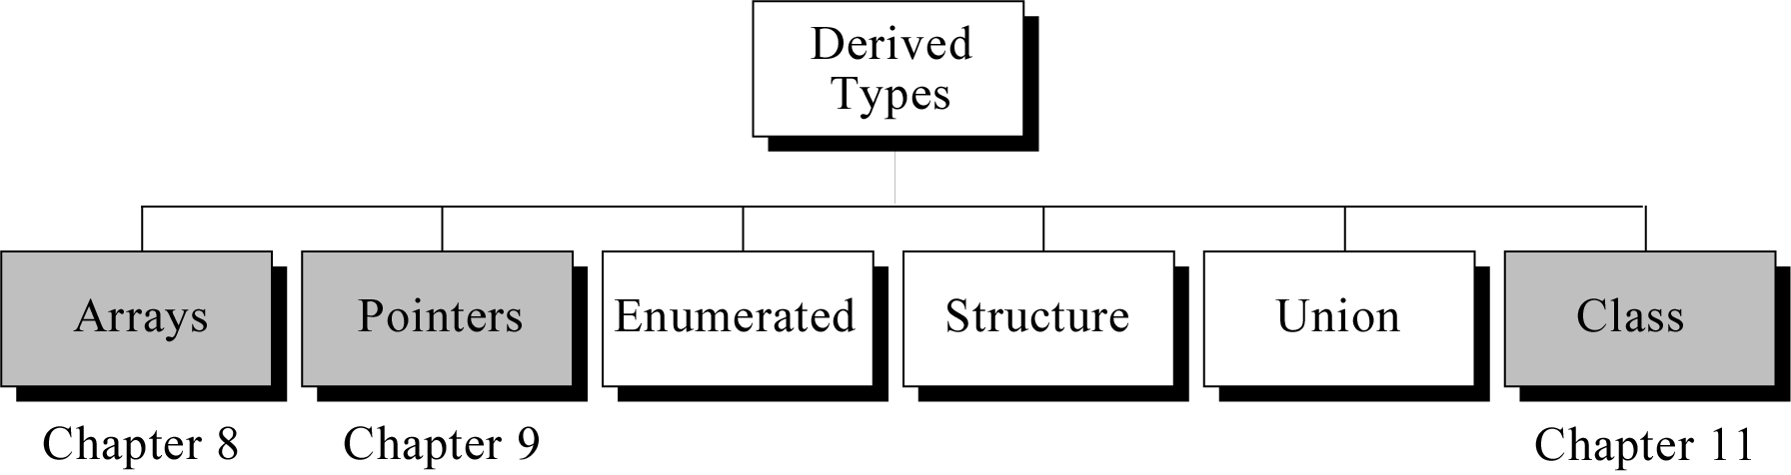
Figure 10-1

Slide 3
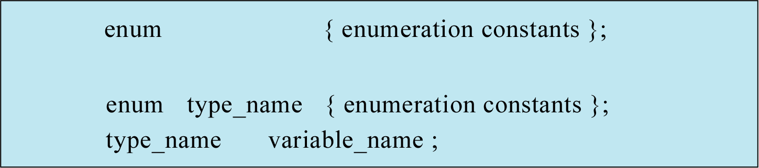
Figure 10-2

Slide 4
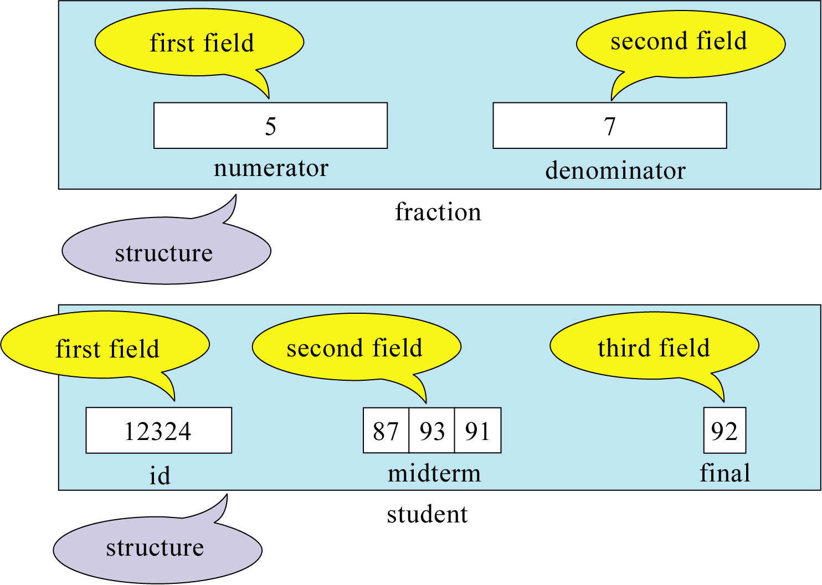
Figure 10-3

Slide 5
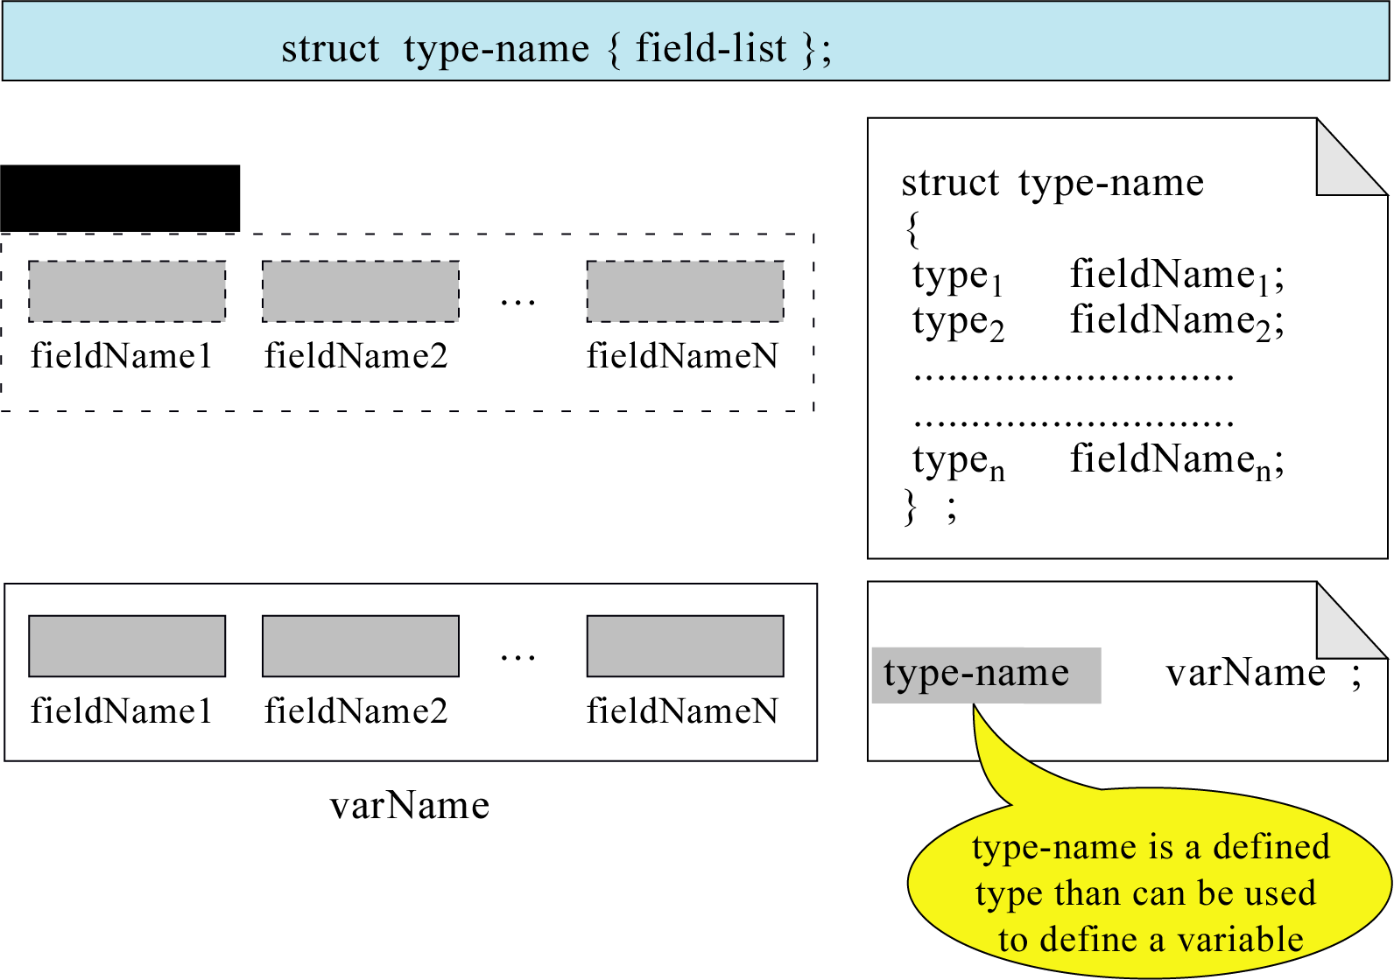
Figure 10-4

Slide 6
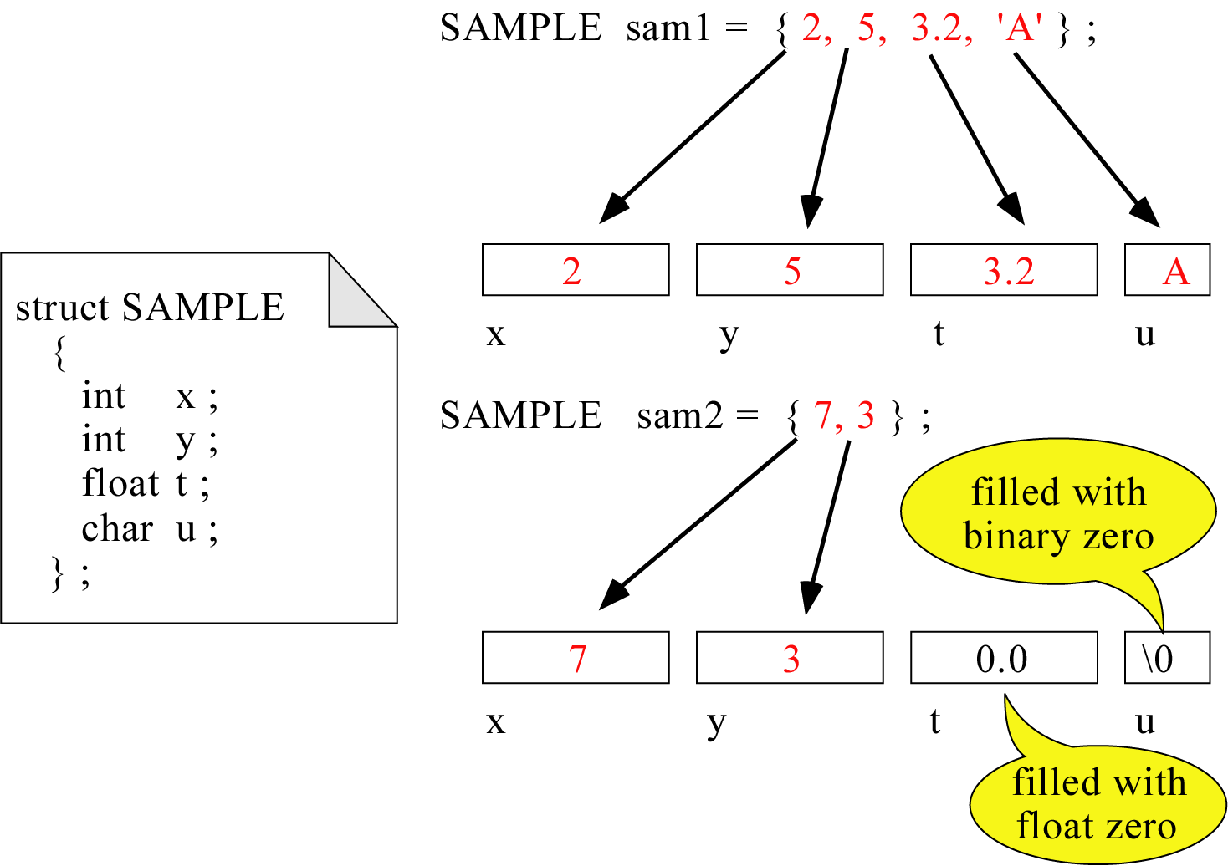
Figure 10-5

Slide 7
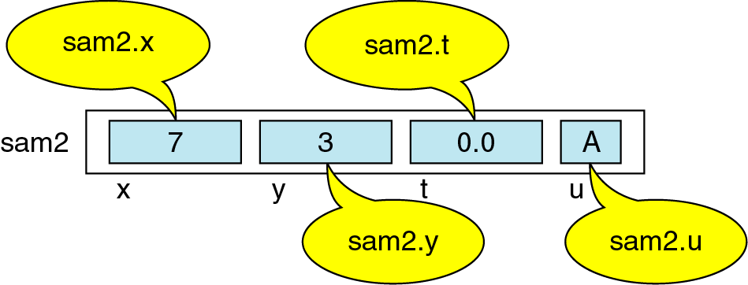
Figure 10-6

Slide 8
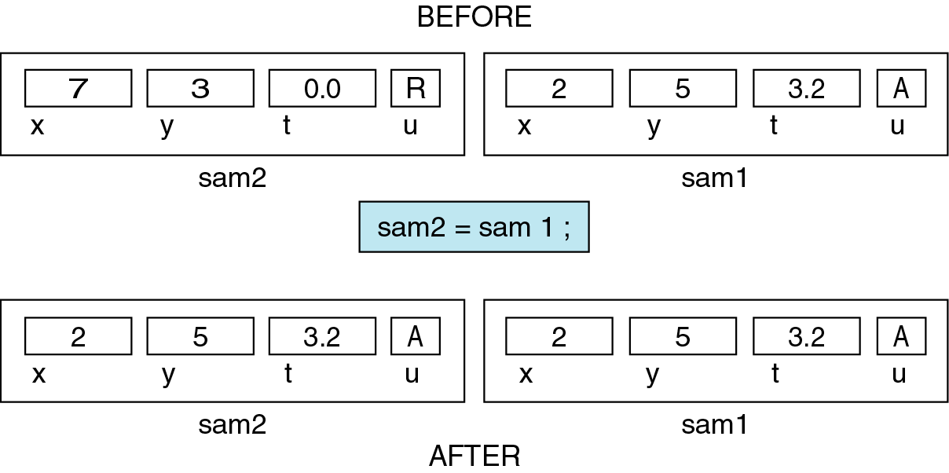
Figure 10-7

Slide 9
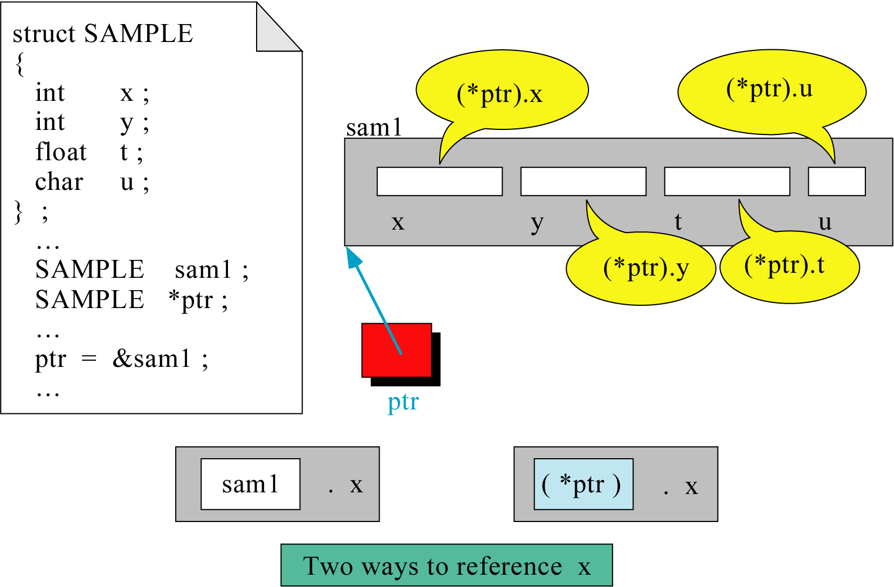
Figure 10-8

Slide 10
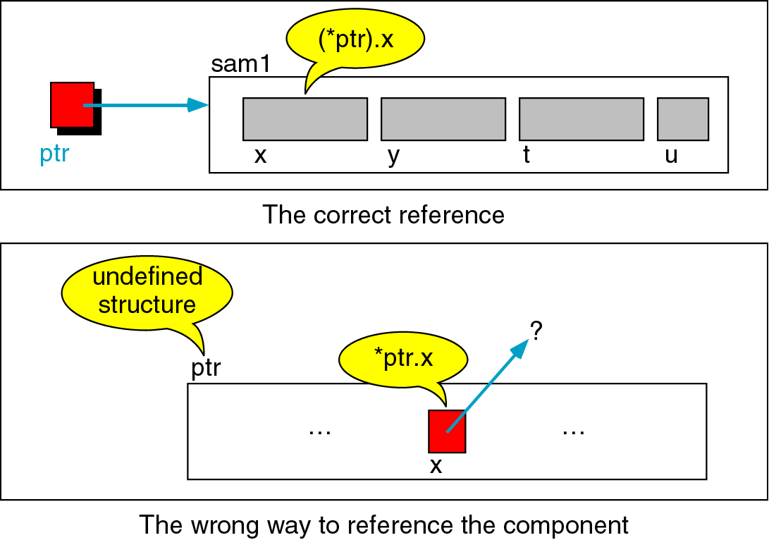
Figure 10-9

Slide 11
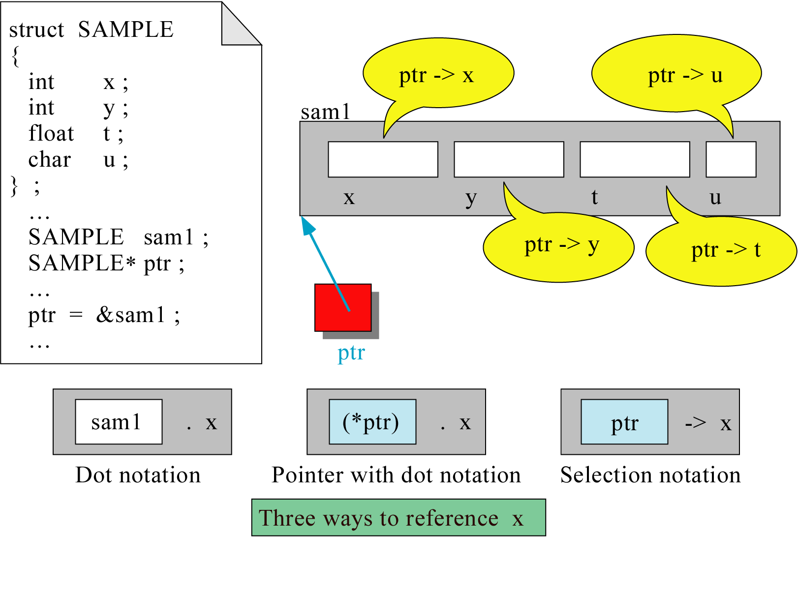
Figure 10-10

Slide 12
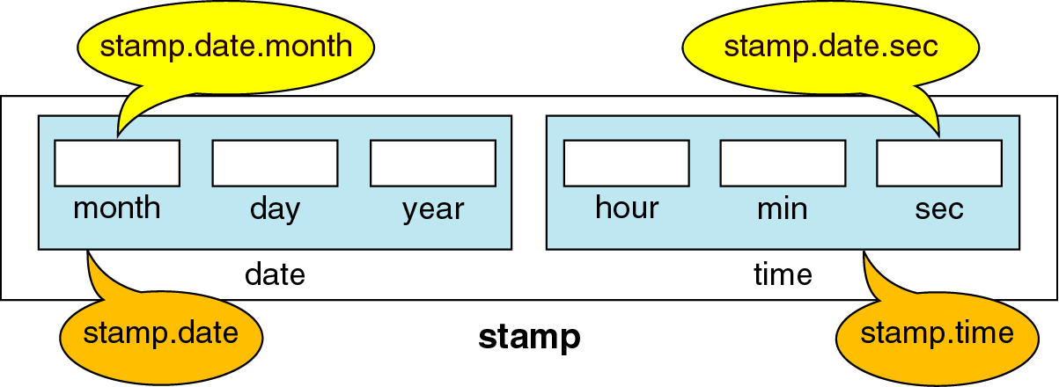
Figure 10-11

Slide 13
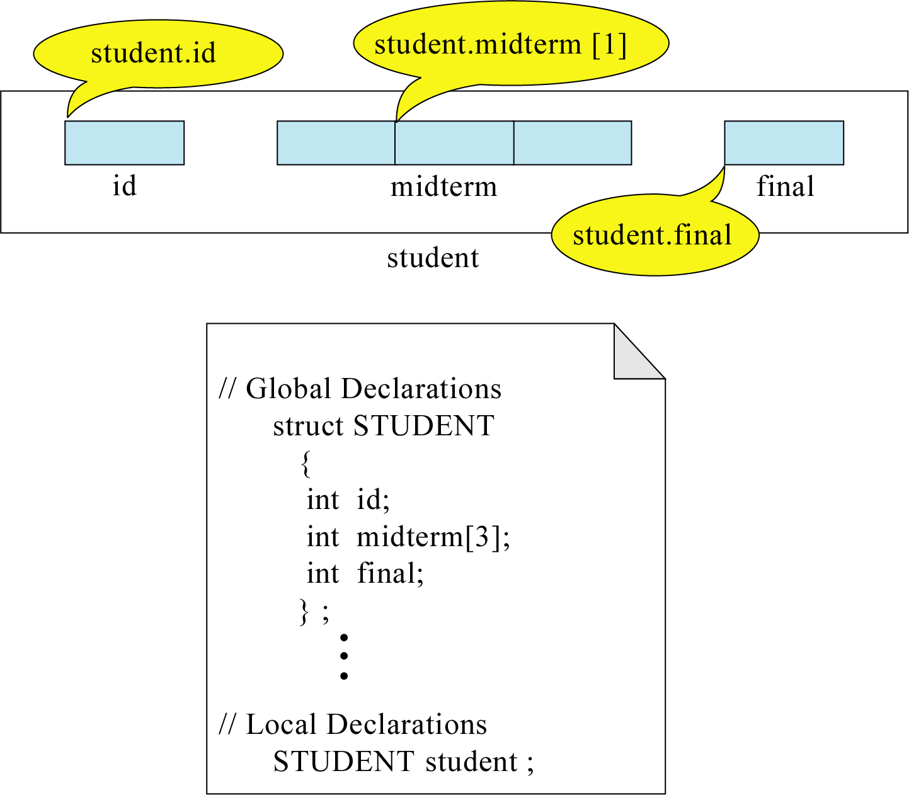
Figure 10-12

Slide 14
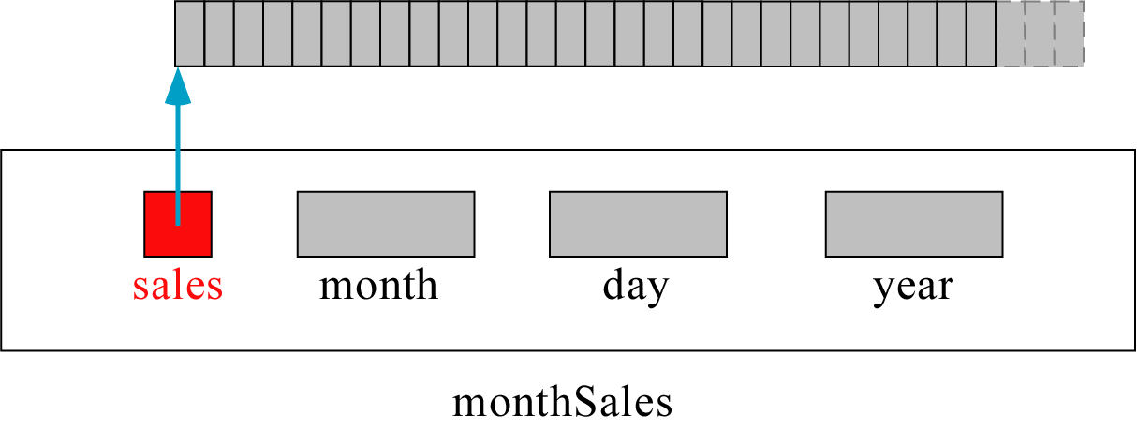
Figure 10-13

Slide 15
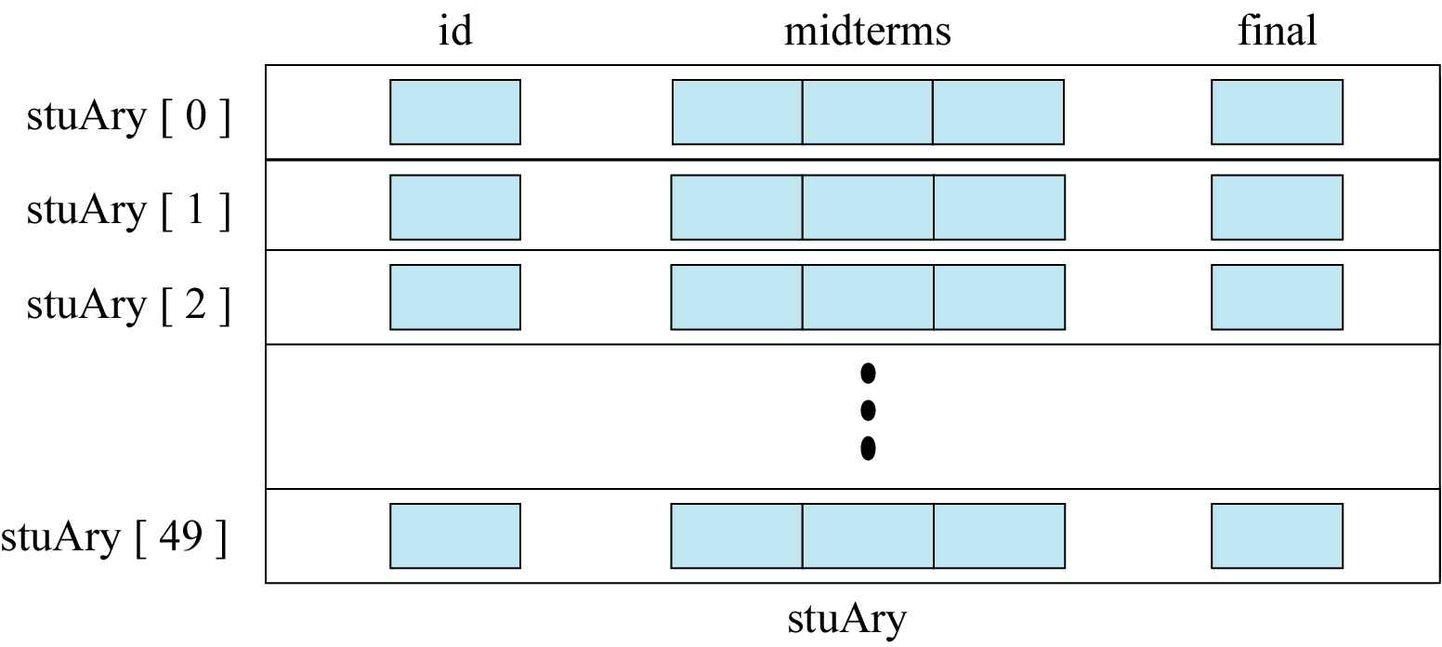
Figure 10-14

Slide 16
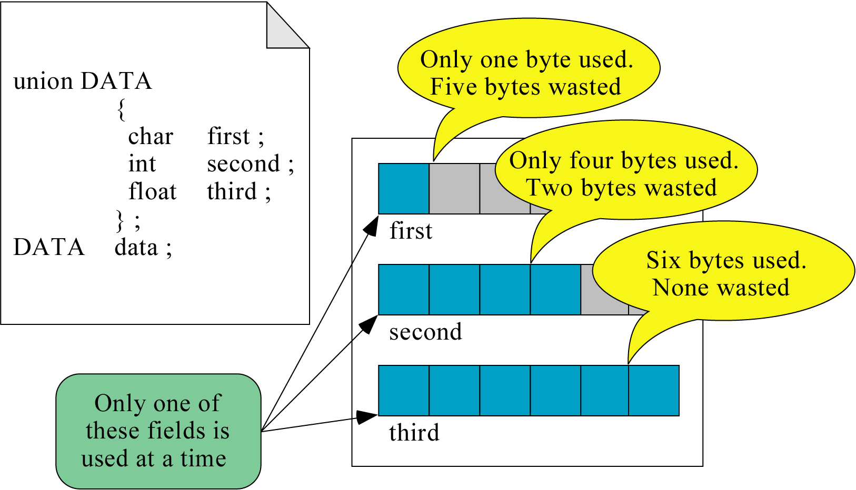
Figure 10-15

Slide 17
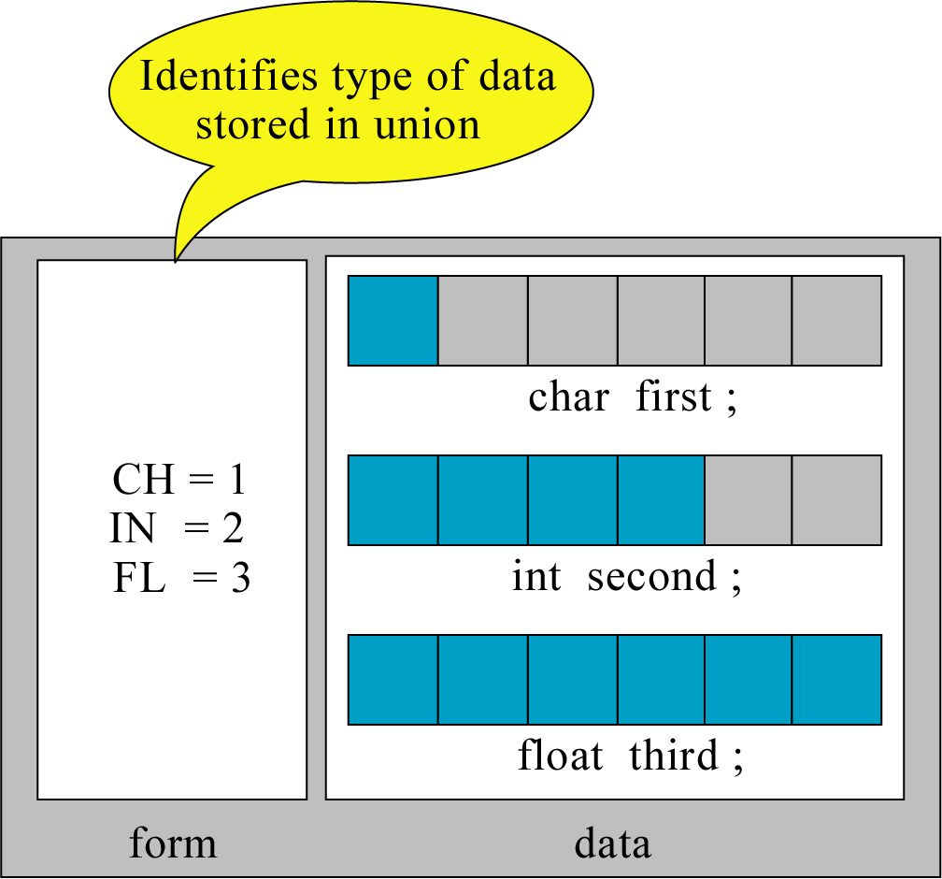
Figure 10-16

Slide 18
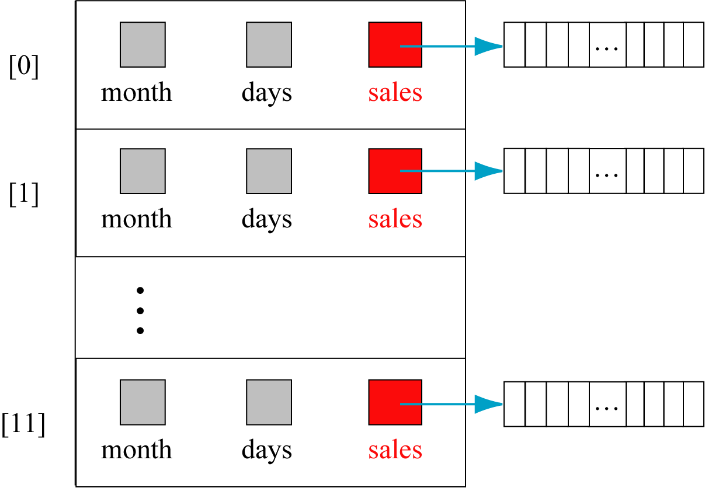
Figure 10-17

Slide 19
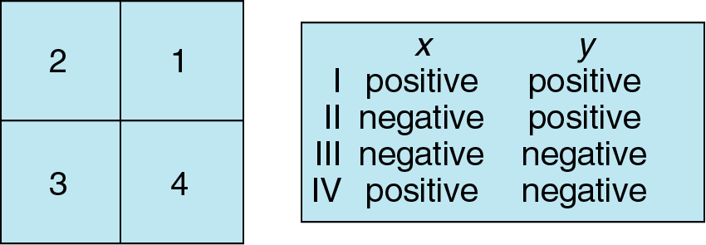
Figure 10-18

Slide 20
Figure 10-19
DATA
ID Quiz1 Quiz2 Quiz3 Quiz4 Exam
23 19 22 23 89
0 23 21 18 76
1717 21 22 18 19 91
STATISTICS
23 25 23 25 96
17 15 12 18 53
21.3 20.1 19.8 21.1 81.3

Slide 21
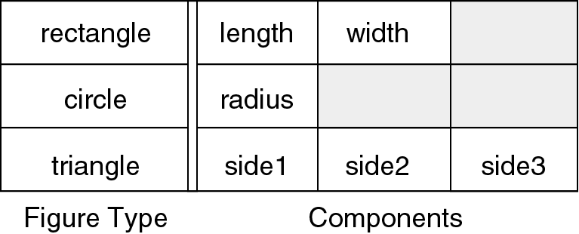
Figure 10-20

