Slide 2
Learning Objectives
Explain why it’s important to know the right word
Relate the connections among hardware, software, “the experience,” and data
Define basic hardware and software terms
Define and give examples of “idea” terms

Slide 3
Hardware, Software, and the Experience
Computing in its most general form concerns data and three phenomena:
Hardware
Software, and
“the experience.”

Slide 4
Hardware, Software, and the Experience
Hardware:
Computers are the physical embodiment of computation.
They represent one of the greatest technological achievements.
Few inventions are more important.

Slide 5
Hardware, Software, and the Experience
Software:
Embodies the programs that instruct computers in the steps needed to implement applications.
Software, unrestricted by the physical world, can direct a computer to do almost anything.

Slide 6
Hardware, Software, and the Experience
The Experience:
Together, hardware and software present a virtual world that doesn’t exist, but which we experience.
These experiences, dictated by the interaction of the virtual and physical worlds, are new and important.

Slide 7
Computers Are Everywhere
They are in laptops, tablets, smart phones, music players, wireless mics, anti-lock brakes, TV remotes, credit card readers, etc.
Through 2010, 24.1 billion ARM processor chips have been shipped
It means that every consumer in the developed world owns more than a dozen

Slide 8
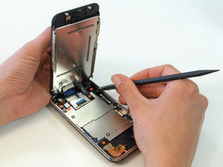
Computers Are Everywhere
Looking Inside:
Computers don’t always have keyboard and printer attached
Notice there are metal plates covering its internal parts
They shield the surrounding environment from electromagnetic radiation
Figure 1.1 An iPhone 3GS when first opened

Slide 9
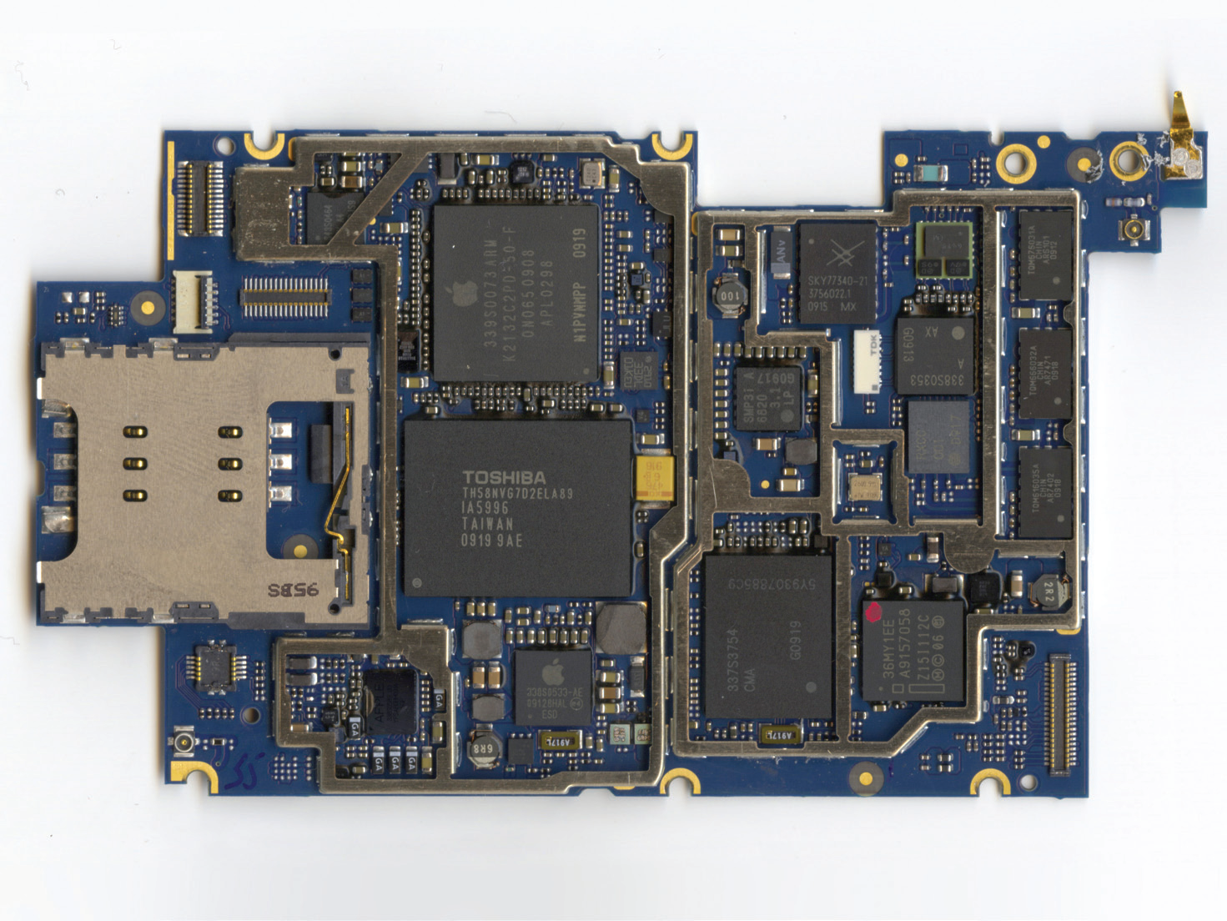
Computers Are Everywhere
Figure 1.2 Top side of the main printed circuit board in the iPhone 3GS; for orientation, the USB port is at left, and processor and memory IC packages are identified. *32-bit describes the size of a typical operation; GB is short for gigabyte (1 billion bytes).

Slide 10
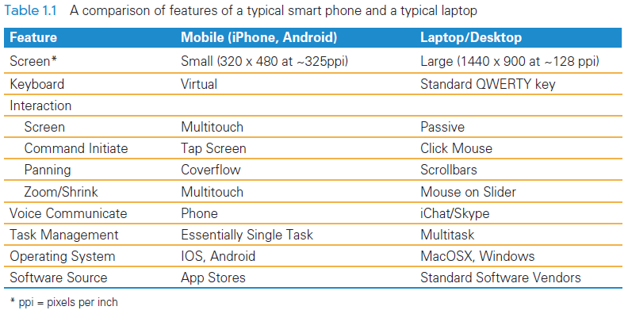
Computers Are Everywhere
Head-to-Head Comparisons

Slide 11
Software
Software is a collective term for programs
Programs are the instructions computers perform to implement applications.
Software “instructs” the computer (hardware), by providing the steps needed to perform a task.
The computer follows the program and carries out the instructions

Slide 12
Software
The Software Stack
Concept used to structure and organize the software in contemporary computer systems
Series of layers of programs that implement user applications.
Each software layer implements operations used to build the layers above.

Slide 13
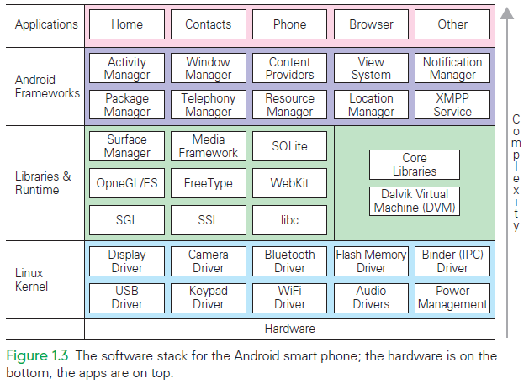
Software

Slide 14
Software
Referring to the figure on the previous slide:
To check out a video on YouTube video using a smart phone, you would:
use the browser application to get to YouTube
the browser app uses the window manager, and several other frameworks
the window manager uses media manager, and several other libraries
the media manager uses the display drivers, and several other kernel operations

Slide 15
Software
Writing software is a difficult and challenging
They instruct an agent to perform some function or action by giving a step-by-step
process.
The agent is anything that can follow the instructions.
For software professionals, the agent is a computer.

Slide 16
Experience
People:
meet online and marry
make unfortunate Facebook posts and lose their jobs
spend hours listening to music, watching videos, and playing games
Most of our interactions with computers are recorded, virtual, and artificial

Slide 17
Experience
Recorded technology
Oldest form of information technology is a recording a scene, performance, event, etc.
Digital copies are approximations of reality
With today’s technology, in most cases the approximation is extremely accurate

Slide 18
Digital Information
Transformation
It is easy to enhance or embellish digital information
Photo editing, video editing, audio remixing are widely practiced
Photoshop has become a verb describing the act of changing a digital image

Slide 19
Digital Information
Synthetic Complexity
The creation of new digital media means that the information is synthesized
It is an alternate version of the world
Examples: animations, cartoons, video games

Slide 20
Digital Information
Synthetic Complexity
Advantages?
With early animations, each frame was drawn by a person and the music was recorded “live”
Contemporary animations are digital art also created one frame at a time, but by a computer
A “start scene,” an “ending scene,” and directions on how to modify the start to get to the end are processed by the computer to create the movie
Digital sounds are added and synchronized to the images

Slide 21
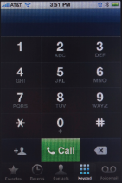
Virtual Worlds
Virtual reality: a world created by computers to simulate the physical world
It is not real, but is perceived “as if” it were
The full VR experience is still under development…but we see it all the time:
Keypads on a smart phone display
Spreadsheet software that look like accounting paper
GPS displays that show a map

Slide 22
Virtual Worlds
Programmers use these features because they are familiar, intuitive, easy to learn, and efficient to use
These examples are “not real, but as if”
Sometimes, the virtual devices are better than the real one:
Example: if you mistype a phone number, you can delete the wrong numbers before you “dial”

Slide 23
Artificial Worlds
Everything else that you experience with computers is simply artificial
Systems like iTunes, Facebook, Twitter, and Angry Birds are entirely the product of human imagination
This means the creators had almost unlimited flexibility when designing
This flexibility to create anything is one of the exciting aspects of computing

Slide 24
Artificial Worlds
Extended Abilities.
Key advantage of software is that it can often do difficult tasks that are user-friendly
These are “artificial” solutions in the sense that they are not the standard techniques used previously
They depend on a computer to “do the work”
We are now “experts” at tasks that were once people’s careers: for example, video editing

Slide 25
Artificial Worlds
New Phenomena.
Systems, such as Twitter, Facebook, YouTube, give us experiences that did not exist before they were created
Some aspects, such as communication via phone and snail mail, did exist
They were not equivalent to social networks, primarily because they are either person-to-person, or person-to-tiny group

Slide 26
Artificial Worlds
New Phenomena/New Problems
New privacy concerns
Spam ( junk mail )
Scams (the Nigerian Widow fraud)
online bullying
stalking (physically following someone)

Slide 27
The Data
Data vs. Information are interchangeable works in computing
Physical Form
Information is literally everywhere in the physical world
Much of it can be captured and converted to digital form.
It is always represented as bits (0’s and 1’s)

Slide 28
The Information You Use
Most of the information used daily is delivered by the World Wide Web
Newspapers, TV, magazines, and libraries also deliver information but in a diminishing role
Some digital data (like GPS or ATM transactions) is not delivered at all by the Web

Slide 29
Sourced Content
Sourced content is content produced for commercial purposes or to fulfill an information dissemination obligation
Examples include newspapers, shopping, government, celebrities, etc.
It is content that is entirely controlled by the source organization or person
The general public cannot add new information to sourced content

Slide 30
Social Content
Social content refers to information created by visitors to the site
Examples include the social networking, media sharing, gaming, and reference
Users generate or contribute to the content of these sites
Although Google and other search engines do not create the content they display, they are not social networking sites

Slide 31
The Files and Databases
The digital information we access through the WWW is stored on Web servers around the world as files and databases.
Sourced content sites create the files and databases and places them on their own servers
Databases are everywhere; your digital music (for example, iTunes) is organized as a database, as are your photos

Slide 32
The Files and Databases
Your smart phone contacts are a database, and much of the other “stuff ” you’ve stored on your phone is organized that way, too.

Slide 33
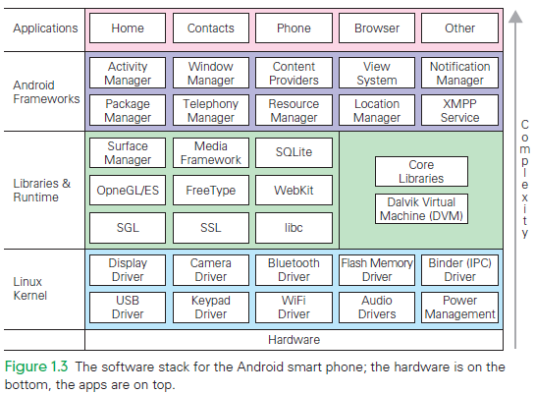

Slide 34
Terms of Endearment
Not only should you learn the right computing terms, but you should also understand how to use them to benefit completely from the technology.
There are two practical reasons for this:
Tech Support: Everyone needs and uses it
To learn a new subject, we must learn its terminology

Slide 35
Tech Support
Usually, you must look up the answer yourself using the Help feature, or you must contact tech support
The technician might not know what you talking about
Without the right word, the search algorithm of the Help facility definitely won’t know what you mean

Slide 36
Algorithms
What’s an algorithm?
An algorithm is a precise, systematic method for producing a specified result
Important points about algorithms:
We use and invent algorithms all the time to solve our problems
Often the agent that “runs” the algorithm is a person, NOT a computer

Slide 37
Algorithms (cont’d)
Computers are clueless. They need to be told what to do
For a method to be precise enough for a computer to follow, everything needs to be spelled out
Programmers make algorithms perfectly precise for computers by writing them in a programming language

Slide 38
Algorithms (cont’d)
People do have a clue, so many things can be left out of an explanation when people have to follow directions
Example:
After finding a letter, a computer has to be told to go back to the beginning of the letter sequence to start looking for the next letter
People figure that out by themselves!

Slide 39
Algorithm Versus Program
Algorithms are a precise, systematic method for producing a specified result
Programs are algorithms that have been specialized to a specific set of conditions and assumptions, and (usually) written in a specific programming language
In most cases however, we use the terms interchangeably

Slide 40
The Words for Ideas
“Abstract”
The word has several meanings:
In natural language: to remove can mean to steal
In computing: to abstract also means to remove, but this time, it’s an idea or a process, and it is extracted from some form of information
Abstractions
Parables and fables require us to abstract the essential point of the story so that we can learn from it

Slide 41
Abstractions
Notice two key points:
Many, but not all the details, of the story are irrelevant to the concept
The abstraction has meaning beyond the story
In computing, separating the relevant from the irrelevant, and applying the abstraction to other cases are essential

Slide 42
The Words for Ideas
“Generalize”
Process to recognize the common idea in two or more situations
To generalize is to express an idea, concept, or process that applies to many situations
The statement that sums up that idea is called a generalization
If it is true most of the time, we can generalize an idea

Slide 43
The Words for Ideas
“Operationally Attuned”
The ability to apply what we know about how a device or system works to simplify its use
Example:
We loosen lids by turning it left and tighten by turning it right
We know this intuitively, but knowing it explicitly makes us operationally attuned
With computing, thinking about how computation works makes it simpler to use

Slide 44
The Words for Ideas
“Mnemonic”
A mnemonic is an aid for remembering something
Example: HOMES (the Great Lakes: Huron, Ontario, Michigan, Erie, and Superior)
Mary’s Violet Eyes Make John Stay Up Nights (Mercury, Venus, Earth, Mars, Jupiter, Saturn, Uranus, Neptune)

Slide 45
Summary
Recognize the three-part decomposition of everyday computing: hardware, software, and the experience.
Recognize Web information sources: sourced and social.
Determine how close to reality our interactions with computers are by identifying recorded, virtual, and artificial content.

Slide 46
Summary
Know and use the right word because as we learn words, we learn ideas; knowing the right words helps us to communicate.
Consider a brief list of “idea” words, such as abstract and generalize.

