Slide 2
Learning Objectives
Give names to computing features that you know intuitively
Explain placeholders and the placeholder technique
Explain how “metaphor” is used in computing
Describe the desktop metaphor, giving examples of appropriate icons
Describe the touch metaphor, giving sample motions
Explain how the desktop and touch metaphors differ

Slide 3
Feedback
A computer assists us, doing whatever we ask it to do
We want our “assistant” to report on the progress of the task it is doing
We need to know that the task was done and when to give another one
Computer systems always give the user feedback about “what’s happenin’ ”

Slide 4
Feedback
Feedback is an indication that either the computer is still working or is done
Feedback takes many forms:
The revision is visible
Areas on the screen become highlighted, shaded, gray, underlined, color change, or you might hear a click

Slide 5




Feedback
Most common form of feedback is that the computer is performing a time-consuming operation
Cursor is replaced by a different icon
Some apps give custom feedback
Or use a progress bar to give an estimate on time remaining
Always expect feedback

Slide 6
Consistent Interface
Regardless of who makes the software, icons and menus tend to be similar
Especially so within a specific company (Microsoft for example)
Look for similar menu names, like File and Edit
Look for similar functions within the menus, like Cut, Copy, Paste in the Edit menu

Slide 7
Consistent Interface
Why?
Companies reuse the same code in each of their applications
Aids you in learning and using additional applications
Certain operations are so fundamental to processing that all apps just use those oprations

Slide 8
New Instance
Under File you usually find a command, New
New creates a “blank” instance of the kind of files the application creates
What is “blank information”?
An empty structure to hold (record) all of the properties of that file and store its content
Example: A new/empty address book entry is ready to hold names, images, and phone numbers about the new individual

Slide 9
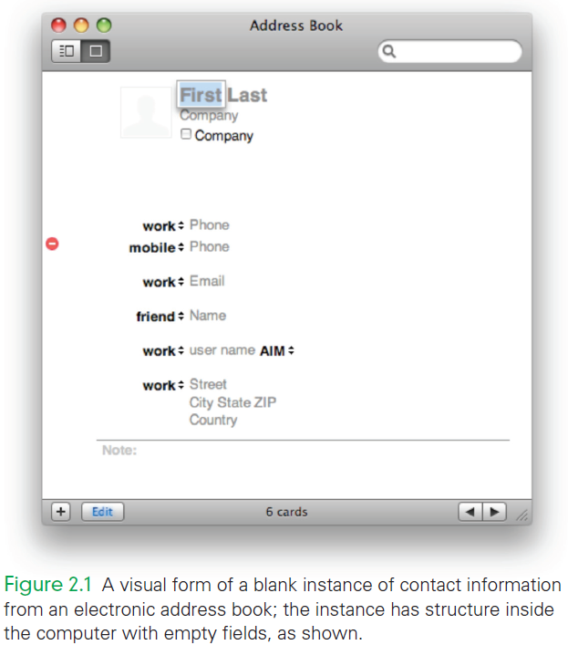
New Instance for the Address Book

Slide 10
Clicking and Blazing
Consistency provides a strong sense of familiarity with a new application
With a new app, two important activities are immediately performed:
“Clicking Around” to explore the application to see what features are available
“Blazing Away” is trying the application in a way you haven’t done so before

Slide 11
Perfect Reproduction
Computers encode information as a sequence of binary digits, 0’s and 1’s
Because of the use of two digits, we call it digital information
Using only 0’s and 1’s means that digital information can be perfectly reproduced or replicated
10010111 10101100 11001010

Slide 12
Exact Duplicate
A second copy is made simply by duplicating the sequence of 0’s and 1’s
This is one way digital improves on analog information
Analog information comes from or is stored on a continuously variable medium
A copy of an image, for example, could come out too dark or too light when compared to the original

Slide 13
The Perfect Reproduction Property of Digital Information
It also doesn’t matter where the copy came from:
Both the original and the copy are the same sequence of 1’s and 0’s
Every copy can be made from the last copy, and still be identical to the original!

Slide 14
Copying
Copy/Paste/Edit
Copy and Paste operations are available in many applications
When editing a file, you can either create content from “scratch” or use Copy/Paste (C/P) to reproduce it from another location
Copy/Paste is generally faster and less error prone

Slide 15
How We Learn Technology
Find and ReplaceAll
In Find/Replace editing operations, the source content to Find is identified in the document
The target content to Replace it with is also identified
Find/ReplaceAll (F/RA) is an all-at-once version of Copy/Paste
Use an abbreviation of a long name or title as a placeholder, then use F/RA to put in the correct name all at once!

Slide 16
Placeholder Technique
When many the purpose or operation of a new technology may seem obvious
Some technologies require instruction (driving a car or using a chain saw!)
Much of the technology we use we figure out on our own
We know intuitively what to do
The technology developers did that on purpose!

Slide 17
Metaphors
In computing, a metaphor is an icon or image used as representative or symbolic of a computation
When designers create a technology, they use metaphors to help users know how to operate their devices without reading a manual
Metaphors are a terrific solution!

Slide 18
The Desktop
In the ‘70s the first personal computer (the Alto) was developed
It was the first computer with a Graphic User Interface when the computer booted
Since the computer was designed for business use, the metaphor that was used for the screen was desktop
Other business metaphors: files, folder, documents

Slide 19
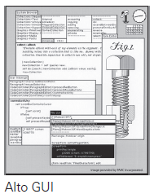
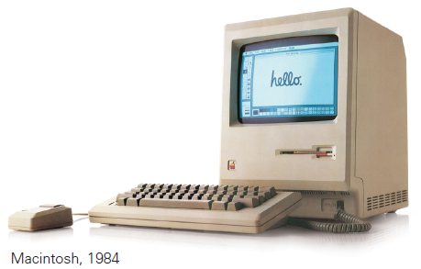
The Desktop

Slide 20
The Desktop
Steve Jobs and Steve Wozniak founded Apple and built computers without GUIs
Jobs saw the Alto and liked the GUI concept
Apple redesigned an unsuccessful personal machine (Lisa), then launched the Mac in 1984
Soon after, Microsoft began developing Windows to replace its DOS system

Slide 21
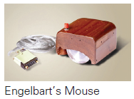
More Computer Metaphors
The Mac first introduced the mouse to the public…another component in desktop metaphor
Apple did not invent it
Stanford Research Institute invented the mouse years in December 1968
When introduced, it was stated that they called it a mouse and didn’t know why they didn’t change the name!

Slide 22
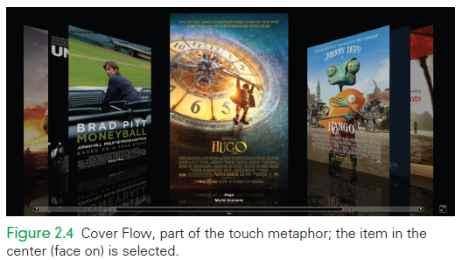
Changing Metaphors
A new idea, the touch metaphor
Users touch the content, smart phones, tablets, and other mobile devices
Example: the Cover Flow mechanism for scanning through a list, using a sweeping motion of the pointer

Slide 23
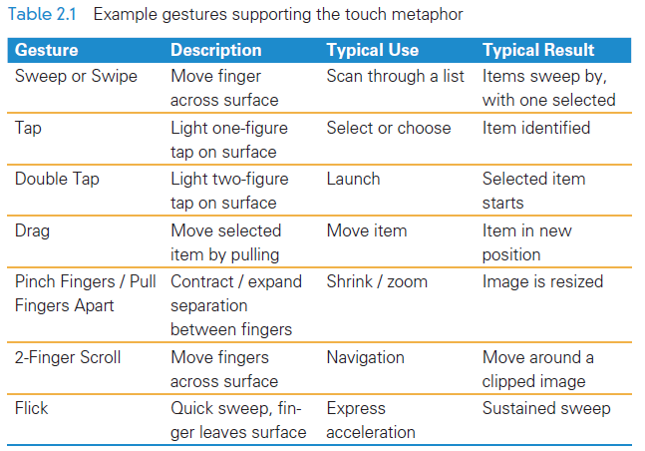
Touch Metaphor Gestures

Slide 24
Metaphor Relationships
The touch metaphor is intended to simplify the use of smart phone and tablets
This technology is not new (use of stylus and touch screen interaction at kiosks)
Touch has no mouse
It’s possible to use the touch metaphor with a trackpad or mouse so it is not limited to mobile devices

Slide 25
Why is Touch a Metaphor?
It’s a way to eliminate the mouse, but…
It changes how humans interact with the computer
Scrollbars using the desktop metaphor for moving through a display
Small screens don’t have room for scrollbars
Direction of motion is opposite between touch and desktop metaphors

Slide 26
Why is Touch a Metaphor?
It changes how humans interact with the computer
With the touch metaphor, your hands are “on” the content
You move the content to where you want it to be
With the desktop metaphor you “slide a window over the content”

Slide 27
Summary of Metaphors
We use technical metaphors daily
They are 100 percent synthetic, created by imagination of the developers
They are meant to simplify the use of the devices.
The touch metaphor will not replace the desktop metaphor
Both have extensively determined how we think and behave with technology

Slide 28
Summary
We can figure out software because designers use consistent interfaces, suggestive metaphors, and standard functionality.
We should explore a new application by “clicking around” and “blazing away.”
Making exact copies is a fundamental property of digital information that we use daily.

Slide 29
Summary
Find and ReplaceAll are standard operations that simplify our computer use.
Metaphors are essential to computer usage because the guide us in learning and using software.
The desktop metaphor is classic; the touch metaphor is newer; they will co-exist.

