Slide 2
Learning Objectives
Tell whether a communication technology (Internet, radio, LAN, etc.) is synchronous or asynchronous; broadcast or point-to-point
Explain the roles of Internet addresses, domain names, and DNS servers in networking
Distinguish between types of protocols (TCP/IP and Ethernet)
Describe how computers are interconnected by an ISP and by a LAN
Distinguish between the Internet and the World Wide Web

Slide 3
Comparing Communication Types
To understand the Internet we need to cover some basic communication vocabulary:
Synchronous Communication
Asynchronous communication
Broadcast
Communication
Multicast
Point-to-point communication

Slide 4
General Communication
Synchronous communication:
Both the sender and the receiver are active at the same time (think of talking on a telephone)
Asynchronous communication:
The sending and receiving occur at different times (think of email and answering machines)

Slide 5
General Communication
Another property of communication concerns the number of receivers.
Broadcast communication: single sender and many receivers (radio and TV)
Multicast: is many receivers, but usually a specific group (specialized topics)
Point-to-point communication: one specific sender and one specific receiver (telephone call)

Slide 6
Internet’s Communication Properties
The Internet supports point-to-point asynchronous communication
The Internet provides a general communication “fabric” linking all computers connected to it
Computers and the network become a single medium

Slide 7
Internet’s Communication Properties
The Internet is fast enough to mimic synchronous communication (like using a phone)
Multicasting is also possible, allowing groups to communicate in chat rooms
You can post video that can be accessed by anyone, as a form of broadcasting (compares with radio or television)

Slide 8
Internet’s Communication Properties
The Internet is a universal communication medium
The Internet also becomes more effective with each additional computer added
If x computers are already attached to the Internet, adding one more results in x potential new connections!

Slide 9
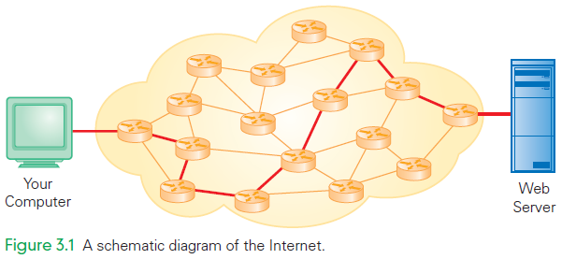
Internet Schematic Diagram

Slide 10
Client/Server Structure
Most interactions over the Internet use the client/server interaction protocol:
When you click a Web link, your computer gets the page for you...beginning the client/server interaction
Your computer is the client computer and the computer with the Web page is the server (Web server)
The client, gets services from the server
When the page is return, the operation is completed and the client/server relationship ends

Slide 11
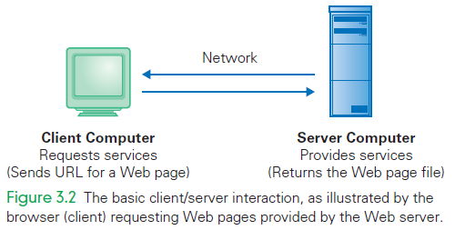
Basic Client/Server Interaction

Slide 12
Client/Server Structure
The client/server structure is fundamental to Internet interactions
A key aspect is that only a single service request and response are involved
The relationship is very brief relationship, lasting from the moment the request is sent to the moment the service is received

Slide 13
Many Brief Relationships
This approach means that the server can handle many clients at a time
For example, between two consecutive client requests from your browser (getting a page and asking for another) that server could have serviced hundreds of other clients
The server is busy only for as long as it takes to perform your request

Slide 14
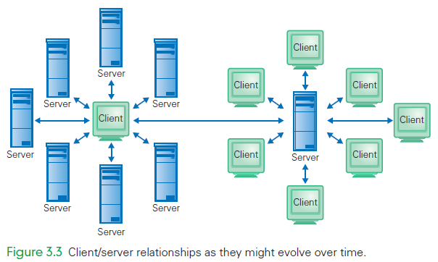
Client/Server Relationships

Slide 15
Getting More Connected
The Internet is primarily a point-to-point asynchronous communication system
Software has been built to implement the many forms of communication
Client software “slices up” the signals coming from the computer’s microphone and video camera into packet-size blocks

Slide 16
Getting More Connected
Content is transferred to the other party, whose client reassembles the sound and image for display
Process relies on a fast and reliable transmission to make it seem like a direct connection
This Internet Protocol is generally fast and reliable enough to work

Slide 17
Computer Addresses
IP Addresses
Each computer connected to the Internet is given a unique address called its IP address
An IP address is a series of four numbers (one byte each) separated by dots
The range of each of these numbers (0–255) allows for billions of IP addresses
New IP addresses are in short supply

Slide 18
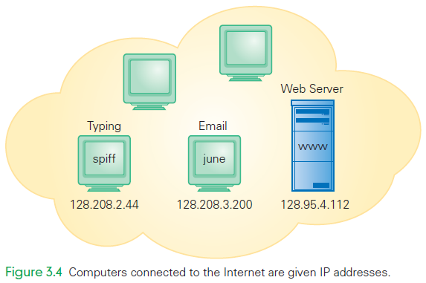
IP Addresses

Slide 19
Computer Addresses
Domain Names
It is hard to remember the numeric IP address of all the computers we communicate with
The Internet uses human-readable symbolic names for computers that are based on a hierarchy of domains
A domain is a related group of networked computers

Slide 20
Computer Addresses
Domain Names
Example: spiff.cs.washington.edu
The name of the computer is spiff
Which is part of the Computer Science and Engineering Department domain (cs)
Which is part of the University of Washington domain (washington)
Which is part of the educational domain (edu)

Slide 21
Computer Addresses
The example shows a hierarchy of domains
Each is a member of the next larger domain
edu is a peer of other top-level domains such as com
These names are symbolic and meaningful, making them easier to read than numbers (and easier to remember)

Slide 22
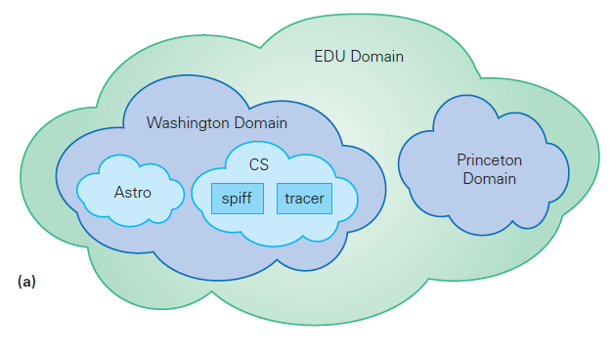
The .edu Domain

Slide 23
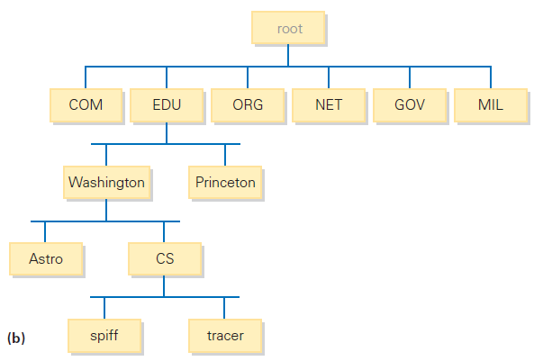
The .edu Domain

Slide 24
DNS Servers
The Domain Name System (DNS) translates the hierarchical, human-readable names into the four-number IP address
Every Internet host knows the IP address of its nearest DNS name server
Whenever the hierarchical symbolic name is used to send information to a destination, your computer asks the DNS server looks up the corresponding IP address

Slide 25
DNS Servers
When your computer asks a DNS name server to translate a name to the IP address, it is in another client/server relationship
If the address is new (and not stored on the DNS server), the server asks an authoritative name server
This server keeps the complete list of the IP addresses and corresponding domain names for all authoritative name servers and computers in its domain

Slide 26
DNS Servers
The root name servers’ addresses are preprogrammed into your computer’s net software.
They are listed at www.rootservers.org together with their mirror sites (helper name servers with identical information).
Notice that computers change their client and server roles all the time. Sometimes they are servers, sometimes they are clients.

Slide 27
Top-Level Domains
Top-level domain names (TLDs):
.edu for educational groups
.com for commercial enterprises
.org for organizations
.net for networks
.mil for the military
.gov for government agencies

Slide 28
Top-Level Domains
The top-level domains were expanded to include biz, info, name, travel, and others
The full list can be found at www.icann.org (ICAAN is Internet Corporation for Assigned Names and Numbers)
The original top-level domains listed all apply to organizations in the United States.

Slide 29
Top-Level Domains
There is also a set of two-letter country designators (ca (Canada), uk (United Kingdom), fr (France), de (Germany, as in Deutschland), etc.)
These allow domain names to be grouped by their country of origin.

Slide 30
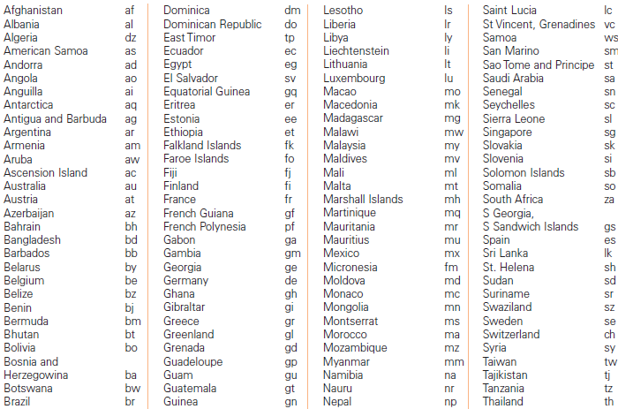

Slide 31
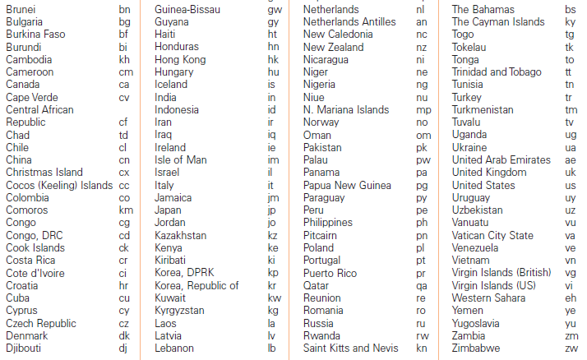

Slide 32
TCP/IP
TCP/IP Postcard Analogy
The Internet is like sending a novel to your publisher using postcards
The novel is broken into small units that fit on a postcard
The “postcards” are numbered to indicate where each belongs in the novel
As each postcard is completed, it is mailed

Slide 33
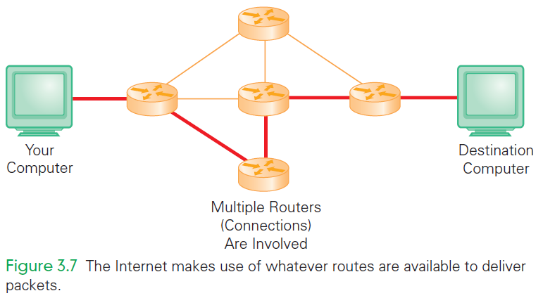

Slide 34
TCP/IP
TCP/IP Postcard Analogy
Sooner or later, your publisher received the postcards, but not necessarily in sequential order
Nor do they take the same route
The cards are finally arranged in order
These “postcards” are really IP packets
They hold: one unit of information, the destination IP, and their sequence number (which packet they are)

Slide 35
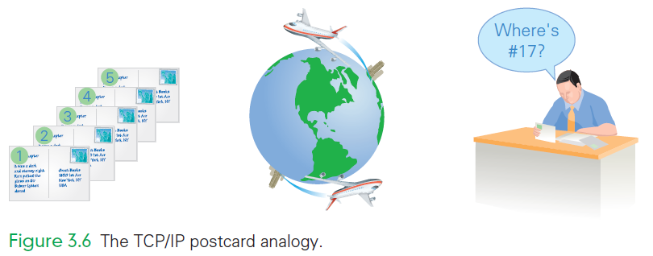

Slide 36
Packets Are Independent
Because each packet can take a different route, congestion and service interruptions do not delay transmissions
Each TCP/IP packet is independent
The TCP/IP protocol works under adverse conditions
If traffic is heavy and the packet progress is slow, the protocol allows the packet to be thrown away

Slide 37
Packets Are Independent
If a packet is killed for whatever reason, the recipient will request a resend
Packets can arrive out of order because they take different routes

Slide 38
Moving Packets: Wires & More
Internet uses telephone carriers for long-distance connections, fiber optics, and separate dedicated lines for connections
The computers do not know or care how the packet is sent, as long as it can be sent and received
Transmissions may rely on multiple technologies as the packets move across the Internet

Slide 39
Far and Near: WAN and LAN
The Internet is a collection of wide area networks (WAN)
These are networks that are not geographically close
The Internet is a collection of point-to-point channels
Meaning packets must visit a sequence of computers (or hops) before they reach their destination

Slide 40
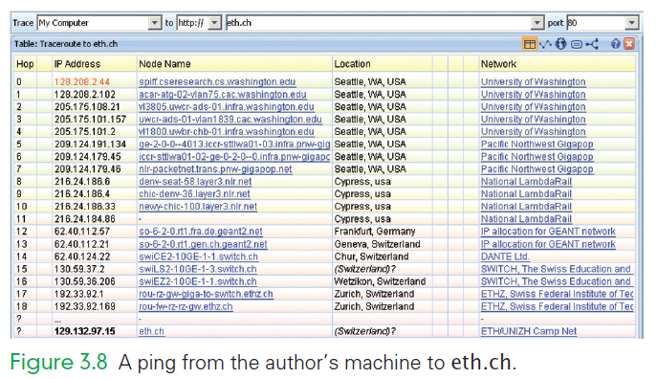
A ping is a “please reply” message

Slide 41
Far and Near: WAN and LAN
A local area network (LAN) is when computers are geographically close
Usually they can be linked by a single cable or pair of wires
Ethernet is the main technology for local area networks
Used for connecting all the computers in a lab or building

Slide 42
Ethernet
The physical setup for an Ethernet network is a wire, wire pair, or optical fiber, called the channel
Engineers “tap” into the channel to connect a computer:
This allows it to send a signal or an electronic pulse or light flash onto the channel
All computers, including the sender, can detect the signal

Slide 43
Ethernet Party Analogy
To understand how an Ethernet network works, consider this:
A group of friends is standing around at a party telling stories.
While someone is telling a story, everyone is listening.
When the story is over, here may be a pause before the next one speaks
Then, someone typically just begins talking and the cycle starts again

Slide 44
Ethernet Party Analogy
Now, insert computer instead of friend:
A group of friends is standing around at a party telling stories.
While someone is telling a story, everyone is listening.
When the story is over, here may be a pause before the next one speaks
Then, someone typically just begins talking and the cycle starts again
computers
A computer
computers are
computer
a computer

Slide 45
Ethernet Party Analogy
We assumed that all “friends” were equal
No had a more import status
Everyone spoke with the same voice
There are differences, however:
Only one computer typically keeps the transmitted information
This broadcast medium is being used for point-to-point communication

Slide 46
Ethernet Party Analogy
A computer wanting to transmit a message:
It starts sending signals and also starts listening to see if the message it gets is the one it sent
If it is, the computer knows it’s the only computer sending, and it completes the transmission
If it isn’t, the computer stops transmitting immediately

Slide 47
Connecting to the Internet
Today there are two basic methods:
Connection via an Internet service provider (ISP)
Connection provided by a campus or enterprise network
Most of us use both kinds of connections

Slide 48
1. Connections by ISP
Most home users connect to the Internet by ISPs
These are companies that sell connections to the Internet
The company places a modem at your house
Modems convert the bits a computer outputs into a form that is compatible with the carrier

Slide 49
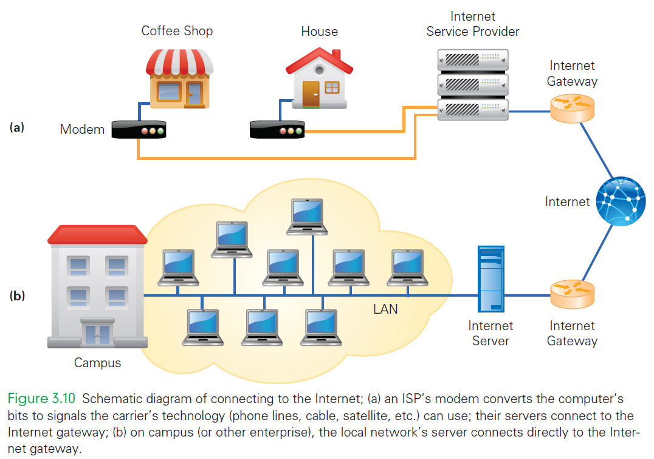

Slide 50
1. Connections by ISP
The signals are sent to the carrier’s business
They are converted (via modem) into a form for the server that connects to the Internet via the Internet Gateway
Digital subscriber line (DSL or ADSL) and cable (TV) are two common providers
Your smart phone also has a modem for connecting to network

Slide 51
2. Enterprise Network Connections
The other way to connect is as a user of a larger networked organization (school, business, or governmental unit)
The organization connects to the Internet by a gateway

Slide 52
Wireless Networks
Variation of a LAN connection
Referred to by its protocol name 802.11
The router is:
Physically connected to an ISP’s modem
Connected to the Internet
Capable of broadcasting and receiving signals, usually radio frequency (rf ) signals

Slide 53
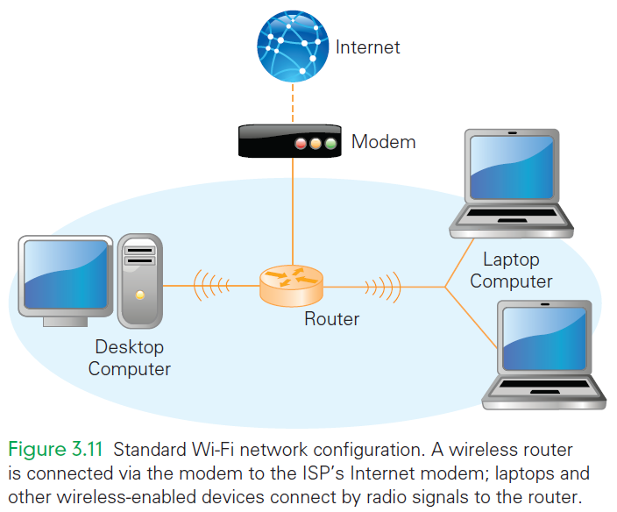

Slide 54
The World Wide Web
Some computers connected to the Internet are Web servers
Computers programmed to send files to browsers running on other computers connected to the Internet.
These Web servers and their files comprise the World Wide Web (WWW)

Slide 55
The World Wide Web
Those files are Web pages
Web servers store and send other kinds of files, too
The files are often used to:
Create the Web page (images or animations)
Help with other Web services (play audio or video)

Slide 56
Requesting a Web Page
Web requests use client/server interaction
Requesting a Web page means your browser is a client asking for a file from a Web server
The file can be found in looking at the URL (Universal Resource Locator)
Web browsers and Web servers both “speak” HTTP

Slide 57
Requesting a Web Page
http://www.cs.washington.edu/homes/snyder/index.html
The URL has three main parts:
Protocol. tells the computers how to handle the file
Server computer’s name or the name given by the domain hierarchy
Page’s pathname. tells the server which file (page) is requested and where to find it

Slide 58
Describing a Web Page
Servers do not store Web pages in the form seen on our screens
The pages are stored as a description of how they should appear on the screen.
The browser receives the description/source file and creates the Web page image that is described

Slide 59
Describing a Web Page
There are two advantages to storing and sending the source rather than the image itself:
A description file usually requires less information
The browser can adapt the source image to your computer more easily

Slide 60
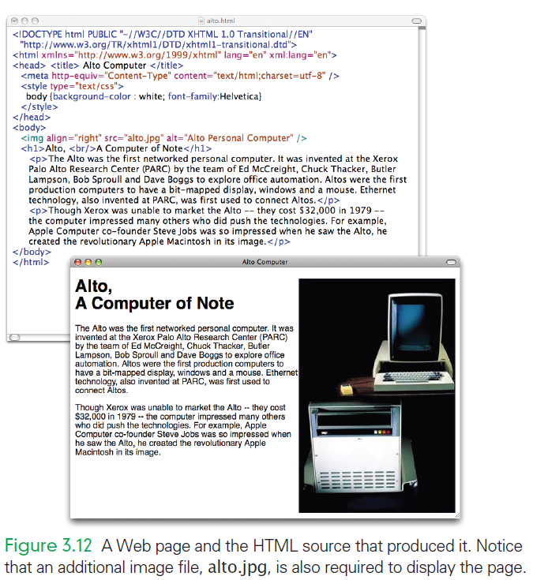

Slide 61
The Internet and the Web
Some Web servers have www as part of their domain name, some don’t
Some Web servers seem to add the www if you leave it out
Some Web servers work either way (both www.moma.org and moma.org display the same Web site)
When is the www required and when is it optional?

Slide 62
The Internet and the Web
Remember that web addresses are simply names
All computers connected to the Internet (including Web servers) have IP addresses
The DNS server requires you to give the name (URL) exactly because the DNS responds to that exact name

Slide 63
The Internet and the Web
An incorrect name/URL and you either access the wrong IP address or the DNS lookup fails (“404 Not Found”)
Computers can be programmed to notice http:// and to redirect you automatically to the correct page
Web administrators may also register all forms of a URL (with and without the “www”)

Slide 64
File Structure
Directory Hierarchy
Remember that folders can contain folders as well as files
This scheme is called the file structure of the computer and forms the directory hierarchy
Think of any hierarchy as a tree
folders are the branch points
files are the leaves

Slide 65
File Structure
Directory Hierarchy
All hierarchies have branch points and leaves
Hierarchy trees are often drawn sideways or upside down
Two terms are standard, however:
Down in the hierarchy means into subfolders (towards the leaves)
Up in the hierarchy means into folders (toward the root)

Slide 66
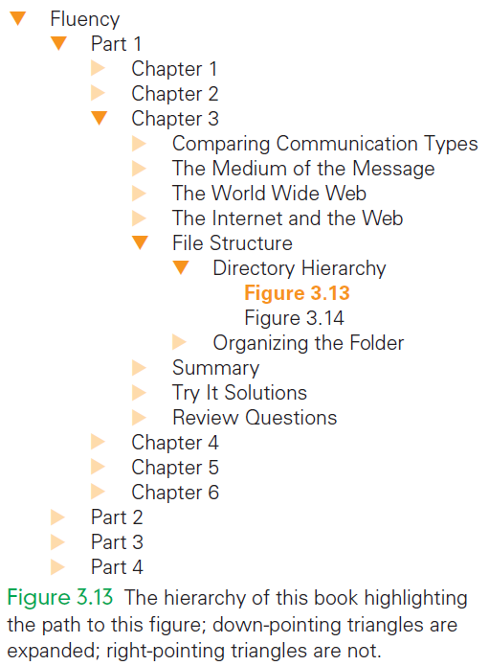

Slide 67
File Structure
Part of the directory hierarchy is shown in the pathnames of URLs: www.nasm.si.edu/exhibitions/gal100/pioneer.html
The page is specified by a pathname that tells the computer how to navigate through the directory hierarchy to the file
Each time there is a slash (/), we move into a subfolder or to the file
We go down in the hierarchy

Slide 68
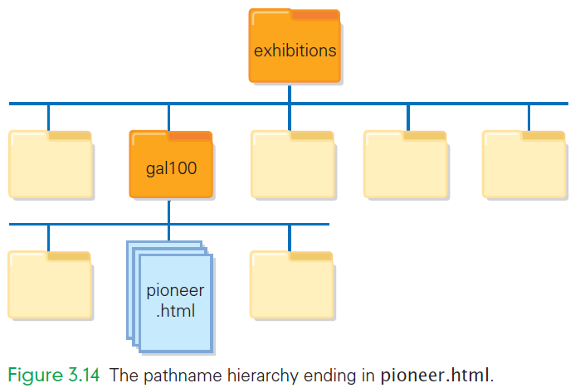

Slide 69
Organizing the Folder
Normally the last item in the sequence is a file name
This is not always necessary or true
When a URL ends in a slash, the browser automatically looks in that folder for a file called index.htm
The index.html file exists only if it was built

Slide 70
Organizing the Folder
Why have a hierarchy?
Most people build hierarchies to organize their own thinking and work
Directories cost nothing
There is no reason not to use them
It is highly recommended

Slide 71
Summary
In this chapter we discussed the basics of networking, including the following:
Basic types of communication: point-to-point, multicast, broadcast, synchronous, and asynchronous.
Networking, including IP addresses, domains, IP packets, IP protocol, WANS and LANS, Ethernet protocol, ISPs, enterprise networks, and wireless networks.

Slide 72
Summary
In this chapter we discussed the basics of networking, including the following:
The difference between the Internet and the World Wide Web.
File hierarchies in preparation for our further study of HTML.

