Slide 2
Learning Objectives
Know the meaning of and use hypertext terms
Use HTML tags to structure a document
Use HTML tag attributes
Use HTML tags to link to other files
Explain the differences between absolute and relative pathnames
Use Cascading Style Sheets to style a Web page
Use HTML to encode lists and tables

Slide 3
Web Pages
Web pages are created, stored, and sent in encoded form
A browser converts them to what we see on the screen
Hypertext Markup Language (HTML) is the main language used to define how a Web page should look
Features like background color, font, and layout are specified in HTML

Slide 4
Marking Up with HTML
The words on a Web page are embellished by hidden formatting <tags>
We use the XHTML or the Extensible Hypertext Markup Language
XHTML tags are also HTML tags, but not vice versa
There are some parts of the original HTML that are not part of XHTML

Slide 5
Formatting with Tags
Tags are words or abbreviations enclosed in angle brackets, < and >
Many tags come in pairs
The second of the pair comes with a slash: <title> Fluency </title>
In XHTML, the tags must be lowercase <TITLE>, <Title>, and <tITle> are illegal
The tag pair surrounds the text to be formatted like parentheses

Slide 6
Formatting with Tags
<title>Serena Williams</title>
These tags can be read as “this is where the title starts” and “this is where the title ends”
<title> is referred to as the start or open tag
</title> is the end or close tag
The title appears on the title bar of the browser

Slide 7
Tags for Bold and Italic
HTML has tags:
for bold text, <b> and </b>
for italic text, <i> and </i>
for paragraphs, <p> and </p>
More than one kind of formatting can be used at a time: <p><b><i>Veni, Vidi, Vici!</i></b></p> produces Veni, Vidi, Vici!

Slide 8
Tags for Bold and Italic
It doesn’t matter in which order you start the tags: italic follows bold, or bold follows italic
You get the same result
The rule is to make sure the tags “nest” correctly…they should mirror each other
All the tags between a starting tag and its ending tag should be matched

Slide 9
Singleton Tags
A few tags are not paired
They do not have a matching ending tag
For those tags, the closing angle bracket > of the singleton tag is replaced by />
Examples: <hr /> produces a horizontal line <br /> continues the text to the next

Slide 10
More Formatting Tags
Documents can be formatted in many ways
Each formatting feature requires its own tag
Programmers and Web designers need to remember a few common tags
Uncommon tags can be looked up: for example, at: www.w3schools.com/tags/default.asp

Slide 11
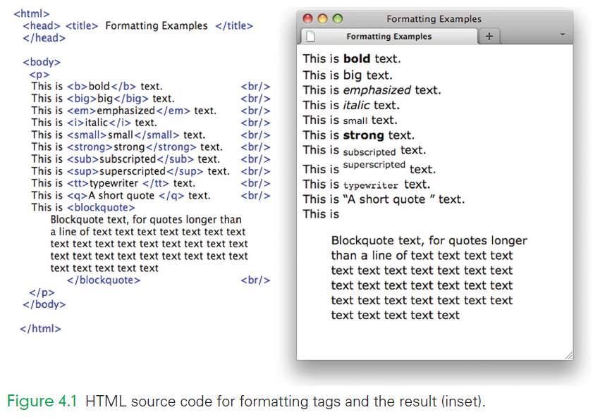

Slide 12
Required Tags
Every Web page is composed of a head and a body
There are three HTML tags required for every Web page:
<head> and </head> enclose the head
<body> and </body> enclose the body
<html> and </html> to enclose those two parts

Slide 13
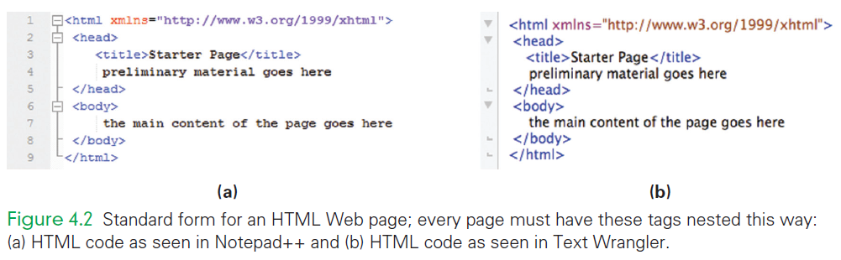

Slide 14
Required Tags
<html xmlns=“http://www.w3.org/1999/xhtml”>
The text following the letters html:
the dialect is XHTML
the part inside of the quotes must be written exactly as given

Slide 15
Required Tags
<head> <title>Starter </title> other stuff goes here…that will come later
</head>
The head section contains the beginning material like the title and other information that applies to the whole page

Slide 16
Required Tags
<body> the main content of the page goes here
</body>
The body section contains the content of the page.
This <html> <head> <body> form must always be followed
All of these tags are required

Slide 17
Configure Your Computer for Writing HTML
Check that two programs are installed:
A browser (check for Firefox)
A text editor (Notepad++ for Windows or Text Wrangler for Macs)
Both programs are free
These programs are preferred for technical reasons

Slide 18
Firefox
Firefox is a free open source browser
Open source means that the program code is publicly available, and any programmer can contribute improvements to it
Firefox is the browser referenced throughout this book
It is available at www.mozilla.com/en-US/firefox/all.html

Slide 19
Text Editor
A text editor is a basic way to process text
Our word processors are called “what-you-see-is-what-you-get” or (WYSIWYG)
Word processors include many application-specific information in their files
This information confuses browsers

Slide 20
Text Editor
You must use a text editor to write HTML
Text editors do not include this extra information, browsers like their files!
Browsers want Web pages written in ASCII characters only
Think of ASCII as the normal keyboard characters with “nothing strange”

Slide 21
Text Editor
Text editors figure out what language you are writing in and color code your HTML to make it easier to read
Operating systems come with text editors installed.
TextEdit can be found on the Mac
Notepad comes with Windows
TextWrangler and Notepad++ are better choices

Slide 22
Hello, World!
To produce your first HTML page, follow these instructions:
In your text editor, open a New document instance.
Carefully type in your text (see next slide)
Remove the preliminary material goes here nothing will replace it, yet
Replace the main content of the page goes here with: <p>Hello, World!</p>
Save the file as starterPage.html
Open the file with the Firefox browser

Slide 23
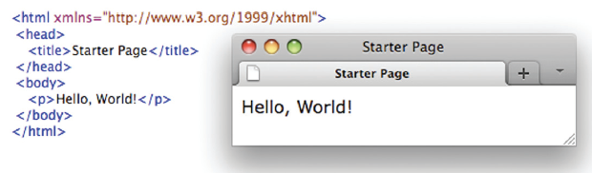

Slide 24
Open with Double-Click
As HTML is written, files must be opened in two applications:
the text editor, to make changes
the browser, to see the changes made
Double-click on the file to open it with the default application (your browser)

Slide 25
Save This Page
All HTML files have the same structure as the starterPage.html file just created
Use it as a template for future HTML coding
Set up a new folder to keep your HTML files in
Using your new page as a template ensure that all pages will have the correct form

Slide 26
Headings in HTML
Documents tend to have headings, subheadings
HTML provides several levels of heading tags:
<h1> and </h1> level one
<h2> and </h2> level two
…
<h6> and </h6> level six
Headings display content on a new line
headings are bold and get less “strong” (smaller and perhaps not so bold) as the level number increases.

Slide 27
HTML Format Versus Display Format
HTML source code tells the browser how to produce the formatted page based on the meanings of the tags
The source’s form is unimportant
HTML is written in a structured format to make it easier for people to understand
Indenting is frequently used to emphasize the tags’ meanings

Slide 28
White Space
Spaces that have been inserted for readability are called white space
White space is created with spaces, tabs, and new lines (return or enter)
HTML ignores white space
The browser turns a sequence of white space characters into a single space

Slide 29
White Space
The only white space exception is preformatted information contained within <pre> and </pre>
This information is displayed as it appears
The width of a line of text is determined by the width of the browser window
A narrower or wider browser window makes the lines break in different places

Slide 30
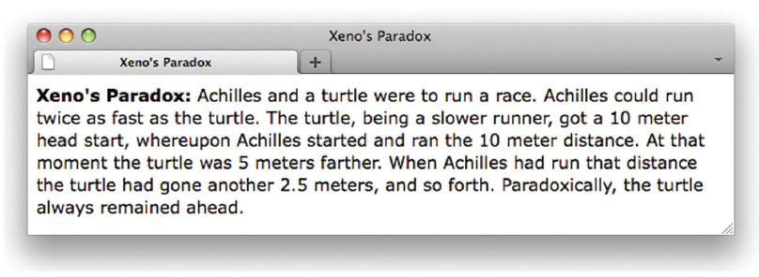
White Space
<p> <b>Xeno’s Paradox: </b>
Achilles and a turtle were to run a race. Achilles could
run twice as fast as the turtle. The turtle,
being a slower runner,
got a 10 meter head start, whereupon
Achilles started and ran the 10 meter distance. At that
moment the turtle was 5 meters farther. When Achilles had run
that distance the turtle had gone another 2.5 meters,
and so forth. Paradoxically, the turtle always remained
ahead. </p>

Slide 31
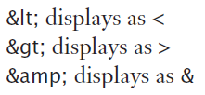
The Escape Symbol
What if the Web page had to show a math relationship: 0<p>r
The browser might misinterpret <p> as a paragraph tag
Using angle brackets as text is prohibited
To show angle brackets, use an escape symbol (&), followed by an abbreviation, followed by a semicolon

Slide 32
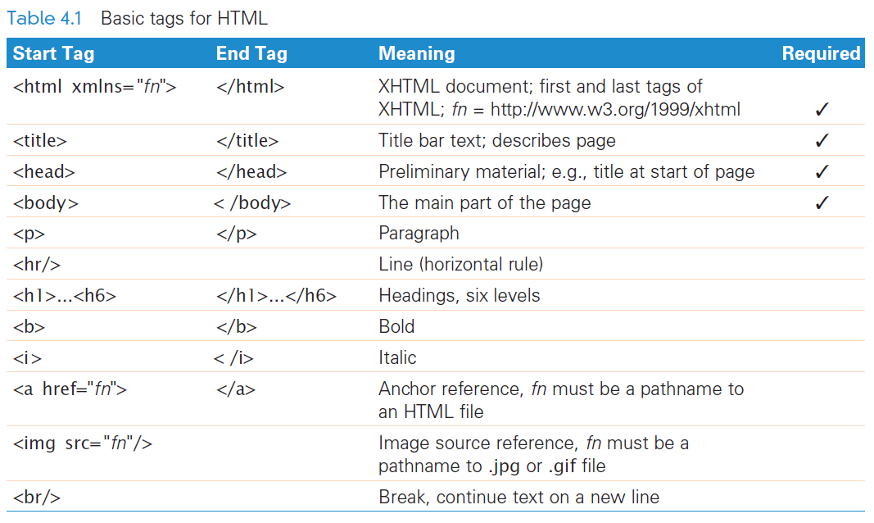

Slide 33
Accent Marks in HTML
Letters with accent marks also use the escape symbol
General form is:
ampersand, followed by the letter, followed by the name of the accent mark, followed by a semicolon
The case of the letter is important!
&eacute; displays as é
&Egrave; displays as È

Slide 34
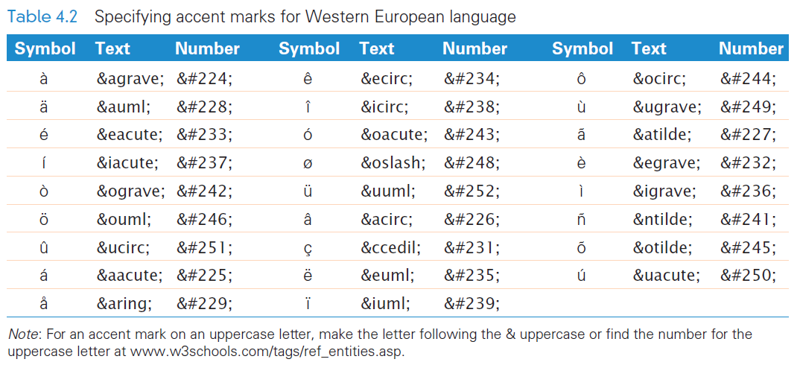

Slide 35
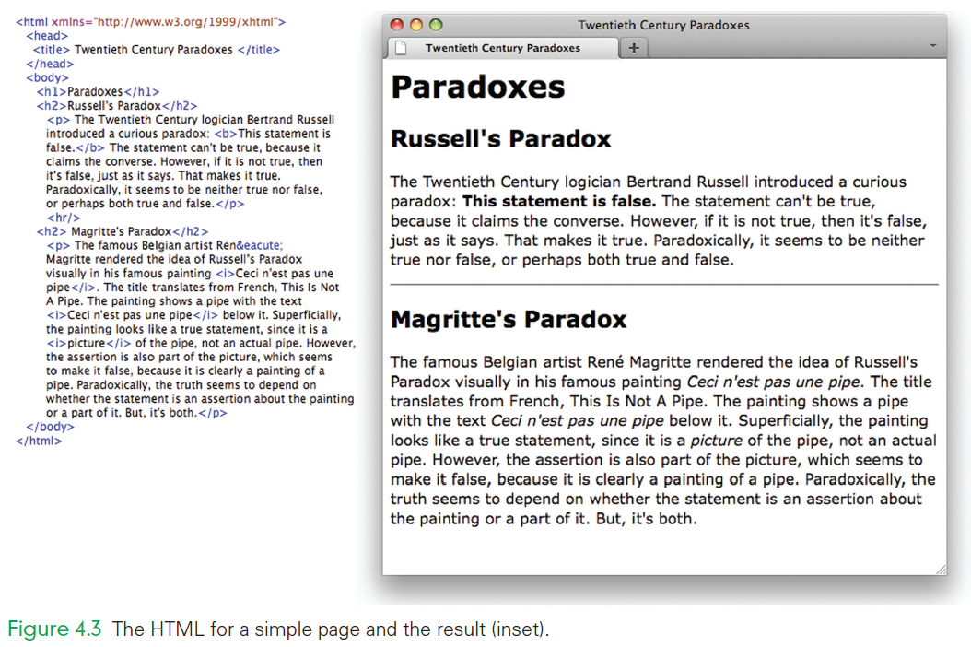
HTML
Notice the following:
The title is shown on the title bar of the browser window
The statement of Russell’s Paradox is in bold
The HTML source paragraphs are indented more than the <h2> heading lines to make them more readable

Slide 36
HTML
Notice the following:
The line between the two paragraphs crosses the width of the browser window
An acute accent is used in Magritte’s first name
The French phrase from the painting is in italics
The word picture is in italics for emphasis

Slide 38
Compose and Check
Most often Web pages are created all at once—both content and form
It is smart to check your typing and your tagging often
Assume a page is okay
Add a few more tags, then the page is wrong
It must be the last tags added that have the error

Slide 39
Compose and Check
A productive way to work is to keep two windows open:
your text editor
your browser
After writing a few HTML formatting tags, save the file
Check the result in the browser by a Reload or Refresh of the source
Repeat

Slide 40
Markup Validation Service
Another way to limit the mistakes you make is to have it automatically validated
This service checks to make sure your XHTML is correct
If it is wrong, the service tells you where the mistakes are and what’s not proper

Slide 41
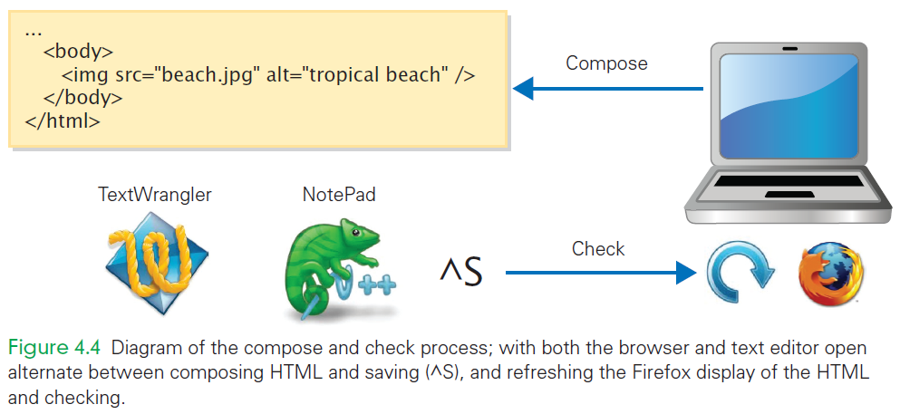

Slide 42
Add Extra Information
To benefit from the automatic checking service, you need to add three more lines to the starterPage.html
These lines are not required for the file to be a proper XHTML page, but they are needed by the checking service
Before the <html . . . > tag, add the lines: <!DOCTYPE html PUBLIC "-//W3C//DTD XHTML 1.0 Strict//EN“ "http://www.w3.org/TR/xhtml1/DTD/xhtml1-strict.dtd">

Slide 43
Add Extra Information
The other line that we need to add is <meta http-equiv="Content-Type" content="text/html; charset=utf-8"/> between <head> and <title>
This code specifies that the character encoding for the Web page will be UTF-8, or Unicode Translation Format for bytes
This Unicode representation will be explained in Chapter 7

Slide 44
Check My Work
With the three lines added, the validation service is ready to be used
Normally, validation doesn’t happen until the HTML page is finished and stable
During “compose and check,” the validation occurs at a “stopping place”
To validate go to the W3C Markup Validation Service at: validator.w3.org/#validate_by_upload

Slide 45
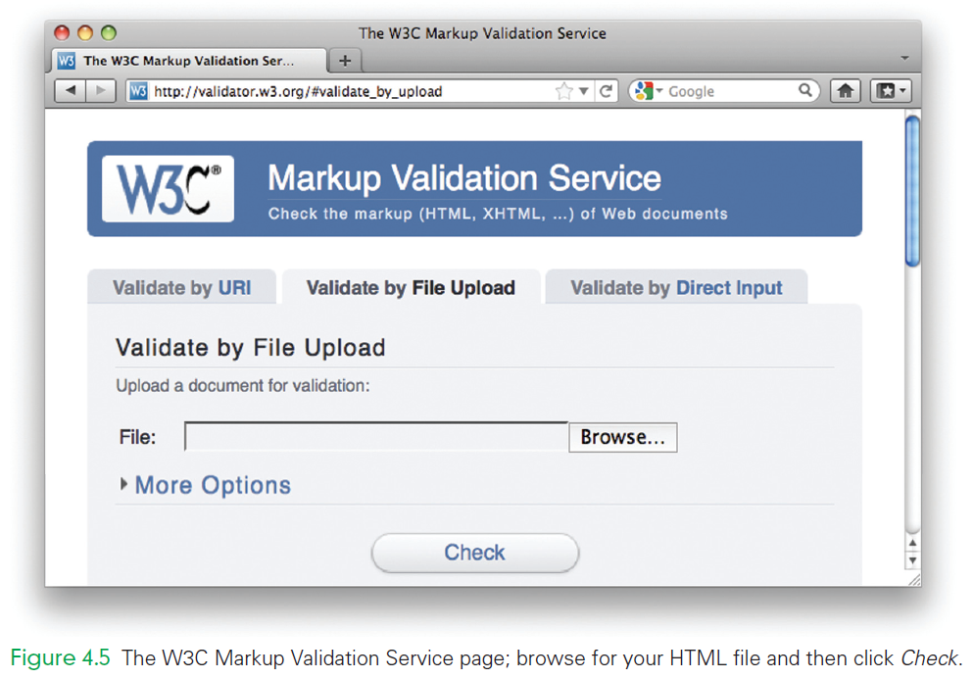

Slide 46
Check My Work
If a green banner comes back: the NHTML checks out
If a red banner comes back, it will have a list of errors with it and an explanation of what’s wrong.
It’s common to have a lot of errors at the start

Slide 47
Marking Links with Anchor Tags
Two Sides of a Link, making hyperlinks
When a user clicks a hyperlink, the browser loads a new Web page
There are two parts to a hyperlink:
the highlighted text in the current document, which is called the anchor text
the address of the other Web page, called the hyperlink reference

Slide 48
Marking Links with Anchor Tags
Both parts of the hyperlink are specified in the anchor tag:
Begin with <a and make sure there’s a space after the a but not before it. a is for anchor.
Give the hyperlink reference using the href attribute href="filename", making sure to include the double quotes.
Close the anchor tag with the > symbol.
Give the anchor text, which will be highlighted when it is displayed by the browser.
End the hyperlink with the </a> tag.

Slide 49

Bertrand Russell

Slide 50
Absolute Pathnames (URLs)
In these anchor tags, the hyperlink reference is an entire URL
The Web browser needs to know how/where to find the page
A URL is made from:
a protocol specification, http://
a domain or IP address, www.bioz.com
a path to the file, /bios/sci/russell.html

