Slide 1
Relative Pathnames
Often links refer to other Web pages on the same site
These pages are all be stored in the same or nearby folders
These anchor tags use relative pathnames
A relative pathname describes how to find the referenced file relative to the file in which the anchor tag appears

Slide 2
Going “Deeper” in a Folder
When the file containing the anchor and the referenced file are in the same folder—we just give the file name <a href="russellbio.html">Russell</a>
When the referenced file is “deeper” in the directory, we simply give the path from the current folder down to the file <a href="biographies/russellbio.html">Russell</a>

Slide 3
Going “Higher” in a Hierarchy
But, what about moving higher up in the hierarchy
This is a UNIX operating system technique
Navigating up to another folder: add ../ to the beginning of the href attribute <a href /biographies/russellbio.htm ”> Russell </a>
Each ../ moves up one level higher in the hierarchy

Slide 4
Structure of the Image Tag
An image tag specifies a file that contains an image: <img src="filename" alt="description"/>
src is the abbreviation for “source”
filename uses the same rules for absolute and relative pathnames as anchor tags
alt value specifies an alternative form for the image, usually a textual description

Slide 5
Structure of the Image Tag
The alt tag was introduced to assist persons who are visually impaired
Screen readers don’t know what the image is, but they can read the description of the alt tag
HTML requires alt tags
When an image is not available or loads slow, browsers display the alt information

Slide 6
GIF and JPG Images
Images can come in several formats
Web pages tend to use two of them:
GIF (pronounced is jif ) (Graphics Interchange Format) best suited for cartoons and simple drawings
JPEG (pronounced JAY·peg) Joint Photographic Experts Group appropriate for high-resolution photographs and complex artwork

Slide 7
GIF and JPG Images
PNG are newer forms of GIF and can also be used on Web pages
PNG stands for Portable Network Graphics format
To tell the browser which format the image is in, the file name should include one of these extensions: .gif, .png, .jpg, or .jpeg

Slide 8
Making an Image Link
We do not have to use text as the anchor
Images can be used as well
Combine an anchor tag with an image tag: <a href="history_red_square.html"> <img src="red.gif" alt="Red Box“></a>
When the page displays, the usual highlighting that links receive will be used to mark the .gif as a link

Slide 9
Attributes
Attributes
An additional specification included inside a tag
The abbreviations href, src, and alt are attributes
Attributes have the form name="value“
the name, such as href, is the attribute
the text in quotes, such as, biographies/russellbio.html, is the value
Values are always enclosed in quotes

Slide 10
The Style Attribute
The style attribute is the most useful attribute
Used to control a huge list of properties for every feature of a Web page
Properties are characteristics of page components, such as color, size, or position.
The value of the style has a standard form: style = "property_name : specification”

Slide 11
The Style Attribute
style = "property_name : specification"
The colon (:) separates the property name from its specification
The spaces on each side of the colon are optional <body style="background-color : black; color : green">
Notice that when more than one property is set with style, the name/specification pairs are separated by a semicolon (;)

Slide 12
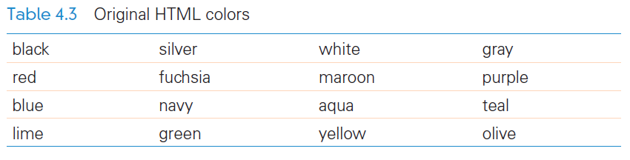

Slide 13
Attributes for Image Tags
The attributes width and height of the image tag can be used to specify the size of an image <img src="puffer.jpg" width="200" height="200" alt="origami puffer fish"/>
The photo puffer.jpg will appear as 200 × 200 pixels, even if the actual size of the photo is 2000 × 2000
Specify only the width or the height of an image

Slide 14
Attributes for Image Tags
The browser will shrink that length or width dimension of the image by some factor f
The browser will automatically reduce the other dimension by the same factor f , producing a smaller picture
Take care in specifying both width and height
Images can become distorted if f is not consistent for both width and height

Slide 15
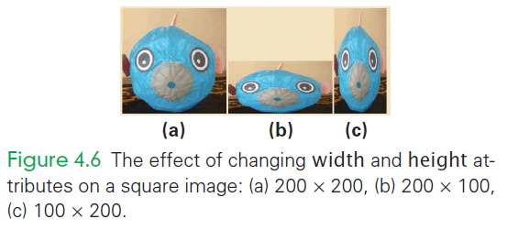

Slide 16
Styling Position for Images
Images are inserted in the page at the point in the text where the tag is specified in the HTML, and the text lines up with the bottom of the image
Messy? Hard to read?
A better way to place images in text is to flow the text around them

Slide 17
Styling Position for Images
You can either by positioning the image on the left with the text to its right, or vice versa
To make the text flow around the image, use the style attribute in the image tag with the value "float:left" or "float:right“
To display an image without any text around it, enclose it in paragraph tags

Slide 18
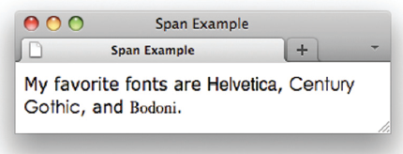
Span
What if there is no tag to add a style attribute?
Use the <span> tag
<span>’s only job is to surround text, and provide a place for style and other attribute information
My favorite fonts are <span style="font-family : helvetica">Helvetica </span>,
<span style="font-family : century gothic">Century Gothic</span>, and
<span style="font-family : bodoni">Bodoni</span>.

Slide 19
Cascading Style Sheets (CSS)
Cascading Style Sheets (CSS) are responsible for much of the design of Web pages
It is a general styling system for documents that simplifies the task of creating complex page designs

Slide 20
Setting Global Style
Repeating style information wherever it is needed can be time-consuming and tedious
It can be placed in one global location inside the <head>
It then applies to the whole page
Place the style information inside a pair of <style> and </style> tags

Slide 21
Setting Global Style
The <style> tag contains a type attribute specifying the form of the style
Within the <style> and </style> are specifications for each tag that should have its properties adjusted
The general syntax is elem_name { prop_name1 : value1 ; prop_nameN : valueN }

Slide 22
Setting Global Style
The text between the tag’s angle brackets, known as the tag element, is given by the element name
When styling a particular tag, use the name only, we are not allowed to use the brackets here
After the element name and inside curly braces ({}) is the list of property—value pairs separated by semicolons

Slide 23
Setting Global Style
For each value pair, the property is separated from its value by a colon
Now, all occurrences of the tag will be styled with these properties
A document can be now given a consistent look without having to repeat the styling information every time a style tag is used

Slide 24
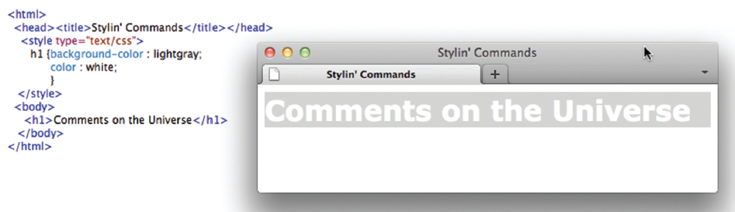

Slide 25
In Styling, Closest Wins
What if you want an exception to the rule?
What if you want the <h2> to look different for one heading?
Just style that specific tags with the style attribute
The basic style is given globally, a specific style is given locally or at that point in the Web page

Slide 26
Adding Class to Style
If a tag should be styled in several different ways, then there are several different classes of styling
A class is a family of styling specifications with a common name
The class is given in two places:
In the style definition inside the style tags in the <head>
At the site in the HTML code when the code is used

Slide 27
Adding Class to Style
<h2 class="scientist"> . . . </h2>
For the style definition, we append the class name (scientist) to the tag with a dot: h2.scientist
Plain <h2> tags are styled with those features that apply to all <h2> tags
Each separate class gives additional styling specifications

Slide 28
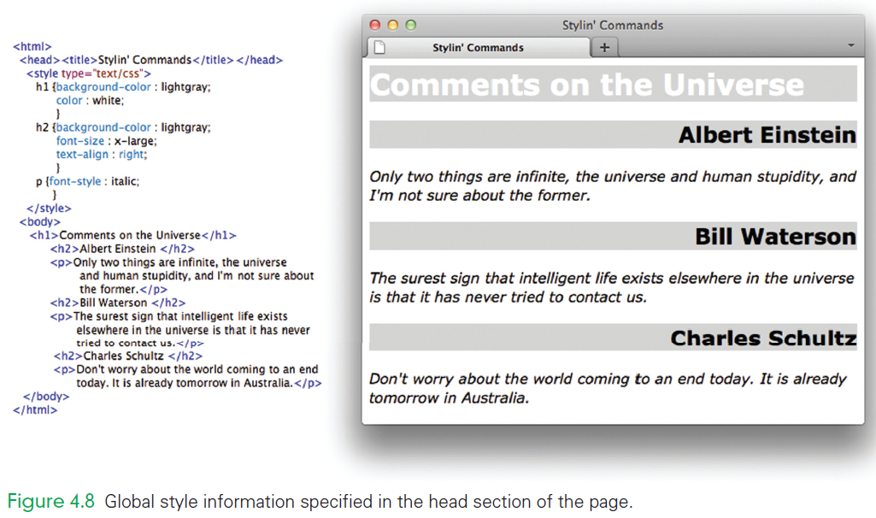

Slide 29
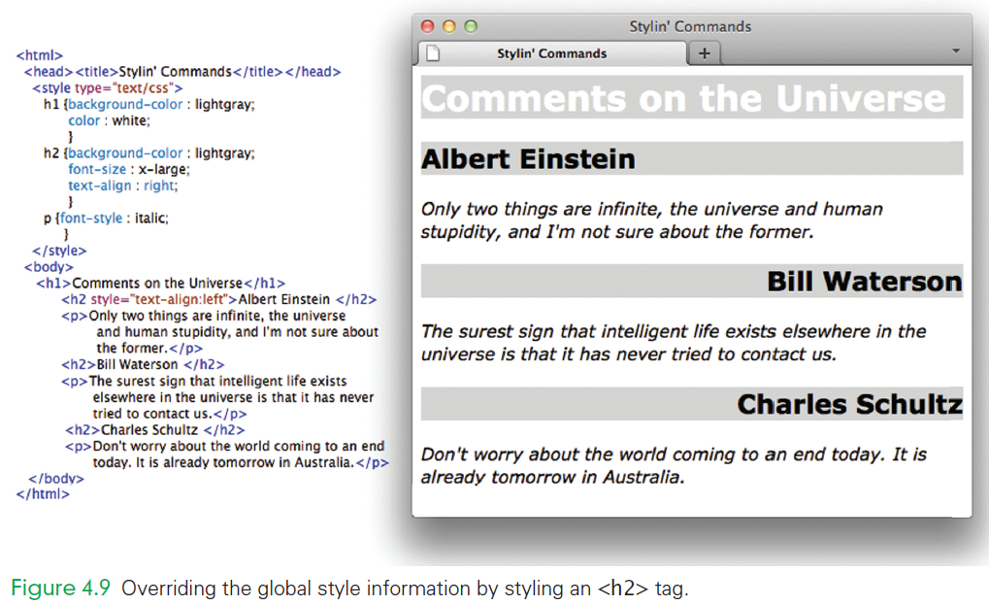

Slide 30
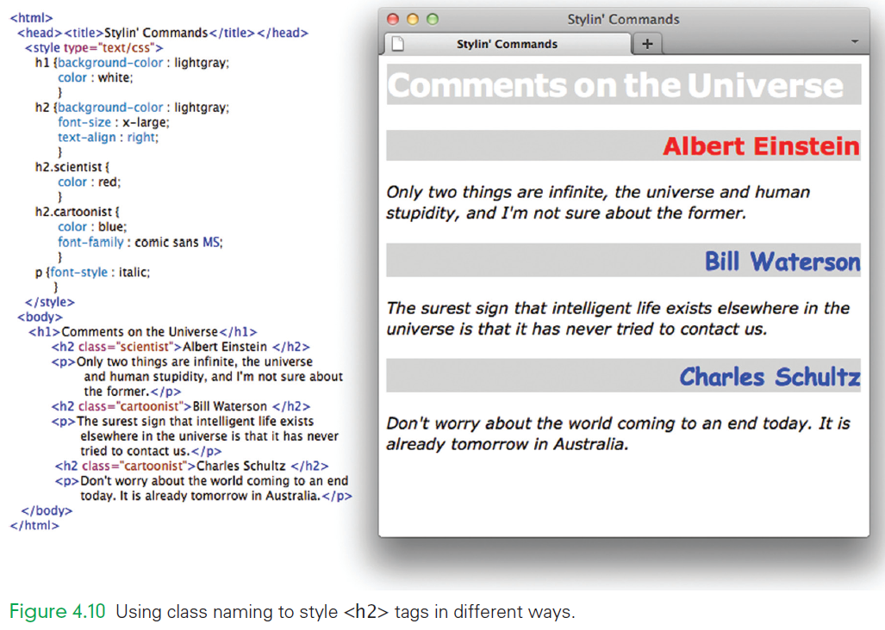

Slide 31
Style from Files
To reuse the style information for multiple works, all of the style information is placed inside a separate file
The browser is told where the style information is by using a <link> tag in the <head>: <link rel="stylesheet" type="text/css" href="AWAstyle.css">
This ensures that a whole site is styled consistently

Slide 32
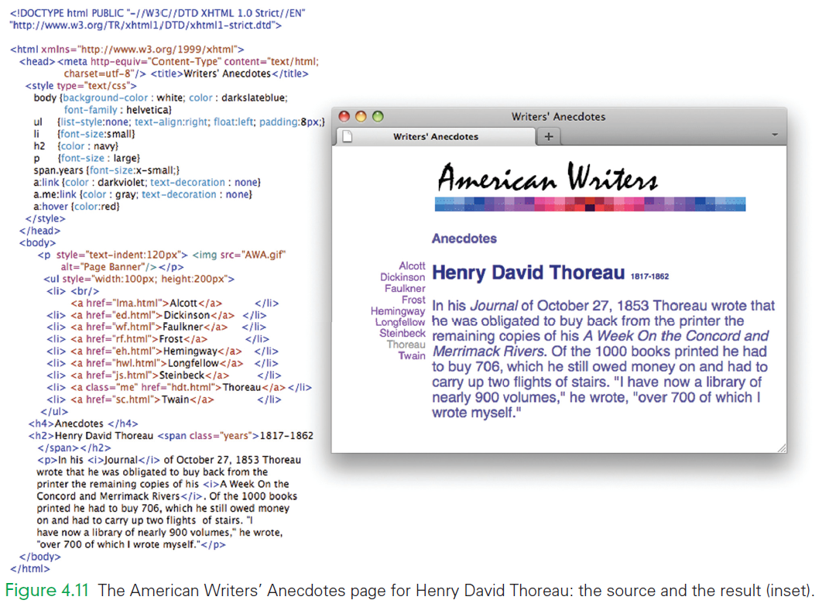

Slide 33
Moving Style to a File
<link rel="stylesheet" type="text/css" href="AWAstyle.css">
Place the global style specification into a file as a sequence of elements and their property/specification pairs
Don’t include the <style> tags!
The style file should be plain ASCII text
The file extension should be .css
Moving the style out shortens the <head> section of the HTML

Slide 34
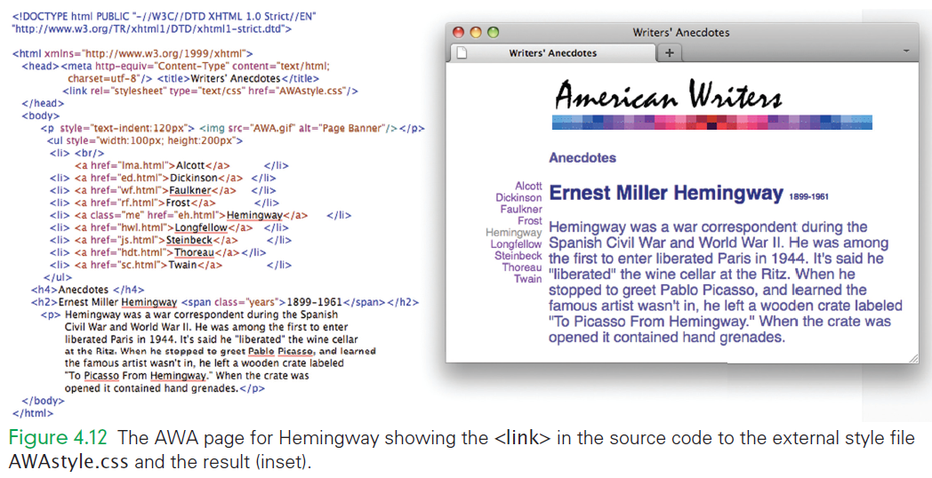

Slide 35
Cascading the Style Sheets
CSS uses the rule “closest style wins”
There are 5 levels of styling information:
Default, given by browser settings
External, given in a file
Global, given in the <head> section
Range, given in an enclosing tag
Site, given by the style attribute

Slide 36
Cascading the Style Sheets
Each level is broader and more general than the level below it
However, there’s a rule: the closest style wins!
This idea of progressively becoming more site specific is the “cascading” behind Cascading Style Sheet
It allows general styles to be adopted at various and overridden later

Slide 37
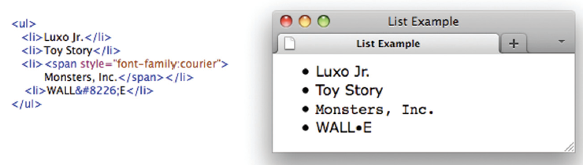
Lists Tags
The easiest type of list is the unordered list
Unordered list tags <ul> and </ul> surround the items of the list
The items are enclosed in list item tags, <li> and </li>

Slide 38
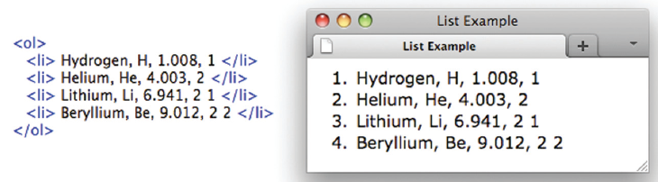
Lists Tags
Another list is the ordered list
It uses the tags <ol> and </ol>
Bullets are replaced with numbers
The ordered list behaves just like the unnumbered list

Slide 39
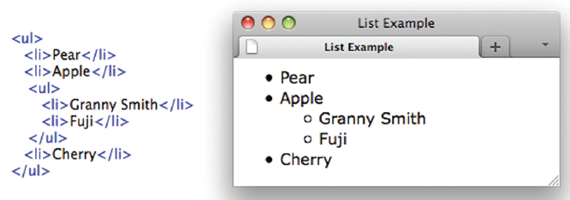
Lists Tags
You can also have a list within a list
Make a sublist within the main list
Notice that sublists use a different bullet symbol

Slide 40
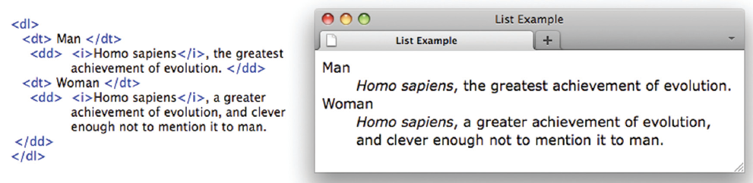
Lists Tags
The definitional list
Indicated by the <dl> and </dl> tags
Definitional lists are made of:
Definitional terms surrounded by <dt> and </dt>
Definitional data surrounded by <dd> and </dd>

Slide 41
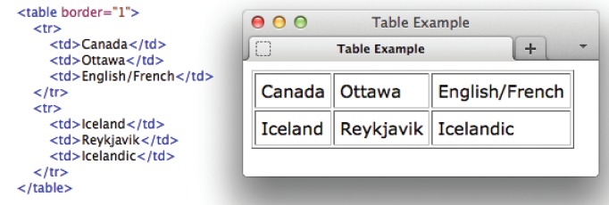
Handling Tables
A table is a good way to present information.
It’s like defining a list of lists
The main list items, called rows, has one or more items, called cells
The browser aligns cells to form columns

Slide 42
Handling Tables
The table is enclosed in <table> and </table>
The table can have a border, if you use the border attribute
Each row is enclosed in <tr> and </tr>
Cells are surrounded by table data tags, <td> and </td>

Slide 43
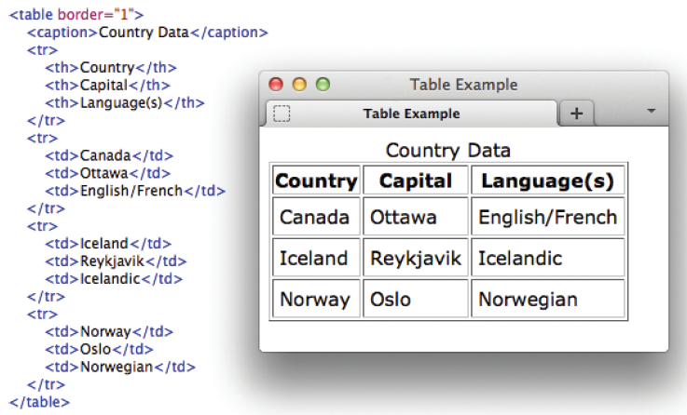

Slide 44
Handling Tables
You can give tables captions and column headings:
Place caption tags within the table tags around the table’s caption
caption tags are <caption> and </caption>
Captions are centered at the top of the table

Slide 45
Handling Tables
Column headings are the first row of the table
In the “heading” row, replace the table data tags with table heading tags <th> and </th>
Column headings display in bold

Slide 46
Pseudo Classes
There are properties to change the style of links
The default is for links to be blue and underlined
Style the anchor tag: a:link {color : darkviolet; text-decoration : none} a.me:link {color : gray; text-decoration : none} a:hover {color:red}

Slide 47
Pseudo Classes
These styles are slightly different from the other tags
The anchor tag has several different states that can be styled separately
These states are referred to as pseudo classes
The three main states are link, hover, and visited

Slide 48
Pseudo Classes
link: the style for an unvisited link
hover: the style for when the cursor hovers over a link
visited: the style for links that have been visited

Slide 49
Summary
Recall the idea of using tags for formatting:
A working set of HTML tags, giving you the ability to create a Web page.
An explanation of how links are marked with anchor tags.
Absolute and relative pathnames. Relative pathnames refer to files deeper or higher in the directory hierarchy.
The two most popular image formatting schemes and how to place them in a page.
Cascading Style Sheets, a general system for styling Web documents.
Lists and tables.

Slide 50
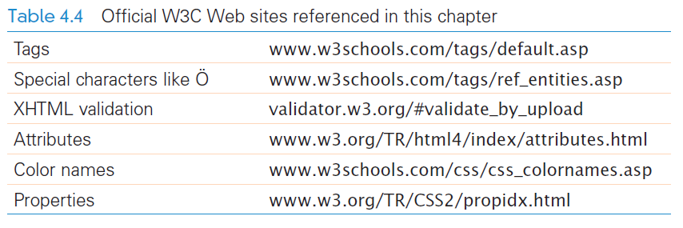
Summary

