Slide 2
Learning Objectives
Explain how a Web search engine works
Find information by using a search engine
Use logical operators, filtering to express complex queries
Recognize and find authoritative information sources
Decide whether Web information is truth or fiction

Slide 3
Web Search Fundamentals
A search engine is a collection of computer programs that help us find information on the Web
No one organizes the information posted on the Web
Search Engines must look around to find out what’s out there and then organize what is found

Slide 4
How a Search Engine Works
The first step, crawling, visits every Web page that it can find
How are the pages found?
The crawler has a todo list that is loaded with a set of pages to start
When a URL is found while crawling a page, it adds that URL to the todo list
The main work of the crawler is to build an index

Slide 5
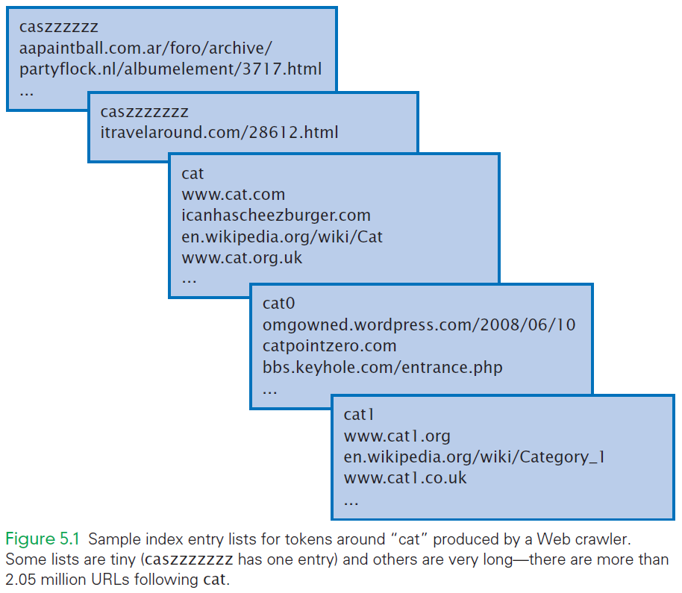

Slide 6
How a Search Engine Works
The index is a list of tokens (or words) that are associated with the page
The token might be part of the page’s title
There are other ways for a token to be associated with a page
For each token, the crawler creates a list of the URLs associated with that token

Slide 7
How a Search Engine Works
The second step is query processing
The user presents tokens (aka search terms) to the query processor
The search engine then looks up the word in the index and returns to you a hit list
By creating the index ahead of time, search engines are able to answer user queries very quickly

Slide 8
Multiword Searches
With a multiple-word query, the pages returned should be appropriate for all of the queried words
AND-query
Each page returned should be associated with all the words
There is no index entry corresponding to a set
There is only a list for the individual words

Slide 9
Intersecting Queries
For multiple words, the query processor fetches the index lists for each of the terms
URLs that are in all of the lists are looked at and compared
The query processor intersects the lists
The URL lists are alphabetized to speed up the processing … it is easier to notice when the same URL is on multiple lists

Slide 10
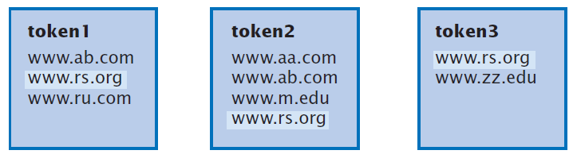

Slide 11
Rules for Intersecting Alphabetized Lists
To intersect several alphabetized lists:
Put a marker (arrow) at the start of each token’s index list.
If all markers point to the same URL, save it, because all tokens are associated with the page.
Move the marker(s) to the next position for whichever URL is earliest in the alphabet.
Repeat Steps 2–3 until some marker reaches the end of the list.

Slide 12
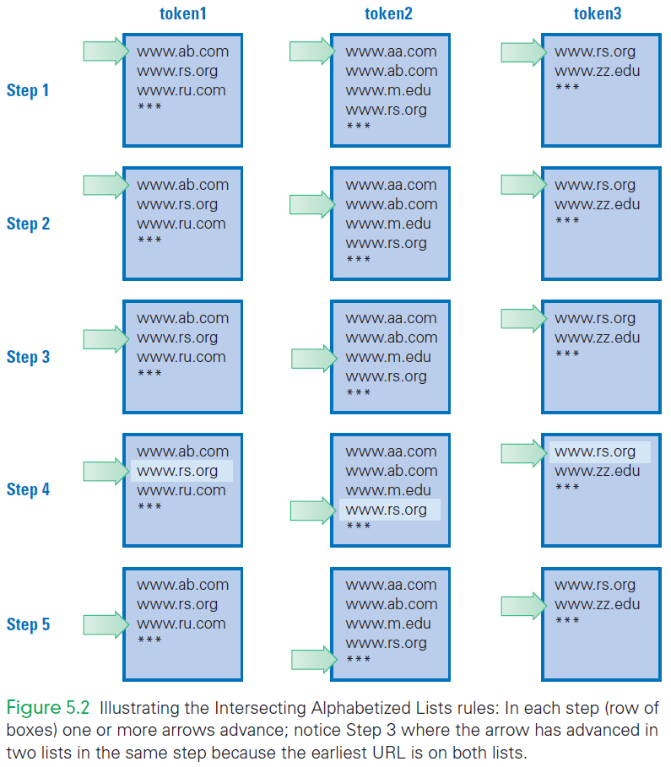

Slide 13
Power of an Indexed Search
The computer:
takes the time to crawl the data (Web pages)
build an index first
find the index entries for each word
intersect the lists to find the information for an AND-query
Search engines can look at billions of Web pages and return an answer in less than a fifth of a second

Slide 14
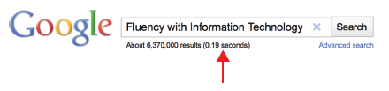

Slide 15
Descriptive Terms
“Hits” on a page means the search term is “associated” with the page
This does not mean the word is “on” the page
Web page structure helps a lot to identify descriptive text

Slide 16
Descriptive Terms
Descriptive text:
Title—The <title> encloses a short phrase describing the whole page
Anchor text—The highlighted link text, inside <a . . . > tags, describes the page it links to
Meta—A <meta . . . > tag in the head section can hold a several sentence description of the page
Alt attributes—The <img . . . > tag has an alt attribute that gives a textual description

Slide 17
Page Rank
Why, when the hit list is returned, the page you’re looking for is often first on the hit list or in the top 10?
The order in which hits are returned to a query is determined by a number called the PageRank
The higher the PageRank, the closer to the top of the list

Slide 18
Links to Other Pages
Google pioneered page ranking as a way to determine which pages are likely to be most important
PageRanking works like a voting system:
If page A links to page B, A’s link adds to B’s importance
Pages that are linked-to by many pages have a higher page ranking and are assumed to be more important

Slide 19
Links to Other Pages
Links from pages with a high page ranking are also viewed as more
PageRank is computed by the crawler:
The crawler looks at page A
It notices the links to page B
It scores one for B
Counting the number of links to a page is not sufficient

Slide 20
Links to Other Pages
After the crawling is completed, the PageRank computation is completed
The query processor is puts together the hit list
The URLs are sorted by their page ranking, highest to lowest, and returned in that order

Slide 21
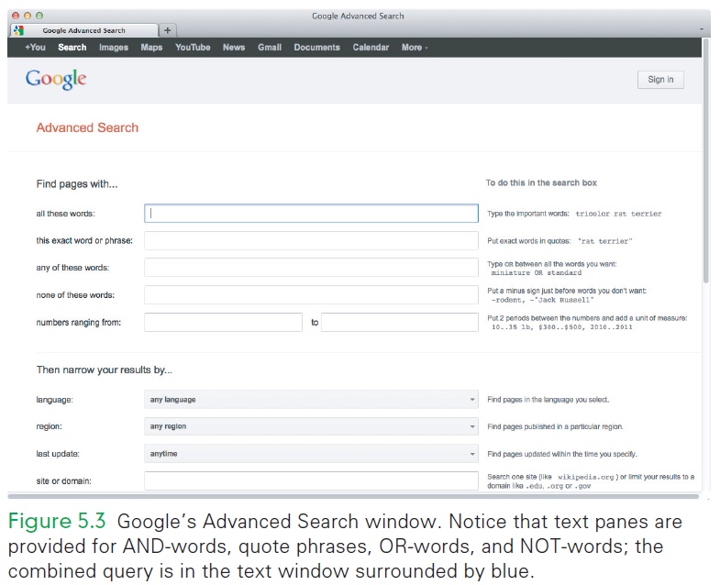

Slide 22
Advanced Searches
human AND powered AND flight
The Logical Operator AND
Basic queries are AND-queries
All words given must be associated with the page for a hit
The word AND is a logical operator
Logical operators specify a logical relationship between the words it connects

Slide 23
Advanced Searches
human AND powered AND flight
The Logical Operator AND
Search engines treat search words as three independent words
The words can appear anywhere on the page in any order
Use of quotes mean the exact phrase must appear as given…this is more than an AND query

Slide 24
Complex Queries
marshmallow OR strawberry OR chocolate
Another logical operator is OR
OR-queries hit on pages that are associated with at least of the words

Slide 25
Complex Queries
tigers AND NOT baseball
Another logical operator is NOT
NOT queries specify words that are not to be associated with the page
AND is included because we want both requirements to be true

Slide 26
Combining Logical Operators
(marshmallow OR strawberry) AND sundae
The logical operators work like arithmetic
They can be combined and grouped using parentheses
Google also uses a minus (–) as an abbreviation for NOT

Slide 27
Restricting Global Search
Many sites offer the opportunity to perform a site search
A site search means looking only on the current site
The site search is usually offered on the homepage with a search window and a Go button

Slide 28
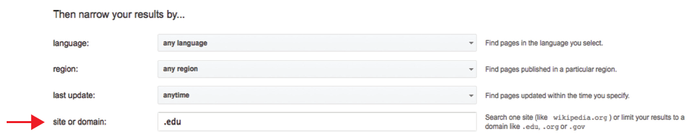
Filtered Searches
Constraints can be used to help pinpoint specific pages
Using these areas on the advanced search, can limit our search hits

Slide 29
Filtered Searches
Site searches don’t necessarily use PageRanking to order the hits
Use of the advanced search filters can be used to get PageRanked hits

Slide 30
Web Searching
Research on the web requires serious consideration and strategies:
Selecting Search Terms choosing good words to include in a query
The Anatomy of a Hit how to use the information returned
Using the Hit List skimming to find what you want quickly
Once You Find a Likely Page locating the desired data on the page

Slide 31
1. Selecting Search Terms
How do you find the best search terms?
It is a sequence of finding ever-more precise terms:
Advanced Search
General Topic
Descriptive Terms
Refining (Adding Words)
Avoiding Over Constraining
Removing Words

Slide 32
1. Selecting Search Terms
Use Advanced Search
Google’s Advanced Search gives control over the results returned
You can do complex queries, but Advanced Search provides control

Slide 33
1. Selecting Search Terms
Begin with the General Topic
Words have multiple meanings
Giving the topic can eliminate most of those conflicting words
Many hits can be eliminated
Start with the topic word(s)

Slide 34
1. Selecting Search Terms
Choose Descriptive Words
Be picky about the words we select
Select precise terms
Take care using terms that have many other meanings—they become less useful

Slide 35
1. Selecting Search Terms
Refine by Adding Words
Begin with a “first guess” search
Check the results
Check the initial hit list to see what you’ve found
The initial list often suggests additional terms to search
This may require several rounds of adding a word to the query each time

Slide 36
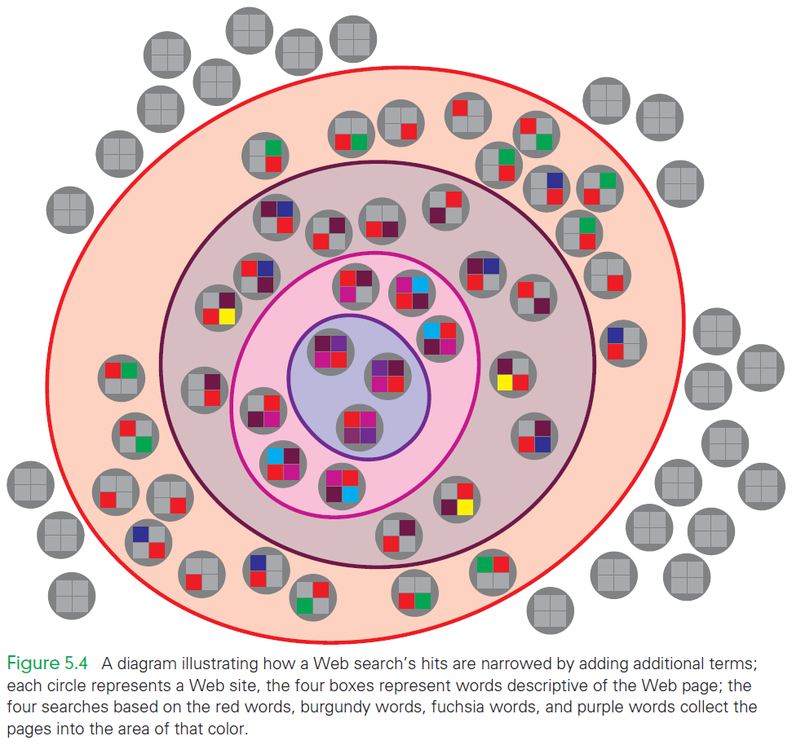

Slide 37
1. Selecting Search Terms
Avoid Over Constraining
Adding more words one at a time works best because interesting pages might be accidentally overlooked
Care is required in this process: Add a word only if you are sure the pages you want will have it

Slide 38
1. Selecting Search Terms
Remove Specific Words (Minus or NOT)
It is useful to consider eliminating pages with certain words
It is the opposite of adding words that may/will appear on a page
The minus sign is a good way to eliminate wrong interpretations of words

Slide 39
2. Anatomy of a Hit
What is displayed with each hit?
Title
This is the text between the page’s <title> and </title> tags.
Snippet
This information is a preview of what might be on the page
Usually a short phrase from the page containing one or more of the searched words

Slide 40
2. Anatomy of a Hit
What is displayed with each hit?
URL
The URL that is linked from the title line
Site Links
These are useful links from the site, which are basically shortcuts
These links are found algorithmically
They are not “sponsored” links – no one is paying for them

Slide 41
3. Using the Hit List
Checking the hits is a process of filtering
Skim the top level of information, and look deeper if it looks promising
If not, continuing skimming

Slide 42
3. Using the Hit List
“Looking deeper” ranks the information:
Title
It’s the first source of information
When the title checks out, look at the . . .
Snippet
Search terms are shown in bold
The context around the occurrence is given
If the snippet checks out, look at the . . .

Slide 43
3. Using the Hit List
“Looking deeper” ranks the information:
URL
The domain of the site hosting the page is given
The site name is the first check of how authoritative the information is
If the URL checks out, look at the . . .
Pageitself
At this point, there is some likelihood that the page includes information you need

Slide 44
4. Once You Find a Likely Page
A page has been found!
A suggestive title
A promising snippet
A reliable domain
How close are we to what is wanted?
First, “roll through the page” checking out its main features
Next, look for a date to see how current it is
Finally, find the location of one of the keywords

Slide 45
4. Once You Find a Likely Page
The goal is still to determine whether you want to stay on the page.
If you’ve found what you want, you’re done
If not, return to the hit list
If the site is good, decide how important it is that the information is perfectly correct:
If the importance is high, cross-check the information with another site
Find corroborating information!

Slide 46
Authoritative Information
Don’t Believe Everything You Read
No one in charge of the WWW, so no one checks to see that the information is correct
Some information is inaccurate
Most information on the Web should be considered suspect
Anyone can post a Web page and make random statements or claims…true, partly true, and completely false

Slide 47
Wikipedia
Wikipedia is an open source document created by knowledgeable and community-minded Internet users
Anyone can contribute to Wikipedia
Wikipedia covers an enormous number of topics
The information contained might not be included in a printed encyclopedia

Slide 48
Wikipedia
Its coverage and timeliness make it a valuable resource
The fact that many people contribute to Wikipedia is both a weakness and a strength
Anyone can add anything to or edit an entry without control
Use Wikipedia as a starting point for research

Slide 49
Using the Web for Research
Applying good research practices will ensure highly reliable information:
Question the information
Does it make sense? Is it believable? Is it consistent? Does the information fit with everything you already know?
Never rely on a single source; always use multiple sources.
Assess the site’s authoritativeness
Vary the kinds of resources you use, including off-line resources.

Slide 50
What Is Authoritative?
Authoritative means that we are looking for what experts say
We assume that experts are well informed on the topic
We assume that what experts say is true
There is no way to verify that what “they” say is true, so we accept that it’s the best available information

Slide 51
Respected Sources
Authoritative information can be gotten from respected organizations
Thousands of professional organizations host trustworthy Web sites
Individuals are also good sources of information as long as we have some reason to believe them

Slide 52
Primary Sources
A primary source is a person who has direct knowledge of the information
People who interview primary sources are secondary sources
They are not as reliable as primary sources
People who watch journalists on TV or read newspaper reports are tertiary sources
They are three levels removed from direct knowledge of the event

Slide 53
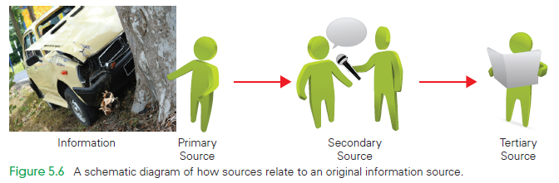

Slide 54
Primary Sources
A secondary source does not mean that the information is wrong, only that the possibility exists
There is no guarantee that even primary sources tell the truth

Slide 55
Authoritative Sources
The easiest way to get authoritative information is to go to a site that you know to be authoritative
Many agencies and organizations publish information you can depend on
By going directly to an authoritative source, you are ensured that the information is reliable

Slide 56
Site Analysis… Good? Bad?
Possible issues for bad sites:
Broken links
Failure to give contact information
Failure to have a non-Web identity
Simplistic design
No recent updates or blog entries
Spelling mistakes
Legitimate sites may have these issues, too!
To decide if a site is legitimate, do a little direct research on the information found there

Slide 57
Summary
In this chapter we have learned the following:
We need software and our own intelligence to search the Internet effectively.
Search engines are composed of a crawler and a query processor.
We create queries using the logical operators AND, OR, and NOT, and specific terms to pinpoint the information we seek.
Filtering and “subtracting” search terms removes extraneous hits.

Slide 58
Summary
In this chapter we have learned the following:
Once we’ve found information, we must judge whether it is correct by investigating the organization that publishes the page, and examining the facts claimed on the page.
We must cross-check the information with other sources, especially when the information is important.

