Slide 2
Learning Objectives
Explain how ordinary precision differs from computing precision
Describe the six-step strategy for debugging
Explain the purpose of each step
Give an example of each step
Apply the six-step strategy for debugging the HTML code for a Web page
Learn how to approach debugging when you don’t understand the system
Appreciate the problems of making perfectly reliable computing systems

Slide 3
Precision: The High Standards of Computing
The best way to handle bugs in computing is not to make any mistakes in the first place!
Humans make mistakes, usually unknowingly
But what about mistakes in writing computer programs?

Slide 4
Be Accurate
An example of how we can be aware of possible mistakes:
Recognizing mistaken substitutions: l for 1, O for 0, \ for /, and so forth
Knowing that certain fonts can be very confusing: Corbel zero (o) and oh (o)
Respecting upper- and lowercase in pathnames (www.ex.org/AllMine.html is likely not to be the same as www.ex.org/allmine.html)
Respecting upper- and lowercase in passwords

Slide 5
Be Observant
A principle of computing is that you should expect feedback when interacting with software
We rely on this feedback (busy icons, etc.)
By paying attention to feedback, we can catch errors as we make them

Slide 6
What’s the Problem?
Debugging is a process by which one figures out why an something isn’t working properly
It is usually applied to computer or communication systems
Debugging relies mostly on logical reasoning and is learned through experience

Slide 7
Debugging in Everyday Life
Debugging is troubleshooting
Humans do it all the time (why didn’t the car start? why didn’t the alarm go off?)
Faults and failures in everyday life usually involve devices that are working systems with a broken or worn-out part
The system is properly designed and constructed, but some part failed

Slide 8
Debugging in IT
Debugging a computation is different
We may have entered wrong data or wrong configuration information into a working system.
When it’s corrected, the system works.
Or…we might have a logical design error…we don’t get what we think we should get
Always begin by assuming the system is correct and working

Slide 9
Whose Problem Is It?
When debugging a computing system, we are almost always part of the problem
We command the computer to do tasks and we input the information
Two of the three possible problems with the system involve us:
wrong data
wrong command
broken system

Slide 10
Whose Problem Is It?
We don’t knowingly make errors…therefor we must be right! And the computer is at fault!
Sometimes it is: both hardware and software errors do happen
Human errors occur more often
Maybe we just misunderstood the system and how it works

Slide 11
Using the Computer to Debug
Not only is the computer unable to debug itself, we can’t debug it directly
Though there may be a bug in the software, most of the program works correctly
There are usually many ways to solve a problem.
Bypassing an error is called a workaround

Slide 12
More About Debugging
Debugging is solving a mystery
By asking questions (“Do I need more clues?”; “Are my clues reliable?) we focus better and discover a solution faster

Slide 13
Steps to Debugging
The first step in debugging is to check that the error is reproducible
Computers are deterministic -- they do exactly the same thing every time if given the same input
Start by trying to reproduce the problem

Slide 14
Steps to Debugging
The next step is to be sure that you know exactly what the problem is
the computer may perform a sequence of operations after an error
These operations must be eliminated first as the focal point of the debugging
Determining the exact problem is critical

Slide 15
Steps to Debugging
A standard next step is to check all of the “obvious” error sources
What kinds of errors are obvious depends on the problem
Checking inputs, connections, links, etc.

Slide 16
Steps to Debugging
Isolate the problem by dividing the operation into those parts that are working and those that are not
Theorize about where the problem is located
Gathering more information if needed
Limit the number of untested assumption
Eliminate as many possibilities as you can

Slide 17
Debugging Recap Guidelines
The following are key points to debug:
Make sure that you can reproduce the error.
Determine the problem exactly.
Eliminate the “obvious” causes.
Divide the process, separating the parts that work from the part that doesn’t.
When you reach a dead end, reassess your information, asking where you may be making wrong assumptions or conclusions; then step through the process again.
As you work through the process from start to finish, make predictions about what should happen and verify that your predictions are fulfilled.

Slide 18

A Debugging Case Study
To illustrate the debugging principles in action, imagine a simple page in HTML
The goal is to get a page that looks like this:

Slide 19

Look Closely At the Page
Working Page
Not Working Page..Firefox

Slide 20

Look Closely At the Page
Working Page
Not Working Page..Safari

Slide 21

Look Closely At the Page
Working Page
Not Working Page..Chrome

Slide 22

Look Closely At the Page
Working Page
Not Working Page..IE

Slide 23
Look Closely At the Page
The best way to get started, is to study the output closely to see where the errors are
The goal is to notice features that are right and features that are wrong
Note that the four browsers display the buggy page differently
All browsers should show a correct page exactly the same
It is sometimes possible to find a bug by comparing how different browsers show it

Slide 24
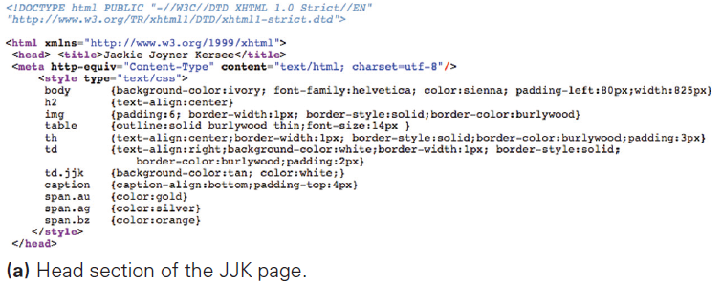

Slide 25
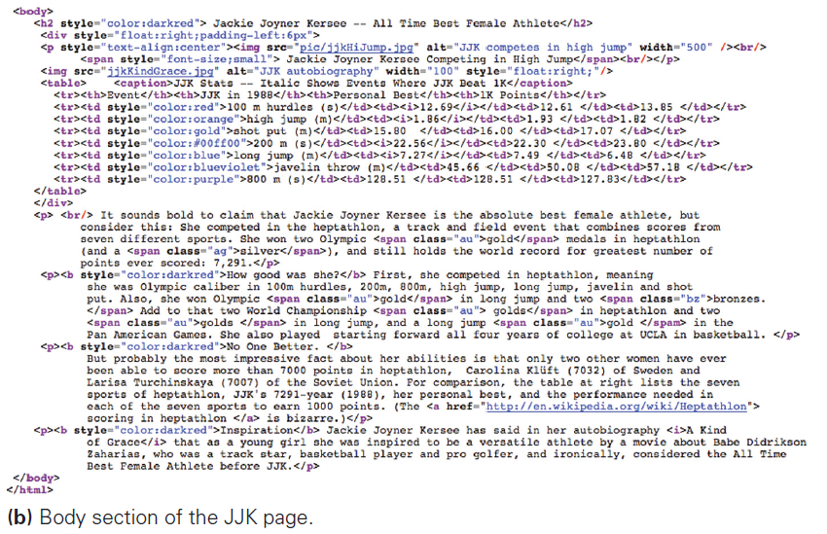

Slide 26
Reproduce the Error
As we begin debugging the HTML:
Recall that the first step is to reproduce the error
Close the browser and reopen the file
There is definitely a problem with our HTML!

Slide 27
Determine the Exact Problem
The next step is to determine the problem exactly
With HTML, identifying the problem is simple:
Look at the displayed page
When there are multiple bugs, pick one to concentrate on

Slide 28
Eliminate the Obvious
Once the problem is known:
Look for the “obvious” causes
Eliminate them
What’s the most obvious problem with a missing image?
The file is not where it should be, so the browser can’t find it
Check to see that the image is in the pic folder, which it is
Problem eliminated

Slide 29
Eliminate the Obvious
The next most obvious error is misspelling the file name:
Check the HTML
The path is messed up: It doesn’t mention the pic folder
After fixing the tag, the image is there!
It was an obvious mistake, so checking the “obvious” problems is smart.
One error down!

Slide 30
Focusing the Search
We return to the “determine the problem step” and continue with the next bug.
Determine the Exact Problem
Eliminate the Obvious
Divide Up the Process
Separate those parts of the system that work from the part that does not
This is not always possible to do perfectly

Slide 31
The “Divide Up the Process” Process
Step through the style section one element at a time
Do the following for each element:
Delete the entire element
Save the file
Refresh the display
Check to see that the only thing different is the styling of the removed element
Undo the deletion to restore the file to its original form

Slide 32
The “Divide Up the Process” Process
If removing an element restores other formatting, then we have found the element that is stopping the styling
We can fix it!
Separate the part that is broken from the parts that work (sound familiar?)

Slide 33
The “Divide Up the Process” Process
To figure out what is wrong with an element in css:
Repeat the process we just went through, eliminating parts of this line to see which one is the problem
Another approach might be to reenter the text
occasionally files get odd
unprintable characters can be hard to locate
retyping requires that we consider each part of the styling again, carefully

Slide 34
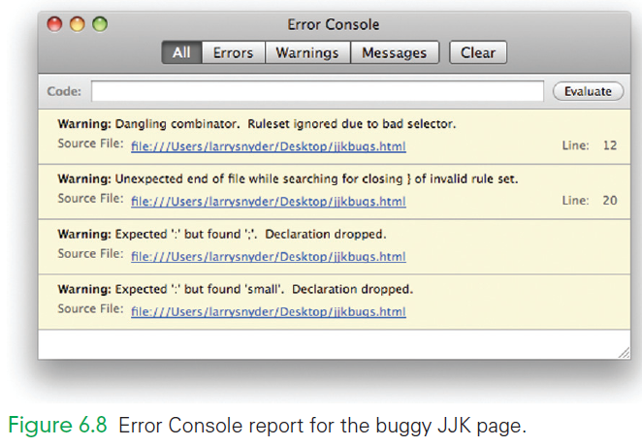
(Tools > Web Developer > Error Console)
In FireFox, go to the Error Console:
Clear whatever errors have accumulated
Refresh the page

Slide 35
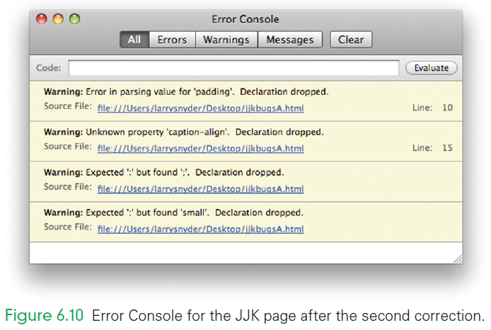

Slide 36
Debugging the Page: A Postmortem
We debugged the mistakes in the page by applying debugging guidelines:
Checked that the book cover file was in the pic folder—it was.
Checked the spelling of the file, but found that the path left out the pic part. Fixed.
Checked that the end tags were all present—they were.
Looked at the Error Console to find two mysterious diagnostics.

Slide 37
Debugging the Page: A Postmortem
We debugged the mistakes in the page by applying debugging guidelines:
Checked that the closing braces were all present—they were.
Separated working from failing code by a process of delete, check, undo—found th had stopped styling.
Checked the th element, and eventually spotted the opening parenthesis. Fixed.

Slide 38
Debugging the Page: A Postmortem
We debugged the mistakes in the page by applying debugging guidelines:
Looked at the Error Console again to find new diagnostics.
Checked padding, and noticed that the unit had not been set. Fixed.
Looked up “caption-align” to find it is “caption-side.” Fixed.

Slide 39
Debugging the Page: A Postmortem
We debugged the mistakes in the page by applying debugging guidelines:
Checked the wrongly colored text, and spotted a typo in the end tag. Fixed.
Checked the caption’s small font specification, and spotted a colon typo. Fixed.

Slide 40
Debugging the Page: A Postmortem
An additional common debugging feature: “Correcting” text that isn’t actually wrong because of a wrong conjecture
When we’re lucky, we end up changing the program text from correct to correct
When we’re unlucky, we change it from correct to incorrect
This means “backing out” and restoring the original

Slide 41
Debugging the Page: A Postmortem
Hiding Other Errors
Notice that the errors found were different from the errors we thought we had originally
This is very common in debugging:
Programmers never say that they are “down to the very last bug” . . . that bug could be hiding one more!

Slide 42
Debugging the Page: A Postmortem
Asking the System to Help
The most effective technique was to use the browser’s Error Console feature
It would have been more effective if the we had better understood the results
The Page Source shows color- and font-coded HTML source that tells us how the browser interprets the page

Slide 43
Debugging the Page: A Postmortem
Asking the System to Help
One of the most powerful debugging techniques is to find ways for the computer to tell us the meaning of the information it stores or the effects of the commands it executes.
Having the computer say how it’s interpreting our instructions can separate the case in which we give the right command—but mess up expressing it—and giving the wrong command.

Slide 44
No Printer Output…
You try to print a document and nothing happens…
The printing problem is solved just like the earlier problems were solved:
Reproduce the error,
Understand the problem, and
Check the obvious causes

Slide 45
No Printer Output…
These steps include:
checking the printer’s control panel, the paper, the cartridges, the cable connections, the file to be printed, the installation of the printer driver,
whether others can print if this is a shared printer, and
whether you can print a different document

Slide 46
No Printer Output…
Take the next step in the debugging strategy: Try to isolate the problem
Because you have printed before, you know your computer is configured correctly.
Try to print a simple document, but it’s the same story
Unplug the printer from the computer and try again to print.
Locate the printer driver’s printing monitor to see what files, if any, are listed

Slide 47
The Print Queue
The print queue for your machine:
A place where printing tasks wait before being processed
The best approach is to cancel or trash all of the jobs in the queue, and restart the queue
Configure the printer so that it tries to print your files immediately rather than queuing them
Is your computer connected/reconnected to your printer?

Slide 48
Ensuring Software Reliability
Software contains bugs, and crashes are frustratingly frequent
Most errors are just an annoyance
What about computers that control life-support systems, medical apparatus, airplanes, nuclear power plants, weapons systems, etc?
Errors in these systems are potentially much more serious

Slide 49
Hardware Failures
Hardware failures can be resolved using techniques such as redundancy…multiple computers performing computations of a safety-critical system
Another technique is dubbed burn in
Most errors show up after few hours of operation
A computer that has a record of successful operation is likely to continue to operate successfully

Slide 50
Software Failures
Software is amazingly complex
Number of possible configurations that a typical program can define grows exponentially
All these states, known as reachable configurations, cannot be examined for correctness
How can we be sure programs work correctly?

Slide 51
Software Failures
Programmers begin with a specification or a precise description of:
the input,
how the system should behave, and
how the output should be produced
The specification doesn’t say how the behavior is to be achieved, just what it should be

Slide 52
Software Failures
Using various design methods, programmers produce the program and test it with sample inputs
Outputs can be checked against the specification
If they do not match, there is a bug and the program must be fixed
A program is said to be correct if its behavior exactly matches its specification

Slide 53
The Challenge
What about the fact that we can’t prove that software is correct?
Accept that software may contain bugs
Poorly tested software is simply unprofessional
Be cautious and informed users and take our business to those who produce the best product

Slide 54
Fail-Soft and Fail-Safe Software
“Safe software” changes the focus from worry about program correctness to concern about the consequences
Testing gives confidence that software works “under normal circumstances”
It is difficult to test software under unusual circumstances

Slide 55
Fail-Soft and Fail-Safe Software
There are two design strategies: fail-soft and fail-safe
Fail-soft means that the program continues to operate, providing a possibly degraded level of functionality
Fail-safe means that the system stops functioning to avoid causing harm
The strategy is to continue to operate as long as service is safely provided
Using software to control potentially dangerous systems means taking a risk

Slide 56
Community Debugging
There are hundreds of chat sites where people post their problems, and other people offer help
If your problem has surfaced before, then a Web search should locate a place where the solution is discussed
Asking the community is a good tactic to keep in mind

Slide 57
Summary
We learned the following:
What debugging is and why we need to know how to do it.
Basic debugging strategy, including the whys and hows of debugging.
To debug a Web page, using the Error Console of the document that shows how the computer interprets the HTML.

Slide 58
Summary
We learned the following:
How to analyze our debugging performance, noting that debugging involves both correct and incorrect conjectures.
That it’s possible to debug a sophisticated system like a computer printer with little more than a vague idea of how it works, by using our standard debugging strategy applied with common sense and courage.

Slide 59
Summary
We learned the following:
That it is practically impossible to have bug-free software. This doesn’t mean that we must quit using computers or accept bugs, but we must watch for unusual behavior that might indicate bugs and take precautions to limit the harm that they can cause.

