Slide 2
Learning Objectives
Explain the link between patterns, symbols, and information
Compare two different encoding methods
Determine possible PandA encodings using a physical phenomenon
Give a bit sequence code for ASCII; decode
Represent numbers in binary form
Explain how structure tags (metadata) encode the Oxford English Dictionary

Slide 3
Digitizing Discrete Information
The dictionary definition of digitize is to represent information with digits.
Digit means the ten Arabic numerals 0 through 9.
Digitizing uses whole numbers to stand for things.

Slide 4
Limitation of Digits
A limitation of the dictionary definition of digitize is that it calls for the use of the ten digits, which produces a whole number
Alternative Representations
Digitizing in computing can use almost any symbols
Any ten distinct symbols will work as long as items are labeled properly.

Slide 5
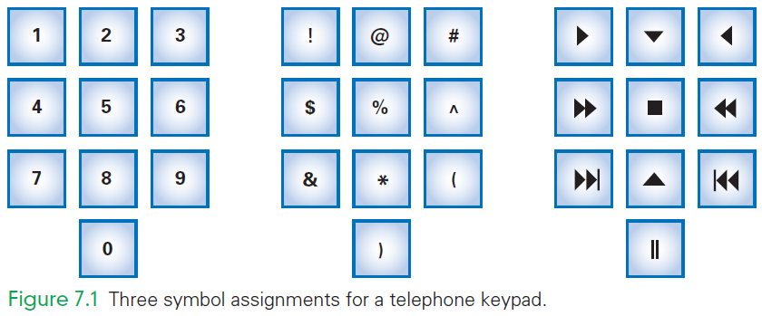

Slide 6
Symbols, Briefly
One practical advantage of digits is that digits have short names (one, two, nine)
Imagine speaking your phone number the multiple syllable names:
“asterisk, exclamation, closing parenthesis”
IT uses these symbols, but have given them shorter names:
exclamation point . . . is bang
asterisk . . . is star

Slide 7
Ordering Symbols
Another advantage of digits is that the items can be listed in numerical order
Sometimes ordering items is useful
To place information in order by using non-digit symbols, we need to agree on an ordering for the basic symbols
This is called a collating sequence
Today, digitizing means representing information by symbols

Slide 8
Fundamental Information Representation
The fundamental patterns used in computing come into play when the physical world meets the logical world
In the physical world, the most fundamental form of information is the presence or absence of a physical phenomenon

Slide 9
Fundamental Information Representation
From a digital information point of view, the amount of a phenomenon is not important as long as it is reliably detected
Whether there is some information or none;
Whether it is present or absent
In the logical world, concepts of true and false are important

Slide 10
Fundamental Information Representation
Logic is the foundation of reasoning
It is also the foundation of computing
The physical world can implement the logical world by associating “true” with the presence of a phenomenon and “false” with its absence

Slide 11
The PandA Representation
PandA is the name used for two fundamental patterns of digital information:
Presence
Absence
PandA is the mnemonic for “Presence and Absence”
A key property of PandA is that the phenomenon is either present or not

Slide 12
The PandA Representation
The presence or absence can be viewed as “true” or “false”
Such a formulation is said to be discrete
Discrete means “distinct” or “separable”
It is not possible to transform one value into another by tiny gradations
There are no “shades of gray”

Slide 13
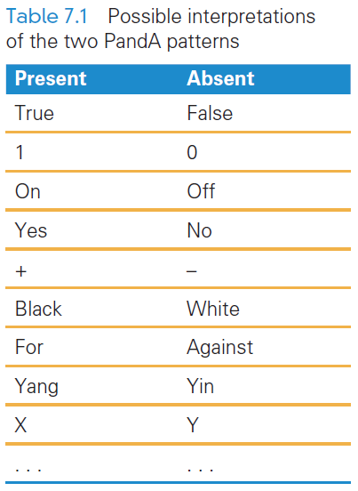
A Binary System
The PandA encoding has two patterns: present and absent
Two patterns make it a binary system
There is no law that says on means “present” or off means “absent”

Slide 14
Bits Form Symbols
In the PandA representation, the unit is a specific place (in space and time), where the presence or absence of the phenomenon can be set and detected.
The PandA unit is known as a bit
Bit is a contraction for “binary digit”
Bit sequences can be interpreted as binary numbers
Groups of bits form symbols

Slide 15
Bits in Computer Memory
Memory is arranged inside a computer in a very long sequence of bits
Going back to the definition of bits (previous slide), this means that places where the physical phenomenon encoding the information can be set and detected

Slide 16
Sidewalk Memory
Imagine a clean sidewalk made of a strip of concrete with lines across it forming squares
The presence of a stone on a square corresponds to 1
The absence of a stone corresponds to 0
This makes the sidewalk a sequence of bits

Slide 17
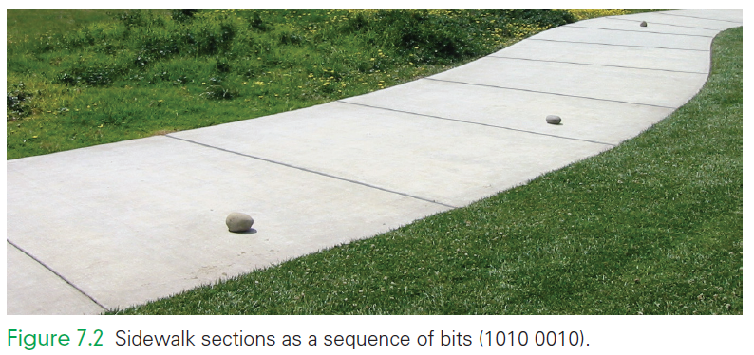
Sidewalk Memory
1
0
0
0
0
1
0
1

Slide 18
Sidewalk Memory
Bits can be set to write information into memory
Bits can be sensed to read the information out of memory
To write a 1, the phenomenon must be made to be present (put a stone on a square
To write a 0, the phenomenon must be made to be absent (sweep the sidewalk square clean)

Slide 19
Alternative PandA Encodings
There is no limit to the ways to encode two physical states
stones on all squares, but with white (absent) and black (present) stones for the two states
multiple stones of two colors per square, more white stones than black means 1 and more black stones than white means 0
And so forth

Slide 20
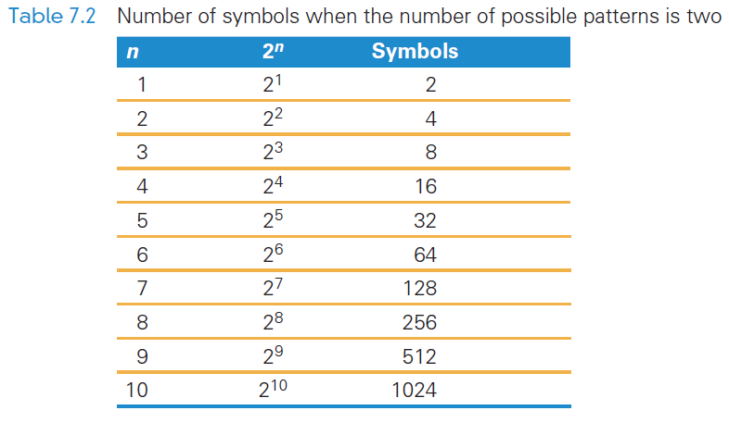
Combining Bit Patterns
The two-bit patterns gives limited resources for digitizing information
Only two values can be represented
The two patterns must be combined into sequences to create enough symbols to encode the intended information

Slide 21
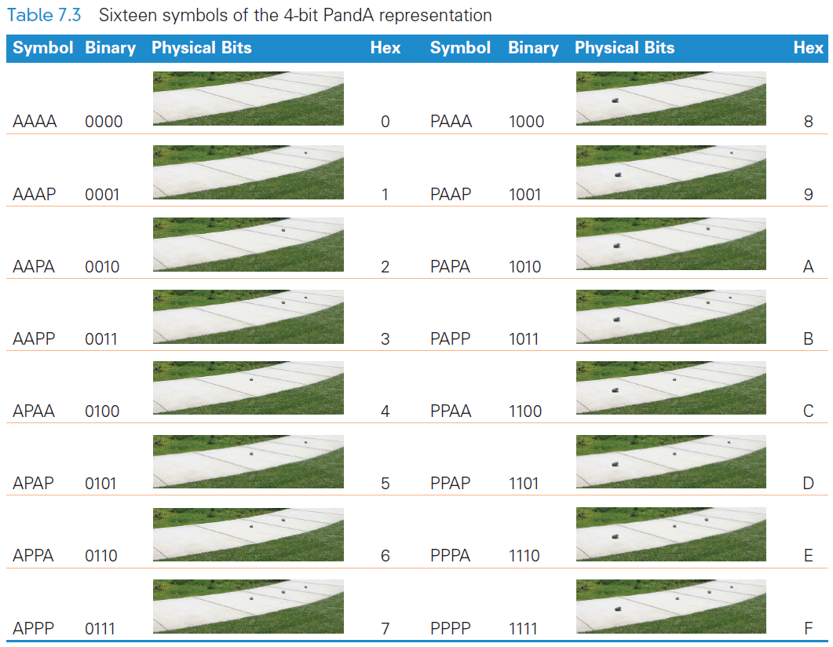

Slide 22
Hex Explained
Hex digits, short for hexadecimal digits, are base-16 numbers
A bit sequence might be given in 0’s and 1’s:
1111111110011000111000101010
Writing so many 0’s and 1’s is tedious and error prone
There needed to be a better way to write bit sequences…hexadecimal digits

Slide 23
The 16 Hex Digits
The digits of the hexadecimal numbering system are 0, 1, ... , 9, A, B, C, D, E, F
Because there are 16 digits (hexits), they can be represented perfectly by the 16 symbols of 4-bit sequences:
The bit sequence 0000 is hex 0
Bit sequence 0001 is hex 1
Bit sequence 1111, is hex F

Slide 24
Hex to Bits and Back Again
Because each hex digit corresponds to a 4-bit sequence, easily translate between hex and binary
0010 1011 1010 1101 2 B A D
F A B 4 1111 1010 1011 0100

Slide 25
Digitizing Numbers in Binary
The two earliest uses of PandA were to:
Encode numbers
Encode keyboard characters
Representations for sound, images, video, and other types of information are also important

Slide 26
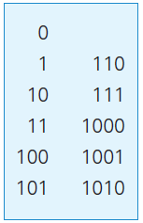
Counting in Binary
Binary numbers are limited to two digits, 0 and 1
Digital numbers are ten digits, 0 through 9
The number of digits is the base of the numbering system
Counting to ten

Slide 27
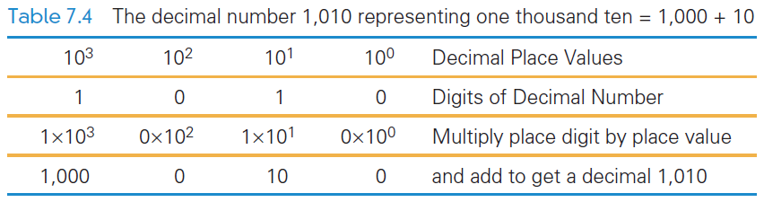
Counting in Binary
With decimal numbers, we use a place value representation where each “place” represents the next higher power of 10
With binary numbers, it is the same idea, but with higher powers of 2

Slide 28
Place Value in a Decimal Number
Recall that To find the quantity expressed by a decimal number:
The digit in a place is multiplied by the place value and the results are added
Example, 1010 (base 10) is:
Digit in the 1’s place is multiplied by its place
Digit in the 10’s place is multiplied by its place
and so on: (0 × 1) + (1 × 10) + (0 × 100) + (1 × 1000)

Slide 29
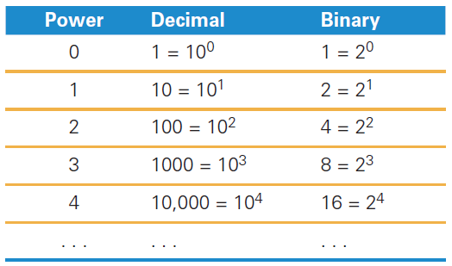
Place Value in a Binary Number
Binary works the same way
The base is not 10 but 2
Instead of the decimal place values: 1, 10, 100, 1000, . . . , the binary place values are: 1, 2, 4, 8, 16, . . . ,

Slide 30
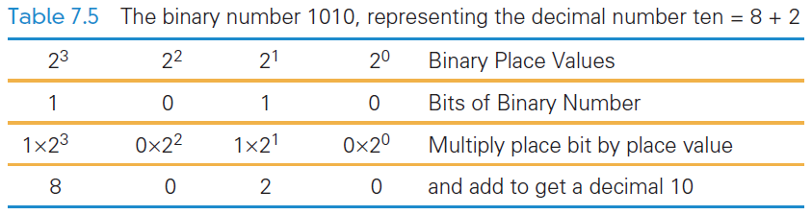
Place Value in a Binary Number
1010 in binary:
(1 × 8) + (0 × 4) + (1 × 2) + (0 × 1)

Slide 31
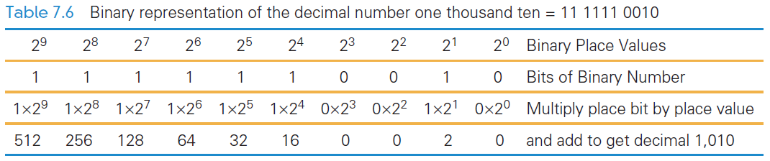

Slide 32
Digitizing Text
The number of bits determines the number of symbols available for representing values:
n bits in sequence yield 2n symbols
The more characters you want encoded, the more symbols you need

Slide 33
Digitizing Text
Roman letters, Arabic numerals, and about a dozen punctuation characters are about the minimum needed to digitize English text
What about:
Basic arithmetic symbols like +, −, *, /, =?
Characters not required for English ö, é, ñ, ø?
Punctuation? « », ¿, π, ∀)? What about business symbols: ¢, £, ¥, ©, and ®?
And so on.

Slide 34
Assigning Symbols
We need to represent:
26 uppercase,
26 lowercase letters,
10 numerals,
20 punctuation characters,
10 useful arithmetic characters,
3 other characters (new line, tab, and backspace)
95 symbols…enough for English

Slide 35
Assigning Symbols
To represent 95 distinct symbols, we need 7 bits
6 bits gives only 2⁶ = 64 symbols
7 bits give 2⁷ = 128 symbols
128 symbols is ample for the 95 different characters needed for English characters
Some additional characters must also be represented

Slide 36
Assigning Symbols
ASCII stands for American Standard Code for Information Interchange
ASCII is a widely used 7-bit (2⁷) code
The advantages of a “standard” are many:
Computer parts built by different manufacturers can be connected
Programs can create data and store it so that other programs can process it later, and so forth

Slide 37
Extended ASCII: An 8-Bit Code
7-bit ASCII is not enough, it cannot represent text from other languages
IBM decided to use the next larger set of symbols, the 8-bit symbols (2⁸)
Eight bits produce 2⁸ = 256 symbols
The 7-bit ASCII is the 8-bit ASCII representation with the leftmost bit set to 0
Handles many languages that derived from the Latin alphabet

Slide 38
Extended ASCII: An 8-Bit Code
Handling other languages is solved in two ways:
recoding the second half of Extended ASCII for the language
using the multibyte Unicode representation
IBM gave 8-bit sequences a special name, byte
It is a standard unit for computer memory

Slide 39
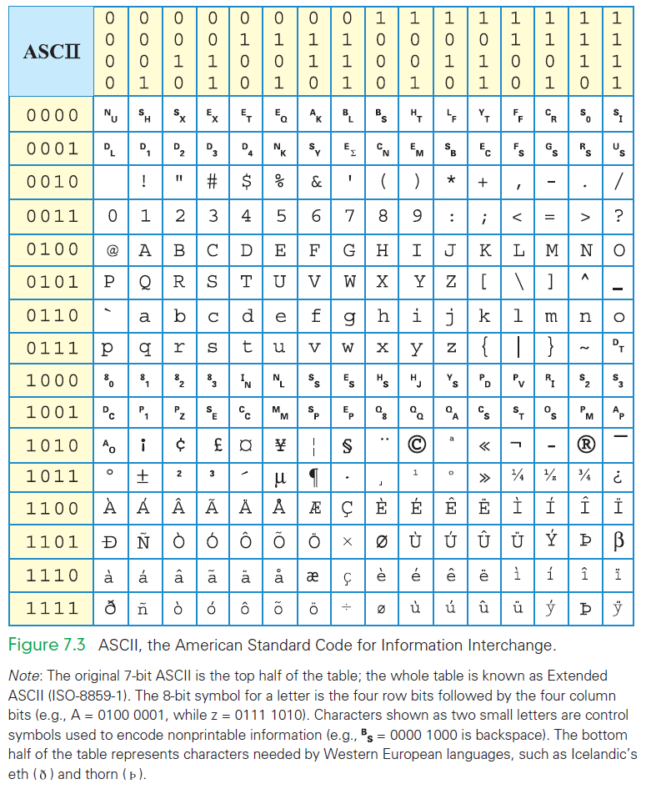

Slide 40
Advantages of Long Encodings
With computing, we usually try to be efficient by using the shortest symbol sequence to minimize the amount of memory
Examples of the opposite:
NATO Broadcast Alphabet
Bar Codes

Slide 41
NATO Broadcast Alphabet
The code for the letters used in radio communication is purposely inefficient
The code is distinctive when spoken amid noise
The alphabet encodes letters as words
Words are the symbols
“Mike” and “November” replace “em” and “en”
The longer encoding improves the chance that letters will be recognized
Digits keep their usual names, except nine, which is known as niner

Slide 42
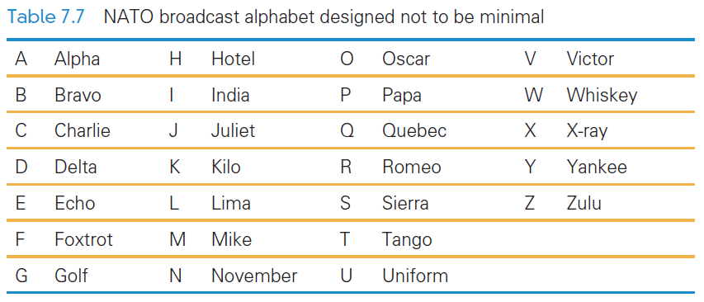
NATO Broadcast Alphabet

Slide 43
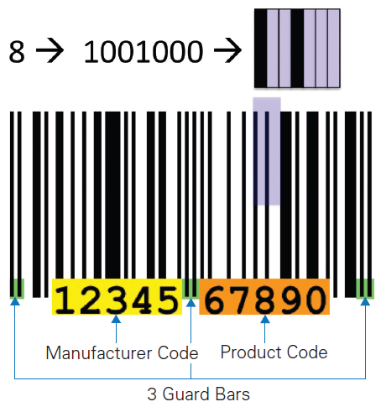
Bar Codes
Universal Product Codes (UPC) also use more than the minimum number of bits to encode information
In the UPC-A encoding, 7 bits are used to encode the digits 0 – 9

Slide 44
Bar Codes
UPC encodes the manufacturer (left side) and the product (right side)
Different bit combinations are used for each side
One side is the complement of the other side
The bit patterns were chosen to appear as different as possible from each other

Slide 45
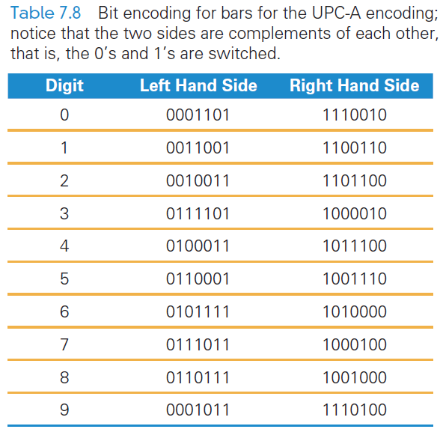
Bar Codes
Different encodings for each side make it possible to recognize whether the code is right side up or upside down

Slide 46
Metadata and the OED
Converting the content into binary is half of the problem of representing information
The other half of the problem? Describing the information’s properties
Characteristics of the content also needs to be encoded:
How is the content structured?
What other content is it related to?
Where was it collected?
What units is it given in?
How should it be displayed?
When was it created or captured?
And so on…

Slide 47
Metadata and the OED
Metadata: information describing information
Metadata is the third basic form of data
It does not require its own binary encoding
The most common way to give metadata is with tags (think back to Chapter 4 when we wrote HTML)

Slide 48
Properties of Data
Metadata is separate from the information that it describes
For example:
The ASCII representation of letters has been discussed
How do those letters look in Comic Sans font?
How they are displayed is metadata

Slide 49
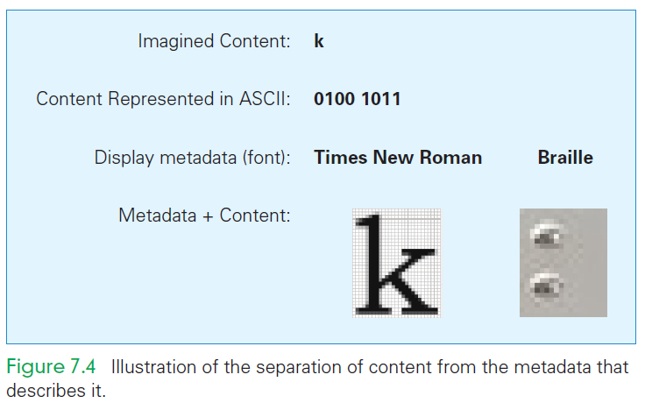
Properties of Data
Rather than fill a file with the Times New Roman font, the file is filled with the letters and note with tags how it should be displayed
Metadata can be presented at several levels

Slide 50
Using Tags for Metadata
The Oxford English Dictionary (OED) is the definitive reference for every English word’s meaning, etymology, and usage
The printed version of the OED is truly monumental is 20 volumes, weighs 150 pounds, and fills 4 feet of shelf space

Slide 51
Using Tags for Metadata
In 1984, the conversion of the OED to digital form began
Imagine, with what you know about searching on the computer, finding the definition for the verb set:
“set” is part of many words
You would find closet, horsetail, settle, and more
Software can help sort out the words

Slide 52
Structure Tags
Special tags can be developed to handle structure:
<hw> is the OED’s tag for a headword (word being defined)
<pr> handles pronunciation
<ph> does the phonetic notations
<ps> parts of speech
<hm> homonym numbers
<e> surrounds the entire entry
<hg> surrounds the head group or all of the information at the start of a definition

Slide 53
Structure Tags
With structure tags, software can use a simple algorithm to find what is needed
Tags do not print
They are included only to specify the structure, so the computer knows what part of the dictionary to use
Structure tags are also useful for formatting…for example, boldface used for headwords
Knowing the structure makes it possible to generate the formatting information

Slide 54
Why “Byte”?
Computer memory is subject to errors
An extra bit is added to the memory to help detect errors
A ninth bit per byte can detect errors using parity
Parity refers to whether a number is even or odd
Count the number of 1’s in the byte. If there is an even number of 1’s we set the ninth bit to 0

Slide 55
Why “Byte”?
All 9-bit groups have even parity:
Any single bit error in a group causes its parity to become odd
This allows hardware to detect that an error has occurred
It cannot detect which bit is wrong, however

Slide 56
Why “Byte”?
IBM was building a supercomputer, called Stretch
They needed a word for a quantity of memory between a bit and a word”
A word of computer memory is typically the amount required to represent computer instructions (currently a word is 32 bits)

Slide 57
Why “Byte”?
Then, why not bite?
The ‘i’ to a ‘y’ was done so that someone couldn’t accidentally change ‘byte’ to ‘bit’ by the dropping the ‘e’ ”
bite bit (the meaning changes)
byte byt (what’s a byt?)

Slide 58
Summary
We began the chapter by learning that digitizing doesn’t require digits—any symbols will do
We explored the following:
PandA encoding, which is based on the presence and absence of a physical phenomenon. Their patterns are discrete; they form the basic unit of a bit. Their names (most often 1 and 0) can be any pair of opposite terms.

Slide 59
Summary
We explored the following:
7-bit ASCII, an early assignment of bit sequences (symbols) to keyboard characters. Extended or 8-bit ASCII is the standard.
The need to use more than the minimum number of bits to encode information.

Slide 60
Summary
We explored the following:
How documents like the Oxford English Dictionary are digitized. We learned that tags associate metadata with every part of the OED. Using that data, a computer can easily help us find words and other information.
The mystery of the y in byte.

