Slide 2
Learning Objectives
Explain how RGB color is represented in bytes
Explain the difference between “bits” and “binary numbers”
Change an RGB color by binary addition
Explain concepts related to digitizing sound waves
Explain the meaning of the Bias-Free Universal Medium Principle

Slide 3
Digitizing Data
Digitizing is more than letters, numbers, and metadata
It is also photos, audio, and video
What are the bits doing?
Digitizing includes other forms of digitized information, known as multimedia
Same principles are used as with letters and numbers to encode information into bits

Slide 4
Color and the Mystery of Light
Color on a Computer Display:
Pixels are small points of colored light arranged in a
Each pixel is formed from three colored lights: red, green, and blue.
Referred to as RGB (always in that order)

Slide 5
Showing Colors
Turning on one light at a time, the display turns red, green, or blue
Turning off all of them makes black
Turning on all of them makes white
All other colors are made by using different amounts or intensities of the three lights
The three colors do not have to be RGB

Slide 6
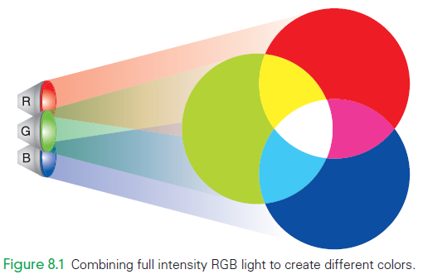
Yellow = R + G?
Combining red and green makes yellow
Taught in elementary school that red and yellow are primary colors
There is a difference between colored light and colored paint

Slide 7
Yellow = R + G?
Paint reflects some colors and absorbs others
When white light strikes paint, some light is absorbed (we can’t see it) and some light is reflected (we see it)

Slide 8
Yellow = R + G?
In the case of a pixel, the light shines directly at our eyes
Nothing is absorbed
Nothing is reflected
Just see pure colored light

Slide 9
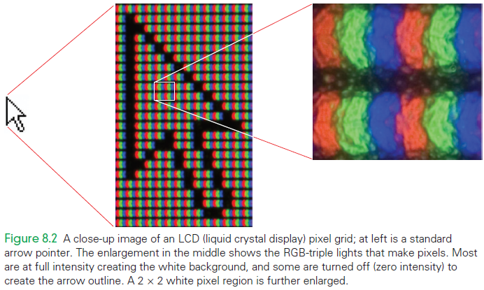
LCD Display Technology
At left in the close-up of an LCD is an arrow pointer with two enlargements of it
From a distance, the pixels appear white
Close up, the pixels are red, green, and blue colored lights

Slide 10
Black and White Colors
The intensity of RGB light is usually given by a binary number stored in a byte
Representing the color of a single pixel requires 3 bytes (1 for each color)
Smallest intensity is 0000 0000
Largest value is 1111 1111
Doing the math from Chapter 7, says the range of values is 0 through 255 for each color

Slide 11
Black and White Colors
Black is the absence of light:
0000 0000 0000 0000 0000 0000 RGB bit assignment for black
White is the full intensity of each color:
1111 1111 1111 1111 1111 1111 RGB bit assignment for white

Slide 12
Color Intensities
Consider blue (0000 0000 0000 0000 1111 1111)
The 8 bits specifying its intensity have position values:
If we want the sub pixel to at half intensity: each bit contributes half as much power as the bit to its left
128 | 64 | 32 | 16 | 8 | 4 | 2 | 1
1 | 1 | 1 | 1 | 1 | 1 | 1 | 1
128 | 64 | 32 | 16 | 8 | 4 | 2 | 1
1 | 0 | 0 | 0 | 0 | 0 | 0 | 0

Slide 13
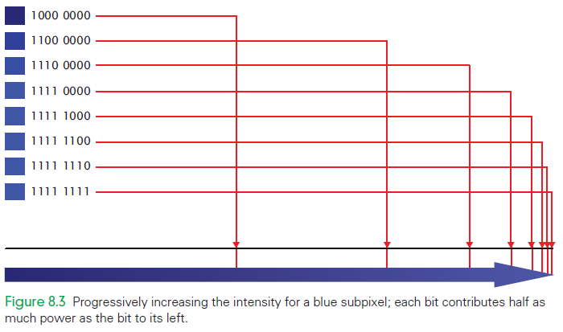
Color Intensities

Slide 14
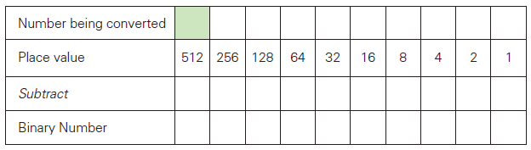


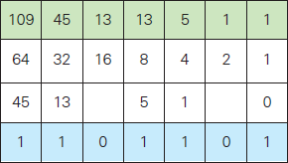
Decimal to Binary
Which powers of 2 combine to make the decimal number?

Slide 15
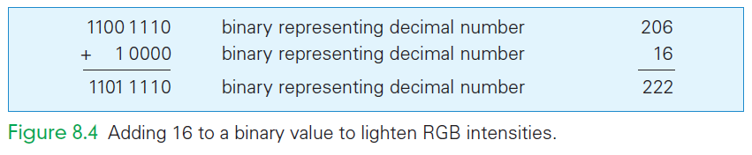
Lighten Up
Changing Colors by Addition
To make a lighter color of gray, we change the common value to be closer to white.

Slide 16
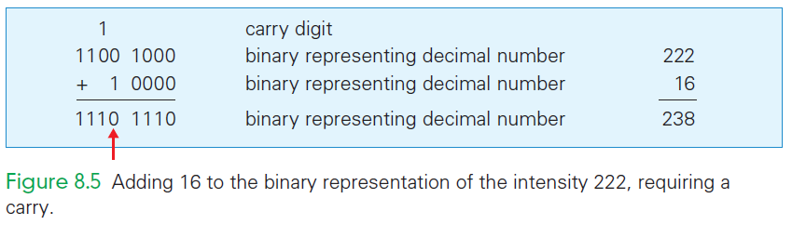
Lighter Still…
Imagine that the color lighter still by another 16 units of intensity for each RGB byte
The 16’s position is already filled with a 1: 1101 1110
“Carry” to the next higher place

Slide 17
Binary Addition
Same as decimal addition but with only two digits
Work from right to left, adding digits in each place position, writing the sum below
Like decimal addition, there are two cases:
Add the two numbers in a place and the result is expressed as a single digit
Add two numbers in a place and the result requires carrying to the next higher place

Slide 18
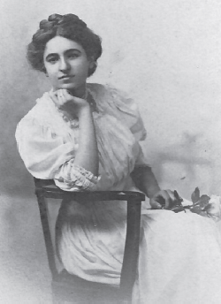
Computing on Representations
When digital information is changed through computation, this is computing on representations.
For example: changing the brightness and contrast of a photo

Slide 19
Brightness and Contrast
Brightness refers to how close to white the pixels are
Contrast is the size of difference between the darkest and lightest portions of the image.
Photo manipulation software often gives the values of the pixels in a Levels graph

Slide 20
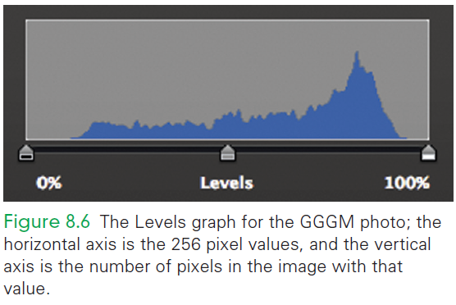
Levels Graph
0 percent is called the black point, or 000000
100 percent is the white point, or ffffff
The midpoint is called the gamma point and it is the midpoint in the pixel range

Slide 21
Brightness
We want all the pixels to be nearer intense white, but to keep their relative relationships
Add 16 to each pixel
A pixel which is 197, 197, 197 becomes 213, 213, 213

Slide 22
Contrast
Goal is not to shift the Levels diagram right, but rather to “stretch it out” toward the right
Add an amount to each pixel as before
add a smaller amount for dark pixels
Add a larger amount for light pixels

Slide 23
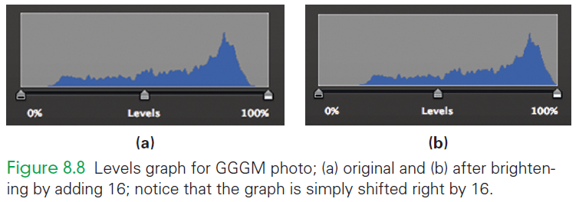
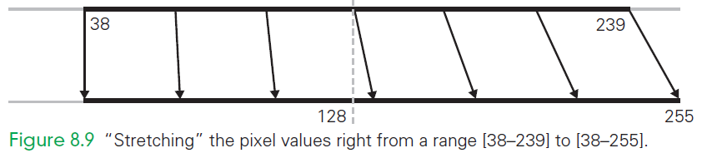
New Levels Graph

Slide 24
New Levels Math
For every original pixel P_{o}, subtract the amount of the lower end of the range: P_{o} – 38
That tells how much to increase each pixel position; smaller (darker) numbers get lightened less than larger (lighter) numbers

Slide 25

New Levels Math
Then we multiply by the size of the new interval divided by the size of the old interval
Add the low end of the original range back in again to return each pixel to its new position along the second line

Slide 26
New Levels Math
The equation for the value in each pixel position of the new image: P_{n} = (P_{o} – 38)*1.08 + 38
Round the answer to a whole number
Try it yourself! For original pixel 239, did you get 255? For original pixel 157, did you get 167?

Slide 27
Adding Color
Whenever the 3 bytes differ in value there is color
Define “highlights” as the lightest 25 percent of the pixels, and “shadows” as the darkest 25 percent of the pixels
Must count the pixels to know those values:
There are 600 × 800 = 480,000 pixels in the image

Slide 28
Adding Color
Pick the lowest pixel value and go up to the next level and keep adding until you have approximately ¼ of the total pixels (in this case 120,000)
Pick the highest pixel value and go down to the next level, adding until you have the top ¼ of the total pixels

Slide 29
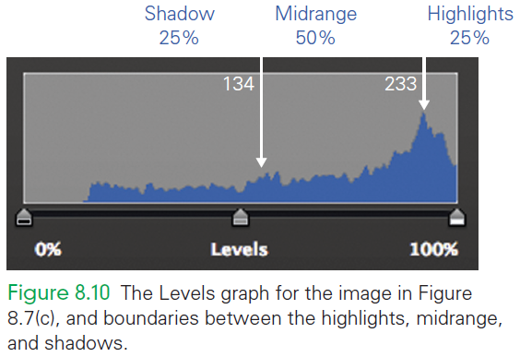
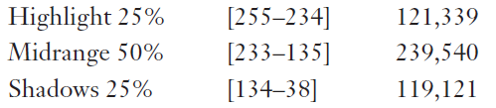
Adding Color

Slide 30
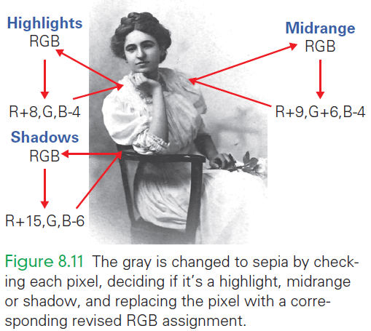
Adding Color
Simple algorithm to colorize an image:
For each pixel, get the red sub pixel and check its range
Using the color modifications given above for that portion of the image adjust the color of each sub pixel

Slide 31
Digitizing Sound
An object creates sound by vibrating in a medium (such as air)
Vibrations push the air causing pressure waves to emanate from the object, which in turn vibrate our eardrums
Vibrations are then transmitted by three tiny bones to the fine hairs of our cochlea, stimulating nerves that allow us to sense the waves and “hear” them as sound

Slide 32
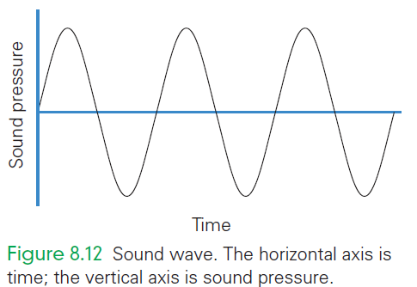
Digitizing Sound
The force, or intensity of the push, determines the volume
The frequency (the number of waves per second) of the pushes is the pitch
continuous (analog) representation of the wave

Slide 33
Analog to Digital
To digitize you must convert to bits
For a sound wave, use a binary number to record the amount that the wave is above or below the 0 line at a given point on our graph
At what point do you measure?
There are infinitely many points along the line, too many to record every position of the wave

Slide 34
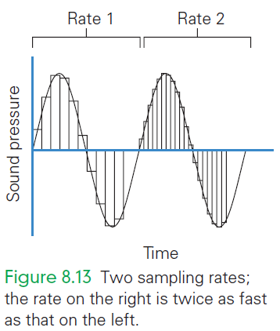
Analog to Digital
Sample or take measurements at regular intervals
Number of samples in a second is called the sampling rate
The faster the rate the more accurately the wave is recorded

Slide 35
Nyquist Rule for Sampling
If the sampling were too slow, sound waves could “fit between” the samples and you would miss important segments of the sound
The Nyquist rule says that a sampling rate must be at least twice as fast as the fastest frequency

Slide 36
Nyquist Rule for Sampling
Because humans can hear sound up to roughly 20,000 Hz, a 40,000 Hz sampling rate fulfills the Nyquist rule for digital audio recording
For technical reasons a somewhat faster-than-two-times sampling rate was chosen for digital audio (44,100 Hz)

Slide 37
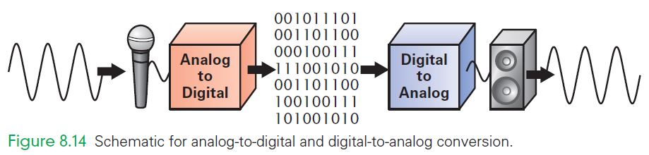
Digitizing Process

Slide 38
Digitizing Process
The digitizing process works as follows:
Sound is picked up by a microphone (transducer).
Signal is fed into an analog-to-digital converter (ADC), which takes the continuous wave and samples it at regular intervals, outputting for each sample binary numbers to be written to memory.

Slide 39
Digitizing Process
The digitizing process works as follows:
The process is reversed to play the sound: The numbers are read from memory into a digital-to-analog converter (DAC)
Electrical wave created by interpolation between the digital values (filling in or smoothly moving from one value to another)
The electrical signal is then input to a speaker which converts it into a sound wave

Slide 40
How Many Bits per Sample?
To make the samples perfectly accurate, you need an unlimited number of bits for each sample
Bits must represent both positive and negative values
Wave has both positive and negative sound pressure
The more bits there that are used, the more accurate the measurement is

Slide 41
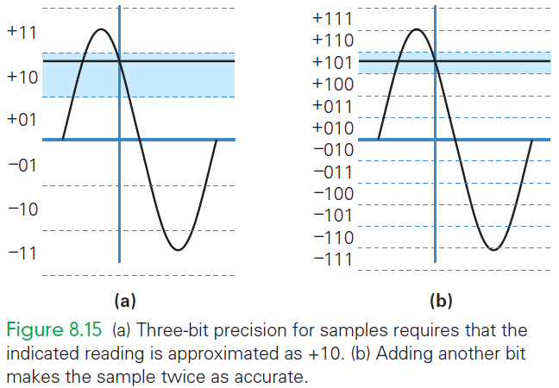
How Many Bits per Sample?
We can only get an approximate measurement
If another bit is used, the sample would be twice as accurate
More bits yields a more accurate digitization
Audio digital representation uses 16 bits

Slide 42
Advantages of Digital Sound
A key advantage of digital information is the ability to compute on the representation
One computation of value is to compress the digital audio or reduce the number of bits needed
What about sounds that the human ear can’t hear because they are either too high or too low

Slide 43
Advantages of Digital Sound
MP3 is really a form of computing on the representation.
It allows for compression (with a ratio of more than 10:1)
Another key advantage of digital representations is that digital can be reproduced exactly

Slide 44
Digital Images and Video
An image is a long sequence of RGB pixels
The picture is two dimensional, but think of the pixels stretched out one row after another in memory

Slide 45
Digital Images and Video
Example:
8 × 10 image scanned at 300 pixels per inch
That’s 80 square inches, each requiring 300 × 300 = 90,000 pixels (or 7.2 megapixels)
At 3 bytes per pixel, it takes 21.6 MB (3 * 7.2) of memory to store one 8 × 10 color image
Sending a picture across a standard 56 Kb/s phone connection would take at least 21,600,000 × 8/56,000 = 3,085 seconds (or more than 51 minutes)

Slide 46
Image Compression
Typical monitor has fewer than 100 pixels per inch (ppi)
storing the picture digitized at 100 ppi is a factor of nine savings immediately.
A 100 ppi picture still requires more than five and a half minutes to send
What if we want to print the picture, requiring the resolution again?

Slide 47
Image Compression
Compression means to change the representation in order to use fewer bits to store or transmit information
Example: faxes are a sequences of 0’s and 1’s that encode where the page is white (0) or black (1)
Use run-length encoding to specify how long the first sequence (run) of 0’s is, then how long the next sequence of 1’s is, then how long the next sequence of 0’s is, then …

Slide 48
Compression
Run-length encoding is “lossless “compression scheme
The original representation of 0’s and 1’s can be perfectly reconstructed from the compressed version
The opposite of lossless compression is lossy compression
The original representation cannot be exactly reconstructed from the compressed form

Slide 49
Compression
MP-3 is probably the most famous compression scheme
MP3 is lossy because the high notes cannot be recovered
JPG (or JPEG) is a lossy compression for images
Exploits the same kinds of “human perception” characteristics that MP-3 does, only for light and color

Slide 50
JPEG Compression
Humans are quite sensitive to small changes in brightness (luminance)
Brightness levels of a photo must be preserved between uncompressed and compressed versions
People are not sensitive to small differences in color (chrominance)

Slide 51
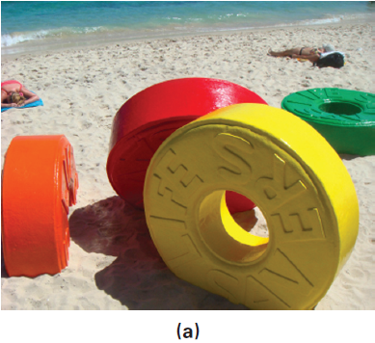

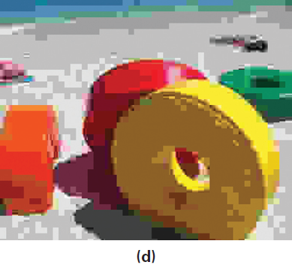
JPEG Compression
JPEG is capable of a 10:1 compression without detectable loss of clarity simply by keeping the regions small

Slide 52
JPEG Compression
It is possible to experiment with levels greater than 10:1
The benefit is smaller files
Eventually the picture begins to “pixelate” or get “jaggies”

Slide 53
MPEG Compression
MPEG is the same idea applied to motion pictures
It seems like an easy task
Each image/frame is not seen for long
Couldn’t we use even greater levels of single-image compression?
It takes many “stills” to make a movie

Slide 54
MPEG Compression
In MPEG compression, JPEG-type compression is applied to each frame
“Interframe coherency” is used
Two consecutive video images are usually very similar, MPEG compression only has to record and transmit the “differences” between frames
Resulting in huge amounts of compression

Slide 55
Optical Character Recognition
Very sophisticated technology that enables a computer to “read” printed characters
OCR’s business applications include:
U.S. Postal Service processing up to 45,000 pieces of mail per hour (2% error rate)
In banking, the magnetic numbers at the bottom of checks have been read by computers since the 1950s

Slide 56
Virtual Reality
Ultimate form of digital representation is to create an entire digital world
Rapidly displaying still images is a standard way to fool our eyes and brain into seeing motion
Virtual reality applies that idea to our other senses and tries to eliminate the cues that keep us grounded in “real” reality

Slide 57
Haptic Devices
Haptic devices are input/output technology for interacting with our sense of touch and feel
For example:
Haptic glove enables a computer to detect where our fingers are and to apply force against them, leaving us with the feeling of holding an object

Slide 58
Latency
The system must operate fast enough and precisely enough to appear natural
Latency is the time it takes for information to be delivered
Long latencies just make us wait, but long latency can ruin the effect!
There is an absolute limit to how fast information can be transmitted—the speed of light

Slide 59
Bandwidth
Bandwidth is how much information is transmitted per unit time
Higher bandwidth usually means lower latency
VR is challenged by both latency and bandwidth limitations
Creating a synthetic world and delivering it to our senses is a difficult technical problem

Slide 60
Bits Are It!
4 bytes can represent many kinds of information
This a fundamental property of information:
Bias-Free Universal Medium Principle: Bits can represent all discrete information;
Bits have no inherent meaning

Slide 61
Bits: The Universal Medium
All discrete information can be represented by bits
Discrete things—things that can be separated from each other—can be represented by bits

Slide 62
Bits: Bias-Free
Given a bit sequence 0000 0000 1111 0001 0000 1000 0010 0000
there is no way to know what information it represents
Meaning of the bits comes entirely from the interpretation placed on them by users or by the computer

Slide 63
Not Necessarily Binary Numbers
Computers represent information as bits
Bits can be interpreted as binary numbers
Bits do not always represent binary numbers
ASCII characters
RGB colors
Or an unlimited list of other things

Slide 64
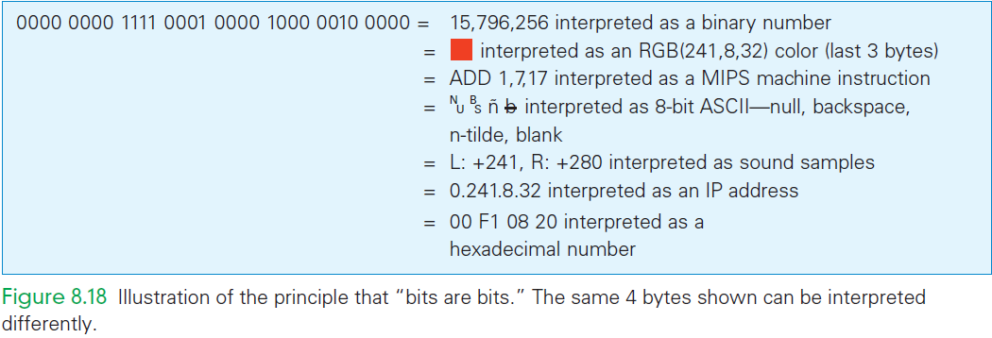
Bits are bits…

Slide 65
Summary
With RGB color, each intensity is a 1-byte numeric quantity represented as a binary number.
Binary representation and binary arithmetic are the same as they are for decimal numbers, but they are limited to two digits.
The decimal equivalent of binary numbers is determined by adding their powers of 2 corresponding to 1’s.

Slide 66
Summary
We can use arithmetic on the intensities to “compute on the representation,” for example, making gray lighter and colorizing a black-and-white picture from the nineteenth century.
When digitizing sound, sampling rate and measurement precision determine how accurate the digital form is; uncompressed audio requires more than 80 million bits per minute.

Slide 67
Summary
Compression makes large files manageable: MP3 for audio, JPEG for still pictures, and MPEG for video. These compact representations work because they remove unnecessary information.
Optical character recognition technology improves our world.
Virtual reality illustrates the complexities of conveying information to all of our senses simultaneously.

Slide 68
Summary
The Bias-Free Universal Medium Principle embodies the magic of computers through universal bit representations and unbiased encoding.

