Slide 2
Learning Objectives
Describe how the Fetch/Execute Cycle works, listing the five steps
Explain the function of the memory, control unit, ALU, input unit and output unit, and program counter
Explain why integration and photolithography are important in integrated circuits
Discuss the purpose of an operating system
Explain the purpose of a compiler
Describe how large tasks are performed with simple instructions

Slide 3
What Computers Can and Cannot Do
What computers can do
Deterministically perform or execute instructions to process information
Deterministically…the computer determines which instruction to do next…it does only what it is “told” to do
They have no imagination, are not creative or purposeful. No sense of irony, subtlety, etc.
Computers only execute instructions

Slide 4
The Fetch/Execute Cycle
“Instruction Execution Engine”…a machine that cycles through a series of operations
Series is called: Fetch/Execute Cycle
Get the next instruction
Figure out what to do
Gathering the data needed to do it
Do it
Save the result, and
Repeat (billions of times/second)!

Slide 5
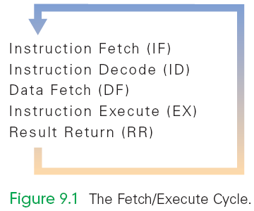
A Five-Step Cycle
These operations are repeated in a never-ending sequence
The step names suggest the operations described in the previous paragraph

Slide 6
Anatomy of a Computer
All computers, regardless of their implementing technology, have five basic parts or subsystems:
Memory,
Control unit,
Arithmetic/logic unit (ALU),
Input unit, and
Output unit

Slide 7
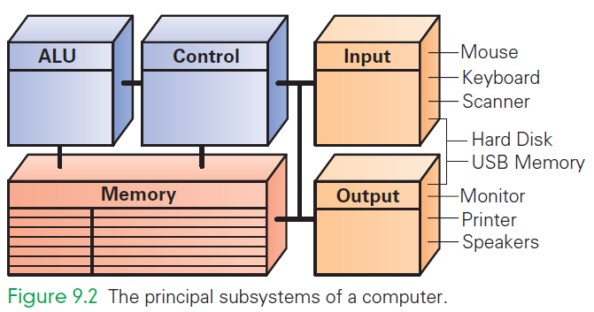
Principal Subsystems of a Computer

Slide 8
1. Memory
Memory stores both the program while it is running and the data on which the program operates
Properties of memory:
Discrete locations
Memory is organized as a sequence of discrete locations
In modern memory, each location is composed of 1 byte (8 bits)

Slide 9
1. Memory
Addresses
Every memory location has an address, whole numbers starting at 0
Values
Memory locations record or store values
Finite capacity
Memory locations have a finite capacity (limited size),
Data may not “fit” in the memory location

Slide 10
Byte-Size Memory Location
Common visualization of computer memory
Discrete locations are shown as boxes holding 1-byte each
Address of location is displayed above the box and the contents of location is shown in the box

Slide 11
Byte-Size Memory Location
That 1-byte memory location can store one ASCII character or a number less than 256
Blocks of four bytes are used as a unit so often that they are called memory words

Slide 12
Random Access Memory
Computer memory is called random access memory (RAM)
“Random access” is out-of-date and simply means that the computer can refer to the memory locations in any order
RAM is measured in megabytes (MB) or gigabytes (GB)
Lots of memory is need to handle the space required of programs and data

Slide 13
2. Control Unit
The control unit of a computer is where the Fetch/Execute Cycle occurs
Its circuitry fetches an instruction from memory and performs the other operations of the Fetch/Execute Cycle on it
A typical machine instruction has the form ADD 4000, 2000, 2080

Slide 14
2. Control Unit
ADD 4000, 2000, 2080
Looks like those three numbers should be added together
What it really means is that whatever numbers are stored in memory locations 2000 and 2080 be added together, and the result be stored in location 4000

Slide 15
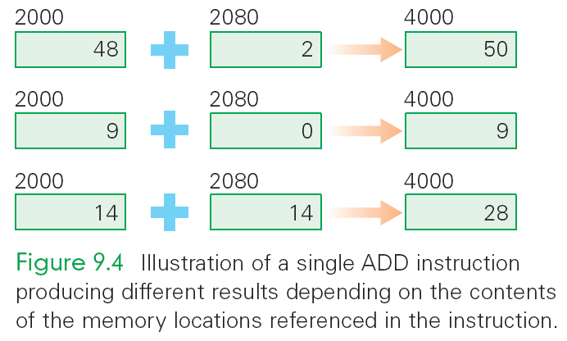
Illustration of a single instruction

Slide 16
3. Arithmetic/Logic Unit (ALU)
“Does the math”
A circuit in the ALU can add two numbers
The circuit uses logic gates or simpler circuits that implement operations like AND and OR
There are also circuits for multiplying, for comparing two numbers, etc.
The ALU carries out each machine instruction with a separate circuit

Slide 17
4. And 5. Input and Output Units
These two components are the wires and circuits through which information moves into and out of a computer
A computer without input or output is useless

Slide 18
The Peripherals
Peripherals connect to the computer input/output (I/O) ports
They provide input or receiving its output
They are not considered part of the computer:
They are only specialized gadgets that encode or decode information between the computer and the physical world

Slide 19
The Peripherals
The keyboard encodes our keystrokes into binary form for the computer
The monitor decodes information from the computer’s memory and displays it on a screen
The peripherals handle the physical part of the operation

Slide 20
Portable Memory & Hard Drives
Some peripherals are used by computers for both input and output:
USB memory
Hard disks/drives
They are storage devices
The hard disk is the alpha-peripheral, being the most tightly linked device to the computer

Slide 21
Hard Disk
Hard disk is essential
Programs and their data must reside in the computer’s memory when programs run
The hard disk can be seen as an extension of the computer’s memory
Typically it is a hundred times larger and several thousand times slower

Slide 22
A Device Driver for Every Peripheral
Most peripheral devices are “dumb”
They provide only basic physical translation to or from binary signals.
Additional information from the computer is needed to make it operate “intelligently”
Added processing by software called a device driver gives the peripheral its standard meaning and behavior
Every device needs a device driver

Slide 23
The Program Counter: The PC's PC
How does the computer determine which instruction it should execute next?
Address of the Next Instruction
The instruction is stored in memory and the computer has its address
Computers use the address (known as the program counter or PC) to keep track of the next instruction

Slide 24
The Program Counter: The PC's PC
The computer gets ready to process the next instruction
It assumes that the next instruction is the next instruction in sequence
Because instructions use 4 bytes of memory, the next instruction must be at the memory address PC + 4 or 4 bytes further along the sequence

Slide 25
Branch and Jump Instructions
Not all instructions are in a strict sequence
The instruction may include a memory location (address) to go to next
This changes the PC, so instead of going to PC+4 automatically, the computer "jumps" or "branches" to the specified location to continue execution

Slide 26
Instruction Interpretation
The process of executing a program is also called instruction interpretation.
The term derives from the idea that the computer interprets our commands, but in its own language.

Slide 27
The Fetch/Execute Cycle
A five-step cycle:
Instruction Fetch (IF)
Instruction Decode (ID)
Data Fetch (DF) / Operand Fetch (OF)
Instruction Execution (EX)
Result Return (RR) / Store (ST)

Slide 28
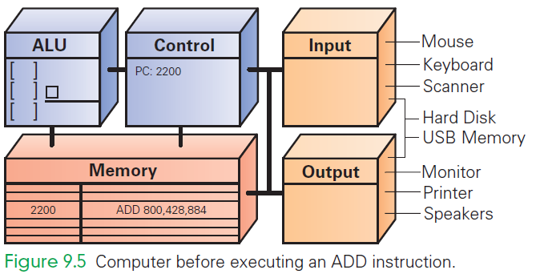
ADD 800, 428, 884
ADD the values found in memory locations 428 and 884 and store the result in location 800

Slide 29
Instruction Fetch (IF)
Execution begins by moving the instruction at the address given by the PC (PC 2200) from memory to the control unit
Bits of instruction are placed into the decoder circuit of the CU
Once instruction is fetched, the PC can be readied for fetching the next instruction

Slide 30
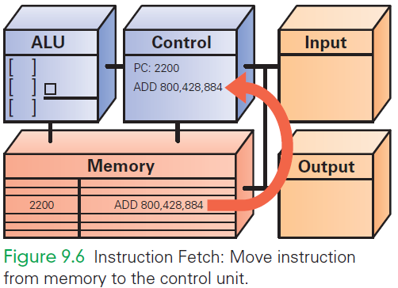
IF
ADD 800, 428, 884

Slide 31
Instruction Decode (ID)
ALU is set up for the operation
Decoder finds the memory address of the instruction's data (source operands)
Most instructions operate on two data values stored in memory (like ADD), so most instructions have addresses for two source operands
These addresses are passed to the circuit that fetches them from memory during the next step

Slide 32
Instruction Decode (ID)
Decoder finds the destination address for the Result Return step and places the address in the RR circuit
Decoder determines what operation the ALU will perform (ADD), and sets up the ALU

Slide 33
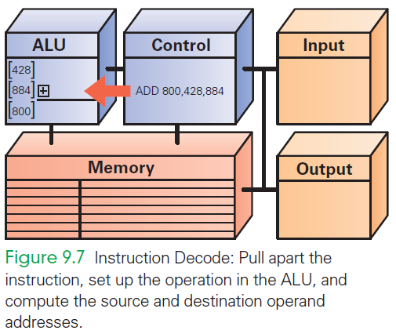
ID
+
ADD
800
428
884

Slide 34
Data Fetch (DF)
The data values to be operated on are retrieved from memory
Bits at specified memory locations are copied into locations in the ALU circuitry
Data values remain in memory (they are not destroyed)

Slide 35
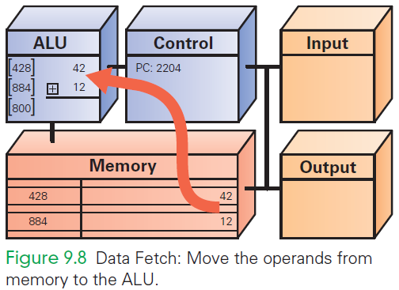
DF
42
12

Slide 36
Instruction Execution (EX)
For this ADD instruction, the addition circuit adds the two source operands together to produce their sum
Sum is held in the ALU circuitry
This is the actual computation

Slide 37
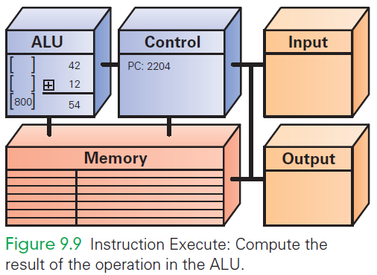
EX
54

Slide 38
Return Result (RR)
RR returns the result of EX to the memory location specified by the destination address.
Once the result is stored, the cycle begins again

Slide 39
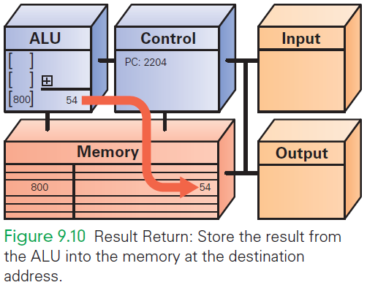
RR
54

Slide 40
Many, Many Simple Operations
Computers “know” very few instructions
The decoder hardware in the controller recognizes, and the ALU performs, only about 100 different instructions (with a lot of duplication)
There are only about 20 different kinds of operations.
Everything that computers do must be reduced to some combination of these primitive, hardwired instructions

Slide 41
Cycling the Fetch/Execute Cycle
ADD is representative of the complexity of computer instructions…some are slightly simpler, some slightly more complex
Computers achieve success at what they can do with speed.
They show their impressive capabilities by executing many simple instructions per second

Slide 42
The Computer Clock
Computers are instruction execution engines.
Since the computer does one instruction per cycle in principle, the speed of a computer depends on the number of Fetch/Execute Cycles it completes per second.

Slide 43
The Computer Clock
The rate of the Fetch/Execute Cycle is determined by the computer’s clock, and it is measured in megahertz, or millions (mega) of cycles per second (hertz).
A 1,000 MHz clock ticks a billion (in American English) times per second, which is one gigahertz (1 GHz)

Slide 44
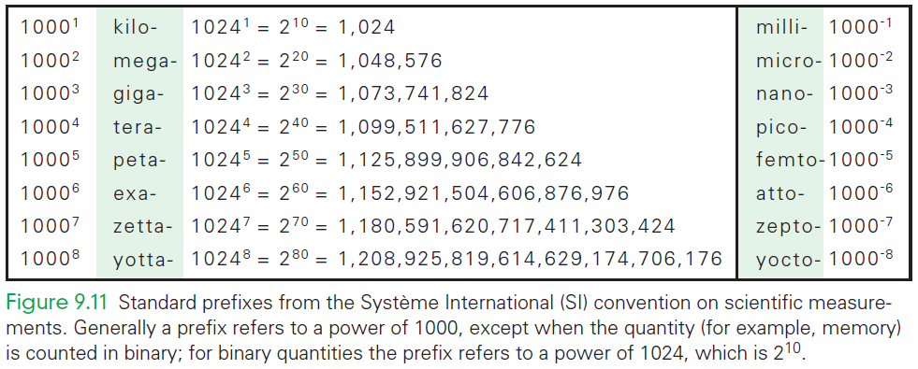
Standard Prefixes

Slide 45
One Cycle per Clock Tick
A computer with a 1 GHz clock has one billionth of a second—one nanosecond—between clock ticks to run the Fetch/Execute Cycle.
In that amount of time, light travels about one foot (~30 cm).
Modern computers try to start an instruction on each clock tick.

Slide 46
One Cycle per Clock Tick
They pass off completing the instruction to other circuitry
This process is called pipelining and frees the fetch unit to start the next instruction before the last one is done
It is not quite true that 1,000 instructions are executed in 1,000 ticks

Slide 47
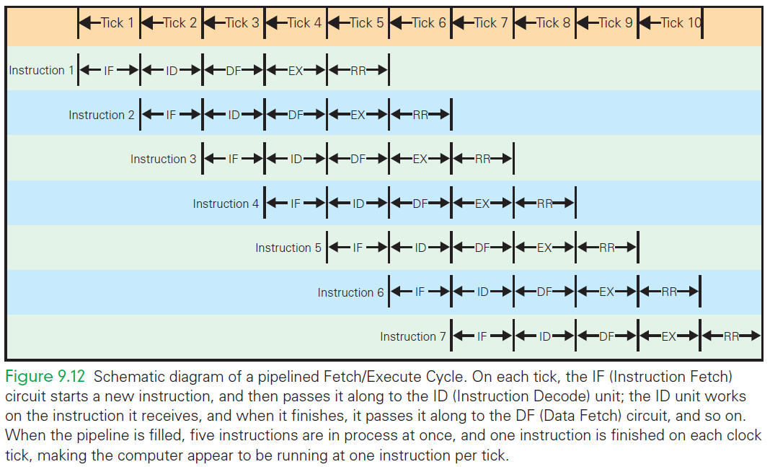
Schematic Fetch/Execute Cycle

Slide 48
A Computer’s View of Software

Slide 49
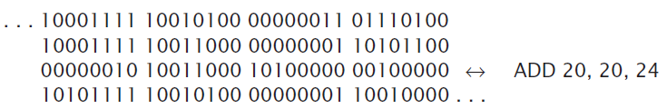
Computer’s View of Software
A program “sees” software as a long sequence of 4-byte groups of bits (0's and 1's)
This binary object file can be hundreds of thousands to millions of words long

Slide 50
Computer’s View of Software
Once installed, the computer runs the software by:
copying the binary instructions into the RAM
interpreting them using the Fetch/Execute Cycle.
It does whatever the instructions tell it to do

Slide 51
Assembly language
The binary object file is the only form a computer can be given software
Computers can be programmed to translate software expressed in other forms into binary object code.
This process includes as assembling.

Slide 52
Assembly language
Assembly language is an alternative form of machine language that uses letters and normal numbers so people can understand it
Computer scans assembly code
As it encounters words it looks them up in a table to convert to binary
Converts numbers to binary, then assembles the binary pieces into an instruction

Slide 53
Programming Languages
Most modern software is written in a high-level programming language
High-level languages are compiled (translated) into assembly language, which is then assembled into binary
These languages are preferred because they have special statement forms that help programmers describe the complicated tasks they want done

Slide 54
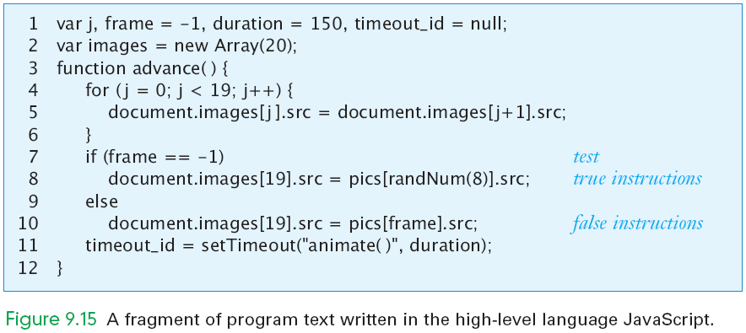
JavaScript Fragment

Slide 55
Operating Systems
The programs for performing basic tasks (like booting up the computer) are called the operating system (OS)
Three most widely used OS:
Microsoft Windows
Apple's Mac OS X
Unix / Linux

Slide 56
Operating Systems
OS fills the gap between the limited capabilities of the hardware and the needs of a useful working environment
OS performs booting; memory, file, and device management, Internet connection
User applications draw on OS facilities (Example, when you save your work, the software asking for file name/location is provided by the OS)

Slide 57
Programming
Programmers use a technique that makes their difficult job easier: they build on previously developed software
Software stack: layers of software of increasing complexity
It is the result of programmers building on the work of other programmers

Slide 58
Programming
All of the software for a user interface (window frame, slider bars, buttons, menus, etc.) are packaged for programmers and provided with the operating system
The ability to create software by combining other software is known as functional composition

Slide 59
Integrated Circuits (ICs)
Miniaturization
Computer clocks run at GHz rates because their processor chips are so tiny
Electrical signals can travel one foot (30 cm) in a nanosecond
Early computers (the size of whole rooms) could never have run as fast because their components were farther apart than one foot
Making everything smaller has made computers faster

Slide 60
Integration
Early computers were made from separate parts (discrete components) wired together by hand
There were three wires coming out of each transistor, the two wires from each resistor, the two wires from each capacitor, and so on
Each had to be connected to the wires of another transistor, resistor, or capacitor

Slide 61
Integration
Active components and the wires that connect them are manufactured from similar materials by a single (multistep) process
IC technology places two transistors side by side in the silicon, and a wire connecting the two is placed in position

Slide 62
Photolithography
ICs are made with a printing process called photolithography:
Begin by depositing a layer of material (like aluminum) on the silicon
Cover that layer with a light-sensitive material called photoresist, and place a mask over it
The mask has a pattern corresponding to the features being constructed
Exposure to uv light causes open areas to harden
Unexposed areas do not and can be washed away leaving the pattern
Hot gases etch the original layer
When the remaining photoresist is removed, the pattern from the remains

Slide 63
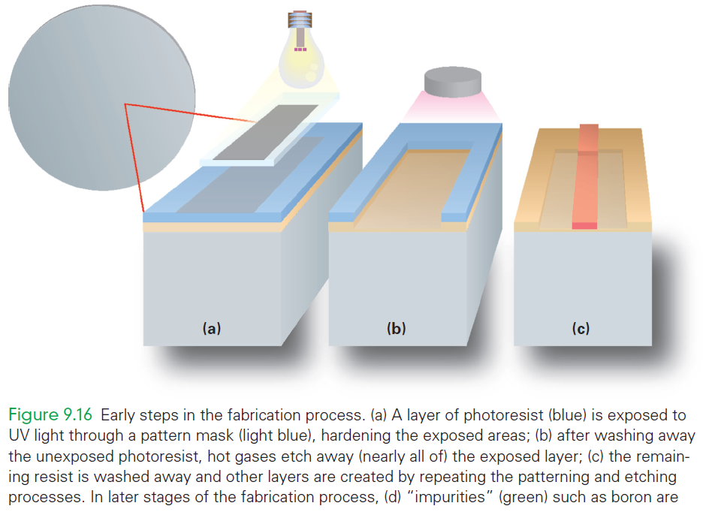

Slide 64
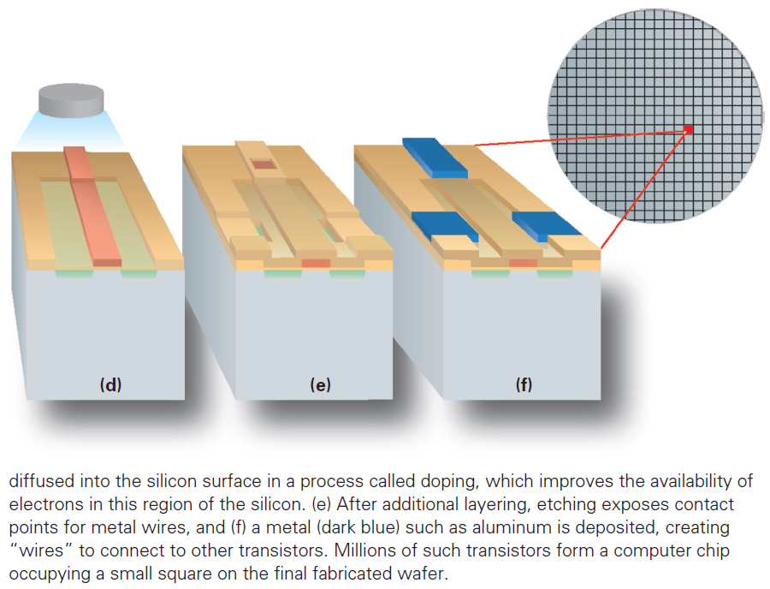

Slide 65
How Semiconductor Technology Works
Silicon is a semiconductor sometimes it conducts electricity and sometimes it does not
The ability to control when semiconductors do and don’t conduct electricity is the main process used in computer construction

Slide 66
On-Again, Off-Again
A simple principle of setting up a situation in which the conductivity of a wire is controlled to create a logical conclusion is needed
It is the basis of all the instructions and operations of a computer
In the ALU hardware, the circuit computes x AND y for any logical values x and y
Such a circuit is part of the ALU, performing the Instruction Execute step of all the AND instructions

Slide 67
The Field Effect
Conductivity of a semiconductor is controlled using the field effect
Objects can be charged positively or negatively
The effect that charged objects have on each other without actually touching is called the field effect
The field effect controls a semiconductor

Slide 68
The Field Effect
The ends of the two wires are specially treated (doped) to improve their conducting/nonconducting properties
The part between the ends is called a channel, because it creates a path for electricity to travel on
An insulator covers the channel
Passing over the insulator is a third wire called the gate

Slide 69
The Field Effect
The silicon in the channel can conduct electricity when it is in a charged field
Charging the gate positively creates a field over the channel
Electrons are then attracted from the silicon into the channel, causing it to conduct
If the field is removed, the electrons disperse into the silicon, the channel doesn’t conduct

Slide 70
Transistors
A transistor is a connector between two wires that can be controlled to allow a charge to flow between the wires (conduct) or not
The transistor is a MOS (Metal Oxide Semiconductor) transistor
Modern computers are developed with CMOS technology (“complementary MOS”)

Slide 71
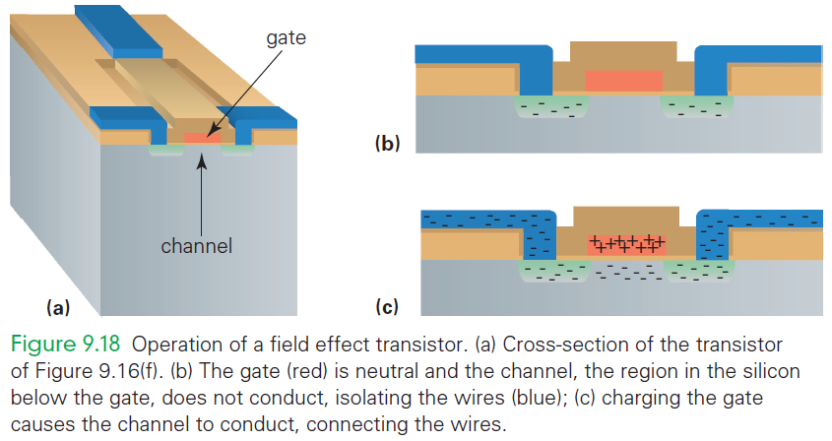

Slide 72
Combining the Ideas
Start with an information-processing task.
Task is performed by an application implemented as a large
The program performs the specific operations of the application
The program’s commands are compiled into many simple assembly language instructions
The assembly instructions are then translated into a more primitive binary form
Fetch/Execute Cycle executes the instructions

Slide 73
Summary
You learned the following:
The repeating process fetches each instruction (indicated by the PC), decodes the operation, retrieves the data, performs the operation, and stores the result back into the memory.
This process is hardwired into the control subsystem, one of the five components of a processor.

Slide 74
Summary
You learned the following:
The memory, a very long sequence of bytes, each with an address, stores the program and data while the program is running.
The ALU does the actual computing.
The input and output units are the interfaces for the peripheral devices connected to the computer.

Slide 75
Summary
You learned the following:
Machine instructions do not refer to the data (operands) directly, but rather indirectly. Thus, different computations can be done with an instruction, just by changing the data in the referenced memory locations each time the instruction is executed.

Slide 76
Summary
You learned the following:
Programmers must create complex computations by software layers, building up simple operations from the base instructions, more complex operations from the simple ones, and so forth.
Programmers use sophisticated programming languages to create operating systems as well as complex applications software.

Slide 77
Summary
You learned the following:
The basic ideas of integrated circuits are integrating active and connective components, fabrication by photolithography, and controlling conductivity through the field effect.

