Slide 2
Learning Objectives
Give examples of how social networking technology can improve society
Describe several tips associated with netiquette and explain the benefits of following them
Give the requirements of a good password, and how to achieve them
Name three permitted/not permitted uses of licensed software
Explain what rights are granted to material that is copyrighted

Slide 3
The Power of the Crowd
The Internet has brought substantial and positive changes to society
Social interactions have been extended well beyond the experiences that previous generations could enjoy
We will focus on a few examples that have brought “positive change”

Slide 4
Crowdsourcing
Refers to solving a problem or achieving a goal by combining the contributions of a large, unconstrained volunteer population
Wikipedia is perhaps the most famous of the crowdsourcing enterprises
The goal is to build a database of all knowledge through a global effort

Slide 5
Be a Martian
Volunteers help NASA by tagging images from the Mars rovers
Crowdsourcing is a new phenomenon made possible by the free and easy communication enabled by the Internet
“Crowd” is obviously important because it increases the number of people working on a project, a benefit for the people with the problem

Slide 6
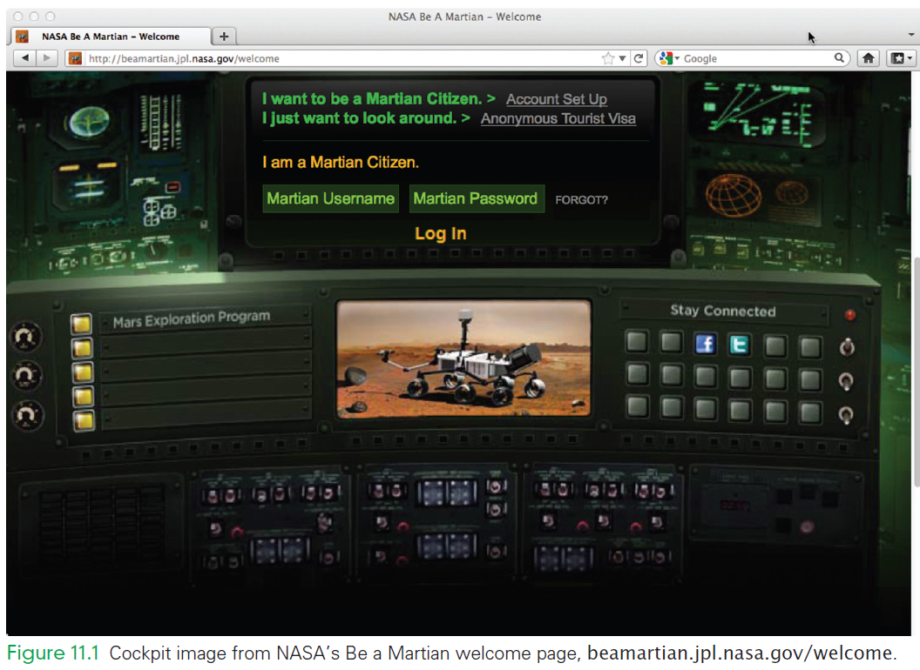
Be a Martian

Slide 7
Be a Martian
By opening up the project to a wide variety of people, participants will have a wide variety of skill sets
Volunteers might actually be faster and more efficient at the task!
Their skills and knowledge might lead to a better solution, as Wikipedia proves in most cases

Slide 8
Crowdsourcing
So, what’s in it for the participants?
It’s fun
Earn points, win prizes
Participants receive a sense of satisfaction that they are contributing to a project
Many projects require skills that are more challenging than watching TV

Slide 9
Foldit
Foldit is a game program in which teams compete to fold a protein
Proteins get all twisted as they float around in cells.
How they fold largely determines how they work (medicine doesn’t “know a protein” until it knows how it folds)

Slide 10
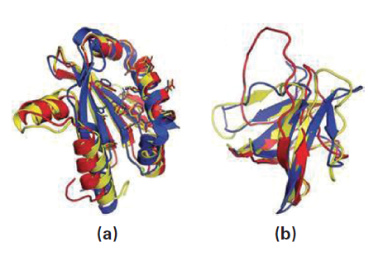
Foldit
Foldit program works on proteins that are important to AIDS, cancer, and Alzheimer’s research
Using Foldit, the structure of the protein associated with the AIDS virus was solved in three weeks

Slide 11
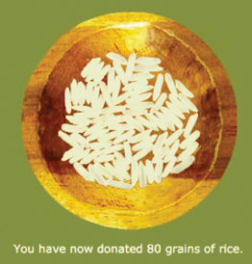
Freerice
Freerice is a vocabulary game:
The player is given an English word and four possible definitions
Picking the right answer donates 10 grains of rice

Slide 12
Kickstarter
People with creative projects pitch their ideas:
They say what they’ll do
How much money they need to do it
Why it’s important, etc.
Donors can contribute toward the goal
If the goal is achieved the project is funded; otherwise, the donors get their money back

Slide 13
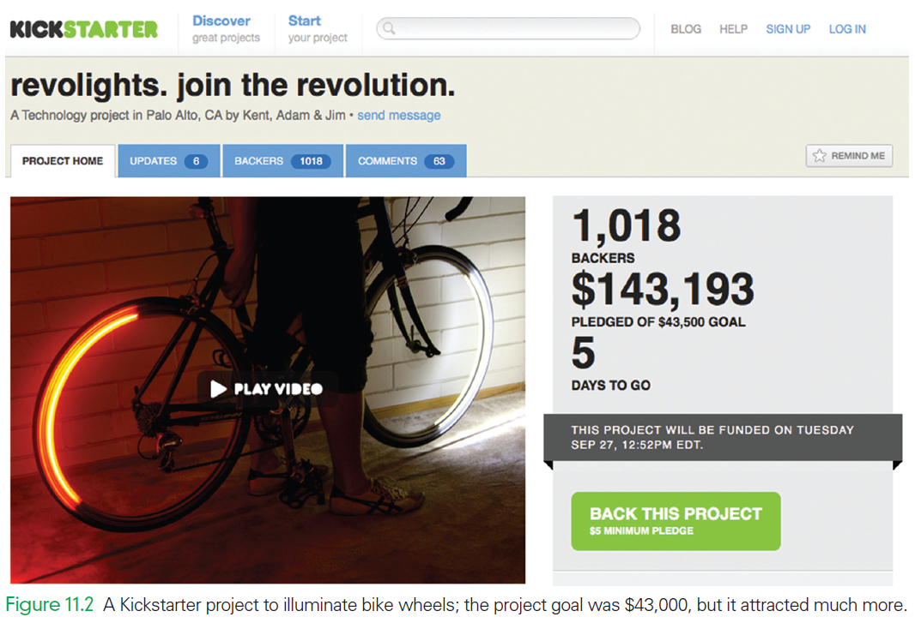

Slide 14
Out on Good Behavior
The online world we live in today is different in many ways than the real world we grew up in
Our range of interactions is much broader; we may never meet face-to-face with the online people
Families and relatives influence our online behavior very little

Slide 15
Out on Good Behavior
We can be anonymous on the Internet, so no one knows if we behave badly…Right?
We are not entirely anonymous online. There are means to get the identities of people on the Internet
We all want to enjoy the benefits the Internet gives us, so our daily uses of the Internet encourages us to behave

Slide 16
Netiquette
Etiquette (guidelines for proper behavior) applies to social interactions on the Internet
Originally developed for email use, but now it is interpreted more broadly to be civilized behavior in any of the social settings on the Internet

Slide 17
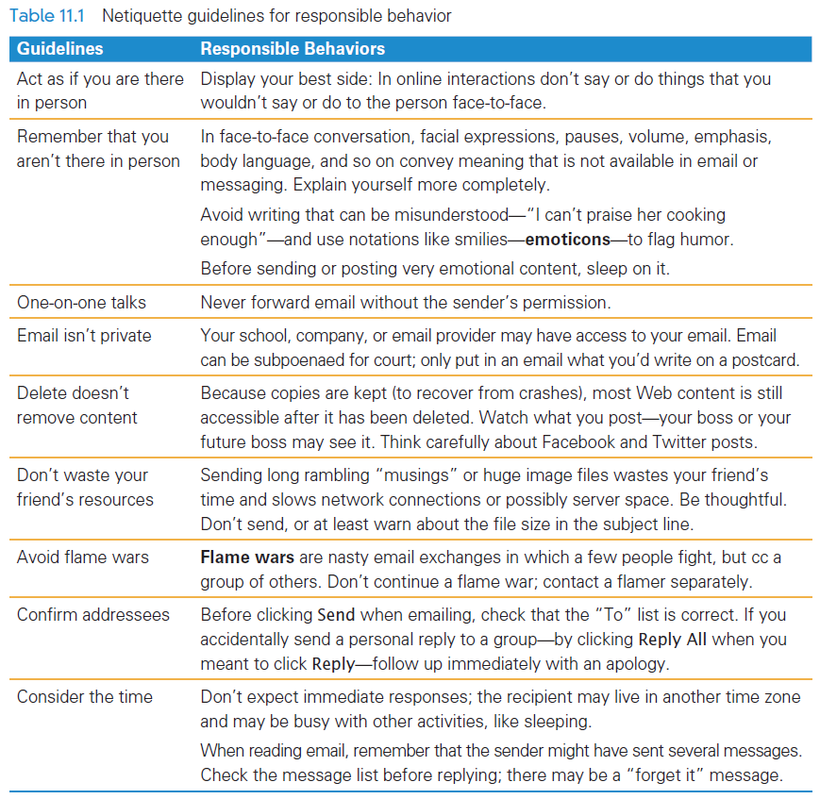

Slide 18
Specific Guidelines for Email
At work we follow rules of respect and good behavior so as to meet general business practices
There are additional good behavior habits to be adopt as well.

Slide 19
Specific Guidelines for Email
Ask About One Topic at a Time
An email message requiring a response should treat only one topic
Because most of us handle one matter at a time, the reader of a one-topic message can respond to the matter and then delete or archive the mail
With multiple topics, it is likely that one or more topics will be dropped or ignored

Slide 20
Specific Guidelines for Email
Include Context
Any email-reading software worth two bits gives you a way to include the original message in a reply
Including the question with the reply is a courtesy.
It provides the context for your answer, so you can give a short reply without leaving the receiver clueless
When you’re answering, put your reply before the included context

Slide 21
Specific Guidelines for Email
Use an Automated Reply
When unable to answer email for a few days, it is polite to set up an automated reply (or vacation message) saying you are away
Indicate, if possible, when you expect to read your email again
The automated reply is generally available from your mail server
Your will know why you’re not responding rather than feeling ignored or snubbed

Slide 22
Specific Guidelines for Email
Answer a Backlog of Emails in Reverse Order
When we keep up with reading our email, we usually answer messages in the order they’re received
When we haven’t answered our email for a while, it’s best to answer email in reverse order
Many of the oldest messages may have resolved themselves while you were away

Slide 23
Specific Guidelines for Email
Clarifying Ownership of Email
Most people assume that sent email is private. It is impolite and inconsiderate to forward
It is impolite and inconsiderate to forward email without getting the sender’s permission.
Asking permission to forward email gives the sender a chance to review the message to decide if there is something in it that should not be passed along

Slide 24

Specific Guidelines for Email
Use Emoticons
The point of email is to communicate clearly
Email (and texts) are casual writing and others may misunderstand if we don’t choose the right word
Emoticons (aka smilies) are familiar
They may help by indicting your intent

Slide 25
Please, Don’t Be Offended
The “Offensensitivity” perspective can be summarized as follows:
Your post will be seen by people all over the world, and you will see posts from people all over the world
You can easily and unintentionally offend them; they can easily and unintentionally offend you

Slide 26
Please, Don’t Be Offended
The “Offensensitivity” perspective can be summarized as follows:
The “problem” is our different cultures, social norms, backgrounds, religions, assumptions, and so forth. You’re not wrong; they’re not wrong. And they are no more likely to change their thinking than you are. Be tolerant. Be respectful.

Slide 27
Expect the Unexpected
Expecting the unexpected is a valuable survival skill in life and in computing.
When something unexpected happens, we should ask
“Why did that happen?”
“What’s going on?”
An essential skill in the social world of computing is, Expect the Unexpected

Slide 28
The Onion
The Onion is a humor magazine specializing in news satire
It produces “news” stories that are almost believable
Rather than checking an unbelievable story by asking if it makes sense many people simply believe it and repeat it

Slide 29
Suspicious Activity
Other kinds of online activity are of greater concern.
Is your software:
“acting” strange?
“behaving” unusually?
These could be indicators of a software problem such as disk fragmentation, or a computer virus infection
If the behavior continues after a reboot, you might need some help

Slide 30
Creating Good Passwords
Passwords are a key part of our daily interaction with computers
The point of a password is to limit access to only those who know a sequence of keyboard characters

Slide 31
How Passwords Work
The computer stores your password encrypted
Encrypted information has been recoded to hide its meaning
Your password is transformed into a cipher text that cannot be easily read
The cipher text is saved

Slide 32
How Passwords Work
The encryption technique used is called a 1-way cipher
No one knows your password except you
The computer doesn’t even know it
It only knows the encrypted version
It verifies that you know it by encrypting what you type in, and comparing to the encrypted version it keeps with your account

Slide 33
How Passwords Work
How can your password be “recovered”?
Systems using a 1-way cipher, it cannot be
The system administrator sets a new, known password
If you say you’ve forgotten your password, s/he gives you a new one (that you change)
Once changed, you are again the only person who knows it

Slide 34
How Passwords Work
What stops someone from asking to have any account’s password changed?
When there are millions of users, what proof does anyone have that you are the owner of the account?
“Security questions”
They provide some evidence that you are you

Slide 35
Poor Passwords
A good password is one that no one is likely to guess, but you can easily remember
Many of us focus on the “easy to remember” part
Someone familiar with us might easily guess them

Slide 36
Poor Passwords
Other weak passwords include:
short passwords (x),
obvious number or letter sequences (123),
standard single dictionary words (password)
Couldn’t a computer be programmed to “guess"?
Generating all possible combinations is possible until the password gets long

Slide 37
Poor Passwords
Software system will not allow zillions of attempted logins
If the correct password isn’t entered after several attempts, the system assumes it’s not a real user
The superuser takes some preventative action
Your main concern is to avoid a password that someone familiar with you could guess

Slide 38
Creating Quality Passwords
There are two goals when creating a password
Easy to remember—pick a topic from which all of your passwords are chosen
Hard to guess—compress, scramble, and recode a password phrase to be unintelligible

Slide 39
1. Easy to Remember
To avoid forgetting a password pick a topic that you will always use to pick passwords
Using one topic helps you remember passwords because they will be associated in your mind
When you try to remember your password, you will know where to start thinking

Slide 40
2. Hard to Guess
Long passwords are harder to guess than short ones
Rule 1: Choose a password that is eight characters or more.
Rule 2: Include numbers and letters (and if allowed, symbols like % and *).
Rule 3: Mix upper- and lowercase letters.
Rule 4: Avoid “dictionary words”

Slide 41
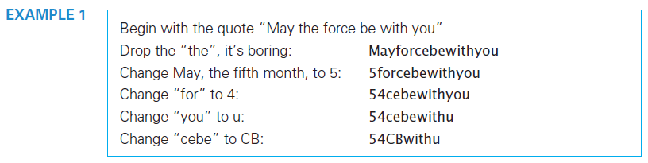

Slide 42
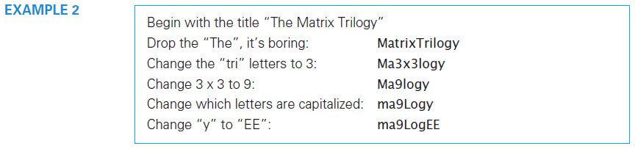

Slide 43
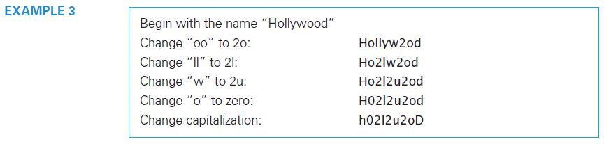

Slide 44
Managing Passwords
One strategy is to have three passwords to use in a variety of circumstances and always use one of them
Four-Digit Numerical Password: for PINs and NOT “obvious”
Six-Letter/Digit Password: when little risk if compromised
Eight+ Symbol Password: for cases where serious risk exists

Slide 45
Managing Passwords
By using the passwords repeatedly, you will have no problem remembering them
If you forget which one you used, there will be only two other possibilities to try.
Chances are that you won’t remember all these places, so just change it when you revisit sites were you’ve used it.
Eventually, the password will be changed everywhere

Slide 46
Spam
Unsolicited commercial email (UCE) is known as spam
A person can be sent more than 100 spam messages a day
There are laws against spam in many places, and spammers are prosecuted, but it still persists

Slide 47
Spam
Spam filters separate legitimate mail from spam
In most cases, your ISP has a spam filter installed
The spam filter software processes email messages as they arrive, separating the spam from the legitimate mail
Determining if email is spam is really just a program’s best guess

Slide 48
Spam
The program scans the email and assigns a score that measures how many properties typical of spam are also properties of the email
If the score is above the threshold, the email is considered spam
Users can check the spam quarantine to be sure no legitimate mail is being stopped

Slide 49
Controlling Spam
After a spam filter scores the email:
It is delivered to your inbox if the score is below your spam threshold
Some mistakes are inevitable
Setting the threshold lets you control how to handle the “close calls.”
A lower threshold says a message is spam based on fewer properties
A higher threshold says a message is spam based on many properties

Slide 50
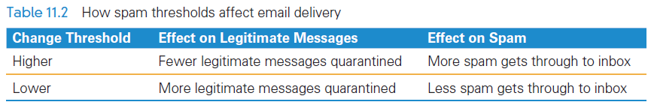

Slide 51
Scams
Nigerian Widow Scam
The Nigerian Widow scam is so common that it has referenced in pop culture
The scam is known as an advance-fee fraud or as 419 fraud

Slide 52
Scams
Nigerian Widow/419 Scam
Someone you never heard of claims to have great wealth that they cannot access
They ask your help in transferring the money out of their country
For your help, you will receive a large share of the money
They emphasize that the operation is confidential
After you agree to help, things go wrong with the transfer

Slide 53
Scams
Nigerian Widow/419 Scam
They need some money to bribe officials or pay various fees before they can get the money
After you agree to help, things go wrong with the transfer, more money is needed before they can get the money
You give them the money thinking you will get much more in the future (this is the “advance fee” part)
The scammers need more and more money as time passes
Eventually you threaten them, and they disappear

Slide 54
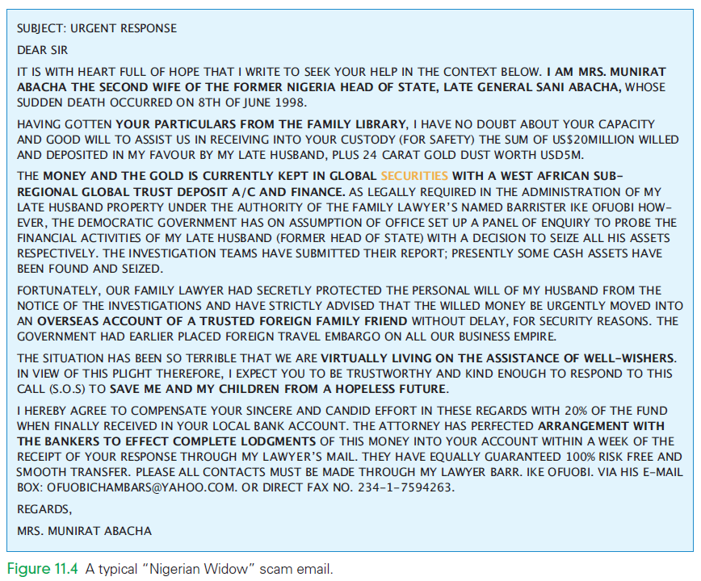

Slide 55
Scams
Nigerian Widow/419 Scam
Unfortunately, the 419 scam has been extremely successful
The U.S. Secret Service claims Americans lose tens of millions of dollars every year to this scam.
In a recent variation, the email says that you have won a lottery in another country

Slide 56
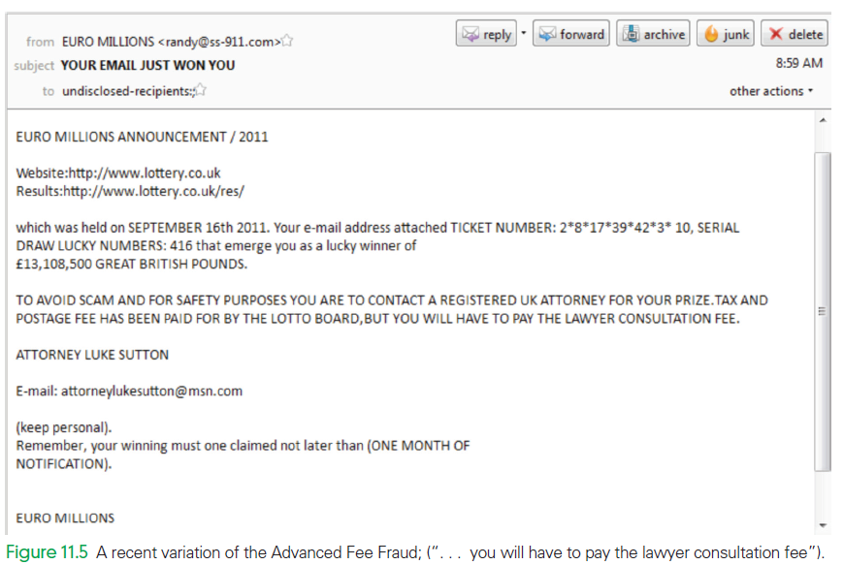

Slide 57
Phishing
The social engineering process of convincing trusting people to give up personal data voluntarily is called phishing (password harvesting fishing)
Spam email is sent out designed to look like it comes from a reputable organization
The mail uses actual content from the reputable organization’s site

Slide 58
Phishing
The message makes one of several claims on behalf of the organization:
Your account has been accessed by unauthorized people
You are owed money
There has been a security breach, which they are trying to fix
They are performing an audit and find possible problems with your account

Slide 59
Phishing
They ask that you log on to a Web site resolve the issue
Most of the links connect to bogus sites that looks like it might be reputable

Slide 60
Phishing…Protection
You can protect yourself from phishing by doing the following:
Open attachments only when you know who sent them and why
Only give information online when you have initiated the transaction yourself
Before entering information, think: “How did I get to this company?”
Pay attention to the domain name of the company

Slide 61
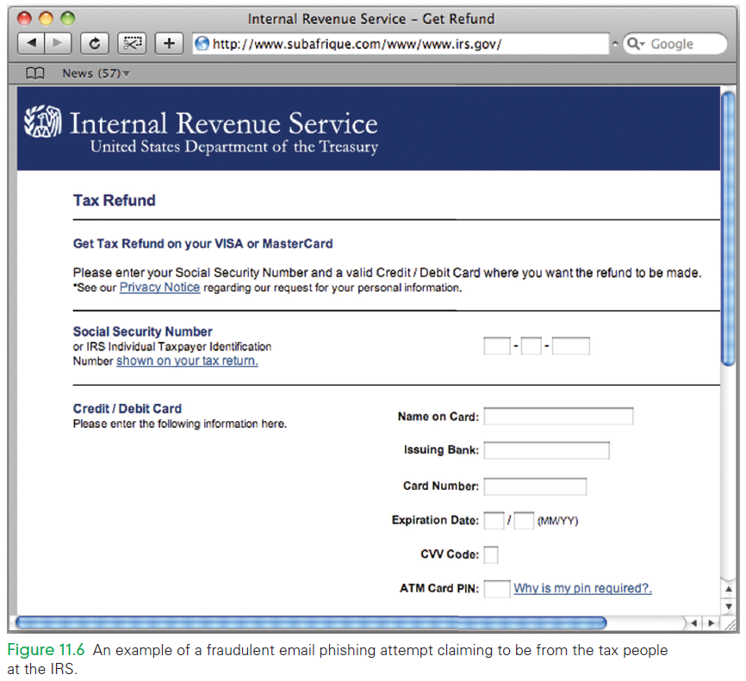

Slide 62
Protecting Intellectual Property
Information is something that can be owned
Information is the result of the creative process
The act of creation gives the creator ownership of the result in the US and most of the world

Slide 63
Protecting Intellectual Property
Sometimes there are multiple forms of ownership
If on her tour Katy Perry sings a song written by Paul Simon, he owns the words and music, she owns the performance
If a person creates something while working for a company, the company generally owns the information

Slide 64
Protecting Intellectual Property
All such human creations are called intellectual property
The two aspects of intellectual property that we are interested in are:
Software, and
Copyright on the Web

Slide 65
1. Software
When you buy software, you actually didn’t buy the software, you leased it
You have the right to use of software, but the ownership remains with the company that marketed it

Slide 66
1. Software
Use of the Software
If the agreement allows us to use the software, we can use it on at least one computer
We may be permitted to use it on all of the computers we own
We can use only one instance at a time
Installing several instances for convenience may be okay

Slide 67
1. Software
Don’t Sell It or Give It Away
Because you don’t own commercial software you cannot give it to your friend
If you do, you would violate the terms of the contract that you agreed to when you opened the software package
Unless the programmer gives you the explicit right to copy and distribute the software, you cannot sell it or even give it away

Slide 68
1. Software
Try Before You Buy
Shareware, software that is usually distributed over the Internet
The idea of shareware is that you can try out the software, and if you like it and use it and then you pay the person who created it
It is an honor system:
If you use the software, you should pay for it
It is unethical to download software on the implied promise of paying for it if you use it

Slide 69
1. Software
Open Source Software
Software from vendors is proprietary, (the vendors keep the source code private)
Software for which the program is publicly available, is known as open source software
Open source seems not to make sense:
Who pays for the technology?
How can a company make money if the product is publicly available?

Slide 70
1. Software
Open Source Software
Companies developing technology often make their products open source to promote wide distribution
Money is made selling specialized versions to corporate clients, providing customer support, and selling other software
Advocates of open source point out that if the software is publicly available, other people work on it and improve it

Slide 71
2. Copyright on the Web
When a person writes a term paper, builds a Web page, or creates a sculpture, s/he automatically owns the copyright on that “work” in the US and most nations of the world
It’s the creator’s copyright unless the creation is “work for hire”
The owner is the person who paid the creator

Slide 72
2. Copyright on the Web
What rights are included in a copyright?
Copyright protects the owner’s right to do the following:
Make a copy of the work
Use a work as the basis for a new work
Distribute or publish the work
Publicly perform the work
Publicly display the work

Slide 73
2. Copyright on the Web
No application or approval is required
The work doesn’t require the © symbol.
It’s copyrighted the moment it’s finished.
You might be tempted to bypass copyright law by restating a work in your own words
If your creation is too much like the original, you’ve produced a derivative work rather than new intellectual property

Slide 74
2. Copyright on the Web
Free Personal Use
Just because someone else owns a work doesn’t mean that you can’t use and enjoy it
You are free to read, view, or listen to it
You can print it (and/or save it) as long as it is for future personal enjoyment

Slide 75
2. Copyright on the Web
When Is Permission Needed?
Generally, if you want to use works in one of these ways (make a copy, use a work as the basis for a new work, distribute or publish the work, or publicly perform the work, you must get permission from the owners

Slide 76
2. Copyright on the Web
The Concept of Fair Use
This is the gray area in which limited use of copyrighted materials is allowed without getting permission.
Fair use is recognized in copyright law to allow the use of copyrighted material for educational or scholarly purposes, to allow limited quotation of copyrighted works for review or criticism, to permit parody, and a few other uses

Slide 77
2. Copyright on the Web
When Is It Fair Use?
What is the planned use?
What is the nature of the work in which the material is to be used?
How much of the work will be used?
What effect would this use have on the market for the work if the use were widespread?

Slide 78
Creative Commons
Allow Copying and Distribution
The Creative Commons has as goals increasing the sharing of intellectual property, and greater creativity
They have developed licenses that allow works to be shared easily:
When a creator posts his or her work on the Internet with a CC license, people are allowed to copy and distribute it

Slide 79
Creative Commons
Allow Copying and Distribution
The Creative Commons (creativecommons.org) licenses are not the same as public domain
Placing a work in the public domain gives up all rights
The CC licenses are middle ground with some rights reserved

Slide 80

Creative Commons
What to Keep, What to Give
There are several options for a Creative Commons license:
Attribution: Others are allowed to copy, distribute, perform, remix, etc., the work, as well as create other work based on it, as long as you get credit for it

Slide 81

Creative Commons
What to Keep, What to Give
There are several options for a Creative Commons license:
Noncommercial: Others are allowed to copy, distribute, perform, remix, etc., the work, as well as create other work based on it, as long as the result is not for sale

Slide 82

Creative Commons
What to Keep, What to Give
There are several options for a Creative Commons license:
No Derivative Work: Others are allowed to copy, distribute, perform, etc., the work, as long as those are verbatim; no derivative works can be created from it

Slide 83

Creative Commons
What to Keep, What to Give
There are several options for a Creative Commons license:
Share Alike: Others are allowed to distribute derivative works only under a license identical to the one governing your work.

Slide 84

Creative Commons Summary
A summary checklist of the CC concepts and implications:
Creators keep the copyright to their work
CC developed licenses for the general “good”; they get no extra rights beyond other users
CC provides tools for tagging your work with the license link
CC licenses allow copying, distributing, and performing
Attribution, which most CC licenses have, gives credit to the creator
Creators can waive any of the rights they keep for themselves

Slide 85
Summary
“Expecting the unexpected” as a useful survival skill. The challenge is to think about the unexpected event and correctly determine whether and how to respond.
Spam, Scams, and Phishing. They are everyday occurrences, but skepticism is a handy tool to avoid trouble.

Slide 86
Summary
Creating an easy-to-remember password. The approach emphasized selecting passwords that are connected to a common topic. It is smart to choose simple passwords when little security is needed and to choose more obscure passwords when there is greater risk.

Slide 87
Summary
Characteristics of copyright. When we create intellectual property, we immediate have copyright to it. When others hold copyright, we may be restricted on how we can use it. Asking permission is always the safest thing to do.

Slide 88
Summary
Creative Commons licenses provide a simple way to create and share intellectual property within the existing laws. It promotes creative communities.

