Slide 2
Learning Objectives
Explain the meaning of privacy; discuss the issues surrounding privacy of information
List and explain the meaning of the OECD Fair Information Practices
Discuss the issues concerning U.S. privacy: Opt-in/Opt-out, compliance/enforcement, coverage
List the ways a computer can be compromised
Explain the security methods used in public key cryptosystems (PKCs)
Perform simple encryption from cleartext to cipher text and perform the reverse decryption

Slide 3
Privacy: Whose Information Is It?
Buying a product at a store generates a transaction, which produces information.
The date and time of the purchase
The product, the cost, and information about other products in the same “market basket.”
Is this information connected to a specific customer?

Slide 4
Privacy: Whose Information Is It?
Buying a product at a store generates a transaction, which produces information.
Paying with cash generally ensures anonymity
Paying by check, credit card, or debit card
Purchasing through mail order or on the Internet
Providing a “preferred customer” number
Buying a product that must be registered for a service agreement or warranty

Slide 5
How Can the Information Be Used?
Transaction information is a normal part of conducting business (keeping a record until our check clears)
The information belongs, then, to the store
If the store decides, based on your previous purchases, to send you ads for other items, the store is using the information for the standard business practice of generating more business

Slide 6
How Can the Information Be Used?
If the store sells your name to others has the information been misused?
Those other businesses are only trying to generate more business.
Is it misused if the information gets to the newspaper and is published?
Has the store broken the law?

Slide 7
Modern Devices and Privacy
In the past, it was hard for people’s privacy to be violated without their knowledge
With modern technological devices, people’s privacy can be violated without their knowing it
Your image and your information deserves “sufficient safeguards against improper circulation”

Slide 8
Controlling the Use of Information
Who controls the use, if any, of the transaction information?
There are four main possibilities:
No Uses. The information ought to be deleted when the store is finished with it.
Approval or Opt-in. The store can use it for other purposes, but only if you approve.
Objection or Opt-out. The store can use it for other purposes, but not if you object.
No Limits. The information can be used any way the store chooses.

Slide 9
Controlling the Use of Information
There is also a fifth possibility, Internal Use:
The store can use the information to conduct business with you (keeping your address, for example), but for no other use
It would not include giving or selling your information to another person or business, but it may not require your approval either

Slide 10
Controlling the Use of Information
If the transaction took place outside the US, the law and standards would place it between (1) and (2) on the spectrum, but very close to (1).
If the transaction occurred in the US, the law and standards would place it between (3) and (4) on the spectrum, but very close to (4)

Slide 11
Controlling the Use of Information
Many Americans assume that there is a privacy law that is close to the fifth case, internal use

Slide 12
A Privacy Definition
Privacy: The right of people to choose freely under what circumstances and to what extent they will reveal themselves, their attitude, and their behavior to others.
Privacy is difficult to define
Generally, privacy concerns four aspects of our lives: our bodies, territory, personal information, and communication

Slide 13
A Privacy Definition
This definition emphasizes first that it is the person who decides the circumstances and the extent to which information is revealed, not anyone else
Second, it emphasizes that the range of features over which the person controls the information embodies every aspect of the person—themselves, their attitudes, and their behaviors

Slide 14
Enjoying the Benefits of Privacy
Sometimes we want publicity, sometimes we don’t
Strong privacy laws insure that we control the dissemination of our information
The benefits to us personally are obvious

Slide 15
Threats to Privacy
What are the threats to privacy?
There are only two basic threats:
Government
Business
(Snooping or gossiping private parties, will be handled by security)

Slide 16
Threats to Privacy
Historically, the governmental threat of spying on its citizens, worries people the most
The business threat is a more recent worry
There are two types of business threats:
Surveillance of employees
The use of business-related information for other purposes.

Slide 17
Voluntary Disclosure
In principle, a person can enjoy perfect privacy by simply deciding not to reveal anything to anyone
It may be in our interest to reveal private information, freely in exchange for real benefits

Slide 18
Benefits of Voluntary Disclosure
Doctors receive our personal information so they can help us stay healthy.
Credit card companies get our personal information to check our credit record in exchange for the convenience of paying with a card.
Employers read our email at work, because we are using the employer’s computer for a job

Slide 19
Benefits of Voluntary Disclosure
The government may have information on us regarding our parents’ names and birthplaces, our race and ethnicity, etc. for the purpose of enjoying the rights of citizenship.
How private can we be when we reveal so much about ourselves, our attitudes, and our behavior?

Slide 20
Fair Information Practices
If people or organizations are free to give or sell the information to anyone else, they are also revealing information about us.
Our privacy is compromised.
There must be clear guidelines adopted for handling private information:
The Fair Information Practices principles.

Slide 21
OECD Fair Information Practices
In 1980 the Organization for Economic Cooperation and Development (OECD) developed an eight-point list of privacy principles that became known as the Fair Information Practices
They have become a widely accepted standard

Slide 22
OECD Fair Information Practices
The public has an interest in these principles becoming law
The principles also give a standard that businesses and governments can meet as a “due diligence test” for protecting citizens’ rights of privacy, thereby protecting themselves from criticism or legal action

Slide 23
OECD Fair Information Practices
An important aspect of the OECD principles is the concept that the data controller (the person or office setting the policies) must interact with individuals about their information, if any, and must be accountable for those policies and actions!

Slide 24
OECD’s Fair Information Practices
The standard eight-point list of privacy principles.
Limited Collection Principle
Quality Principle
Purpose Principle
Use Limitation Principle
Security Principle
Openness Principle
Participation Principle
Accountability Principle

Slide 25
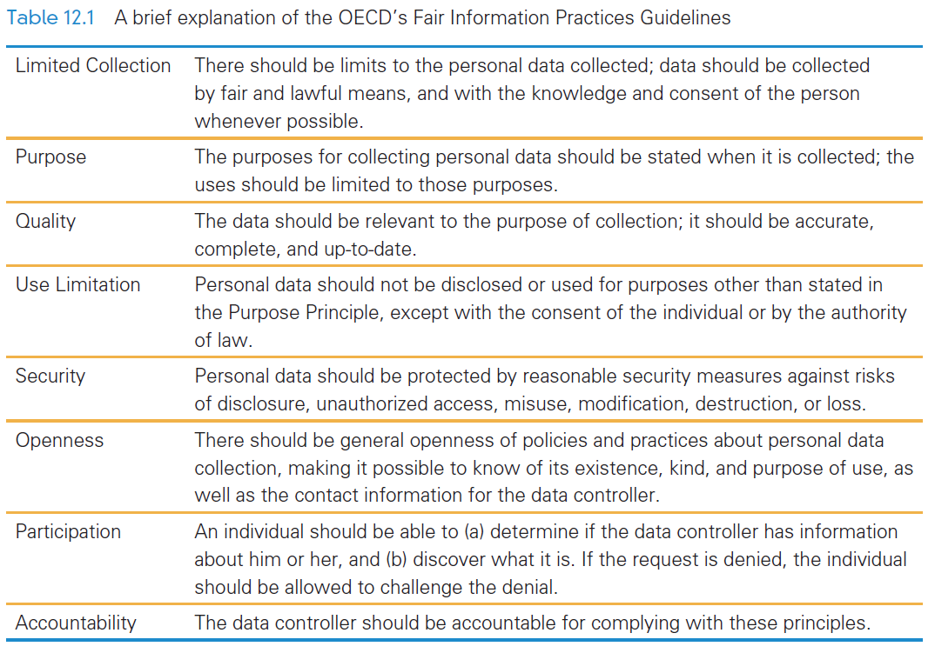

Slide 26
Privacy Worldwide
Privacy is not enjoyed in much of the world at the OECD standard
Privacy often comes in conflict with private or governmental interests:
Example, the United States has not adopted the OECD principles, possible because many U.S. companies profit by buying and using information in ways that are inconsistent with the OECD principles

Slide 27
Privacy Worldwide
The Chinese government isn’t going to protect the right to privacy when it denies other basic human rights
Many non-EU countries have also adopted laws based on OECD principles
One provision in the EU Directive requires that data about EU citizens be protected by the standards of the law even when it leaves their country

Slide 28
U.S. Privacy Laws
The Privacy Act of 1974 limiting the government’s ability to invade people’s privacy
The U.S. Patriot Act of 2002 (and its reauthorization in 2005) have seriously weakened its protections.
The US failed to meet the requirements of the EU Directive concerns information stored by businesses

Slide 29
U.S. Privacy Laws
US Sectoral Laws and Privacy:
Electronic Communication Privacy Act of 1986
Telephone Consumer Protection Act of 1991
Driver’s Privacy Protection Act of 1994
Health Insurance Privacy and Accountability Act of 1996
The sectoral approach provides very strong privacy protections in specific cases

Slide 30
Privacy Principles: Abroad
There are three weaknesses in the US privacy laws:
Opt-in/Opt-out,
Enforcement,
Coverage

Slide 31
1. Opt-in/Opt-out
Refers to the approval and objection aspects of privacy
“Opt-in” means the business cannot use it unless the person opts-in or explicitly allows the new use
“Opt-out” means the business can use it unless the person explicitly opts-out or denies the new use
The US the default is opt-out

Slide 32
1. Opt-in/Opt-out
Privacy principles as far back as 1972 have consistently required opt-in for all changes in use otherwise the person does not control the use of private information. (Opt-in is actually a longer-standing principle than stated

Slide 33
2. Compliance/ Enforcement
How do organizations meet their obligations under the principles?
OECD-subscribing countries have introduced offices to perform the duties of the data controller
There is no such person/office in the US
The FTC proposes that U.S. companies “comply voluntarily” as a result of “market pressure”

Slide 34
3. Coverage
The OECD rules apply to all stored and transmitted information, though exceptions can be made by law
Countries adopting the Fair Information Practices have everything covered
Unless the United States passes an explicit law there are almost no constraints. Most information is unprotected

Slide 35
Privacy Success Story
The Do-Not-Call List
In the 1990s households would receive numerous calls from telemarketers trying to sell products
The “industry self-policing” mechanism was a little-known system requiring a person either (a) to write a letter to the industry association or (b) to opt-out online by paying a fee using a credit card. People had to pay to stop being harassed!

Slide 36
Privacy Success Story
The Do-Not-Call List
The US government set up the Do-Not-Call List, a central place where people could simply give their phone number to stop telemarketers.
Instant success! Ten million households opted-out on the first day of operation
Today more than 175,000,000 are on it
The telemarketing business has largely collapsed

Slide 37
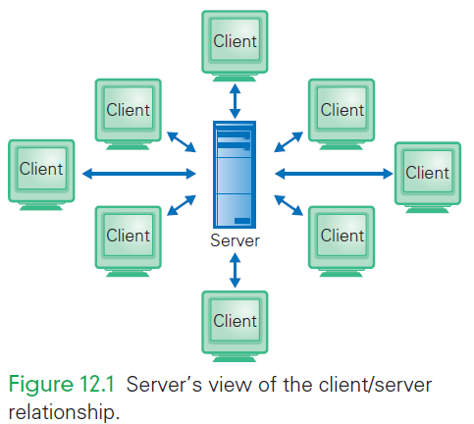
Cookies
Cookies are a standard computer science concept originally used by Netscape engineers to connect the identity of a client across a series of independent client/server events

Slide 38
Cookies
Imagine this is your bank’s server, and you are a client
The server is helping many clients at once, and to know who’s who, the server stores a cookie of information that uniquely identifies you

Slide 39
Cookies
Cookies are exchanged between the client and the server on each transmission of information, allowing the server to know which of the many clients is sending information

Slide 40
Cookies
Many sites use cookies, even when the interaction is not intended to be as secure as a bank transaction (National Air and Space Museum sent the above)
The meaning of the fields is unimportant
The first is the server and the last is the unique information identifying the session

Slide 41
Cookie Abuse
There is a loophole called a third-party cookie
A cookie is exchanged between the client and server making the interaction private
But, if the Web site includes ads on its page, the server may direct it to link to the ad company to deliver the ad
This new client/server relationship place a cookie on your computer

Slide 42
Cookie Abuse
All browsers allow users to control how cookies are processed
You could turn them off, forcing the browser to ask you every time whether you will accept a cookie or not
Turning off cookies prevents you from being able to bank online
Simply set your browser’s cookie policy to your own comfort level

Slide 43
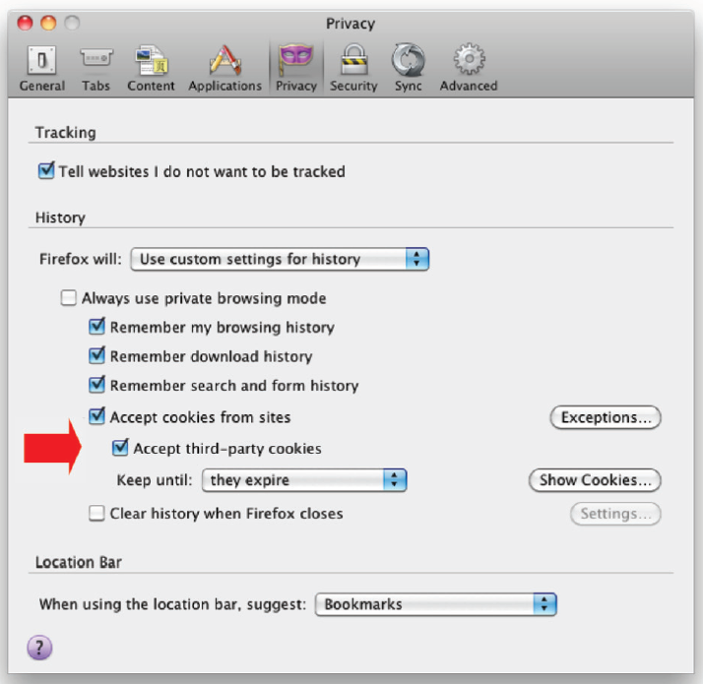

Slide 44
Tracking
Tracking is the practice of a Web site automatically sending details about a visit to other content providers
This is an emerging problem of concern to privacy experts
The consequences of being tracked are not yet fully understood
HTTP has a tracking flag telling servers what your tracking preferences are

Slide 45
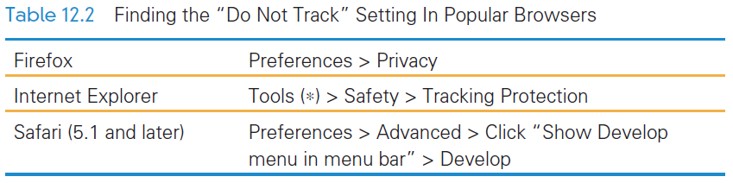
Do Not Track
Notice that Google’s Chrome browser does not support user requests not to track.

Slide 46
Cell Phone Location Tracking
Another tracking issue is unfolding…it is cell phone location tracking
Cell phone carriers know the locations where cell phones are used based on the proximity to cell phone towers
What happens to the location data, which allows a person’s movements to be tracked and archived?

Slide 47
Cell Phone Location Tracking
Freedom of Information request in 2010
Privacy groups launched a request to handle cell phone information
For a landline, finding out who a person calls normally requires a warrant
The same is currently not true with regard to cell phones

Slide 48
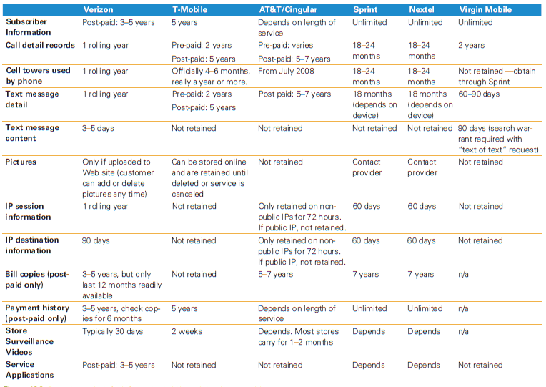

Slide 49
Identity Theft
The Security Principle of the Fair Information Practices is also important
The Security Principle states that those who hold private information are obligated to maintain its privacy against unauthorized access and other hazards
Americans do not enjoy protection from this principle either

Slide 50
Identity Theft
How can this private information be used?
One possibility is identity theft the crime of posing as someone else for fraudulent purposes
Over 800 identity thefts have been reported from the one instance of private information “viewed” by unauthorized persons!

Slide 51
Managing Your Privacy
In the United States, protecting your privacy is your job:
Adjust your cookie settings in your browser to match your comfort level.
Read the privacy statement of any site before you give it information
Review the phishing protections given in Chapter 11 to avoid scams
Be skeptical. Paranoia isn’t necessary, but skepticism is.

Slide 52
Managing Your Privacy
In the United States, protecting your privacy is your job:
Familiarize yourself with the current assaults on privacy; they’re often announced in the national media, but it’s easy to find them at sites such as EPIC (www.epic.org).
Consider writing to your congressperson for U.S. adoption of OECD’s Fair Information Practices.

Slide 53
Digital Security
Computer security is a topic that is in the news almost daily.
Remember the long list of “dos and don’ts” for online behavior?
Do check with the sender before opening an attachment you’re unsure about
Don’t fall for phishing emails
And the other’s from Chapter 11?

Slide 54
Koobface…Facebook
Koobface is a worm that targets social media and the main operating systems
You receive a message from a “friend” whose computer is infected
You are directed to a Web site to see a
When you reach the Web site the video isn’t streamed, but a message says that first you have to install an updated version of some software

Slide 55
Koobface…Facebook
Instead, you’re about to get a worm.
If you take the bait, and install the worm, your machine is infected
Koobface is gathering your log-in information, like account numbers and passwords
It also participates with other Koobface-infected computers as part of a botnet to generate income for the “bad” guys

Slide 56
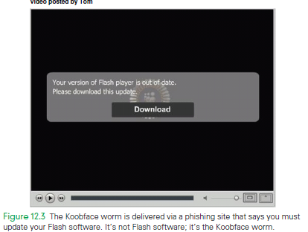
Koobface…Facebook
In security circles, such compromised, Internet-connected computers are known as zombies

Slide 57
Viruses and Worms
Software viruses and worms are classified as malware, or malicious software
Viruses and worms are programs that can clone themselves
The difference between these two:
Viruses hide in other software, and “fire up” when that software is run
Worms find your address book or friends list, and send themselves as email or messages to your contacts

Slide 58
Viruses and Worms
They can also harm your computer:
Maliciously harming the information stored on your
Using your computer and Internet connection to send spam, or other practices (zombie)
Grabbing secure information from your computer such as your passwords, account numbers, etc
Propagate and move on to your friends and family

Slide 59
Vectors of Attack
There are five methods/vectors of virus or worm attack:
Email Attachments
Spoofed Links
Social Engineering
P2P File Sharing
Bluetooth and MMS File Transfers

Slide 60
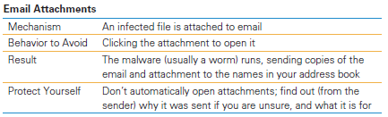
1. Email Attachments
The email attachment is actually a program
By clicking the attachment, the program runs
The instructions make a copy of the email (program and all) as well as the code.
They go to the address book on your computer and send the copied email to everyone listed

Slide 61
1. Email Attachments
The people who send you worms are people who regularly send you email—they just didn’t know they sent it!
If you are not sure why you got the attachment, email the sender and ask BEFORE opening it.
Not all attached files are created equal. Some are riskier than others.

Slide 62
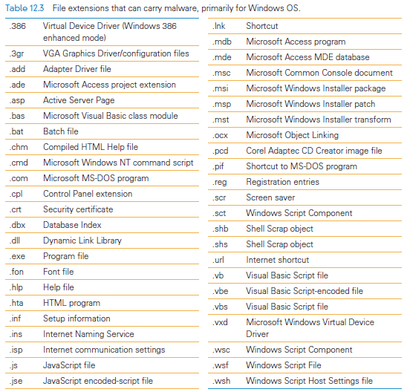
File Extensions and Malware

Slide 63
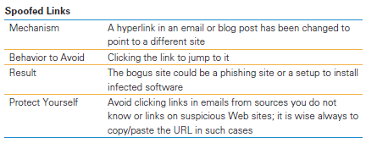
2. Spoofed Links
Hyperlinks are specified on Web pages by the following form: <a href="http://site.com/puter/goes2">Site U C Underlined In Blue </a>
There are two parts:
One is the part the computer uses (the actual site)
The other part is the text you see

Slide 64
2. Spoofed Links
To be clear: It’s fine to click links as follows:
When the site containing the link can be trusted
When the site containing the link was found in a Google or Bing search
When you typed the URL yourself
Those cases are always safe. Other situations can be riskier.

Slide 65
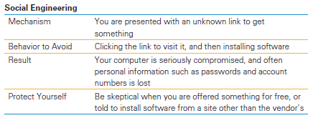
3. Social Engineering
This is the Koobface case.
It induces you to see a video, which you could recognize as a trick when you’re asked to upgrade Flash
There are other ways in which the site can do harm, and just visiting is enough

Slide 66
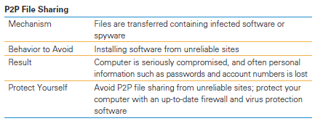
4. P2P File Sharing
Peer-to-peer (P2P) file sharing is a popular way to share files
While it can be convenient, it can also be quite risky

Slide 67
4. P2P File Sharing
P2P refers to the relationship between computers that are communicating over the Internet
Each of the computers—yours and someone else’s—is a “file server” for the other
Predators can set up “bait” such as pirated music to attract users, and then to become a peer, you install their (infected) software

Slide 68
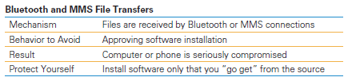
5. Bluetooth & MMS File Transfers
Smart phones and other hand-held devices are now as susceptible to malware as laptops and desktops.
An attack sends infected files with extensions like .jpg or .mp3, which should be fine. When “played” they ask to install software.

Slide 69
Plan of Action
As more technology is created, more ways to abuse it will be developed
So, what to do?
Here’s a brief plan of action:
Installing protective systems
Tuning the installed protections
Behaving to avoid difficulties

Slide 70
1. Installing Protective Systems
The first rule of security is to set up a barrier:
Firewall. A firewall is a barrier between two networks, or in the “personal” firewall case, between the Internet and your computer.
Generally, firewalls filter network traffic that is trying to cross the barrier.
It allows through only those messages with a destination in the protected area

Slide 71
1. Installing Protective Systems
The first rule of security is to set up a barrier:
Virus Protection. Anti-virus software must be operating at all
Install virus protection software
Keep it current!

Slide 72
1. Installing Protective Systems
The first rule of security is to set up a barrier:
Anti-Spyware. Spyware is software that snoops on your private information, causes advertising pop-ups, and monitors your Internet behavior for advertising purposes.
Anti-spyware protection is often bundled with anti-virus software.
Find a package that includes both!

Slide 73
1. Installing Protective Systems
The first rule of security is to set up a barrier:
Rootkit Detection. A rootkit is malware that directly manipulates the operating system data structures to hide its presence.
Rootkits have become a much more serious problem in recent years for those visiting certain sites
Install a rootkit detector

Slide 74
2. Tuning the installed protections
Stay Up-to-Date
Recent versions of Windows have automatic OS updates for fixing or delivering security “patches”
This process must be allowed; browsers also depend for their effectiveness on automatic updates.

Slide 75
2. Tuning the installed protections
Browser Sense.
The browser is the main entry point for external information
Its security is critical
Get one that is sound and responsive in the face of new security threats
Do not use the security-plagued older versions

Slide 76
2. Tuning the installed protections
Emailer Sense
Use an email program, such as Thunderbird, that is responsive to security issues
Spam Filter
Periodically check your spam quarantine to be sure that you are not missing emails
Adjust the threshold if spam is still getting through

Slide 77
2. Tuning the installed protections
Wi-Fi Protection
A computer is using a wireless connection to the Internet, is receiving and sending all of its information by radio broadcast
Any computer can listen to it!
Use encrypted networks!
When setting up a wireless network, use Wi-Fi Protected Access (WPA or WPA2) encryption

Slide 78
2. Tuning the installed protections
Disable File Sharing
Though convenient, it is a risky to leave it running in large wireless network situations
Leave it turned off until you absolutely need it,
Turn it off as soon as you’re done

Slide 79
3. Behaving to Avoid Difficulties
Download Cautions
The greatest security risk to your computer is installing compromised software
Install only good software
For shareware trust sites like SourceForge and ZDNet,V3

Slide 80
3. Behaving to Avoid Difficulties
Careful with Attachments
Only open email attachments when you are expecting them
Contact the sender to find out what the attachment is about

Slide 81
3. Behaving to Avoid Difficulties
Password Protection
Adopt a set of passwords
Use strong passwords for sensitive uses
Password-protect your computer

Slide 82
Encryption
Information that is recoded to hide its true meaning uses encryption
A major component of encryption is the key
They come in two forms:
Private
Public

Slide 83
Encryption
The key is a “magic number” used to transform text into gibberish (cipher text)
Both the sender and receiver must agree on the key
The process of sending an encrypted message is a five-step algorithm

Slide 84
Encryption
5-Step Encryption algorithm:
The sender breaks the message into groups of letters
“Multiply” each group of letters times the key
Send the “products”/results from the “multiplications” to the receiver
The receiver “divides” the “products” by the key to recreate the groups
Assemble the groups into the message

Slide 85
Encryption
This works because the math works
The “reversibility” of encryption makes them 2-way ciphers
Only the sender and receiver know the key, making the products useless numbers
This is a secure communication
The technique just explained is called private key encryption, or symmetric- key cryptography

Slide 86
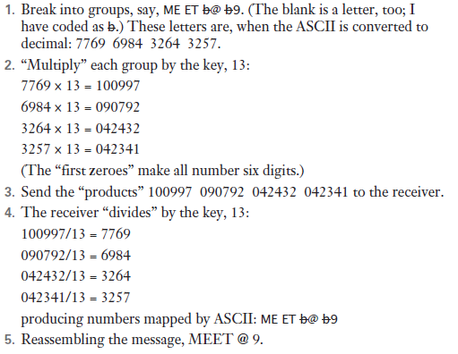
Encryption Example

Slide 87
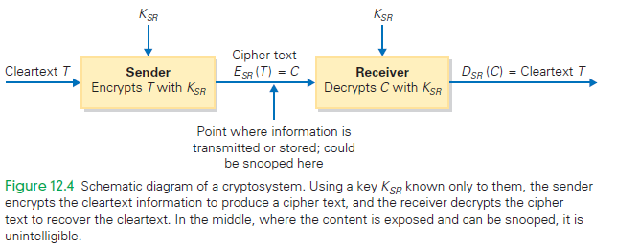
Cryptosystem Schematic Diagram

Slide 88
Private Key Encryption
Real encryption systems use much longer blocks (hundreds of letters) and larger keys
Multiplication, division are not the only operations that can be used for encryption
All that is needed is for an operation to have an inverse (divide is the inverse of multiply)

Slide 89
Private Key Encryption
Private key encryption works very well
Only one small problem: The sender and receiver have to agree on the key, which means they need to communicate somehow
Usually, they meet face-to-face (they can’t email, they don’t have a key yet!)

Slide 90
Public Key Encryption
To avoid that face-to-face meeting, publish the key!
Use public key encryption
Two special prime numbers multiplied together

Slide 91
Public Key Encryption Steps
After, the receiver publishes the special key, K, the following happens:
The sender breaks up the message into blocks as before
The sender cubes each block, and divides by K, keeping only the remainders
The remainders are transmitted

Slide 92
Public Key Encryption Steps
After, the receiver publishes the special key, K, the following happens:
The receiver raises each remainder to a high power determined by the prime numbers and known only to him
The receiver divides by K, too, and saves only the remainders, which are the original blocks.
The receiver assembles the message.

Slide 93
How Do We Know It Works?
K, the magic public key, is just two prime numbers, p and q, multiplied together
It is possible to figure out those two numbers from the published key in theory.
This process, called factoring, is tough if the numbers p and q are large (60 digits apiece)
It is impractical to factor them no matter how powerful the computer!

Slide 94
Redundancy Is Very, Very, Very Good
Take precautions with your technology!
Businesses archive files daily and store these backups off-site
They have a system recovery team to clean up after a disaster strikes
They also have system redundancy—multiple computers performing the same work, so that when one fails, another is up and running

Slide 95
Fault Recovery Program
Full backup
A complete copy of everything written on the system as of a date and time
Partial backup
Changes since the last full (or partial) backup are saved
“Changes” means to keep a copy of any files or folders that have been created or modified

Slide 96
Fault Recovery Program
After a disaster, recover by installing the last full backup copy
Then make the changes saved in the partial backups in order
Continue with each partial backup until the most recent
That’s as close to “full recovery” as possible

Slide 97
Backing Up a Personal Computer
First, you need a place to keep the copy, and you need software to make the copy.
The two easiest “places” to keep the copy are on an external hard disk or “in the cloud”
The “cloud” company’s computers store the information for you and they take responsibility of keeping it available to you

Slide 98
Backups
You don’t have to back up the following:
Information that can be recreated from some permanent source
Information that was saved but that has not changed
Information that you don’t care about

Slide 99
Recovering Deleted Information
If you accidentally delete important files, file restoration (that backup copy!) is great!
Backups can save evidence of crimes or inappropriate behavior (digital copies of files are easy to create and store)
Two copies of email are produced immediately when the Send button is clicked—one in the sent mail directory, and one somewhere else

Slide 100
Summary
Revealing personal information can be beneficial, so the people and organizations that receive the information must keep it private. The guidelines for keeping data private have been created by several organizations, including the Organization for Economic Cooperation and Development (OECD).

Slide 101
Summary
Guidelines often conflict with the interests of business and government, so some countries like the United States have not adopted them. Because the United States takes a sectoral approach to privacy, adopting laws only for specific business sectors or practices, much of the information collected on its citizens is not protected by OECD standards.

Slide 102
Summary
The shortcomings for privacy conditions in the United States are Opt-in/Opt-out, compliance/enforcement, and coverage.
The “third-party cookie” loophole allows companies to gather information; identity theft is an unresolved problem. The best way to manage privacy in the Information Age is to have OECD-grade privacy laws.

Slide 103
Summary
Public key cryptography (PKC) is a straightforward idea built on familiar concepts.
Computer scientists have not yet proved the invincibility of the RSA scheme, but it can be “made more secure” simply by increasing the size of the key.

Slide 104
Summary
Viruses and worms cause damage. We can reduce the chance of infection by installing and running anti-virus software. We must be aware of hoaxes and phishing scams.
We can implement a plan of action to ensure that our personal computers remain private and secure.

Slide 105
Summary
There are two key features of encryption: private key and public key techniques.
Backing up computer files is an essential safeguard. It ensures that your files will survive for a long time, even if you don’t want them to.

