Slide 2
Learning Objectives
Explain how data is organized in spreadsheets
Describe how to refer to spreadsheet rows, columns, and cell ranges
Explain relative and absolute references
Apply concepts of relative and absolute references when filling a formula
Explain the concept of tab-delimited input and output

Slide 3
Arranging Information
Frequently, textual information is organized into lists:
shopping lists
invitation lists
“to do” lists
class lists
Computers don’t have your knowledge about how big the list is
Separate lines help the computer get it

Slide 4
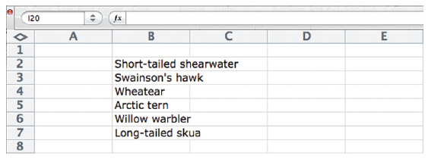
An Array of Cells
Spreadsheets give us an array of cells that for setting up a list
The lines are part of the GUI
They help the computer and us agree on:
What an item is
How the positions of items are related to each other

Slide 5
An Array of Cells
Four of the six items do not fit within the lines provided
Entries do not straddle cells
Each item occupies only the cell in which it is typed
Items only spill when the cells to their right are unused
We can either let the entries be clipped or make the cells wider

Slide 6
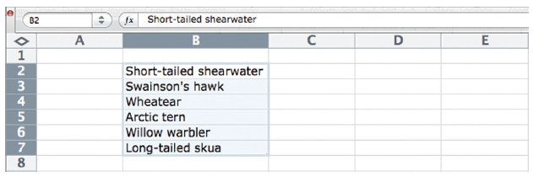
Sorting the Data
A common operation on any list is to alphabetize or sort it
We must specify which items to sort
Select the list by dragging the cursor across the cells
Resulting selection is indicated with highlighting

Slide 7

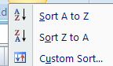
Sorting the Data
All of the items are selected (including the white item)
The item is a different color only because it was the first cell selected
The Sort . . . operation is either among the menu items or is an icon
Sorting can be either ascending or descending

Slide 8
Sorting the Data
The sorting software orders the list alphabetically on the first letter of the entry
The spreadsheet views that the cell entries are “atomic” or “monolithic”

Slide 9
Adding More Data to the List
Spreadsheets give us the ability to format cell entries with the kinds of formatting found in word processors:
italics, bold, font styles, font sizes, justification, colored text and so on
Formatting facilities are frequently are found under the Format menu

Slide 10
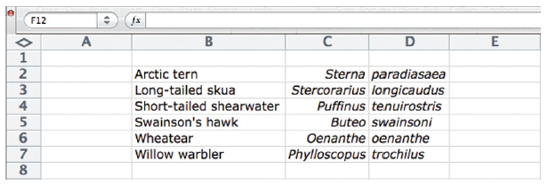

Slide 11
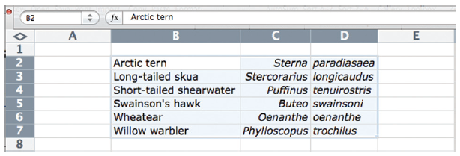
Naming Rows and Columns
If the whole list is highlighted, how do we specify which column should be sorted?
Spreadsheet programs automatically provide a naming scheme for referring to specific cells
Columns are labeled with letters and the rows are labeled with numbers

Slide 12
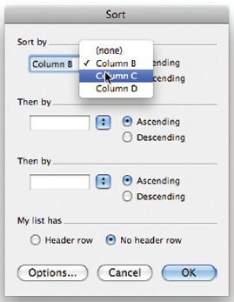
Naming Rows and Columns
This allows us to refer to a:
whole column by its letter
entire row by its number

Slide 13
Naming Rows and Columns
The naming scheme allows a group of cells to be referenced:
Naming the first cell and the last cell and placing a colon (:)
Example: B2:D7 is called a cell range

Slide 14
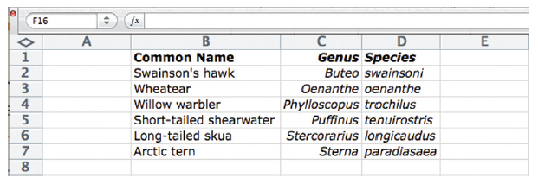
Headings
It is convenient to name the rows and columns with more meaningful names…give them headings

Slide 15
Spreadsheet Summary
Spreadsheets are formed from cells that are displayed as rectangles in a grid
Information entered in a cell is treated as an elemental piece of data
A list of items that can be sorted
Spreadsheets provide a labeling for specifying the column/row

Slide 16
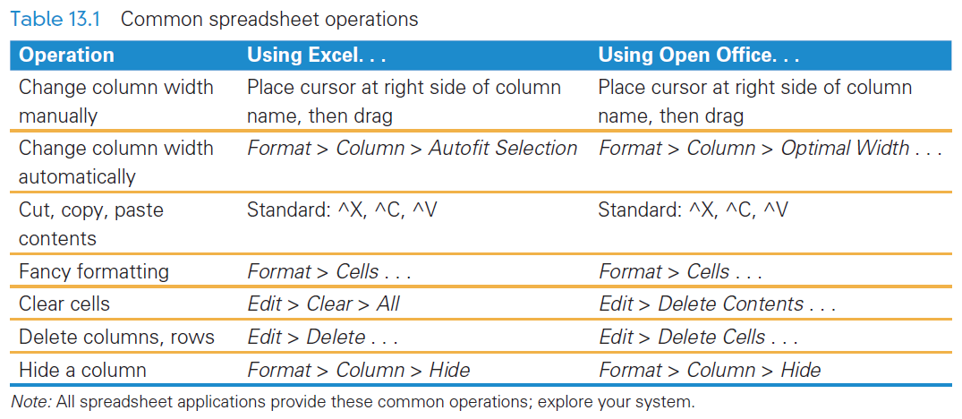
Common Spreadsheet Operations

Slide 17
Computing with Spreadsheets
Spreadsheets don’t have to contain a single number to be useful
Their most common application is to process numerical data
Numerical data is usually associated with textual information so most spreadsheets allow both

Slide 18

Writing a Formula
First, decide what you want to calculate
Are the values in a particular cell (such as F2)
Within a cell:
Begin a formula with a = (equals sign)
Type a cell address (or click it) when
Enter the math operand and any numbers that may be involved =F2 * 0.621

Slide 19
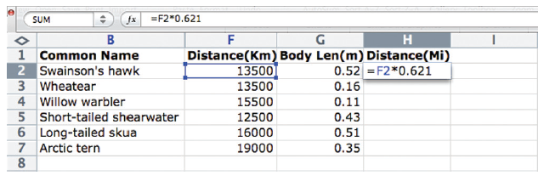
Writing a Formula

Slide 20
Writing a Formula
Using a cell address (F2) in a formula means that if the value in F2 ever changes, then the value (in H2) automatically changes
H2 holds a formula, not text or a number
H2 is actually: H2 = F2 x 0.641

Slide 21
Repeating a Formula
Similar computations can be done for other cells in that column:
Enter them in the same way as you entered the first formula
Copy/Paste. Don’t worry, it does NOT copy the formula exactly!
Filling. This “pulls the formula into other cells

Slide 22
Copy/Paste
When a cell is selected in Excel, it is indicated by an animated highlight (the dashes revolve around the box)
Other spreadsheet software simply shows a solid box around the item.
The cell’s contents are shown in the Edit Formula window
Copy this cell, select the remaining cells in the column by dragging the mouse across them, and Paste (^V)

Slide 23



Copy/Paste
Check the result in the cell.
The original cell had the formula: F2 * 0.621
The new cell has the formula: F3 * 0.621
This
The formula was transformed into F3*0.621 when it was pasted

Slide 24

Filling
Filling is another way to copy information, including formulas, to another cell
Notice the small box or tab in the cell’s lower-right corner
This is the fill handle

Slide 25

Filling
When the handle is grabbed, it becomes a +
“Pull” the handle down the column (or across a row)
This process is known as filling
It automates copying and pasting

Slide 26
Transforming Formulas: Relative Versus Absolute
The spreadsheet software automatically transforms the formulas as it pastes/fills them into a cell
The cell contains a relative cell reference (F2)
Spreadsheets allow two kinds of cell references—relative and absolute
The absolute cell reference to this cell is $F$2

Slide 27
Relative Versus Absolute
Relative means “relative position from a cell”
In the formula H2 =F2*0.621 into H2, the software noticed that cell F2 is two cells to the left of H2
The formula refers to a cell in the same row, but two cells to the left
This is a relative reference

Slide 28
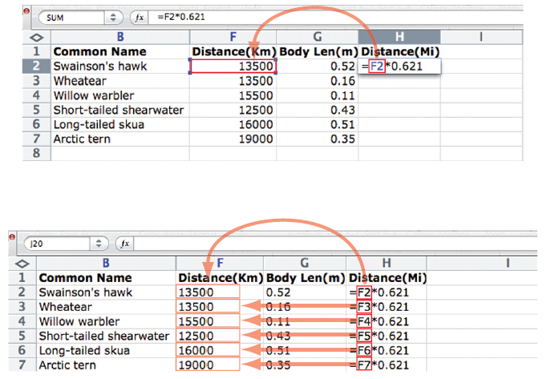
Relative Versus Absolute

Slide 29
Relative Versus Absolute
Absolute references always refer to a fixed position—the software never adjusts it
There are two ways a formula can be relative, making four cases:
F2—column and row are both relative
$F2—absolute column, but relative row
F$2—relative column, but absolute row
$F$2—column and row are both absolute

Slide 30
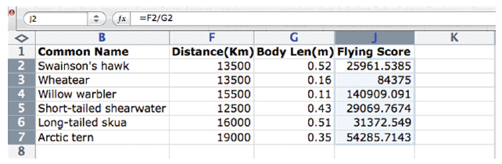
Cell Formats
The scores are somewhat difficult to read because they have too many digits
All spreadsheet software provides control over formatting

Slide 31
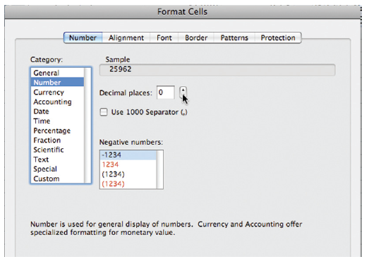
Excel’s Formatting GUI

Slide 32
Cell Formats
This GUI gives us control over:
The types of information in the fields (Category)
The number of decimal digits for the Number category chosen
Setting the “1000s” separators (commas for North America)
The display of negative numbers

Slide 33
Functions
Spreadsheet software provides functions for computing common summary operations
totals (sum), averages, maximums (max), and others
To use these functions, give the function name and specify the cell range to be summarized in parentheses after it: =max(J2:J7)

Slide 34
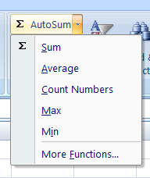
Functions
There is a full list of function names under Insert > Insert Function. . . .
A computation value inherits the formatting of the cell
When the function is then dragged across to other columns, it brings its formatting with it

Slide 35
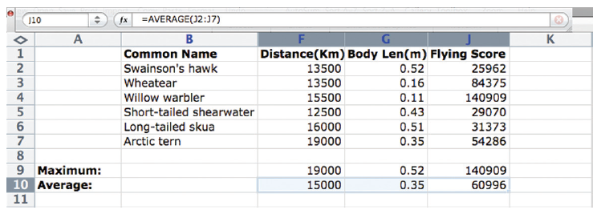
Filling Hidden Columns
Notice the hidden columns between G and J
When we “unhide” these columns, we have computed the maximum and average of the hidden columns

Slide 36
Charts
Spreadsheets organize our data and compute new values
It is helpful to see the results graphically when comparing values
Spreadsheet software makes creating charts easy
Select the values to be plotted and then click Chart. . .

Slide 37

Charts
There are choices of graph styles:
The software detects that the column has a heading and uses it as a label the point as a key to the right.
Clicking (or right-click) on any part of the graph, gets a pop-up window that offers editing options

Slide 38
Daily Spreadsheets
Spreadsheets are convenient, versatile tools that simplify computing
Here are some ways to use spreadsheets to organize:
Track our performance in our exercise program
Set up an expense budget
Keep a list of books and DVDs we’ve lent
Follow our favorite team’s successes
Save records generated while online banking
Address books

Slide 39
Solving a Problem of Personal Interest
Scenario:
Time Zone Cheat Sheet… people you want to chat with live in different time zones… it’s not always convenient to chat when you want to because they may be sleeping, working, or studying

Slide 40
Series Fill
There is certain data that are “special:” days, dates, and time.
When the software fills these values, it automatically increments them
Adding 1 to Sunday results in Monday
Adding 1 to January 31 results in February 1
Adding 1 to 12:00 am produces 1:00 pm
However, if you type Sunday and want Sunday, use Copy/Paste

Slide 41
Series Fill
The best way to use series fill is to:
Enter the first two items of the series into adjacent cells
Select the two cells
Pull on the handle to fill either the row or column
The double-cell fill indicates a series where increment between successive items is the difference between them

Slide 42
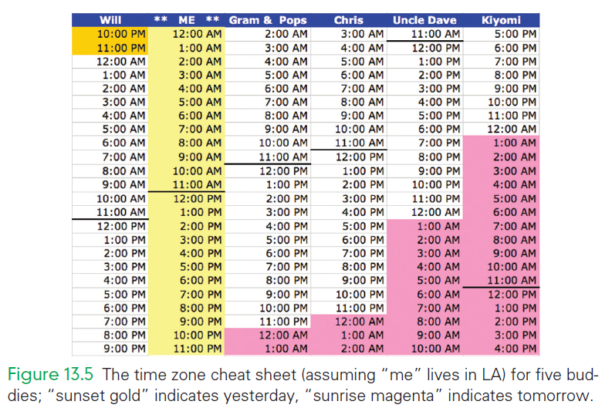
Time Zone Cheat Sheet

Slide 43
Getting Started…
Begin by placing the headings at the top
Under your name enter midnight
Fill down the column to the end of the day
Next, add the times in for your friends
Grab the fill handle and fill the column up and down
The software assumes that rows above are earlier and rows below are later

Slide 44
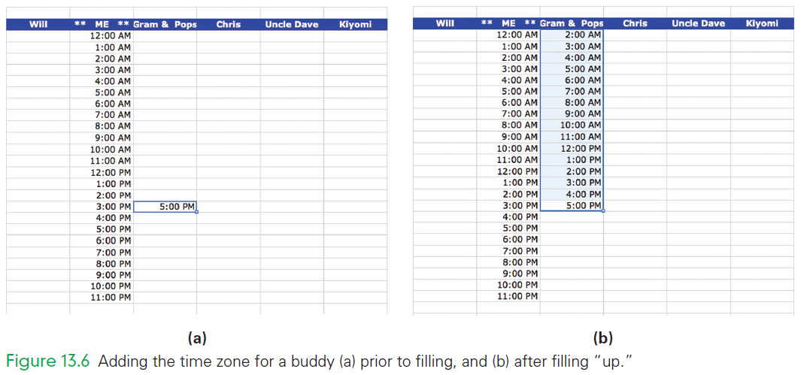

Slide 45
Finishing Up the Time Zones
Add colors to the cells that refer to “yesterday” and “tomorrow” to remind you of day changes
Any cells that start a column and contain “PM” refer to yesterday
Any cells that end a column and contain “AM” times refer to tomorrow

Slide 46
Solving a Problem of Personal Interest
Scenario:
Paying Off a Loan…your uncle has agreed to lend you the money, but he’s charging 5% interest.
To decide how much to borrow, create a spreadsheet of monthly payments required for different amounts borrowed for different times

Slide 47
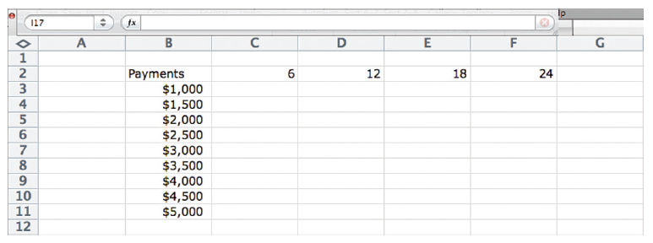
Paying Off a Loan Initial Setup

Slide 48

Paying Off a Loan
Among the functions available with spreadsheets is the “payment” (PMT) computation
The GUI is displayed for PMT:
The inputs to the function are:
The monthly interest Rate, which is 1/12th of the annual rate
The number of payments (Nper) is the amount in row 2 for this column
The present value, or the amount of the loan (Pv)

Slide 49
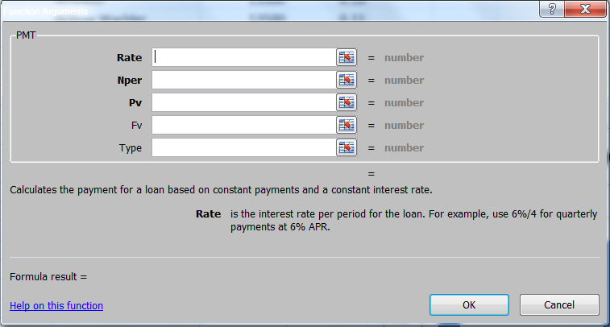
PMT GUI

Slide 50
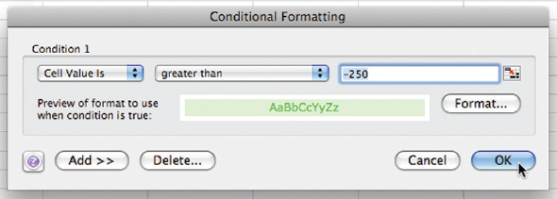
Conditional Formatting
Specifying the format of a cell under certain conditions is called conditional formatting
Decide what the conditions are that you want to see

Slide 51
Importing Data
Much of the data we are interested in comes from some sources
It has probably already been organized
This other data is called foreign data
Importing previously formatted data into a spreadsheet can be tricky
Spreadsheet software makes it easier if guidelines are followed

Slide 52
Tab-Delimited Data
Spreadsheets prefer to import foreign data as tab-delimited text
“Text” means ASCII text or files with a .txt extensions
Numbers are represented as individual numeral characters rather than a single binary number

Slide 53
Tab-Delimited Data
“Tabdelimited” means that each cell’s entry is delimited or ends with a tab in the file
Each row is delimited with a return
There are other delimiters as well:
Spaces
Commas
Copying and pasting tab-delimited text is a simple way to import foreign data

Slide 54
Tab-Delimited Data
Lists with some other form can often be converted into tabdelimited form
Copy the foreign data into a text editor or word processor
Editing it using Search/Replace, using the placeholder technique
The goal is to substitute a tab or other delimiter for a delimiter in the file

Slide 55
Tab-Delimited Data
World Wide Web information is already in text form
Some spreadsheet software allows for copying a table from HTML and pasting it into a spreadsheet
If it doesn’t work, try another browser before beginning the task of reformatting the foreign data

Slide 56
Guidelines for importing foreign data
When possible, save foreign data as tab-delimited ASCII text in a file with a .txt extension.
When foreign data comes from the Web, select a browser that supports Copy/Paste of tagged tables.
When the foreign data format is messed up, use a text editor with Search/Replace, apply the placeholder technique, and write the revised data with a .txt extension. Import the resulting file.

Slide 57
Arranging Columns
Spreadsheets are designed to manipulate rows and columns of information easily
To re-arrange columns:
Insert a new empty column where you want a column moved to
Cut and Paste the column that is to be moved into the empty column

Slide 58
Summary
In this chapter we explored the basic ideas of spreadsheets. We learned the following:
Spreadsheets present an array of cells, each of which is capable of storing one data item: a number, a letter sequence, or a formula.
Numbers and text can be formatted so that they display as we prefer—proper font, correct number of digits, and so on.

Slide 59
Summary
In this chapter we explored the basic ideas of spreadsheets. We learned the following:
The power of spreadsheets comes from entering formulas that calculate new values based on the values in other cells.
The formula is one side of an equation, which the computer solves for us, preserving the equality whenever the numbers that the formula depends on are changed and displaying the new value in the cell.

Slide 60
Summary
In this chapter we explored the basic ideas of spreadsheets. We learned the following:
In addition to performing arithmetic on the cells, we can apply functions to individual items or to whole cell ranges.
Both relative and absolute references to cells are needed depending on the circumstances.
In addition to sorting, there are functions for finding totals, averages, the maximum or minimum, and others.

Slide 61
Summary
In this chapter we explored the basic ideas of spreadsheets. We learned the following:
Spreadsheets are a practical tool for routine computing.
It’s easy to teach ourselves more about spreadsheets simply by trying them with courage.
Spreadsheets may be the most useful software for personal computing.

