Slide 2
Learning Objectives
State the two basic design criteria for creating effective spreadsheets
Explain how conditional formatting of spreadsheet entries applies an interpretation to spreadsheet information
Explain conditional formulas, and their components and behavior
Perform “what if” analysis with a spreadsheet
Use AutoFiltering and advanced filtering to customize
spreadsheet lists
Explain the importance of symbolic naming of spreadsheet cells

Slide 3
Designing a Spreadsheet
When we make a spreadsheet to find an answer and then delete it, all that matters is that the computation was right
When a spreadsheet is used repeatedly, it becomes a tool of planning, analysis, and decision-making
To be effective, a spreadsheet must be well designed, informative, and flexible

Slide 4
Design Guidelines
Two basic principles for setting up effective spreadsheets:
Focus on Form: Make the form logical, the layout clean, and the entries clear and easy to use
Explain Everything: It should be possible to know immediately what every cell means

Slide 5
Focus on Form
A spreadsheet is used in solving problems
It must be easy to understand and easy to work with
Arrange the data logically:
Descriptive information should be on the top and left sides
Summary information should be on the bottom and right sides

Slide 6
Focus on Form
Fonts should be clear
Colors should be used in moderation
Be an attraction, not a distraction
Use a separate sheet for each table
Individual sheets make working with multiple tables more manageable
Hiding information that isn’t needed is also a good way to make a spreadsheet clear and easy to use

Slide 7
Explain Everything
Include meaningful column headings and identifying information about the rows
Cells and ranges are assigned symbolic names so the content becomes meaningful
For summary information cells, choose modifiers like total and largest
For computations, include comments to explain assumptions made when creating the formulas

Slide 8
The Trip Sample Spreadsheet
Scenario:
Two friends wonder if it’s possible to drive to the Arctic Circle from Chicago.
The trip to Inuvik is 3,663 miles from home and will take three days and eight hours of driving time.
The given driving time is continuous, which they do not plan to do.
Use a spreadsheet to figure out how long it will take and how much it will cost.

Slide 9
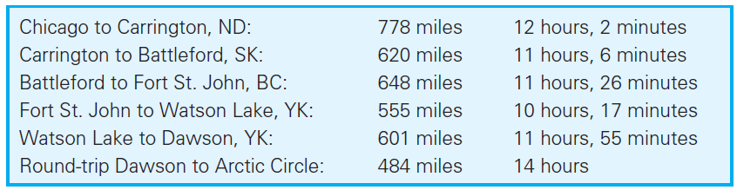
Applying the Rules
The trip is a five-day trek from Chicago to Dawson, Yukon Territory
From Dawson, they will drive to the Arctic Circle and back to Dawson that night

Slide 10
Applying the Rules
Friends will be included to offset costs
The friends are interested in how much the trip will cost
Part of the trip is through the United States where gas is priced by the gallon in US $
Part of the trip is through Canada where petrol is priced by the liter in Canadian $

Slide 11
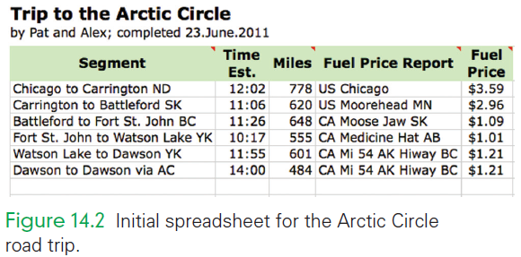
Initial Spreadsheet

Slide 12
Applying the Rules
The spreadsheet has a title listing the authors and stating the completion date
Columns are assigned clear headings
The heading row is filled with a soft color that separates it from the content
A clean, sans serif font presents the data justified in the cells

Slide 13

Applying the Rules
Comments

Slide 14
Applying the Rules
Comments or “Sticky notes”:
Cells with comments have a red triangle in the cell’s upper right corner
Hovering the cursor over the cell displays the comment
To insert a comment in Excel, select the cell and then navigate Insert > New Comment
To edit it, select the cell and navigate Insert > Edit Comment
To remove a comment, navigate Edit > Clear > Comments

Slide 15
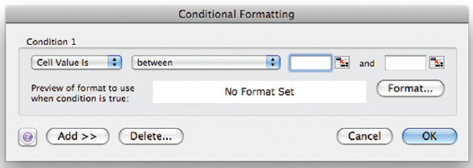
Conditional Formatting
Cell Value Is
This window lets users specify one or more conditions
If the program finds that these conditions apply to the cell, it formats the entry in the manner specified
Users specify the condition by picking one of a set of relationships and filling in the limits

Slide 16
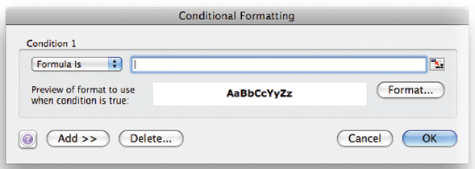
Conditional Formatting
Formula Is
It’s possible to format items based on a formula
Using Formula Is allows for a comparison with a cell other than the one being

Slide 17
Defining Names
It can be helpful when designing a spread-sheet to give names to components of the sheets
A name is a word or phrase assigned to a cell or range of cells
Once the name has been assigned, it can be used wherever cell references would be used
, such as in formulas. Using names reduces
the chance of messing up range specifications, and minimizes the likelihood
that errors will creep in when columns and rows are added later.
We illustrate this idea by revising the friends’ spreadsheet to use names. After
choosing Insert > Name > Define . . . , we are presented with the Define Name
window,
shown in Figure 14.7(a). The range is automatically filled in for us based

Slide 18
Defining Names
It can be helpful when designing a spread-sheet to give names to components of the sheets
A name is a word or phrase assigned to a cell or range of cells
Once the name has been assigned, it can be used wherever cell references would be used

Slide 19
Defining Names
Using names reduces the chance of messing up range specifications
Errors are minimized when columns and rows are added/deleted
Choose Insert > Name > Define . . . and enter a name
The software assigns the name to that range

Slide 20
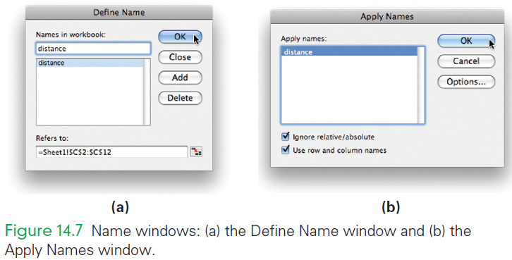
Defining Names
Now, choose Insert > Name > Apply to allow the use of the name

Slide 21
“What If” Analysis
Scenarios
A speculative or “what if ” analysis is supported in spreadsheet software by a tool called Scenarios
A scenario is a named alternative to a spreadsheet based on different inputs
A scenario is an aid to understanding changes in plans

Slide 22
“What If” Analysis
The Add Scenario window is the place to name a scenario
The software fills in the cell(s) that will change
Clicking OK takes us to the Scenario Values window
Clicking OK takes us back to the Scenario Manager window where the newly added scenario can be seen in the list

Slide 23
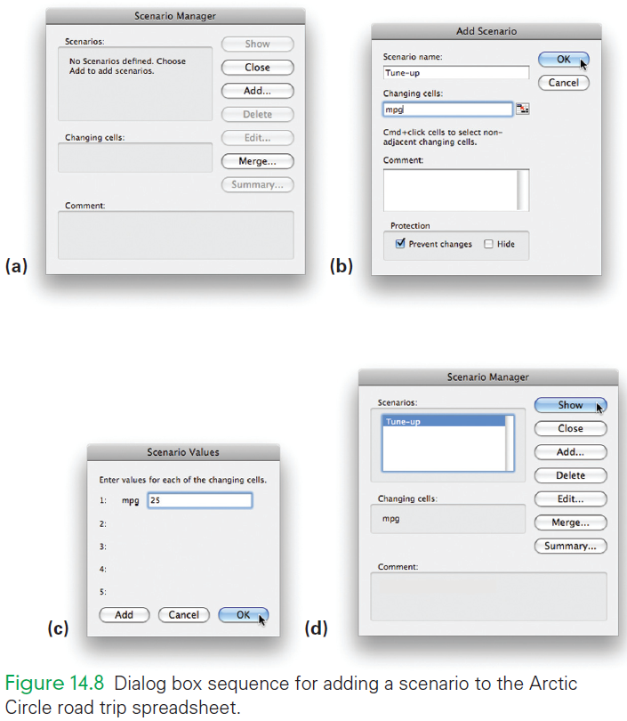

Slide 24
“What If” Analysis
At the bottom of the Scenario Manager window, there is a Summary. . . Button
When clicked, a dialog box appears asking what cell we consider the “bottom line” of the computation
Aka, if the scenario came to pass, what value are we most interested in
Click OK again, and you are presented with the Scenario Summary

Slide 25
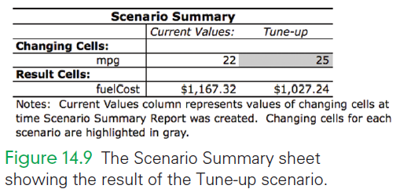

Slide 26
Reusing Scenarios
Having set up the scenarios earlier, it is possible to rerun them to see how the end result changes
Once run, navigate to the Scenario Manager and click Summary

Slide 27
Analyzing Data Using Filtering
Use of the Filtering tool allows access to subsets of information held in a spreadsheet
Filtering selects only certain rows from a list
It applies only to spreadsheet tables that have column headings
Filtering lets users create a customized version of a spreadsheet list that is limited to the rows meeting some criterion

Slide 28
Analyzing Data Using Filtering
AutoFilter
Select any cell in the list
Choose Data > Filter > AutoFilter
The result is a redrawn spreadsheet list with triangle menu buttons by each column heading
The menu buttons give you options for filtering the list based on data in that column

Slide 29
Analyzing Data Using Filtering
AutoFilter
Clicking a button opens the menu and presents the options:
include sorting rows
displaying rows containing a limited number of values
displaying only those rows matching a specific value in the column

Slide 30
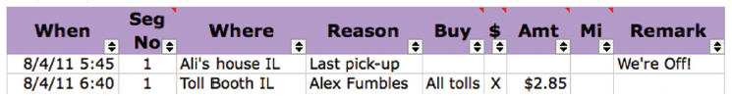
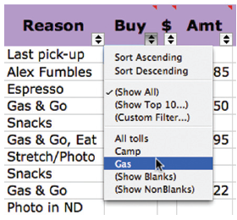
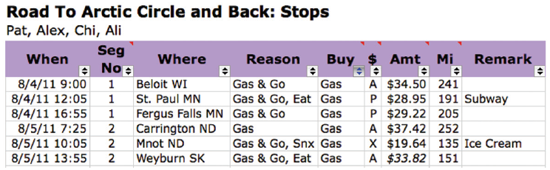

Slide 31
Advanced Filtering Setup
To apply advanced filtering, provide a column name and a filtering criterion:
First, add a new column Give the new column the same heading as the column containing the data to be filtered
Second, in the cell below the heading, enter criterion to indicate that values in the other column by the same name should be filtered for that criterion

Slide 32
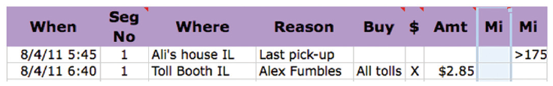

Slide 33
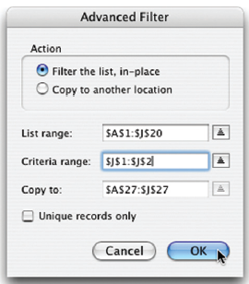
Executing an Advanced Filter
To run the actual filtering operation, select a cell in the column to be filtered
Next, choose Data > Filter > Advanced Filter. . . , which displays the Advanced Filter window

Slide 34
Executing an Advanced Filter
The List range gives the dimensions of the list that is going to be filtered
The Criteria range is where users specify the setup column
Enter the range covering the heading and the criterion
Clicking OK produces a filtered table

Slide 35
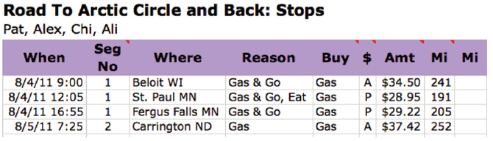

Slide 36
Executing an Advanced Filter
To restore the original table, choose Data > Filter > Show All
The Copy to option in the Advanced Filter window specifies a new place on the spreadsheet to place the filtered result
It can be handy to have both the original and filtered result to compare

Slide 37
Filtering on Multiple Criteria
The Advanced Filtering feature allows multiple criteria
These criteria are specified during setup by defining multiple columns
During execution the Criteria range is enlarged to cover all criteria
Filtering is extremely useful

Slide 38
Summary
This chapter has taught several advanced spreadsheet techniques.
You learned the following:
Two basic principles underline the design of effective spreadsheets: (1) focus on form and (2) explain everything.
Conditional formatting can apply an interpretation to the data in a spreadsheet so that it is easy to perceive.

Slide 39
Summary
This chapter has taught several advanced spreadsheet techniques.
You learned the following:
Conditional formulas using the IF( ) function allow complex, case-specific data definition and analysis.
Naming the cells and regions of a spreadsheet allows the parts of a spreadsheet to be referenced in a convenient and less error-prone way.

Slide 40
Summary
This chapter has taught several advanced spreadsheet techniques.
You learned the following:
“What if” analysis is a particularly powerful application of spreadsheets in which the consequences of alternative information can be assessed.
Filtering effectively customizes spreadsheet data to particular cases.

