Slide 2
Learning Objectives
Use XML to describe the metadata for a table of information, and classify the uses of the tags as identification, affinity, or collection
Explain the differences between everyday tables and database tables
Explain how the concepts of entities and attributes are used to design a database table
Use the six database operations: Select, Project, Union, Difference, Product, and Join
Describe the differences between physical and logical databases
Express a query using Query By Example

Slide 3
Differences Between Tables and Databases
When we think of databases, we think of tables of information:
iTunes show the title, artist, running time on a row
Your car’s information is one line in the state’s database of automobile registrations
The U.S. is a row in the demography table for the World’s listing of country name, population, etc.

Slide 4
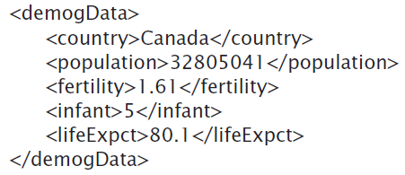
Canada’s Demographic Information

Slide 5
The Database’s Advantage
Metadata is the key advantage of databases over other approaches to recording data as tables
Database software can search for the <country> tag surrounding Canada
The <country> tag will be one of several tags surrounded by <demogData> tags
The computer knew which data to return based on the availability of the metadata

Slide 6
The Database’s Advantage
The tags for the CIA database fulfill two of the most important roles in defining metadata:
Identify the type of data: Each different type of value is given a unique tag.
Define the affinity of the data: Tags enclose all data that is logically related.

Slide 7
The Database’s Advantage
<country>, <population>, and similar tags have the role of identification because they label content
<demogData> tag has the role of implementing affinity because it keeps an entry’s data together

Slide 8
XML: A Language for Metadata Tags
XML stands for the Extensible Markup Language
It is a tagging scheme
What makes XML easy and intuitive is that there are no standard tags to learn
Tags are created as needed!
This trait makes XML a self-describing language

Slide 9
XML: A Language for Metadata Tags
There are a couple of rules:
Always match tags
Basically anything goes
XML works well with browsers and Web-based applications
XML must be written with a text editor to avoid unintentionally including the word processor’s tags (see Chapter 4)

Slide 10
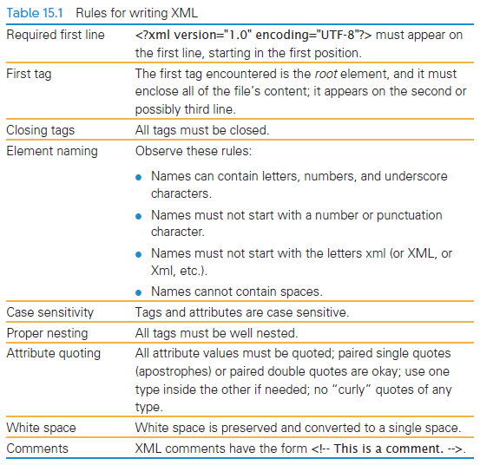
Rules for Writing XML

Slide 11
XML
As with HTML, the tag and its companion closing tag surround the data
XML tag names cannot contain spaces
Both uppercase and lowercase are allowed
XML is case sensitive
Like XHTML, XML doesn’t care about white space between tags

Slide 12
XML Example
Scenario:
Create a database for the Windward Islands archipelago in the South Pacific
Plan what information will be stored
Develop those tags:
<archipelago>
<island>
<iName> Tahiti </iName>
<area>1048</area>
</island>
⁞
</archipelago>
Affinity role

Slide 13
XML
<?xml version = "1.0" encoding="UTF-8" ?>
This required line is added at the beginning of the file
Note the question marks.
This line identifies the file as containing XML data representations
The file also has standard UTF-8 encoded characters

Slide 14
Expanding the Use of XML
To create a database of the two similar items (in this chapter, archipelagos), put both sets of information in the file
As long as the two sets use the same tags for the common information, they can be combined
Extra data is allowed and additional tags can be created (<a_name> to indentify which archipelago is being used)

Slide 15
Expanding the Use of XML
Group sets of information by surrounding them with tags
These tags are the root elements of the XML database
A root element is the tag that encloses all content of the XML file
In Figure 15.1 the <archipelago> tag was the root element

Slide 16
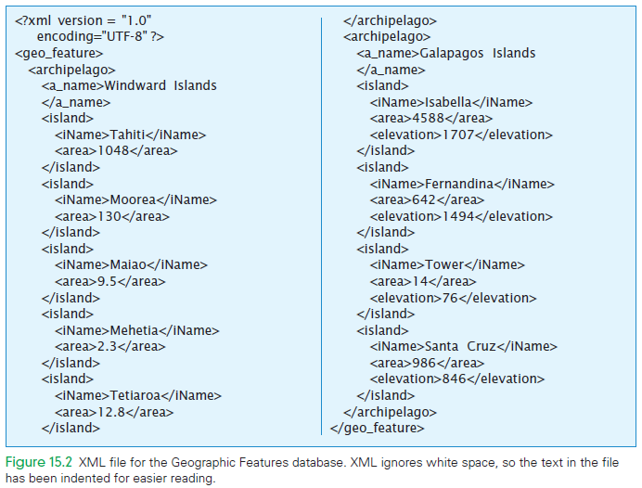
New root element

Slide 17
Attributes in XML
XHTML tags can have attributes to give additional information
Tags of XML also have attributes
They have a similar form
Must always be set inside simple quotation marks
Tag attribute values can be enclosed either in paired single or paired double quotes

Slide 18
Attributes in XML
Writing tag attributes is easy enough
The rules for using quotes are straightforward
Use attributes is to use them for additional metadata, not for actual content

Slide 19
Effective Design with XML Tags
Identification Rule: Label Data with Tags Consistently
You can choose whatever tag names you wish to name data, but once you’ve decided on a tag for a particular kind of data, you must always surround that kind of data with that tag.

Slide 20
Effective Design with XML Tags
Label Data with Tags Consistently
One advantage of enclosing data with tags is that it keeps data together
It might be difficult to combine databases written by two different people
Tags can be edited by Find/Replace to change the tag names

Slide 21
Effective Design with XML Tags
Affinity Rule: Group Related Data
Enclose in a pair of tags all tagged data referring to the same entity. Grouping it keeps it all together, but the idea is much more fundamental: Grouping makes an association of the tagged data items as being related to each other, properties of the same thing.

Slide 22
Effective Design with XML Tags
Group Related Data
Plan on tags that can group same, not similar, items.
This is an important association to consider when developing tags and the database

Slide 23
Effective Design with XML Tags
Collection Rule: Group Related Instances
When you have several instances of the same kind of data, enclose them in tags; again, it keeps them together and implies that they are related by being instances of the same type.

Slide 24
Effective Design with XML Tags
Group Related Instances
A group of five islands were grouped inside an <archipelago> tag
A group of two archipelagos were grouped inside a <geo_feature> tag

Slide 25
Effective Design with XML Tags
The Collection Rule and the Affinity Rule are different
The Affinity Rule groups the data for a single thing
The Collection Rule groups the data of several instances of the same thing
The tags may be the same

Slide 26
Effective Design with XML Tags
The first association is among properties of an object
The second association is among the objects themselves (entities)
Being grouped by the Collection Rule doesn’t preclude being an object

Slide 27
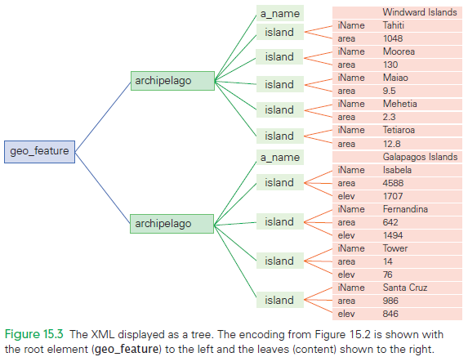

Slide 28
Relational Databases
Relational databases describe the relationships among the different kinds of data
These relationships allow the software to answer queries about them
Every relational database can be described by XML
Every XML description is NOT a relational database

Slide 29
Entities
An entity is anything that can be identified by a fixed number of its characteristics (attributes)
The attributes have names and values
The values are the data that is stored in the table
In relational databases, an attribute is a “column of a table”

Slide 30
Entities
The attribute’s name is the tag used in the Identity role
The attribute values are the content enclosed in the tags
An entity is a group of attributes collected together by the tag used in the Affinity role
The entity is that object that is being described by all the tags

Slide 31
Entities
The tag used in affinity is the entity’s name
The tags within are its attributes
“island” is an entity
“name”, “area”, and “elevation are the attributes
“archipelago” is also an entity

Slide 32
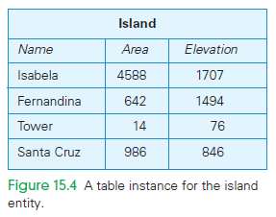
Table Instance for Island Entity

Slide 33
Entities
Entity defines a table...the name of the entity is the name of the table
Each column is one of the possible attributes
The values in the columns are the attributes’ values, and the rows are the entity instances
A specific set of values for the attributes of an entity is an entity instance
Any table containing specific rows is said to be a table instance

Slide 34
Entities
In addition to having a name, attributes also have a data type (such as number, text, image)
The data type defines the form of the information that can be stored in a field
By specifying the data type, database software prevents us from accidentally storing bad information in a table

Slide 35
Properties of Entities
A relational database table can be empty
It is a table with no rows
An entity is anything defined by a specific set of attributes
A table exists with a name and column headings
Once entity instances have been specified, there will be rows
Among the instances of any table is the “empty instance”

Slide 36
Instances Are Unordered
Each distinct table is a different table instance
Two table instances will have a different set of rows
Tables with the same rows (but reordered) are the same table instance
The order of the rows doesn’t matter in databases

Slide 37
Instances Are Unordered
The attributes (columns) are also considered to be unordered
The attributes or column heading have a name, they are not tracked by position
Column information stays in columns
They cannot switch to being a row
Row information stays in rows
They cannot switch to being a column

Slide 38
Uniqueness
There are few limits on what an entity can be
Things that can be identified from each other qualify as entities
Entities can be distinguished by their attributes they are unique
No two rows in a database table can be the same
Unique instances is what is intended when a database is setup

Slide 39
Keys
What attributes distinguish the rows in a database table?
Single attributes might be sufficient
Multiple attributes might be required to ensure uniqueness
Any set of attributes for which all entities are different is called a candidate key
Database tables usually have several candidate keys

Slide 40
Keys
One of the candidate keys is the primary key
The primary key is the one that the database system will use to decide uniqueness
Candidate keys qualify only if they distinguish among all entities forever
If no combination of attributes qualifies as a candidate key, then a unique ID must be assigned to each entity

Slide 41
Atomic Data
Databases treat the information as atomic
The information cannot be decomposed into smaller parts
The “only atomic data” rule is usually relaxed for certain types of data:
Dates, time, and currency
A date value 01/01/1970 must be treated as a single unity
The format of the data attribute, say dd/mm/yyyy, allows the program to understand how the field decomposes

Slide 42
Database Schemes
Tags are a cumbersome way to define a table
Database systems specify a table as a database scheme or database schema
The scheme is a collection of table definitions that gives the name of the table, lists the attributes, their data types, and identifies the primary key

Slide 43
Database Schemes
Each database system has specific requirements for how a scheme is presented
There are no universal rules

Slide 44
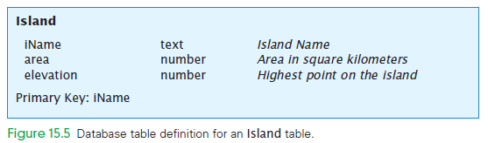
Database Table Definition

Slide 45
XML Trees and Entities
Reminder: relational database tables and XML trees are not the same
Relational databases are more restrictive than XML trees
The limits make them more powerful and allow them to do more

Slide 46
XML Trees and Entities
The Collection Rule:
When entity instances are grouped, all entities within the tag must have the same structure
The structure defines the attributes that make up a row
When the <a_name> tags was added inside of <archipelago> tags, the relational requirement that all entities have the same structure was violated

Slide 47
Database Tables Recap
Tables in databases are not simply an arrangement of text
Tables have a structure that is specified by metadata
The structure of a database table is separate from its content
A table structures a set of entities by naming the attributes and giving their data types

Slide 48
Database Tables Recap
The entities of the table are represented as rows
Rows and columns are unordered in databases
Tables and fields should have names that describe their contents
Fields must be atomic
One or more attributes define the primary key

Slide 49
Operations on Tables
A relational database is a collection of database tables
The main use of a database is to look up information
Users specify what they want to know and the database software finds it
The data is in the database, but it’s not stored in a single table
The data must be describe in a way that the computer can figure out how to find it

Slide 50
Operations on Tables
Database operations allows queries of a database in a way that lets the software find the answer
Operations can be performed on tables to produce tables
The questions asked of a database are answered with a whole table
There may be several answers forming the table
If there is no answer, the table will be empty

Slide 51
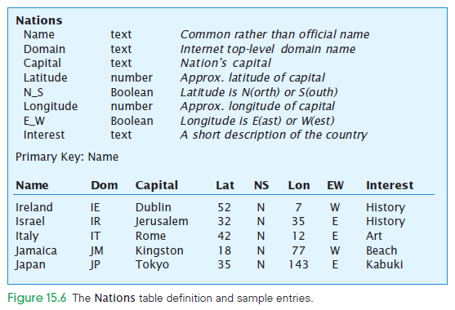

Slide 52
Select Operation
The Select operation takes rows from one table to create a new table
The Select operation is specified by giving the table from which rows are to be selected and the test for selection: Select Test From Table

Slide 53
Select Operation
The Test is to be applied to each row of the given table to decide if the row should be included in the new result table
The Test is a short formula that tests attribute values
The Test is written using attribute names, constants like numbers or letter strings, and relational operators <, ≤, ≠, =, ≥

Slide 54
Select Operation
The relational operators test whether the attribute value has a particular relationship
If the Test is true, the row is included in the new table
The information used to create the new table is a copy
The original table is not changed by Select
The Test can be more than a test of a single value

Slide 55
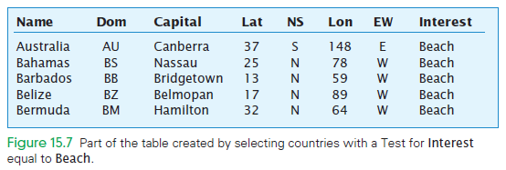

Slide 56
Project Operation
Project (pronounced prōJECT) is the operation that builds a new table from the columns of an existing table
Specify the name of a table and the columns (field names) from it to be included in the new table Project Field_List From Table

Slide 57
Project Operation
The new table may have as many rows as the original table, but a different number of columns
Project does not always result in a table with the same number of rows as the original table
Both Select and Project operations are used to “trim” base tables to keep some of the rows and some of the columns

Slide 58
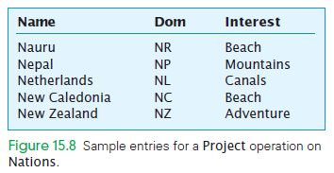

Slide 59
Union Operation
Another operation that can be performed on tables is to combine two tables
This only makes sense if they have the same set of attributes
The operation is known as Union Table1 + Table2

Slide 60
Union Operation
Read the plus sign (+) as “combined with”
Union can be used to combine separate tables

Slide 61
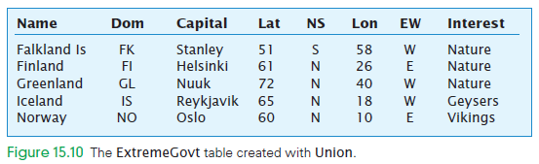

Slide 62
Difference Operation
Removing from one table the rows also listed in a second table is called the Difference Operation Table1 − Table2
Difference makes sense when the table’s fields are the same

Slide 63
Product Operation
The Product operation on tables is accomplished by multiplying tables together
The Product operation creates a supertable Table1 × Table2

Slide 64
Product Operation
The super table has the columns from both tables
The first table has five attributes
The second table has six attributes .
The Product table has eleven attributes
The rows of the new table are created by appending or concatenating each row of the second table to each row of the first table

Slide 65
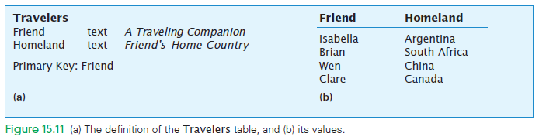
Super = Nations × Travelers
Results in
A new table with ten fields (8 fields from Nations and 2 fields from Travelers)
Yields a total of 920 rows

Slide 66
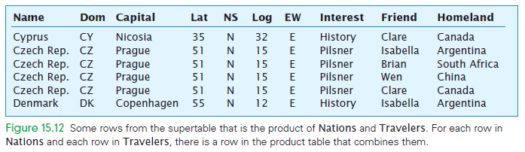

Slide 67
Product Operation
The Product operation merges information that may not “belong together”
Product is used to create a supertable that contains both useful and useless rows
The supertable may be “trimmed down” using Select, Project, and Difference to contain only the intended information

Slide 68
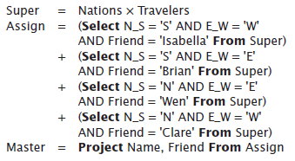
Product Operation
The Super table is the product table discussed earlier with a row for each nation paired with each friend
The Assign table is then created by Union (+) that combines four tables

Slide 69
Product Operation
The tables were created by a Select operation from Super.
The resulting Assign table has 230 rows with one of the friends’ names assigned to each country

Slide 70
Database Operations
These five basic operations on tables are straightforward and simple
These five are the only operations needed to create any table in a relational database
Database software incorporates these operations
Creating tables from tables…we are using these operations

Slide 71
Join Operation
Another powerful and useful operation for creating database tables is Join
Join can be defined from the previous five primitive database operations of the last section
It is so useful, it is usually provided as a separate operator in database software

Slide 72
Join Operation
Join combines two tables, but it doesn’t necessarily produce all pairings
If the two tables each have fields with a common attribute, the new table produced by Join combines only the rows from the given tables that match on those fields Table1 Table2 On Match

Slide 73
Join Applied
There are at least two ways to think about the Join operation:
It is a “lookup” operation on tables For each row in one table, locate a row (or rows) in the other table with the same value(s) in the common field(s)
If found, combine the two; if not, look up the next row

Slide 74
Join Applied
There are at least two ways to think about the Join operation:
Another way is to see it as a Product operation forming all pairs of the two tables, and then eliminating all rows that don’t match in the common fields with a Select
Join is called a natural Join because the natural meaning of “to match” is for the fields to be equal

Slide 75
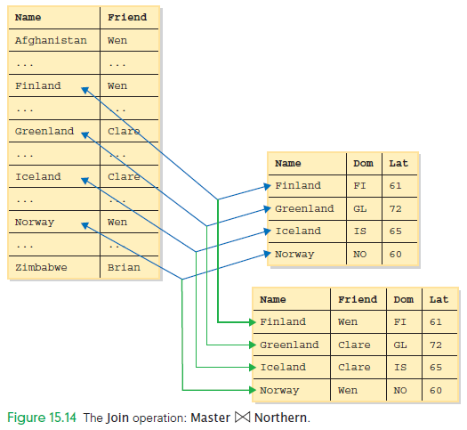

Slide 76
Structure of a Database
There are two forms of tables:
The physical database Stored on the disk drives of the computer system Permanent repository of the database
The logical database known as the view of the database created for users on-the-fly customized for their needs

Slide 77
Physical Database
The physical database is designed by database administrators
Data must be accessed fast
The physical database is set up to avoid redundancy (duplicate information)
There is a good chance that data stored in various places will not be updated

Slide 78
Logical Database
The logical database shows users the view of the information they need and want
It doesn’t exist permanently, but is created every time they need it
The logical database is retrieved from the one copy stored in the physical database, and provided to the users as needed

Slide 79
Logical Database
Creating a new copy each time is essential
If it were to be created once and then stored on the user’s computer, then there would be two copies of the information
The other advantage of creating specialized versions of the database for each user is that different users want to see different information

Slide 80
Queries
A query is a specification using the five operations and Join that define a table from other tables
Queries are written in the standard database language SQL (Structured Query Language)
SQL allows a new query to be run each time it is selected or opened

Slide 81
Defining Physical Tables
Database Schemes
The metadata specification of a database’s tables is given by a database schema
Interactive software helps define a database schema
The database schema describes the database design

Slide 82
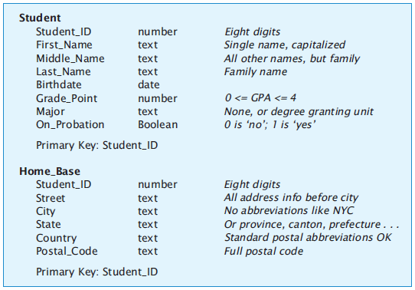

Slide 83
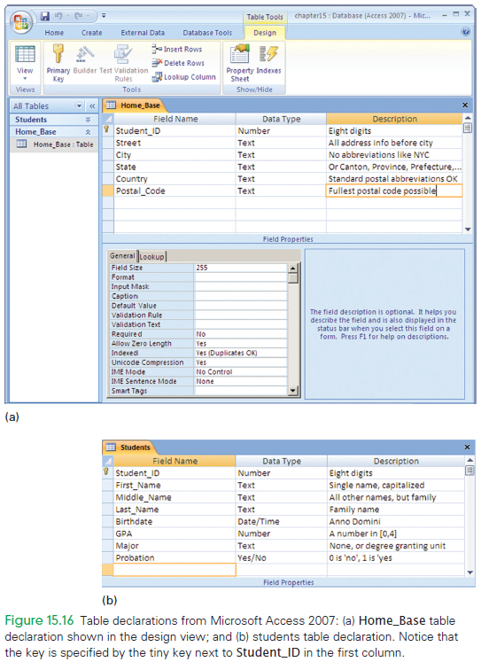

Slide 84
The Idea of Relationships
A relationship is a correspondence between rows of one table and the rows of another table
Relationships are part of the metadata of a database and are critical to building the logical database from the physical database

Slide 85
Relationship Examples
Familiar relationships illustrate that their description often ends with a preposition
Father_Of the relationship between a man and his child
Daughter_Of the relationship between a girl and her parent
Employed_By the relationships between people and companies

Slide 86
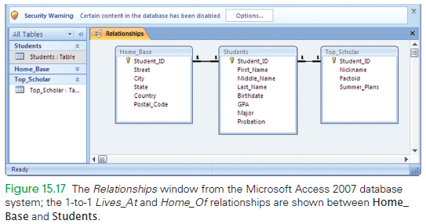

Slide 87
Practical Construction Using QBE
Database systems can make the development of a Join easy
Query By Example (QBE) is available to us in Microsoft Access
The software provides a template of a table, and we fill in what we want in the fields
That is, we give an example of what we want in the table
The software then figures out a query that creates the table from the sample table

Slide 88
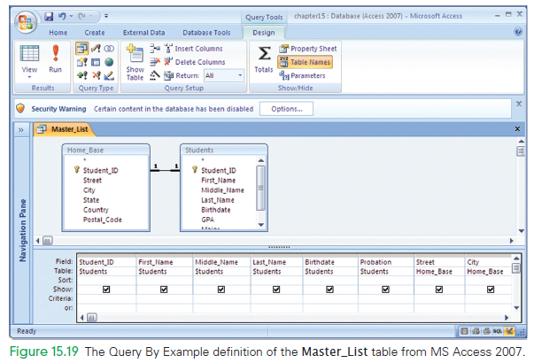

Slide 89
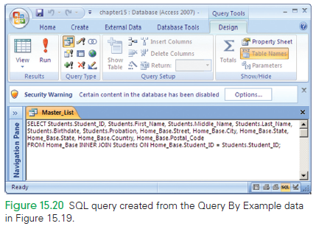

Slide 90
Summary
In this chapter we followed a path from XML tagging through to the construction of logical views using QBE.
You learned a lot, including the following:
XML tags are an effective way to record metadata in a file.
Metadata is used to identify values; it can capture the affinity among values of the same entity, and can collect a group of entity instances.

Slide 91
Summary
You learned a lot, including the following:
Database tables have names and fields that describe the attributes of the entity contained in the table.
The data that quantitatively records each property has a specific data type and is atomic.

Slide 92
Summary
You learned a lot, including the following:
There are five fundamental operations on tables: Select, Project, Union, Difference, and Product. These operations are the only ones you need to create new tables from other database tables.
Join is an especially useful operation that associates information from separate tables in new ways, based on matching fields.

Slide 93
Summary
You learned a lot, including the following:
Relationships are the key to associating fields of the physical database. The physical database resides on the disk drive; it avoids storing data redundantly and is optimized for speed.
The main approach for creating logical views from physical data is the join-and-trim technique.

Slide 94
Summary
You learned a lot, including the following:
There is a direct connection between the theoretical ideas of database tables and the software of database systems.

