Slide 2
Learning Objectives
Explain the relationship between XML and XSL
Describe how to express metadata using XML
Demonstrate the incremental creation of a database
Explain the relationship between tags and templates
Show how to use tag attributes to display images
State how information is hidden in XML databases

Slide 3
Thinking About a Database
Regular Versus Irregular Data
Relational databases can be tables with regular rows, attributes, keys, relationships
Allows for queries where computers do all the organizing and displaying the
Data needs to be “regular” following a rigid structure imposed on it.
Relational databases may be powerful, but very often the information to record isn’t regular

Slide 4
iDiary Preliminaries
iDiary will hold information that is found daily:
text, photos, URLs of interesting sites, animations, poems, videos, etc.
Use XML to specify the metadata
The database will be an XML tree
For iDiary, we will follow the Identity, Affinity, and Collection rules (see Chapter 15)

Slide 5
iDiary Preliminaries
Collecting information is not necessarily organization
Data needs structure
Organizing the data helps us keep track of what we have, and it also helps the computer display it
For iDiary, the database will be organized using time/date sequences

Slide 6
Physical Versus Logical
The XML tree is the physical database, it is not a relational database
The logical database is our view of iDiary
For querying iDiary, XSL (a tagging language) is used
XSL stands for Extensible Stylesheet Language
It is an integral part of XML and standardized Web databases

Slide 7
iDiary Preparation
When creating, start small and add as you go
If the small database is working, and a new feature is added and the database no longer works, then the new feature has an error
This is part of debugging

Slide 8
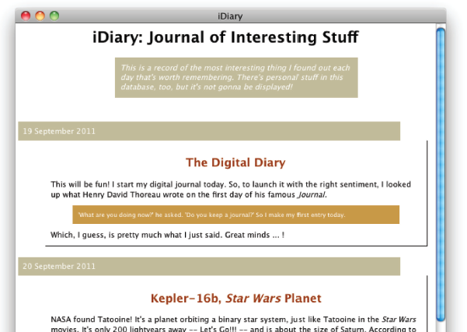
iDiary: Journal of Interesting Stuff

Slide 9
The XML Definition
Entries in the database will be a list of countries
Each will have a name and a tour that contains a list of sights
The name of the file contains the country’s flag as a tag attribute for the <name> tag

Slide 10
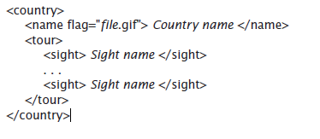
XML Definition

Slide 11
XML Definition
Use a standard text editor to enter the data
Add <tags> as you go
The file must have the .xml file extension AND include: <?xml version="1.0" encoding="UTF-8"?> as the first line of the file

Slide 12
XML Definition
The root element is the Collective tag enclosing all items in an XML file
<travels> is the root element of this tree
Countries will be listed within using this structure
Save the file as travels.xml

Slide 13
Direct Check of XML
The file is shown in a browser
The browser uses a stylesheet to show information
With XML, and the second line commented out, the browser shows the XML tree
Color coding helps check that the structure is right

Slide 14
Direct Check of XML
The display is active , meaning that tags can be opened and closed in the Affinity or Collection manner
Close the <tour> tags by clicking the minus (−) signs
Closing parts of the database allows us to see the some tags without the clutter of other tags

Slide 15
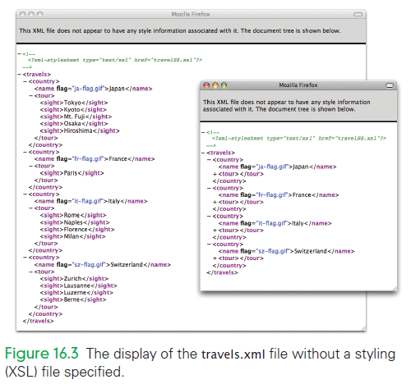

Slide 16
Displaying with XSL
Style information tells the browser how to display a markup language like XML
Tags are eliminated when using the style information
Information is then displayed based on the style description

Slide 17
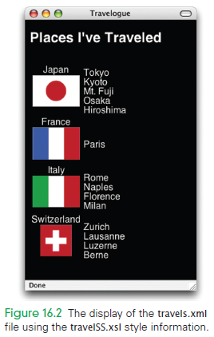

Slide 18
XML with Style
XML contains style information much like Cascading Style Sheets.
Cascading Style Sheets are separate files with a .css extension
XML sheets use an .xsl extension
The files are connected because <?xml-stylesheet type="text/xsl" href="travelSS.xsl"?> is listed as second line
The line must be exactly as shown with the correct file name

Slide 19
The Idea of XSL
XSL formatting :
The .xsl file contains a series of rules on how to format the information enclosed in XML tags
There is only one rule or template per tag
The template uses XHTML (remember Chapter 4?)

Slide 20
The Idea of XSL
When the XML file is opened in a browser:
The database (DB) and stylesheet (SS) are input to a transformer
The transformer “walks” the XML tree, converting all of the tags to HTML according to the template
When the “walk” is finished, the HTML page is displayed

Slide 21
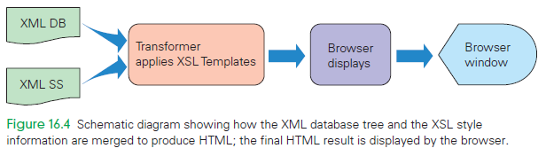

Slide 22
XSL Templates
When reviewing XSL templates:
Notice that there are tags everywhere
XSL is XML
The first line is the required first line of any XML file
The second line is also required

Slide 23
XSL Templates
There are five different tags used in the XML tree
There are five templates in the XSL file, one for each tag
The templates have a standard form specifying how to display the tags in XHTML

Slide 24
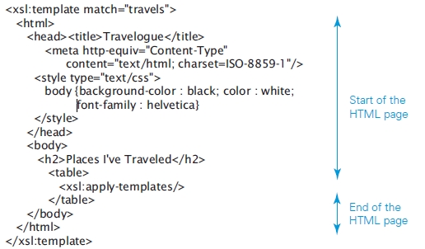
Creating the Travelogue Display
between the <xsl:template . . .> tags are XHTML tags

Slide 25
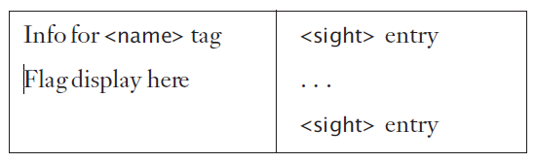
Visualizing the iDiary Database
The template includes the heading and body tags
These tags are <table> tags, because the content of the travels.xml file is going to be displayed as a table:

Slide 26
Visualizing the iDiary Database
Each <country> will be a row in the table
There are two items in the first cell of the table: the name and the flag image
The second cells contains a list of items of sights that may been seen on a tour

Slide 27
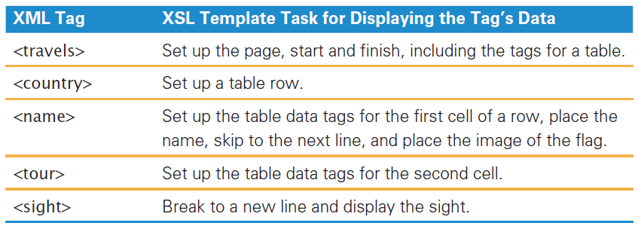
Summary of the XML tags style roles used for iDiary
Each XML tag plays a stylistic role in the overall creation of the Web page.

Slide 28
The apply Operation
<xsl:apply-templates/> tag:
This is a stand-alone tag with no mate
The tag is included once in each template
The meaning of the tag is that whatever is inside the tag should be processed
means, “now process whatever is inside this tag”

Slide 29
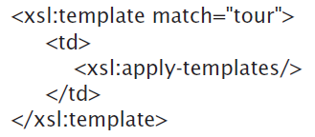
The apply Operation
Example (in English):
“When encountering a <tour> tag:
Place a <td> tag in the accumulating XHTML definition
Process the items found within the <tour> tag (which will be a bunch of <sight> tags)
Place the </td> tag to complete the table

Slide 30
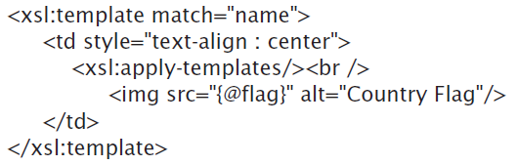
Tag Attributes
To display an image requires the <img src . . ./> tag
Note the form, it includes {@flag}
@flag refers to the value of the tag attribute of the <name> tag (which gives the file name flag.gif

Slide 31
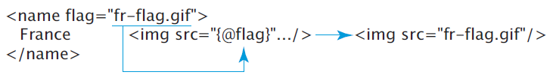
Tag Attributes
Placing a tag attribute reference in braces in XSL:
Causes the tag attribute’s value from the XML to be placed inside the quotes specifying the file source name

Slide 32
Summary of XSL.
Open the .xml file with a browser
It finds the specified .xsl file
The browser’s transformer begins to process the XML tree
As it finds the tags, it checks for a template in the .xsl file

Slide 33
Summary of XSL.
The browser then does what the template says and places the XHTML
The browser then process the other information within the tags
When it’s done, it appends remaining XHTML tags to the HTML definition
Finally, it displays the resulting Web page

Slide 34
The iDiary Database
When creating, we’ll use an incremental approach that will naturally guide you:
Getting started
Creating a first entry
Thinking about the nature of things
Developing tags and templates

Slide 35
1. Getting started
First concern is building the XML database
XML allows us to think up the tags and enables us to have any structure we want!
That means, we have a design task:
What are our needs?
What kind of structure will meet those needs?
We will be storing information about “things”
There will be a sequence of entries with a date entry and information to be stored

Slide 36
1. Getting started
Creating the XML Database:
First, decide on the Affinity tag (use <entry>)
Second, decide on the Collection tag (use <idiary>)
Creating the XSL Stylesheet:
The XSL stylesheet will need to recognize the two tags

Slide 37
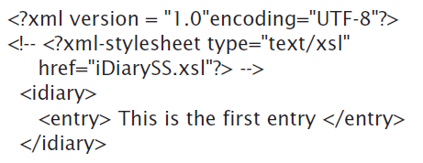
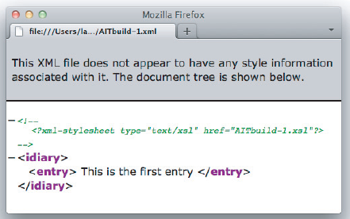

Slide 38
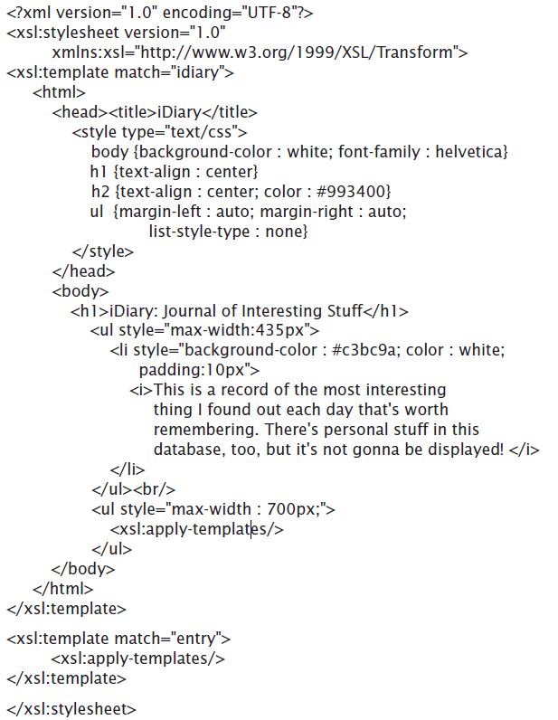
This contains the setup for the Web page: the title, heading, and italicized
comment at the start of the page

Slide 39
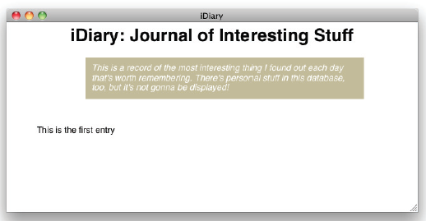

Slide 40
2. Creating a first entry
Consider what goes inside of each <entry> tag:
Start with the September 19 entry
Since the entry is the entity that is going in the database, what items should be enclosed by it?
The date is one part (use <date>)
Content is the other part (use <cool>, since the content will include cool stuff

Slide 41
2. Creating a first entry
Date Tagging:
This refers to the decisions surrounding the metadata for calendar dates
Since data in databases is atomic, we cannot refer to the day, month, and year separately if it is written: <date>September 19, 2011</date>
This, however, would be a lot to type: <date><month>September</month><day>19</day><year>2011</year></date>

Slide 42
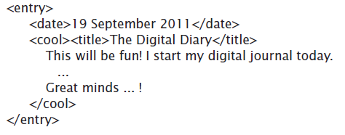

Slide 43
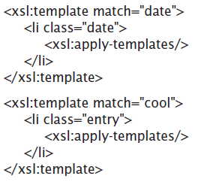
2. Creating a first entry
Now add templates to the iDiary.xsl file
The two tags will both be displayed as list items with <li> tags, with different “looks”
Use CSS properties to identify how each <li> tag will look

Slide 44
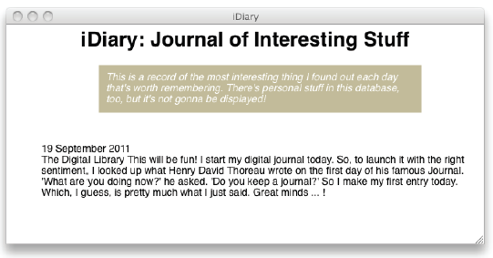

Slide 45
2. Creating a first entry
Class Styling:
The styling for the <li> tags uses some unfamiliar CSS
The features are straightforward, but we haven’t seen them before
For more information on these types of features, see the CSS tutorial at www.w3schools.com/cssref/default.asp

Slide 46
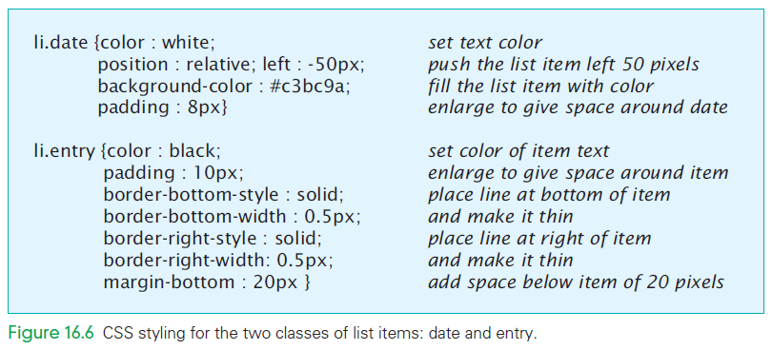

Slide 47
3. Thinking about the nature of things
When creating an entry, all of the information must be captured digitally
Data can take many forms
These forms will affect both the XML and the XSL definitions

Slide 48
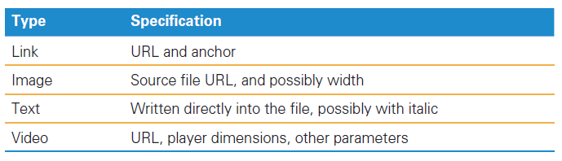
3. Thinking about the nature of things
Recognizing the Need for Specific Tags
When considering the design of the XML, notice that we must specify different data for each type of content

Slide 49
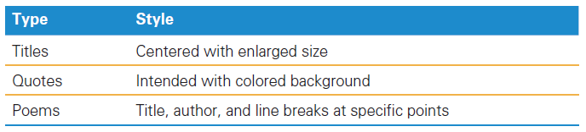
3. Thinking about the nature of things
Recognizing the Need for Specific Tags
Each of tag requires that we specify different information
They also require different formatting.
The text within each tag can take several different forms

Slide 50
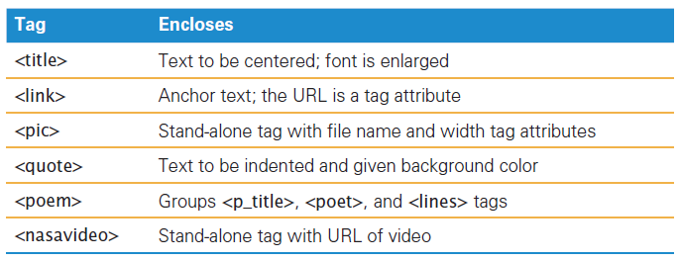
3. Thinking about the nature of things
Choosing Specific Tags.
Knowing that different kinds of data need different tags (each database attribute requires its own tag), a new tag is assigned to each kind of data stored in iDiary

Slide 51
3. Thinking about the nature of things
The <poem> tag is an Affinity tag grouping three other tags that give the title of the poem, the author, and the lines
In addition to <title> there is included:
a <p_title> for the poems Here, <title> will be centered and larger than the normal text

Slide 52
3. Thinking about the nature of things
Because there is a need for different tags for different kinds of information, the role of the <cool> tag changes slightly
Previously it was an Identification tag and enclosed the most interesting thing
Now, the role of the <cool> tag is that of an Affinity tag
It groups together all of the different forms of information

Slide 53

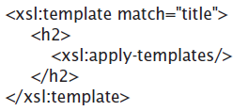
4. Developing tags and templates
The Title Tag
This tag announces the most interesting thing entry:
The text is centered and uses HTML heading tags to enlarge the font:

Slide 54
4. Developing tags and templates
The Link Tag
The <link> tag specifies a Web link
The Web link has two parts:
The tag encloses the anchor text
The URL is specified using the tag attribute
The stylesheet must place an <a href...> tag and enclose the tag attribute value in quotes

Slide 55
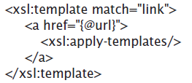
4. Developing tags and templates
The Link Tag
The template to do that is:
The @ symbol is the XSL reference to the tag attribute of the XML tag

Slide 56
4. Developing tags and templates
The Picture Tag
The <pic> tag is a stand-alone
The tag encodes the file name of the image and its desired display width
Note that as a stand-alone tag is terminated by the />

Slide 57

4. Developing tags and templates
The Picture Tag
A stand-alone tag does not enclose anything
There is no need for the <xsl:apply-templates/> tag
This makes the <pic> tag slightly different from those we’ve seen

Slide 58
4. Developing tags and templates
The Quote Tag
Quotes are an example of text that should be set off and noticeable
Use the <blockquote> HTML tag and style it as liked:

Slide 59
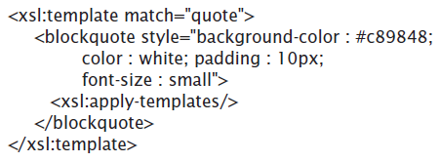
4. Developing tags and templates
The Quote Tag
We can style the implementing <blockquote> tag in the <head> section of the page, but it is just as easy to style it inline:
By classifying different types of text, there is tight control on the format of the page

Slide 60
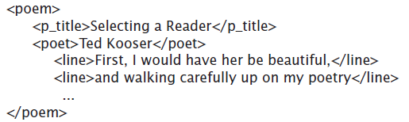
4. Developing tags and templates
The Poetry Tags
We identify several attributes of poetry (title, author, lines) and assign tags to each.
They are enclosed in the Affinity tag <poem>

Slide 61
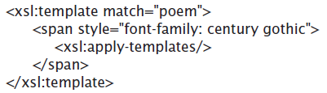
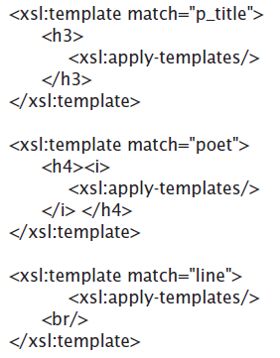
4. Developing tags and templates
The Poetry Tag Templates:

Slide 62
4. Developing tags and templates
The Video Tag
To include videos in the iDiary, embed a connection to the player
Most sites that stream videos have an “embed” button near the video, and clicking it gives you all of the HTML you need to show the video
Packaging this information into an XSL template accesses the video

Slide 63
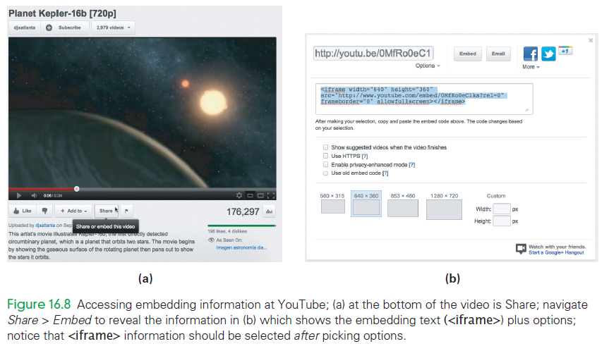
4. Developing tags and templates
The Video Tag

Slide 64
4. Developing tags and templates
The Video Tag
Develop the XML and XSL as you did for the stand-alone tag: <pic file=. . . />
The approach allows for simply providing the URL and getting the formatting automatically

Slide 65
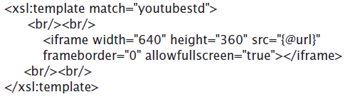
4. Developing tags and templates
The Video Tag
For the XSL text, use the <iframe> text format
Replace the URL with the reference to the <youtubestd> tag’s URL attribute: "{@url}”

Slide 66
4. Developing tags and templates
The Video Tag
Notice there is one additional change from the text that received from YouTube:
the last attribute in the <iframe> tag is allowfullscreen
This is not a legal attribute since they are to be followed by an equal sign and a “value”
All this attribute is saying is that it’s Okay to let the user display at full screen size allowfullscreen = "true"

Slide 67
4. Developing tags and templates
Another Video Source
Video embedding varies a lot
The <youtubestd> tag probably won’t work for other videos
You may need to develop a new tag for each video source
To make an XSL template for new video tag, do the same thing you did before:
Remove the URL
Replace it with the "{@url}" reference
Set the two attributes to be assigned the value true

Slide 68
Archiving Photos
As the page was built, the iDiary.xml and iDiarySS.xsl files and photos have been on the desktop
These need to be placed in a permanent location
Store the photos in a separate folder within the folder containing the two database files (call the folder imFiles)

Slide 69
Archiving Photos
There are two choices for specifying the path to these pictures
Add the path in the XML file as part of the <pic . . ./> tag (<pic file="imFiles/planet.jpg" . . . />)
Add it in the XSL file as part of the <pic . . . /> tag template (<img src="imFiles/{@file}" . . . >)
The first solution is the more flexible, allowing references to images stored elsewhere on the Internet as well as other folders

Slide 70
Hiding Information
All of the information in the database is displayed
We do have to tag everything, and we must provide a template to process each tag, but…
But, we don’t have to display it!

Slide 71

Hiding Information
Add a tag <personal> that encloses our personal thoughts.
Assume the <personal> tag is inside of the <cool> tag
It’s wise to include a comment to remind ourselves what we’re displaying

Slide 72

Hiding Information
You need to tell the transformer to “process the information enclosed in the matched tag,” or “leave it out”:
When the transformer gets to a <personal> tag, it checks to see what to do

Slide 73
Hiding Information
With no instructions to apply templates to the enclosed information, it skips the information inside the tags
Note that including personal information in the file without enclosing it in tags, or tagging it but not providing a template will result in the information displayed

Slide 74
Entering Data into the Database
Create a "template" for a new entry in the XML database file
Use placeholders or dummy file names for URLs, widths, etc.
To use, copy/paste this "template" and edit into the specific content for the new entry

Slide 75
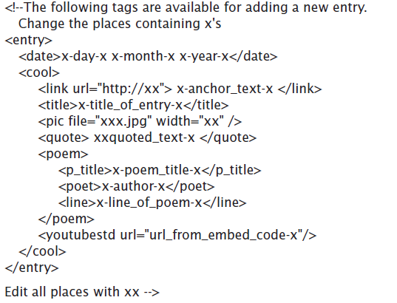
Entering Data into the Database

Slide 76
Summary
From this case study you now understand the following:
XML databases can record irregular data that relational databases cannot.
An XML database can be directly displayed by opening it in a browser.
Adding a stylesheet line to XML and building templates in XSL allows the XML file to be attractively formatted using HTML so that it can be displayed by a browser.

Slide 77
Summary
From this case study you now understand the following:
A complex database can be set up incrementally, adding tags and templates one at a time, and checking that they work as planned.
An XML database can optionally hide some of its information, allowing for the selective display of its contents.

