Slide 2
Learning Objectives
Tell the difference between name, value, and variable
List three basic data types and the rules for specifying them in a program
Explain the way in which the assignment statement changes a variable’s value
Write expressions using arithmetic, relational, and logical operators
Write conditional and compound statements

Slide 3
Programming Concepts
Programming is the act of formulating an algorithm or program
A systematic means of solving a problem is designed
Someone (and a computer) can follow the instructions and produce the intended result for every input, every time

Slide 4
Programming Concepts
The program must be able to perform or be executed without the programmer
All steps must be spelled out precisely and effectively
All contingencies must be planned for

Slide 5
Programming Concepts
Programming requires thinking
Basic programming concepts provide tools needed to formulate any computation
Trying to program an algorithm precisely using English is hopeless
Natural languages are too ambiguous for directing anything as clueless as a computer

Slide 6
Programming Concepts
Programming languages have been developed to help programmers in two ways:
Precision
Specialized for using the earlier mentioned concepts
Using a programming language is actually easier than writing in English

Slide 7
Programming Concepts
This chapter introduces the following programming concepts:
Names, values, and variables
Declarations
Data types, numbers, string literals, and Booleans
Assignment
Expressions
Conditionals

Slide 8
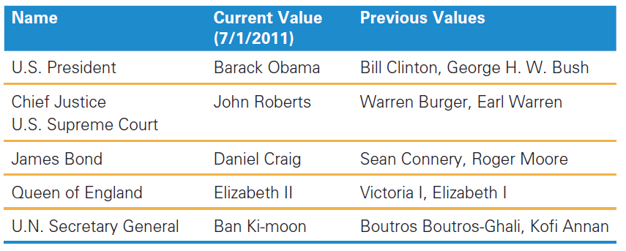
Names, Values, and Variables
Names Have Changing Values
Names and values are separable in programming
Names have changing values

Slide 9
Names, Values, and Variables
Names change in computer programs
A program is a fixed specification of a process
As the process evolves, the old names must refer to these new values
In computing, the name is always separable from the value, and the value can be changed

Slide 10
Variables Are Names in a Program
In programming terminology, the names are called variables
Variables mean that values vary
The most commonly used programming language operation is the command to change the value of a variable:
Called assignment

Slide 11
Identifiers and Their Rules
The letter sequence that makes up a variable’s name is called the identifier
Identifiers have a particular form
Identifiers must begin with a letter, followed by any sequence of letters, numerals, or the underscore symbol
Identifiers are not allowed to contain spaces

Slide 12
Identifiers and Their Rules
Note two features of identifiers:
The underscore symbol can be used as a word separator
It makes identifiers more readable
There is a “no spaces” rule
Identifiers are case sensitive
uppercase and lowercase letters are different

Slide 13
Variable Declaration Statement
Programs are usually written “starting from scratch”
The first thing to do when writing any program is to state or declare what variables will be used
Declaring variables is done using a command called a declaration
In JavaScript, the declaration command is the word var, followed by a list of the identifiers for the variables to be declared, separated by commas

Slide 14
Variable Declaration Statement
var area, radius;
This command declares that two identifiers (area, radius) will be used as variables

Slide 15
The Statement Terminator
A program is simply a list of statements;
Each statement must be terminated by some punctuation symbol;
The statement terminator in JavaScript is the semicolon;
The computer needs the semicolon to know when a statement is complete;
Terminate every statement with a semicolon;

Slide 16
Rules for Declaring Variables
Every variable used must be declared
JavaScript allows declaration statements anywhere in the list of statements
Variable declarations announce what variables will be used in the program
Declare variables first

Slide 17
Undefined Values
The declaration states that the identifier is the name of a variable
The name has no value at first, it is not defined
It is a name that doesn’t name anything
The name is declared but there is no value assigned yet
The value is undefined

Slide 18
Initializing a Declaration
Sometimes there is an initial value for identifiers
JavaScript allows setting the initial value as part of the declaration
This is called initializing the variable
Declaring variables with initial values is written as:
var taxRate = .088;
var balanceDue = 0;

Slide 19
Initializing a Declaration
Variables can be declared and initialized by separating them with commas:
var taxRate = .088, balanceDue = 0;
Usually several variables are declared in a single declaration statement when the variables are logically related
If the variables are not related, they are usually specified in separate statements

Slide 20
Three Basic Data Types of JavaScript
There are three types of data in JavaScript programs that will be used in this book:
numbers,
strings, and
Booleans

Slide 21
Rules for Writing Numbers
There are rules for writing numbers
One “unusual” aspect of numbers in programming is that there are no “units”
Numbers must be written in decimal form (0.33, not 33%; 10.89, not $10.89)
Standard computer numbers:
Have about 10 significant digits
Range from as small as 10⁻³²⁴ to as large as 10³⁰⁸

Slide 22
Rules for Writing Numbers
Numbers and computer arithmetic are unexpectedly subtle
As a general rule, the “safe zone” for numbers is the range from 2 billionths to 2 billion plus or minus

Slide 23
Strings
Strings are a common kind of data
Strings are “sequences of keyboard characters”
Notice that a string is always surrounded by single (') or double (") quotes
Strings can initialize a declaration
Strings are needed when manipulating text

Slide 24
Rules for Writing Strings in JavaScript
There are rules for writing strings in JavaScript:
Strings must be surrounded by quotes, either single (') or double ("), which are not curly
Most characters are allowed within quotes except:
the return character ( ), backspace character, tab character, \, and two little used others
Double quoted strings can contain single quotes, and vice versa

Slide 25
Rules for Writing Strings in JavaScript
There are rules for writing strings in JavaScript:
The apostrophe (') is the same as the single quote
Any number of characters is allowed in a string.
The minimum number of characters in a string is zero (""), which is called the empty string

Slide 26
Strings
To use double quotes in a string, enclose the string in single quotes: var answer = 'He said, "No!“ ‘
If our string contains single quotes, enclose it in double quotes: var book = "Guide to B&B's"
Since the apostrophe is commonly used in possessives and contractions, use double quotes as the default

Slide 27
String constants or string literals
The term literal means that the characters are typed literally in the program
There are rules about how to write literals:
The surrounding quotes are removed when the literal is stored in the computer
Any character can be stored in the computer’s memory
Prohibited character can be the value of a string in the computer by using the “escape” mechanism

Slide 28
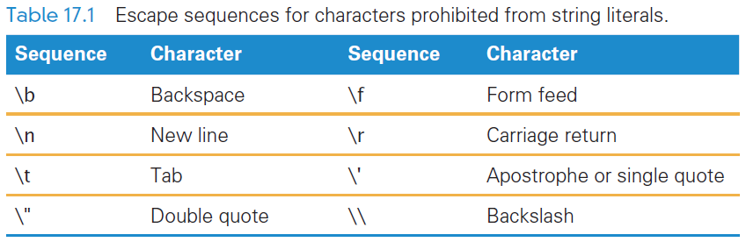
Escape Mechanisms
For JavaScript, the escape symbol is the backslash (\)
The escape sequences are converted to the single characters they represent when stored in the computer’s memory

Slide 29
Boolean Values
Another kind of value is the Boolean value (Booleans)
There are only two Boolean values: true and false
Boolean values are written as letter sequences, they are values, not identifiers or strings
Booleans are used implicitly throughout the programming process

Slide 30
Values in Programming
The different kinds of values of a programming language are called its data types
There are three types used here for JavaScript:
numbers,
strings, and
Booleans
There are several other types

Slide 31
The Assignment Statement
If variables are to change values in an algorithm or program, there should be a command to do so
The assignment statement changes a variable’s value
An assignment statement has three parts that always occur in this order:
<variable> <assignment symbol> <expression>;

Slide 32
The Assignment Statement
<variable> <assignment symbol> <expression>;
<variable> is any declared variable in the program
<assignment symbol> is the language’s notation for the assignment operation
<expression> is a kind of formula telling the computer how to compute the new value
Like any other statement, an assignment statement is terminated
by a semicolon. JavaScript’s <assignment symbol> is the equal sign (=), and
you’ve already seen the assignment operation as the initializer for variable
declarations.

Slide 33
The Assignment Statement
The assignment statement is terminated by a semicolon
JavaScript’s <assignment symbol> is the equal sign (=)

Slide 34

Assignment Symbol
Different programming languages use different symbols for indicating assignment
The three most widely used symbols are:
The equal sign (=)
The colon/equal sign pair (:=)
The left pointing arrow (←)
An example of an assignment is:

Slide 35
Interpreting an Assignment Statement
To understand how assignment works, you must think of a value flowing from the right side (expression side) to the left side (variable side)
The assignment symbol should be read as “is assigned ” or “becomes” or “gets”
These terms emphasize the role that the assignment symbol plays in changing the value of the variable named

Slide 36
Interpreting an Assignment Statement
In an assignment statement everything to the right of the assignment symbol is computed/evaluated first
If there are any variables used, their current values are used
The evaluation produces a value that then becomes the new value of the variable named on the left side

Slide 37
Interpreting an Assignment Statement
Executing the sample assignment statement: weeks = days/7;
The current value of days is retrieved from memory
That value is divided by 7
The answer becomes the new value of the variable weeks

Slide 38
Three Key Points About Assignment
There are three key points to remember about assignment statements:
All three of the components must be given
The flow of the value to the name is always right to left.
The values of any variables used in the expression are their values before the start of execution of the assignment
This last point is the most important

Slide 39
An Expression and Its Syntax
Programming is not mathematics but it has its roots there
One programming concepts is an algebra-like formula called an expression
Expressions describe the means of performing an actual computation
Expressions are built of variables and operators:
addition (+) and subtraction(–)
multiplication (*) and division (/ )
These are called the arithmetic operators

Slide 40
Arithmetic Operators
Expressions usually follow rules similar to algebraic formulas
Multiplication must be given explicitly with the asterisk (*) multiply operator: a * b
Multiplication and division are performed before addition and subtraction
They have a higher precedence than addition and subtraction
Parentheses can bypass that order

Slide 41
Arithmetic Operators
Superscripts (x²) are prohibited
Some languages have an operator for exponents or powers, but not JavaScript
If we want to square the value of x, then you must multiply it times itself: x * x

Slide 42
Arithmetic Operators
Operators like + and * are called binary operators
They on two values
The values are called operands
There are also unary operators
Negate (−) has only one operand
This is NOT subtract

Slide 43
Arithmetic Operators
Another useful operator is mod
The modulus (mod) operation (%) divides two integers and returns the remainder
The result of a % b for integers a and b is the remainder of the division a/b
Examples: 4%2 is 0 because 2 evenly divides 4
5%2 is 1 because 2 into 5 leaves a remainder of 1

Slide 44
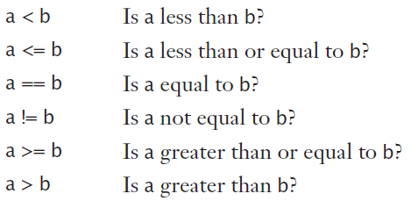
Relational Operators
Relational operators make comparisons between numerical values
The relationship between two numbers is tested
The outcome of the comparison is a Boolean value of true or false
The “equal to” relational operator (==) is a double equal sign
The “not equal to” operator uses the !

Slide 45
Logical Operators
The relational test results in a true or false outcome
Either the two operands are related to each other, or they are not
It is common to test two or more relationships together
This requires that relational expression results be combined

Slide 46
Logical Operators
Logical and
The && is the logical and operator
It plays the same role AND plays in query expressions
The outcome of a && b is true if both a and b are true; otherwise, it is false
The operands a and b can be variables, or expressions, or a mix

Slide 47
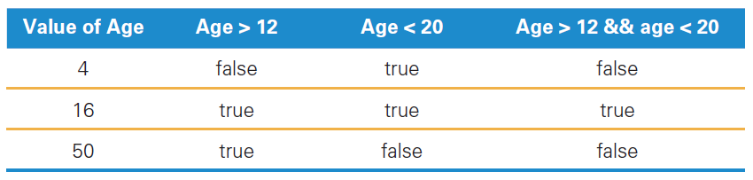
Logical and

Slide 48
Logical Operators
Logical or
The outcome of a || b is true if:
either a is true or b is true
if they are both true
It is false only if both are false
&& and || have lower precedence than the relational operators
Relationals are always tested first
It doesn’t matter how the operands of || are produced; it only matters that they are true or false values.

Slide 49
Logical not
logical not (!)
It is a unary operator, taking only a single operand
Its outcome is the opposite of the value of its operand
By placing the logical not operator in front of the parenthesized expression, we have a new expression with the opposite outcome

Slide 50
Operator Overload
Operator overload is a technical term meaning the “use of an operator with different data types”
Strings to numbers or to Booleans
Operators usually apply to a single data type
4 + 5 produces the numerical result of 9
If operands are strings, what does the + mean?

Slide 51
Concatenation
When we use + with strings, it joins the strings by the operation of concatenation
It just means that the two strings are placed together if we want them joined
The meaning of + is overloaded:
+ to mean addition when operands are numeric
+ means concatenation when the operands are strings

Slide 52
Conditional Statements
A conditional statement or a conditional makes testing numbers and strings simple
The conditional has the form: if (<Boolean expression>) <then-statement>;
The <Boolean expression> is an expression evaluating to true or false
The <then-statement> is any JavaScript statement

Slide 53
if Statements and Their Flow of Control
if (waterTemp < 32) waterState = "Frozen";
The <Boolean expression> is called a predicate
It is evaluated, resulting in a true or false outcome
If the outcome is true, the <then-statement> is performed
If the outcome is false, the <then-statement> is skipped

Slide 54
if Statements and Their Flow of Control
if (waterTemp < 32) waterState = "Frozen";
Writing the <then-statement> indented on the following line is common practice
Programmers write the <then-statement> indented on the following line to set it off
The indent emphasizes its conditional nature

Slide 55
Compound Statements
Programming languages allow for a sequence of statements in the <then-statement>
Group multiple statements by surrounding them with “curly braces” {}
{} collects single statements together to become a compound statement

Slide 56
Compound Statements
The opening { is placed immediately after the predicate to signal that a compound statement is next
The closing } is placed conspicuously on its own line after the last statement within the compound
The closing } should not be followed by a semicolon

Slide 57
if/else Statements
The if/else statement contain statements that will be executed when the condition’s outcome is false
if (<Boolean expression>)
<then-statement>;
else
<else-statement>;

Slide 58
if/else Statements
The <Boolean expression> is evaluated first
If the <Boolean expression>’s outcome is true:
The <then-statement> is executed
The <else-statement> is skipped
If the <Boolean expression>’s outcome is false:
The <then-statement> is skipped
The <else-statement> is executed

Slide 59
Nested if/else Statements
Both the <then-statement> and the <else-statement> can contain an if/else
The rule in JavaScript and most other programming languages is that the else associates with the (immediately) preceding if
This can be confusing to read
The best policy is to enclose the <then-statement> or <else-statement> in compound curly braces whenever they contain an if/else

Slide 60
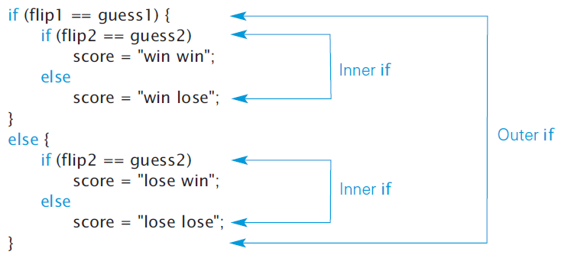

Slide 61
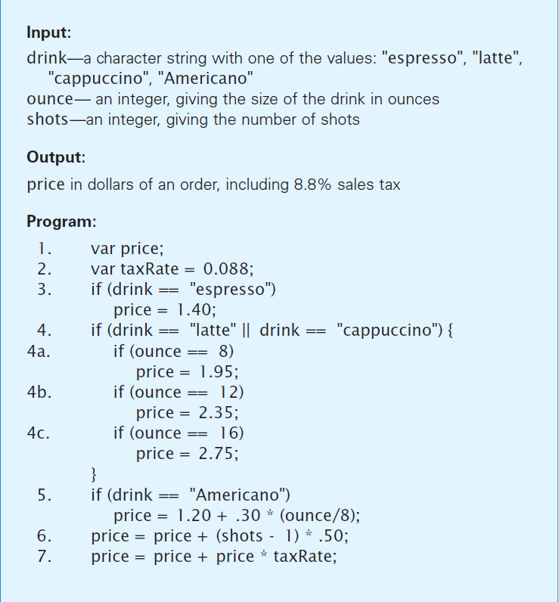
The Espresso Program
The program computes the price of four kinds of espresso drinks based on:
The type of drink
The size of drink
The number of additional shots
Plus tax

Slide 62
The Espresso Program
The input variables are listed at the start of the program, as is the output
The input variables are assumed to be given
The program will create the output

Slide 63
The Espresso Program
The output is declared to be a variable in the first statement of the program.
Statements 3 through 5 determine the kind of drink and establish the base price

Slide 64
The Espresso Program
The following lines are executed with the purchase of a double tall latte:
Line 3 is executed: The test drink == "espresso" fails, because the variable drink has the value "latte“ The then statement is skipped

Slide 65
The Espresso Program
The purchase of a double tall latte:
Line 4 is executed: The test drink == "latte" || drink == "cappuccino“ has a true outcome

Slide 66
The Espresso Program
The purchase of a double tall latte:
Line 4a is executed: The test ounce == 8 has a false outcome, so its then statement is skipped
Line 4b is executed: The ounce == 12 test is true, so the then statement is executed

Slide 67
The Espresso Program
The purchase of a double tall latte:
Line 4c is executed: The ounce == 16 test fails, so its then statement is skipped
Line 5 is executed: The drink == "Americano" test fails, so its then statement is skipped

Slide 68
The Espresso Program
The purchase of a double tall latte:
Line 6 is executed: This causes the value of shots minus 1 to be multiplied by .50, resulting in the value .50, which is added to price, yielding price ⇐⇒ 2.85

Slide 69
The Espresso Program
The purchase of a double tall latte:
Line 7 is executed: Current value of price is multiplied by taxRate, resulting in 0.25, which is added to price to compute the final value of 3.10, which is assigned to price

Slide 70
Summary
In basic programming, you now understand the following:
Name–value separation is an important concept. It’s one of the ways that programming differs from algebra.
Letter sequences that make up a variable’s name (identifiers) must be declared. Variables can be initialized when they are declared. Changing the value of a variable is possible by using assignment.

Slide 71
Summary
In basic programming, you now understand the following:
An assignment statement has a variable on the left side of the symbol and an expression on the right side. The operation is to compute the value of the expression and make the result the new value of the variable. This makes information flow from right to left in an assignment statement. Statements like x = x + 1; make sense in programming, but not in algebra.

Slide 72
Summary
In basic programming, you now understand the following:
There are three JavaScript data types of interest to us—numbers, strings, and Booleans—and we can build expressions to compute values of these types.
Standard arithmetic operators and relationals compute on numbers, and logical operations on Booleans. In defining concatenation, you learned about “operator overload.”

Slide 73
Summary
In basic programming, you now understand the following:
As a rule, all programming statements are executed one after another, starting at the beginning. The conditional statements are the exception. JavaScript’s two conditional forms are if and if/else. These allow statements to be executed depending on the outcome of a Boolean expression called a predicate.

Slide 74
Summary
In basic programming, you now understand the following:
We must be careful to group statements within a compound statement to make it clear which statements are skipped or executed. We also must be careful when using if/else in a conditional so that the if and else associate correctly.

Slide 75
Summary
In basic programming, you now understand the following:
The espresso program illustrates most of the ideas in this chapter. The program uses both numeric and string data types, as well as the declaration, assignment, and conditional statement forms.

