Slide 2
Learning Objectives
Use the Bean Counter application as a model to do the following:
Write input elements
Create a button table
Write an event handler in JavaScript
Produce a GUI similar to that of the Bean Counter
Trace the execution of the Bean Counter, saying what output is produced by a given input
Explain event-based programming in JavaScript and the use of event handlers

Slide 3
Preliminaries
HTML files are simple ASCII text
Avoid word processor formatting since it confuses browsers
We’ll use the basic text editor of Chapter 4 for our JavaScript development
File format must be text or txt
File extension must be html
Operating system knows an html file will be processed by a browser

Slide 4
Creating your JavaScript…
Opening your starterPage.html in a text editor
Save it with the file name, bean.html
To include JavaScript in an HTML file, enclose the JavaScript text in: <script type="text/javascript"> … </script> tags

Slide 5
Creating your JavaScript…
Information included between these tags is the subject of this chapter
Time to test your program?
Save it
Find the file on your computer and open it
JavaScript will run with HTML

Slide 6
The html…
<html>
<head>
<title>Convert F to C</title>
</head>
<body>
<script language=JavaScript><!--
insert program here…
//--></script>
</body>
</html>
This MUST appear before program
Convert algorithm to program and insert here
This MUST appear at end of program

Slide 7
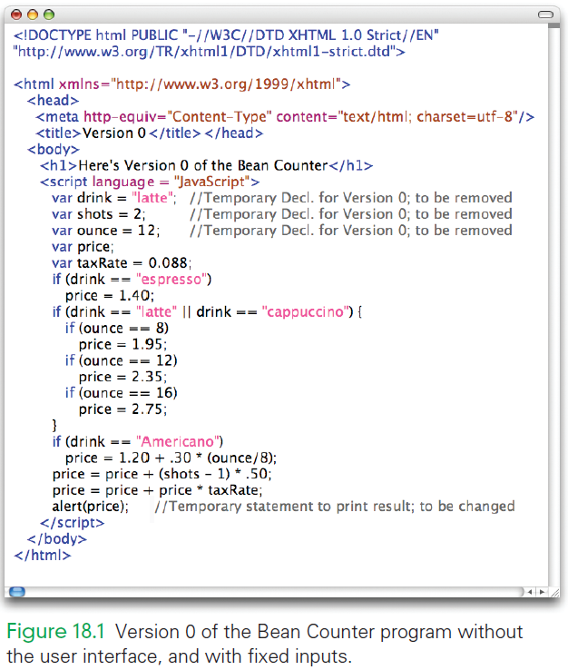
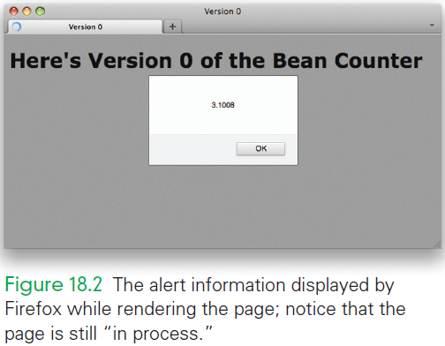
Bean Counter v.0

Slide 8
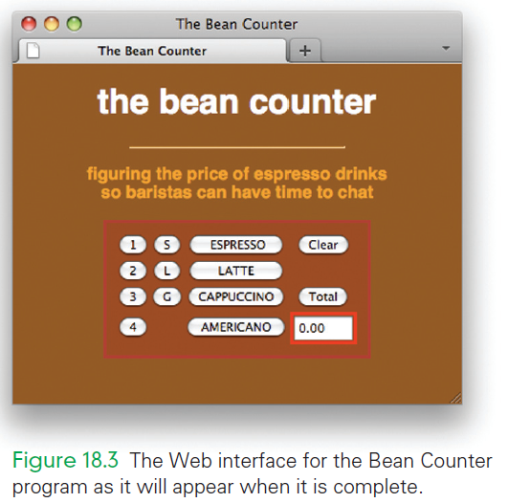
What We’re Aiming for …

Slide 9
Background for the GUI
Quick HTML Review
Change the title to <title>The Bean Counter </title>
Add a global <style> section in the head,
Replace “Hello, World” with: <h1> heading that reads “the bean counter”
Add a horizontal line (<hr/>) followed by a paragraph: “Figuring the price of espresso drinks so baristas can have time to chat.”

Slide 10
Background for the GUI
Quick HTML Review
Add <br/> is needed to display the paragraph slogan on two lines
Format it to be shorter than the full window
Format the text:
Choose saddlebrown as the background color, darkorange for the font color, and Helvetica for the font family
Make the heading white

Slide 11
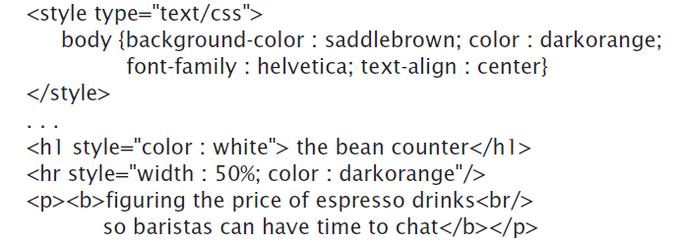
So far…

Slide 12
Interacting with a GUI
Input facilities like buttons and checkboxes are known as elements of HTML forms
They assist with activities like ordering products or answering survey questions
When a form is complete, it is sent to the computer for processing
Input elements, while not part of a survey, are still need so form tags must be used

Slide 13

Forms
The form tags surround all input elements
The action attribute of form is required for input
Action attribute usually tells the browser how to process the form
We will leave it empty since we don’t need to send the form for processing

Slide 14
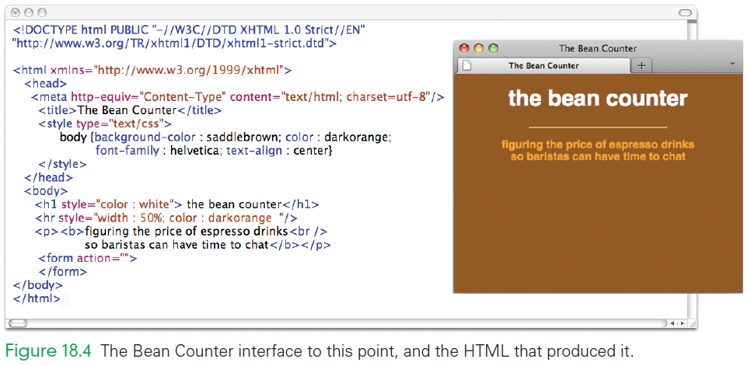
So Far, So Good?

Slide 15
Events and Event Handlers
When the GUI inputs are used they cause an event to occur
Buttons have a “click event” (as in you click the mouse to select the button)
An event is an indication from the computer (operating system) that something just happened (mouse click)

Slide 16
Events and Event Handlers
The JavaScript program needs to respond to that click:
It needs to do the operation that corresponds to the button command
When JavaScript “finds out” about the event, it runs a piece of program called the event handler
An event handler is the program that responds to the click

Slide 17
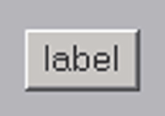
Three Input Elements
Button
<input type="button" value="label " onclick="event_handler " />
value gives the text to be printed on the button
onclick gives the event handler’s JavaScript instructions
When the button is clicked, JavaScript’s event handler is executed

Slide 18

Three Input Elements
Text Box
<input type="text" name="identifier " value="displayed_text" size="6“ onchange="event_handler " />
identifier is the name of the element
value is the text to be placed in the box
onchange gives the event handler’s JavaScript instructions

Slide 19

Three Input Elements
Radio Button
<input type="radio" name="identifier“ onclick="event_handler " />label text
identifier is the name of the element
label text is shown beside the button
onclick gives the event handler:
When the radio button is clicked, the center darkens to indicate that it is set
The event handler’s JavaScript instructions are performed

Slide 20
Creating the GUI
All that remains is to:
create a table
fill in the entries
Make sure to place the table between the form tags to ensure that the browser understands the inputs

Slide 21
Creating the GUI
The table is a four-row, four-column table with two empty cells
Buttons appear in all of the occupied cells but one
Table is mostly a table of buttons
Imagine what the algorithm might be for building the table

Slide 22
Creating the GUI
The algorithm for building the table:
Create a button table.
Delete two buttons.
Insert text box.
Label the buttons.
Primp the interface.

Slide 23
1. Create a Button Table
<td>
<input type="button" value="b" onclick = ' '/>
</td>
"b" is a placeholder for the button label
' ' is a placeholder for the JavaScript text of the event handler

Slide 24
1. Create a Button Table
table {margin-left : auto; margin-right : auto; text-align : center }
using CSS:
The table is centered by specifying that the left and right margins should be automatically positioned
text-align : center must also be included if we want IE users to see the table centered

Slide 25
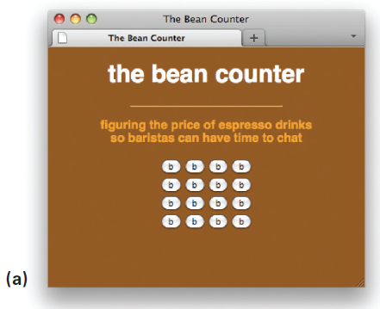

Slide 26
2. Delete Two Buttons
In row 2, cell 4, and row 4, cell 2, remove the <input. . . /> because these cells must be empty
Cells can be empty, but they still need to be surrounded with <td> and </td> tags

Slide 27
3. Insert Text Box
<input type="text" name="price" value="0.00" size="5“ onchange=' '/>
Text box in the lower right corner is needed
Modify the button input to be a text input by changing the type to text
Name the text box "price" because that’s the information that is computed with the program code for display

Slide 28
3. Insert Text Box
<input type="text" name="price" value="0.00" size="5“ onchange=' '/>
Window is “5” characters wide since no drink inputs will result in a price of more than four digits plus the decimal point
Change the onclick event handler to onchange

Slide 29
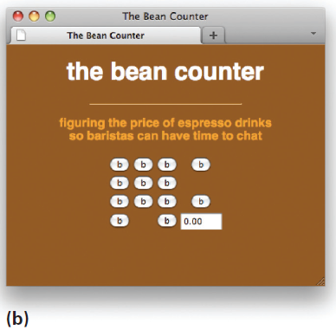

Slide 30
4. Label the Buttons
Next, go through each of the table cells and change the value attribute of each button from “b” to its proper button label
First column is the number of shots
Second column is the drink sizes
Third column is the type of drinks (espresso, latte, cappuccino, Americano)
The two items in the last column are the controls: (Clear, Total)

Slide 31
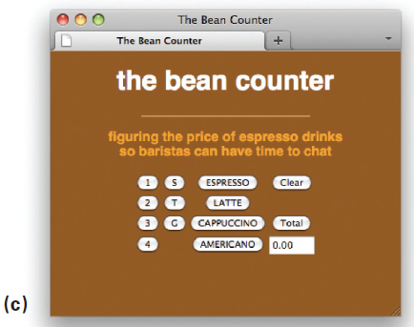

Slide 32
5. Primp the Interface
The buttons would look better if they were all the same width
Because the button is as wide as its value text, simply add spaces before and after the drink name to make the button wider and to balance the position of the text

Slide 33
5. Primp the Interface
Give the table a background color
Remember that colors can be numeric
Make #993300 the background color
Add a border to the table styling:
Make it a medium solid line
Color should be firebrick
Add 8 pixels of padding to the buttons
Add a medium red border to the price text box

Slide 34
What We’re Aiming for …

Slide 35
Event-Based Programming
The Bean Counter program should behave like a calculator
Each time a button is clicked, something should happen
This is a user-caused event
Programming the Bean Counter application amounts to defining in JavaScript the actions that should be performed when each button is clicked

Slide 36
The onclick Event Handler
<td>
<input type = "button" value = "Total" onclick =' '/>
</td>
An onclick event handler is used because we want the computer to do the action we programmed when the Total button is clicked

Slide 37
The onclick Event Handler
<td>
<input type = "button" value = "Total" onclick =' '/>
</td>
To use JavaScript to calculate the price, we insert the price computation code inside the quotes for the onclick attribute
We now have an onclick event handler!

Slide 38
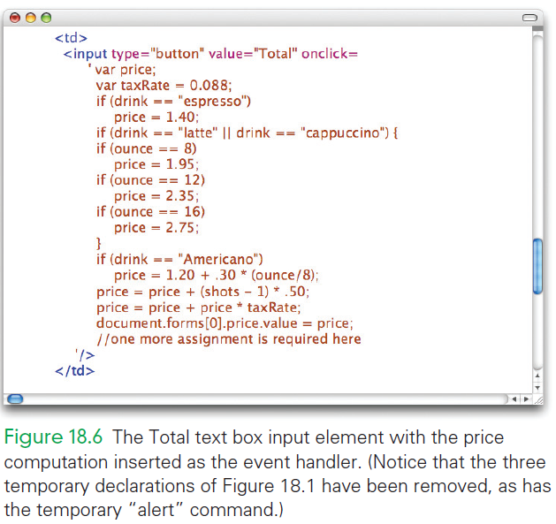

Slide 39
What Happens in a Click Event?
When the Total button is clicked:
The browser looks for the onclick event handler in the Total button input tag
The browser finds the JavaScript instructions to perform the button action
The browser runs those instructions, which implements the action, and then waits for the next event

Slide 40
Shots Button
<td>
<input type = "button" value = "1" onclick = 'shots = 1' />
</td>
For the shots buttons
The number of shots the customer requests is identified by which shot button is selected
The 2 button assigns shots the value 2, etc.

Slide 41
Size Buttons
<td>
<input type = "button" value = " S " onclick = 'ounce = 8' />
</td>
Action to be performed on a click event for the size buttons is to assign the appropriate value to the ounce variable

Slide 42
Size and Drink Buttons
<td align="center">
<input type = "button" value = " ESPRESSO "
onclick = 'drink = "espresso" ' />
</td>
The drink is assigned as "espresso", not "ESPRESSO", as written on the button
JavaScript code behaves as though there were 52 letters in the alphabet: 26 lowercase and 26 uppercase!

Slide 43
Clear Button and Initializations
Clicking the Clear button resets all of the variables (drink, ounce, and shots) to their initial values
But, there are no initial values yet!
Sometimes in programming, you need to go back and add information…it is not always perfect the first time through!

Slide 44
Clear Button and Initializations
<script type = 'text/javascript'>
var shots = 1;
var drink = "none";
var ounce = 0;
</script>
Declarations should be placed at the beginning of the program just after the <body> tag
Declarations must be enclosed in <script> tags

Slide 45
Clear Button and Initializations
<td>
<input type = "button" value = "Clear" onclick = 'shots = 1; drink = "none"; ounce = 0;
document.forms[0].price.value = "0.00"' />
</td>
Initial value for shots is 1 (every espresso drink has at least one shot)
Initial values for drink and ounce are chosen to be illegal values, so that an error message, indicating that an input is missing

Slide 46
Clear Button and Initializations
<td>
<input type = "button" value = "Clear" onclick = 'shots = 1; drink = "none"; ounce = 0;
document.forms[0].price.value = "0.00"' />
</td>
The Clear button should make these same assignments setting everything back to their initial values
The document.forms statement places 0.00 in the price window

Slide 47
Referencing Data Across Controls
Browser records all of the information about a Web page in a data structure called the Document Object Model, or DOM
The DOM records information about:
The forms used in the page
The images used on the page, etc

Slide 48
Referencing Data Across Controls
Entries are created for forms, images, and other elements in the order in which the information is encountered in HTML
Example:
Our one form is recorded as forms[0]
Computer counting always starts at 0 instead of 1! So the first item with a computer is always 0.

Slide 49
Referencing Data Across Controls
For each form, the input controls are recorded
Input controls can have several attributes, that are also recorded (such as price input control with a value attribute of "0.00“)
In JavaScript, when one statement in one element to change a value in another element the browser must be told how to navigate among the elements

Slide 50
Dot Operator
Is used to aid in navigation between elements
object.property
Selects the property of the object
Read references right to left:
Use “of” for dot: as in “property of object”
document.forms[0].price.value = "0.00“ is read as “the value attribute of the price input of the forms[0] form of the document is assigned 0.00.”

Slide 51
Changing the Window
When the assignment changes the value back to 0.00, the browser displays the assigned value and the 0.00 is treated as an output
input as output?
The window is seen from both the user’s and the computer’s point of view. If one side gets information (input) from it, the other must have put (output) the information

Slide 52
Displaying the Total
The Total event handler must show the price – the output
This is handled in the same way that the Clear button event handler clears the price window—by assigning to the value attribute of price
The final line of the Total event handler is replaced by document.forms[0].price.value = price;

Slide 53
Critiquing the Bean Counter
Every design must be critiqued to ensure that it meets the requirements:
Did it solve the problem ?
Can it be improved?
Experiment with the Bean Counter application to see how well it works.
Does the design fulfill the barista’s needs?

Slide 54
Critique… Numbers Versus Money
The final price is shown as a decimal number with several decimals not as currency with only two decimal points
Add: document.forms[0].price.value = Math.round(price*100)/100; to the last line of the Total button event handler
This changes the price from a “dollars amount” to a “cents amount”

Slide 55
Critique… Numbers Versus Money
The result is then rounded by using the built-in JavaScript function Math.round( ) to eliminate any digits to the right of the decimal point that is less than a penny
Finally, that result is divided by 100 again to convert back to a “dollars amount”

Slide 56
Critique… Numbers Versus Money
This computation is a standard way to remove unwanted digits…it’s not perfect, but it gets us to the correct amount
Final changes should read: document.forms[0].price.value = (Math.round(price*100)/100). toString( ).match(/ \.\d]{4}/);

Slide 57
Organization
The organization of the buttons is generally consistent with how the application will be used
Espresso drinks are typically named with syntax of “how many shots?”, “what size?”, and “what kind of drink?” “double tall latte”

Slide 58
Feedback
The form does not give a barista any feedback about the current settings of the variables
There should always be feedback for every operation.
Adding a window above each column of buttons that gives the current setting might be helpful

Slide 59
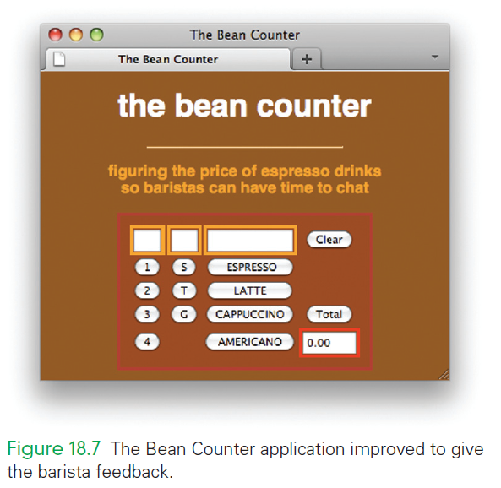

Slide 60
Bean Counter Recap
Referencing Variables
Declarations are usually placed at the start of a program.
Place the declarations right after the <body> tag, inside the <script> and </script> tags.
An event handler of one element needs to place a value in the window of another element, it must describe how to navigate to the item it wants to change using dot operators

Slide 61
Bean Counter Recap
Referencing Variables
The Bean Counter application illustrates three different ways to reference data values in an event-handling program:
as variables local to a handler (taxRate),
as variables global to all the handlers (drink), and
as a variable in another element (document.forms[0].price.value)

Slide 62
Program and Test
The programming process was (and is) incremental
Begin by producing a minimal 14-line HTML program and test it
Add to it and test it
Improve one feature at a time and test as you go

Slide 63
Program and Test
Write and solve one event handler at a time
Are there similarities among the various events?
Can those similarities help in developing the other event handlers?
Finally, critique the result

Slide 64
Program and Test
This strategy of breaking the task into tiny pieces and testing the program after each small milestone had two advantages:
At no point did we have to solve a complex task!
Continual testing meant that we immediately knew where any errors were located…the newly added code!

Slide 65
Assess the Program Design
When the initial design is completed, critiqued the result
This is not a critique of the programming, but a critique of how well our solution solved the problem (did it fulfill the barista’s needs?
This is an important part of any design effort, but especially so for software

Slide 66
Summary
Used HTML to set up a context in which event handlers perform the actual work. The setup involved placing buttons and other input elements on a Web page, so a user could enter data and receive results. This is the input /output part of the application and it is principally written in HTML.

Slide 67
Summary
Wrote JavaScript code for the event handlers. This is the processing part of the application. We used the event-based programming style and the basic instructions of Chapter 17. This style will be used throughout the rest of the book. HTML will simply be the input / output part of a program written in JavaScript.

